Slide 1
GROUP 7
Incremental Learning on Large Data
Feed-forward neural network predicting quantity sold
BZAN 554 · Group Assignment 1
0.536
Test R²
45 s
Training time
424 MB
Peak RAM
500k
Records
Ansley · Rebecca · Ximin
Notes:
Group 7. Lead with the headline: test R2 = 0.536, which is well above a linear regression baseline of 0.374 on the identical split. 500,000 records learned one mini-batch at a time, 45 seconds, under 424 MB of RAM during training.

Slide 2
Required Deliverables — Where to Find Them
Requirement | Slide | Status
R² on training and test set | 7 | Done
Learning curve (MSE moving average) | 8 | Done
Variable importance plot | 9 | Done
Multiple partial dependence plots | 10 | To insert
RAM usage | 11 | Done
Training time | 11 | Done
Who did what | 12 | Done
Group ID in filename + slide 1 | 1 | Done
Notes:
This slide is the grader's index. Every item in the assignment PDF is listed with the slide that answers it. The only open item is the partial dependence plots: run make_pdp_v2.py, paste the PNG onto slide 10, then change 'To insert' to 'Done'.

Slide 3
The Data
500,000
records
5
input features
0
missing values
19 MB
on disk
Inputs → predict quantity
Target: quantity
• sku — product identifier
• price — listed price
• order — nth time in stock
• duration — time on site
• category — product category
Statistic | Value
Mean | 22.82
Std. deviation | 50.51
Range | 0 – 4,165
Heavily right-skewed → we standardize
the target before training
Notes:
Categoricals are already integer-encoded and numerics divided by a constant, per the assignment note. Zero missing values, so no imputation. The key observation is the target scale: mean 23 but max 4,165. That skew drove a design decision on slide 6.

Slide 4
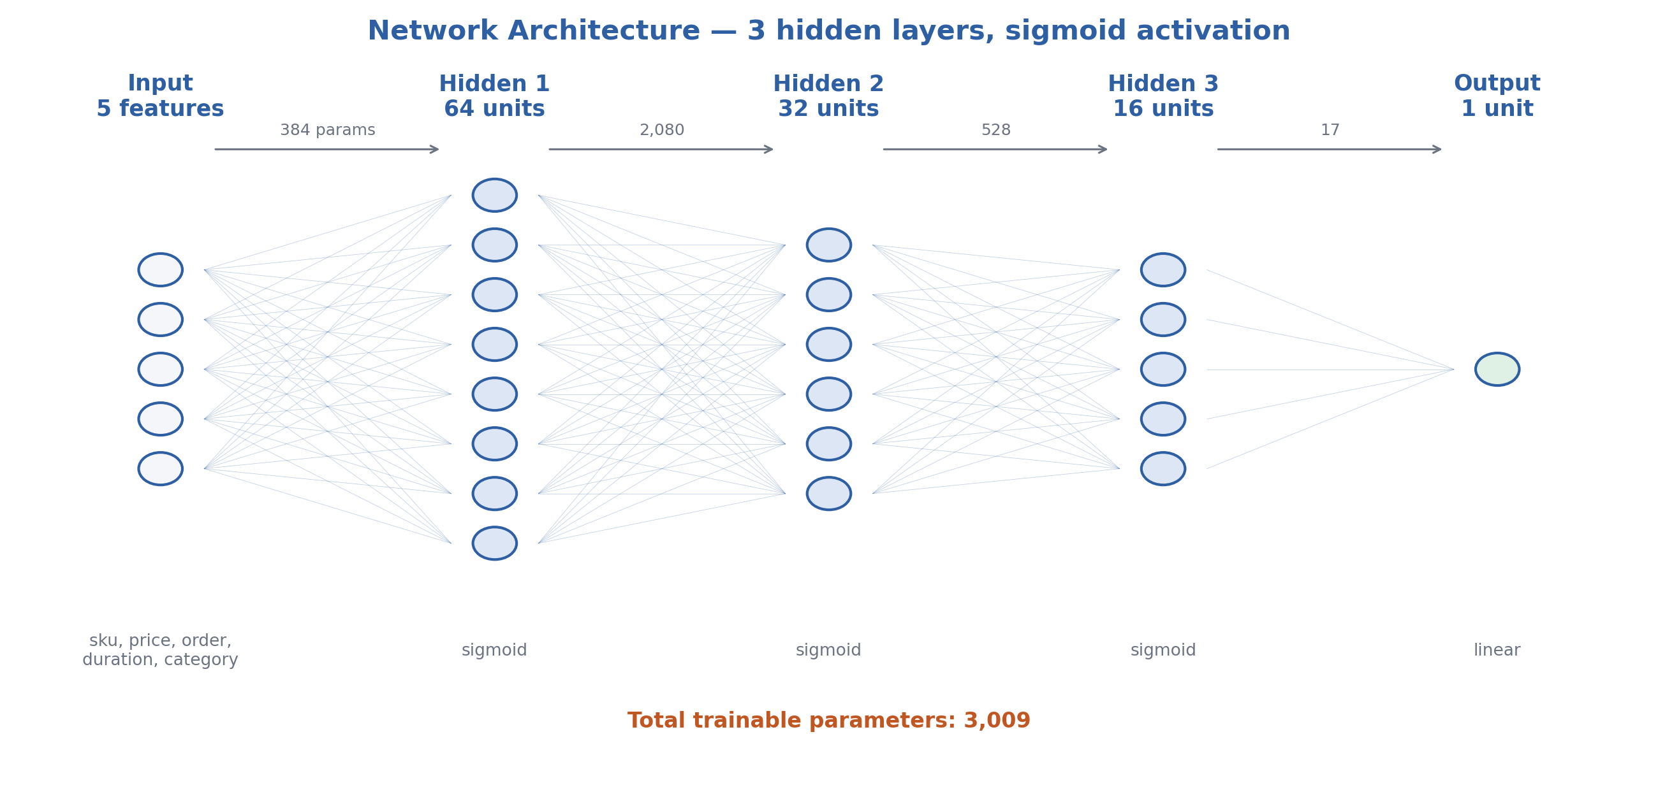
Network Architecture
AS REQUIRED
3 hidden layers · sigmoid activation · linear output for regression
Notes:
Matches the specification exactly: three hidden layers, sigmoid activation. Parameter count derivation, useful for the exam: (5x64+64)=384, (64x32+32)=2080, (32x16+16)=528, (16x1+1)=17, total 3,009. Why 64-32-16? A funnel compresses 5 inputs into progressively coarser features. Why is the output layer linear? Quantity is unbounded and positive; a sigmoid output would squash predictions into (0,1) and cap them.

Slide 5
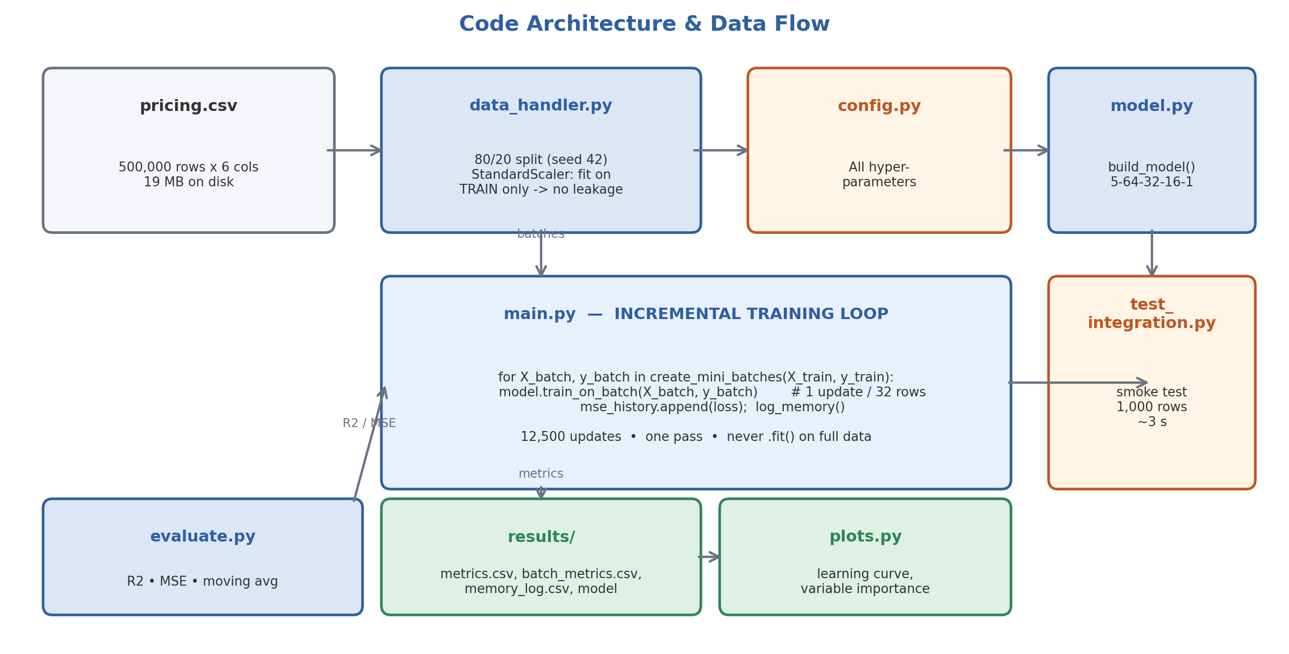
Code Architecture
Notes:
Modular by design so three people could work in parallel. config.py holds every hyperparameter, so no value is ever edited inline and runs stay traceable. The critical correctness detail: StandardScaler is fit on the training split only, then applied to test. Fitting on all 500k rows first would leak test information.

Slide 6
How the Model Learns Incrementally
for X_batch, y_batch in create_mini_batches(X_train, y_train):
model.train_on_batch(X_batch, y_batch)
mse_history.append(loss)
log_memory(batch_count)
Never .fit() on the full data
• 32 rows per update
• 12,500 updates
• one pass (1 epoch)
Key design decision
Decision | Why | Effect on test R²
Standardize the target y | Raw y (max 4,165) forced huge gradients that saturated the sigmoid units | 0.35 → 0.52
Learning rate 0.001 → 0.005 | Sigmoid gradients are small; larger steps needed within a single pass | 0.519 → 0.532
Notes:
This is the strongest slide for showing understanding. The target-scaling fix was diagnosed, not guessed: raw y has mean 23 and max 4,165 while inputs sit near zero, so the network had to emit large values, producing large gradients that pushed the sigmoid units into their flat regions where the derivative approaches zero. Standardizing y fixed it and gained about 0.17 R2. IMPORTANT: do not attribute the improvement from 0.32 to 0.54 to random seed variation. It came from these two deliberate changes. Also note MSE is reported in original units by multiplying by the variance of y (sigma squared, not sigma).

Slide 7
Results — R²
REQUIRED
0.5362
Training set R²
0.5356
Test set R²
Benchmarked on the identical 80/20 split
Model | Test R² | Test MSE
Predict the mean | 0.000 | 2,478.8
Linear regression | 0.374 | 1,550.7
Our neural network | 0.536 | 1,151.2
Train ≈ test → no overfitting. Beats linear regression by 0.16 R².
Notes:
Test set created by train_test_split with seed 42, 400k train / 100k test, and never used for training or tuning. The gap between train and test is 0.0007, so there is no overfitting. The comparison table is what makes the number meaningful: R2 = 0.536 on its own is just a number, but beating a linear model by 0.16 shows the network is capturing genuine non-linearity. R2 = 0 is exactly the performance of predicting the mean for every row.

Slide 8
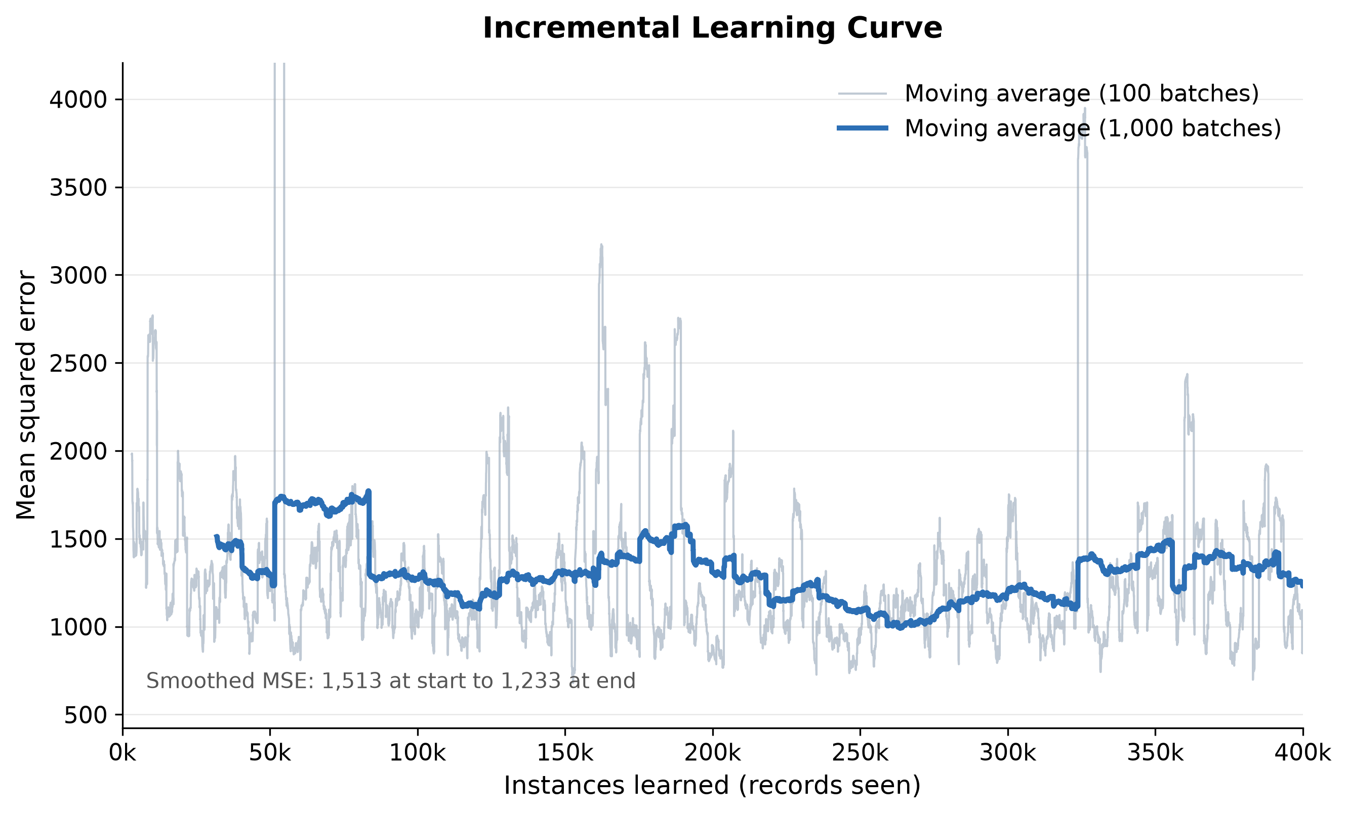
Required — Learning Curve
REQUIRED
Moving-average MSE falls 1,461 → 1,257 across 400,000 instances learned.
Individual batches are noisy (32 rows each); the moving average shows the trend.
Notes:
X-axis is instances learned, y-axis is the moving average of MSE, exactly as specified. The moving average is essential: a single 32-row batch ranges from about 300 to 5,000 MSE, so raw per-batch values look like pure noise. Do NOT quote MSE_first_batch (455) against MSE_last_batch (1,747) from metrics.csv as evidence of anything. Those are single batches and they suggest the model got worse, which is an artifact of batch-level variance. The smoothed trend is the honest measure. The curve is still descending at the end, which tells us a second epoch would likely help.

Slide 9
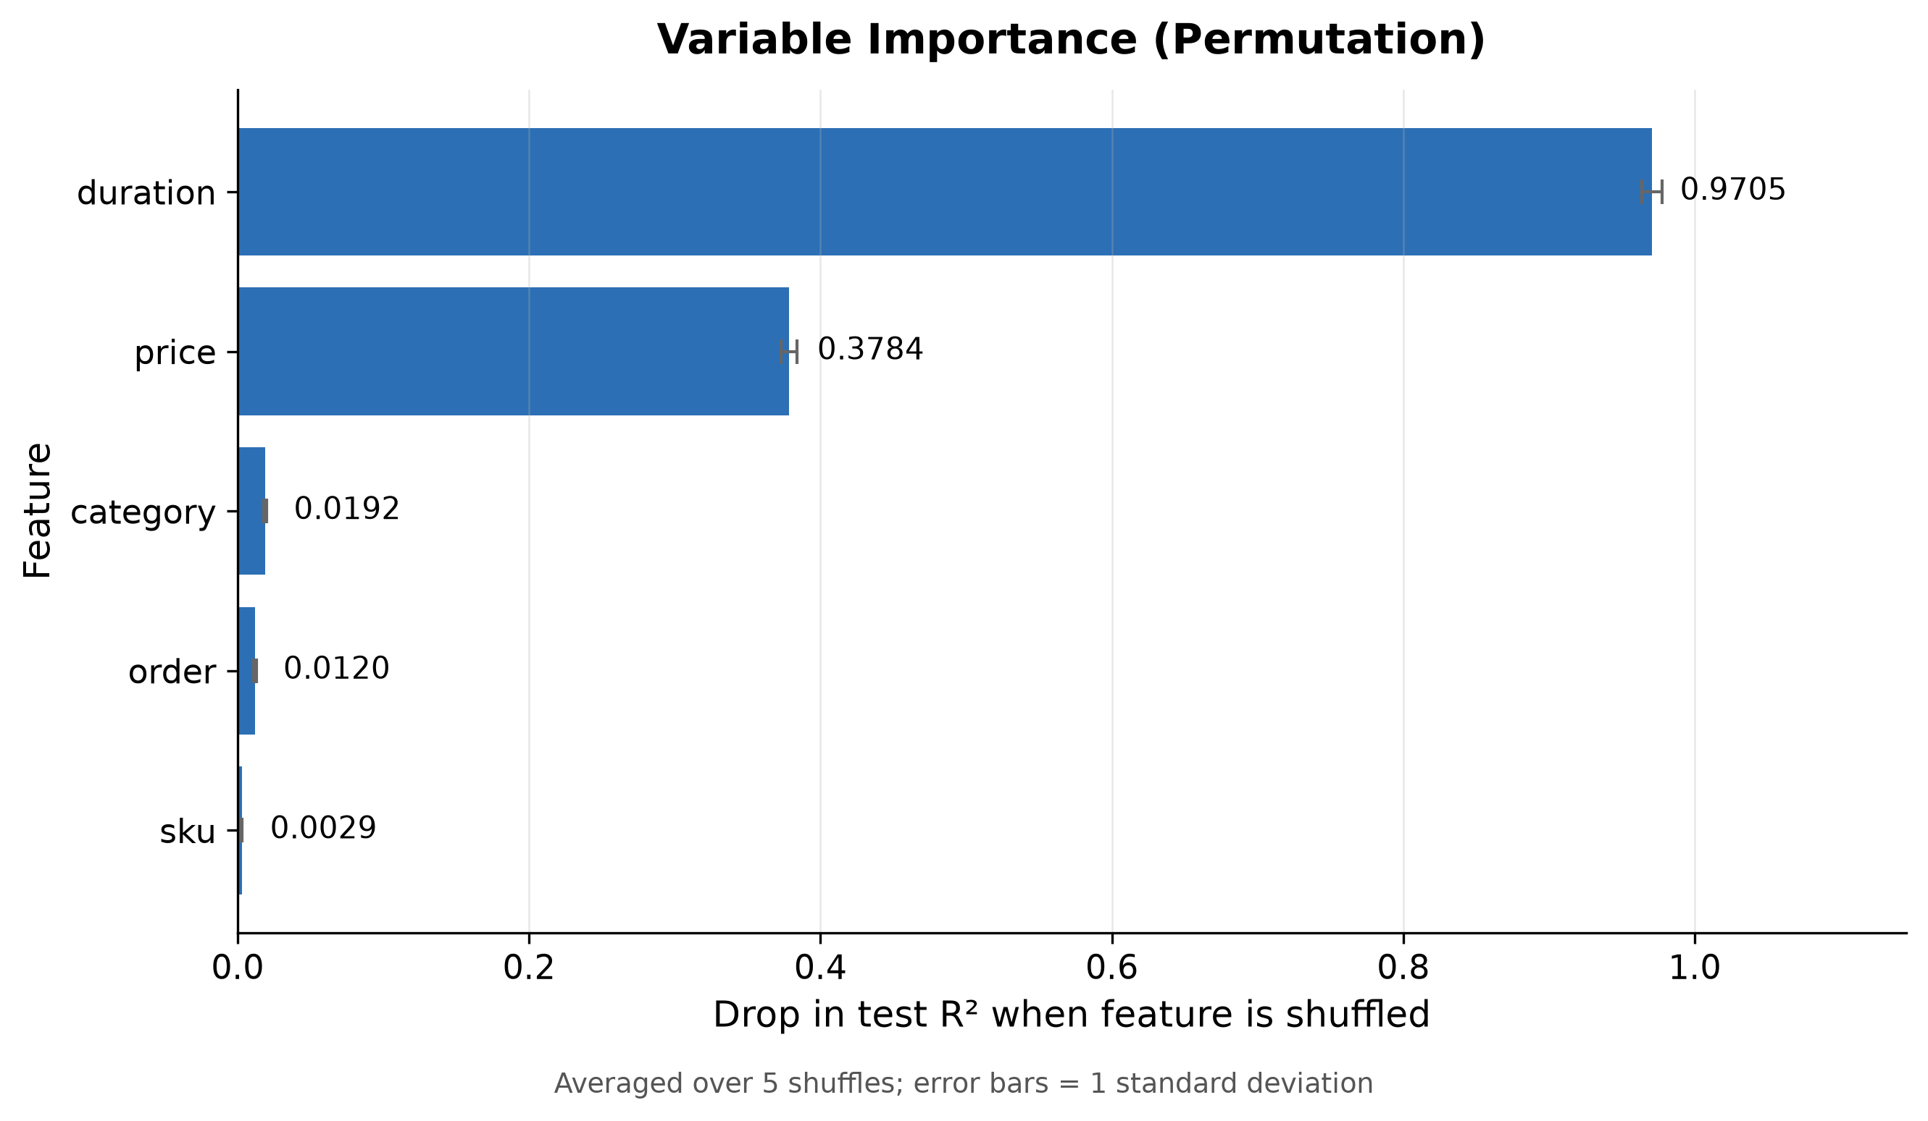
Required — Variable Importance
REQUIRED
Ranking
Feature | Drop in R²
duration | 0.971
price | 0.378
category | 0.019
order | 0.012
sku | 0.003
duration and price carry
almost all signal.
sku, order, category are
nearly irrelevant.
Notes:
Method: permutation importance. Shuffle one feature in the test set, re-predict, and measure how far R2 falls. Averaged over 5 shuffles; error bars are one standard deviation. Why can the drop exceed 1.0? Shuffling duration makes predictions worse than simply predicting the mean, so R2 goes negative and the drop from 0.536 exceeds 1. That is expected, not a bug. Caveat worth mentioning: sku and category were standardized as if numeric, which understates their importance because the network sees a meaningless ordering. One-hot encoding would be the fix.

Slide 10
Required — Partial Dependence Plots
TO INSERT
PASTE results/pdp_grid.png HERE
Run: python make_pdp_v2.py (from the code/ folder, ~60 s)
Then delete this box and insert the image.
Expected shapes: duration → strongest, steepest curve · price → clear negative slope
sku / order / category → near-flat, consistent with the importance ranking
Notes:
A partial dependence plot sweeps one feature across its range while holding all others at their observed values, then averages the model's predictions. It shows the shape and direction of an effect, whereas variable importance shows only magnitude. make_pdp_v2.py rebuilds the seed-42 split and re-fits the scaler on training rows only, so the transform is identical to training with no leakage. It also converts predictions back to real quantity units. Sanity check the output against slide 9: duration should dominate, price should slope downward.

Slide 11
Required — RAM Usage & Training Time
REQUIRED
Memory
Time
Stage | MB
At start | 346.4
After data load | 383.7
Peak during training | 423.7
Drift over 12,500 updates | +6.5
Measure | Value
Total training | 45.0 s
Per mini-batch | 3.6 ms
Records / second | ≈ 8,900
12,500 weight updates
in 45 seconds on a laptop.
Memory is flat during training.
Mini-batching means RAM does not
grow with the number of records.
Honest limitation: we still read the whole CSV once (19 MB fits in RAM).
The training loop is genuinely incremental and would scale unchanged to a file larger than RAM using pandas chunksize.
Notes:
Measured with psutil at every batch, 12,506 rows logged in memory_log.csv. The number that matters is the drift: 6.5 MB across 12,500 updates, meaning no memory leak and no accumulation. Be ready for this question: metrics.csv reports a peak of 553 MB, higher than the 424 MB shown here. That spike happens AFTER the training loop, when model.predict is called on all 400k rows at once for evaluation. The training loop itself never exceeded 424 MB. Quoting 553 MB would undercut our own argument. Anticipate the fair challenge that this dataset fits in RAM, so address it directly as shown in the orange box.

Slide 12
Team Contributions
REQUIRED
Member | Focus | Delivered
Ansley | Data & training loop | Data exploration; loading and mini-batch generator; 80/20 split; incremental training loop; memory tracking with psutil; full-run execution
Rebecca | Model & evaluation | Architecture design and implementation; R² and MSE functions; moving average; target-scaling fix; learning curve and importance plots
Ximin | Testing & documentation | Testing checklist with expected ranges; 1,000-row test samples; run log and issue tracking; baseline benchmarks; master checklist; this presentation
Notes:
Required by the assignment. Confirm each description with Ansley and Rebecca before submitting so everyone agrees with how their work is represented.

Slide 13
What We Learned & What We'd Do Next
What worked
Known limitations
• Mini-batch updates keep RAM flat
• Target scaling mattered most (+0.17 R²)
• Beat linear regression by 0.16 R²
• Clean split — no leakage, no overfitting
• Whole CSV read once, not chunked
• Single epoch — curve still descending
• sku / category scaled as if numeric
• Scaler not saved with the model
Next steps, measured not guessed
Change | Expected test R² | Note
Batch 256 + 10 epochs, lr 0.01 | ≈ 0.550 | also ~2× faster
One-hot encode category | — | removes false ordering
Notes:
Closing on limitations reads as understanding rather than oversight. The batch-size figure comes from an actual sweep: at a fixed single epoch, larger batches are WORSE (batch 256 scores about 0.521 versus 0.532 at batch 32) because batch size divides the number of weight updates. 400k rows at batch 32 gives 12,500 updates; at batch 256 only 1,563. Larger batches only win when the saved time is spent on more epochs. A gradient boosting model on these same five features reaches about 0.589, so the remaining gap is mostly the three sigmoid layers, not the batch size.

