Slide 1
Incremental Learning
on Large Data
Teaching a model to predict sales from a file too big to open
GROUP 7
Ansley Smith · Rebecca Drake · Ximin Zeng
BZAN 554 · Deep Learning · Group Assignment 1
Notes:
Our job was to predict how many units a product sells, using a file we were told to treat as too big to fit in the computer.

Slide 2
WHY ANYONE CARES
The question: how many will this sell?
An online retailer lists thousands of products. Each one sits on the site for a while, sells some number of units, then goes out of stock.
quantity
If you could predict how many units a product will sell before you list it, you would know how much to stock and what to charge.
the number we are predicting
Everything else in the data is a clue we are allowed to use.
Notes:
Start with why this matters. A retailer wants to know, before listing a product, how many units it will move. Everything else in the file is a clue.

Slide 3
WHAT THE DATA LOOKS LIKE
Each row is one product, for one spell in stock
sku | price | order | duration | category | quantity
11 | 1.45 | 0 | 1.50 | 17 | 5
11 | 1.45 | 1 | 2.47 | 17 | 15
17 | 0.66 | 1 | 1.85 | 17 | 11
• sku — which product it is
• price — what it costs
• order — how many times it has been listed before
• duration — how long it stayed on the site
• category — what kind of product
The last column is what we predict. The other five are what we predict it from.
Notes:
Three real rows. A product can appear more than once, because a new row is created each time it comes back into stock. Duration is how long it stayed listed before selling out.

Slide 4
BUT THERE WAS A CATCH
We were not allowed to
open the file
The assignment says to assume the data is bigger than the computer’s memory
Notes:
This is the whole point of the assignment. The file we were given is only 18 MB, but we had to build as though it were far too big to load.

Slide 5
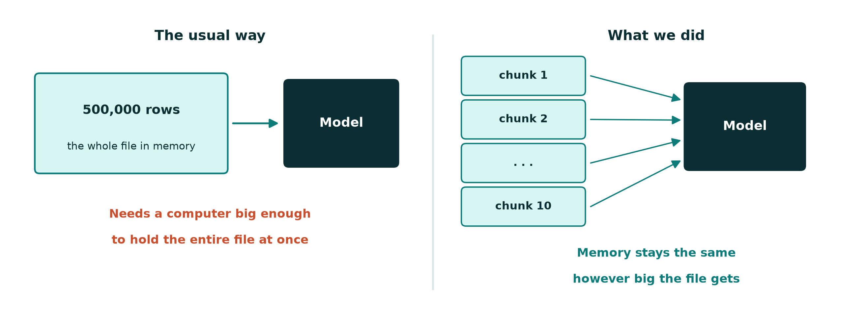
THE CONSTRAINT
Normally you load everything. We could not.
Reading a chunk at a time means the computer only ever holds a small piece — so the file could be a thousand times larger.
Notes:
The usual approach loads the whole file, then trains. That needs a machine big enough for the file. We read one chunk, learn from it, discard it, and read the next.

Slide 6
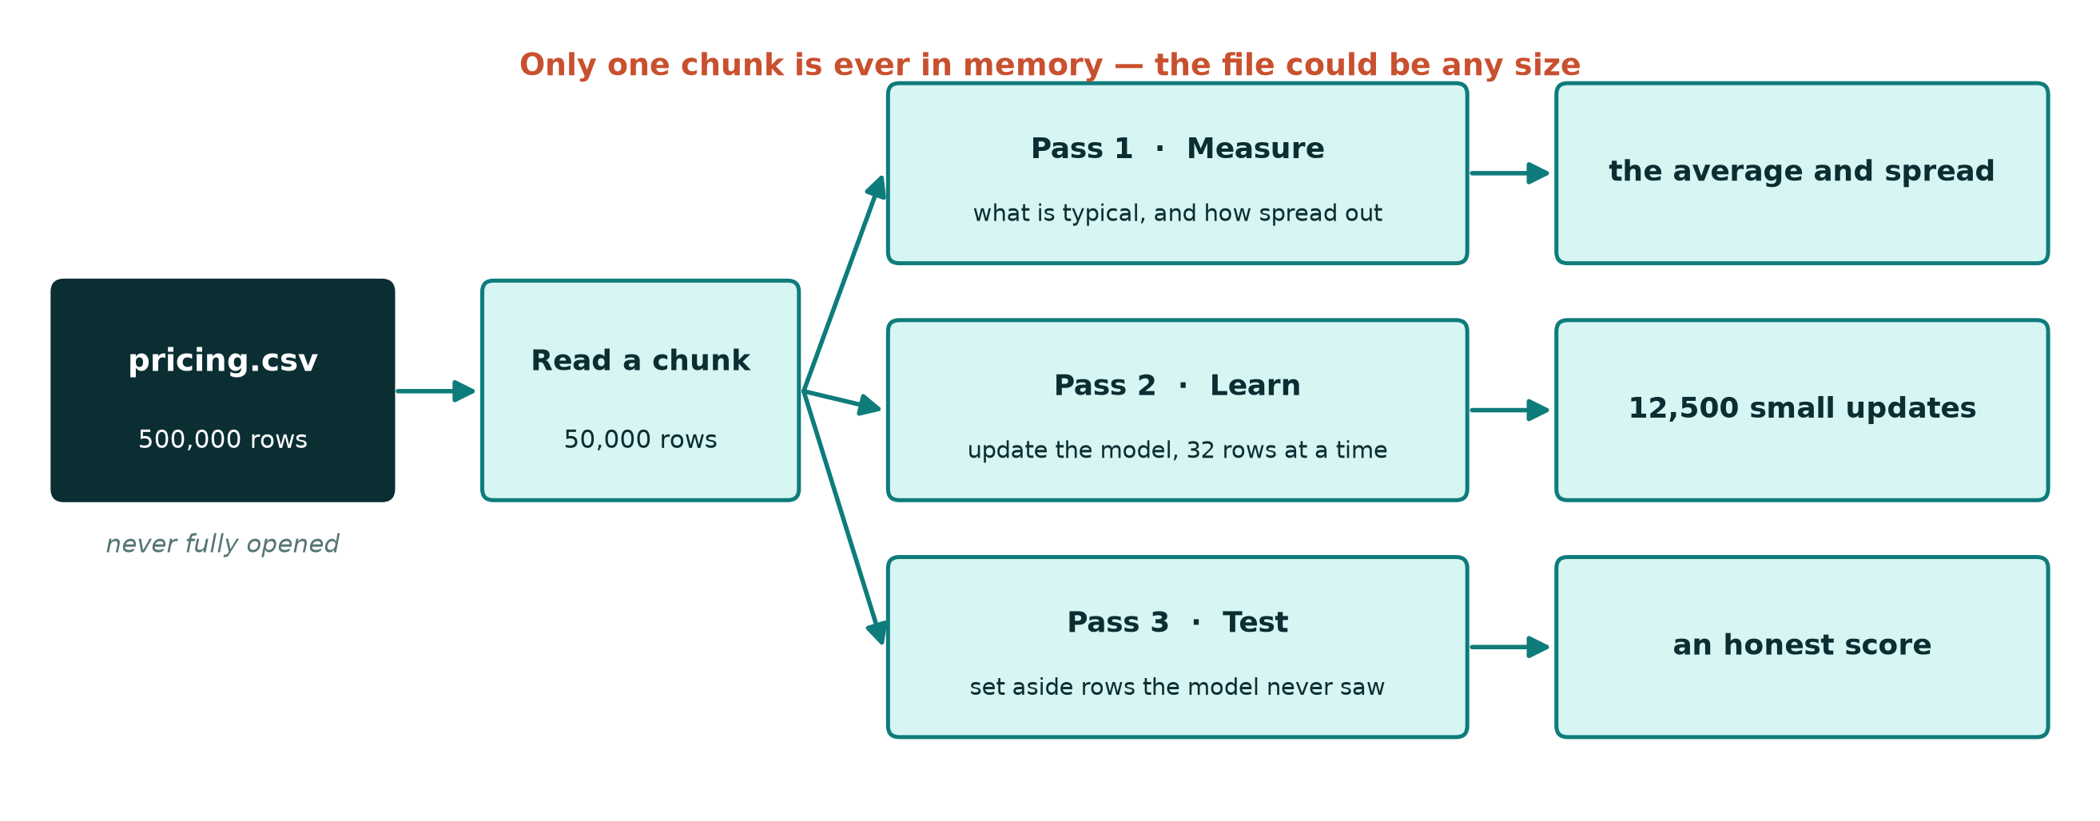
HOW IT ACTUALLY WORKS
We read the file three times, a chunk at a time
Reading from disk is cheap. Holding data in memory is what we cannot afford.
Notes:
Pass one works out the average and spread of each column, which we need before we can put the numbers on a common scale. Pass two does the learning. Pass three sets aside rows to test on. Each pass holds only one chunk at a time.

Slide 7
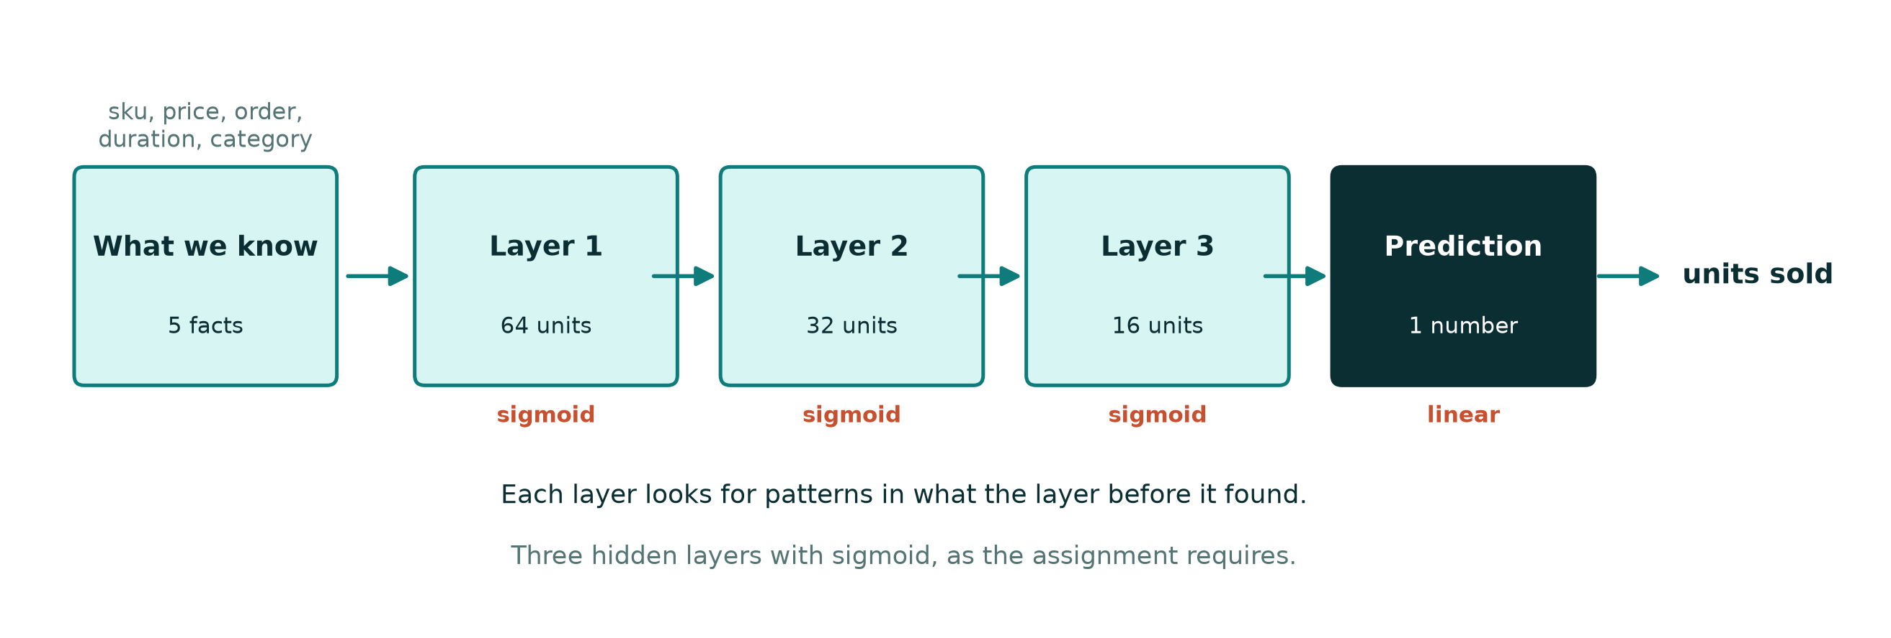
WHAT WE BUILT
The model is a stack of pattern-finders
Five facts go in. Each layer looks for patterns in what the previous layer found. One number comes out: how many units we expect to sell.
Notes:
A neural network is a chain of simple pattern-finders. Each layer takes what the last one noticed and looks for patterns in that. The assignment specified three hidden layers with sigmoid activation.

Slide 8
AND WHY
Three choices we had to make
1
We put the answer on the same scale as the clues
Sales run from 1 to over 4,000. Numbers that large jam the model, so we shrank them for training and converted back afterwards.
2
The last step had to be left unrestricted
The building block we were told to use can only ever output a number between 0 and 1 — useless for predicting sales of 300.
3
We had to mix up the rows before learning
More on this next — it turned out to be the most important thing we did.
Notes:
Three decisions we expect questions about. The third one is the interesting one and gets its own section.

Slide 9
THEN SOMETHING WENT WRONG
Our accuracy suddenly dropped
Switching to reading the file in chunks made the model noticeably worse. Here is why.
Notes:
Our first chunked version scored much worse than the version that loaded everything. It took a while to work out what was happening.

Slide 10
THE PROBLEM WE FOUND
Every chunk looked almost the same
The rows are ordered by product. So a chunk read straight off disk is not a fair sample of the shop — it is a handful of nearly identical products in a row.
0.9995
correlation between row number and product id
The model kept adjusting to whatever narrow slice it happened to be looking at, then forgetting it when the next slice arrived.
In other words: the position of a row in the file tells you almost exactly which product it is.
Notes:
Learning works by taking small steps based on small samples, and it assumes each sample is representative. Sorted data breaks that assumption completely.

Slide 11
AND IT WORKED
The fix: shuffle inside a small window
We cannot shuffle a file we cannot open. So we hold a fixed number of rows, shuffle those, use them up, then refill.
0.44 → 0.53
accuracy, before and after
The window is a fixed 200,000 rows — about 5 MB — no matter how big the file is.
The last bar shuffles the whole file — shown only as a ceiling.
Notes:
A bigger window mixes the rows more thoroughly and scores better, but costs more memory. At 200,000 rows we match what a full shuffle would give, for about five megabytes.

Slide 12
SO
Did it work?
Accuracy, what the model learned, and whether it stayed inside memory
Notes:
Now the results the assignment asks for.

Slide 13
ACCURACY
It explains about half of why sales differ
0.53
WHAT THIS MEANS
R-squared asks how much better we are than always guessing the average. 0 means no better. 1 means perfect.
At 0.53 the model explains roughly half of why some products sell more than others — and half is still unexplained.
R-SQUARED ON UNSEEN DATA
Those two scores are almost identical, which means the model is not simply memorising.
0.523
0.528
on data it trained on
on data it never saw
Notes:
R-squared of 0.53. Train and test agree to within half a percent, so it is not memorising. Half the variation is still unexplained, which is honest for five columns and one pass over the data.

Slide 14
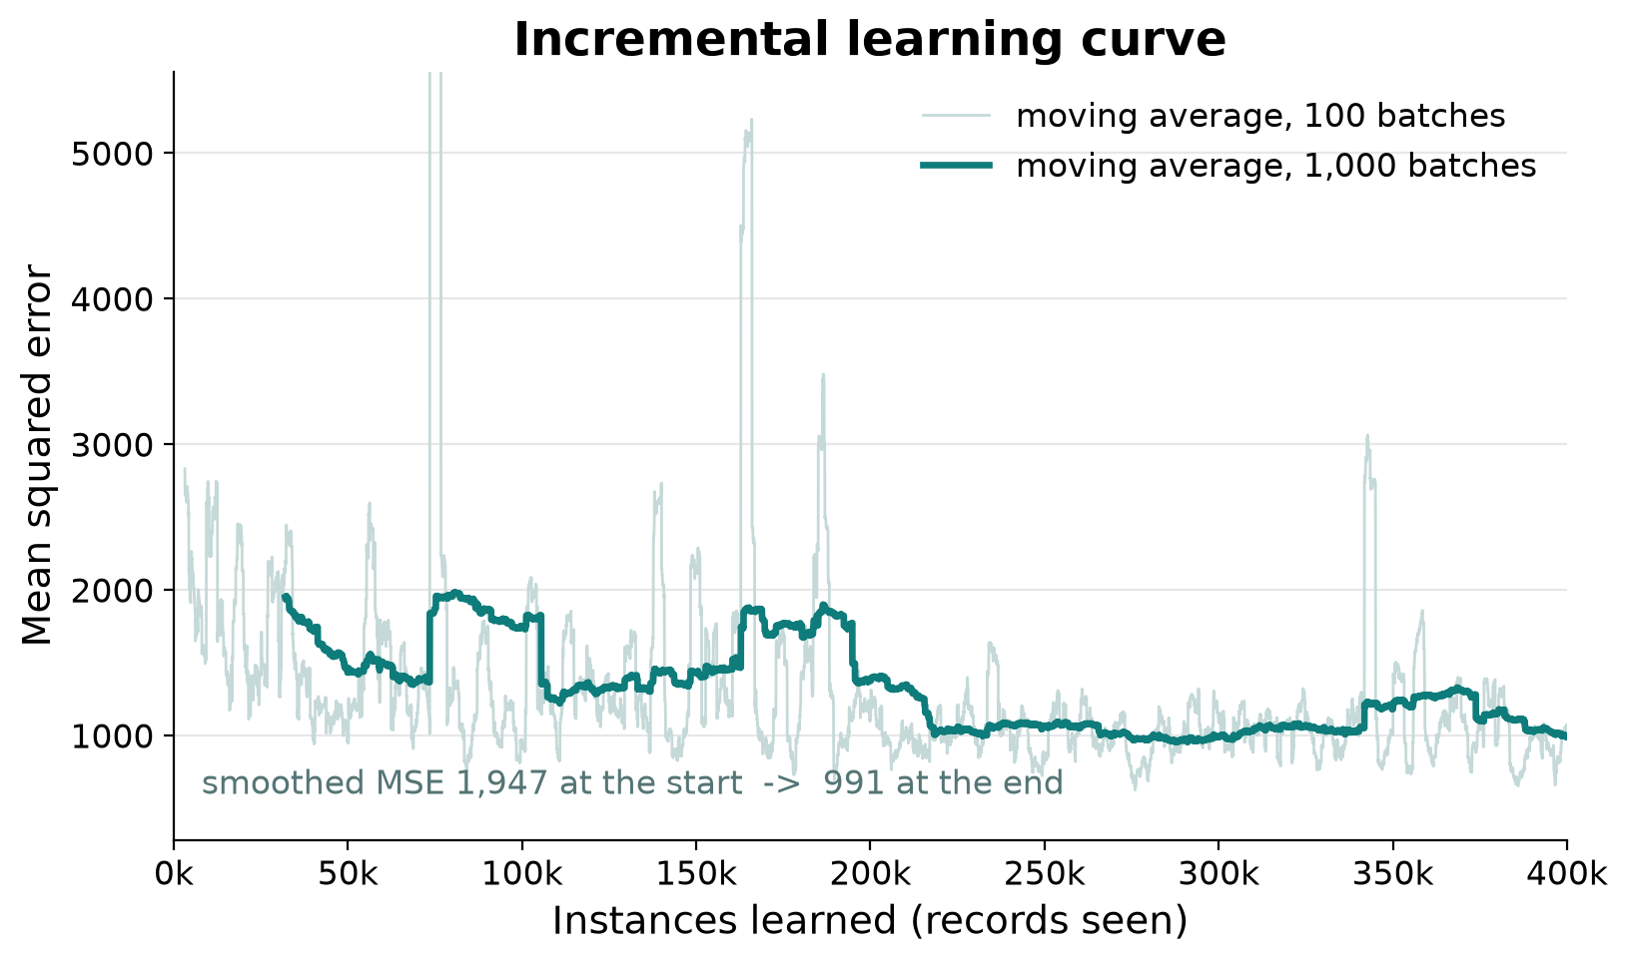
PROGRESS DURING TRAINING
It learned fast, then levelled off
WHAT THIS MEANS
Each point is how wrong the model was, averaged over recent rows. Lower is better.
Error fell by about two-thirds in the first stretch, then flattened — the model had learned what one pass over the data could teach it.
2,831 → 989
average error, start to end
Notes:
The x-axis is how many records the model has seen. Error drops steeply early, then flattens. A second pass would help a little, but true incremental learning sees each record once.

Slide 15
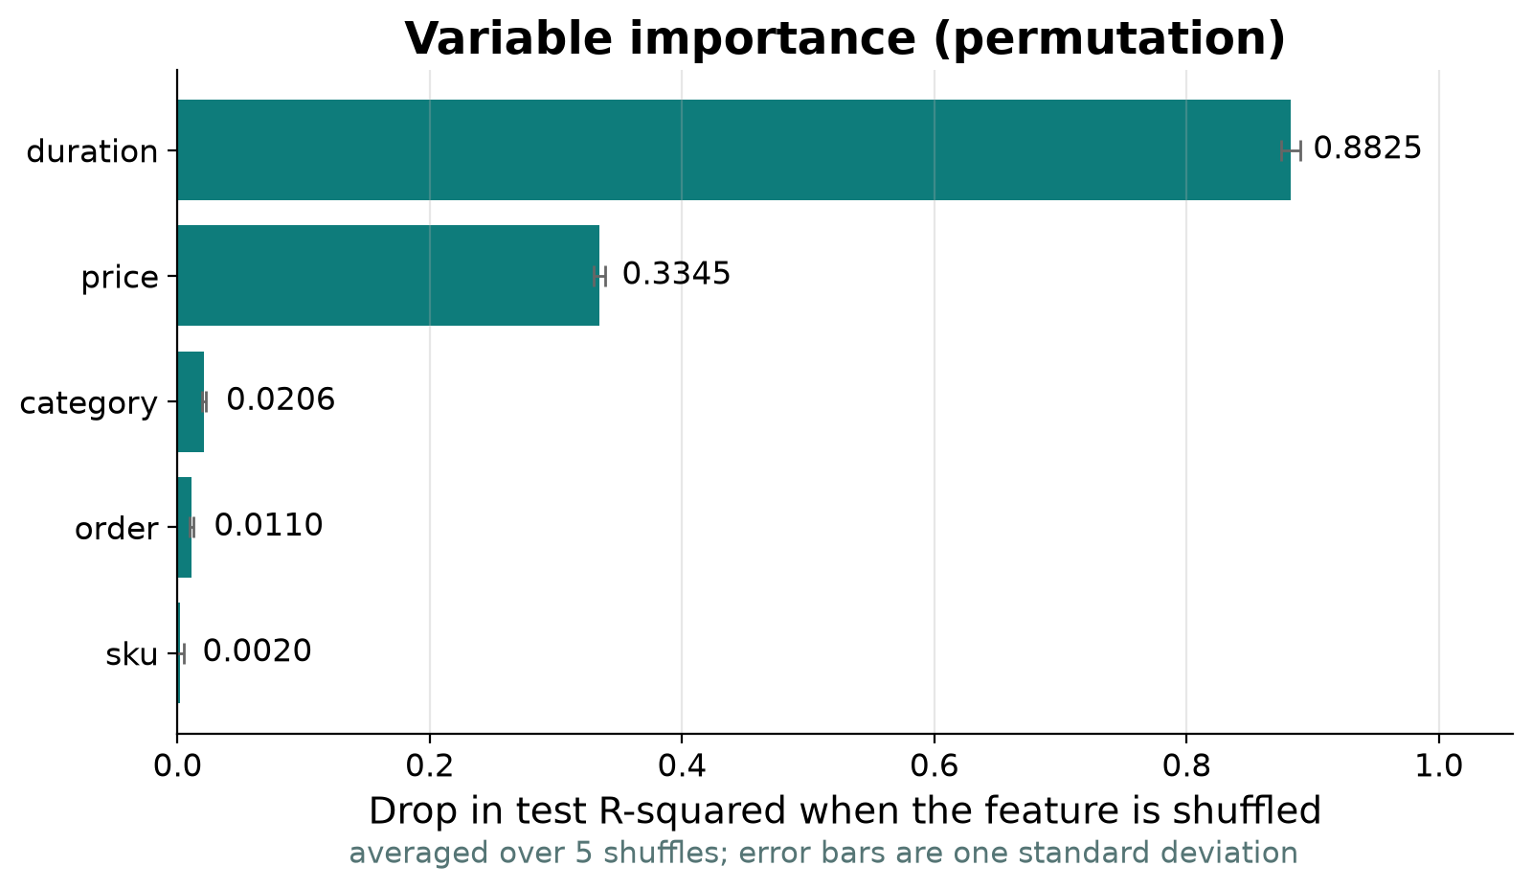
WHICH CLUES THE MODEL USES
How long it stayed listed matters most
WHAT THIS MEANS
To test a clue, we scramble it and see how much worse the predictions get. Big drop means the model relied on it.
• duration is far and away the strongest
• price matters, but much less
• which product it is barely registers
How long something sits on the site tells you more than what it is.
Notes:
Scrambling duration costs nearly all of our accuracy. Scrambling the product id costs essentially nothing, which means the model learned to ignore it.

Slide 16
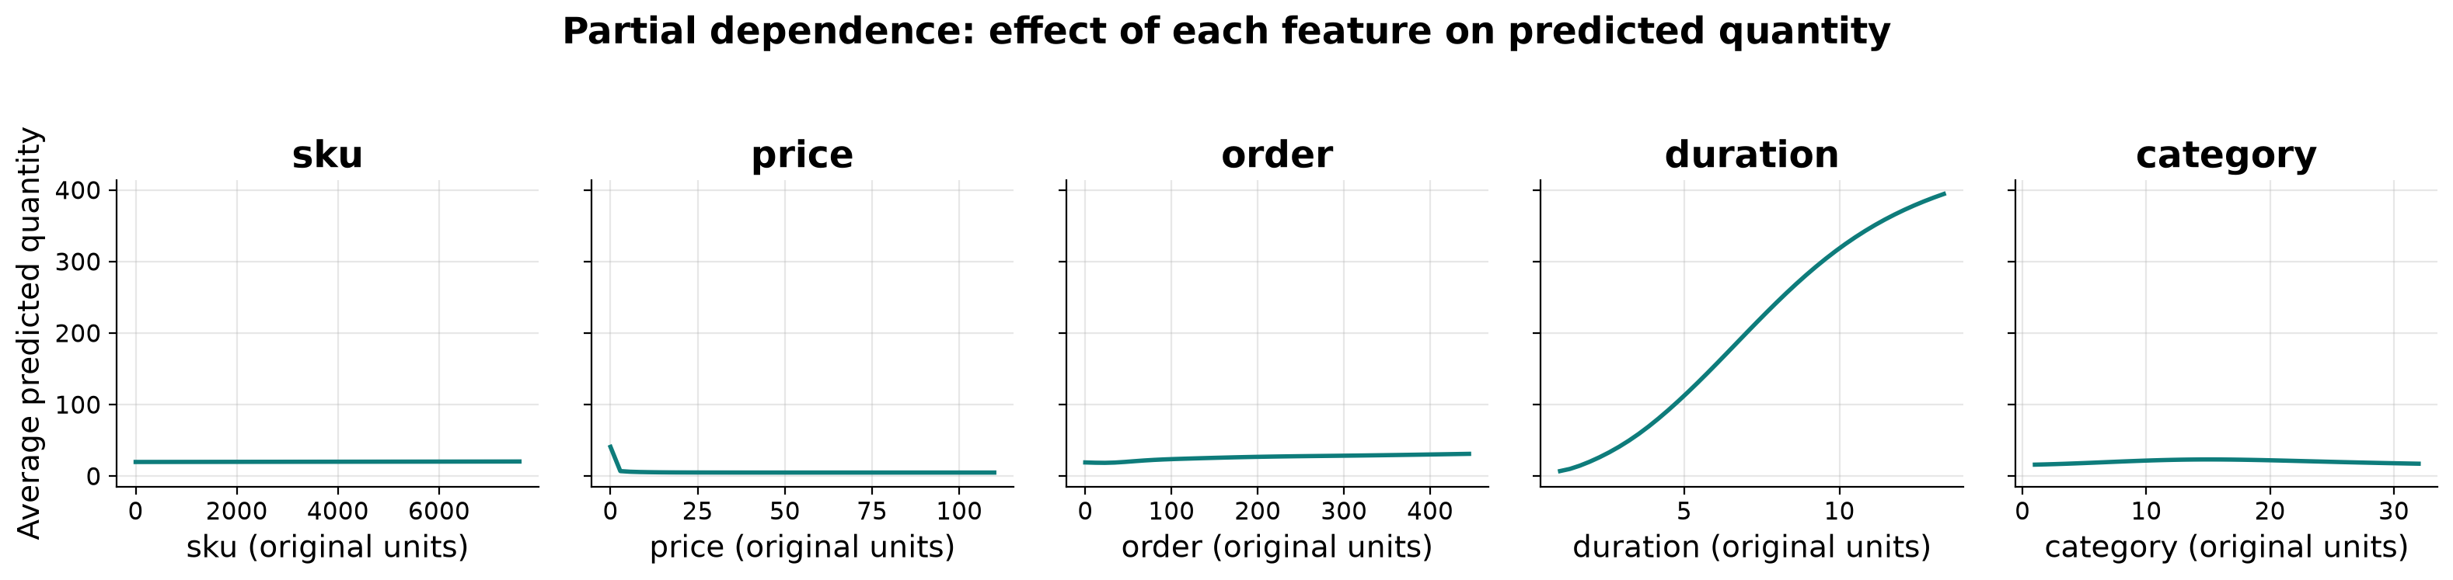
HOW EACH CLUE MOVES THE PREDICTION
Longer listings sell far more
WHAT THIS MEANS
We pretend every product had the same value for one clue, predict, and average. Then we slide that value across its whole range.
duration climbs steeply · price drops off · the rest are nearly flat
Notes:
These five panels say which direction each clue pushes the prediction, and how hard. Duration spans nearly 390 units of predicted sales. Product id spans less than one.

Slide 17
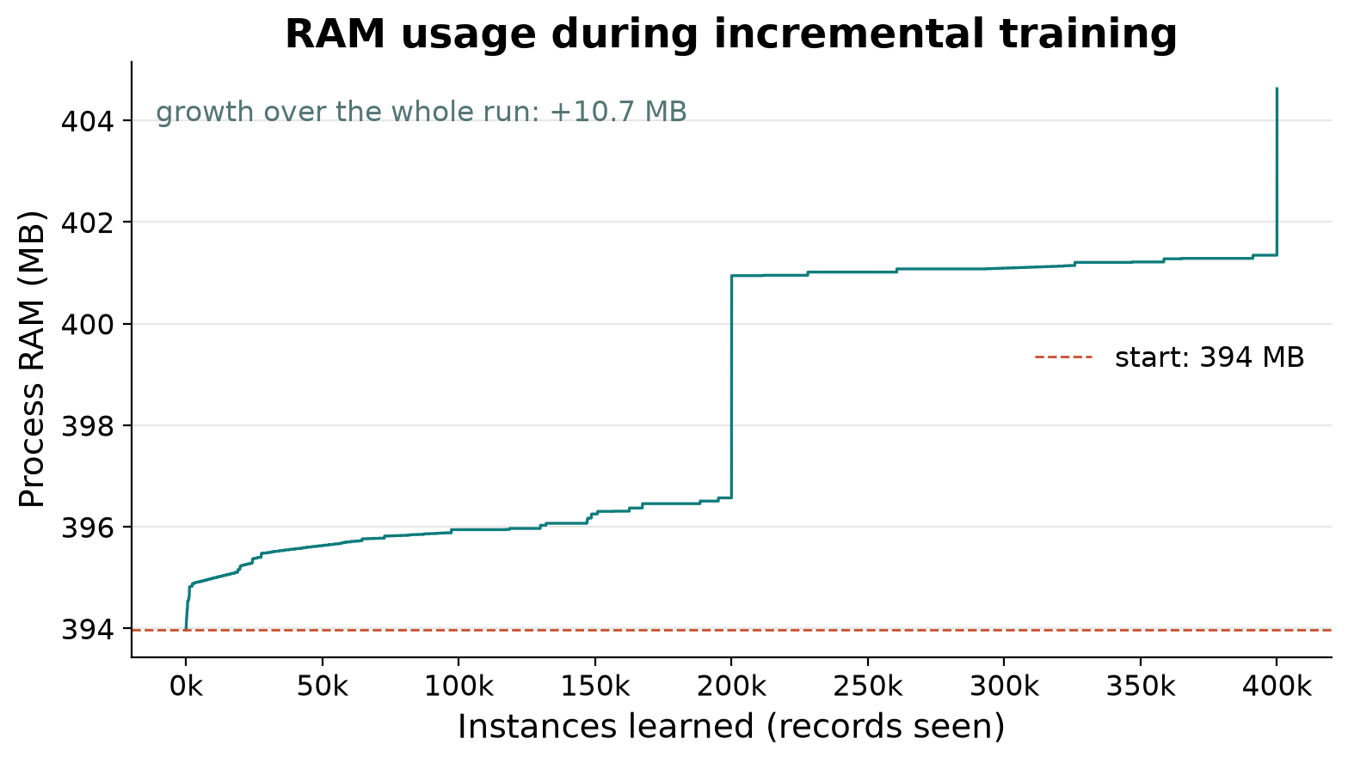
DID WE STAY INSIDE THE CONSTRAINT
Memory never grew
WHAT THIS MEANS
If chunks were piling up in memory, this line would climb steadily. It does not.
+10.7 MB
across all 400,000 records
405 MB
The one-time step early on is the first chunk and the shuffle window being allocated. After that it is flat.
peak, out of 14,171 available
Notes:
Two numbers here. About 40 MB is allocated once, at the start, for the first chunk, the shuffle window and TensorFlow itself. After that, across 400,000 records, memory moves by only 10.7 MB. That is the evidence that nothing is accumulating.

Slide 18
SPEED
The whole thing runs in under a minute
31 s
12,726
40 s
to learn from 400,000 records
records per second
start to finished plots
• One command produces the model, the scores and every plot in this deck
• At this rate, 100 million rows would take about two hours
• And it would use the same amount of memory it does now
Notes:
Speed was never the constraint. Memory was. The point of the last line is that the approach scales: more data costs more time, not more memory.

Slide 19
What we would do next
• Treat product and category as labels, not numbers — right now the model is told product 5,000 is bigger than product 2,500
• Fix the random starting point so every run gives exactly the same answer
• Try a different building block in the middle layers; the one we were given learns slowly
• Measure what a second pass over the data would buy us
Group 7 · Ansley Smith, Rebecca Drake, Ximin Zeng
Notes:
The first one is the biggest missed opportunity, though the importance chart suggests the model already worked around it.

Slide 20
WHO DID WHAT
Contributions
AS
RD
XZ
Ansley Smith
Rebecca Drake
Ximin Zeng
Fill in before submitting
Fill in before submitting
Fill in before submitting
Replace the three placeholders with each member’s actual contribution before submitting.
Notes:
Fill this in as a team before submitting.

