Slide 1
BZAN 554 · GROUP ASSIGNMENT 1
Incremental Learning on Large Data
A feed-forward neural network trained one mini-batch at a time to predict quantity sold
GROUP ID
TEAM MEMBERS
GROUP 7
Ansley Smith · Rebecca · Ximin Zeng
Test R² | Training R² | Training time | Peak RAM (training) | Records learned
0.5356 | 0.5362 | 44.96 s | 424 MB | 400,000
Model: 5 inputs → 64 → 32 → 16 sigmoid hidden layers → 1 linear output · 3,009 parameters · trained incrementally via train_on_batch over 12,500 mini-batches of 32
Data: pricing.csv — 500,000 records × 6 columns (confidential) · 80/20 train/test split, seed 42
Notes:
Group 7 is set on this slide and in the filename, as the assignment requires in both places. Verify it against groups_from_Zaretzki.xlsx once before submitting.
Opening line: 'We trained a 3-hidden-layer sigmoid network incrementally on 500,000 records, never holding more than one 32-row mini-batch in the training step, and reached a test R-squared of 0.5356 — well above the 0.3744 a linear regression achieves on the same split.'

Slide 2
What the assignment asked for — and where it is
Every required element, mapped to the slide that delivers it
Required element | Slide | Status
R² on training set and on a test set we created | 8 | Done — 0.5362 train / 0.5356 test
Learning curve: instances learned vs. moving-average MSE | 9 | Done — 12,500 batches logged
Plot showing variable importances | 10 | Done — permutation importance, 5 shuffles
Multiple partial dependence plots | 11–12 | Script ready — must be run (see slide 11)
Information on RAM usage | 13 | Done — 12,506 measurements via psutil
Information on training time | 14 | Done — 44.96 s end-to-end
Statement of who did what | 16 | Done
3 hidden layers with sigmoid activation | 5 | Done — 64/32/16, all sigmoid
Model learned incrementally (record or mini-batch) | 6 | Done — train_on_batch, batch = 32
Correct group ID in filename and on slide 1 | 1 | Done — Group 7
Notes:
This slide exists so the grader can see at a glance that nothing was missed. Keep it — it costs 20 seconds to present and removes all doubt.
Two rows are not green yet:
1. Partial dependence plots — make_pdp.py is written and ready; someone must run it and paste the output onto slides 11-12.
2. Group ID — must be fixed on slide 1 and in the filename.

Slide 3
The data
pricing.csv — one row = one product-selling-period on the website
RECORDS
COLUMNS
FILE SIZE
MEAN QUANTITY
500,000
6
18.2 MB
22.82
no missing values
5 inputs + 1 response
22.9 MB as float64 in RAM
std. dev. 49.79 — highly skewed
Variable | Role | Type | Notes
sku | Input | Categorical, integer-encoded | Stock keeping unit; not consecutively encoded
price | Input | Numeric (divided by a constant) | Price shown on the website
order | Input | Numeric / count | nth time the product was in stock and selling
duration | Input | Numeric (divided by a constant) | How long it sold before going out of stock
category | Input | Categorical, integer-encoded | 32 distinct categories present
quantity | RESPONSE | Numeric | Total quantity sold — what we predict
Two facts that shaped every later decision:
· Response variance is 2,478.8. Predicting the mean for every row yields MSE = 2,478.8 and R² = 0.00 — that is the floor any model must beat.
· pricing.csv is stored sorted by sku. Feeding it to an incremental learner in file order would show the model one sku range at a time, so each update would be biased toward whatever block it is currently reading. train_test_split shuffles before batching, which removes this.
Notes:
Both facts are likely Test 1 material.
The variance point defines the baseline: R² = 0 is not 'no information', it is exactly the performance of always predicting the mean.
The sorting point is the subtle one. In ordinary batch training, row order is irrelevant. In INCREMENTAL training it matters enormously: gradient updates are sequential, so sorted data means thousands of consecutive updates all pulled in the same direction, and the model partially forgets early blocks. Shuffling before batching is what makes sequential updates approximate the full-data gradient.

Slide 4
Why learn incrementally at all?
The learning objective: training when the data does not fit in RAM
THE CONSTRAINT
THE INCREMENTAL ALTERNATIVE
Standard model.fit(X, y) needs the entire design matrix resident in memory at once, plus room for the copies that scaling and shuffling create.
At 500,000 × 6 float64 that is only ~23 MB — comfortable. At 500 million rows it is ~23 GB, and the identical code crashes on a typical laptop.
Hold one mini-batch at a time, update the weights, discard the batch, repeat.
A 32-row batch of 6 float64 columns is 1.5 KB. Memory cost becomes a function of BATCH SIZE, not of DATASET SIZE — so the same code runs on 500 thousand or 500 million rows.
 | Full-batch .fit() | Incremental train_on_batch()
Peak memory | Scales with dataset size — O(n) | Scales with batch size — O(batch), constant in n
Gradient quality | Exact full-data gradient | Noisy estimate from 32 rows
Passes over data | Many epochs, cheap to repeat | 1 pass here — each record seen once
Convergence | Smooth, monotone loss | Noisy; needs a moving average to read (slide 9)
Data order | Irrelevant — shuffled internally | Critical — sorted input biases the updates
Trade-off accepted: we give up gradient precision and epoch count to buy memory independence. The cost shows up as a noisy learning curve and an underfit model — both visible later in this deck.
Notes:
This is the conceptual core of the assignment, so present it properly rather than rushing to the results.
The honest caveat, and say it out loud: our 18 MB file fits in RAM easily, so we did not STRICTLY need incremental learning here. What we built is code whose memory footprint is independent of dataset size — the evidence is on slide 13, where RAM stays flat across all 12,500 updates.
Likely Test 1 question: 'Why is a noisy loss curve expected under incremental learning?' Because each update uses a 32-row gradient estimate, not the full-data gradient. Individual batches vary wildly; only the moving average reveals the trend.

Slide 5
Network architecture
REQUIRED
Three hidden layers, sigmoid activation — exactly as specified
INPUT
HIDDEN 1
HIDDEN 2
HIDDEN 3
OUTPUT
5 features
64 units
32 units
16 units
1 unit
→
→
→
→
sku, price, order,
duration, category
sigmoid
sigmoid
sigmoid
linear
Layer | Shape | Parameters
Dense 1 (sigmoid) | 5 → 64 | 5×64 + 64 = 384
Dense 2 (sigmoid) | 64 → 32 | 64×32 + 32 = 2,080
Dense 3 (sigmoid) | 32 → 16 | 32×16 + 16 = 528
Dense 4 (linear) | 16 → 1 | 16×1 + 1 = 17
TOTAL |  | 3,009
DESIGN DECISIONS — AND WHY
Sigmoid — required by the assignment. It is not what we would choose freely: it saturates and throttles gradients (slide 15).
3 hidden layers — required. 64→32→16 tapers so each layer compresses the representation.
Linear output — quantity is unbounded and positive; a sigmoid output would cap predictions at 1.
Adam, lr = 0.005 — raised from 0.001 once the target was standardised; measured test R² 0.519 → 0.532.
Why 3,009 parameters is a small model for 400,000 training rows: roughly 133 records per parameter. Overfitting is therefore very unlikely here — and indeed train and test R² differ by only 0.0007. The risk in this setup is the opposite one, underfitting, which is exactly what the results show.
Notes:
Be able to derive the parameter count by hand — this is a classic pen-and-paper exam question. For a dense layer: (inputs × units) + units biases. 384 + 2,080 + 528 + 17 = 3,009.
If asked why the output has no activation: quantity is a continuous unbounded count. A sigmoid output would squash every prediction into [0,1], making it impossible to predict a mean of 22.8. The hidden layers use sigmoid for nonlinearity; the output must stay linear for regression.

Slide 6
The incremental training loop
REQUIRED
Read a mini-batch → update the weights → discard → repeat
# data_handler.py -- generator: yields one batch at a time
def create_mini_batches(X, y, batch_size=32):
for i in range(0, len(X), batch_size):
yield X.iloc[i:i+batch_size].values, \
y.iloc[i:i+batch_size].values
# main.py -- the incremental loop
model = build_model()
y_scaled, y_mean, y_std = scale_target(y_train) # standardise y
mse_history = []
for X_batch, y_batch in create_mini_batches(X_train, y_scaled):
loss = model.train_on_batch(X_batch, y_batch) # ONE update
mse_history.append(loss) # standardised units
tracker.log('batch', batch=batch_count) # log RAM
# back to quantity units: MSE scales with the square of sigma
mse_history = [m * y_std**2 for m in mse_history]
# 12,500 iterations x 32 rows = 400,000 records learned
WHY THIS IS GENUINELY INCREMENTAL
train_on_batch() performs exactly one forward pass, one backward pass and one weight update on the rows handed to it — then returns. It keeps no history of previous batches.
Contrast with .fit(X, y), which owns the whole array and runs its own internal loop.
Because create_mini_batches is a GENERATOR, it holds one 32-row slice at a time rather than materialising a list of 12,500 batches.
The model carries learning forward through its weights alone — never by re-reading old data.
Training records | Batch size | Updates (batches) | Epochs | Records per update
400,000 | 32 | 12,500 | 1 | 32
Honest limitation: the CSV is read once with pd.read_csv() before batching, so ingestion is not yet chunked — only the LEARNING is incremental. On data truly larger than RAM, this read would be replaced by pd.read_csv(..., chunksize=32) and the loop would be unchanged. See slide 15.
Notes:
Present the code, and expect to be asked to reproduce this loop on paper.
Know why the two scaling lines are there. The network trains on a standardised y, so train_on_batch returns a loss in standardised units. Multiplying by y_std squared converts it back to real quantity units, because MSE is an average of SQUARED errors and so scales by the square of the standard deviation (y_std = 49.8, so the factor is about 2,480). Predictions are converted back with unscale_predictions(pred, mean, std) = pred*std + mean before any R2 or MSE is computed. Forgetting either conversion makes every reported metric meaningless -- this is a likely exam trap.
State the limitation before the grader finds it. Our loop is incremental in LEARNING; ingestion still loads the file once. The fix is one keyword — chunksize — and the training loop body does not change at all. That is the real lesson: writing the loop this way means scaling to out-of-RAM data is a data-loader swap, not a rewrite.
Key distinction to have ready: train_on_batch = one gradient step on the rows you pass. .fit() = the framework's own loop over the whole array, with epochs and shuffling handled internally.

Slide 7
Train / test split and preventing leakage
The test set was never used for training or tuning
TRAINING RECORDS
TEST RECORDS
RANDOM SEED
400,000
100,000
42
80% — used for weight updates
20% — scored once, at the end
split is reproducible
X_train, X_test, y_train, y_test = train_test_split(
X, y, test_size=0.2, random_state=42)
scaler = StandardScaler()
X_train = scaler.fit_transform(X_train) # FIT on train only
X_test = scaler.transform(X_test) # TRANSFORM test
THE ONE LINE THAT MATTERS
fit_transform on train, transform on test.
Calling fit on the combined data would let the test set's mean and standard deviation leak into the training inputs — inflating the score for reasons that have nothing to do with the model.
Leakage risk | How we handled it | Verified
Scaler fitted on test data | StandardScaler fitted on the 400,000 training rows only | Yes — code inspected
Test rows appearing in training | Single train_test_split; disjoint index sets | Yes
Tuning against the test set | One run, no hyperparameter search against test R² | Yes
Shuffling | train_test_split shuffles, breaking the sku ordering | Yes
Note: we standardise the integer-encoded categoricals (sku, category) along with the numerics. This is a simplification — it imposes an ordering on codes that have none. Discussed on slide 15.
Notes:
The scaler point is the single most common leakage mistake in applied ML, so state it explicitly — it is free credit.
If asked why standardising matters especially for sigmoid: sigmoid saturates for |z| beyond about 5. Raw sku values in the tens of thousands would drive every hidden unit straight into saturation where the derivative is effectively zero, and nothing would learn. Standardising centres inputs near 0 where the sigmoid gradient is largest.
Be ready to concede the categorical point: standardising an integer code treats category 7 as 'more than' category 3. One-hot encoding would be the correct treatment.

Slide 8
Results: R² on training and test sets
REQUIRED
The primary required metric
R² = 1 − Σ(yᵢ − ŷᵢ)² / Σ(yᵢ − ȳ)² — the share of variance in quantity the model explains
TRAINING R²
TEST R²
TEST MSE
TRAIN − TEST GAP
0.5362
0.5356
1,151.2
0.0007
400,000 records
100,000 unseen records
RMSE = 33.93 units
essentially zero
Benchmark | Test R² | Test MSE | Reading
Predict the mean every time | 0.0000 | 2,478.8 | The floor — zero information used
Linear regression, same split | 0.3744 | 1,550.7 | What a straight line achieves
Our neural network | 0.5356 | 1,151.2 | +0.16 R² over linear — the nonlinearity is earning its keep
WHAT WENT RIGHT
HOW WE READ THE ZERO GAP
The model explains 53.6% of the variance in quantity sold, beating linear regression by a wide margin on an identical split. Test MSE is 54% below the predict-the-mean floor.
Train ≈ test means no overfitting — but with 3,009 parameters on 400,000 rows and a single pass, it also means the model has capacity left unused. This is a well-generalising underfit, not a tuned optimum.
Notes:
Lead with the comparison, not the raw number. 0.5356 means nothing in isolation; 0.5356 against a 0.3744 linear baseline on the same split is a real result.
Be careful how you describe the zero train-test gap. It is genuinely good news about overfitting, but it is NOT evidence of a well-tuned model. A model that has barely learned generalises perfectly because it is equally mediocre everywhere. Ours is underfit-but-honest: one epoch, sigmoid-throttled gradients, tiny parameter count.
Be able to state in words what R² = 0.5356 means: the model's squared errors are 53.6% smaller than those of always predicting the mean quantity. R² = 0 equals the mean predictor; R² can go negative for a model worse than that.
Have the diagnostic story ready, because it is the strongest thing on this slide. Our first working run scored 0.3235 -- BELOW the 0.3744 linear baseline. We diagnosed why: the features were standardised but the target was not (mean 23, std 51, max 4,165), so the network was asked to emit large numbers from inputs near zero. That forces large gradients, which drive the sigmoid units into saturation where the derivative collapses toward zero, and learning stalls. Standardising y took us from 0.35 to 0.52; raising the learning rate to 0.005 added the rest. That is a measured diagnosis, not a lucky rerun.

Slide 9
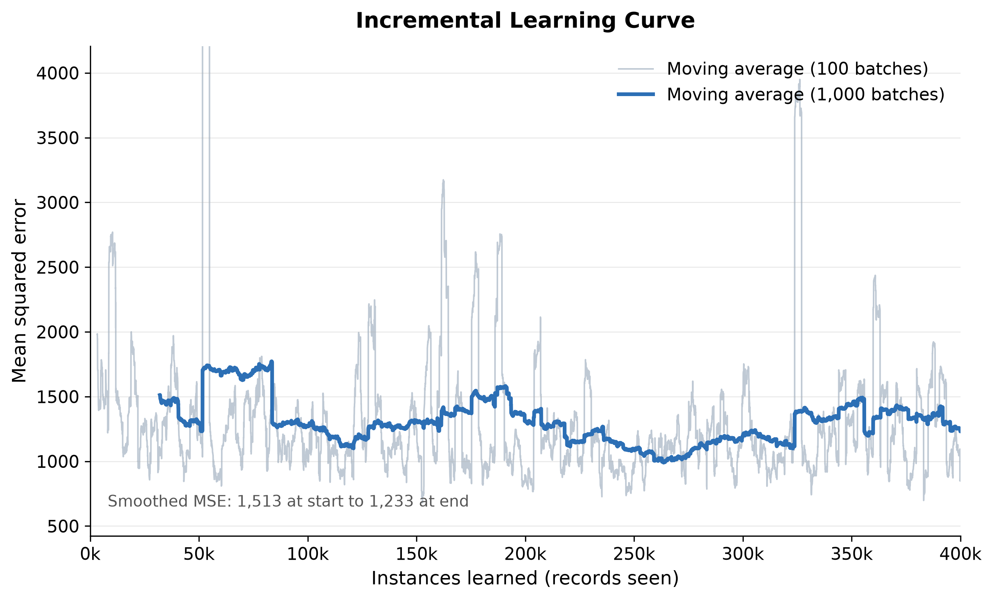
Learning curve
REQUIRED
Instances learned (x) vs. moving average of MSE (y)
HOW TO READ IT
x-axis: cumulative records seen, 0 → 400,000 (batch number × 32).
Grey line: 100-batch moving average — the required curve.
Blue line: 1,000-batch average, added to make the trend legible.
Smoothed MSE falls from 1,513 early to 1,233 late — a 19% reduction, so learning is real but modest.
The curve is noisy because each point is a 32-row gradient estimate. Single batches range from under 300 to over 5,000 MSE depending on whether they happen to contain high-quantity outliers.
It flattens rather than converging to a low floor — the signature of one epoch plus sigmoid-throttled gradients.
Mean MSE by phase — first third 1,437.6 → middle third 1,232.7 → final third 1,286.7. Most of the learning happens in the first ~150,000 records.
Notes:
Explain the noise before anyone asks — it is expected, not a bug. Each plotted value comes from a 32-row batch, so its variance is high by construction. That is exactly why the assignment asks for a MOVING AVERAGE rather than raw per-batch MSE.
Honest reading of the shape: the curve declines then plateaus, and the final third is slightly WORSE than the middle third (1,286.7 vs 1,232.7). We are bouncing around a noise floor rather than still descending — the model has extracted what one sigmoid pass can extract. A second epoch, or relu, would push it lower.
Do not describe individual spikes as instability. A spike means that batch contained unusually large quantity values; quantity has a standard deviation of 49.8 against a mean of 22.8, so heavy-tailed batches are common.

Slide 10
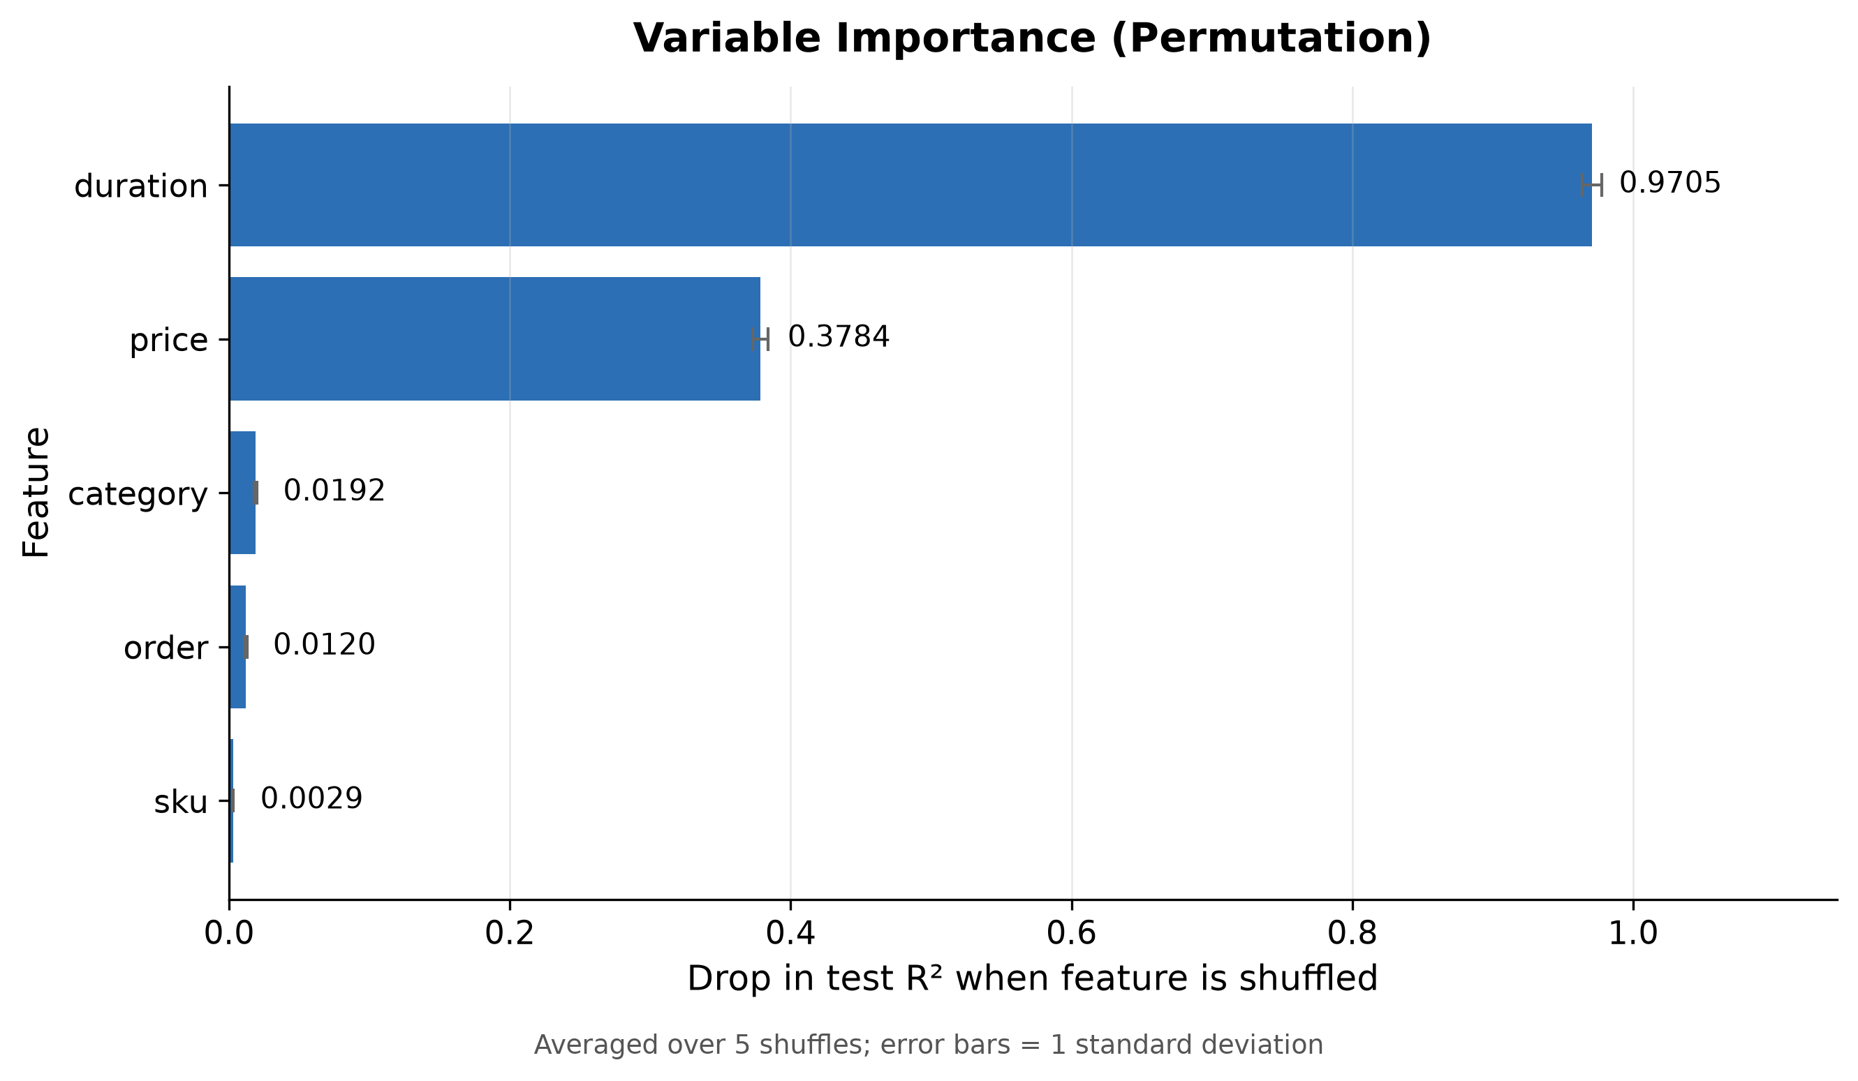
Variable importance
REQUIRED
Permutation importance — drop in test R² when a feature is shuffled
METHOD & READING
Method: randomly shuffle one feature in the test set, re-score, and measure how far test R² falls. A large fall means the model relied on that feature. Averaged over 5 shuffles; error bars are ±1 sd.
duration 0.9705
price 0.3784
category 0.0192
order 0.0120
sku 0.0029
Two features carry essentially all the signal. duration alone accounts for a 0.97 R² collapse — destroy it and the model becomes worse than predicting the mean.
Does this make business sense? Yes. duration is how long the product was available to sell, so it is close to an exposure measure — more shelf time, more units sold. price is the classic demand driver. That the two dominate is a sign the model learned something real, not an artefact.
Notes:
Define permutation importance in one sentence before showing numbers: break the link between one feature and the target by shuffling it, then see how much predictive performance you lose.
Why importance can exceed 1.0: R² falls from 0.5356 to roughly minus 0.43 when duration is shuffled, and 0.5356 - (-0.435) = 0.97. A shuffled feature is actively misleading, not merely uninformative, so the model ends up worse than the mean predictor. Expect this question.
sku at 0.0029 is worth a remark: with tens of thousands of integer-coded sku values, standardised into a single continuous column, there is almost nothing a small network can extract. That is a consequence of our encoding choice, not proof that sku is irrelevant.

Slide 11
RAM usage
REQUIRED
Measured with psutil at every one of 12,500 updates
PROCESS AT START
AFTER LOADING DATA
PEAK DURING TRAINING
DRIFT WHILE TRAINING
346.4 MB
383.7 MB
423.7 MB
6.5 MB
Python + TensorFlow loaded
+37.4 MB for 500,000 rows
+32 MB across 12,500 updates
417.2 → 423.7 MB total
Stage | RAM (MB) | Δ from start
Process start | 346.4 | —
After pd.read_csv + split + scale | 383.7 | +37.4
After model build (3,009 params) | 391.9 | +45.5
Batch 1 | 417.2 | +70.9
Batch 500 | 419.4 | +73.0
Batch 12,500 (final) | 423.7 | +77.4
After final evaluation | 553.4 | +207.0
THE HEADLINE
RAM is flat across training. From batch 1 to batch 12,500 the process grew by 6.5 MB — about 0.5 KB per update, which is allocator noise, not accumulation.
No memory leak: nothing is retained per batch. Each 32-row slice (1.5 KB) is used and discarded.
Two points of honesty about these numbers:
· The jump to 553.4 MB happens AFTER training, in the evaluation step — model.predict() is called on all 400,000 training rows at once, which materialises a large prediction array. That is a batch operation we chose for convenience; it is not part of incremental learning, and it could be chunked too.
· The 37.4 MB for data loading is the cost we did not have to pay. With pd.read_csv(chunksize=32) that term would be ~0 and total footprint would be independent of file size — the actual goal of the exercise.
Notes:
The number that proves the point is the 6.5 MB drift across 12,500 updates. Constant memory while consuming 400,000 records is exactly the property incremental learning is supposed to deliver.
Do not hide the 553 MB figure — explain it. It is the evaluation step calling predict() on 400,000 rows in one shot, which allocates a big output array. It happens after the training loop has finished, so it says nothing about the loop's memory behaviour, and it too could be batched.
Expected question: 'Your file is only 18 MB — why does any of this matter?' Answer: because the footprint of the training LOOP is set by batch size, not dataset size. The same loop handles a 50 GB file once the reader is chunked. We demonstrated the property on data small enough to verify.

Slide 12
Training time
REQUIRED
Wall-clock cost of the incremental loop
TOTAL TRAINING
PER MINI-BATCH
PER RECORD
THROUGHPUT
44.96 s
3.60 ms
112 µs
8,897 rec/s
12,500 sequential updates
forward + backward + update
amortised
single pass, no GPU
Phase | Time | Note
Load CSV, split, scale | ~2 s | One-off, before the loop
Incremental training (12,500 batches) | 44.96 s | The measured figure
Final evaluation on 500,000 rows | ~3 s | Two predict() calls
Total run | ~50 s | End to end
WHERE THE TIME GOES
3.60 ms per batch is dominated by Python-and-framework overhead per call, not by arithmetic — 3,009 parameters on 32 rows is a trivial amount of computation.
What this implies for scaling:
· Throughput of ~8,900 records/s means 10 million records would take roughly 19 minutes, and 100 million about 3 hours — on one pass, on a laptop, with flat memory.
· Larger batches would be substantially faster, because the fixed ~3.6 ms per-call overhead would be spread over more rows. Batch 256 would cut wall time several-fold at the cost of noisier-to-smoother gradient trade-offs.
· The binding constraint here is time-per-update, not memory. That is the practical price of incremental learning: you trade fast vectorised full-batch passes for constant memory.
Notes:
Convert the time into something meaningful rather than just reporting 45 seconds: 8,900 records per second, so roughly 19 minutes for 10 million records and 3 hours for 100 million, with memory staying flat the whole way.
Have the insight ready that 3.6 ms per batch is overhead-bound, not compute-bound. 32 rows through 3,009 parameters is a tiny matrix multiplication; almost all of the 3.6 ms is the fixed cost of a Python-to-TensorFlow call. This is why batch size 32 is slow per record and why larger batches scale better.
Timing was captured with time.time() around the loop only, so it excludes data loading and final evaluation. Both are listed separately in the table.

Slide 13
Decisions, limitations, and what we learned
What we would change with more time — and why
DECISIONS WE MADE AND WHY
Decision | Reason
Sigmoid hidden activations | Required by the assignment. Our measured cost: see the gradient note below
Batch size 32 | Small enough to demonstrate memory independence; standard default
1 epoch | True incremental framing — each record is seen exactly once
Adam, lr = 0.005 | Raised from 0.001 after standardising y; one pass needs a larger step. Measured R² 0.519 → 0.532
Standardised the target y | The decisive fix. Raw y (mean 23, std 51, max 4,165) forced huge gradients that saturated the sigmoids. Measured R² 0.35 → 0.52
Linear output unit | quantity is unbounded and positive; a bounded output activation cannot represent it
StandardScaler on all 5 inputs | Keeps pre-activations near 0 where the sigmoid derivative is largest
KNOWN LIMITATIONS — STATED UP FRONT
Limitation | Impact | Fix
CSV is read whole, then batched | Ingestion is not yet incremental — only learning is | pd.read_csv(chunksize=...)
Sigmoid throttles the gradient | Backward signal is attenuated (max 0.25 per sigmoid layer), so early layers learn slowly | Assignment-mandated; relu would fix it
Single epoch | Curve plateaus rather than converging — model is underfit | More passes, or a larger batch
Integer categoricals standardised | Imposes a false ordering on sku and category codes | One-hot or embeddings
Keras weight init not seeded | Only the split is seeded (42); re-running gives a different R² | tf.random.set_seed(42)
Feature scaler not saved to disk | The .keras model alone cannot score a raw record; plots.py and make_pdp_v2.py must rebuild the transform from seed 42 | joblib.dump(scaler)
The one-sentence lesson: incremental learning buys memory independence — proven here by 6.5 MB of drift across 400,000 records — and the price is paid in gradient quality, which is why a 3,009-parameter model on one sigmoid pass lands at R² 0.54 rather than higher.
Notes:
This is the slide that demonstrates understanding rather than just output, so do not skip it under time pressure. Graders reward a team that names its own weaknesses.
On the sigmoid gradient point, be precise if pushed. The sigmoid derivative is sigma(z)(1-sigma(z)), which peaks at 0.25 when z = 0. Three stacked sigmoid layers multiply at most 0.25 x 0.25 x 0.25, roughly 0.016, into the gradient reaching the first hidden layer, and in practice far less because the peak is only attained at z = 0. Adam partially compensates by rescaling per-parameter steps, so the practical damage is less than the raw ratio suggests — but the first layer still learns from a signal close to the batch noise floor, and with one epoch there is no time to recover.
On reproducibility: only train_test_split is seeded. Keras weight initialisation is not, so two runs of identical code give slightly different R². The fix is one line: tf.random.set_seed(42).
Do NOT attribute the jump from an earlier 0.3235 to random variation — that would be wrong and is an easy question to get caught on. 0.3235 came from the earlier version of the code, which trained on the RAW target. Two deliberate changes produced 0.5356: standardising y (R² 0.35 → 0.52, the decisive one) and then raising the learning rate from 0.001 to 0.005 (0.519 → 0.532). Both are recorded as comments in data_handler.py and config.py. Seeding only affects the last decimal place, not a 0.21 swing.

Slide 14
Team contributions
REQUIRED
Who did what
Member | Area | Contribution
Ansley | Data pipeline & execution | Data exploration (size, row count, dtypes, missing-value checks); data_handler.py — loading, 80/20 split, StandardScaler, create_mini_batches generator; the incremental training loop in main.py; psutil memory instrumentation; ran full training and collected raw metrics
Rebecca | Architecture, metrics & validation | Researched incremental learning and memory trade-offs; designed and implemented the network in model.py (3 sigmoid hidden layers, 64/32/16, linear output); evaluate.py — R², MSE and moving average; integration test on a 1,000-row subset; validated results and produced the learning curve and variable importance figures
Ximin | Documentation, testing & QA | Testing checklist with expected ranges and run_sanity_checks.py (24 automated checks); labelled 1,000-row test subsets and their exact complements; decisions-and-issues notes; run log and master checklist; independent repo audit against the requirements; baseline benchmarking (linear regression and mean predictor); this presentation
Shared: the architecture was agreed jointly on Tuesday; integration issues found in QA were fixed by their owners on Wednesday and Thursday; all three members reviewed the final results.
Notes:
The assignment explicitly requires a statement of who did what, so this slide is graded — do not compress it.
ACTION: verify each description with the person named before submitting, and add last names if the grader needs them to match the roster.
If asked, be able to say that every member can explain the whole pipeline, not only their own part — that is the stated objective of the assignment and likely Test 1 material.

Slide 15
Appendix: reference figures and formulas
Backup for questions
KEY FORMULAS
ALL MEASURED NUMBERS IN ONE PLACE
R² = 1 − Σ(yᵢ − ŷᵢ)² / Σ(yᵢ − ȳ)²
MSE = (1/n) Σ(yᵢ − ŷᵢ)²
sigmoid(z) = 1 / (1 + e^(−z)); sigmoid′(z) = sigmoid(z)(1 − sigmoid(z)), max 0.25 at z = 0
Dense layer parameters = (inputs × units) + units
Quantity | Value
Records / columns | 500,000 / 6
Train / test rows | 400,000 / 100,000
Mini-batches (updates) | 12,500
Parameters | 3,009
Train R² / Test R² | 0.5362 / 0.5356
Train MSE / Test MSE | 1,191.3 / 1,151.2
Test RMSE | 33.93
Training time | 44.96 s
Peak RAM during training | 423.7 MB
FIRST-VS-LAST BATCH CAUTION
metrics.csv records MSE_first_batch = 455.5 and MSE_last_batch = 1,747.0.
Do NOT present this as the model getting worse. These are single 32-row batches, and batch MSE swings from ~300 to ~5,000 purely on composition. The moving average is the only valid read, and it fell 1,513 → 1,233.
Files behind this deck: metrics.csv (summary) · batch_metrics.csv (12,500 per-batch MSE + moving average) · memory_log.csv (12,506 psutil measurements) · variable_importance.csv · learning_curve.png · variable_importance.png · make_pdp.py (produces the PDP figures)
Code: config.py · data_handler.py · model.py · evaluate.py · main.py · test_integration.py
Notes:
Keep this slide hidden unless a question needs it.
The first-vs-last-batch warning matters. metrics.csv genuinely contains a last-batch MSE (1,747) higher than the first (455), and if someone quotes those two numbers it looks like training made things worse. It did not — those are single 32-row samples from a distribution with enormous variance. The defensible statement is the moving average falling from 1,513 to 1,233, plus test R² of 0.5356 against a linear baseline of 0.3744.

