Slide 1
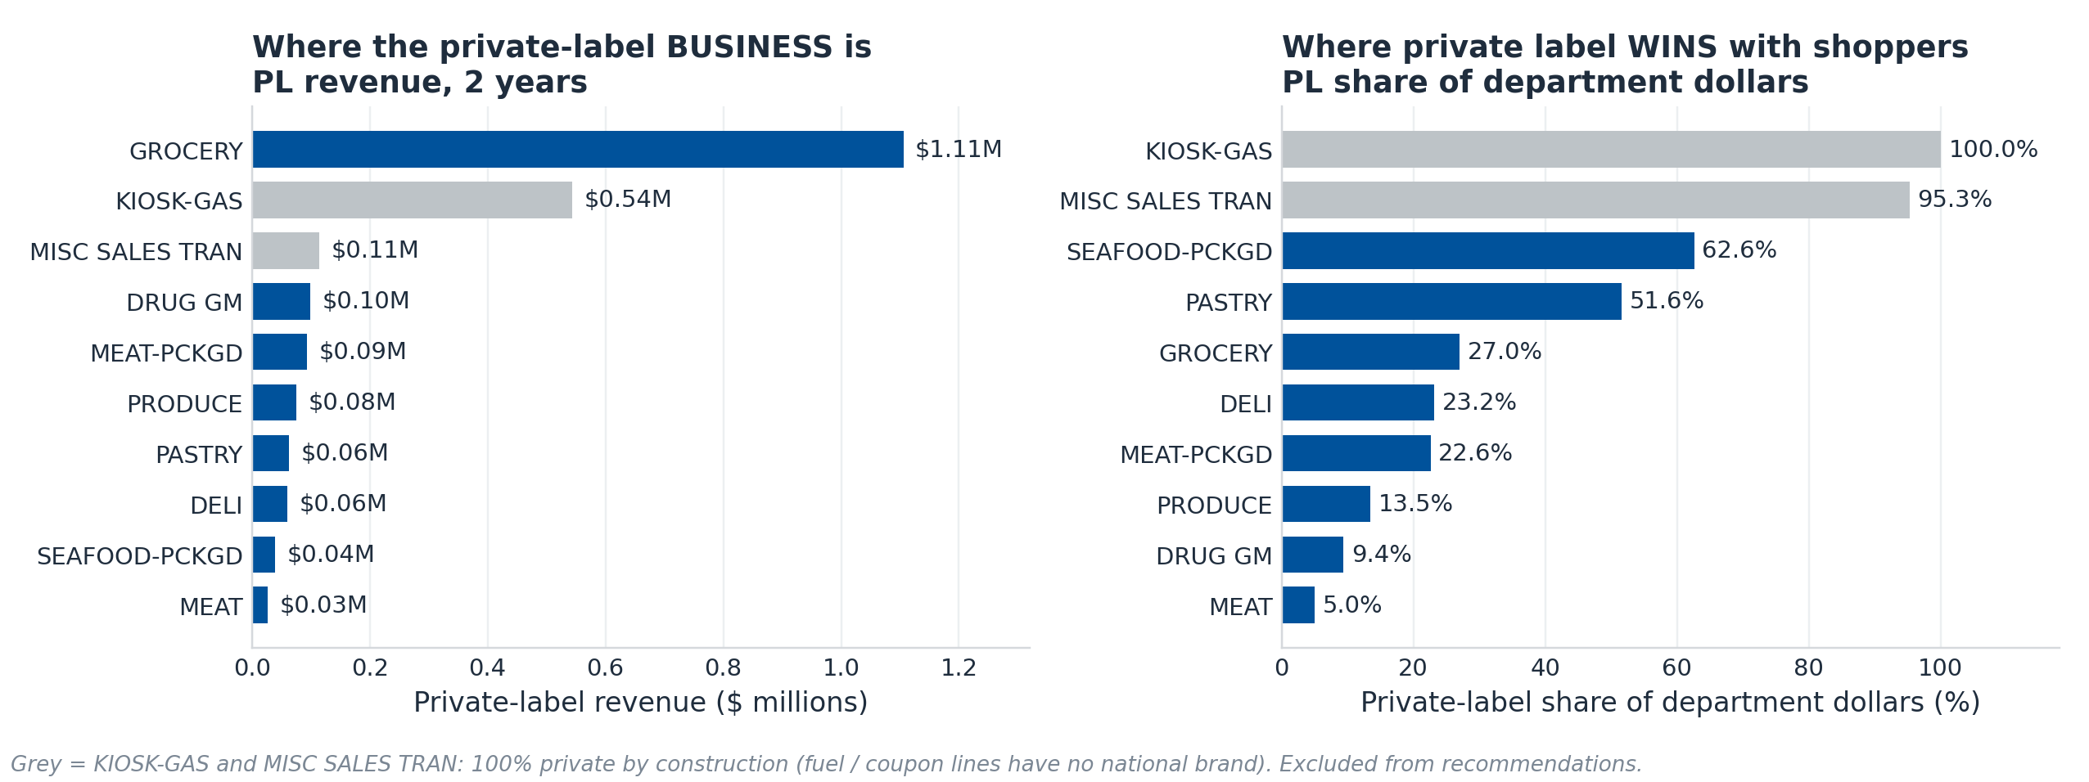
WHERE DO THEY BUY IT? | Private label by department
Revenue and share point to different aisles — GROCERY is the engine, DRUG GM is the gap
UNIT OF ANALYSIS Dollar totals are summed at the line item (the accounting atom). Every claim of a difference is made at the household × department — one household's PL share of spend in one aisle, one shopper one vote, so no heavy shopper can carry the result.
WHAT THIS CHANGES
The two rankings disagree.
GROCERY holds $1.11M of private-label revenue — 68% of all genuine PL dollars — yet its 27.0% share is beaten by PASTRY (51.6%) and SEAFOOD-PCKGD (62.6%).
So size and strength live in different aisles: report only revenue and you chase GROCERY, only share and you chase a rounding error.
TWO DEPARTMENTS ARE NOT REAL
KIOSK-GAS (100%) and MISC SALES TRAN (95.3%) are fuel and coupon lines with no national brand on the shelf. Mechanically 100%, not a shopper choice — dropped from all recommendations.
BIGGEST SINGLE CATEGORY
FLUID MILK PRODUCTS — $182.5K of PL revenue at 88.9% share, from 2,421 households.
2,595,732 transaction rows → 2,576,815 analysed: 99.3% of rows and 100.0% of dollars retained. Zero/negative lines and unlabelled brands dropped.
Ximin Zeng | 1 of 2
Notes:
[~75 sec] Now WHERE in the store.
UNIT FIRST, because you will ask. Dollars are summed at the line item — that is the accounting atom. But every difference I claim is measured at the household-by-department level: one household's private-label share of spend inside one aisle. I did that because the question is about shopper behaviour, not transactions — at item level a single 400-trip household would drive the whole test. One shopper, one vote.
Handling: 2.6 million rows in, 99.3% of rows and effectively 100% of dollars retained. Nothing material was dropped.
THE CHART. Left is where the private-label business IS. Right is where private label WINS. They are not the same aisle. GROCERY is $1.11M of private-label revenue — about two-thirds of the real total — but its 27% share is beaten by PASTRY at 52% and packaged SEAFOOD at 63%.
And be honest about the grey bars: KIOSK-GAS and MISC SALES TRAN are 100% private label because fuel and coupon lines have no national brand to compete with. That is mechanical, not a preference. I exclude them from anything I recommend.
Biggest single category: fluid milk, $182K at 89% share.

Slide 2
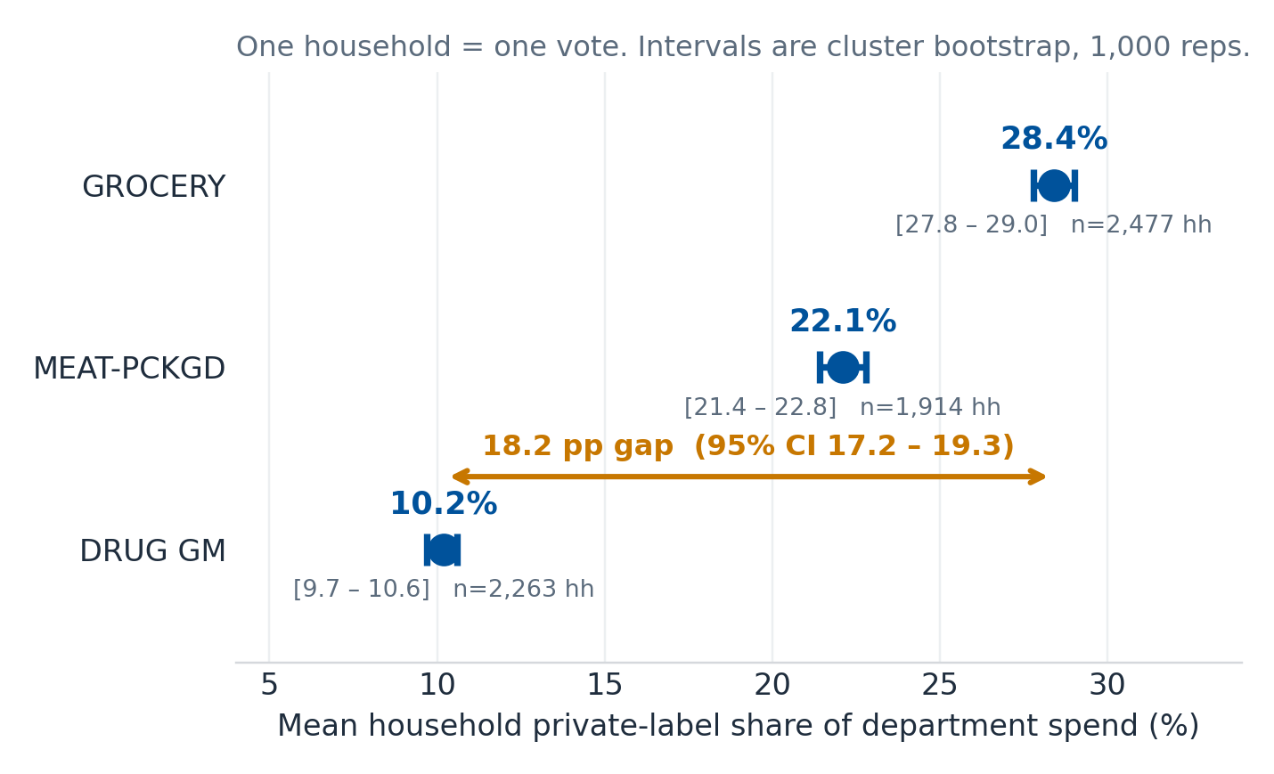
IS IT REAL? | Magnitude, certainty, and the rival explanations
An 18-point gap that survives every check we could throw at it
ALTERNATIVE EXPLANATION 1 — IS IT JUST SHELF SPACE?
Private label is only 7.9% of DRUG GM's assortment vs 22.7% of GROCERY's, so availability is a real rival explanation.
Ruled out, partly. Dollar share ÷ assortment share gives a preference index >1 in every department: MEAT-PCKGD 1.31, DRUG GM 1.20, GROCERY 1.19. Shoppers over-select private label relative to what is stocked everywhere — so shelf space suppresses the level but does not create the ranking.
ALTERNATIVE EXPLANATION 2 — IS IT JUST DIFFERENT SHOPPERS?
Restricting to households that shop all focus departments holds shopper mix constant by construction. The order is unchanged: GROCERY 27.3%, MEAT-PCKGD 21.3%, DRUG GM 9.9% (Friedman).
A per-item check also leaves the ranking intact, so the finding is not an artefact of the dollar metric.
MAGNITUDE & MULTIPLICITY
Households put 28.4% of GROCERY dollars into private label but only 10.2% of DRUG GM — an 18.2-point gap we are 95% confident sits between 17.2 and 19.3 points.
All 10 pairwise comparisons were run and Tukey-adjusted for running them; all 10 separate. Welch ANOVA and Kruskal–Wallis agree, so the result does not rest on normality.
LIMITS — WHAT WE CANNOT CLAIM
Two years of one chain, observational: we measure where private label is chosen, not what a shelf change would cause. Margin is unobserved, so "most revenue" is not "most profit." A proper claim needs a randomised facing/price test by department and cost data.
Household × department observations; households spending <$30 in a department over two years excluded. Cluster bootstrap resamples households, not rows.
Ximin Zeng | 2 of 2
Notes:
[~75 sec] Is the gap real, and how big?
In business language: households spend 28.4 cents of every GROCERY dollar on private label, but only 10.2 cents in DRUG GM. That is an 18-point gap, and I am 95% confident the true gap is between 17 and 19 points. The intervals are cluster bootstrapped over households because a household shows up in several departments — a textbook t-interval would be too narrow.
MULTIPLICITY: I ran all 10 pairwise comparisons and adjusted for all 10 with Tukey. All 10 separate. Welch ANOVA and Kruskal–Wallis agree, so this does not depend on a normality assumption — which matters because the outcome is bounded at 0 and 1 and piled up at both ends.
NOW THE HONEST PART — two rival explanations.
One: maybe it is just shelf space. Private label is only 8% of DRUG GM's assortment versus 23% of GROCERY's. So I divided dollar share by assortment share. Every department comes out above 1 — MEAT-PCKGD 1.31, DRUG GM 1.20, GROCERY 1.19 — meaning shoppers over-select private label relative to what is stocked, everywhere. Shelf space suppresses the level; it does not create the ranking.
Two: maybe it is different shoppers. So I looked only at households that shop all five departments — same people, every aisle. Ranking identical.
LIMITS: this is two years of one chain and it is observational. I can tell you where private label is chosen; I cannot tell you what adding facings would cause. And I have no margin data, so most revenue is not most profit. To make the stronger claim I would need a randomised facing or price test by department, plus cost data.
IMPLICATION for the recommendation: MEAT-PCKGD has the strongest genuine appetite (index 1.31) on only 17% of the assortment — that is the under-shelved opportunity. GROCERY is the engine to protect.

