Slide 1
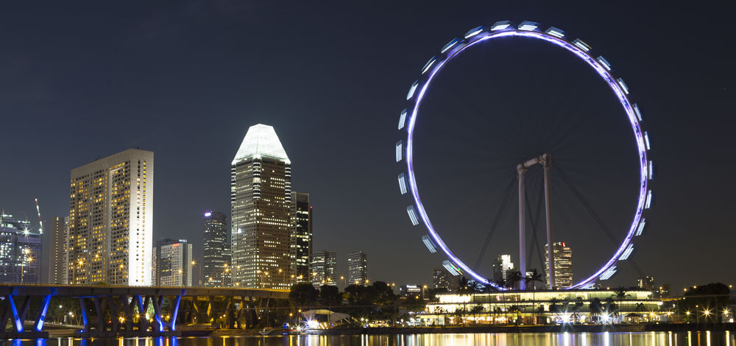










PowerShell Conference Asia
Workshop: DSC Pull Server

Slide 2

Whoami
Name : Ben Gelens
Job : Consultant
MVP : CDM (PowerShell)
Company : InSpark
Email : ben@bgelens.nl
Twitter : @bgelens
GitHub : bgelens
Blog : bgelens.nl
PowerShell Conference
Singapore 2018

Slide 3
Agenda
Slides: What is DSC again?
Slides: Configuration modes
Slides: Pull Server architecture
Setting up a Pull Server with SQL backend
Stage a configuration and resource module
Onboarding a node (discuss configuration options)
Look at reporting data
PowerShell Conference
Singapore 2018
Notes:
1 hour workshop
Assumption that dsc concepts are not a mystery anymore (will very quickly explain basics during discussion on configuration modes)
Requirements to follow along:
1 VM Windows Server 2019 with SQL Express installed
1 VM Windows Server 2016 / 2019

Slide 4
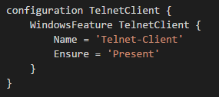


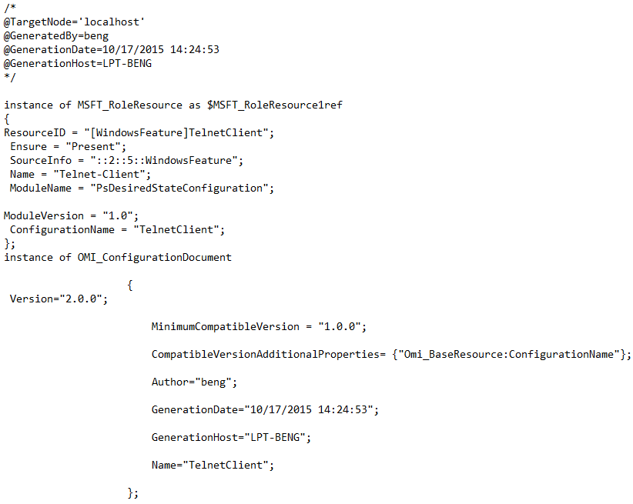







Recap: What is DSC again? Heterogeneous Configuration Management Platform
LCM
3rd Party Adapters
Resources
PowerShell Conference
Singapore 2018

Slide 5


Configuration modes
Pull Server
Resources
CIM Session
Http(s) / SMB
Pre-staged resources
Push
Pull
PowerShell Conference
Singapore 2018

Slide 6





Architecture
HA DB
Shared Storage containing:
Configuration Documents (MOF’s)
Resource Modules
Registration Key file
Pull Servers
PowerShell Conference
LCM
Singapore 2018

Slide 7
Thank you!

