Slide 1
SeqGAN for Music Generation
Benjamin Genchel¹, Ryan Rose²
¹ bgenchel3@gatech.edu
² rrose37@gatech.edu

Slide 2
Contents
What is SeqGAN?
Why was it developed?
How does it work?
SeqGAN for Music Generation
Inputs
Baseline
Evaluation
Next Steps

Slide 3
What/Why is SeqGAN?
DNN architecture aimed at solving the problem of using Generative Adversarial Networks (GAN) for sequence generation.
Issues with standard GAN models in this domain:
Designed for continuous outputs – the loss from the discriminator is used to guide the generator to slightly adjust its output in a continuous space towards something more realistic. How to adjust ‘slightly’ when only certain values are allowed?
Designed to evaluate a complete output – in sequence generation, a loss (and thus a discriminator judgement) is needed at each step of the generation. How can a discriminator make a judgement on the realism of something incomplete?
SeqGAN solves these issues by treating the generator as a stochastic policy (probabilistically choosing ‘actions’ in an ‘environment’) in a reinforcement learning framework.

Slide 4
How does SeqGAN work?
Generator – Long Short Term Memory Recurrent Neural Network (LSTM-RNN)
Discriminator – Convolutional Neural Network (CNN)
Need to provide a reward (for a full sequence) at every time. How?
Monte Carlo Rollouts (Just like AlphaGo, which makes this project inherently successful by association) – at every intermediate time step, sample unknown tokens based on the current policy to create a full sequence.
Current policy is modeled by the Generator G_{𝛳}
Final action-value function is the average of Discriminator output from final sequence and all rollouts.

Slide 5
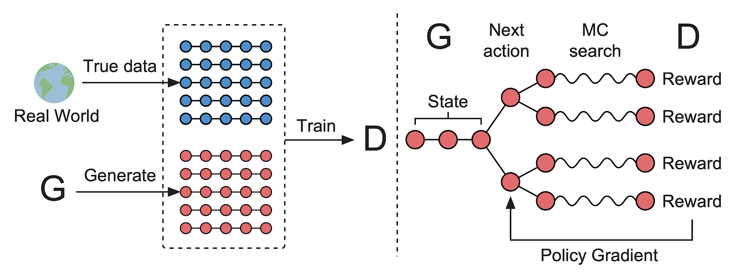
How does SeqGAN work?
Pre train Generator using MLE (standard sequence model procedure)
Pre train Discriminator with Pre trained Generator
Adversarially Train Generator and Discriminator using policy gradient updates

Slide 6
SeqGAN for Music
Model music as a sequence of ticks
24 ticks per quarter note = 96 ticks per bar
1 tick = length 37 vector
36 note possibilities spanning 3 octaves + rest
Add conditioning information by appending to each tick
Train SeqGAN to generate music 4 to 8 bars at a time
Original Paper
Trained on Nottingham Dataset ’sampling’ each song at 1 tick = 0.4 seconds.
Evaluated using BLEU score, and shown to perform better than standard MLE sequence learning, though not much information is provided
Notes:
Probably lead with, “so, how are we going to use this for symbolic music generation”

Slide 7
Dataset
200+ Bebop (Jazz, Late 1930s – 1970s) Lead Sheets
Originally in musicXML format, converted to tick format.
Why Lead Sheets?
Monophonic Melody + Chord Information
monophonic melody much easier to deal with both conceptually for us developers and practically for the network.
chord information gives useful musical context for notes.

Slide 8
Current Progress
Original model implemented and running.
Dataset half finished
Transcribing 200 Lead Sheets from the Real Bebop Book
Supplementing with the Charlie Parker Omnibook
Data pipeline fully implemented and tested.

Slide 9
Next Steps
Continue/Finish creating dataset
Confirm model results on Nottingham Dataset match up with original paper.
Adapt model for Bebop dataset.
Perform original evaluation on Bebop dataset.
BLEU Score.
MSE (Mean Squared Error)
Perform Statistical Evaluation (Yang, Lerch 2018)
Compares distribution of generated data to training data along a number of different dimensions.

