Slide 1
Use Case Description
IoT devices generate humidity and temperature readings every 30 seconds.
Capture the IoT data in a persistent store in a consumable format.
Create dashboards for
min and max of temperature and humidity for a given period.
The lag between the time data is recorded and the data is captured in the persistent store
The lag between the time data is recorded and the data is available in the dashboard.

Slide 2
Data Pipeline - 2
jmeter
with MQTT Plugin
RabbitMQ
Pulsar
Client
temperature
topic: iot-input
Every 30 seconds
queue: iot-events
jmeter
with MQTT Plugin
MarkLogic Data Hub
Client
humidity
Staging
Every 30 seconds
Final
Grove App
polls every 2 minutes
(4)Pulsar
ElasticSearch
Kibana
Sink Connector
Source Connector
topic : iot-output
index : iot-events-index

Slide 3
Example Messages/Documents
IoT Message
DHF - Staging
DHF - Final
{
"type": "temperature",
"value": {
"min": 63,
"max": 73,
"unit": "fahrenheit"
},
"time": 1610147705622
}
{
"type": “temperature",
"value": {
"min": 63,
"max": 73,
"unit": "fahrenheit"
},
"time": 1610147705622,
"hash": "4507e04b9d4680e25b1f8dcbf714bb68"
}
{
"envelope": {
"headers": {},
"triples": [],
"instance": {
"info": {
"title": "Event",
"version": "0.0.1",
"baseUri": "http://example.org/"
},
"Event": {
"unit": “fahrenheit",
"min": 63,
"max": 73,
"recordedAt": "2021-01-08T23:49:05.633Z",
"availableAt": "2021-01-08T23:49:08.212822Z",
"type": “temperature",
"hash": "4507e04b9d4680e25b1f8dcbf714bb68"
}
},
"attachments": {
"type": “temperature",
"value": {
"min": 63,
"max": 73,
"unit": "fahrenheit"
},
"time": 1610147705622,
"hash": "4507e04b9d4680e25b1f8dcbf714bb68"
}
}
}
Elastic Search
{
"_index": "iot-events-index",
"_type": "_doc",
"_id": "vuho5HYB0hfLGs4zKYA6",
"_score": 6.2791467,
"_source": {
"Event": {
"unit": "fahrenheit",
"min": 63,
"max": 73,
"recordedAt": "2021-01-08T23:49:05.633Z",
"availableAt": "2021-01-08T23:49:08.212822Z",
"type": “temperature",
"hash": "4507e04b9d4680e25b1f8dcbf714bb68"
},
"pickedAt": "2021-01-08T23:50:05.631107Z"
}
}

Slide 4
Technology Components
Component | Description
RabbitMQ | RabbitMQ is the message broker for capturing the messages from the IoT Devices. The rabbitmq_mqtt plug-in is enabled to support MQTT. Going by the default configuration, The MQTT messages are listened at the default port 1883 MQTT messages published to topic amq.topic The MQTT messages are bound to transient queue iot-events by routing key iot-humidity & iot-temperature.
MarkLogic DHF | MarkLogic DHF is the persistent store in this data pipeline. The messages are persisted in its raw format to Staging database. The data hub flow steps are run to harmonize the messages to consumable enterprise documents. A transform is run (configurable) during ingest and a transform is (configurable) is run during read. The DHF project should be installed prior to configuring the Data pipeline.
Apache Pulsar | Apache Pulsar is the core component in the data pipeline which provides reliable transport of data from one component to another. RabbitMQ produces the messages to Pulsar topic iot-input using the built-in Pulsar source connector for RabbitMQ. The newly built MarkLogic Sink connector pulls the messages from the topic iot-input and persists to MarkLogic Staging database of DHF. The harmonized consumable messages are queried every two minutes (configurable) by the newly built source connector for MarkLogic and written to pulsar topic iot-output.
Elasticsearch | Elasticsearch is the search and analytic solution in the pipeline. The built-in pulsar sink connector for Elasticsearch pulls the messages from topic iot-output and makes it available in Elasticsearch index io-events-index
Kibana | Kibana is the visualization solution in the pipeline that integrates very well with Elasticsearch. Kibana can discover the indexes in Elasticsearch and lets to create dashboards.
Jmeter | To simulate iot devices, Jmeter with MQTT plugin (mqtt-jmeter) is used. https://github.com/xmeter-net/mqtt-jmeter A temperature and humidity event is created every 30 seconds.

Slide 5
Connector configurations
{
"batchSourceConfig": {
"discoveryTriggererClassName": "com.marklogic.pulsar.config.CronTriggerer",
"discoveryTriggererConfig": {
"__CRON__": "0 0/2 * * * ?"
}
},
"className" : "com.marklogic.pulsar.MarkLogicSource",
"configs" : {
"mlConnectionHost" : “mydomain",
"mlConnectionPort" : 8011,
"mlDatabase" : "data-hub-FINAL",
"mlSecurityContext" : "BASIC",
"mlUserName" : "dh-admin-1",
"mlPassword" : “mypassword",
"mlConnectionType" : "GATEWAY",
"mlSimpleSSL" : "true",
"mlPathToCertFile" : "",
"mlPasswordForCertFile" : "",
"mlExternalName" : "",
"mlHostNameVerifier" : "ANY",
"mlTlsVersion" : "TLSv1.2",
"mlSSLMutualAuth" : "false",
"dmsdkBatchSize" : 100,
"dmsdkThreadCount" : 10,
"dmsdkTransform" : "IoTTransForm",
"dmsdkTransformParams" : "",
"dmsdkSourceQuery" : "cts.andQuery([cts.collectionQuery('Event'),cts.pathRangeQuery('//*:instance/Event/availableAt', '<', fn.currentDateTime()),cts.pathRangeQuery('//*:instance/Event/availableAt', '>=', fn.currentDateTime().subtract('PT2M'))])",
"dmsdkIsSourceQuerySerialized" : "false"
}
}
{"configs":{
"host": "192.168.0.35",
"port": "5672",
"virtualHost": "/",
"username": "admin",
"password": "admin",
"queueName": "iot-events",
"connectionName": "Rabbit IOT Source",
"requestedChannelMax": "0",
"requestedFrameMax": "0",
"connectionTimeout": "60000",
"handshakeTimeout": "10000",
"requestedHeartbeat": "60",
"prefetchCount" : "0",
"prefetchGlobal" : "false"
}}
Marklogic Source Connector Configuration
RabbitMQ Source Connector Configuration
{"configs":{
"elasticSearchUrl": "http://localhost:9200",
"indexName": "iot-events-index",
"username": "",
"password": ""
}}
Elasticsearch Sink Connector Configuration
Requires a pathRange Index on availableAt property and a transform IoTTransform

Slide 6
Connector configurations
{"configs" : {
"mlConnectionHost" : “mydomain",
"mlConnectionPort" : 8010,
"mlDatabase" : "data-hub-STAGING",
"mlSecurityContext" : "BASIC",
"mlUserName" : "dh-admin-1",
"mlPassword" : “password",
"mlConnectionType" : "GATEWAY",
"mlSimpleSSL" : "true",
"mlPathToCertFile" : "",
"mlPasswordForCertFile" : "",
"mlExternalName" : "",
"mlHostNameVerifier" : "ANY",
"mlTlsVersion" : "TLSv1.2",
"mlSSLMutualAuth" : "false",
"dmsdkBatchSize" : 1,
"dmsdkThreadCount" : 1,
"dmsdkTransform" : "insertHashTransform",
"dmsdkTransformParams" : "",
"mlDocumentCollections" : "iot",
"mlDocumentFormat" : "JSON",
"mlDocumentMimeType" : "",
"mlDocumentPermissions" : "rest-reader,read,rest-writer,update",
"mlDocumentURIPrefix" : "/iot/input/",
"mlDocumentURISuffix" : ".json",
"mlIdStrategyForURI" : "UUID",
"mlIdStrategyPath" : "",
"mlAddTopicAsCollections" : "true",
"dhfType" : "dhs",
"dhfProperties" : "default",
"dhfPropertiesPath": "",
"dhfFlowName" : "IoT-Flow",
"dhfFlowSteps" : "2"
}
}
Marklogic Sink Connector Configuration
Requires a transform insertHashTransform and a DHF Flow IoT-Flow.
The transform is optional. If not configured the messages will be persisted in staging as-is.

Slide 7
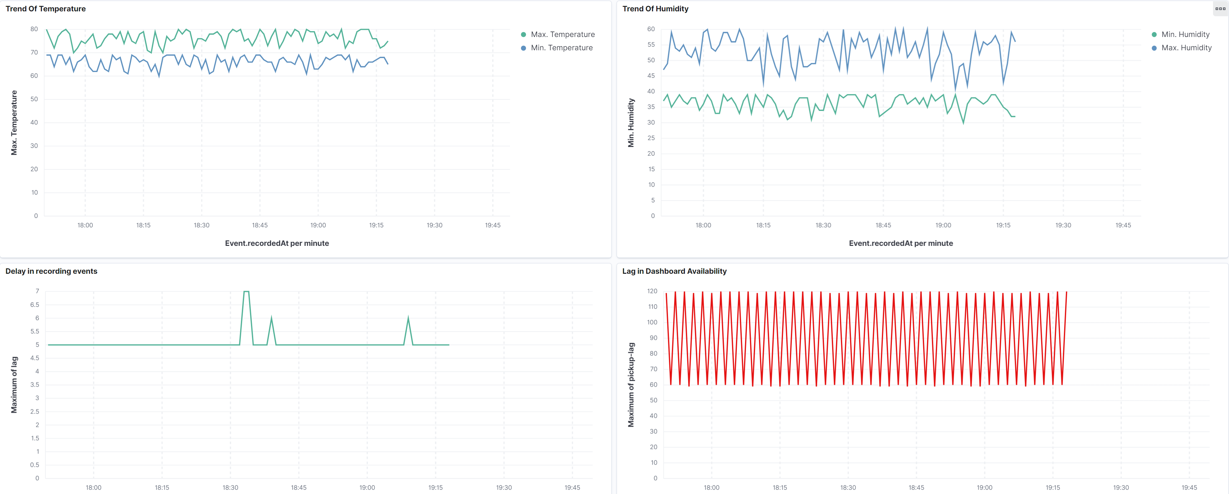
Kibana Dashboard
Timeline of the temperature readings
Timeline of the humidity readings
The delay between the time event is produced by device to the time the event is persisted in MarkLogic. The demo produces a delay of 5 seconds
The delay between the time event is produced by device to the time the event is available in Kibana dashboard. The demo produces a delay of maximum 120 seconds because MarkLogic source connector is configured to query every 2 minutes.

