Slide 1
N-Mixture Models Data Integration
Casey Setash, Colorado Parks and Wildlife
casey.setash@state.co.us

Slide 2
Motivation: N-Mixture Models
Royle 2004
Another example of a hierarchical model
One of the ways to estimate abundance with imperfect detection
Mark-Recapture
Removal sampling
Distance sampling
Double observer
N-mixture models
Notes:
You have talked through a variety of modeling frameworks and specific types thus far and many of those have been hierarchical models
This lecture is going to focus on a couple of other examples of hierarchical model
All require auxiliary information to estimate detection

Slide 3
Basic Model Description
Use: estimate abundance when mark-recapture is not feasible
Originally built for sparse data (few sites, few occasions, small detection probability, some zeros)
Data inputs: repeated counts at the same sites
Assumptions:
Poisson and binomial distributions are true descriptions of state/observation processes
Variation in counts within a site is due only to observer error
All between-site variation stems from underlying abundance process
Closed population with respect to births, deaths, and migration between occasions
Abundance at each site is random and independent of abundance at all other sites
Constant detection probability, p, across individuals
No double counting
Notes:
Original goal – estimate abundance from point counts alone
Mixture of distributions – underlying abundance is distributed as a Poisson
Count data are distributed binomial
Constant detection – across individuals – no trap happiness or shyness incorporated
you can put covariates on it or allow it to vary temporally

Slide 4
Data Structure Example
Site | N | Visit 1 | Visit 2 | Visit 3 | Visit 4 | Visit 5
1 | 6 | 2 | 3 | 3 | 5 | 3
2 | 2 | 0 | 2 | 1 | 1 | 1
3 | 4 | 0 | 0 | 3 | 3 | 2
4 | 1 | 0 | 1 | 0 | 0 | 1

Slide 5
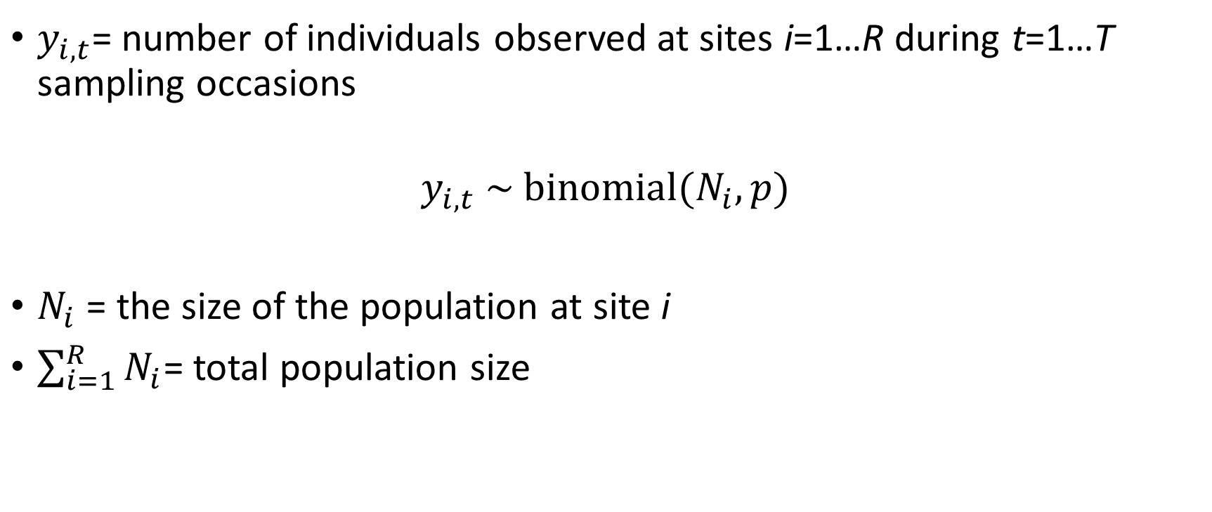
Basic Model Structure
$y_{i,t}$= number of individuals observed at sites i=1…R during t=1…T sampling occasions
$$y_{i,t} \sim binomial(N_{i}, p)$$
$N_{i}$ = the size of the population at site i
$\sum_{i=1}^{R}{N_{i}}$= total population size

Slide 6

Basic Model Structure
Observation Process: $y_{i,t} \sim binomial(N_{i}, p)$
State Process: $N_{i}$ $\sim$ Poisson(λ)
Each site has expected abundance λ
Notes:
- What makes this a hierarchical model?

Slide 7

Basic Model Structure
Observation Process: $y_{i,t} \sim binomial(N_{i}, p)$
State Process: $N_{i}$ $\sim$ Poisson(λ)
Priors: log(λ) $\sim$ normal(0, 1000)
logit(p) $\sim$ normal(0, 0.5)
Notes:
Right now lambda and p do not have any subscripts – you’re making the assumption that they don’t vary by site or time
In the original model, Royle called this N_i, the site level abundance, a random effect with a Poisson prior distribution
By using a Poisson here, you’re assuming that individuals are distributed in space completely at random and independently
We’ll see later that you can use other distributions to model the variation in abundance, including negative binomial, which allows for extra variation

Slide 8
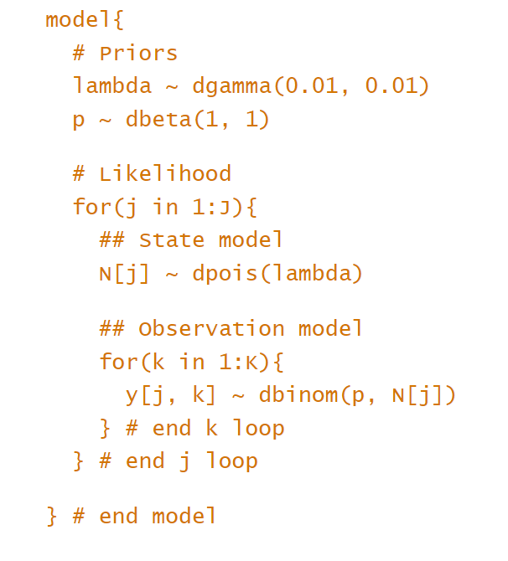
JAGS Code

Slide 9
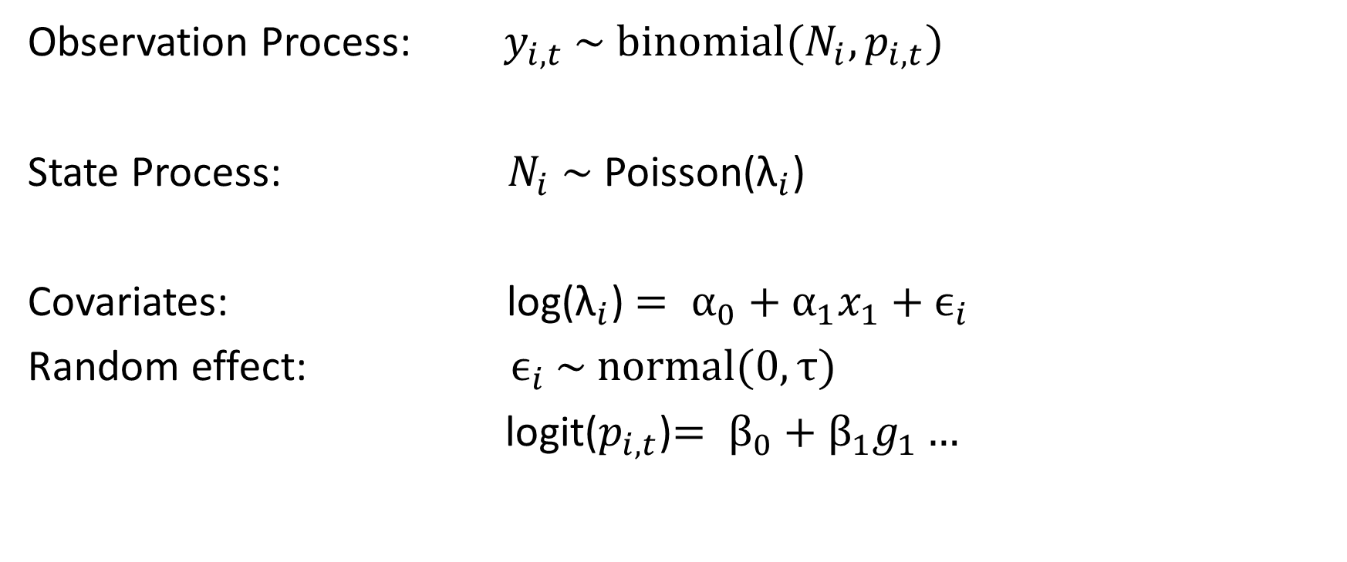
Model Structure Extensions
Observation Process: $y_{i,t} \sim binomial(N_{i},p_{i,t})$
State Process: $N_{i}$ $\sim$ Poisson(${\text{λ}}_{i}$)
Covariates: log(${\text{λ}}_{i}$) $= α_{0}+α_{1}x_{1}+ϵ_{i}$
Random effect: $ϵ_{i} \sim normal(0,τ)$
logit($p_{i,t}$)$= β_{0}+β_{1}g_{1}…$
Notes:
Can include site level covariates (i) on lambda and site AND occasion level covariates on p
Site level could be the same for both or different

Slide 10
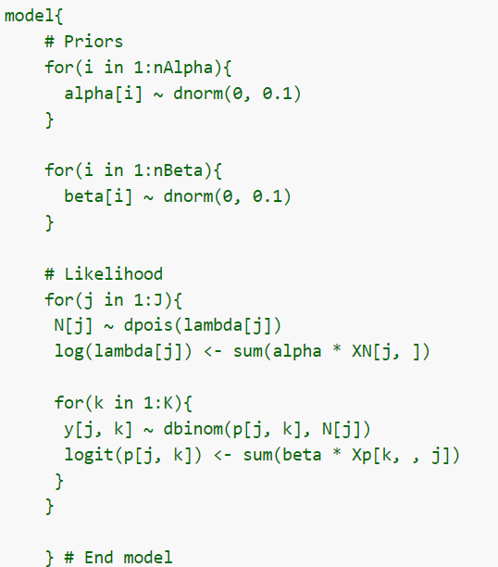
JAGS Code - Covariates
Notes:
alpha and beta are vectors containing the intercept and slope coefficients, XN is a matrix with one row per site and one column per covariate (including a column of 1’s for the intercept), and Xp is a 3-d array with dimensions K×x×JK×x×J (where xx is the number of covariates in the detection model, including the intercept).
Coding with a vector of coefficients and a matrix of covariates is super useful
Speeds up model fitting
Easily remove or add covariates without having to change your model code each time

Slide 11

Model Structure Extensions – Dail-Madsen
Observation Process: $y_{i,t} \sim binomial(N_{i}, p)$
State Process: $N_{i,1}$ $\sim$ Poisson(λ)
$N_{i,t}= S_{i,t}+ G_{i,t}$
${ S}_{i,t}\sim binomial(N_{i,t−1, }ɸ)$
$G_{i,t}\sim Poisson(\text{γ}N_{i, t−1})$
Notes:
Open or dynamic N-mixture model
2011 paper
Literally didn’t know what this was until making this lecture even though I semi pretended to during my PhD
This is being used now pretty regularly – IMBCR data
Royle model allows for temporary emigration as long as the superpopulations are unaffected
You have your sampled sites, but some animals’ home ranges overlap those sites and are considered a superpop – works well during a period of known inactivity (breeding season)
However if we have additions or deletions (primarily deaths) during that period, it hugely biases total abundance
What we’re doing here with the open model is giving N_it, site and time specific abundance, the Markov property
Only depends on N_i,t-1, site level abundance at the previous occasion
Less restrictive than assuming abundance is equal across time OR that abundance at t is independent of time at t+1
That N_i,1 is the initial spatial distribution of animals to sites, so we still use a Poisson (or NB)
We then model N_it, as the sum of these two random variables, S_it and G_it
S_it is the animals in site i at time t who survived in that site since t-1
G_it denotes gains at site i since t-1
Phi, then, is survival, and gamma is the arrival rate
It’s also implying that arrival rate may depend on N_i,t-1 because it’s the product
CANNOT distinguish between deaths and emigrants or births and immigrants because individual identity is not recorded

Slide 12
Model Structure Extensions
Other distributions
Negative binomial
Zero-inflated Poisson
Multinomial
Integrated – known fate or distance
Multiple age/sex “states”
Spatial movement of animals
Notes:
3) Other distributions
negative binomial, zero-inflated Poisson, multinomial

Slide 13
Coding Options
Maximum Likelihood:
Unmarked (Fiske and Chandler 2011) – pcount function
Bayesian Estimation:
Specify yourself using JAGS, Nimble, INLA, or STAN
ubms package (Kellner et al. 2022)

Slide 14
Simple Example
Basile et al. (2021) Ecological Indicators
Abundance, species richness and diversity of forest bird assemblages – The relative importance of habitat structures and landscape context
How does bird abundance respond to landscape context in forests of similar structure?

Slide 15
Simple Example
Black Forest, SW Germany
Point counts repeated up to 3 times per year in 126 one-ha plots
Species divided up by feeding/nesting guilds
1. Assemblage process: w_{k} ∼ Bernoulli(Ω)
2. Single species abundance: N_{ik}|w_{k} ∼ Poisson(w_{k} λ_{k})
3. Detection process: y_{ijk}|N_{ik} ∼ Binomial(N_{ik}, p_{ijk})
log(λ_{k}) = model coefficients*forest covariates
Notes:
if the species k belongs or not to the assemblage w, was modelled as a Bernoulli process. The latent abundance N of species k at plot i was modelled as a Poisson distribution, using the log link. The repeated counts y of species k at plot i during replicate j were used to model the detection process, as a binomial distribution, using logit link.
- DBH living trees, DBH dead trees, and volume of lying deadwood related to abundance

Slide 16
N-Mixture Models
Pros
Another option to estimate abundance when data are limited
Count data are “cheap”
Don’t need auxiliary info (distance, double observer, etc.)
Easy to describe and implement the model
Widely applicable to count datasets
Cons
Trade-off between temporal replication and spatial replication
Parameters may not be identifiable
Sensitive to model assumption violations

Slide 17
Identifiability
Definition reminder – the ability to estimate every parameter in a model individually rather than as the product of a smaller set of parameters
Example:
One sampling occasion (T=1)
Observed counts are distributed as Poisson(pλ)
p and λ are not identifiable
Even when T=2 or 3, the likelihood surface that you are maximizing may be too flat – end up with infinite MLEs of expected abundance
More occasions and including covariates on p and λ can help
Notes:
- it’s the variation in counts over time that allows you to estimate p separately – we’re assuming all of that variation in counts is coming from imperfect detection because the pop is closed

Slide 18
Controversy
Barker et al. (2017)
Need auxiliary information on p to estimate it separately
Even if you assume p is constant, data can be generated by processes other than the N-mixture model
Essentially estimating relative abundance
Might as well just use Poisson regression
Notes:
Relative abundance – the number of individuals multiplied by an unknown constant like detection
If that detection is the same across areas, the ratio of relative abundances is the same as the ratio of absolute abundances so you can compare abundance of one site RELATIVE to another
Poisson regression explains patterns but does not necessarily represent the ecological data generating process underlying repeated counts
N-mixture models were developed based on data generating process – absolute abundance is Poisson distributed and observed data are binomial with the only variation in counts due to detection
Many of peoples’ issues with these models stems from the fact that the likelihood contains an infinite sum – you’re summing over the latent abundance states (N_it)
in practice, you replace infinity with some large constant K, which you have to determine by trial and error
At super low abundance or detection probabilities, there are no values of K where these estimates become stable – rather, as K increases, so does abundance estimate

Slide 19
Controversy
Kery (2017)
Tested Barker et al’s doubts about identifiability with 137 bird datasets
No issues for Poisson and ZIP N-mixture models
Negative binomial models had issues for 25% of datasets
Small sample sizes caused issues (<267 sites)
Covariates did not affect identifiability
Notes:
Marc Kery of the Swiss Ornithological Institute tested some of these doubts with a bunch of real life empirical datasets from Swiss Breeding Bird Atlas (2318 1-km2 quadrats) surveyed 2-3 times per breeding season, 2012-2016
Published just 4 months after the Barker paper
They had capture histories for each territory within a quadrat so it was akin to a mark recapture analysis
They collapsed this information down to fit the N mix model, essentially getting rid of individual identity, to see whether they lost parameter identifiability
Did not have any issues with Poisson, but you did have to go in and alter that K value for models using a NB

Slide 20
Controversy
Link et al. (2018)
N-mixture models are very sensitive to violation of assumptions
Tested double counting, unmodeled variation in λ, and unmodeled variation in p
Small violations have been shown to result in large biases in abundance estimates
Violations are hard to detect using goodness-of-fit tests
Notes:
If the closure assumption is violated, the model basically interprets changes in observed counts as detections or nondetections rather than changes in population abundance – these changes then lead to a low estimate of p and thus an increased estimate of N, leading to abundance that’s biased high
There are a lot of assumptions that are harder to relax than with mark recapture models
You have to know what these assumptions are and whether you’re violating them, and really just use a better methodology if you need reliable estimates of abundance

Slide 21
N-Mixture Models – Final Thoughts
“We stress from the outset that, in principle, N-mixture models work: if the model is correct (an exact depiction of the data generating process), if the parameter values are not extreme, and if we have adequate data, the N-mixture models can be estimated with high precision.”
“Our conclusion is that for estimating absolute abundance, there is no substitute for mark–recapture analysis: N-mixture modeling relies too heavily on questionable and poorly verifiable model assumptions.”
– Link et al. 2018, Ecology

Slide 22
SWITCHING GEARS

Slide 23
Data Integration
Moving on!
Other names: integrated models, data fusion, assimilation, combination
Commonly heard terms:
Integrated population model (IPM)
Integrated species distribution model (iSDM or IDM)
Integrated community model (ICM)
Integrated dynamic N-mixture model
Super trendy topic in the past several decades

Slide 24
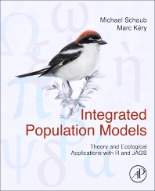
What is it?
A type of hierarchical model
Multiple disparate data sets that each contain information about a shared process with one or more shared parameters
Combine the processes into a single model
Identify shared parameters
Write a model that links them based on the different data sets
“…datastream-specific observation submodels that inform a common ecological model” – Gilbert et al. 2021
Notes:
Disparate data sets is somewhat subjective
In practice, in your code, you are essentially linking separate submodels by calling parameters the same name

Slide 25
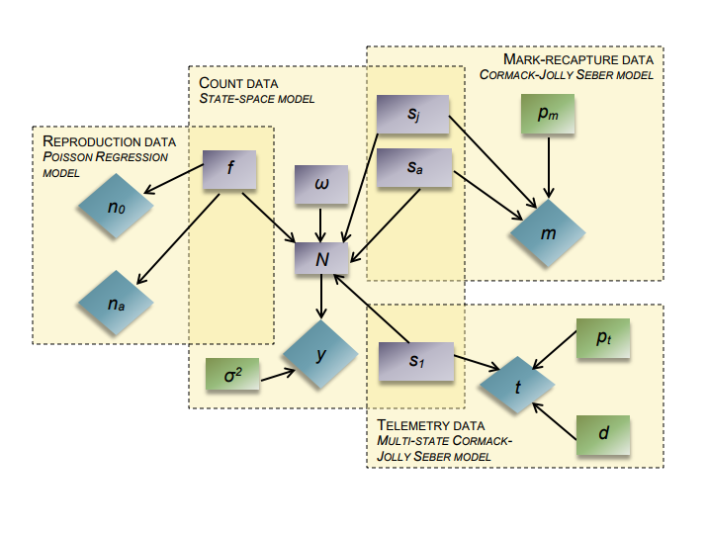
Integrated Population Model
Notes:
- Going to go through the basic steps of one of the more common integrated models
Zipkin and Saunders 2018 DAG
- These are common data types – do not HAVE to be these types
Blue diamonds are data
Purple rectangles are demographic parameters
Green rectangles are observation parameters
Dotted lines are submodels
W = immigration
Sig2 – observation error on count data
D = recovery rate of dead individuals
P = encounter rate for telemetry data
Main people – Marc Kery and Michael Schaub, Fitsum Abadi, Elise Zipkin and students – IPM book
What’s nice – you can share information from each submodel to more precisely estimate parameters while also accounting for multiple sources of uncertainty

Slide 26
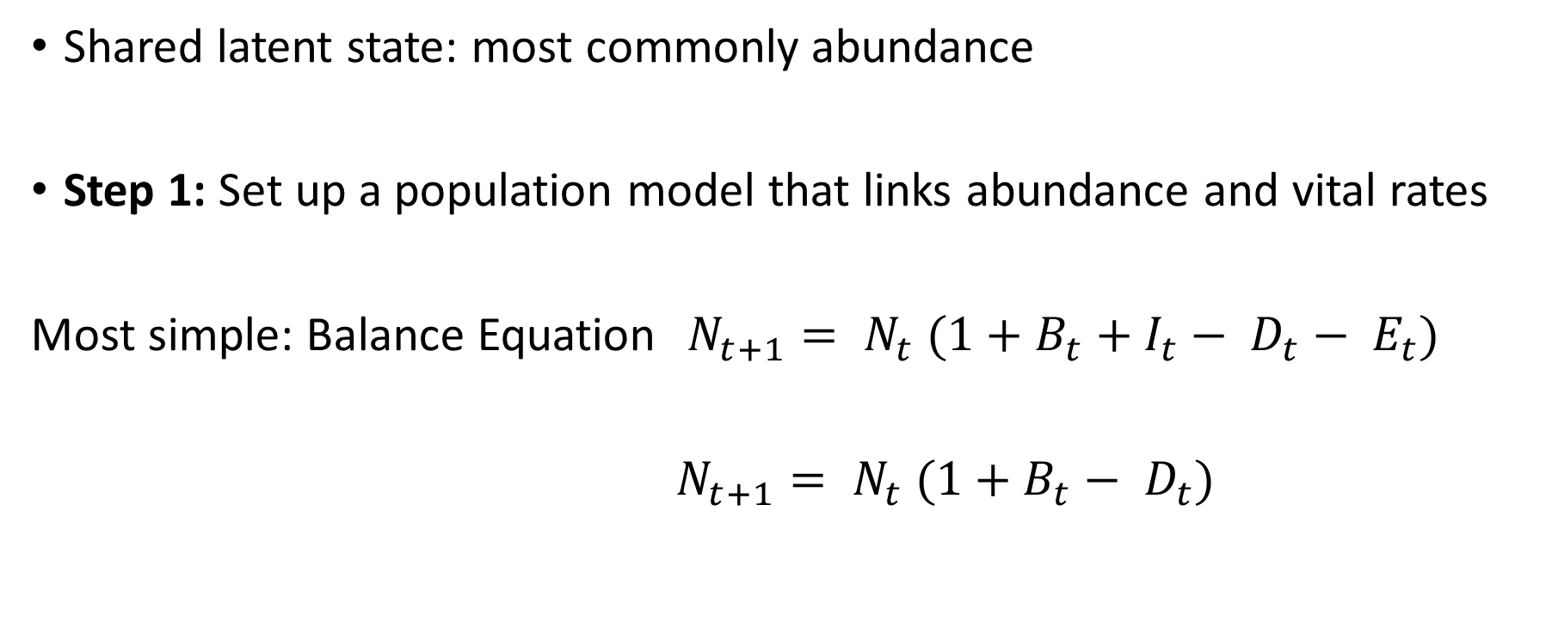

Integrated Population Model
Shared latent state: most commonly abundance
Step 1: Set up a population model that links abundance and vital rates
Most simple: Balance Equation $N_{t+1}= N_{t} (1+B_{t}+I_{t}− D_{t}− E_{t})$
$N_{t+1}= N_{t} (1+B_{t}− D_{t})$
$$λ_{t}=exp⁡(r_{t})$$
Notes:
In the heuristic we just saw, the parameter of interest shared among all submodels was abundance
What is actually linking all of those submodels?
The underlying commonality between all submodels is the population model
Can be as simple as this basic balance equation you learn in some of your earliest days of pop dy classes

Slide 27

Integrated Population Model
Structured version of balance equations
Matrix projection models (Caswell 2001)
Integral projection models
$$n_{t+1}=A_{t}n_{t}$$
$$A_{t}=\left[\begin{matrix}f_{1} & f_{2} \\ S_{1} & S_{2}\end{matrix}\right]$$
$$n_{t}=\left[\begin{matrix}n_{1} \\ n_{2}\end{matrix}\right]$$
Notes:
How complex this model gets depends on your questions of interest, the complexity of the organism’s life cycle, and the quantity and quality of data – can it support lots of heterogeneity (differences in age and sex classes, time trends, etc.)
Usually REALLY helps to start out with a life cycle diagram, which we’ll get to

Slide 28
State-Space Models
Hierarchical model
Can decouple observation error from process variation of interest (e.g. environmental stochasticity)
Key component of an IPM
Two sets of equations:
State process or process model – describes the development of the true state of a system over time
Observation process – relates the true (latent) state to the observations (counts)
Notes:
Brief aside on SSM
The state part of this process is your population model – what we just went over
Basically separating out the variation in your observed counts into one contribution from the underlying true dynamics of the state (N or population model) and another contribution from an observation process
Obs process describes how an obs at time t is linked with the true state at that time

Slide 29
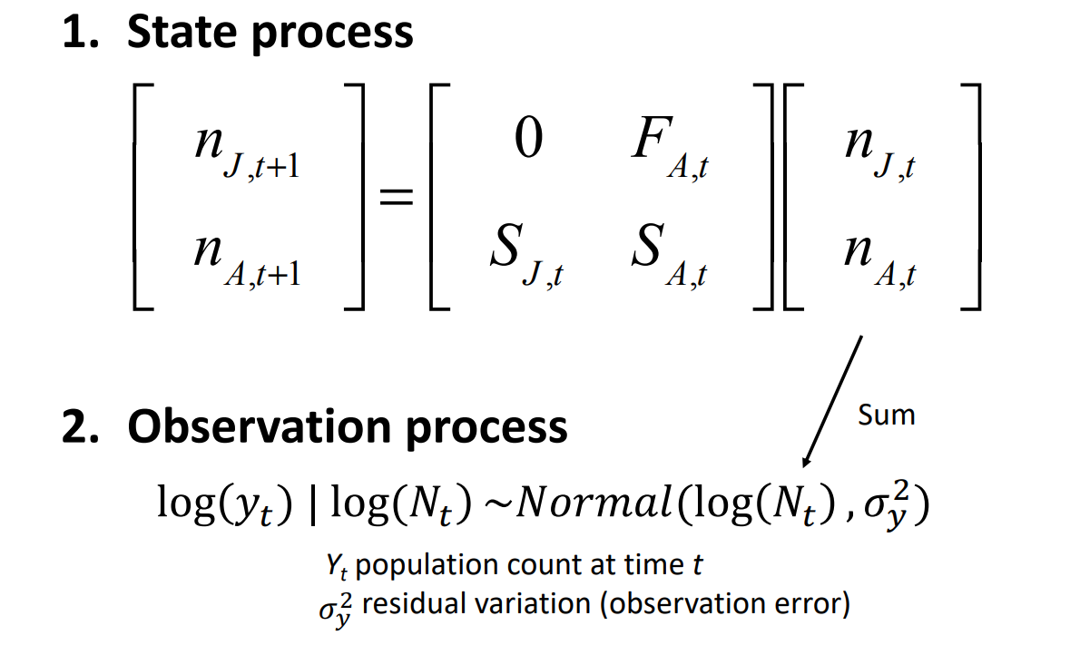
State-Space Likelihood in IPM
Notes:
J is juv, A is adult
My notation is not consistent among slides so don’t let it freak you out

Slide 30
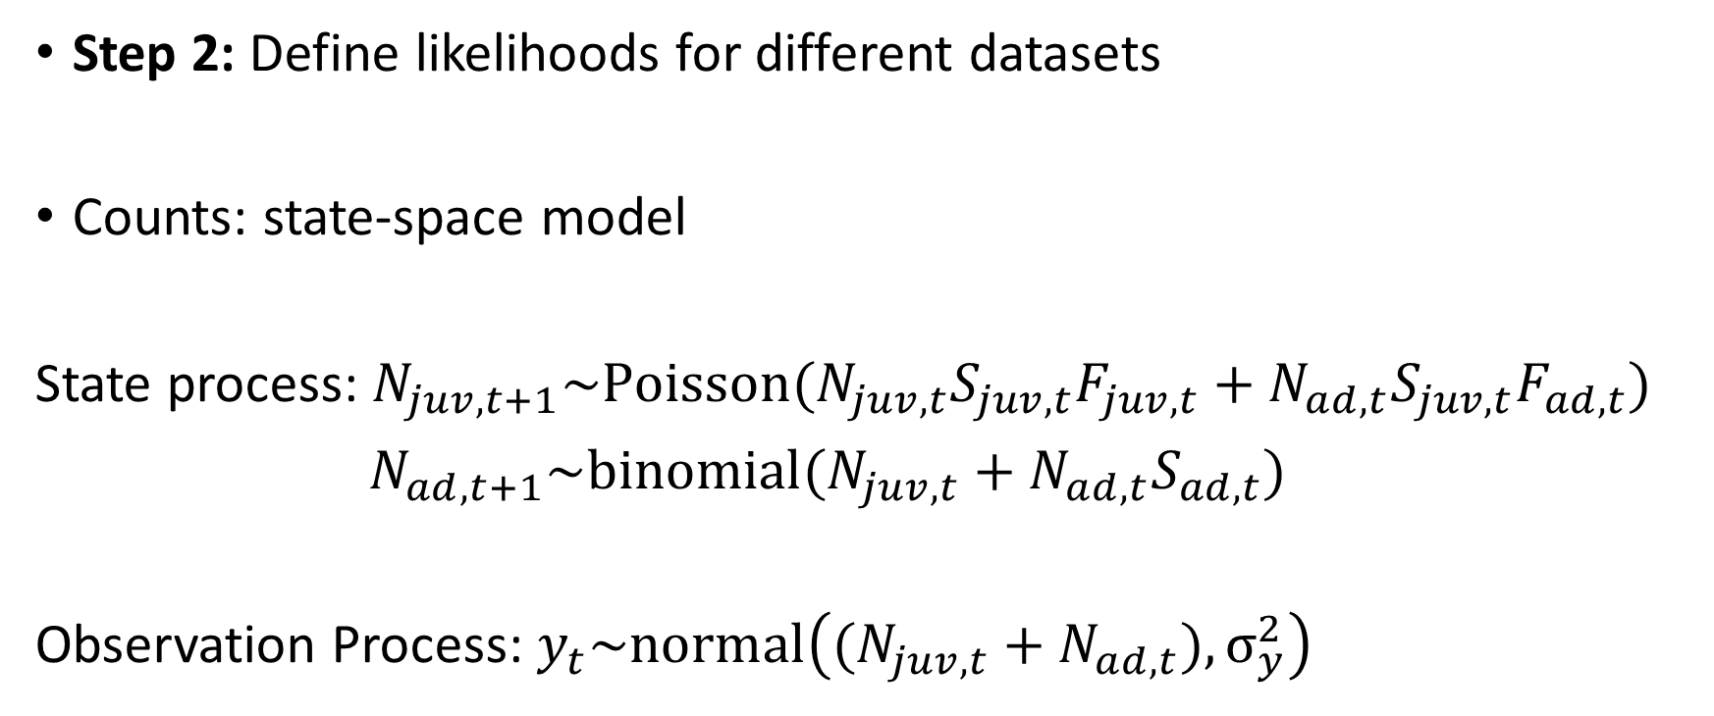

Integrated Population Model
S: survival
F: productivity
Njuv: pop size of juveniles
Nad: pop size of adults
$σ_{y}^{2}$: census/residual error
y: counts
Step 2: Define likelihoods for different datasets
Counts: state-space model
State process: $N_{juv,t+1}\sim Poisson(N_{juv,t}S_{juv,t}F_{juv,t}+N_{ad,t}S_{juv,t}F_{ad,t})$
$N_{ad,t+1}\sim binomial(N_{juv,t}+N_{ad,t}S_{ad,t})$
Observation Process: $y_{t}\sim normal\left((N_{juv,t}+N_{ad,t}), σ_{y}^{2}\right)$
Notes:
The fact that you have distributions here for both the state process and the observation process means these processes are stochastic
This makes the model a hierarchical model
The latent states N represent random effects

Slide 31

Integrated Population Model
S: survival
P: recapture probability
m: m-array
Step 2: Define likelihoods for different datasets
Capture-Recapture Data: CJS or multinomial
$$L_{CJS}(S_{juv},S_{ad},P|m)$$
Notes:
- Shorthand to represent the likelihood of a CJS model

Slide 32

Integrated Population Model
F: productivity
J: number of nestlings
Step 2: Define likelihoods for different datasets
Productivity Data: Poisson regression
$$J \sim Poisson(F)$$
$$\log\left(F\right)= β_{0}+β_{1}x_{1}…$$

Slide 33

Integrated Population Model
Step 3: Put them all together into a joint likelihood
$L_{IPM}\left(N,S_{juv},S_{ad},F,P,σ_{y}^{2} | y,m,J\right)=L_{1}\left(N_{1}\right)×L_{o}(N,$ $σ_{y}^{2}|y)×L_{s}(N,S_{juv},S_{ad},F)×L_{CJS}(S_{juv},S_{ad},P|m)×L_{p}(F|J)$
Notes:
N1 is separated out because you have to estimate the first year’s population size separately
The likelihood for the later years use a Markovian process – Nt times this projection matrix to get Nt+1 – can’t do that with the first year
Point out common parameters across likelihoods

Slide 34
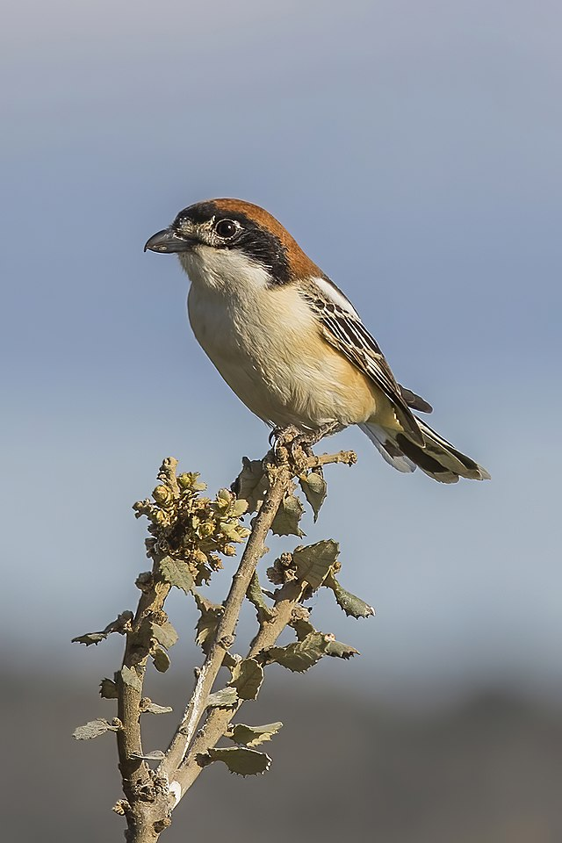
IPM Example
Woodchat Shrike
Monitored for 34 years in Germany
Nested in extensive orchards, ate large insects
Long-term decline in Germany, France, and Switzerland
Searched nesting territories
Located nests, counted eggs, hatchlings, and fledglings
Marked nestlings and adults with color bands
Notes:
Local recruits are locally-born, surviving individuals that return to the study area. Surviving adults are at least 2 years old and were present in the study area in the previous year already. Finally, immigrants are born outside of the study area, at least 1 year old and never reproduced in the study area before (but we assume nothing about any earlier reproductive events elsewhere).
We must make a number of decisions, e.g., decide how many age classes or which states we want to include,
whether to base the model on a pre- or postbreeding “census,” whether to model females only or also include males, and
whether to include demographic and environmental stochasticity (i.e., variability) or density dependence.

Slide 35
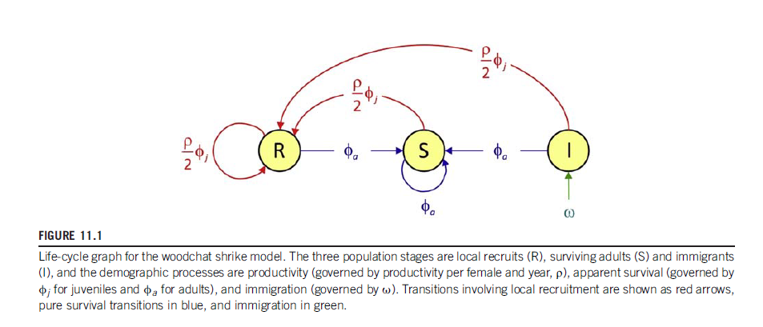
IPM Example
Life cycle graph
Pre-breeding census, female-based model
Local recruits, surviving adults, immigrants
Notes:
Local recruits are locally-born, surviving individuals that return to the study area. Surviving adults are at least 2 years old and were present in the study area in the previous year already. Finally, immigrants are born outside of the study area, at least 1 year old and never reproduced in the study area before (but we assume nothing about any earlier reproductive events elsewhere).

Slide 36
IPM Example
Life cycle graph
Pre-breeding census, female-based model
Local recruits, surviving adults
Notes:
Local recruits are locally-born, surviving individuals that return to the study area. Surviving adults are at least 2 years old and were present in the study area in the previous year already. Finally, immigrants are born outside of the study area, at least 1 year old and never reproduced in the study area before (but we assume nothing about any earlier reproductive events elsewhere).

Slide 37
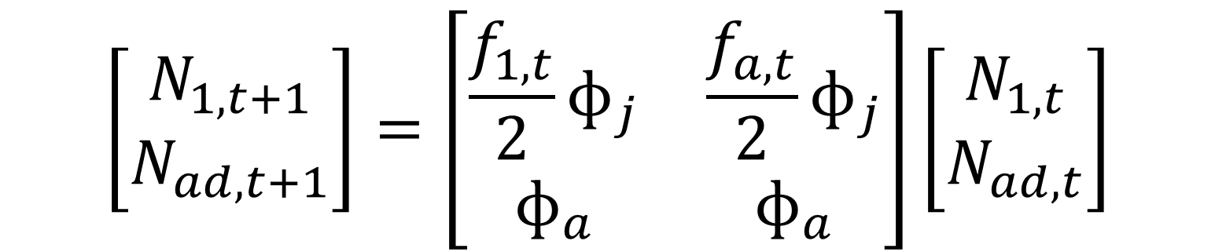
IPM Example
Population model
$$\left[\begin{matrix}N_{1,t+1} \\ N_{ad,t+1}\end{matrix}\right]=\left[\begin{matrix}\frac{f_{1,t}}{2}ɸ_{j} & \frac{f_{a,t}}{2}ɸ_{j} \\ ɸ_{a} & ɸ_{a}\end{matrix}\right]\left[\begin{matrix}N_{1,t} \\ N_{ad,t}\end{matrix}\right]$$
Notes:
Censused at start of May
Pre-breeding census
Point out which matrix elements match with life cycle diagram

Slide 38

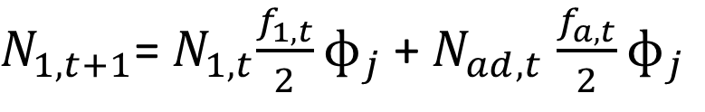
IPM Example
Population model
$$\left[\begin{matrix}N_{1,t+1} \\ N_{ad,t+1}\end{matrix}\right]=\left[\begin{matrix}\frac{f_{1,t}}{2}ɸ_{j} & \frac{f_{a,t}}{2}ɸ_{j} \\ ɸ_{a} & ɸ_{a}\end{matrix}\right]\left[\begin{matrix}N_{1,t} \\ N_{ad,t}\end{matrix}\right]$$
$N_{1,t+1}$=${ N}_{1,t}\frac{f_{1,t}}{2}ɸ_{j}$ +${ N}_{ad,t}$ $\frac{f_{a,t}}{2}ɸ_{j}$
$$N_{ad,t+1}=(N_{1,t}+N_{ad,t})ɸ_{a}$$
Notes:
- How we actually write out that matrix multiplication and then eventually code it

Slide 39
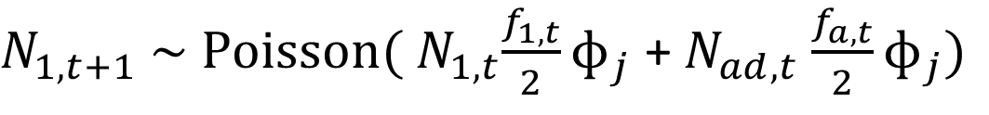
IPM Example
Population model
$$\left[\begin{matrix}N_{1,t+1} \\ N_{ad,t+1}\end{matrix}\right]=\left[\begin{matrix}\frac{f_{1,t}}{2}ɸ_{j} & \frac{f_{a,t}}{2}ɸ_{j} \\ ɸ_{a} & ɸ_{a}\end{matrix}\right]\left[\begin{matrix}N_{1,t} \\ N_{ad,t}\end{matrix}\right]$$
$N_{1,t+1}$ $\sim Poisson({ N}_{1,t}\frac{f_{1,t}}{2}ɸ_{j}$ +${ N}_{ad,t}$ $\frac{f_{a,t}}{2}ɸ_{j})$
$$N_{ad,t+1}\sim binomial(ɸ_{a}{, N}_{1,t}+N_{ad,t})$$
Notes:
Gave them stochasticity – treating this latent state as a random variable
We can also give them demographic stochasticity by treating f (productivity) and phi (survival) as random variables pulled from distributions
Have different options for modeling temporal variability
Fixed or random time effects
With or without correlation among demographic rates (eg across age/stage classes)
We’re using uncorrelated random effects

Slide 40

IPM Example
Population model
$$\left[\begin{matrix}N_{1,t+1} \\ N_{ad,t+1}\end{matrix}\right]=\left[\begin{matrix}\frac{f_{1,t}}{2}ɸ_{j} & \frac{f_{a,t}}{2}ɸ_{j} \\ ɸ_{a} & ɸ_{a}\end{matrix}\right]\left[\begin{matrix}N_{1,t} \\ N_{ad,t}\end{matrix}\right]$$
Notes:
This is the state-space model
Top row of code is juveniles, bottom is adults

Slide 41
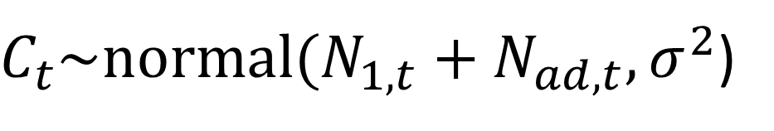
IPM Example
Observation model
C = counts (data)
$C_{t}\sim normal(N_{1,t}+N_{ad,t}, σ^{2}$)
Notes:
sig is observation error but also residual error of IPM (from lack of fit of the process model)
Could stop here and try to estimate everything from single time series of counts
Most parameters would not be separately estimable – estimates would strongly depend on chosen priors
Must add demographic info to render them estimable

Slide 42


IPM Example
Poisson model
J = number of fledglings
$$J_{t}\sim Poisson(f_{i,t})$$
Notes:
- Age and year are indexing tricks in JAGS, so your f estimates are going to be a matrix of productivities with row corresponding to juv and adults and column corresponding to year

Slide 43
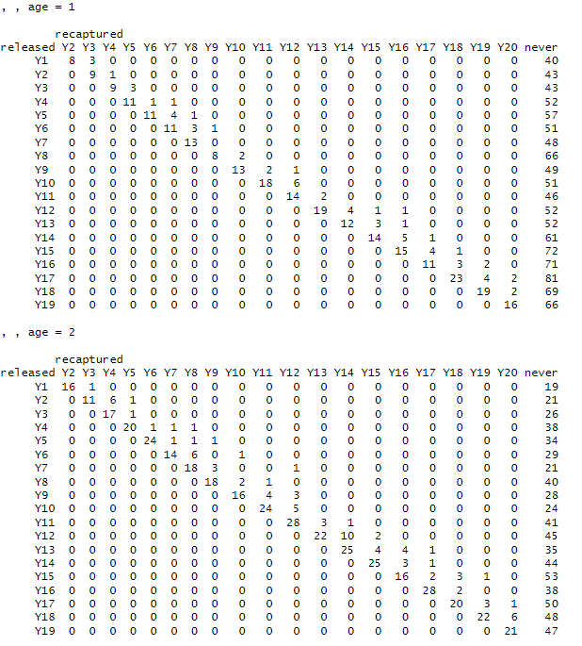
IPM Example
CJS model
Data in m-array format
Notes:
Typical CH is 101110 for an individual
This is condensing them down into cohorts for a given year

Slide 44
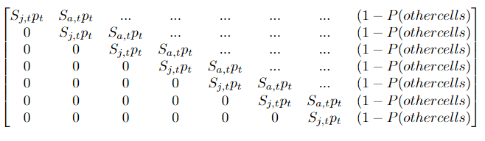
IPM Example
CJS model

Slide 45
IPM Example
CJS model
( ) ~
multinomial( , 51)

Slide 46
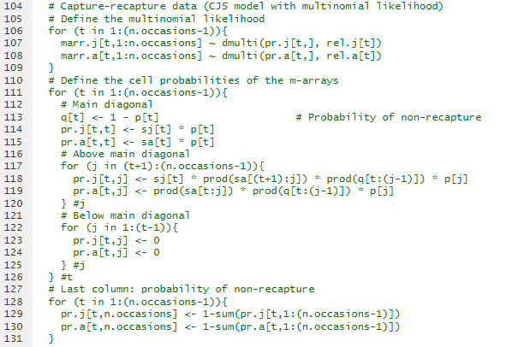
IPM Example
CJS model

Slide 47
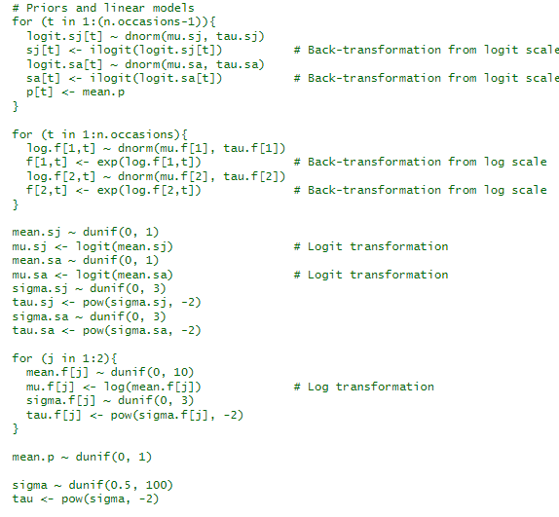
IPM Example
Priors

Slide 48
IPM Example – Practical notes
Where is the joint likelihood in the JAGS code?
It’s defined implicitly by a series of simpler, local relationships
Practically, the same name of parameters in the different likelihoods insures the integration
Assumptions
The assumptions that each submodel requires also apply to the IPM
Additional assumptions due to integration
Independence of datasets
Common demography – datasets stem from the same population

Slide 49

IPM Example
Notes:
This is the state-space model

Slide 50
IPM Example – Practical notes
Where is the joint likelihood in the JAGS code?
It’s defined implicitly by a series of simpler, local relationships
Practically, the same name of parameters in the different likelihoods insures the integration
Assumptions
The assumptions that each submodel requires also apply to the IPM
Additional assumptions due to integration
Independence of datasets
Common demography – datasets stem from the same population
Notes:
Datasets stemming from different pops can bias vital rate estimates
Example – count breeding ducks, band migrating ducks

Slide 51
IPM Example – Practical notes
How accurate is the pop size estimated with an IPM?
Depends on the type of error that we have while counting individuals
Are counts correct on average (both types of error – double counting and under counting – occur)?
Only imperfect detection?

Slide 52
IPM Example – Practical notes
Goodness-of-fit:
Can be extremely challenging (but important) – area of current research
Assess the fit of each submodel (e.g., posterior predictive checks)
Derived/latent quantities expected to be the most biased if the submodels do not fit well

Slide 53
IPM Example – Practical notes
Modes of analysis
Bayesian
Most flexible and often easiest for ecologists
Frequentist
Faster computation
Easier model selection (AIC)
State process requires normal distribution – not always representative of data generating process
Kalman Filters needed – can be more complicated

Slide 54
Integrated Species Distribution Model
“…datastream-specific observation submodels that inform a common ecological model” – Gilbert et al. 2021
Spatial point process – expected abundance determines whether a species occurs in an area and true abundance within that area
Hunter harvest data and camera trap data

Slide 55
Data Integration - Advantages
Often results in improved accuracy and precision
Makes use of multiple datasets
Can reconcile bias among datasets
Can make additional parameters estimable
Time series of counts + capture-recapture = productivity
Propagation of uncertainty from vital rate estimates to other outcomes (abundance, population growth rates)
Notes:
Recently integrated community models have become popular
Pull information from commonly detected species to inform rarely detected species – important to understand underlying assumptions about data

Slide 56
Data Integration - Words of Warning
“Moreover, the advent of data integration makes rigorous data even more valuable as a reference for identifying and adjusting for deficiencies in opportunistic data in the context of data mining.” – Latif et al. 2024
Notes:
This has become so common and we’ve really entered the era of “BIG DATA”
Often the methods and applications are developed before ways to validate them
Probably hear this a lot, but no statistics are going to make up for poor sampling
Sometimes the hard-won, small dataset specific to a certain study site is more valuable than the eBird continent wide dataset if it’s sampled rigorously

Slide 57
Data Integration – More Resources
Kery and Schaub Bayesian IPM Workshop – 2025 in Fort Collins
All info can be found in their IPM textbook from 2022
Neil Gilbert iSDM Lecture and GitHub - https://www.youtube.com/watch?v=8pOyTjBFeOI
Other good examples in lectures on Youtube
Check IPM papers for code examples – good place to start

Slide 58
