Slide 1





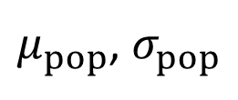










$μ_{pop}$, $σ_{pop}$
$$μ_{1}$$
$$μ_{2}$$
$$μ_{3}$$
$$y_{1}$$
$$y_{2}$$
$$y_{3}$$
$$y_{4}$$
$$y_{5}$$
$$y_{6}$$
$$y_{7}$$
$$y_{8}$$
$$y_{9}$$
$$y_{10}$$
$$y_{11}$$
$$y_{12}$$

Slide 2













$μ_{pop}$, $σ_{pop}$
i^{th} = observation of j^{th} group
$$μ_{1}$$
$$μ_{2}$$
. . .
$$μ_{n}$$
$$y_{1,1}$$
$$y_{2,1}$$
$$y_{3,1}$$
$$y_{4,1}$$
$$y_{1,2}$$
$$y_{2,2}$$
$$y_{3,2}$$
$$y_{4,2}$$
. . .
$$y_{1,n}$$
$$y_{2,n}$$
$$y_{3,n}$$
$$y_{4,n}$$

Slide 3
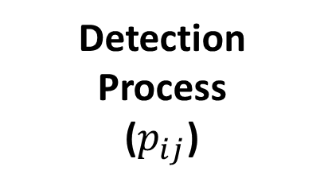
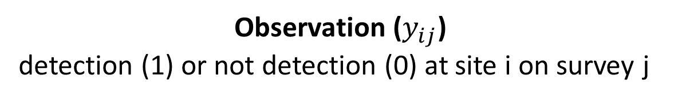

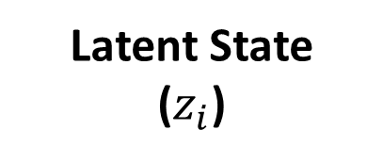
Observation ($y_{ij}$)
detection (1) or not detection (0) at site i on survey j
Detection Process
($p_{ij}$)
Latent State
($z_{i}$)
$y_{ij}$ ~ Bern($z_{i}×p_{ij})$
$$z_{i}\sim Bern\left(ψ_{i}\right)$$

