Slide 1
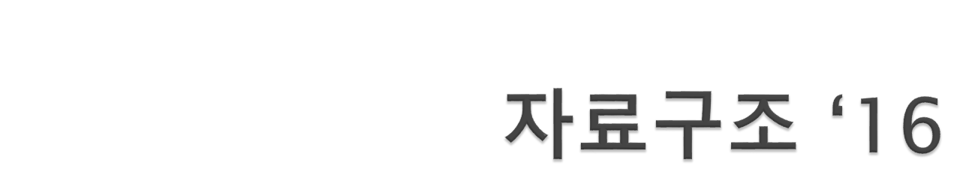
Moon, Sung Hyun

Slide 2
Instructor
  문성현 :
  smoon5@Hotmail.com [자료구조]
Lecture
  Time (1): Tues 15:00, Thur 16:30
  Time (2): Tues 16:30, Thur 15:00
  Classroom : 6202
Text
  자바로 배우는 쉬운 자료구조, 이지영, 한빛미디어, 2008
Prerequisite
  JAVA

Slide 3
Exams
  Midterm : 18, Oct 18:00
  Final : 13, Dec 18:00
  No exception will be allowed
Grading
  Mid-term : 35%
  Final : 35%
  homework: 20%
  Participation and attendance: 10%
Course web page:
  Report.skhu.ac.kr

Slide 4

Data structures is concerned with the representation and manipulation of data.
All programs manipulate data.
So, all programs represent data in some way.
Data manipulation requires an algorithm.
We shall study ways to represent data and algorithms to manipulate these representations.
The study of data structures is fundamental to Computer Science & Engineering.

