Slide 1
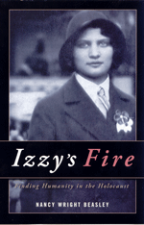
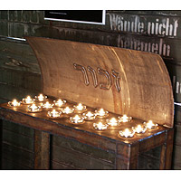
Virginia Holocaust Museum Tour
Friday, September 29th
2:30 – 5:00
Tour the Virginia Holocaust Museum
as a follow-up to the
JSRCC Book Discussion of Izzy’s Fire.
College van leaves Parking Lot (adjacent to Burnette Hall)
at 2:30 and returns at approximately 5:30 p.m.
The Tour is FREE. Reservations are required.
Make your reservation by e-mail to ksteele@reynolds.edu; provide the number of attendees.

