Slide 1
GUNS, GERMS, AND STEEL
The Fates of Human Society
  Jared Diamond
Presentation Prepared by Marti Leighty
March 2, 2006

Slide 2
Book’s Major Question:
Peoples of Eurasian origin, especially those still living in Europe and Eastern Asia and in places where their cultures have spread, dominate the world in power and wealth.
Other peoples have been decimated, subjugated and even exterminated by Eurasian colonists.
WHY????

Slide 3
OBJECTIONS
“If we explain why some people came to dominate, may this not seem to justify the domination?”

Slide 4
DIAMOND’S THESIS
History followed different courses for different peoples because of differences in people’s environment, not because of biological (genetic) differences among the people themselves.

Slide 5
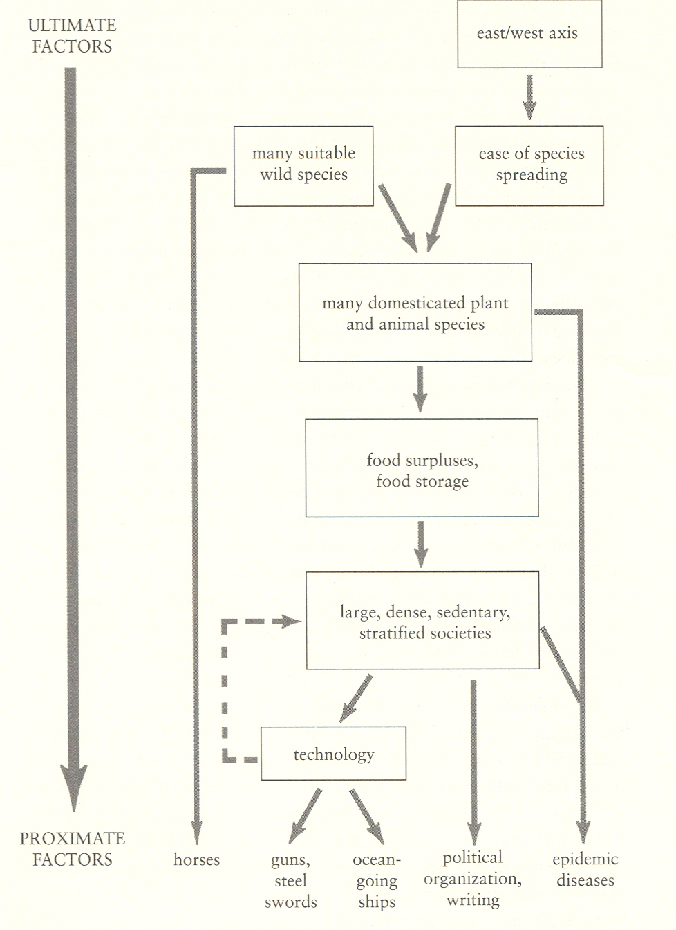

Slide 6
EUROPEANS ENCOUNTER NATIVE AMERICANS
These first encounters encapsulate the factors that generally led to Eurasian conquest; that is, the whole can be summarized with this part of the story.

Slide 7
Inca Emperor Atahualla encounters the Spanish Conquistador Francisco Pizarro at Cajamarca in 1532
Atahualla 80,000 soldiers; Pizarra 168
Pizarro captures Atahullpa, collects enormous ransom, then kills him anyway
Battle key to conquest of Inca empire

Slide 8
Why Does Pizarro Succeed?
Domesticated horses used in battle
Incas already divided by civil war which rose from an epidemic of smallpox
Pizarro got there as a result of European maritime technology developed by a centralized political state

Slide 9
Pizzarro possessed steel swords
He also had guns but they weren’t particularly effective at this point
Written Spanish documents had contributed information about the resources of the Incas and the central role played by Atahualla, predicting his demise would devastate Incas

Slide 10
Food Production
Why did food production not evolve in large, geographically suitable areas of the globe?
Why did the dates of food production development vary so widely?
Were the humans different, or was the environment?

Slide 11
All people on earth were once hunter-gathers; why did some leave this behind and others not?

Slide 12
“Food production systems evolved as a result of the accumulation of many separate decisions about allocating time and effort” (Diamond).
Food production developed as a way to provide the most calories (particularly of protein)_ with the least amount of effort.

Slide 13
The major significance of evolving into food production was to free up time so that certain tribal members could become SPECIALISTS: weapon makers, container makers, tribal leaders, medicine men, etc.

Slide 14
In cultures that evolved food production, the major factors contributing were:
Decline in the availability of wild foods
Increased availability of domesticable wild plants
Development of technologies for collecting, processing and storing wild foods

Slide 15
How Were Wild Plants Domesticated?

Slide 16
Selection of largest and most attractive plants
Preferential planting of “best” seeds
Favoring beneficial mutations in plants (almonds)
Selection of seeds that did not germinate simultaneously
Selection of self-pollinators
Notes:
All of these evolved slowly over thousands of years. Almonds but not acorns

Slide 17
Problems With Food Cultivation in Much of North America
Major grain crop, corn, was very tiny, took thousands of years to evolve into modern size, not self-pollinating, and very low in protein
Wild grasses largely limited to rice which also was low in protein
Few (turkey and dog) domesticable animals to assist in production or to be eaten

Slide 18
Advantages of Western Eurasia
Largest land mass in Mediterranean climate
Great diversity of wild plants and animals
Greatest seasonal climatic variety—more annuals
56 prize grasses

Slide 19
Range of altitudes led to staggered harvests
Less competition from hunter-gatherers

Slide 20
Why New Guineans Didn’t Develop Agriculture
No domesticable grain crops
Root crops lacking in protein
No domesticable large mammal species

Slide 21
In coastal areas, consumed fish which shows openness to new foods
In highlands, frequent protein starvation (which may have been a factor in areas where cannibalism existed)

Slide 22
Mississippi Florescence
Refers to arrival of dozens of crops from Mexico. Once introduced, they were widely cultivated. This is evidence that once crops arrived, indigenous people planted and cultivated them.

Slide 23
All of this supports Diamond’s thesis that differences in the arrival of plant production were based, not on limitations of the people but on biota.

Slide 24
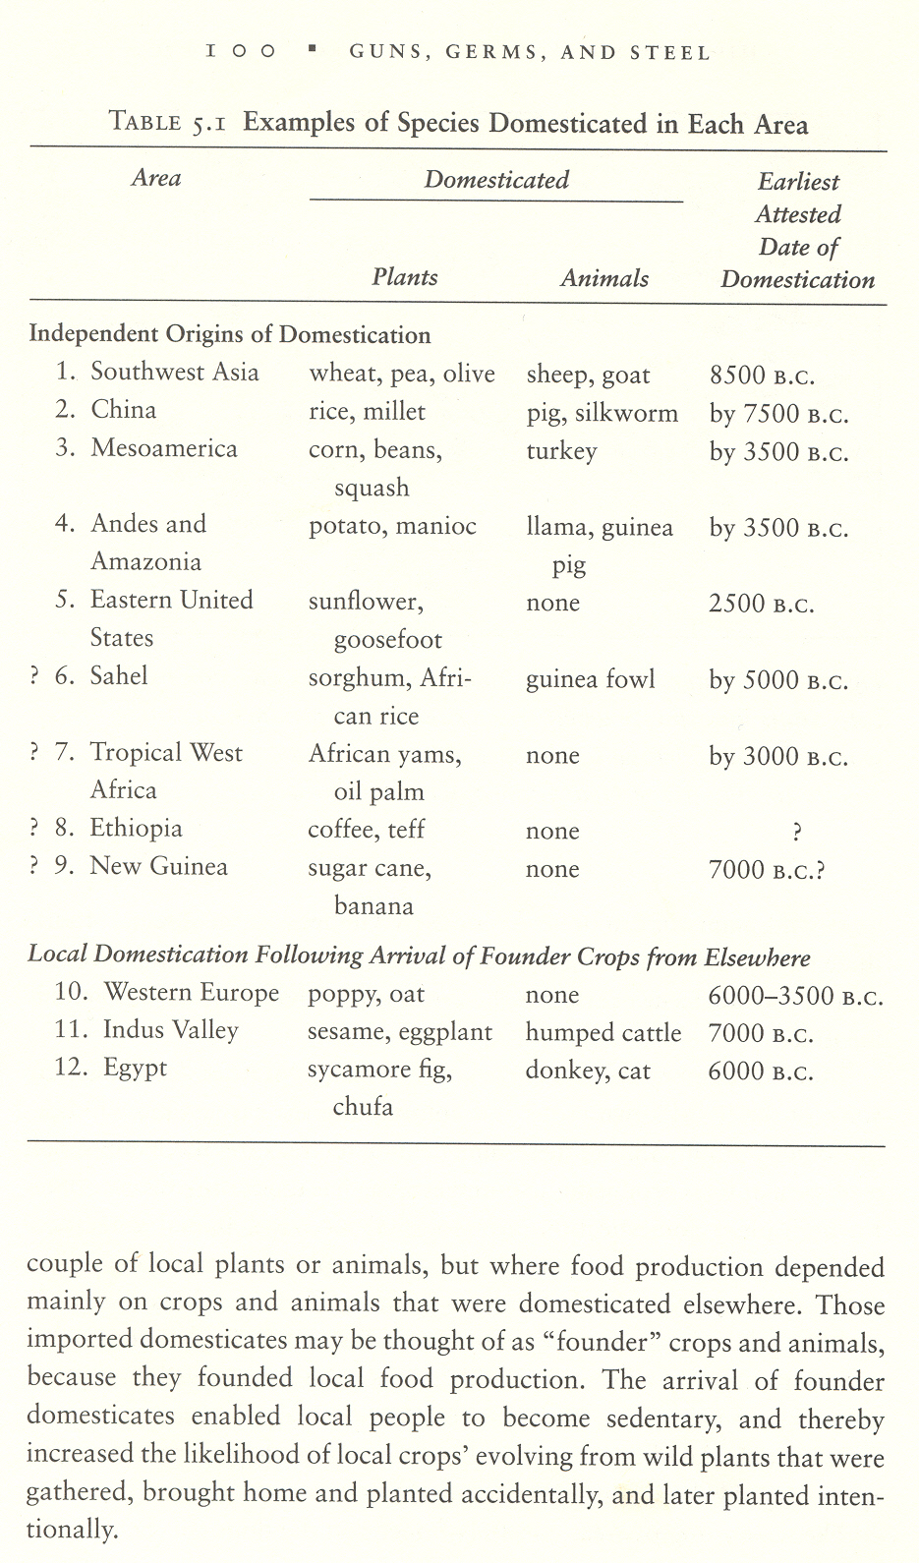

Slide 25
The Role of Domesticable Animals in Food Production
“Domesticable animals are all alike; every undomesticable animal is undomesticable in its own way” (Diamond).

Slide 26
Provided by Domestic Animals
Meat
Milk Products
Fertilizer
Transport
Leather
Military assault vehicles
Plow traction
(Germs)

Slide 27
Domestication is the process by which wild animals are transformed into something more helpful to humans.

Slide 28
Eurasia had 13 0f 14 domesticable animals.
Notes:
See slide of these animals

Slide 29
The Major Five
Sheep (Asiatic mouflon)
Goat (Besoar goat of West Asia)
Cow, ox, cattle (aurochs, now extinct, found in Eurasia
Pig (wild boar, distributed over Eurasia and North Africa)
Horse (wild horses from Russia)

Slide 30
The Minor Nine
Camel (Arabia and Central Asia)
Llama and alpaca (Andes)
Donkey (African wild ass of Northern Africa)
Reindeer (Northern Eurasia)
Water buffalo (Southeast Asia)

Slide 31
Yak (Himalayas and Tibetan plateau)
Bali cattle (banteng from Southeast Asia)
Mithan (the gar of India and Burma)

Slide 32
Why Were Eurasia’s Animals Domesticated?
Why Eurasia's horses but not Africa’s zebras?
Why Eurasia’s pigs but not America's or Africa’s?
Why Eurasia’s cattle but not buffalo?

Slide 33
Was it the peoples or the animals?
The evidence that it was the animals themselves is based on the rapid adoption of domesticable animals once they arrived from other places.

Slide 34
There were repeated 19th and 20th century attempts to domesticate Eland, moose, ox, zebra, and bison.
Modern geneticists met with little success—so too indigenous peoples.

Slide 35
Why “perpetually wild”?
Diet
Growth rate
Problems with Captive Breeding (pandas, cheetahs, vicunas
Nasty and dangerous dispositions ( grizzly bear, American buffalo, zebra)
Tendency to panic when approached (all gazelle species)
Notes:
Some too finicky about diests, sosts of supplying food (calorie costs) elephants grow to adulthood too slowly

Slide 36
Social structure: Domestic animals live in herds, have a dominance hierarchy, overlap ranges rather than have exclusive territory.

Slide 37
Role of Direction of Major Axes in Dissemination of Ideas and Products

Slide 38
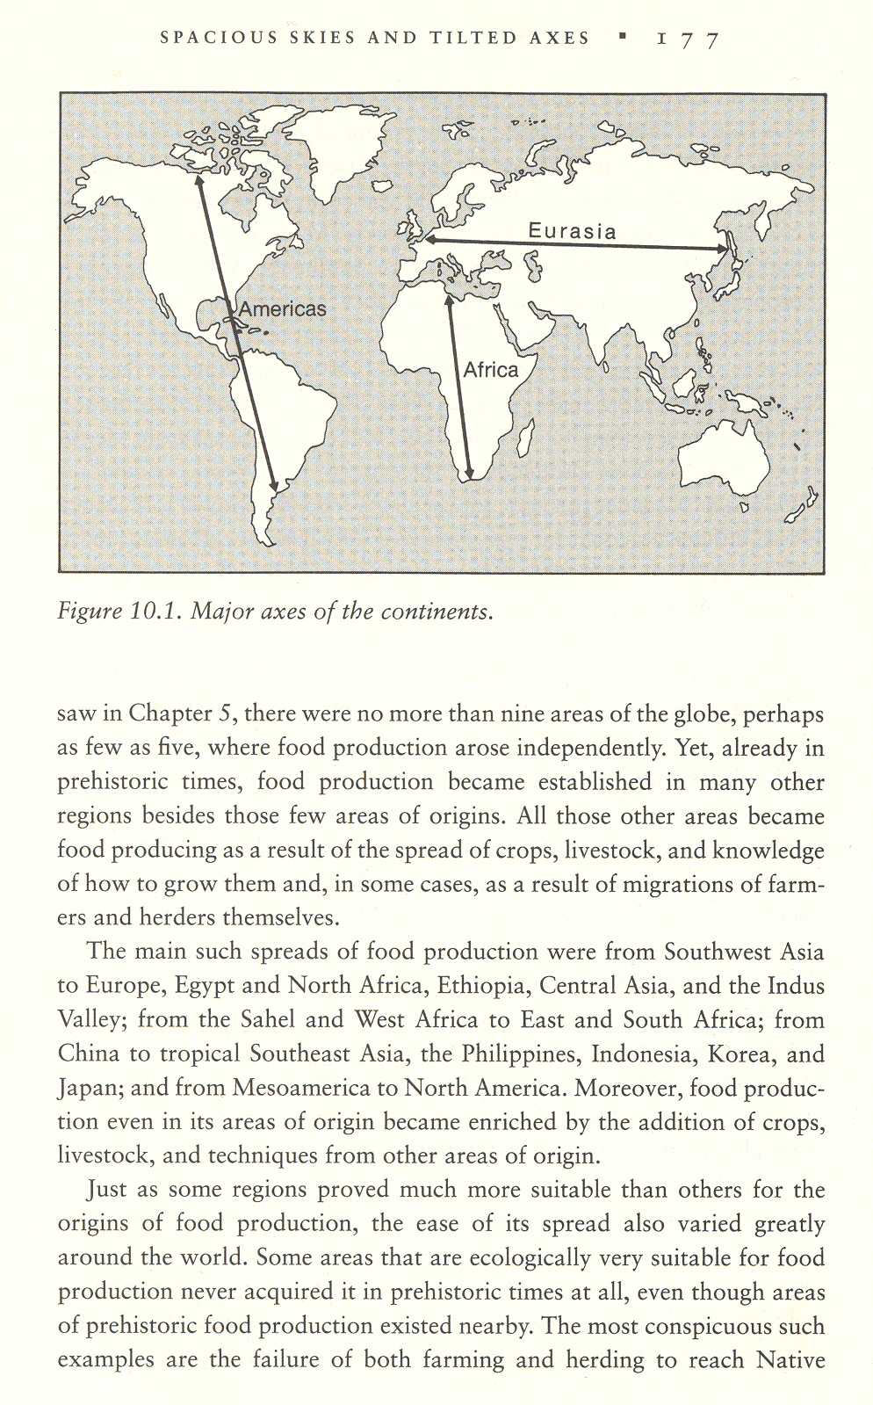
Why Did Ideas About Plants and Animals spread more quickly in Eurasia?

Slide 39
GERMS!!
Diseases have been major shapers of history
Influenza of 1918
European conquests of Americas (Spanish conquistadors, English settlers)
Notes:
See chart of major axses

Slide 40
Eurasia sight of major infectious diseases: Why?
Many diseases zoonotic
Critical masses of people because of efficient food production
Crowd diseases could not survive in small bands of people
Leprosy, yaws, hookworms may be oldest because could survive in smaller tribes

Slide 41
Farming and agriculture increase diseases and disease spread
Farms live around and often fertilize with their own sewage
Densely packed human populations
Evolution of world trade routes (distributed smallpox)
Notes:
Add chart of diseases from livestorck

Slide 42
New Zoonotic Diseases?
AIDS
Lassa Fever
Lyme Disease
Hanta viruses

Slide 43
Syphilis is suspected of being only disease transferred from native Americans to Euarsia.

Slide 44
Development of Written Language Critical
Writing is the key to transmit knowledge to distant lands and to retain knowledge
Writing was developed by agricultural groups because food production allows for the development of specialists (scribes)

Slide 45
With the exception of Egyptian and Chinese all writing systems are derived from early Mesoamerican writing.
Phoenicians provided representational consonantal alphabet
Greeks invented representation of vowel sounds

Slide 46
Written language aided in conquering of new lands.
Notes:
Last slide.

Slide 47
GUNS AND STEEL

Slide 48
Why Did Eurasians Possess Technology First?
Technology develops cumulatively rather than in isolated acts
Technology finds most of its uses AFTER invention
Technology requires a society to adopt it

Slide 49
Religions vary widely in their willingness to adopt technology
Depending on geography, information about technological advances will reach some people and not others

Slide 50
Descendents of those societies that achieved centralized government and organized religion earliest ended up dominating the modern world.

Slide 51
“The combination of government and religion has thus functioned together with germs, writing, and technology as one of the four main sets or proximate agents leading to history's broadest pattern.
How did governments and religions arise?

Slide 52
Levels of Social Organization Evolve from Least to Most Complex
Bands
Tribes
Chiefdoms
States

Slide 53
Bands
Tiny populations: typically 5-80 people
Most are close relatives by birth or marriage
All humans lived in bands until 40,000 years ago

Slide 54
Bands
Usually nomadic: live in areas where food is scarce
Land used jointly by whole group
No specialization: all able-bodied individuals forage for food
Economic System: Reciprocal Exchange
No laws, treaties, or police to help resolve disputes
Notes:
But being closely related helps!

Slide 55
Tribes
Society with hundreds of people, usually settled in many villages
Shared language and culture
More than one kinship group
Land belongs to clans within a tribe
Everyone knows everyone else by name and relationship

Slide 56
Tribes
Social system egalitarian
No upper or lower class
No one can become more wealthy
Government still egalitarian
Decisions are made in a group
May have “big man” with limited power; still would live like others

Slide 57
Chiefdoms
Population: several thousands to tens of thousands
Arose about 7500 years ago with rising populations
In 1492 widespread in North and South America, Africa, Polynesia

Slide 58
States
Populations of 50,000 to 1 billion
Usually have literate elites
Sometimes literate population
Arose first in Mesopotamia, later in Mesoamerica, China, Southeast Asia, Andes, West Africa

Slide 59
Religion
Early: tribal deities
Polytheist
Standardized temples and religions evolve under influence of kings
Often these kings were head of state religion
Monotheism evolves
Temples or religious centers are crucial to economic redistribution, writing, crafts, technology

Slide 60
Advantages of States and Centralized Religions
Primarily as they allow for specialization
Provide critical mass for technologies to emerge, be adapted, and spread
May reduce numbers of armed conflicts
Dissemination of ideas and information

Slide 61
Religions
Can unite a people with shared goals and beliefs
May create central “mythos”: idea that God wants them to spread this religion
Missionaries played critical role in providing Eurasian ideas and technology to isolated populations.

