Slide 1


Assessing Learning in Information Literacy: Impetus ♦ Implementation ♦ Impact
J. Sargeant Reynolds Community College, Richmond, Virginia
Hong Wu, Coordinator of Information Literacy and Digital Services
Denise Woetzel, Reference / Information Literacy Librarian
Beth Bensen-Barber, Assistant Professor of English
Ghazala Hashmi, Coordinator, Quality Enhancement Plan
Georgia International Conference on Information Literacy Georgia Southern University, Savannah, Georgia September 2012

Slide 2
Successful integration of information literacy across the curriculum:
Librarians
Instruction
Assessment
Faculty
Notes:
Like in many academic libraries, developing information literacy skills in students has been part of the core mission of Reynolds libraries. Our librarians have been working diligently to fulfill this responsibility for decades. Over the years through our experience, we have learned that the key to a successful information literacy program is for librarians to collaborate with faculty members. However, the road to collaboration is not without challenges. It takes years of hard work, and most importantly, an institutional charge to make it happen. We’ve also learned that instruction alone will not be sufficient to ensure accountability. Assessment provides important impetus as well as measurement for institutional effectiveness. It is also valuable for providing guidelines for future improvement and demonstrating the value of a library as a partner in teaching and learning. So successful integration of information literacy across the curriculum consists of the collaboration between librarians and faculty members, information literacy instruction, plus assessment. The project we piloted in spring 2012 tells exactly the story.

Slide 3
Impetus
late 1990s Governor’s Blue Ribbon Commission presents a charge to higher education institutions
2000 State Council of Higher Education for Virginia (SCHEV) establishes regular assessment and reporting requirements for core competencies
2002 Virginia Community College System (VCCS) Task Force develops guidelines for assessing core competencies
2003 VCCS administers James Madison University’s Information Literacy Test
Notes:
Although librarians at J Sarge have been dedicated to promoting information literacy for decades, the instruction is not mandated. It’s only available upon faculty request. However, we got some impetus in the late 1990s, when the Governor charged a Blue Ribbon Commission to evaluate the needs and goals of higher education in Virginia for the 21st century. The Commission concluded that evidence of high quality outputs is essential in assuring stakeholders that investment in higher education is producing results. It identified six core competencies which included written communication, information literacy/technology, quantitative reasoning, scientific reasoning, critical thinking, and oral communication. It recommended that these areas be assessed regularly and the results of such assessments be shared with the public.
The State Council of Higher Education for Virginia (SCHEV) adopted these core competencies in 2000 and required Virginia colleges and universities to report on two areas of competency every two years.
In response, in 2002, Virginia Community College System (VCCS) established the Task Force on Assessing Core Competencies which recommended a system-wide assessment plan.
In 2003, VCCS administered the Information Literacy Test (ILT) to a select group of graduating students of each college. Assessment questions were developed from the skill sets covered in James Madison’s Go for the Gold information literacy tutorial.

Slide 4
Information Literacy Test Results (2003)
 | Number tested | Average Score | Median Score | Percent that met standard
VCCS | 3,678 | 36.4 | 37 | 24.40%
JSRCC | 511 | 31.18 | 31 | 16.05%
Notes:
Our information literacy test results were pathetic. At the VCCS level, the average score is 36.4 while it’s only 31.18 at Reynolds. 24.40% of the VCCS test takers met standard while only 16% of Reynolds students met standard.

Slide 5
Dilemmas
No institutional mandate or guidance was articulated on how to map information literacy within the curricula.
Information literacy instruction is dependent upon faculty requests.
Limited librarians on staff are available to offer instruction across the board.
One hour/one shot library instruction sessions produce limited results.
Notes:
Here are our dilemmas:
Although there was a mandate for assessment, there was no institutional mandate or guidance on how to map information literacy within the curricula; Information literacy instruction is dependent upon faculty requests; In addition, there were limited librarians on staff to offer instruction across the board; and those one hour/one shot library instruction sessions produced limited results due to the lack of time, enhancement and student engagement.

Slide 6
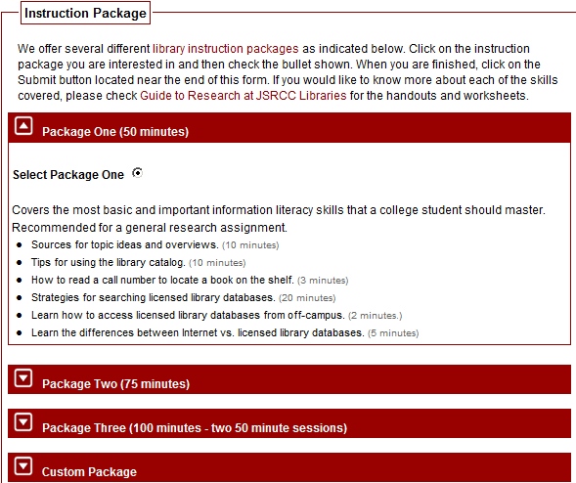
Responsive Measure 1
Enhanced instructional workshops provided upon faculty request.
Notes:
In response to the poor performance of our students on the assessment, we enhanced our instructional workshops provided upon faculty request. We created four packages for instructors to choose from. We listed the skill sets to be introduced in each package and the amount of time we needed to cover each skill. This not only provided the faculty members a overview of expected learning outcomes, but also provided guidelines to librarians on what to cover in each session. We have over a dozen full and part time librarians offering library instruction among three campuses. We want to make sure we sing from the same music sheet.

Slide 7
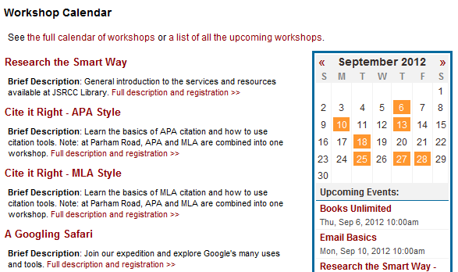
Responsive Measure 2
Offered students open session workshops.
Notes:
In addition, we offered students open session workshops. If students don’t get a chance to receive information literacy instruction through their registered courses, we hope they get a chance to sign up for one of these general or specific workshops. We posted the flyers around the library and included a flyer in student orientation package.

Slide 8
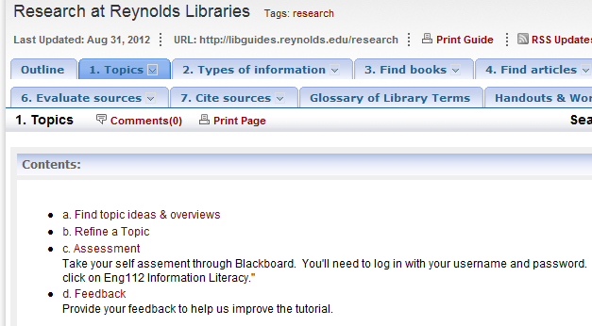
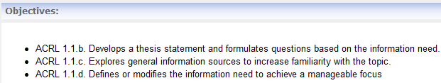
Responsive Measure 3
Developed online modules based on ACRL IL standards
Notes:
In addition to the above face to face instruction, we created the online research guide based on ACRL’s information literacy standards. It includes seven modules covering the skill sets for a complete research process. We were hoping the online tutorial could be used by distance education students or by instructors who prefer students to receive self-paced instruction on their own time. Over the years, we have instructors who adopted some of the modules, but not the tutorial in its entirety, until we did the experiment last spring….

Slide 9
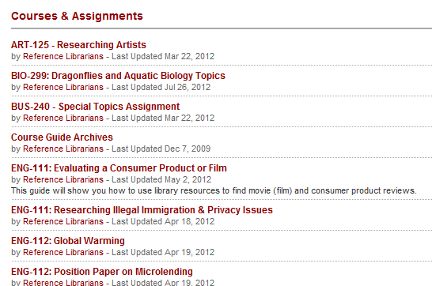
Responsive Measure 4
Created course-based and assignment-specific LibGuides
Notes:
We created course-based and assignment-specific LibGuides for instructors to link into Bb. Almost each of our face to face instruction session is accompanied by a libguide.

Slide 10
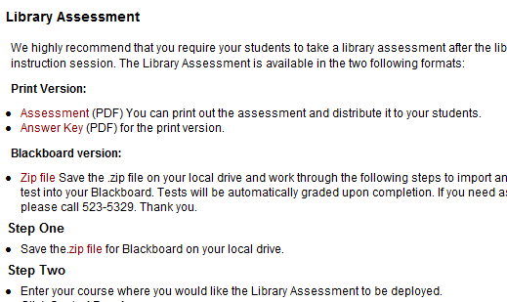
Responsive Measure 5
Created a 20-question assessment for students to complete after a library instruction session.
Notes:
We didn’t forget about assessment
We created a 20-question assessment for students to complete after a library instruction session. Instructors could choose to print it out or implement it through Bb. We provided instruction for the procedure, but we’ve never had any instructors request it…

Slide 11
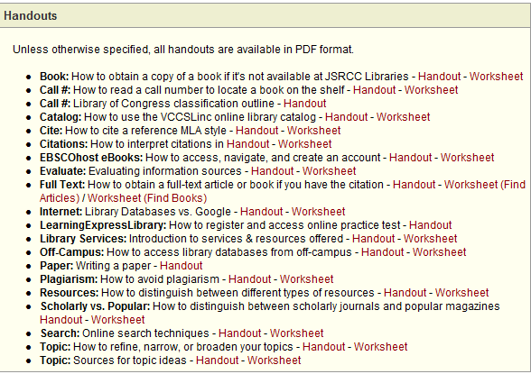
Responsive Measure 6
Created research handouts & exercise sheets.
Notes:
In addition to the 20 question multiple choices assessment, we created research handouts & exercise sheets for open-ended questions. Some instructors did adopt some of these exercise sheets….

Slide 12
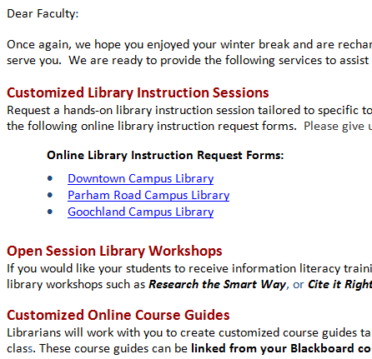
Responsive Measure 7
Emailed Information Literacy instruction reminders each semester.
Notes:
At the beginning of each semester, we sent our email reminders about all our offerings on information literacy training…

Slide 13
Continuing Issues
Despite these efforts,
We still had no institutional guidance or mandate for the effective delivery of information literacy skills or their necessary placements within the curricula.
We continued to struggle with the lack of coordinated collaboration between librarians and faculty.
Notes:
Despite all these efforts,
We still had no institutional guidance or mandate
We continued to struggle with the lack of coordinated collaboration between librarians and faculty members, until we have the qep and fipsy grant. Denise will introduce to you our breakthroughs

Slide 14
Breakthroughs
JSRCC’s Quality Enhancement Plan (a five-year, institution-wide strategic plan) focused attention upon providing support for students within online courses and upon assessing student learning outcomes in distance courses.
Information literacy was identified as one of the SLOs that would be targeted and assessed.
This assessment effort is supported by a three-year federal grant, Funds for the Improvement of Post-Secondary Education (FIPSE).
Notes:
A major breakthrough came in 2008 when the Reynolds Community College identified the The Ripple Effect as the model for its Quality Enhancement Plan (QEP). It seeks to transform student success in distance courses by supporting both students and faculty engaged in online learning and teaching.
Information literacy was identified as one of the student learning outcomes or SLOs that would be targeted and assessed.
In 2009, the college received a three-year grant totaling $400,602 from the Fund for Improvement of Post-Secondary Education (FIPSE), funded by the United States Department of Education. The FIPSE grant has significantly helped to support the institution’s efforts in developing, implementing, and assessing its Quality Enhancement Plan. Ghazala can provide more details on our QEP and FIPSE grant later in this presentation.
Since then, librarians & faculty have actively worked with the QEP team including its subcommittees to explore ways to integrate information literacy into the curriculum instead of only through individual faculty requests for instruction.

Slide 15


Breakthroughs
Librarians & faculty members began to engage in active conversations at QEP Subcommittees.
Notes:
Librarians and faculty have collaborated together on two QEP subcommittees.
In the SLO Assessments subcommittee, librarians collaborated with both English faculty and ITE-115 faculty to incorporate information literacy modules including assessment questions for each of these modules into these curriculums. In the ITE-115 course which is called Introduction to Computer Applications and Concepts, faculty have incorporated 3 of our 7 IL modules which includes identifying types of information sources, searching the library databases, and searching the open web as well as comparing the various types of sources and when it is best to use a particular source.
In the Student Readiness & Orientation subcommittee, one of the projects that librarians & faculty collaborated on was the development of an Orientation to Learning Online course on Blackboard. This two-week, noncredit course is marketed to students who are considering taking an online class and are not sure yet if it is right for them as well as those who have already taken an online class and did not do well. Some of the learning units that were developed for this course included time management, online communication & netiquette, plagiarism, as well as an orientation to library resources & services unit. The course was first offered in August of 2001 and so far we have received very positive feedback from students who complete this course’s exit survey. As far as feedback on the library resources & services unit:
One student commented that “research part was not my favorite--but i understand its importance in distant learning and was well appreciated.”
Another student commented “I would have liked perhaps to have one more project using the Library Resources.”
And a third student commented “Since this is not my first year in college, the lessons toward the end were not very helpful. Also, I feel that there should have been more lessons on online library resources.”
And a forth student commented that “CDL 001 gives an excellent overview of the resources available both on campus and online . . . there was not time to examine every resource in great detail, but what is helpful is knowing where to go for future reference. Thinking about this 4th comment, I am reminded of the students I meet in my in-class instruction sessions every semester who comment to me afterwards:
That the session was so helpful and I wish I knew about these resources and services sooner. It would have saved me time and frustration.
Or I could have done a better job with my research assignments or papers last semester or this whole past year if I had known about these resources and services the library provides.
And when I think about theses last two students’ comments it further confirms (at least to me) the need to better incorporate information literacy throughout the Reynolds curriculum and exposing students’ to IL skills beginning with their 1st semester at Reynolds.

Slide 16
Managing Guidelines
Student instruction should cover core information literacy competency skills as identified by SCHEV
Instructional elements should be easy and flexible to implement across curricula
Instructional materials should lend themselves to ease of evaluation, revision, and updates
Instructional materials should be available for online delivery in order to reach both on-campus and distance students
Assessments and data collection should not be cumbersome for faculty
Notes:
During our many discussions on the best ways to assess information literacy at Reynolds, the librarians came up with these guidelines and agreed that the online IL modules the librarians created along with creating assessment questions on Blackboard would be the best method.

Slide 17
Modules Adopted
Research at Reynolds Libraries IL modules based on standards/skills covered in:
ACRL’s IL Standards
VCCS Core Competency Standards for IL
James Madison University’s Go for the Gold Tutorial and Information Literacy Test (ILT).
VCCS Libraries’ Connect for Success Tutorial
Notes:
Research at Reynolds Libraries 7 IL modules were developed using LibGuides, a content management system the library purchased from the SpringShare company. Skill sets covered in each of the 7 modules are based ACRL’s standards as well as the Virginia Community College System’s core competency standards for IL & James Madison University’s Go for the Gold Tutorial. The skill areas covered in these 7 modules include identifying, accessing, and evaluating information.
The Reynolds Library modules were first developed in 2004. The modules were later revamped in 2007 and then migrated to LibGuides in 2009. The LibGuide modules are much more dynamic and interactive compared to the original modules we created.
Before this project, the modules included handouts and corresponding worksheets but no assessment tool. (Link to the modules and show some pages)
I should also mention that a group of VCCS librarians across the state of Virginia collaborated on the development and updating of information literacy modules for our VCCS Library consortium. This tutorial, called Connect for Success, was updated in 2010 using SoftChalk, an elearning lesson builder application (Link to Connect for Success and show some pages). These modules are also based on ACRL’s standards as well as VCCS’ core competency standards for IL and James Madison University’s Go for the Gold Tutorial. The Connect for Success tutorial does have two assessment tools available. At the end of each module, students can link to a quiz via Google Docs and automatically have their scores emailed to their student email account which they can forward to their instructor. The alternative option is for faculty to download the assessments for each module into their Blackboard Grade Center.
After some discussion and evaluation, the librarians and English faculty involved in this project decided to adopt our Reynolds modules instead of the VCCS Connect for Success modules because they are tailored to Reynolds Library’s resources & services as well as the IL needs of our students. We can also easily revise these LibGuide modules when the need arises - unlike the Connect for Success tutorial where a consensus needs to be reached on a consortium level.

Slide 18
Implementation (Part One)

Slide 19
Collaborative Efforts: Librarians’ Perspective
Identified Eng112 as our target course for assessment.
10 assessment questions were created for each of the 7 modules.
Librarians from both within & outside of JSRCC reviewed all 7 modules as well as the assessment questions for each module.
Modules and questions were revised based on the initial reviews.
English faculty were invited to review the modules and assessment questions. Further revisions were made.
Notes:
Reynolds librarians have worked most closely with English faculty over the years to provide IL face to face sessions to their classes. We identified ENG-112 as our target course as it requires that students write essays that require researching and citing sources.
Throughout 2010 librarians discussed with English faculty ways to better incorporate information literacy into all English classes instead of only through individual faculty requests for instruction.

Slide 20
Collaborative Efforts: Librarians’ Perspective (continued)
30 assessment questions were developed for the pre/post test. English faculty provided feedback on which questions to include.
Feedback Survey questions were developed for each module.
A Camtasia clip was developed to provide students with instructions for navigating and completing the modules.
Librarians entered all seven modules and assessments into Blackboard.
Notes:
Feedback Survey questions were developed for each module to glean information on each module’s usefulness and user-friendliness and to improve the modules. Google Docs was used to create the survey questions and the survey for each module was added to this LibGuide.

Slide 21
Implementation (Part Two)
Integrating English Department Faculty

Slide 22
Collaborative Efforts: Faculty Perspective
English Faculty Subcommittee Chair mapped the seven modules into the Eng112 curriculum to provide participating faculty with guidance.
Nine previously successful Eng112 students were solicited to pilot test the modules in Fall 2011.
English faculty were recruited and trained to integrate the online modules into their course sections in Fall 2011.
Notes:
A dozen ENG-112 students who completed the modules received a $25.00 Barnes & Noble gift card.
Ghazala and Beth recruited a dozen ENG-112 faculty to integrate the modules into their course.

Slide 23
Collaborative Efforts: Faculty Perspective (continued)
Five faculty agreed to participate in the project as a control group.
No online Library Research Guides were integrated within the control sections.
Instructors taught IL skills as usual to their sections
One instructor integrated one library session for her section.
Control group included urban and suburban students but no distance or dual students.
Students completed pre- and post-assessments.

Slide 24
Collaboration
Two English faculty reviewed all seven modules
Nine students volunteered (six finished the reviews)
Students received $25 Barnes and Noble gift card
Do we need this slide?
Notes:
As part of the ongoing assessment processes and the current QEP at JSRCC, librarians and faculty at JSRCC participated in an intensive study in which we examined information literacy in our second semester comp course.
Prior to Fall 2011, many English faculty had been requesting library instruction in a variety of formats. English faculty were also conducting their own renditions of library instruction and information literacy, by integrating a number of useful worksheets and online modules. As Hong and Denise have already mentioned, faculty were not making full use of the resources available to us through the libraries’ Web site in the form of handouts, links, and modules.
In Fall 2011, the English department formed an assessment committee, charged with assessing how effectively our English 112 course teaches information literacy. Hong, Denise, and Ghazala recruited faculty from the assessment committee to review the modules and offer feedback from a pedagogical perspective.
Myself and another faculty member were asked to review the seven library modules from the perspective of an English professor for the purposes of preparing the modules for a pilot study to be conducted in Spring 2012. After offering feedback to Hong and Denise and after they revised the modules, we then recruited nine students who had completed English 112 to review the modules and offer feedback.

Slide 25
Pilot Student Feedback
Insert student comments from feedback on modules
Need to get these from Hong and Denise
Notes:
To request student volunteers, we contacted additional English faculty to submit names of students they thought might be good candidates to review the modules based on their previous performance in English 112. We sought a total of ten students and had nine agree to participate, with six completing the reviews successfully.
Student volunteers received email instructions on how to access, review, and assess the modules. Our Blackboard Administrator enrolled each student volunteer in a Blackboard course titled “Eng 112 Information Literacy,” where they followed instructions in the site.
They were asked to
Review the information and materials carefully
Complete the Self-assessment to see how well they had learned the material
Complete the Feedback Survey embedded at the end of each module
The student reviews began on November 1, 2011 and completed on November 18, 2011. Upon successful completion of the review process, students received $25 Barnes and Noble gift cards.
Student feedback was valuable as they offered critical reviews of modules and their accompanying assessments.

Slide 26
Participating ENG112 Sections Represented Varied Course Delivery Formats

Slide 27
All JSRCC Campuses were Represented

Slide 28
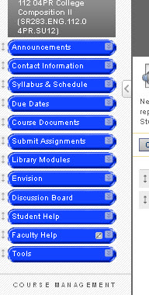
Integration
Blackboard
Integrated pre- and post-tests
Integrated all seven modules
Integrated all seven assessments
Revised syllabi to include due dates for reading and taking assessments
Integrated into BB Gradebook
Notes:
In order to participate in the study, faculty agreed to integrate all seven modules and have students complete the pre- and post-tests and assessments associated with each module.
Integration began with Blackboard, revising syllabi, and understanding how integrating the module assessments would impact Blackboard’s gradebook.
Each participating instructor was enrolled the Blackboard course titled “Eng 112 Information Literacy.”
Workshops included training faculty on how to integrate the Blackboard modules course into their own courses.

Slide 29
Faculty Training
Extensive communications to introduce project to faculty and invite participation
Two Training Workshops for Faculty
ENG112 Outcomes stressed
Sample course schedules (two options)
Textbook integration handouts
How-to Blackboard integration (course copy)
Directions for submitting pre- and post-assessment scores to Coordinator
Notes:
In preparation for the study, we offered a number of group and individual workshops in which we trained faculty in the following areas:
Understanding the English 112 Learning Outcomes
Revising course schedules to show integration of the modules
Raising awareness of which chapters and sections of the two textbooks in use corresponded with modules
Understanding how to integrate the Information Literacy Blackboard course into existing sections of English 112
After the initial workshops, we found that we were continuing to offer support when finding glitches in the assessments or to offer general assistance with the modules.
The study concluded at the end of the Spring 2013 semester with faculty submitting spreadsheets indicating scores on both the pre- and post-tests.

Slide 30
Impact
What did we learn?

Slide 31
Measuring the Value of Providing Information Literacy Instruction in ENG112
Both sets of students – the Control Group as well as the Treatment Group – entered ENG112 at comparable levels of competency in research skills.
The data confirms that ENG112 is an appropriate site for instruction in information literacy skills: students enter ENG112 with some basic understanding of research skills but not enough to demonstrate competency in this area of learning.

Slide 32
Students make significant improvement in IL Skills in ENG112
Post-test Results: Both the Treatment Group and the Control Group made significant progress.
Control Group Improvement: 7.30 points, on average
Treatment Group Improvement: 20.15 points, on average.
Treatment Group achieved a solid level of “competency” in research skills, scoring 76%, on average.
Control Group neared “competency,” scoring 66%, on average.

Slide 33
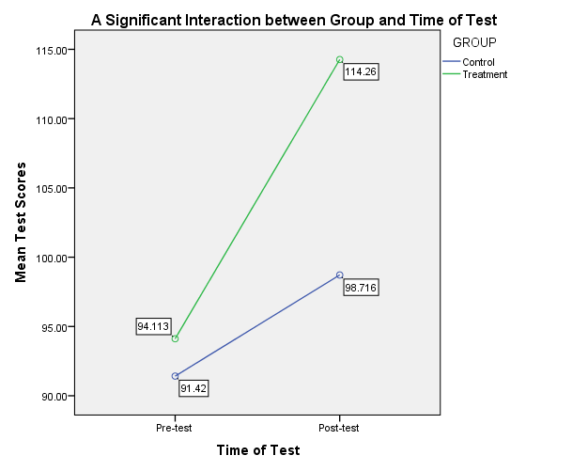

Slide 34
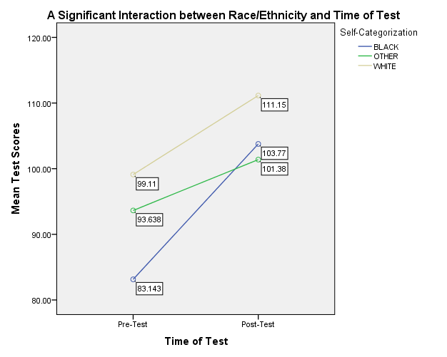
Significant and Observable Effects for African American Students
The most significant impact was observed upon skills development of African American students.
Notes:
At pre-test time, African American students scored significantly lower than White students, on average.
The average scores of students classified as Other indicate no reliable difference between “Other and White,” or “Other and African American.”
By post-test time, however, African American students’ scores were commensurate with the scores of other students, on average.
The slope of the blue line (African American students) is steeper than the slope of the other two groups.
The difference in slopes of the blue line (African American students) and the brown line (White students) is statistically significant.
On average, African American students began the semester scoring at an average of 55% correct responses. By post-test, however, they were earning about 69% correct, on average, which is commensurate with the 74% correct average for White students and the 68% correct average for Other students.
“By the end of the course, everyone had made progress, but African American students had compensated for an initial disadvantage. Something is happening in ENG 112 that is leveling the playing field for Black students, at least in terms of information literacy skills.” – Sandi Fulton, Coordinator of Assessment and Institutional Research

Slide 35
The Good News
ENG112 is having a direct and significant impact on student learning outcomes in the area of information literacy.
The integration of online library research guides within ENG112 results in even more significant gains for students in research skills.
African American students begin ENG112 with a skills disadvantage when compared to Caucasian students and to students classified as “Other.” However, African American students make
1. the most significant gain in learning by the end of a semester,
2. surpass the “Other” category, and
3. reach very close to “competency” level by time of post-test.

Slide 36
What We Learned and Where We are Going
The data supports the need to initiate policy discussions now for the effective integration and delivery of information literacy skills to students throughout the curriculum.
English Department faculty will develop a task force to promote the systematic integration of all library research guides within all ENG112 sections.
Other discipline faculty are being introduced to the effective integration of the Library Research Guides.

