Slide 1





JSRCC Libraries
Your First Stop for Information and Research Needs!
http://www.reynolds.edu/library

Slide 2




Resources
Over 83,000 books in our print collection.
Over 300 journal, magazine & newspaper subscriptions in our print collection.
Print collection includes Bestseller, Career, ESL and Juvenile books.
Thousands of online books available via the NetLibrary Service.
Over 200 databases providing access to millions of online full-text journals, magazine & newspaper articles.
Educational VHS & DVD collection.
New Popular audio book & DVD collection.
Use the VCCSLinc Library Catalog to search for material available at all 3 campus libraries.

Slide 3

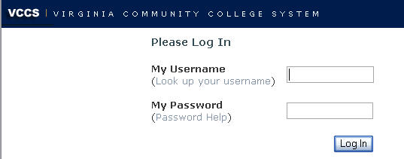

Off-Campus Access to
Library Databases
When you click on any JSRCC Library database link on the library's web site, the VCCS login screen will appear.
Type your My JSRCC login, the same username and password as you use for your Blackboard. You will then be connected to the database.
For more information, click on Off-Campus Access from the Library’s home page.

Slide 4




Borrowing From Other Libraries
Richmond Academic Library Cooperative Promotes resource sharing between the Richmond area’s academic libraries and the library of Virginia by providing reciprocal borrowing privileges to students and faculty.
Interlibrary Loan Service that allows JSRCC Libraries to borrow materials from other libraries around the world.

Slide 5





Research Help
Information Literacy Sessions
Online Course, Subject & Research Guides
Tailored workshops for your department
PDO Library Workshops - A variety of research workshops are offered during the year.
One-on-one Research Consultations
Ask a Librarian - Drop by the Reference Desk, e-mail us, or call us.

Slide 6

Faculty & Staff Services
Course Reserves – Place materials on reserve for in-library use or check-out.
Recommend a Purchase - Recommend new material to be added to the libraries’ collections.
Make a Suggestion - Let us know how we can further meet your research and information needs.

Slide 7
Library Locations, Hours, &
Contact Information
Locations:
  Downtown Campus – 2nd Floor, Room 231
  Parham Campus – Burnette Hall, Room 115
  Western Campus – Bldg. C20, Room 201
Hours & Contacts:
  Open 6 days a week including evenings & Saturdays
  Detailed hours & contact information available at: http://www.reynolds.edu/library/hours.htm

