Slide 1

The What, Why, and How of Blogging
JSRCC Libraries
Presented by Denise Woetzel on 11/21/06

Slide 2
What is a blog?
A blog is basically a journal that is available on the web. Blogs are used for social and professional networking.

Slide 3
Blog Terminology
Blogger - The person who writes or edits posts on a blog.
Blogging - Authoring a blog, maintaining a blog or adding an article to an existing blog.
Blogosphere - used to describe the world or community of blogs and blogging.
Posts / Entries - Individual articles on a blog.
Weblog - another term for blog (web + log).

Slide 4
Blog History Timeline
1992 – Tim Berners-Lee (WWW pioneer), creates the first What’s New web page.
December 1997 - Jorn Barger coins the term weblog in 1997.
November 1998 - Cameron Barrett publishes the first list of blog sites on the Camworld web site.
1999 - Peter Merholz decides to pronounce the term we-blog, eventually shortened to “blog.”
July 1999 - Pita, the first free build-your-own-weblog tool is launched,
August 1999 - A company called “Pyra Labs” releases “Blogger,” a service that lets anyone publish a blog.
9/11/01 – Marks a tipping point for blogs.
2004-05 - Blogging software (e.g., Blogger, WordPress) makes it easier for people to create blogs and gives blogs a consistent look.

Slide 5
Blog Statistics
8% of Internet users, or about 12 million American adults, keep a blog. ¹
39% of Internet users, or about 57 million American adults, read blogs. ¹
54% are under 30 ¹
37% have a degree ¹
38% are students ¹
51% have been blogging for less than one year ¹
According to Technorati data, there are about 75,000 new blogs a day, about 1.2 million posts daily, or about 50,000 blog updates an hour.²
Technorati is currently tracking 57. 4 million blogs.²
1. Bloggers: A Portrait of the Internet's New Storytellers, July 19 2006
Telephone Survey conducted by the Pew Internet & American Life Project.
Full report available at: http://www.pewtrusts.org/pdf/PIP_Bloggers_071906.pdf
2 . About Technorati, http://www.technorati.com/about/

Slide 6
Blog Concept
    “the blog concept is about three things: Frequency, Brevity, and Personality.”
        Evan Williams, co-creator of Blogger software

Slide 7
Common Blog Characteristics
Frequently updated (typically daily or weekly)
Dated & time-stamped posts appear in reverse-chronological order
Archives of past blog entries
Often theme or topic oriented
Allow comments
Often include web or RSS feeds
Commonly refer to or provide links to other blogs or web sites
Often include photographs, video & audio clips, etc.
Permanent links to posts on blog site
Categories feature
Search feature

Slide 8
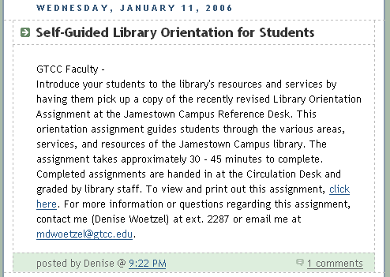
Anatomy of a Blog Entry
Title of Post
Date of Post
Content
Links
Author
Time Stamped
Comments

Slide 9
Types of Blogs
  Personal blogs
    Diaries or journals on the web where people share their personal life experiences including family & friends, photos, music, books, gossip, and more.

Slide 10


Slide 11


Slide 12
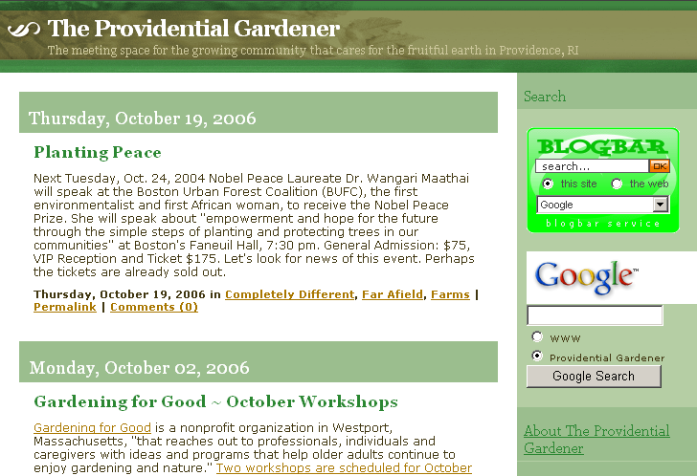

Slide 13
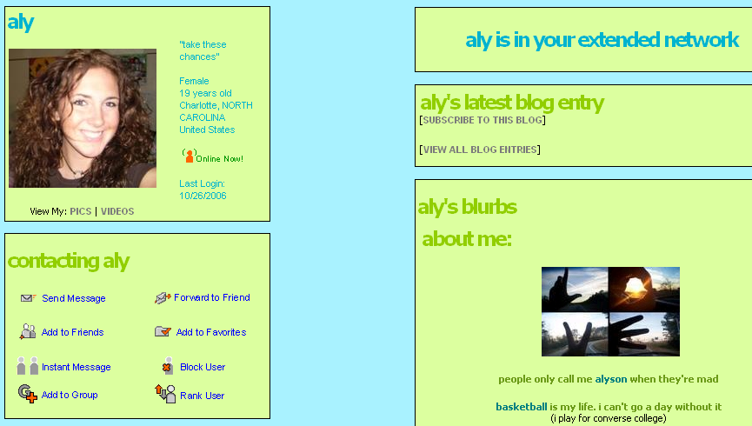

Slide 14
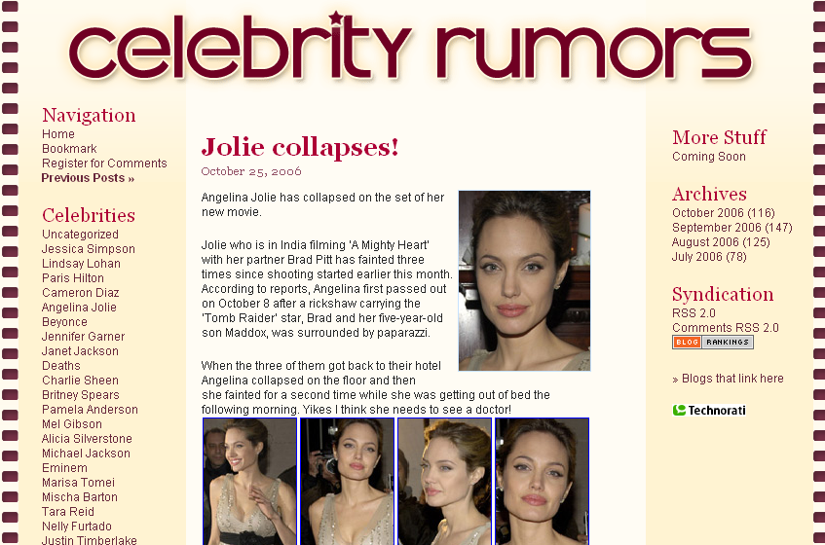

Slide 15
Types of Blogs
  Political
    Commentary on political news and events.

Slide 16
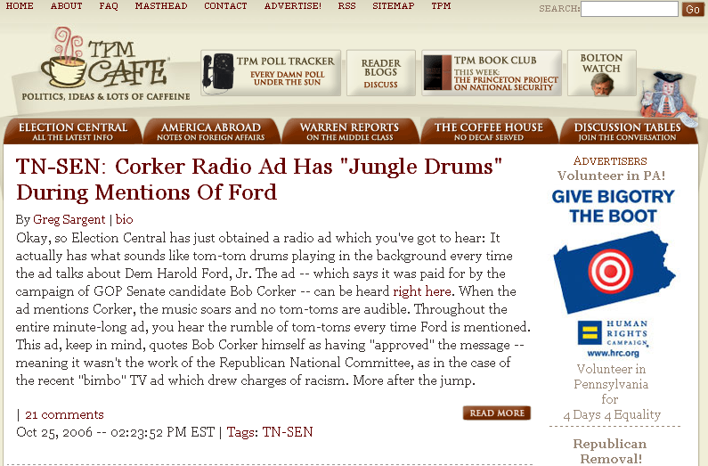

Slide 17
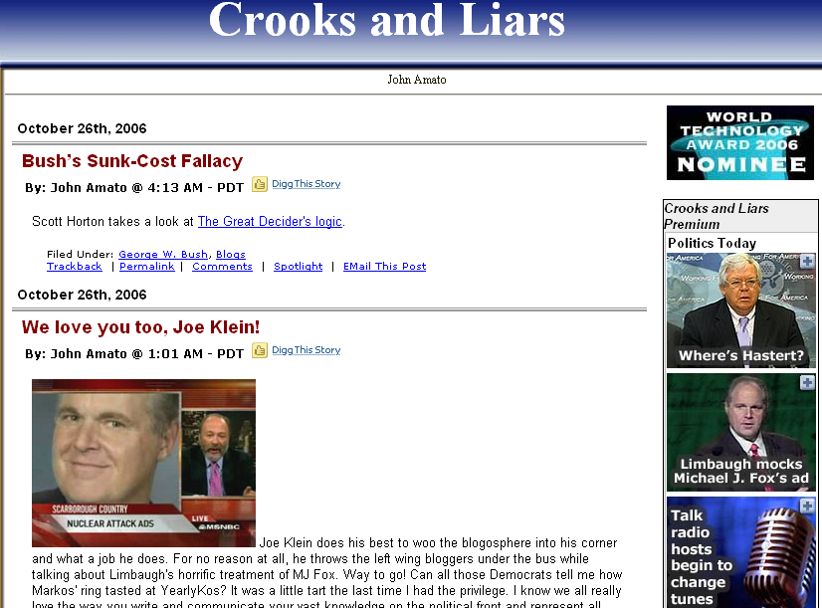

Slide 18
Types of Blogs
  Commercial
    External communication - press releases, jobs posts, product or service information, customer relations, and more.
    Internal communication - information shared among employees or between project teams or departments.

Slide 19
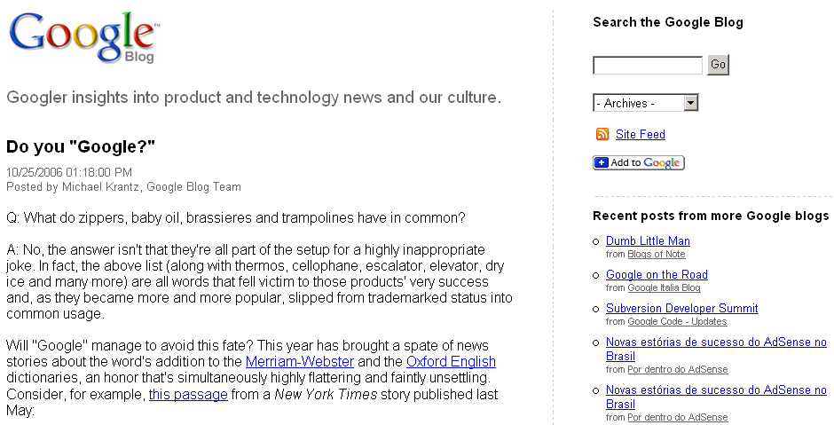

Slide 20


Slide 21
Types of Blogs
  Professional
    Used as an open discussion forum to share expertise, best practices, and current trends in a particular profession (e.g., librarians, computer programmers, lawyers, etc.)

Slide 22
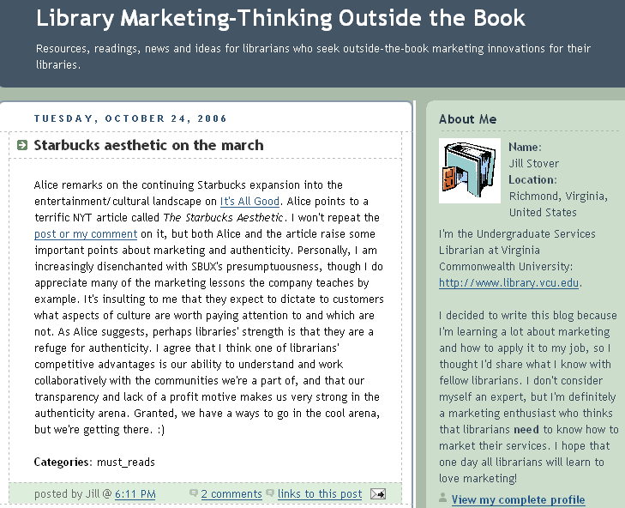

Slide 23
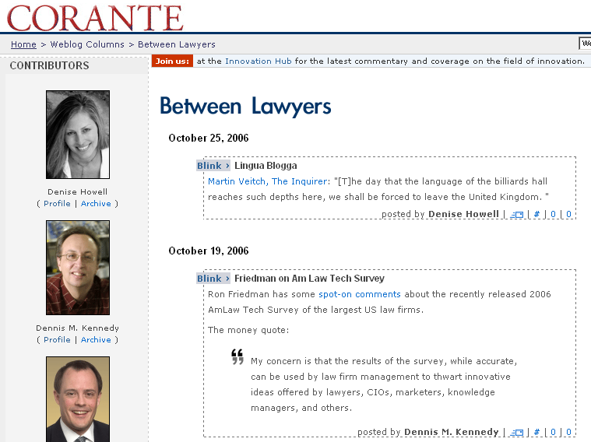

Slide 24


Slide 25
Types of Blogs
  Academic
    Faculty and staff blogs – used to share expertise, best practices, and current trends in academia.
    Faculty blogs – used as an e-learning tool (e.g., class assignments, class discussions, essays & other assignments posted by students).
    Student blogs - announce events, share their experiences and opinions.

Slide 26
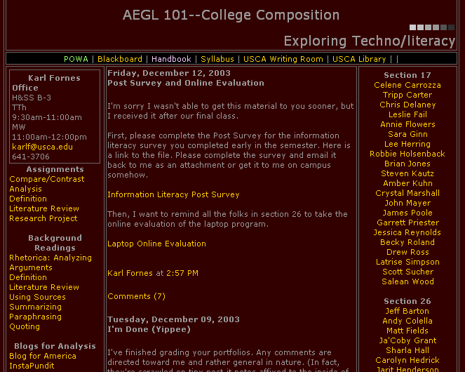

Slide 27


Slide 28
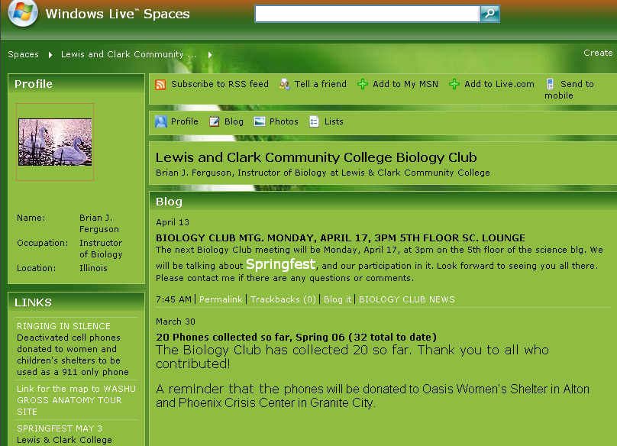

Slide 29
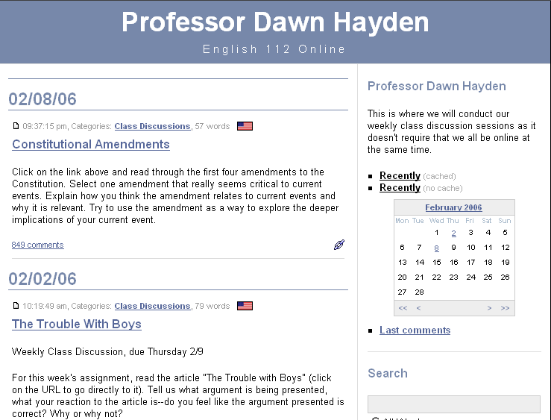

Slide 30


Slide 31
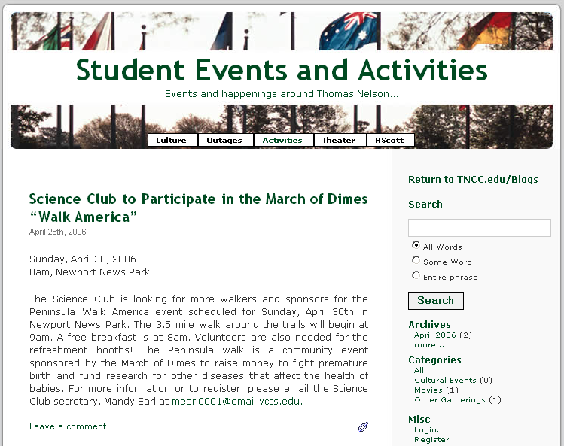

Slide 32
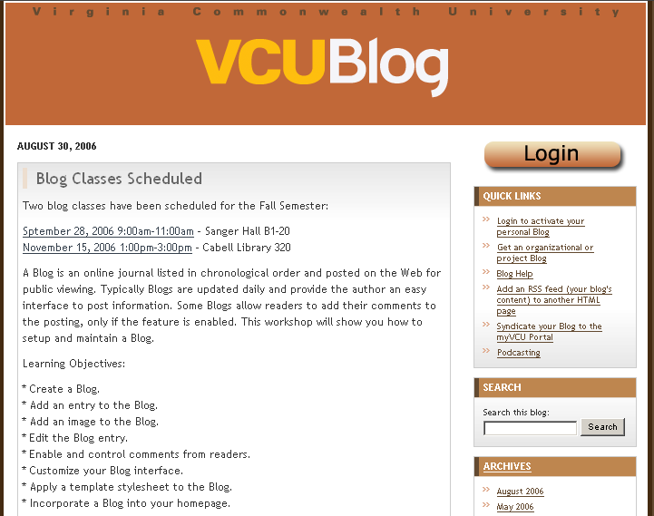

Slide 33
Why Blog?
Timely – staying informed on current trends or what’s hot
Rapid publishing alternative - writing practice, instant peer review, creative outlet
Democratic - open forum for sharing opinions
High level of autonomy
Sharing / connecting with family, friends, and peers
Creating a culture of knowledge sharing – encouraging collaboration.
Localizes information on a particular topic or theme
Gets to the point
Easy to use

Slide 34
Blog Pitfalls
Need to commit to adding content on a regular and frequent basis.
Infrequent participation = less dynamic blog site
Information overload
Redundant
Obsolete
Trivial
Organization of archives can be an issue
Measuring use is difficult - Which posts are being read?

Slide 35
Blog Pitfalls
Misinformation in the form of inaccuracy, rumors, or bias
Legal pitfalls for commercial or professional blogs – leaking private or secure information
Blog censorship – editing & deleting content, comments
Spyware, Adware, Browser hijacking software
Stalkers, harassment

Slide 36
Planning & Development
Audience & purpose
    Make it worth reading
    Participation – who will be allowed to post or comment?
Who will be responsible for managing blog?
    Designing, content, editing, etc.
    Blog policy
Choosing the right technology
    Hosting service
    Software download
    Systems support

Slide 37
Blog Reviews & Comparisons
Time to check: Are you using the right blogging tool? http://www.ojr.org/ojr/stories/050714gardner/
Blog Software Comparison Chart, http://www.ojr.org/ojr/images/blog_software_comparison.cfm
  Online Journalism Review, USC Annenberg

Slide 38
Free Blog Services
There are many blog hosting services that are free and easy to use. These services allow people with little or no technical background to update and maintain their own blog.

Slide 39
Free Blog Services
Blogger - http://www.blogger.com/start
Word Press - http://wordpress.com
My Space - http://www.myspace.com
Live Journal - http://www.livejournal.com
Windows Live Spaces - http://spaces.live.com
Yahoo 360^{o - http://360.yahoo.com}

