Slide 1
Assignment 2: Usability & Accessibility Scavenger Hunt
Ben Gibson

Slide 2
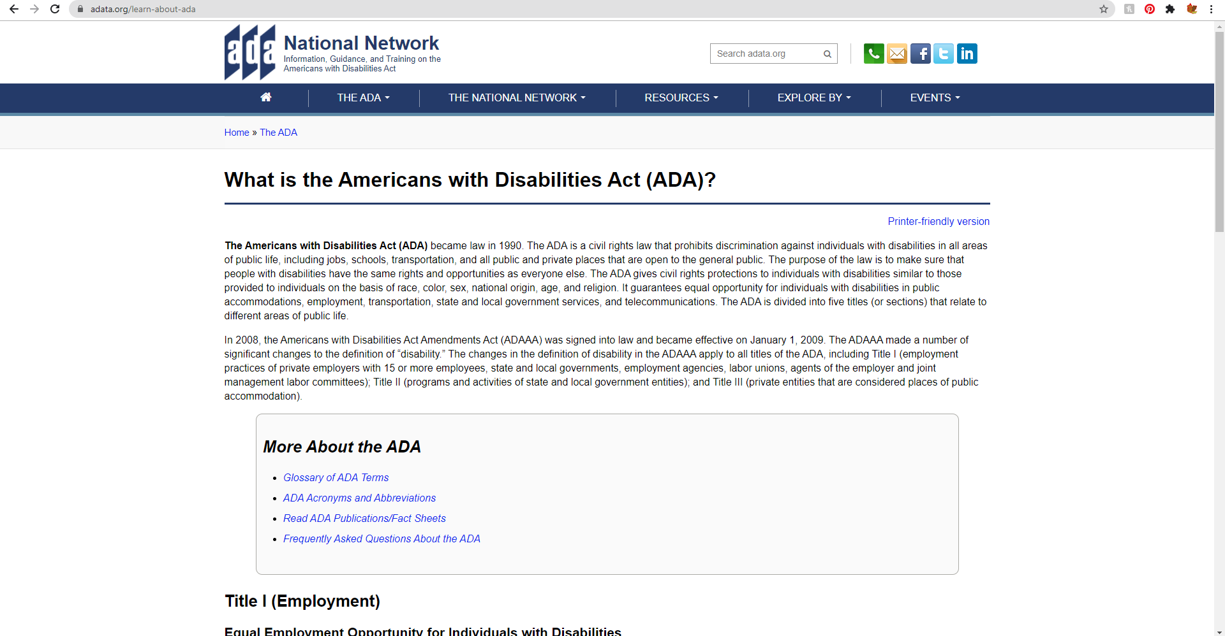
User Control and Freedom
https://adata.org/
This site goes about this by having easy access to changing pages no matter where you are on the site. An example of this is there multiple ways to get to the home page such as clicking the home page, clicking the available home link, or clicking the back arrow.

Slide 3
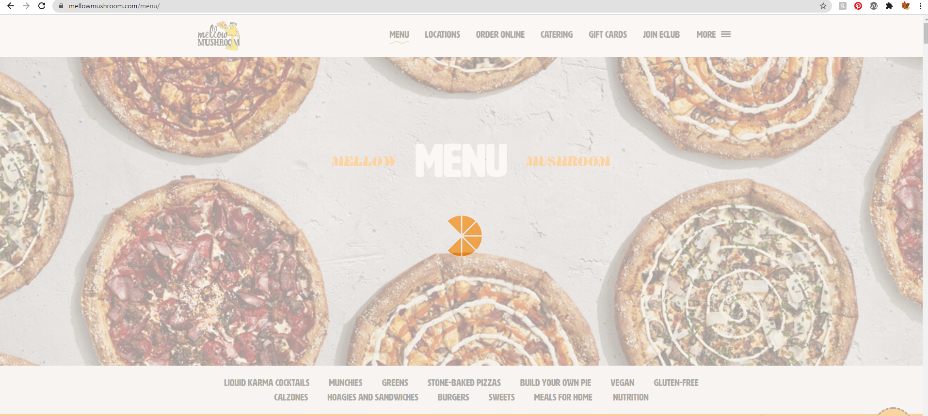
Visibility of System Status
https://mellowmushroom.com/menu/
When switching between pages, a pizza loading symbol appears to indicate that the site is loading.

Slide 4
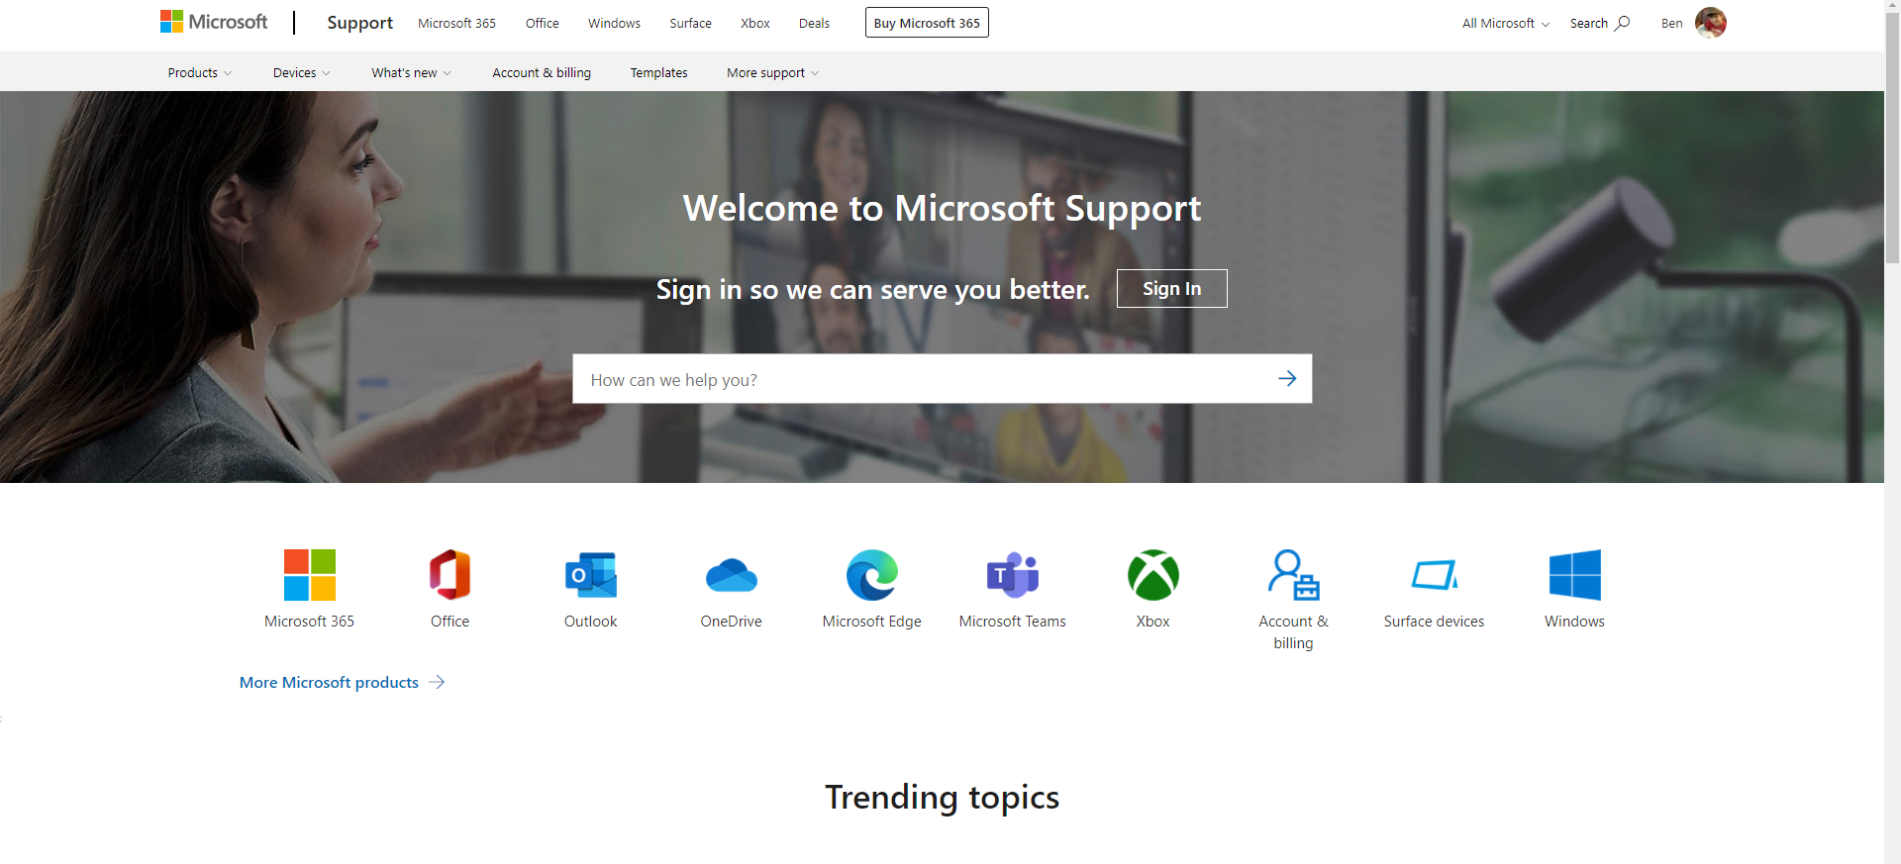
Help and Documentation
https://support.microsoft.com/en-us
The site has an obvious search bar in the center of the screen and displays multiple area in which you can receive assistance.

