Slide 1
Machine Learning: Optimizing Email Campaign Profit Margin & Email Click-decision
An analytical approach to email campaign design
Blake Gilliland

Slide 2
Objectives & Topics
Question: Can we systematically optimize profit for email campaigns?
Emails always cost money, but people rarely click. Can we tip the scales in our favor?
Who clicks most often, and why? Can we design better emails to improve click probability?
Goal:
Systematically maximize the probability of a click and ROI of a sent email
Recommendations & Next Steps
Consideration for alternative approaches
Implementation
Enhancements

Slide 3
Agenda
Results Summary
Brief lookahead at our results
Analysis Deep Dive
Understanding our Data + Click Rate Patterns
Look at CR disparities across individual features
Visualize feature interactivity pertaining to CR
Machine Learning: Comparing models and understanding lift from baseline
What is our goal with ML in the context of this problem?
How do we define success when building a predictive model?
Comparing model performance: Feature importance, Profit Margin
Conclusion
Next Steps
Implementation
Follow up thoughts

Slide 4
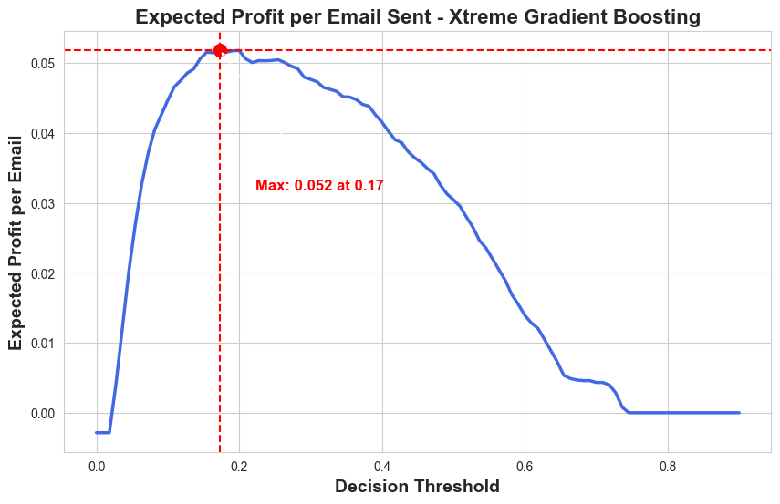
Results Summary
Becoming profitable with ML Model
Assume current state breaks even
70k emails: $3.5k with ML vs $0 baseline
ML: +$.052/email vs $0/email baseline
67% increase in revenue vs baseline
Enhance click-rate with enhanced email design strategy
Reduce Word-Count
Strengthen base of returning customers
Take advantage of feature interactivity

Slide 5
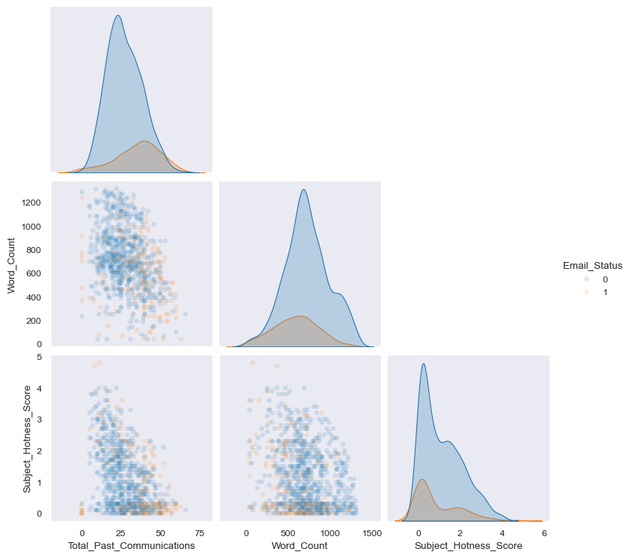
Data overview
19.6% overall click rate for 68k emails sent
Key data points
About the Recipient
Historical activity
Location
About the Email
Campaign category
Type and Source
Content
Time Sent

Slide 6
Click Rate Patterns
Looking at noteworthy Click Rates across individual features.

Slide 7
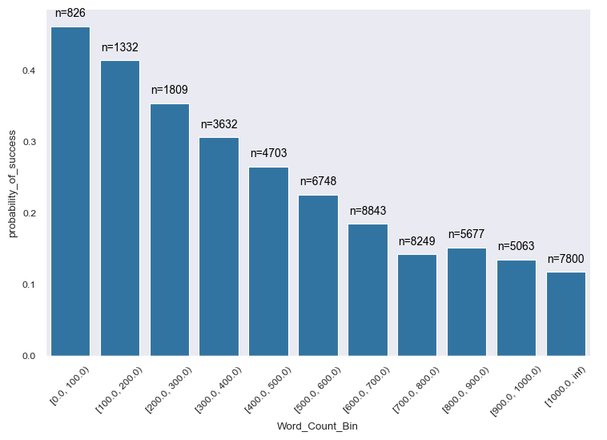
Click Probability: Word Count
Word Count on its own is highly related to click decision
600+ words → Worse than guessing (≤ 20%)
High proportion of observations with 600+ words (35.6k, 52%)

Slide 8
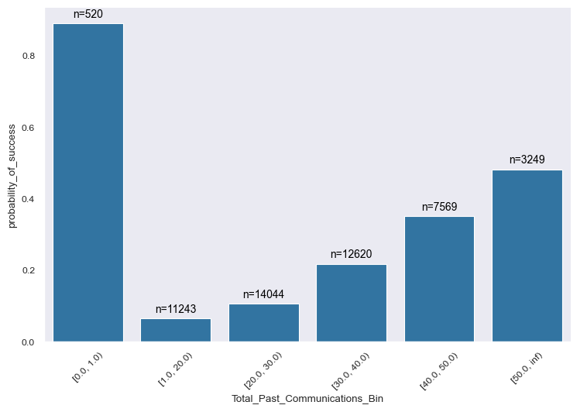
Click Probability: Past Communications
New recipients most likely to click, but this is related to a single Campaign Type (1)
Not strictly within our control
40+ past emails → ≥ 30% click rate
~40% of recipients ≤ 20% click rate

Slide 9
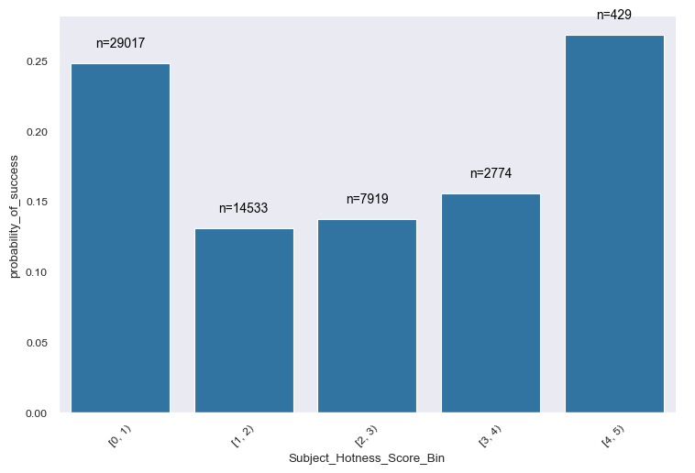
Click Probability: Subject Hotness
Seems like little ROI for ‘hotter’ subjects overall
Will soon learn how Campaign Type impacts this entire picture
40% of recipients between [1,4) hotness → ≤15% CR

Slide 10
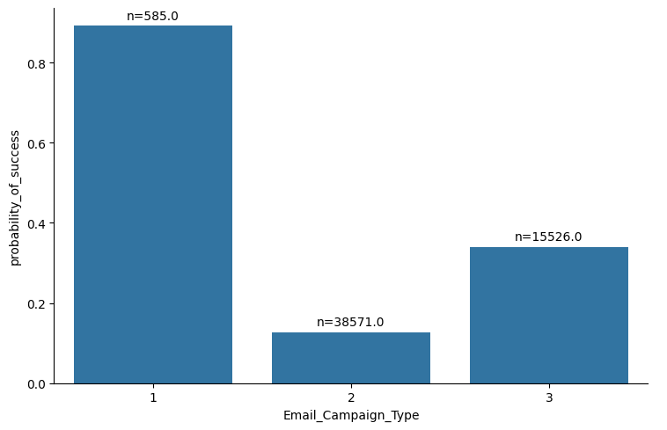
Click Probability Campaign Type
Campaign 1
New recipients only (Past Communications = 0)
Emails contain 0 images and only 1 link
Subject Hotness is always < 1
Campaign 2
Not restricted to a domain
Campaign 3
Subject Hotness is always <1

Slide 11
Click Probability: Feature Interactions
Looking at Click Rate between features

Slide 12
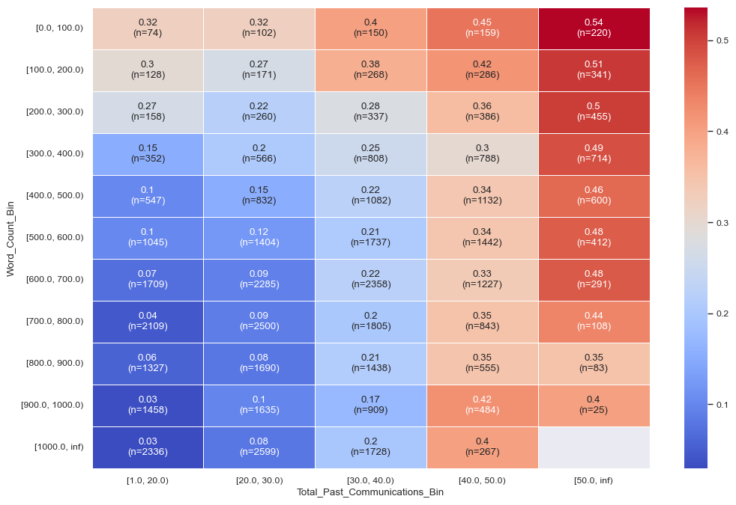
Past Communication & Word Count
Sensitivity to Word Count drops as recipient becomes more veteran
High volume in worst bins:
≤ 30 emails & ≥ 600 words
38% of recipients, 9% CR

Slide 13
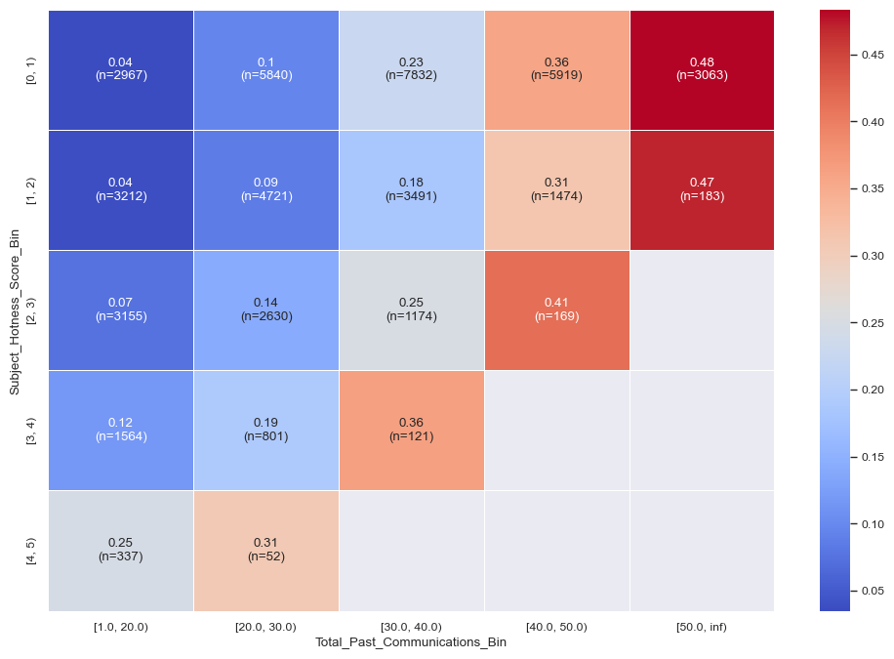
Past Communication & Subject Hotness
Sensitivity to Subject Hotness drops as recipient becomes more veteran
Low ’Hotness’ only does well for higher email counts
New recipients respond better to hotter subjects
High volume in worst bins:
35% of recipients in <4 hotness, <30 emails → 10% CR

Slide 14
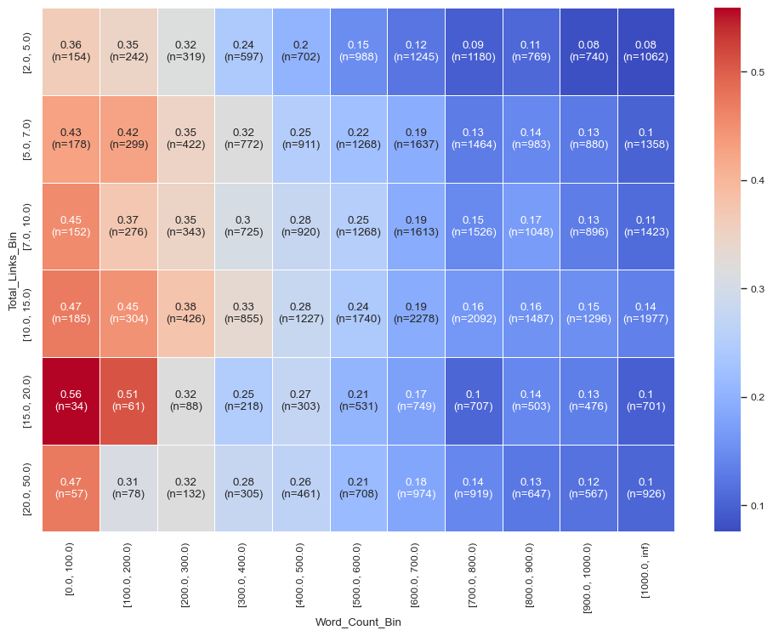
Word Count & Total Links
Links-per-Word Count
Higher ratio → Better CR
Smaller sample sizes for higher probability groups, but trend is clear
Plurality closer to dark blue than orange

Slide 15
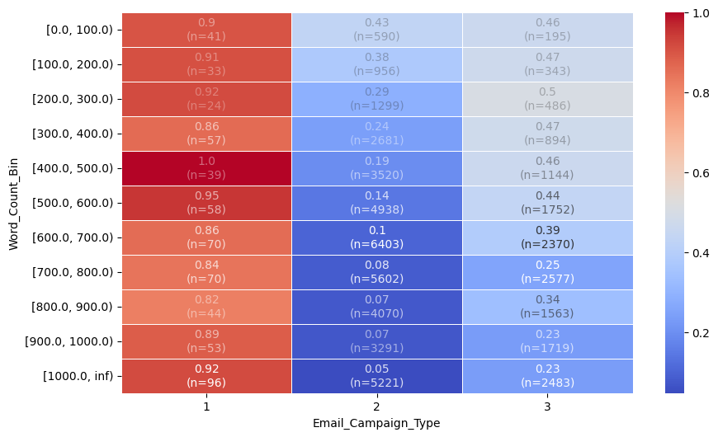
Campaign Type & Word Count
Campaign Type is highly interactive with many features and behave uniquely between them
Camp-2 is overall poor but do well for low Word Counts
43% of recipients are ≥500 words and in Camp-2 → ~9% CR
Camp-1 is anomalous
All brand new recipients
Camp-3 is responsible for high CR

Slide 16
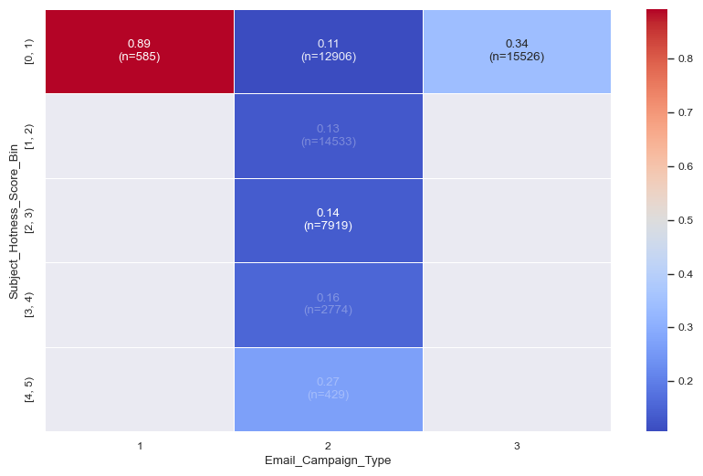
Campaign Type & Subject Hotness
Recall we had observed negative trend for Subject Hotness and Click Rate
Trend is opposite initial indication due to Campaign Types
Ends up being strongest interactive signal in ML model

Slide 17
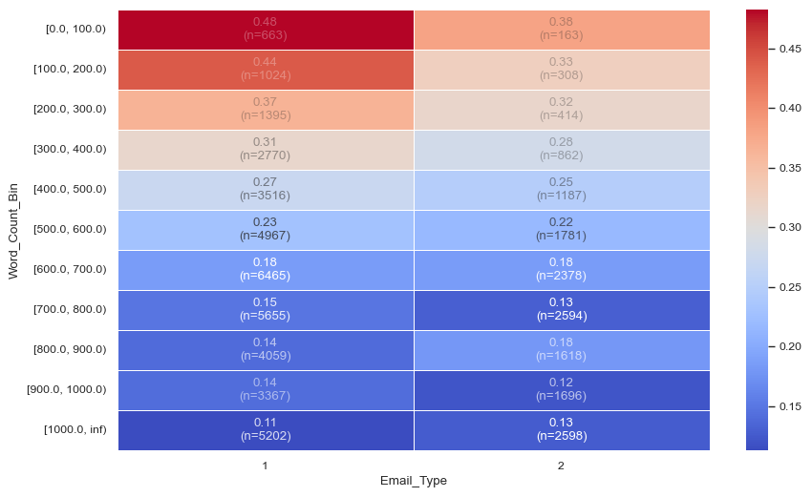
Email Type & Word Count
ET-1 has a higher CR than ET-2 generally, but is exacerbated by Word Count
Particularly for WC <300

Slide 18
Takeaways: Email Design Enhancements
Reducing Word Count improves Click Rate across the board and is the easiest quick win
Establishing a loyal customer base results in long-term click rate success
Outside the scope of this project, but an obvious emphasis for any retail business
Choosing the right Campaign Type
How much control do we have on the Campaign Type? Seasonal? Our discretion? Special event?
Learn from Campaign 2
Hotter subjects → more clicks
Choosing the Email Type
Do we control Email Type?
Type 1 should be emphasized especially for fewer word counts
Choosing the Email Source Type
Do we control the email source? Are these 3rd party vendors or internal systems?
Those receiving from Source-1 can tolerate more words if necessary

Slide 19
Machine Learning: Optimizing Profit Margin
Using the insights from Click Rate analysis to predict click decision and optimize profit margin

Slide 20
Defining Success for Machine Learning
What is a good predictive model for our use case?
Primary focus is cost savings, secondary is revenue generation. Why?
Things to consider
Better than random
If we can be better than random chance at knowing who will click (or more importantly, who won’t click), we will make more money
Stability and reliability
What happens as time passes?
Interpretability
Can we understand why the model is better than random chance? (ie what features matter?)

Slide 21

Optimizing Profitability
Defining how to optimize profit margin using classification
TP = True Positives
FP = False Positives
R_Click = Revenue per Click
C_Email = Cost per Email
How do we use this equation in practice?

Slide 22
Comparing Model Performance
Model | Added Profit Margin/Email | P(Click) Threshold | F1 | Recall | Precision
Random | $0.0 | 19% | 19% | 19% | 19%
Logistic Regression | $.049 | 49% | 50% | 65% | 41%
Random Forest | $.052 | 17% | 50% | 72% | 39%
HistGradientBoost | $.050 | 18% | 50% | 72% | 38%
XGBoost | $.052 | 17% | 51% | 74% | 38%

Slide 23
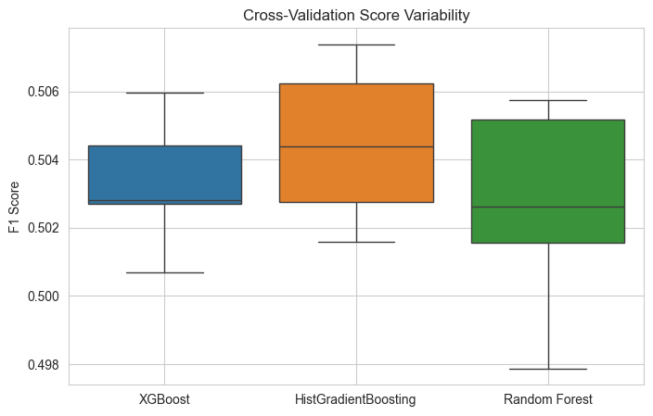
Choosing a model: variability
For our main 3 model candidates we observe differences in model stability
XGBoost is least variable indicating higher stability, all while maximizing performance relative to other models

Slide 24
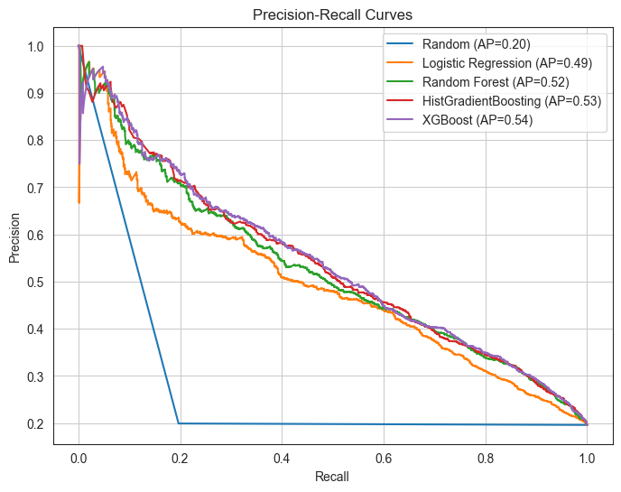
Choosing a Model: Stability
How do we trade off Added Cost (TN→FP’s) with Gained Revenue (FN→TP’s)?
Area-Under-Curve maximized for XGBoost, indicating optimal tradeoff

Slide 25
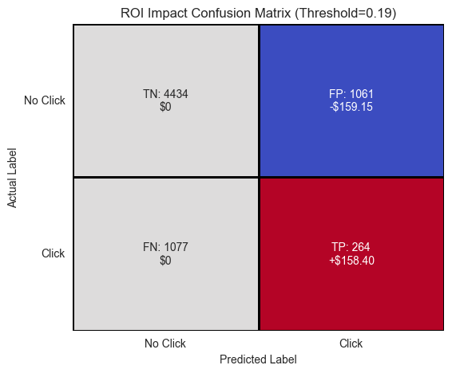
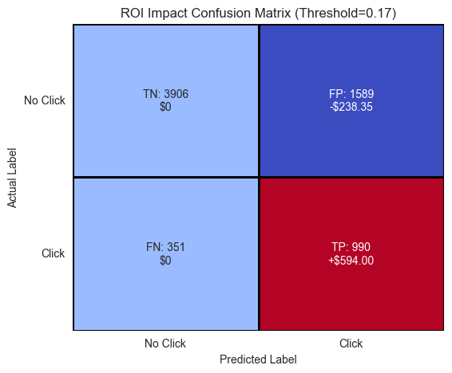
ROI Impact: Cost vs Revenue
Random Chance (top graphic):
False Negatives: $808 in unseen revenue
TP + FP: Breaking even on profit
ML Model (bottom graphic)
FN→TP:
Converting false negatives to true positives generates revenue - $545 gained from prior
FN/FP Tradeoff
More FP’s, but is offset by gained revenue

Slide 26
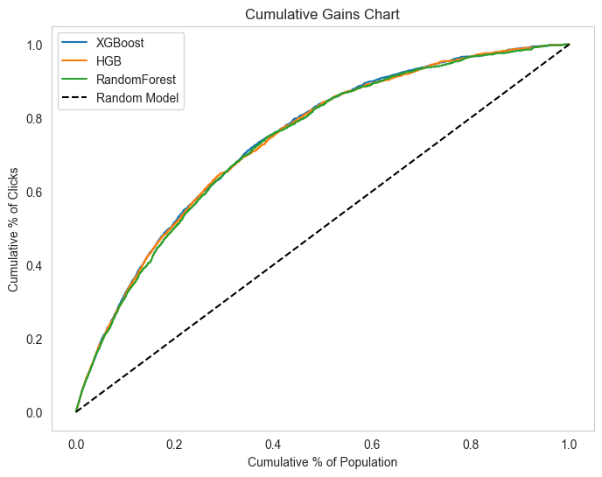
Cumulative Gains
Note how much faster we can accumulate clicks (ie revenue) using our model
80% of the clicks gained by 50% of the emails sent
Profit margin driven by ability to not waste cost on people highly unlikely to click

Slide 27
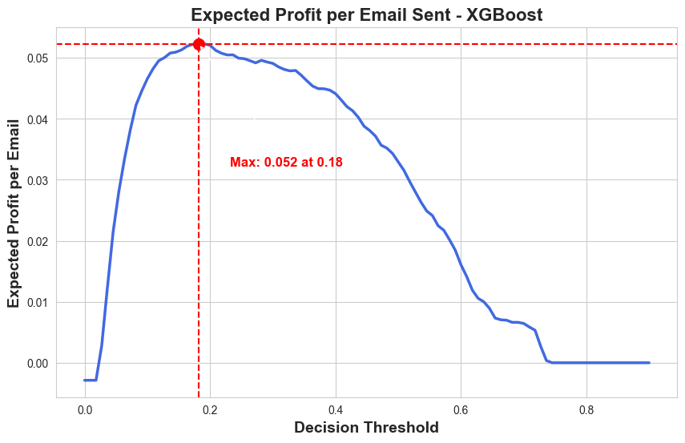
Optimization Curve
Decision thresholds inform the model the minimum probability needed to be classified as a Click
We optimize profit at 17% with a margin of $.052/email
Graph shows18% would have optimized test set
Indicates strong model performance on unseen data

Slide 28
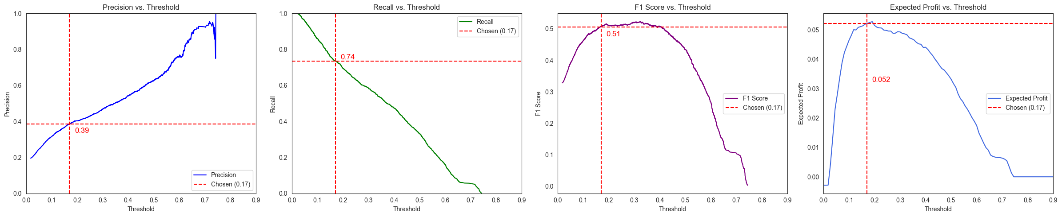
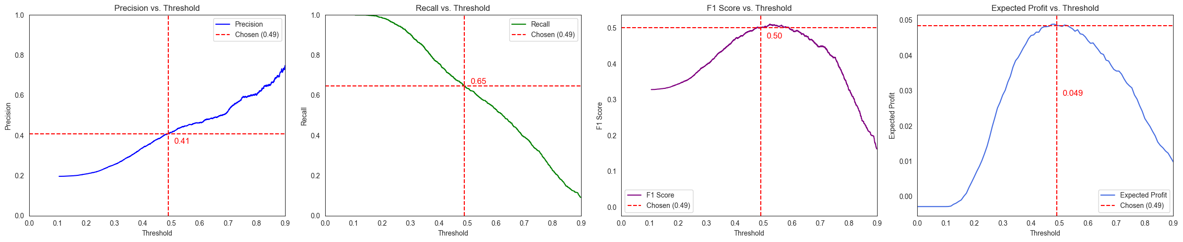
Probability and Expected Profit Why threshold matters

Slide 29
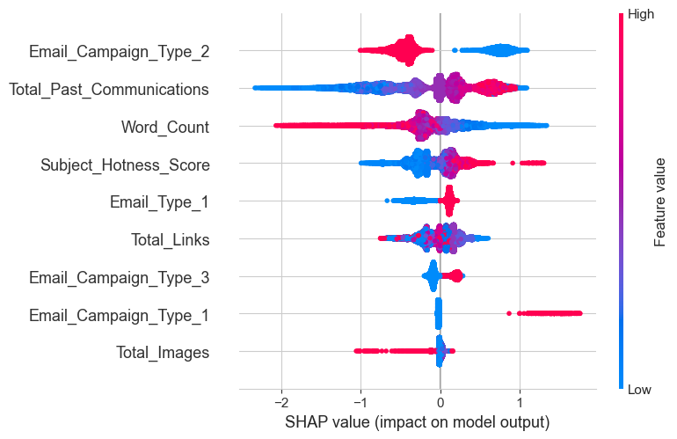
SHAP: Feature Importances
SHAP values tell us how different features impact classification decision
Communication history and the Campaign Type=2 are strongest indicators
Total Images and other Campaign Types less indicative
Note we did not use all features from data set

Slide 30
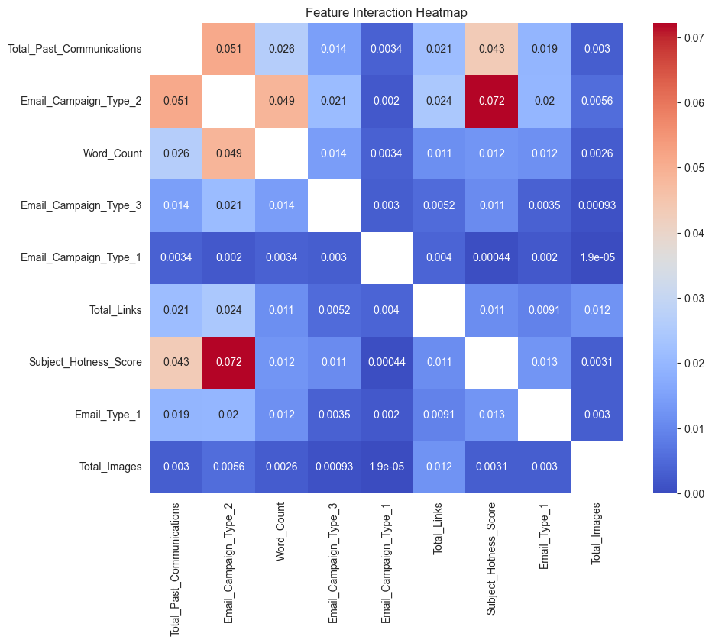
SHAP: Interactions
Strong interactions between Campaign Type=2 and numeric features
Recall probability heatmaps!

Slide 31
Conclusion
Next Steps, Recommendations, Follow Ups

Slide 32
Conclusion
Recommendations
Use XGBoost model to determine who should be sent an email based on collected data
Monitor performance of model by collecting click data and observing performance across campaigns
Improve email design strategy by following the indicated interactivity between features we can control such as Word Count, Source, Type, Subject Hotness, and Campaign
Next Steps & Reflections
We should investigate further whether these models really are the best for this use case
Could there be alternative feature engineering methods to extract more signal to boost performance?
What other data would be useful to enhance predictive power?
Historical data on recipient interaction with emails or our product more generally
Time series information on time of year emails are sent
Demographic information on who are receiving the emails (so long it follows compliance)

