Slide 1
Machine Learning: Optimizing Email Campaign Profit Margin & Email Click-decision
An analytical approach to email campaign design
Blake Gilliland

Slide 2
Objectives & Topics
Question: Can we systematically optimize profit for email campaigns?
Emails always cost money, but people rarely click. Can we tip the scales in our favor?
Who clicks most often, and why? Can we design better emails to improve click probability?
Goal:
Systematically maximize the probability of a click and ROI of a sent email
Recommendations & Next Steps
Consideration for alternative approaches
Implementation
Enhancements

Slide 3
Agenda
Results Summary
Brief lookahead at our results
Analysis Deep Dive
Understanding our Data + Click Rate Patterns
Look at CR disparities across individual features
Visualize feature interactivity pertaining to CR
Machine Learning: Comparing models and understanding lift from baseline
What is our goal with ML in the context of this problem?
How do we define success when building a predictive model?
Comparing model performance: Feature importance, Profit Margin
Conclusion
Next Steps
Implementation
Follow up thoughts

Slide 4
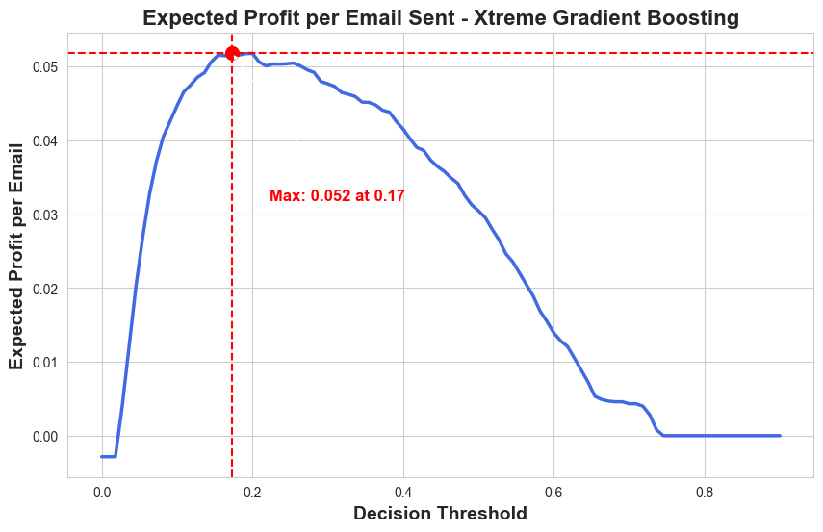
Results Summary
Becoming profitable with ML Model
Assume current state breaks even
70k emails: $3.5k with ML vs $0 baseline
ML: +$.052/email vs $0/email baseline
67.4% increase in revenue vs baseline
Enhance click-rate with enhanced email design strategy
Reduce Word-Count
Strengthen base of returning customers
Take advantage of feature interactivity
Notes:
67.4% increase in revenue comes from the fact that we converted 726 False Negatives to True Positives out of 1077 FN’s
Relatively marginal difference between tuned models, but this can mean millions at high volumes of emails or clicks

Slide 5
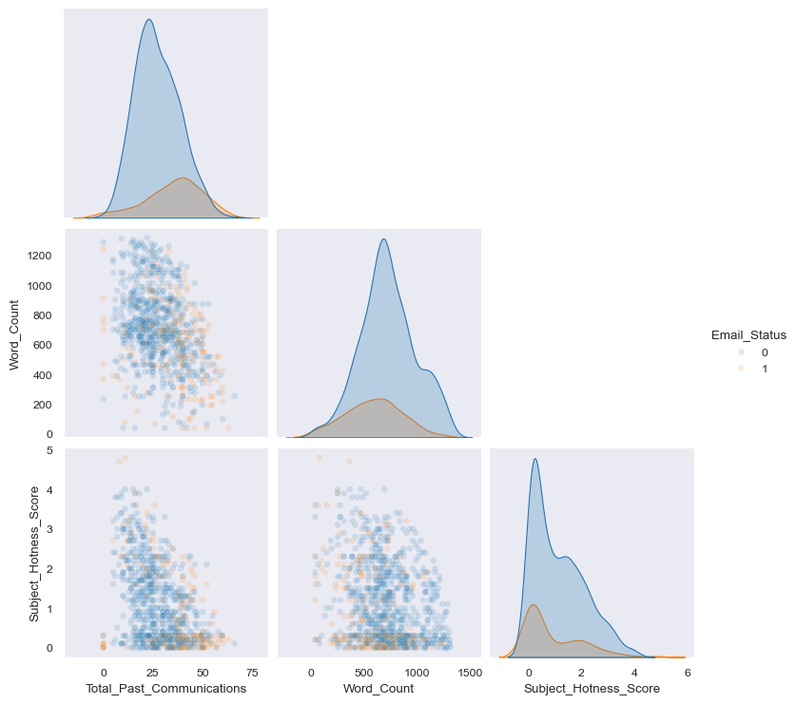
Data overview
19.6% overall click rate for 68k emails sent
Key data points
About the Recipient
Historical volume
Location
About the Email
Campaign category
Type and Source
Content
Time Sent

Slide 6
Click Through Rate Patterns
Looking at CTR across individual features

Slide 7
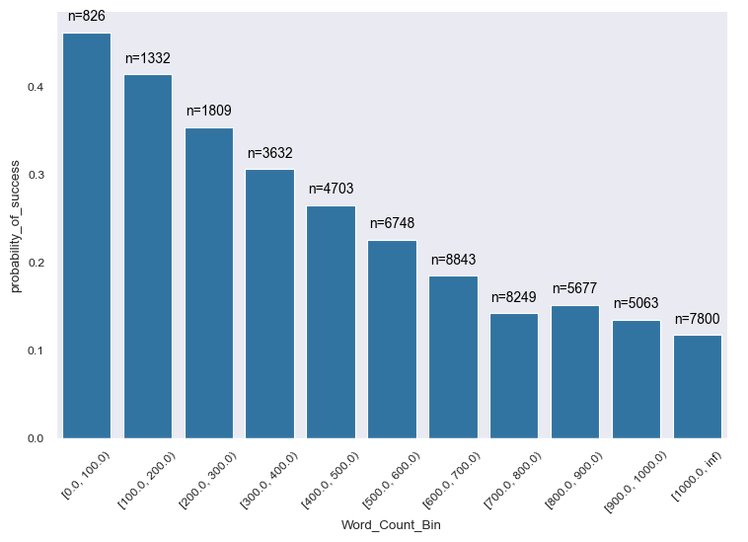
CTR: Word Count
Word Count on its own is highly related to click decision
600+ words → Worse than guessing (≤ 20%)
High proportion of observations with 600+ words (35.6k, 52%)

Slide 8
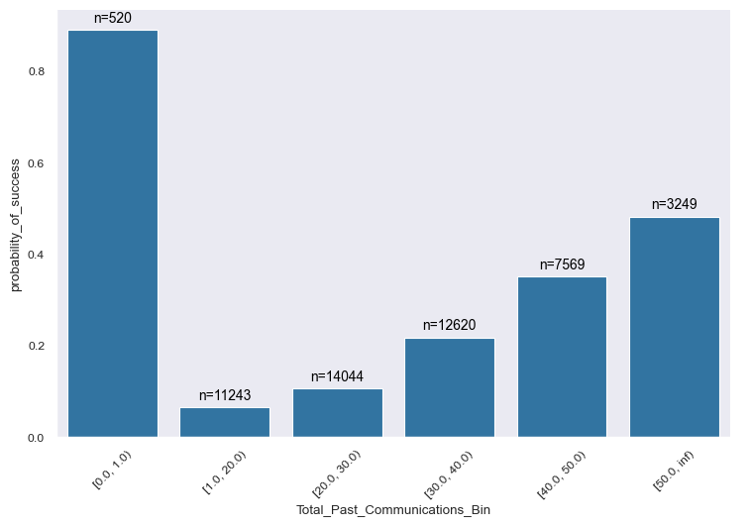
CTR: Past Communications
New recipients most likely to click, but this is related to a single Campaign Type (1)
Not strictly within our control
40+ past emails → ≥ 30% click rate
~40% of recipients ≤ 20% click rate
Notes:
Note:
Does not imply we should not send emails to people with few past communications. Rather, suggests that we should think about how we can boost voluntary subscriptions, or whatever it is that identifies the higher volume group (ie get people to want to receive emails)

Slide 9
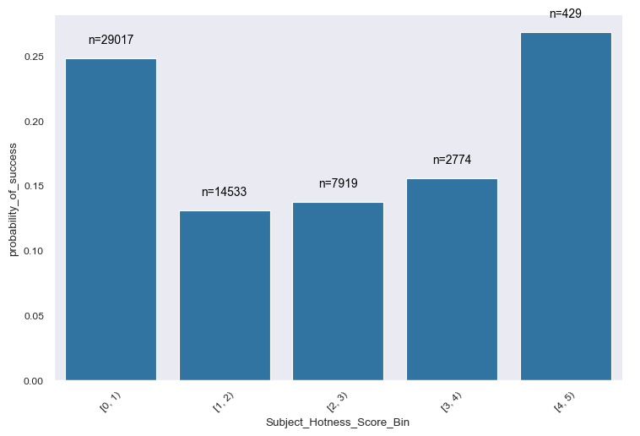
CTR: Subject Hotness
Seems like little ROI for ‘hotter’ subjects overall
Will soon learn how Campaign Type impacts this entire picture
40% of recipients between [1,4) hotness → ≤15% CR

Slide 10
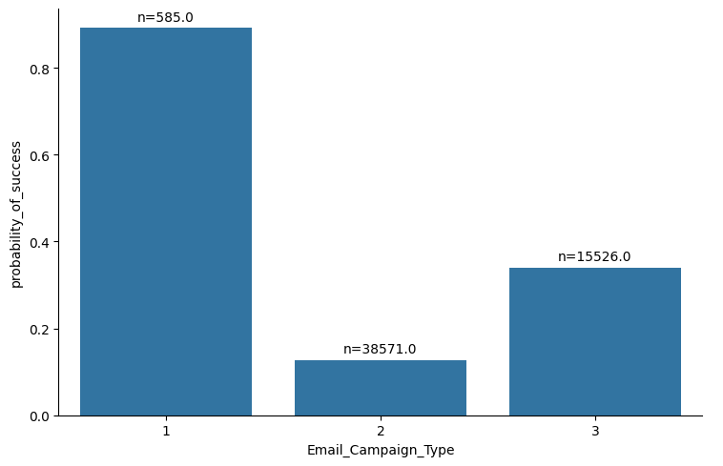
CTR: Campaign Type
Campaign 1
New recipients only (Past Communications = 0)
Emails contain 0 images and only 1 link
Subject Hotness is always < 1
Campaign 2
Not restricted to a domain
Campaign 3
Subject Hotness is always <1

Slide 11
CTR: Feature Interactions
Looking at CTR between features

Slide 12
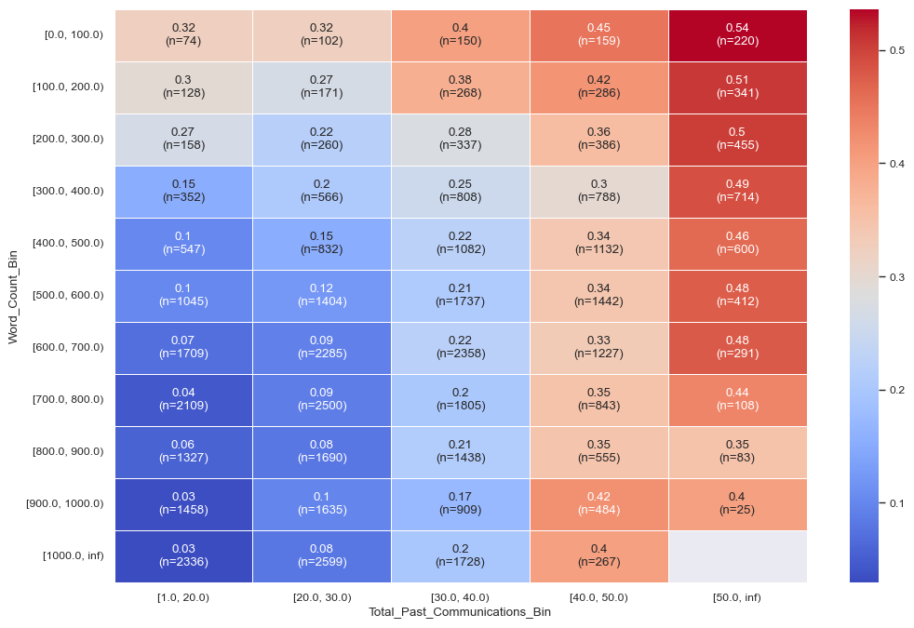
Past Communication & Word Count
Sensitivity to Word Count drops as recipient becomes more veteran
High volume in worst bins:
≤ 30 emails & ≥ 600 words
38% of recipients, 9% CR

Slide 13
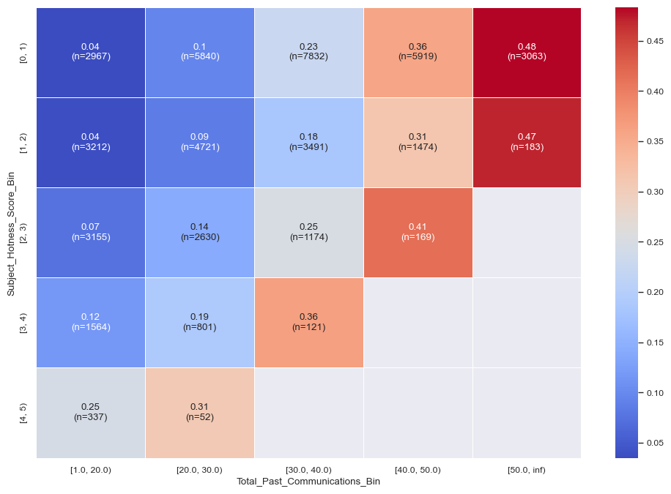
Past Communication & Subject Hotness
Hot emails don’t typically get sent to veteran recipients
New recipients respond better to hotter subjects
High volume in worst bins:
35% of recipients in <4 hotness, <30 emails → 10% CR
Notes:
Note:
We don’t send hot emails to veteran recipients
Takeaway:
Make sure rookie recipients are getting hot subjects only (4+, TPC < 30)
For vets, it could make sense to only send hot emails, but would require a controlled test since we don’t seem to have a lot of data

Slide 14
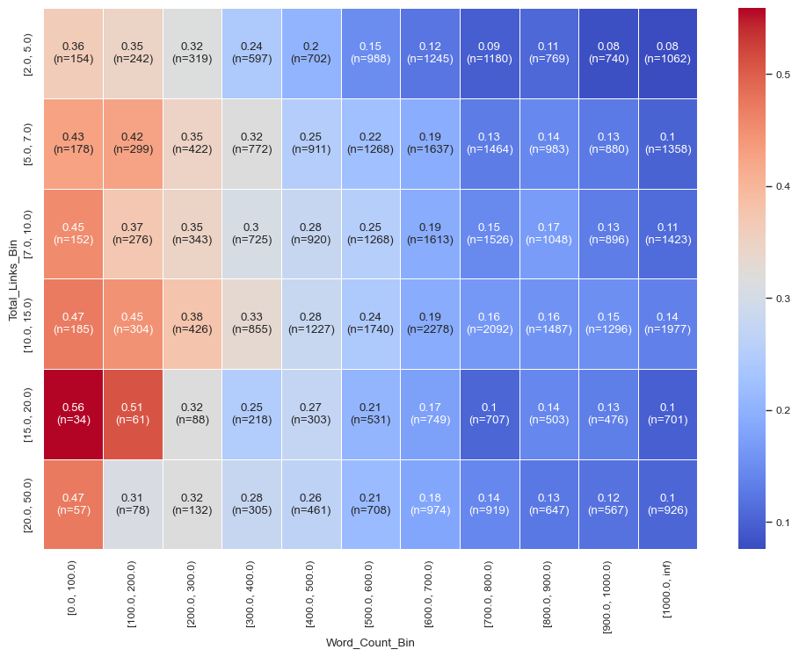
Word Count & Total Links
Links-per-Word Count
Higher ratio → Better CR
Smaller sample sizes for higher probability groups, but trend is clear
Plurality closer to dark blue than orange

Slide 15
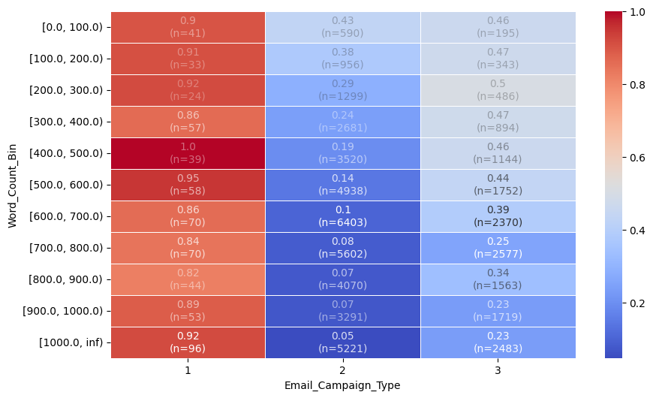
Campaign Type & Word Count
Campaign Type is highly interactive with many features and behave uniquely between them
Camp-2 is overall poor but does well for low Word Counts
43% of recipients are ≥500 words and in Camp-2 → ~9% CR
Camp-3 is highly likely to click, just has been lower volume
Also has most volume in higher word count bins
Notes:
Emphasize that lower word counts will always be a better option
Can note that Camp-3 is less sensitive to word count than Camp-2, so some scenarios may exist where it makes sense to send higher word counts

Slide 16
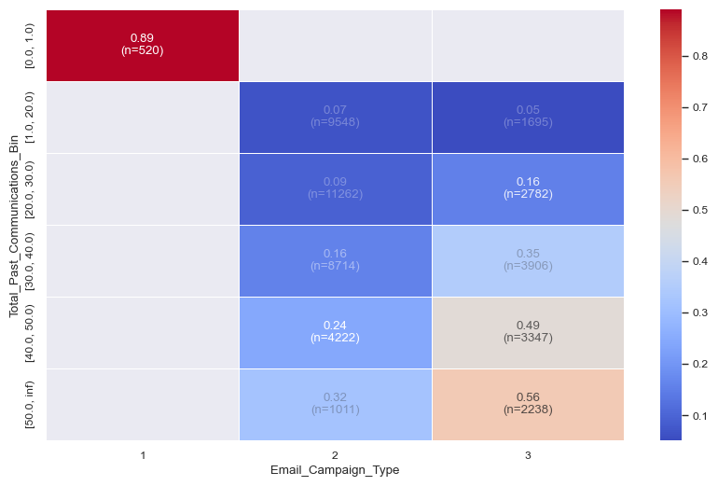
Campaign Type & Past Communications
Separation across past communication bins
Camp-3 highly sensitive to past email volume
CTR over doubles after 30 emails

Slide 17
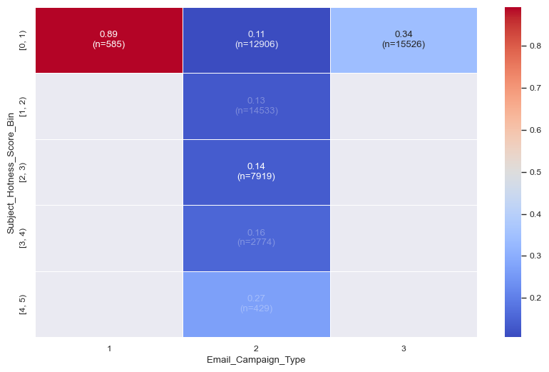
Campaign Type & Subject Hotness
Camp-2 is only campaign with different subject hotnesses
Subject hotness doing well univariately for low scores may be related to Campaign Type
Implies hotter is better for Camp-2
Would this hold generally?

Slide 18
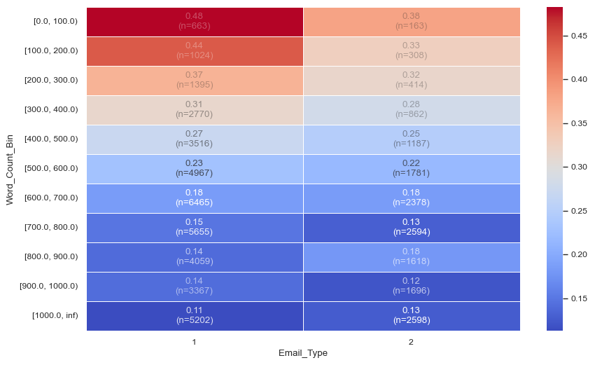
Email Type & Word Count
ET-1 has a higher CR than ET-2 generally, but is exacerbated by Word Count
Particularly for WC <300

Slide 19
Takeaways: Email Design Enhancements
Reducing Word Count improves Click Rate across the board and is the easiest quick win
Establishing a loyal customer base results in long-term click rate success
Choosing the right Campaign Type
Choosing the Email Type/Email Source Type
Notes:
Reducing Word Count improves Click Rate across the board and is the easiest quick win
Establishing a loyal customer base results in long-term click rate success
Outside the scope of this project, but an obvious emphasis for any retail business
Choosing the right Campaign Type
How much control do we have on the Campaign Type? Seasonal? Our discretion? Special event?
Learn from Campaign 2
Hotter subjects → more clicks
Choosing the Email Type
Not useful for prediction but certainly has differences in CTR, and interacts with word count and past communication,
Do we control Email Type?
Type 1 should be emphasized especially for fewer word counts
Choosing the Email Source Type
Not useful for prediction but certainly has differences in CTR, and interacts with past communication,
Do we control the email source? Are these 3rd party vendors or internal systems?
Those receiving from Source-1 can tolerate more words if necessary

Slide 20
Machine Learning: Optimizing Profit Margin
Using the insights from Click Rate analysis to predict click decision and optimize profit margin

Slide 21
Defining Success for Machine Learning
What is a good predictive model for our use case?
Primary focus revenue generation + cost savings (ie profit), not necessarily F1
Things to consider
Better than random?
Stability and reliability
Interpretability
Notes:
Things to consider
Better than random
If we can be better than random chance at knowing who will click (or more importantly, who won’t click), we will make more money
Stability and reliability
What happens to our model as time passes?
How does the model do with strictly unseen data?
Interpretability
Can we understand why the model is better than random chance? (ie what features matter?)

Slide 22

Optimizing Profitability
Defining how to optimize profit margin using classification
TP = True Positives
FP = False Positives
R_Click = Revenue per Click
C_Email = Cost per Email
How do we use this equation in practice?
Notes:
We divide by the total number of emails sent, not by the total number of emails predicted to be sent or else we would just simply always predict an email to be sent. Need the threat of FN’s to be incorporated into decision or else we won’t see a critical point on our profit curve.

Slide 23
Optimization Curve
Decision thresholds inform the model the minimum probability needed to be classified as a Click
We optimize profit at 17% with a margin of $.052/email
Notes:
The equation from previous slide allows us to create a function which will have a critical point where profit per email is maximized.
The independent variable is the level of certainty we prefer when classifying the observation from the data.
The classifier we use is the one that gives us the best PR-AUC, which we look at later on
This critical point shows us how much more money we could make per email by using ML instead of randomly guessing.

Slide 24
Comparing Model Performance
Model | Added Profit Margin per Email | Avg Precision | F1 | Recall | Precision
Random | $0.00 | 19.7% | 19% | 19% | 19%
Logistic Regression | $.049 | 49.3% | 49% | 75% | 36%
Random Forest | $.052 | 52.4% | 50% | 72% | 39%
HistGradientBoost | $.050 | 53.4% | 50% | 72% | 38%
XGBoost | $.052 | 53.9% | 51% | 74% | 38%

Slide 25
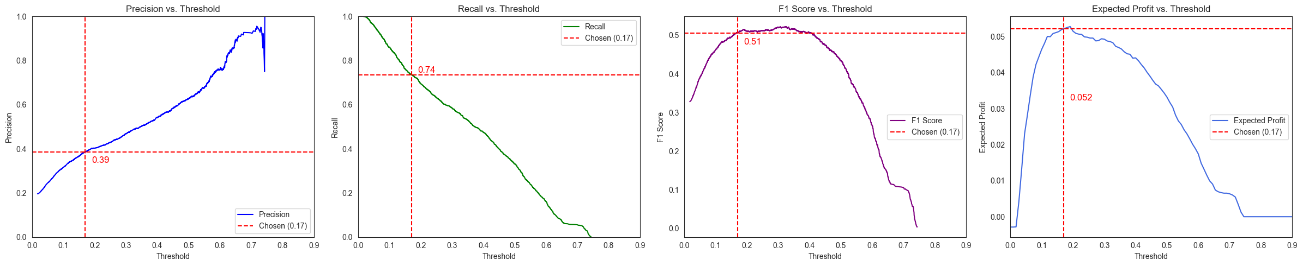
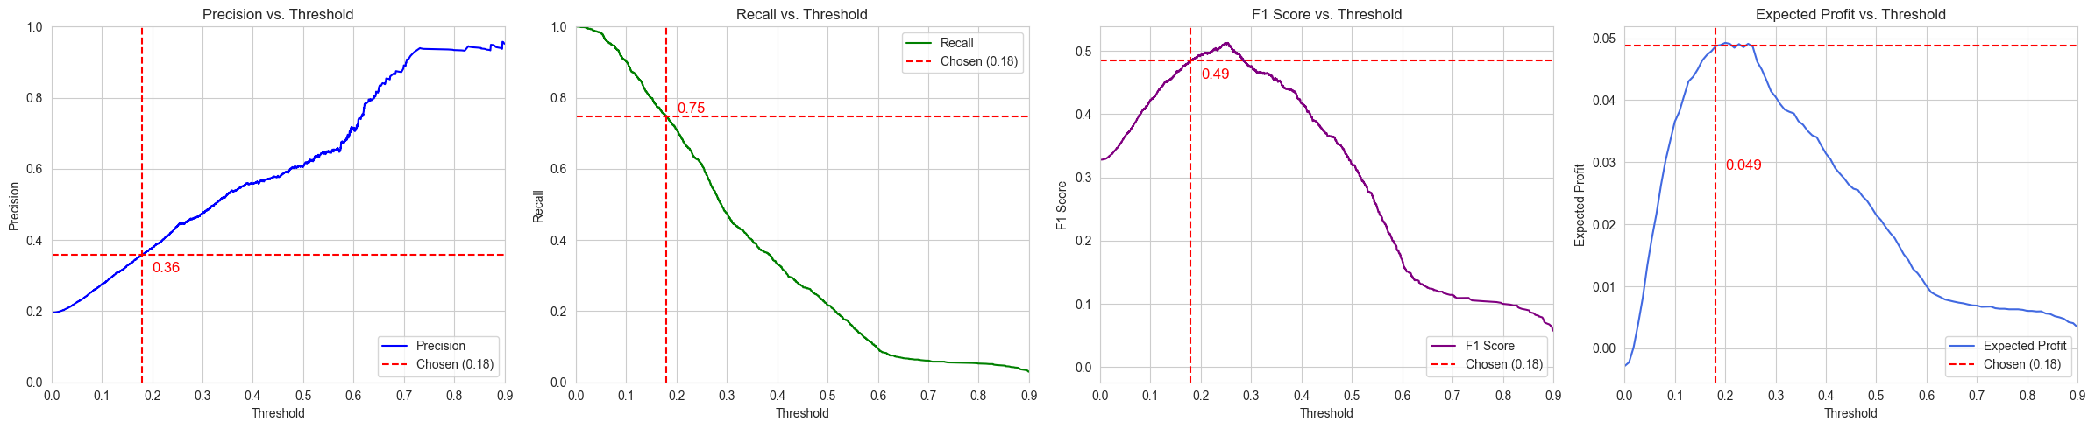
Decision Thresholds
Notes:
Comparing best vs worst tuned models

Slide 26
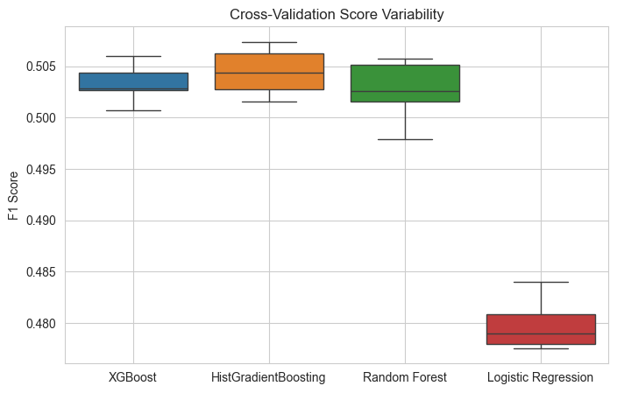
Choosing a model: variability
For our main 4 model candidates we observe differences in model stability
XGBoost is least variable indicating higher stability, all while maximizing performance relative to other models

Slide 27
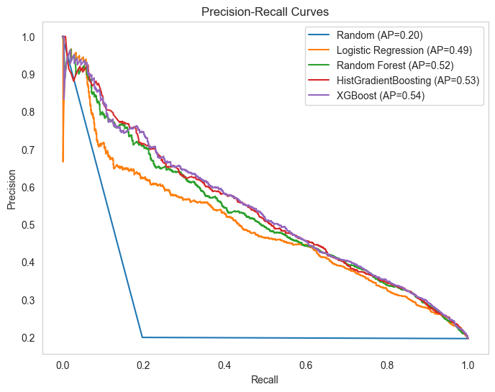
Choosing a Model: Stability
How do we trade off Added Cost (TN→FP’s) with Gained Revenue (FN→TP’s)?
Area-Under-Curve maximized for XGBoost, indicating optimal tradeoff

Slide 28
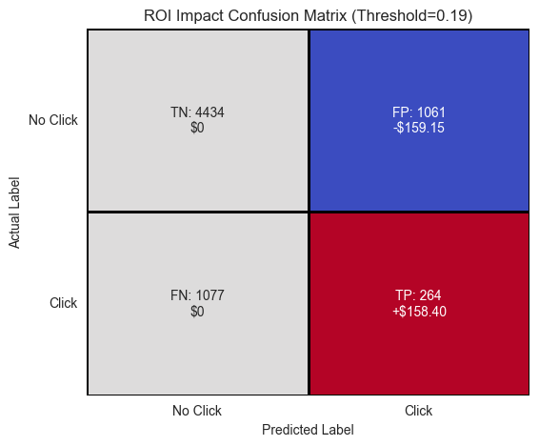
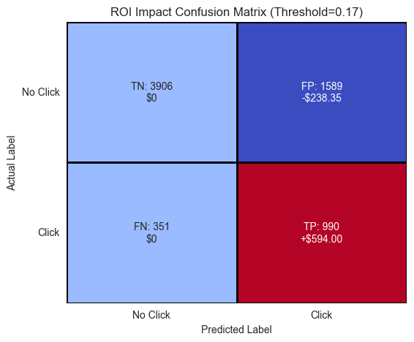
ROI Impact: Cost vs Revenue
Random Chance (top graphic):
False Negatives: $808 in unseen revenue
TP + FP: Breaking even on profit
ML Model (bottom graphic)
FN→TP:
Converting false negatives to true positives generates revenue - $545 gained from prior
FN/FP Tradeoff
More FP’s, but is offset by gained revenue

Slide 29
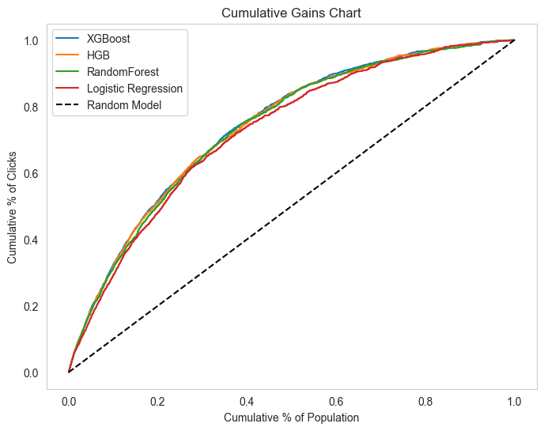
Cumulative Gains
Click Accumulation:
Model gains clicks with fewer emails sent
80% of the clicks gained by 50% of the emails sent

Slide 30
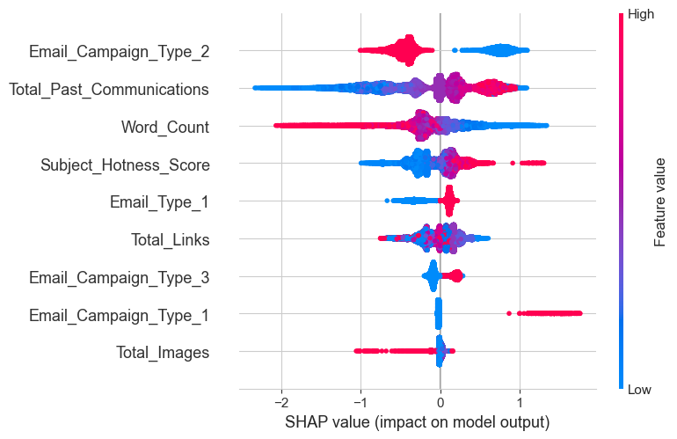
SHAP: Feature Importances
SHAP values tell us how different features impact classification decision
Communication history and the Campaign Type=2 are strongest indicators
Total Images and other Campaign Types less indicative
Note we did not use all features from data set!

Slide 31
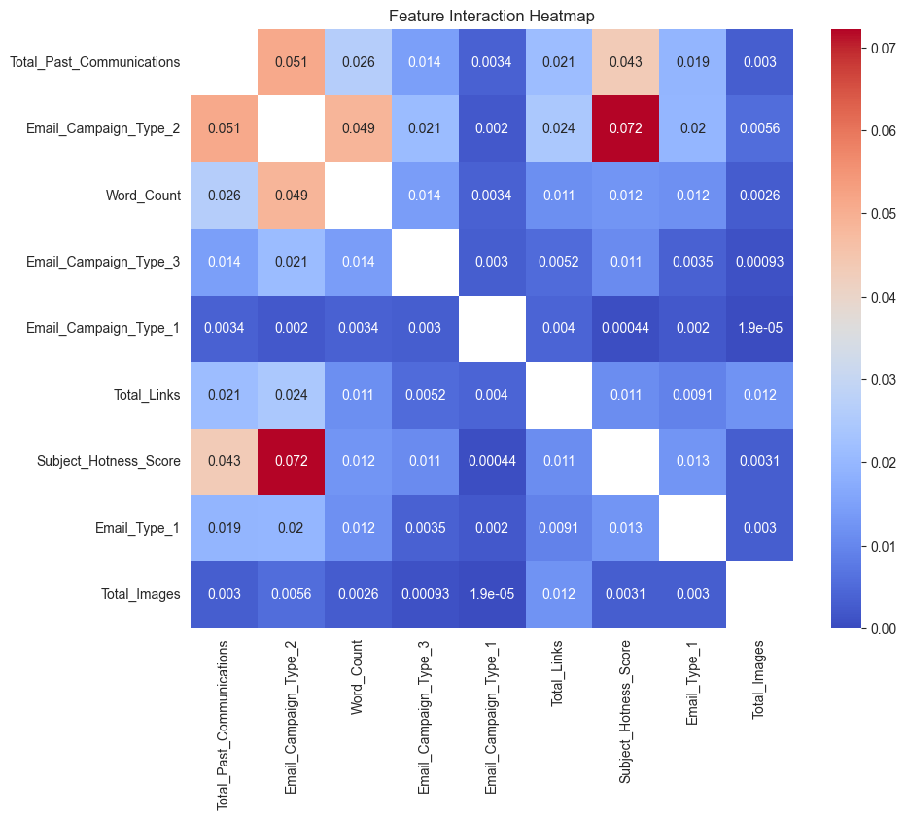
SHAP: Interactions
Strong interactions between Campaign Type=2 and numeric features
Recall probability heatmaps!

Slide 32
Conclusion
Recommendations
Use XGBoost model
Monitor performance of model
Improve email design strategy
Next Steps & Reflections
Investigate whether these models really are optimal
What other data would be useful to enhance predictive power?
Notes:
Recommendations
Use XGBoost model to determine who should be sent an email based on collected data
Monitor performance of model by collecting click data and observing performance across campaigns
Improve email design strategy (with intent of improving CTR) by following the indicated interactivity between features we can control such as Word Count, Source, Type, Subject Hotness, and Campaign Type
Investigate how we can organically increase volume in higher ‘past communication’ bins
Conduct AB tests to see if Past Communication and Hotness are related (since we don’t have observations of high hotness + high past communication, only low hotness + high past comm)
Next Steps & Reflections
We should investigate further whether these models really are the best for this use case.
Could there be alternative feature engineering methods to extract more signal to boost performance?
What other algorithms best suit this data?
Could we use more advanced hyper parameter tuning techniques like Bayesian search instead of random search?
What other data would be useful to enhance predictive power?
Historical data on recipient interaction with emails or our product more generally
Time series information on time of year emails are sent
Demographic information on who are receiving the emails (so long it follows compliance)

