Slide 1
¿Can You Catullus Who Cicero-te it?
Classifying Latin Poets Based on Latin Text
Brendan Gilroy and Mackenzie Mitchell

Slide 2
Data
Catullus (84-54 BC): Personal Poems scraped from http://rudy.negenborn.net/catullus/catullus2.htm
Virgil (70-19 BC): Epic Poems scraped from https://www.sacred-texts.com/cla/virgil/
Juvenal (Late 1st Century-Early 2nd Century AD): Satirical Poems obtained from http://www.perseus.tufts.edu
Horace (65-8 BC): Lyrical Poems obtained from http://www.perseus.tufts.edu
Ovid (43 BC-17 AD): Mythological Poems obtained from http://www.perseus.tufts.edu
Caesar (100-44 BC): Historical Prose obtained from http://www.perseus.tufts.edu
https://io9.gizmodo.com/a-latin-poem-so-filthy-it-wasnt-translated-until-the-2-1589504370

Slide 3
EDA

Slide 4
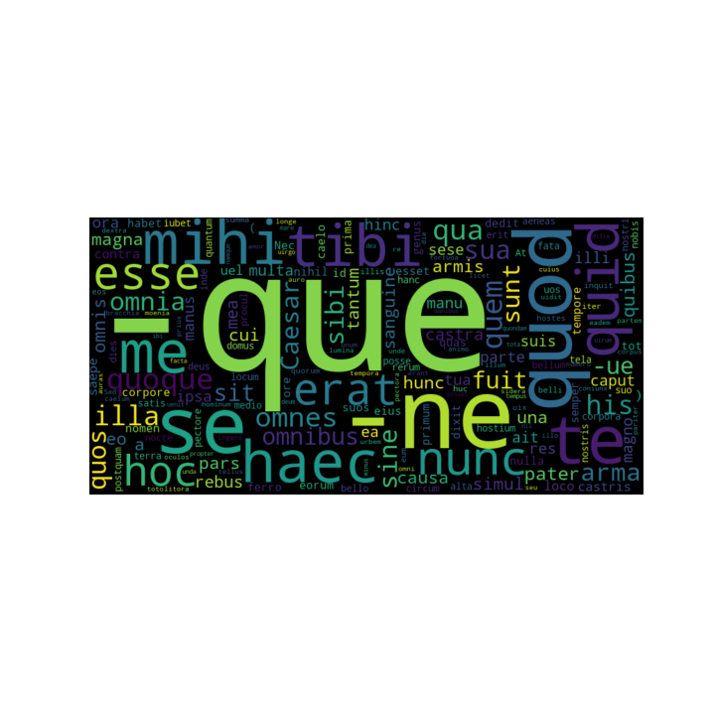
-que: and
-ne: negates turns sentence into a question
Est Catullus: Catullus is here
Estne Catullusque Cicero: Are Catullus and Cicero not here?
Notes:
-que: and
-ne: turns into question.

Slide 5
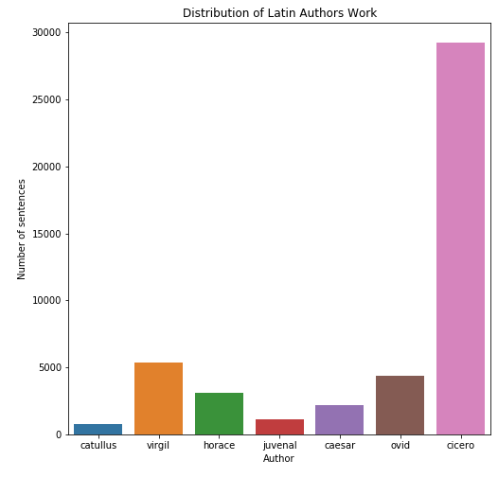

Slide 6
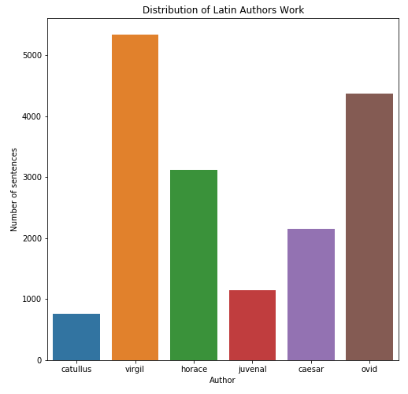

Slide 7
Modeling

Slide 8
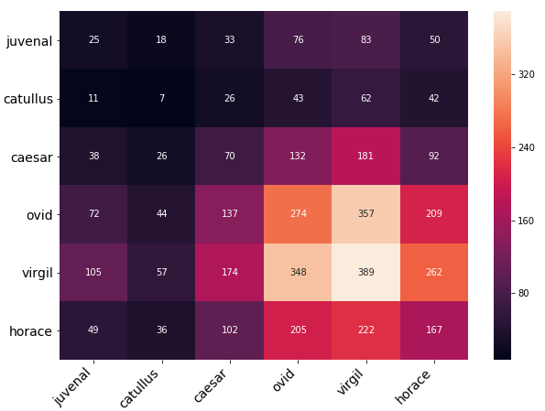
Dummy Classifier
Juvenal Recall: 8.77%
Catullus Recall: 3.72%
Caesar Recall: 12.99%
Ovid Recall: 25.07%
Virgil Recall: 29.14%
Horace Recall: 21.38%
Notes:
Average recall: 16.85%

Slide 9
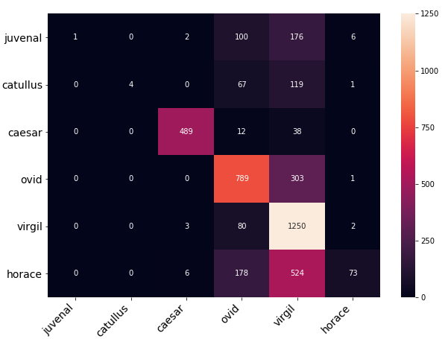
Multinomial Naive Bayes’ Classifier with TF-IDF
Juvenal Recall: 52.63%
Catullus Recall: 25.65%
Caesar Recall: 97.59%
Ovid Recall: 77.12%
Virgil Recall: 83.90%
Horace Recall: 32.52%
Notes:
Average Recall: 61.57%

Slide 10
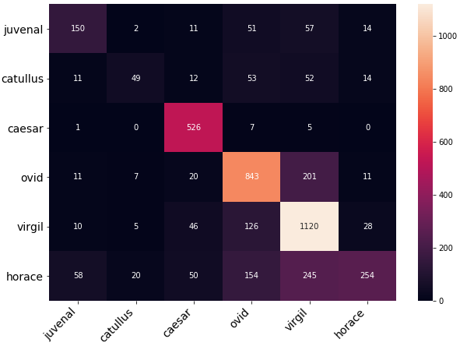
Complementary Naive Bayes’ Classifier with TF-IDF
Juvenal Recall: 52.63%
Catullus Recall: 25.65%
Caesar Recall: 97.59%
Ovid Recall: 77.13%
Virgil Recall: 83.90%
Horace Recall: 79.13%
Notes:
Average Recall: 69.34%

Slide 11
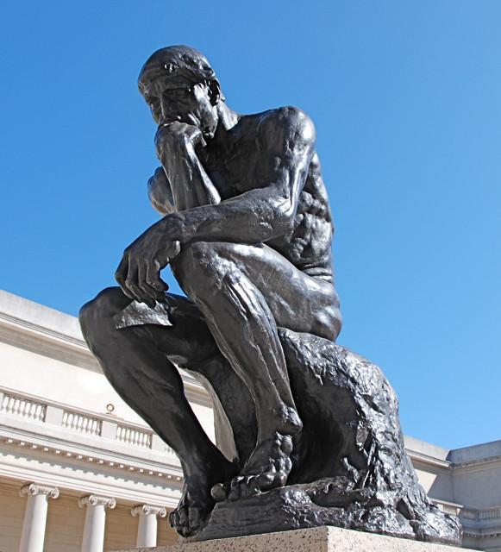
Final Thoughts
Caesar is the most distinctive writer out of our authors.
This was expected. He is the only one who writes prose.
Virgil was the next best performing class.
This program does well at detecting Virgil’s epic poems
Ovid & Horace were also classified well in this analysis
Ovid: mythological poems
Horace: lyrical poems
The program does not classify Catullus’ personal poems or Juvenal’s satirical poems well

Slide 12
Next Steps
To improve the model, we would like to:
Fix the class imbalance
Removing authors who don’t have as many sentences/works
Catullus
Performing a feature reduction method
LSA: Latent Semantic Analysis
Try classification using the translated texts
Conclusion

