Slide 1
Grassroots-Driven Approaches to Information Sharing: A Bottom-Up Perspective
October 15, 2025 @BGIN #13
Miho Hirashita, operation manager of JPCrypto-ISAC
Georgetown University Law Center LL.M. of 2026

Slide 2
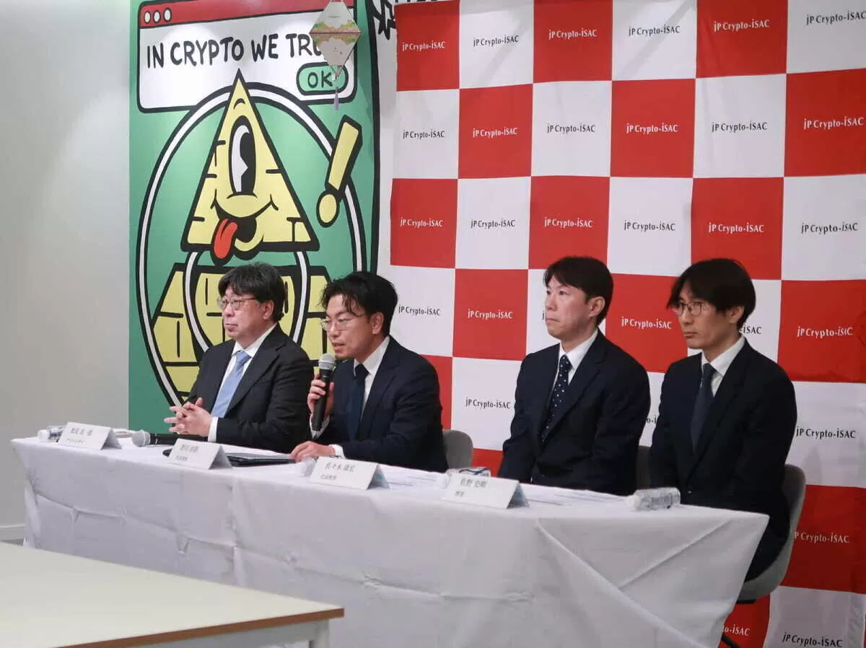

From Silos to Sharing: The JPCrypto-ISAC Model
Self-help
28 registered VASPs
JFSA
Mutual aid
Government support
JPCrypto-ISAC

Slide 3
The Birth of JPCrypto-ISAC: Responding to a Growing Need
Name | General Incorporated Association JPCrypto-ISAC
Establishment | January 17, 2025
Membership (as of Sep 30,2025) | Regular members |  | JFSA registered VASPs | 11 of 28 (Including companies that are effectively dormant)
 | Support members |  | Third Party Wallet vendors Stablecoin issuer Cloud Infra Vendor Audit Firms Other vendors | 2 1 1 2 3 (Total 9)
Structure | Statutory Bodies Optional Organization |  | Board Member 3, Auditor 1, Part-Time Staff 1, External Advisor 3
Main incidents | May 2024 | The DMM Bitcoin Hack: A $305 Million Crypto Heist in Japan
 | Feb 2025 | The Bybit Hack: A $1.5 Billion Ethereum Breach
 | May 2025 | Joined IPA J-CSIP. Began distributing vulnerability information to members.
 | June 2025 | Launched the Third-Party Risk Management Working Group

Slide 4
Organization Structure (Statutory requirements)
General Incorporated Association
= Non-profit organization
General Meeting
Auditor
Board Meeting
Administration
Volunteer Operation
Manager
Working Group
・・・
WG １
WG n

Slide 5
Basic Comparison on the Economy
As of 2025 | Japan | US
Nominal GDP (USD Trillion) | 4.19 (about 13.7% of the US GDP), 5th global GDP | 30.51
Household Financial Assets (USD Trillion) | 14.9 (about 13% of the US’s) | 115.5
Per Capita Financial Assets (USD) | 118,000(about 1/3 of the US’s) | 348,000
Asset Composition: Cash & Deposits (%) | 50%(about 3.85 times of the US’s) | 13%

Slide 6
Digital Asset Market Comparison
As of 2025 | Japan | US
Spot Trading Volume (USD Billion) | 13.1 (about 5.95% of the US’s) | 220.0
Margin Trading Volume (USD Billion) | 10.4 (about 5.78% of the US’s) | 180.0
Custody Balance (USD Billion) | 34.5(about 6.9% of the US’s) | 500.0
Number of Accounts (Million) | 12(about 1/4 of the US’s) | 50
Notes:
Japan has a highly active retail investor base, with over 12 million accounts registered at crypto exchanges as of early 2025.
The market includes both spot and margin trading, with monthly volumes exceeding JPY 3.4 trillion (approx. USD 23 billion).
Popular exchanges include bitFlyer, Coincheck, and bitbank, which offer a wide range of crypto assets and user-friendly interfaces.

Slide 7
Capabilities of Domestic VASPs in Japan
(USD million)
 | VASPs | Customer Crypto Assets Under Custody | Net Profit for the Current Term
1 | bitFlyer | 7266 | 4.9
2 | CoinCheck | 5868.6 | 1.7
3 | BitBank | 4481 | 1.4
4 | SBIVC Trade | 2718 | 5.3
5 | GMO Coin | 2665 | 1.6
coinbase | 328,000 | 2,579
Binance | 160,000 | Not disclosed
Notes:
Japan’s domestic Virtual Asset Service Providers (VASPs) operate under one of the most stringent regulatory frameworks in the world, contributing to a high level of trust and stability in the country’s crypto ecosystem.

Slide 8
Token use case expansion and Token Taxonomy in Japan
2008 Bitcoin White paper
2017 Payment Service Act
Virtual Asset
2018 Financial Instrument Exchange Act
（ICO）
↓
（STO）
CBDC
Stable Coin
2023 Payment Service Act & Trust Bank Act
Stable Coins
Virtual Assets
Security Tokens
NFTs
Dao/
Governance Token
Credential
Other use case
Trust bank, MSB
VASP
financial instruments business operator
self-regulated by voluntary guidances
businesses directly regulated by JFSA
Notes:
Japan is recognized as one of the most proactive countries in the regulation and development of cryptocurrency markets. The country has established a comprehensive legal framework that balances innovation with investor protection, making it a unique environment for crypto trading.
Cryptocurrencies were officially recognized as legal payment methods in Japan in 2017 through amendments to the Payment Services Act (PSA) and the Financial Instruments and Exchange Act (FIEA). All cryptocurrency exchanges must register with the Financial Services Agency (FSA) and comply with strict Anti-Money Laundering (AML) and Know Your Customer (KYC) requirements.
Japan has introduced one of the world’s earliest stablecoin regulations, allowing only banks, trust companies, and licensed fund transfer providers to issue stablecoins. These issuers must ensure redemption at par and maintain price stability. It mandates foreign stablecoin issuers to maintain collateral assets such as bank deposits or government bonds in the account in Japan, and limit non-deposit assets (e.g., short-term bonds) to 50% of reserves.

Slide 9
Essential Structure for JPCrypto-ISAC Operation
* Wallet Vendors
* Cloud Infra Vendors
*Bridging Projects
*Smart Contracts
*Other OSS community
Risk Control
JPCrypto-ISAC
Cooperation
National Police Agency (NPA)
Incident response
Security Patch
Japanese Financial Service Agency(JFSA)
Information Data feed
Data transformation
intermediatory
Japan’s sectorial ISACs
Information-Technology Promotion Agency, Japan（IPA）
Assistance in responding to cyberattacks
BGIN
Common Vulnerabilities and Exposures (CVE) Program
Japan’s Vulnerability Information Database
Framework、guideline、best practice
Figure legend:
as is
to be
SEAL-ISAC etc
MITRE
Data feed

Slide 10
Supply Chains in Blockchain-Based Systems
VASPs, Stablecoin Issuers
Domestic Wallet Vendors
Oversea
Wallet Vendors
In house development
Cloud Infrastructures
Supply Chain (smart contracts, Dapps, bridging projects, other OSS contributors, etc.)
No OSS policy
Layer 1 blockchain

Slide 11
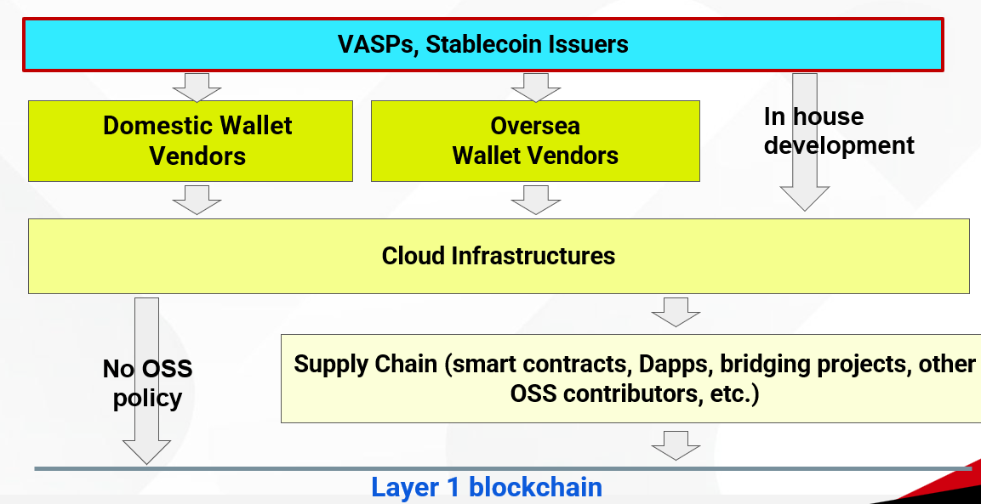
Challenge in Auditing the Crypto Asset Ecosystem
Lack of dynamic audit/evaluation methods
Annual audits can't keep up with rapid changes
Static audits miss evolving risks→ Need flexible guidelines over fixed standards
Challenges in the VASP itself

Slide 12
Need for Neutral Third-Party Evaluation and Information Sharing Framework
Limited Audit Coverage by the self regulatory bodies
→ Relying solely on VASPs means no internal audit will be conducted by the company.
Challenges in the industory

Slide 13
Challenge in Talent Development
Shortage of Skilled Security Professionals
Urgent Need for International Standardization and Domestic Talent Development (Due to cross-border nature of crypto assets)
Challenges in the industry

Slide 14
Challenge in Key & Wallet Management
No standardized operations, Reactive Measures Only After Incidents
Trial-and-error leads to design flaws
Lack of log tracking & disaster recovery planning→ need for sharing on operational
good practice
Collaboration between VASPs and Vendors are critical

Slide 15
Challenges in Bridges, Smart Contracts and other OSS projects
No established risk models
Poor transparency in access rights & upgrades
→Mindset shift and incentives for OSS contributors are essential
Emerging Challenges

Slide 16
Challenge in Continuity and Visibility of Supply Chain Audits
Alignment with International SBOM Standards is critical
Lack of Learning from Past Incidents
→ Need to share best practices (collection & utilization methods) across the industry
Emerging Challenges

Slide 17
Taking the First Step Amid Challenges :the Third-Party Risk Management WG
Key Challenges to Address by the Third-Party Risk Management WG
Capturing rapid changes in the business environment beyond annual audits
Promoting audit practices despite weak audit culture among VASPs
Raising industry-wide security levels amid a shortage of skilled professionals
Standardizing key management operations and sharing best practices
Tackling the complexity of supply chain management

Slide 18
Guidelines, Self-Regulations and Practices for VASPs
Payment Service Act (PSA)
Administrative Guidelines issued by JFSA
FFIEC, FDIC, OCC Guidelines
Refer to
Cybersecurity Guidelines for the Financial Sector
Refer to
Refer to
NIST Frameworks
FISC Security Guidelines on Computer Systems
JPCrypto-ISAC
Third-Party Risk Management Practice and Tool kit

Slide 19
Deliverables of WG : Launched of the best practice and tool kit in Sep.
Collection of Best Practices for Applying Security Standards
Standardized Checklist for Vendor Selection
Standardized System Architecture Diagrams and Key Questions for Third-Party Vendor Hearings to Understand Potential Attack Points
Standard Addendum to Master Service Agreements Granting Audit Rights to Contractors

Slide 20
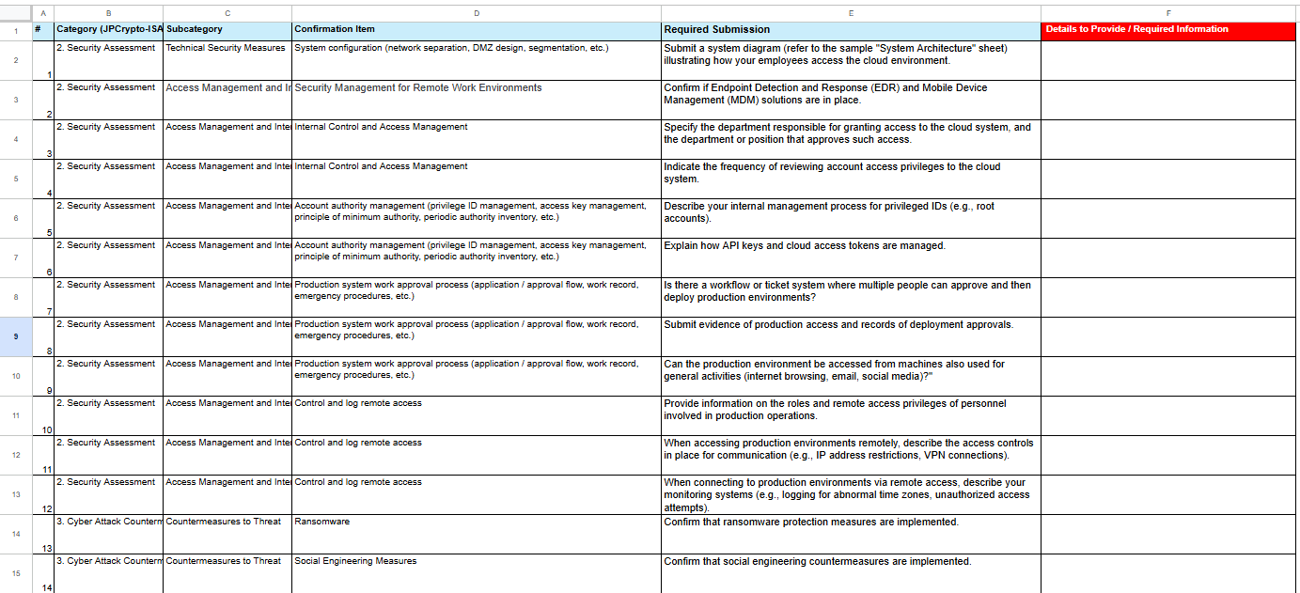
Standardized Checklist for Vendor Selection (Extract)

Slide 21
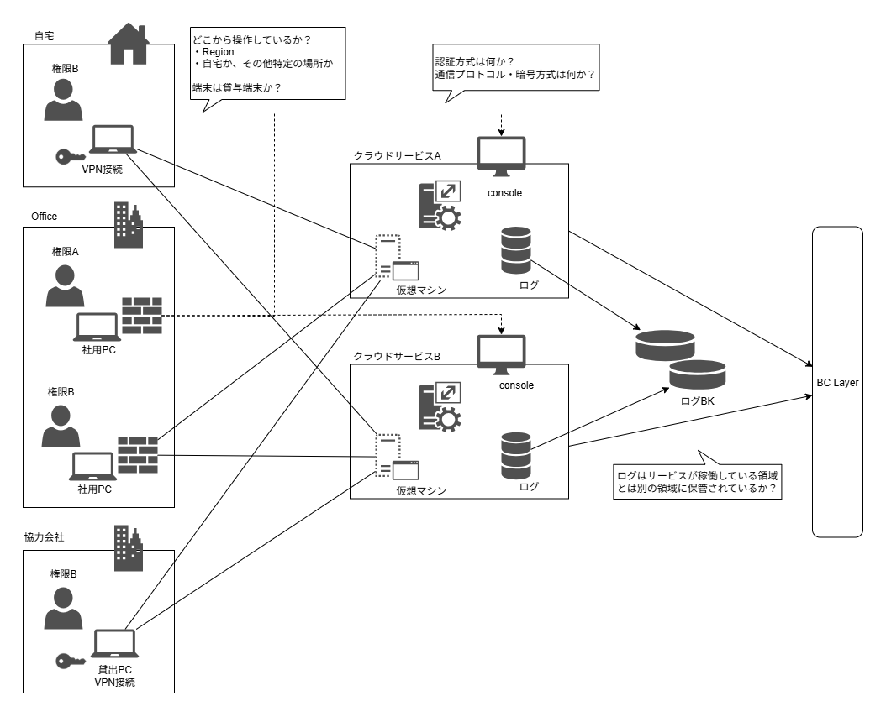
Standardized System Architecture Diagrams
Cloud architecture, access devices, and privilege information
governance controls, not deep technical details like source code
key management and access control
transaction flow and signature process

Slide 22
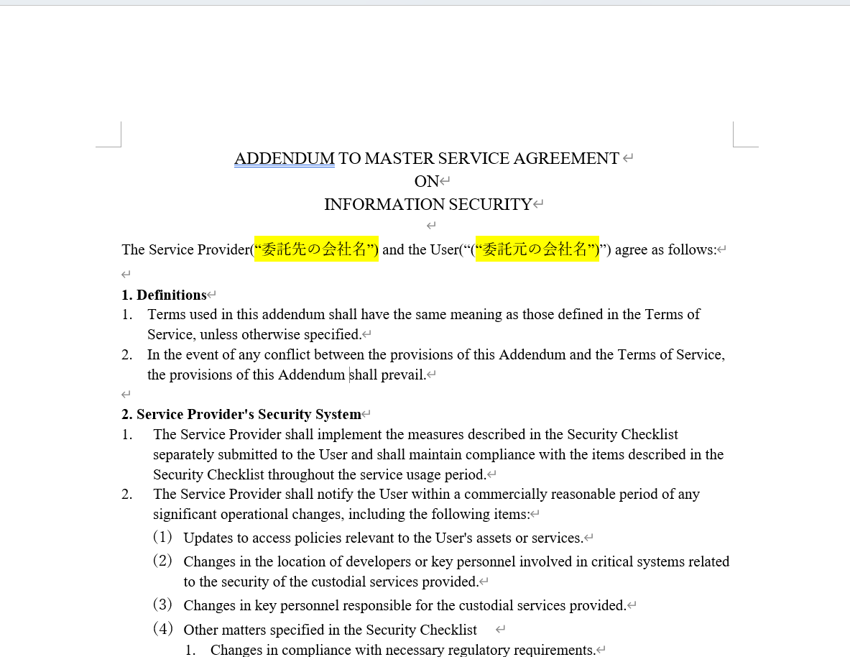
Standard Addendum to Master Service Agreements
Audit rights
Timely reporting
Cooperation during regulatory inspections
Mandatory incident reporting
Standardized reporting format
Vulnerability assessment test plan

