Slide 1
The pursuit of happiness: what makes nations thrive?
Exploring the Impact of Wealth, Health and Education
Notes:
Hello everyone. For my capstone project, I chose to explore a topic relevant to every person in every country—happiness. Happiness is more than just how we feel personally—it’s emerging as a powerful indicator of national progress embraced by governments and researchers worldwide. The World Happiness Report, published annually, assesses well-being beyond traditional economic measures. We often hear the saying that ‘money can’t buy happiness,’ but the data tells a more nuanced story. My core question was: What factors drive national happiness, and how do these drivers vary globally? To answer that, I analyzed data from the World Happiness Report alongside World Bank’s development indicators, focusing on three crucial elements: GDP, health, and education. I also explored how these factors interact by looking at patterns across countries and regions, and by the end, we’ll see what makes the happiest nations stand out — and what could happen if lower-happiness countries improved in certain areas. This work matters because with better measurements, countries can make smarter choices to improve real lives—not just statistics.

Slide 2
What are the key drivers of national happiness and how do they differ across countries?
How does wealth relate to happiness?
At what point does money stop making people happier?
How do health and education influence happiness?
What would happen if a low-happiness country improved key happiness drivers?
Notes:
Hello everyone. For my capstone project, I chose to explore a topic relevant to every person in every country—happiness. Happiness is more than just how we feel personally—it’s emerging as a powerful indicator of national progress embraced by governments and researchers worldwide. The World Happiness Report, published annually, assesses well-being beyond traditional economic measures. We often hear the saying that ‘money can’t buy happiness,’ but the data tells a more nuanced story. My core question was: What factors drive national happiness, and how do these drivers vary globally? To answer that, I analyzed data from the World Happiness Report alongside World Bank’s development indicators, focusing on three crucial elements: GDP, health, and education. I also explored how these factors interact by looking at patterns across countries and regions, and by the end, we’ll see what makes the happiest nations stand out — and what could happen if lower-happiness countries improved in certain areas. This work matters because with better measurements, countries can make smarter choices to improve real lives—not just statistics.

Slide 3
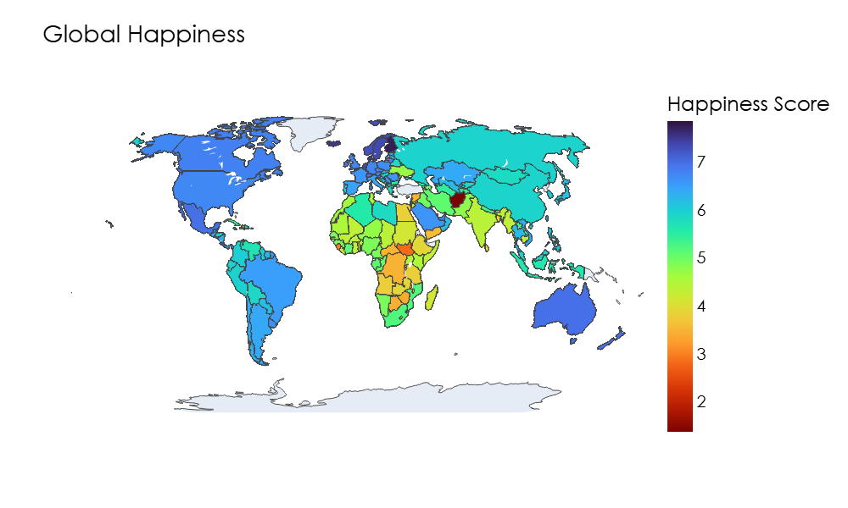
Happiness around the world 2024
Notes:
This world map displays happiness scores from 2024, with colors representing relative happiness levels—lighter shades signify happier countries and darker shades for less happy countries. Northern European countries, such as Finland and Denmark, consistently lead the rankings. On the other hand, parts of Africa and South Asia generally record lower happiness scores. These trends reflect complex socio-economic factors, including income levels, education quality, health services, governance structure, and cultural aspects. Recognizing these geographic patterns is essential for targeting specific policy interventions to improve well-being in underserved areas. Maps like this are especially useful for spotting which regions are outliers, helping policymakers prioritize efforts. So, before we dig into specifics, the takeaway here is that happiness tends to cluster — high in well-developed regions and lower in areas with economic or social challenges.

Slide 4
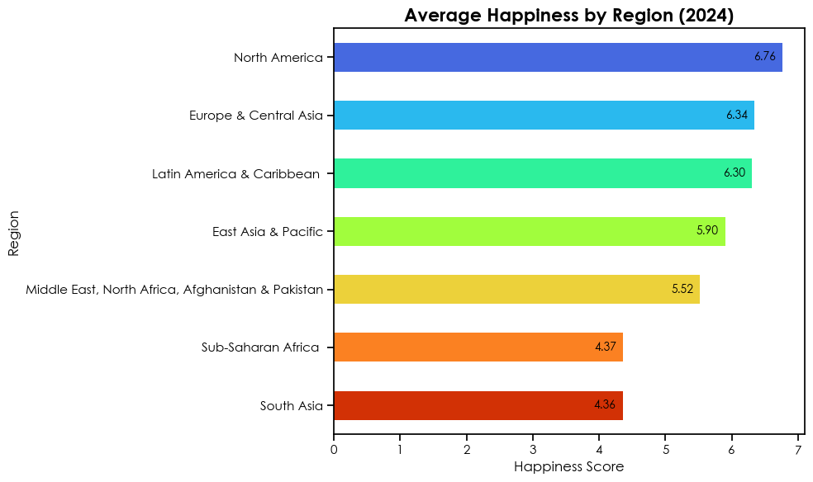
Blank slide
Regional differences in happiness: a snapshot
Notes:
This regional bar chart distills the data into average happiness scores by geographic areas for the latest year. Noticeable disparities appear—regions like Northern Europe and North America consistently score higher, while Sub-Saharan Africa and South Asia lag behind. These variations correspond strongly with differences in economic prosperity, investment in health infrastructure, and education access. Such disparities underscore global inequality and the necessity for tailored development efforts addressing region-specific challenges. It also highlights that policy recipes for happiness are not ‘one size fits all’—local context plays a big role.

Slide 5
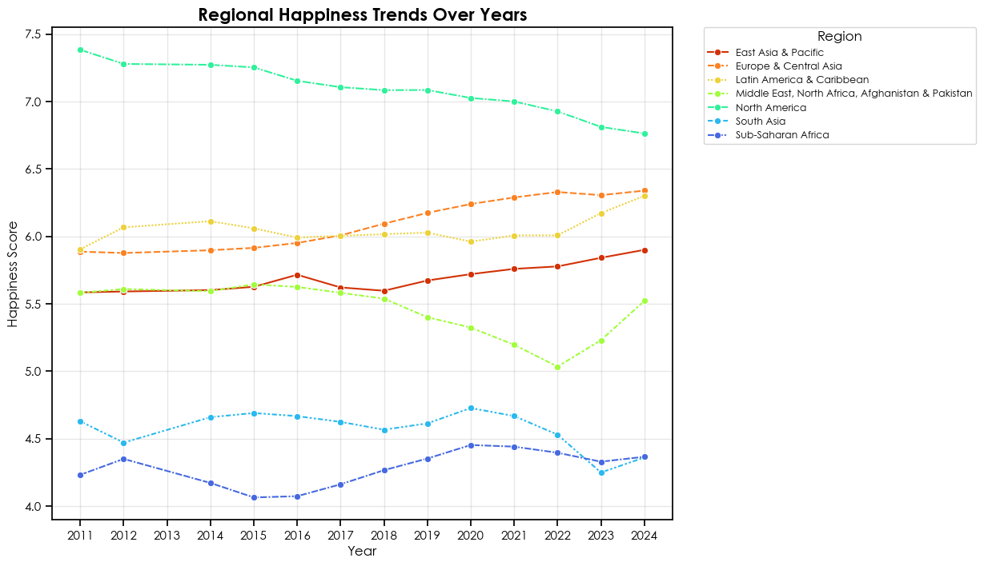
Blank slide
How Regional happiness has changed over the years
Notes:
Moving beyond snapshots, the line chart traces happiness trends over recent years across regions. This longitudinal perspective reveals that while some regions experience steady improvements, others have volatile or stagnant happiness trajectories. For example, Europe demonstrates relative stability with gradual gains, reflecting sustained policy focus on social welfare. Sub-Saharan Africa shows fluctuations possibly due to political instability, economic swings and health crises. Tracking these trends over time helps policymakers and researchers understand the effectiveness of interventions and where renewed efforts are required. Long-term data like this are vital to spot which changes truly work and which are just temporary blips.

Slide 6
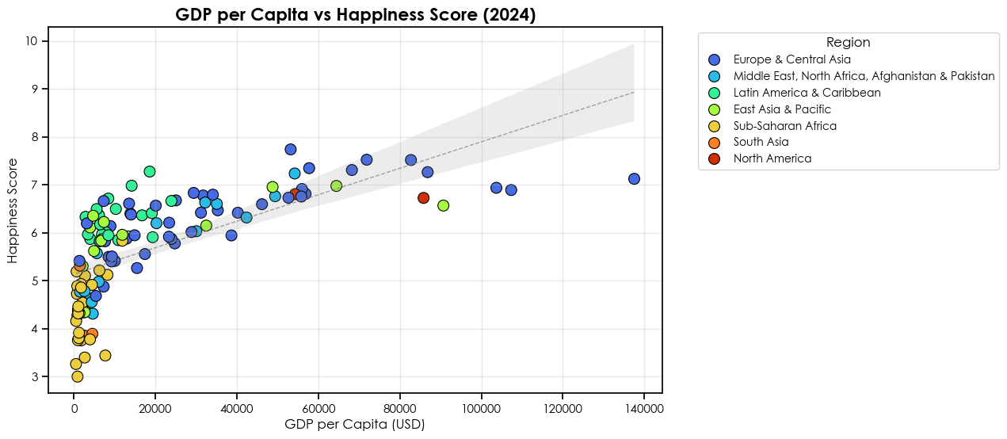
Does more money make us happier?
Notes:
Analyzing GDP per capita against happiness scores reveals an evident positive relationship. Generally, higher income correlates with higher happiness levels—supporting the idea that economic well-being paves the way for a better quality of life. However, the scatter plot also illustrates numerous outliers. Some countries achieve higher happiness than their GDP levels suggest, highlighting the importance of social capital, governance quality, and other non-monetary factors. Similarly, some wealthier countries show modest happiness levels, indicating economic success alone isn’t sufficient. These observations emphasize that wealth’s relationship to happiness is nuanced and multifaceted. It’s a reminder that even with growth, leaders must invest in the human side of development.

Slide 7
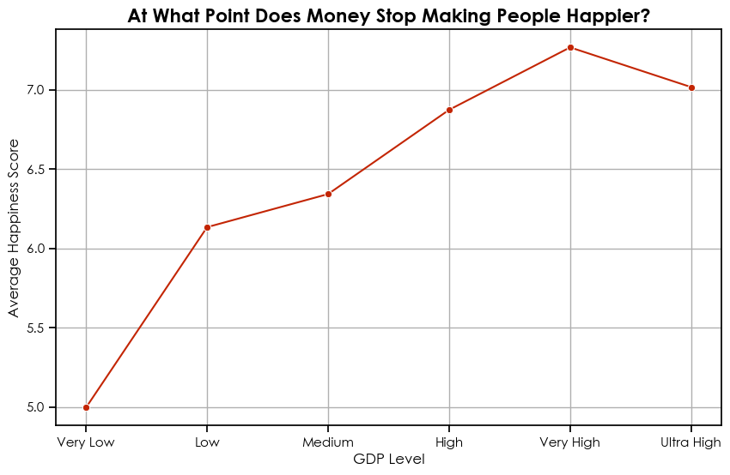
The point of diminishing returns
Happiness increases quickly from very low to medium GDP levels
Beyond ‘High GDP’, the happiness curve flattens
Suggests that after basic comfort, wealth adds less to happiness
Notes:
Grouping countries by income levels and examining their average happiness illustrates a steep increase in happiness from low to middle income groups. This jump correlates with basic needs being met—security, nutrition, shelter, and access to essential services. However, at higher income levels, the curve plateaus, reflecting the ‘diminishing returns’ concept. Beyond a certain economic status, additional wealth does little to increase reported happiness. Instead, individual happiness becomes increasingly sensitive to other factors such as health quality, community engagement, education, and personal freedoms. This pattern also supports findings from psychology and sociology showing that once people feel safe and secure, relationships and engagement matter much more.

Slide 8
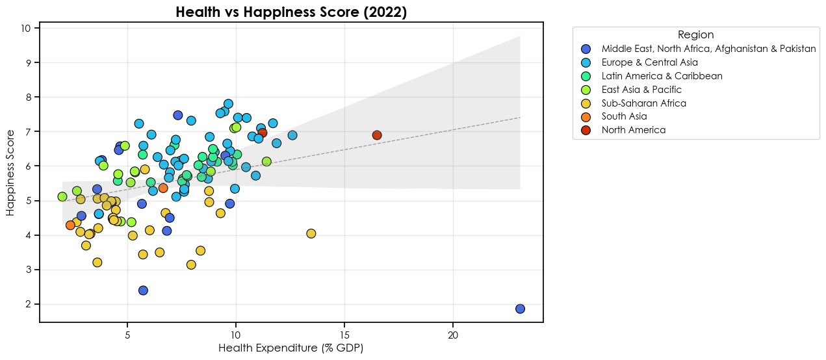
Health investment and well-being
Notes:
Examining health expenditure reveals a strong positive association with happiness. Countries investing more in healthcare systems generally report higher happiness scores, highlighting the critical role of health in well-being. Yet, we observe cases where high spending doesn’t translate into proportionally higher happiness—signaling that system efficiency, equitable access, and healthcare quality are equally vital. This suggests that well-rounded health policies focusing on fairness and effectiveness are necessary for translating funding into happiness gains. Universal access and prevention often make a bigger difference than just spending more on hospitals or medication.

Slide 9
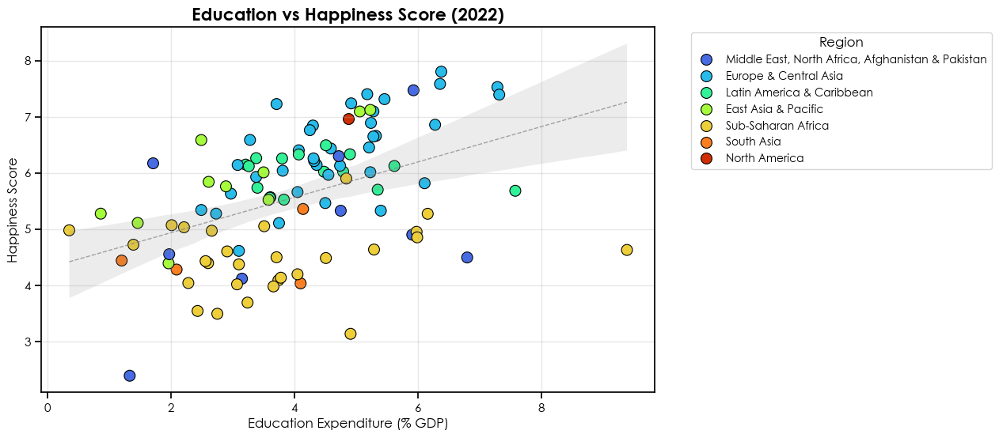
Education and opportunity
Notes:
Delving into education, the data consistently shows that more educated populations report greater happiness. Education fosters employment opportunities, health literacy, and engagement in civic processes—all contributors to a sense of purpose and personal fulfillment. Education also correlates with increased social capital, building strong communities and networks that support mental and emotional well-being. Thus, education emerges not just as an economic tool but a fundamental pillar of national happiness. Countries that focus on lifelong learning, not just basic schooling, often see long-lasting happiness improvements.

Slide 10
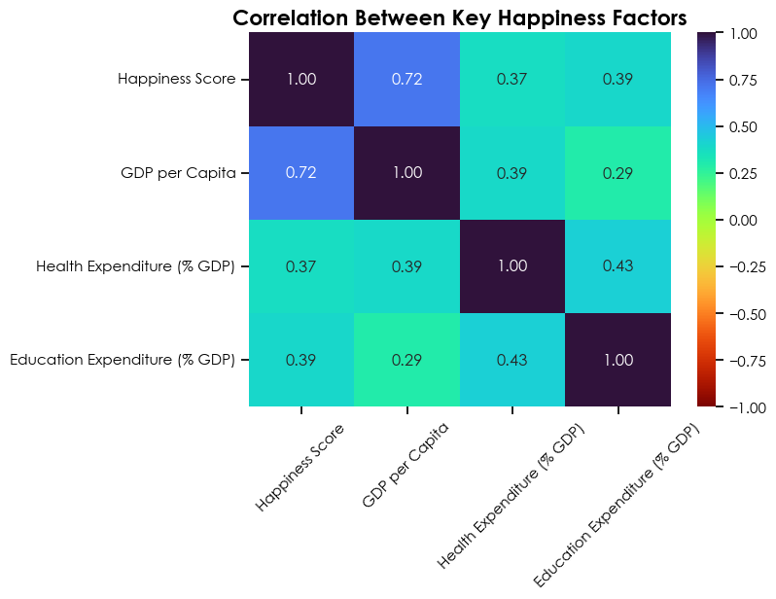
How strong are these relationships?
GDP strongest but health and education close behind
All are positively related
Notes:
A correlation heatmap quantifies these relationships, ranking GDP highest in influence, followed by health and education indicators. Their combined explanatory power confirms their importance in shaping happiness across nations. These findings support theories arguing for holistic development approaches incorporating economic, health, and educational policies. Bringing all these factors together in one visual lets us see clearly which indicators matter most for driving well-being.

Slide 11
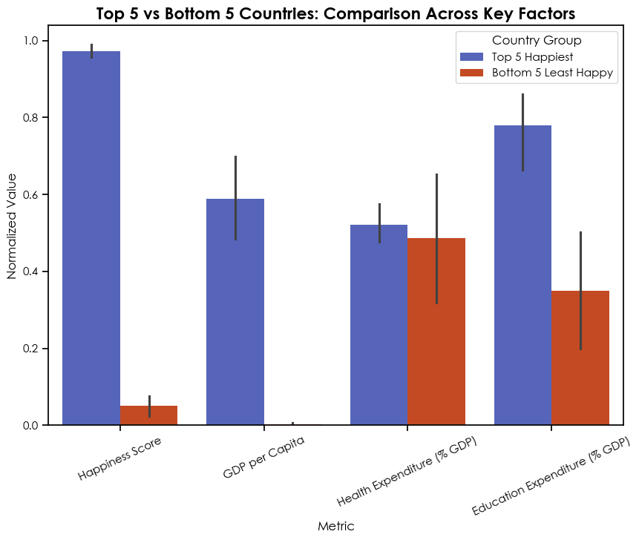
Top 5 vs bottom 5: what sets them apart?
Blank slide
Top 5 benefit from stronger economies and services
Bottom 5 face multi-dimensional deficits
Highlights global inequality in happiness drivers
Notes:
Comparing the top five happiest and bottom five least happy countries reveals stark contrasts beyond GDP. For this part of the analysis, I grouped the five countries with the highest happiness scores and the five with the lowest, then calculated the average value for each group in each metric. I also normalized the data—scaling each metric to a common range—this allows for a standardized and objective comparison. The chart you see shows these group averages side by side, rather than individual countries. Less happy countries suffer from lower health and education investment levels, coupled with economic challenges—painting a multidimensional picture of barriers to happiness. In contrast, the happiest nations exhibit balanced performance across economic and social welfare measures, reinforcing the importance of comprehensive investment policies. It’s clear that raising well-being is rarely about one reform—it takes combined improvements in multiple areas to see real impact.

Slide 12
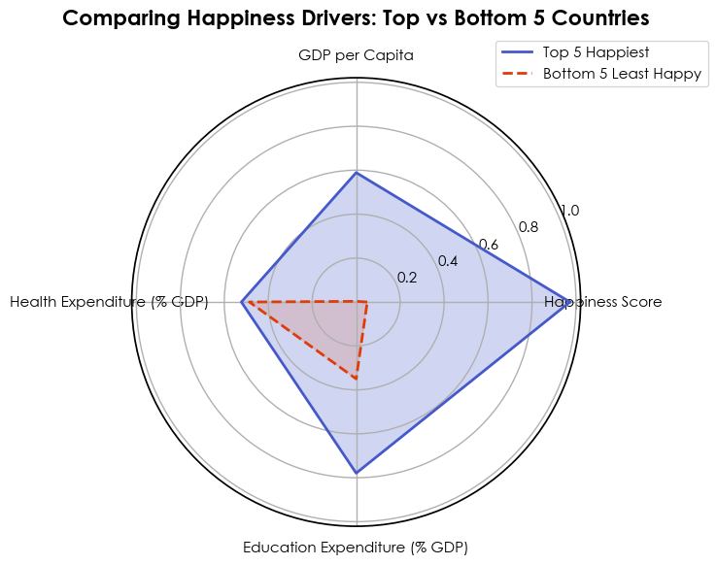
Balanced happiness: a comparison of key drivers
Happiest nations perform consistently well across all metrics
Least happy countries show weaknesses across all metrics
True happiness depends on balance
Notes:
The radar chart highlights these contrasts in a single, unified view. Top-performing countries dominate across GDP, health, and education axes, while the lowest-ranking ones fall short. This visualization underscores that no single factor suffices; sustained happiness relies on a network of economic and institutional strengths. Differences in the shapes of a radar chart can reveal where countries would benefit most from new policy or investment.

Slide 13
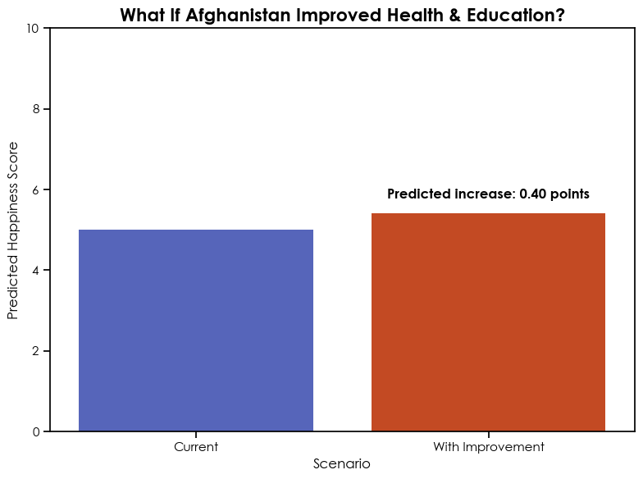
What if a less happy country improved Key metrics
Shows the role of targeted policy changes
Helps guide resource allocation and development planning
Shows realistic paths to higher well-being
Notes:
To explore practical implications, I developed a regression model simulating outcomes if a lower-happiness country raised its health and education metrics to global mid-levels. For the model, I selected Afghanistan, since it consistently ranks at the bottom of the World Happiness Report. The model predicts a point four-zero increase in Afghanistan’s happiness score if key social investments were made. While this may sound modest, even small improvements can be life-changing for countries at the lower end of the scale—moving national well-being closer to global averages and showing the real potential of targeted policies. Predicted increases in happiness scores suggest that targeted social investments can yield substantial well-being improvements, providing a quantitative basis for policy prioritization. This ‘what if’ analysis is a useful tool for governments to forecast the impact of social policies before making big investments.

Slide 14
What can we learn from the happiest countries?
GDP matters but only up to a point
Health and education are powerful happiness drivers
Balanced investment leads to sustainable well-being
Data can guide smarter policy
Notes:
In closing, while GDP is pivotal for satisfying fundamental needs, our analysis emphasizes that lasting happiness hinges on quality health and education services, and inclusive social policies. Successful nations balance prosperity with human capital development, fostering environments where citizens thrive emotionally, physically, and socially. Recognizing this multidimensionality is essential for anyone interested in crafting policies to improve well-being. In the end, societies that invest in all people—not just profits—lay the groundwork for the happiest and healthiest futures.

Slide 15
Thank you

