Slide 1
League of Legends Counter Pick application
By: Jieyi Hu, Daniel Ruhnke, Dane Greer, and Skyler Wright

Slide 2
Introduction
A Gaming Experience Improving Application
Goes With Most Popular Action Real Time Strategy Game League of Legends
Help User To Make Smart Decision In Game

Slide 3
League of Legends
In League of Legends, players assume the role of a character or ‘champion’, with unique abilities, battling in a team of 5 players against another team of 5 players.
The object of the game is destroy the opposing team’s nexus, a building in the middle of their base, protected by defensive structures.
Each game starts the same, with each champion starting off weak and progressing by accumulating gold and experience of the course of the game.

Slide 4
Motivation
Passion about the game
Lack of similar product in the market
Those in the market only help individual player make single counter decision. But it is a team game.
Do-able
In short time
With no budget
With only four and five people

Slide 5
Waterfall Method
We decided to just use the standard Waterfall Method.
It made it easier to organize the project.
It works well for small or short project.

Slide 6
Execution
Met once a week for 5 weeks for each phase
Requirements
Design
Development
Testing
Deployment

Slide 7
Original Idea
We decided to create an application that would allow the user to find out the best possible champion to pick in a draft game.
This expands on other apps that only do counters for single champions. Our app decides the best possible counter for the entire team.
Our original plan was to include team counter, team synergy, champion classification, spell counter and so on.

Slide 8
Original Design
We decided to make our own User Interface that would resemble the League of Legends champion select screen.
The champion data was going to be stored in a database. The information would be used to figure out the counters of different champions to each other.
Once selected the champions and possible bans, then the app would parse through the data and output the champions with the best counters and team synergy.

Slide 9
Functional Requirement: 1 UI interface
We will create a user interface that somewhat resembles the League of
legends client. Both teams will have their champions on the left side.
In the middle there will be a box with the champions. As selections are
made. The program will update with the current best champions to
pick, the moderate champions to pick, and finally the worst champions
to pick.
The interface will, for the most part, resemble the League client. Champions will be picked by their picture in the middle of the box.
There will also be boxes to separate the champions into the corresponding lanes. Making it easier to pick for the lane you want.
Desirable

Slide 10
Functional Requirement: 2 Database of Champions
Create a database that holds information relevant to each champion in the game.
The table will hold information such as name, position, mobility, sustain, damage, etc.
Create a table that holds information on which champion is stronger versus another champion.
The table will have a list of each champion on the rows and columns. Making sure each champion has a number value associated with each other champion, and vice versa.
Create a table that includes information on which summoner spells are good versus certain champions.
Optional

Slide 11
Functional Requirement: 3 Counter-pick Algorithm
Create an algorithm that sorts through the champion counter table, and outputs the list of possible counters.
The counters will represent the enemy team as a whole, and not a single champion counter pick.
Included in the algorithm will also be the ability to recommend champions based on team synergy.
The search will find 3 tiers of champions to display, good, medium, and bad.
The search will automatically change the counter picks whenever a new champion is selected.

Slide 12
Technology
MySQL for Database
C# for User Interface
Dropbox for online teamwork and data sharing
LOLCounter.com for data source

Slide 13
Database
Developed using MySQL
Stored general info about each champion (AD, AP, etc.) from official LoL website
Retrieved win percentages for each champion matchup from elophant.com
Stored these in entity relation

Slide 14
Database
Worst query time (before refining) ~.6 seconds
Re-organized relations table to reduce storage space and number of tuples
Worst query time (after refining) <.1 seconds
Reasons for abandoning:
Localhost v. External server
Extraneous information

Slide 15
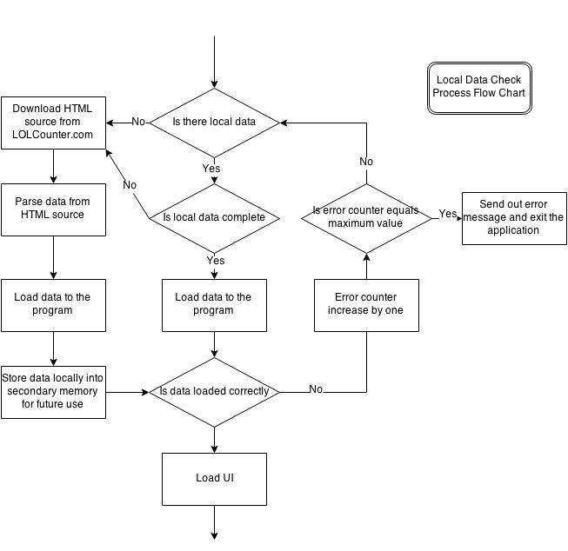
Local Data Check Process Flow Chart

Slide 16
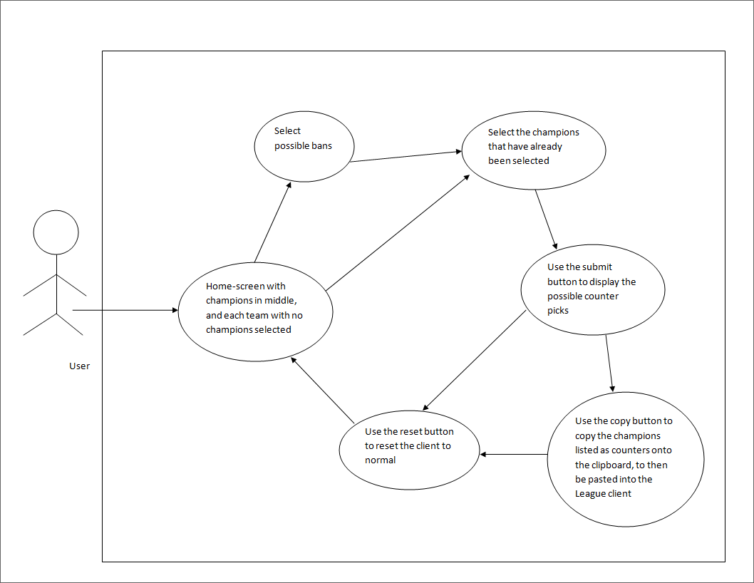
UI Diagram

Slide 17
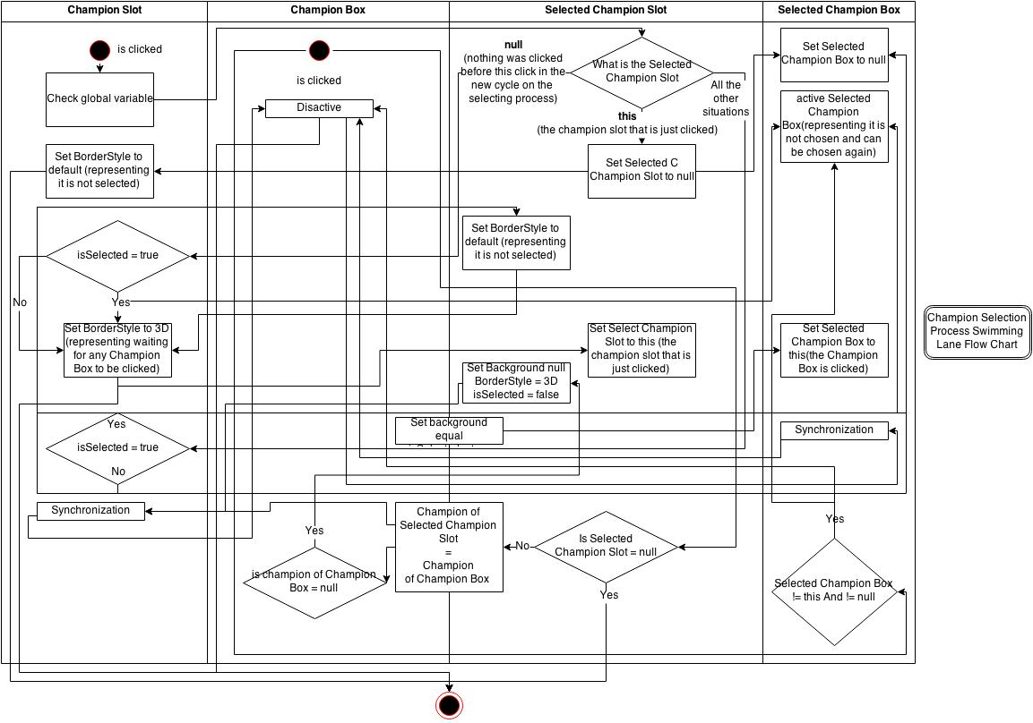
Champion Selection Process Swimming Flow Chart

Slide 18
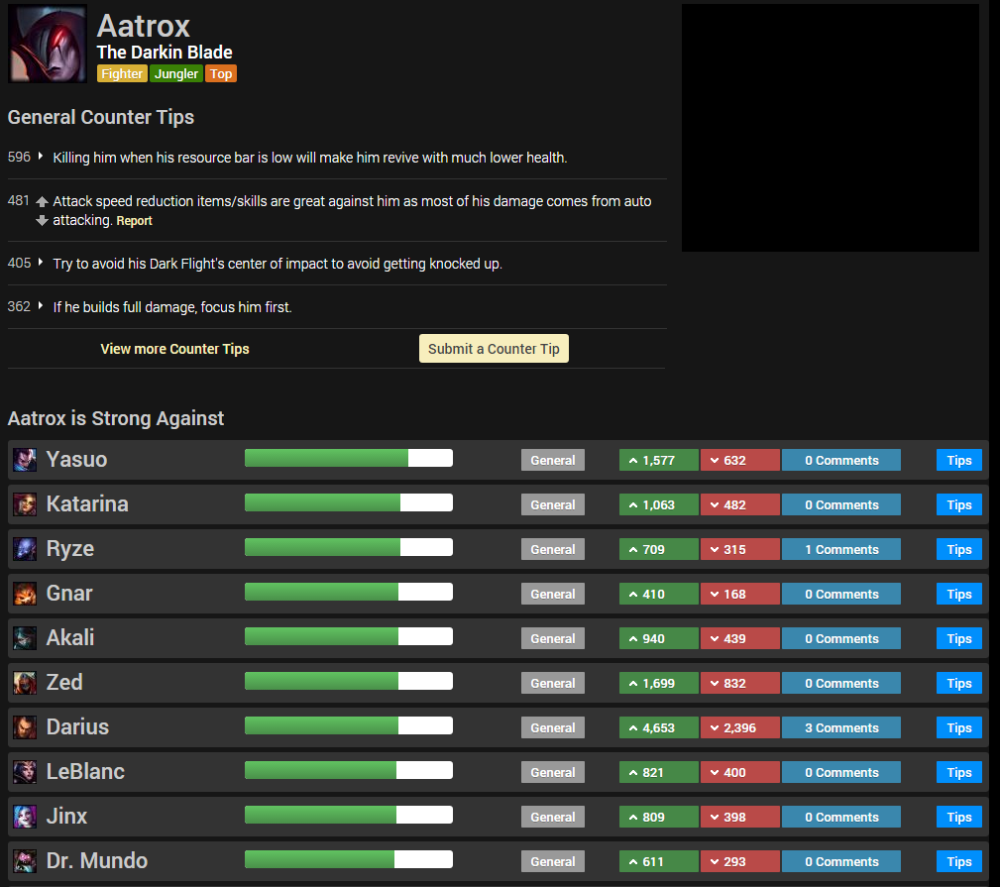
Data Source

Slide 19
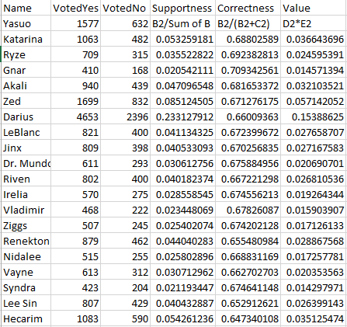
Algorithm

Slide 20
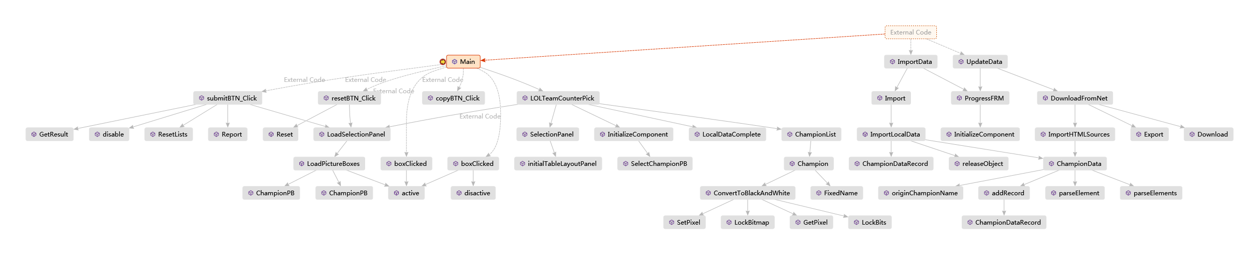
Call Stack

Slide 21
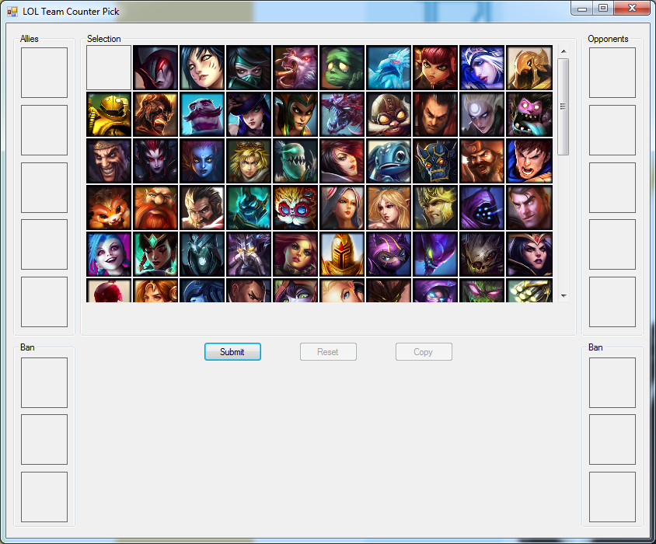
User Interface

Slide 22
Final Changes
In the end we ended up changing a few things from our original idea.
We created the UI in C#. The interface, while not the exact same, has the same look of the league client.
Instead of using a database, we decided to just download the information into local memory from lolcounter.com, through HTML.
This data is saved into an Excel file and parsed when the application is used.

Slide 23
Future Work
Things to consider in the future would be the addition of different classifications. Being the best counters versus the okay counters and the worst champions to pick.
Also, adding a filter, to filter the counter picks from the different roles used in play (top, jungle, mid, ADC, support).
Adding team synergy, champion properties, spell counter into selection decision making for the program
Showing tips for champions when the cursor hover on top
Weekly Data update, Local data re-organizing
Store local data in a faster accessed format

Slide 24
Demo

