Slide 1

Weather delays related to the airline industry
Brian Glaude & Jesus Jasso
Project 2

Slide 2
Objective
Find a relationship between daily weather events and airline travel delays. Inspired by planning upcoming trips (after COVID)
Map showing the total number of weather events by city
  Filter by Top 10 overall events for (2017, 2018, 2019)
  Filter by Top 10 events per year
  Filter by Top 10 cities
Map showing the Top overall delays
  Filter by Top 10 overall delays for (2017, 2018, 2019)
  Filter by top 10 delay events
  Filter by Top 10 cites delays

Slide 3
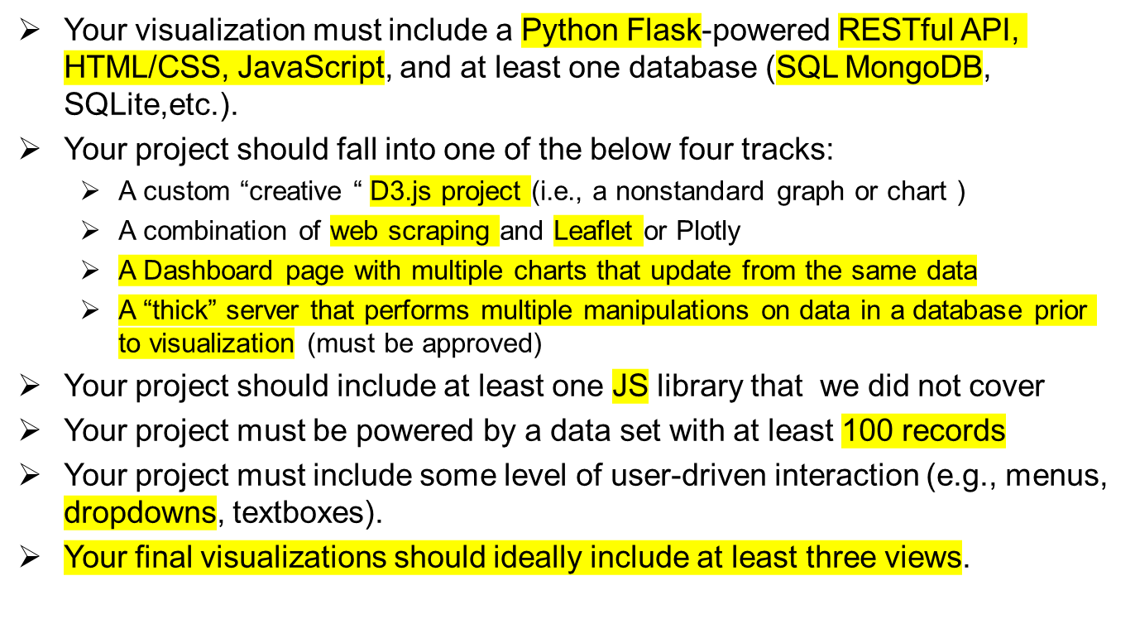
Specific Requirements

Slide 4
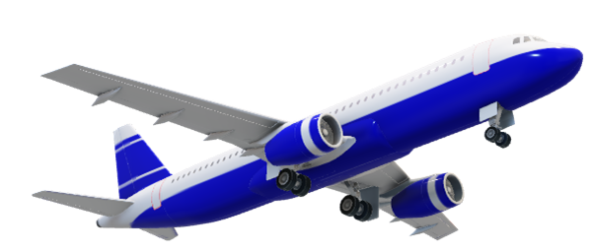
Visualizations Used
Python Flask
Restful API
HTML
CSS

Slide 5
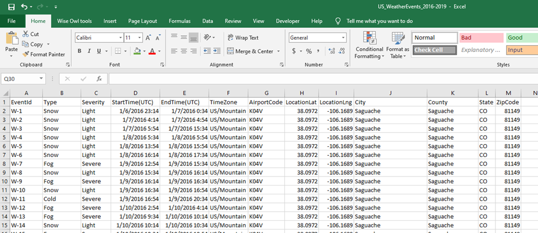
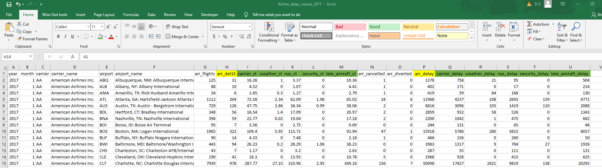
Datasets
Airline_delay_causes_2017
12, 519 records
US_WeatherEvents_2016-2019
Before cleaning - 5,059,833 records. This is way over the excel limit of 1,048,576 records.
After cleaning 24,049
Notes:
1st Airlines dataset
simple
2nd Airlines
After cleaning 24,04

Slide 6
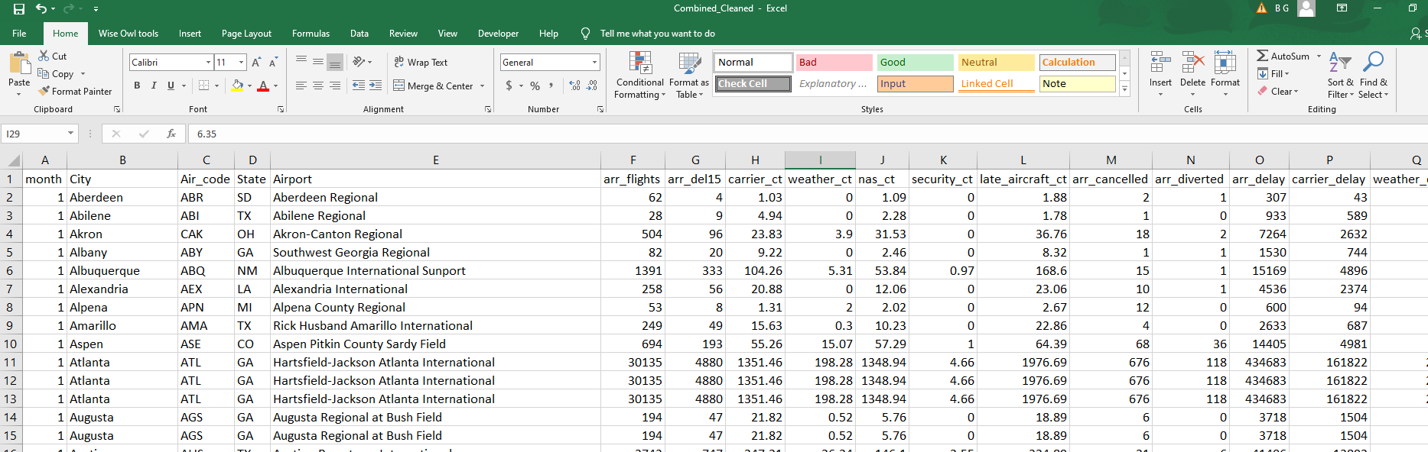
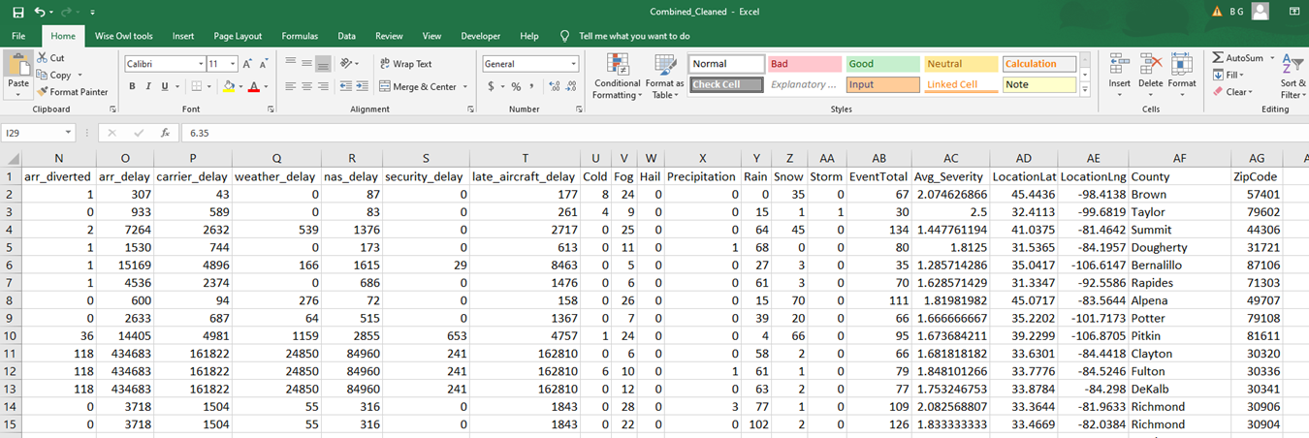
Datasets Combined Files
Notes:
1st Airlines dataset
simple
2nd Airlines
After cleaning 24,04

Slide 7
Visualizations coming to life

Slide 8
Dash Boards

Slide 9
Sources
https://www.kaggle.com/sobhanmoosavi/us-weather-events?select=US_WeatherEvents_2016-2019.csv
https://www.transtats.bts.gov/OT_Delay/ot_delaycause1.asp?pn=1&periodfrom=24245&periodto=24245

Slide 10
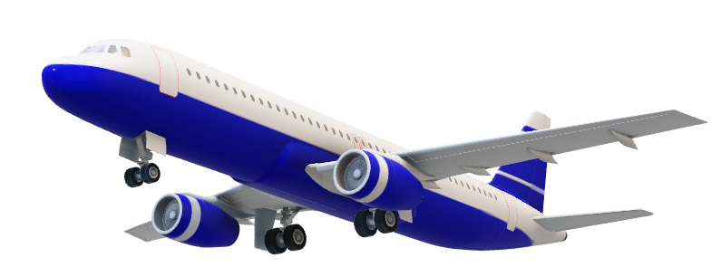
Thank You

