Slide 1
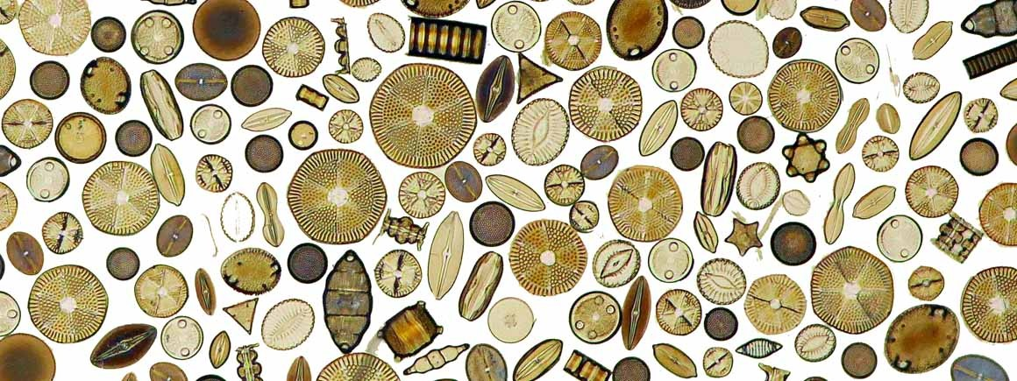
Diatom classification
Barbara Glemser
Machine Learning with TensorFlow 25S

Slide 2
Problem and Data
Microscopic single cell algae
Silica shell
Produce 20-30% of the worlds oxygen
Indicator for health of aquatic ecosystems
Highly trained people needed for identification
© Adams TS 558

Slide 3
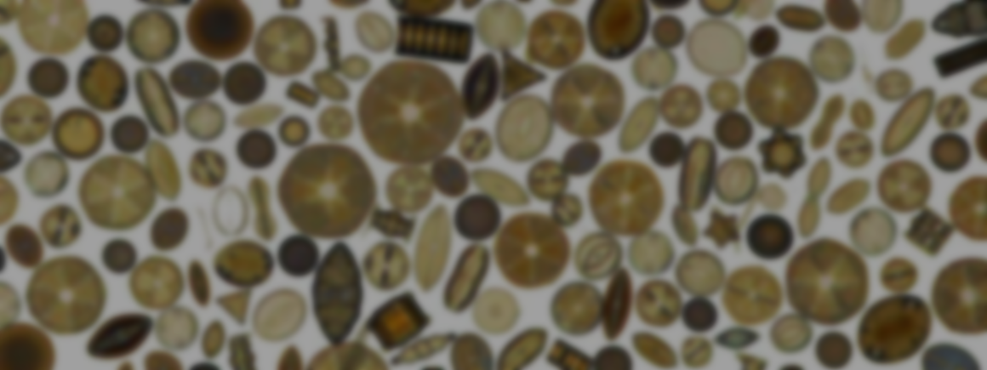
Problem and Data
Microscopic single cell algae | Silica shell | Produce 20-30% of the worlds oxygen | Highly trained people needed for identification

Slide 4
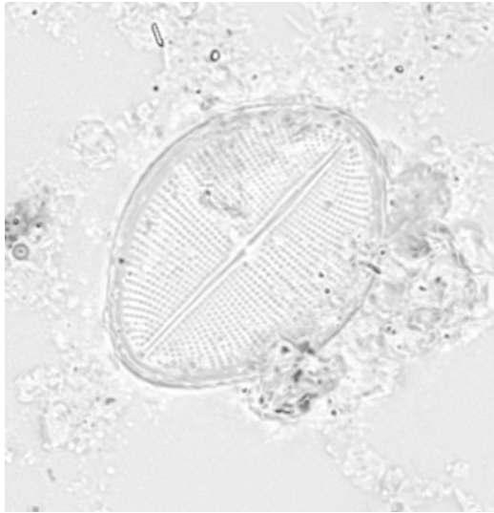
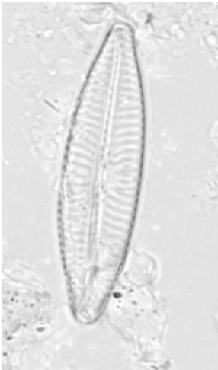
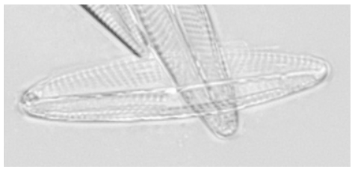
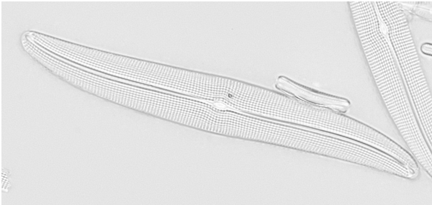
Example images
Navicula simulata
Cocconeis pediculus
Navicula recens
Gyrosigma acuminatum
Reality is different → Dataset wants to display reality
Damaged shells
Background debris
Others shells in the images
Venkataramanan, Kloster, Burfeid-Castellanos et al. (2024): “UDE DIATOMS in the Wild 2024”: An new image dataset of freshwater diatoms for training deep learning models.

Slide 5
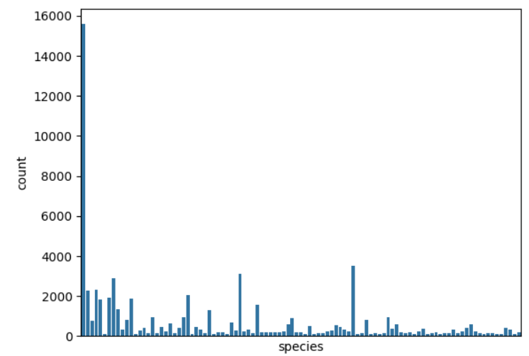
Dataset
101 species with at least 100 images per class
Super clean dataset
Number of images not evenly distributed

Slide 6
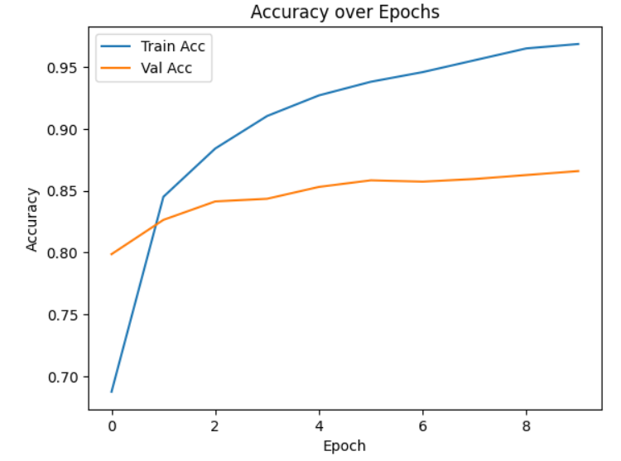
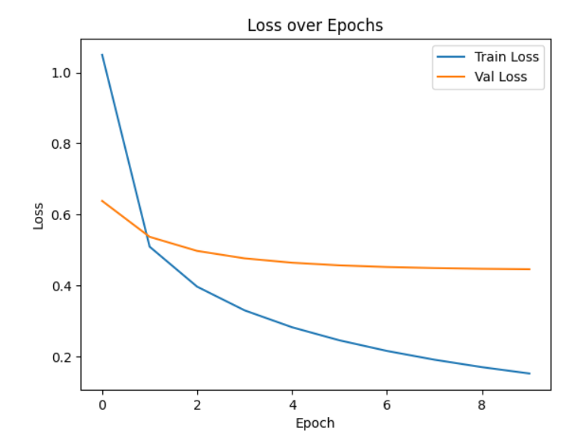
Baseline model
Used simple model MobileNetV2
Used a subset of my data as it took really long

Slide 7
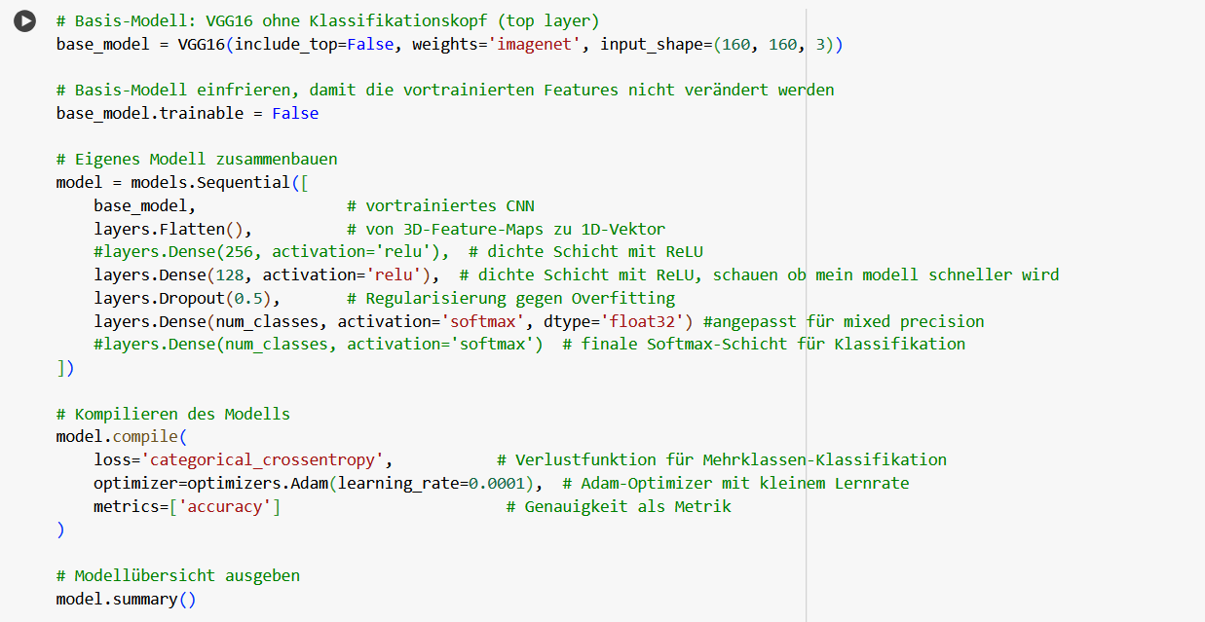
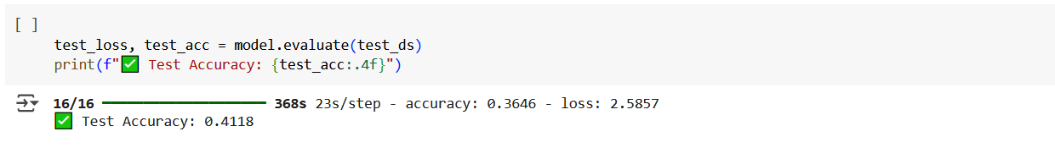
Model I
Wanted to try VGG model
Quite large model → long time
Cut down dataset to 51 species with same amount of images
Accuracy of 40% after 10 epochs

Slide 8
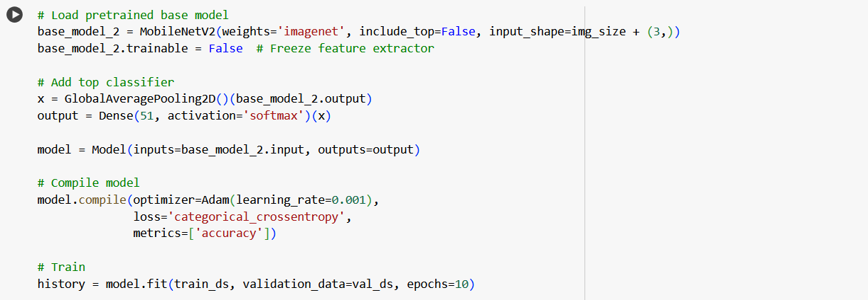
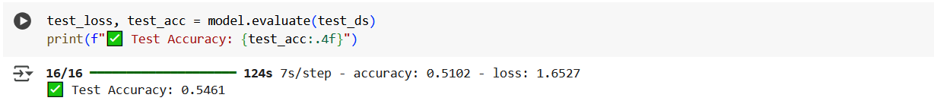
Model II
Switched to MobileNet2 →speed
No image augmentation used
Better accuracy after 10 epochs

Slide 9
Struggles/learning
Underestimated difficulty in working with the amount of images
Spend a lot of time researching how to make model faster
No time left to play with the models → on ToDo list

