Slide 1
Chapter 10. 隱像術
10.1 Introduction
10.2 Previous Work
10.3 Virtual Image Cryptosystem
10.4 Empirical Tests

Slide 2
10.1 Introduction
Images have been widely used in our daily life.
The image security has become an important issue in current computer world.
Image cryptology is a very useful tool to defend the information security.

Slide 3
10.2 Previous Work
Schwartz(1991)
  A new graphical method for encryption of computer data
Bourbakis and Alexopoulos(1992)
  Picture data encryption using SCAN patterns
Kuo(1993)
  Novel image encryption technique and its application in progressive transmission
Chang and Liou(1994)
  An image encryption scheme based on quadtree compression scheme

Slide 4

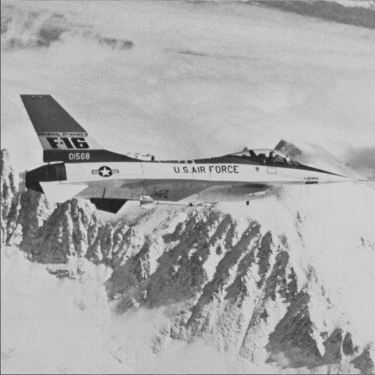
Apply the traditional cryptosystem on images
encryption
decryption
Original Image
Cipher Image
Decrypted Image

Slide 5
Problems
The cipherimage is meaningless.
  Image Camouflage(影像偽裝)
Image size is huge.
  Image Compression(影像壓縮)
The decrypted image containing a small distortion is usually acceptable.
  Vector Quantization(向量量化編碼法)

Slide 6
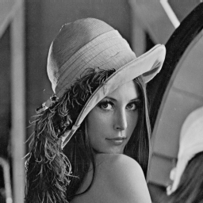
10.3 Virtual Image Cryptosystem
Advantages:
Camousflage
Security
Compression
Acceleration
Original Image
Decrypted Image
Virtual Image
encryption
decryption
Cipher Image

Slide 7
Vector Quantization Encoder
w
VQ encoder
h
Codeword
i
k
i
‧‧‧‧‧‧
‧
‧
Compressed Data
(indices)
Codebook
Original Image

Slide 8
Vector Quantization Decoder
w
VQ decoder
h
Codeword
i
k
i
‧‧‧‧‧‧
‧
‧
Compressed Data
(indices)
Codebook
Decompressed image

Slide 9
The principle of the Virtual image cryptosystem
Separate O into a set of vectors {O₁,O₂,O₃,…,O_{nO}}.
Separate V into another set of vectors {V₁,V₂,V₃,…,V_{nv}}.
Let O be the original image.
Let {V₁,V₂,V₃,…,V_{nv}} be the codebook.

Slide 10
Encryption
Randomly generate the transformed-origin G and the project-direction D.
Project {V₁,V₂,V₃,…,V_{nv}} to D based on G.
Sort the projected results, and obtain {V’₁,V’₂,V’₃,…,V’_{nv}}.

Slide 11
Encryption (cont.)
w
VQ encoder
h
Codeword
V’₁
i
V’₂
k
V’₃
i
‧‧‧‧‧‧
‧
‧
Relationship I
between O and V
V’_{nV}
Codebook
Virtual Image V
Original Image O

Slide 12
Encryption (cont.)
Encrypt w, h, no, G, and D into w_{c}, h_{c}, no_{c}, G_{c}, and D_{c} by DES-like, respectively.
Encrypt I into I_{c}, Where I_{c}=I_{XOR} X and X is the bit-string containing G, D, G, D, … only.
Hide w_{c}, h_{c}, no_{c}, G_{c}, D_{c} and I_{c} into the pixels of V.
Cipher Image V^{c}

Slide 13
Decryption
w
VQ Decoder
h
Codeword
V’₁
i
V’₂
k
V’₃
i
‧‧‧‧‧‧
‧
‧
Relationship I
between O and V
V’_{nV}
Codebook
Virtual Image V
Original Image O

Slide 14
10.4 Empirical Tests
Test1:
Original Image Airplane
512X512

Slide 15
Virtual Image
Lena
256X256
Cipher Image
Lena
256X256
PSNR=37.87 dB

Slide 16
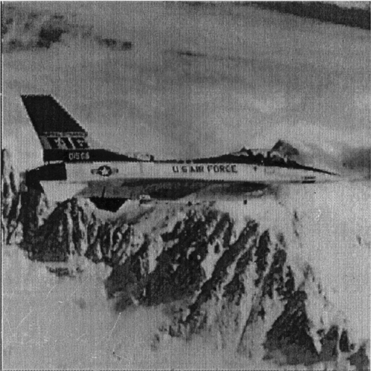
Decrypted Image Airplane
512X512
PSNR=30.22 dB

Slide 17
Test2:
Original Image Airplane
512X512

Slide 18
Virtual Image
Lena
360X360
Cipher Image
Lena
360X360
PSNR=45.13 dB

Slide 19
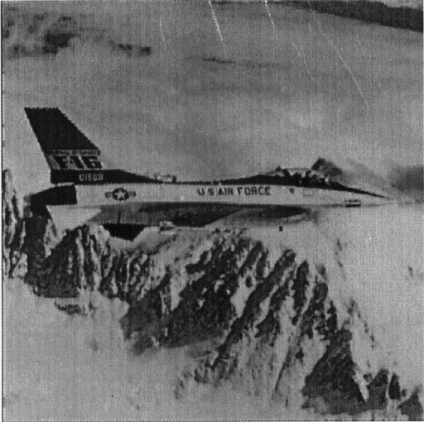
Decrypted Image Airplane
512X512
PSNR=30.22 dB

Slide 20
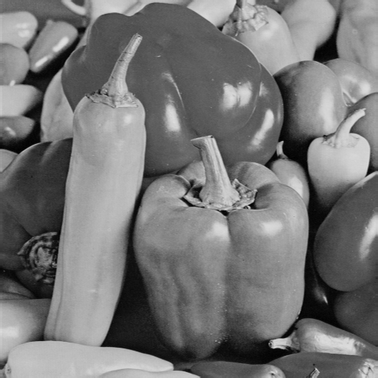
Test 3:
Original Image Peppers
512X512

Slide 21
Virtual Image
Lena
256X256
Cipher Image
Lena
256X256
PSNR=37.60 dB

Slide 22
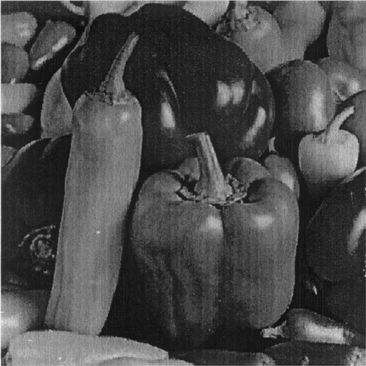
Decrypted Image Peppers
512X512
PSNR=29.91 dB

Slide 23
Test 4:
Original Image Peppers
512X512

Slide 24
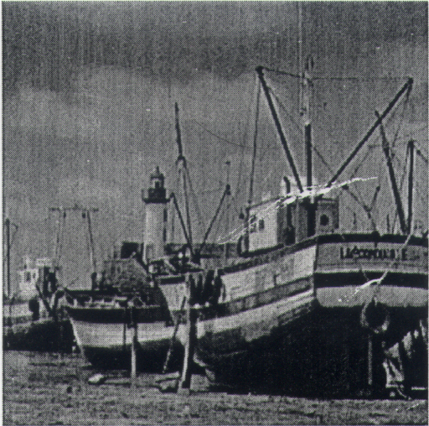
Virtual Image
Boat
256X256
Cipher Image
Boat
256X256
PSNR=37.74 dB

Slide 25
Decrypted Image Peppers
512X512
PSNR=30.31 dB

Slide 26
Security Analyses
The camouflage is the first safeguard of our cryptosystem.
Suppose the illegal users detect that the virtual image is fake:
  We have proven that none can break our cryptosystem by any attack.

Slide 27
Conclusions
The advantages of our image cryptosystem:
  Camousflage
  Security
  Compression
  Acceleration
This image cryptosystem is suitable for all applications of images; such as printer, scanner, and camera.

