Slide 1
第十一章
離散小波轉換之影像壓縮法
–SLCCA
(Significance-Linked Connected Component Analysis)

Slide 2
Outlines
介紹
量化
建構連續係數
重要係數區鏈結
SPIHT影像壓縮程序
實驗結果

Slide 3
介紹
SLCCA由Chai、Vass與Zhuang學者提出 (1999)
一種離散小波影像壓縮方法
三項主要技術：
  量化DWT轉換後的係數
  建構連續係數
  重要係數區鏈結

Slide 4
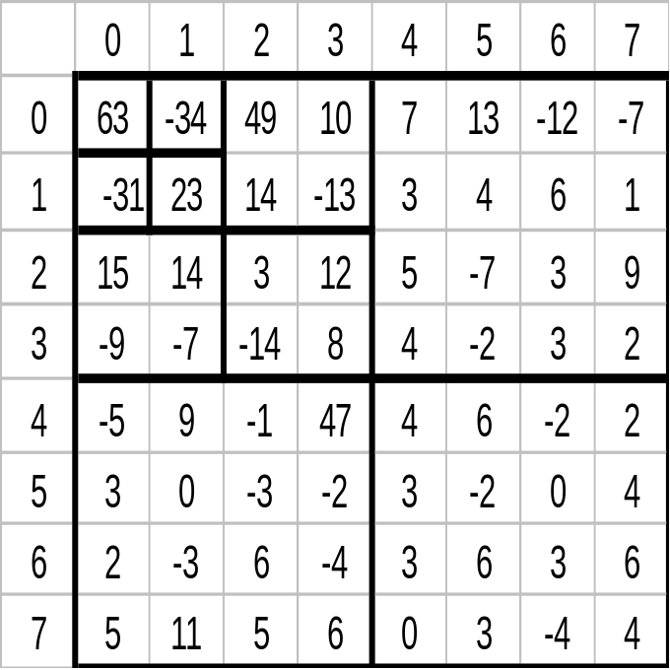
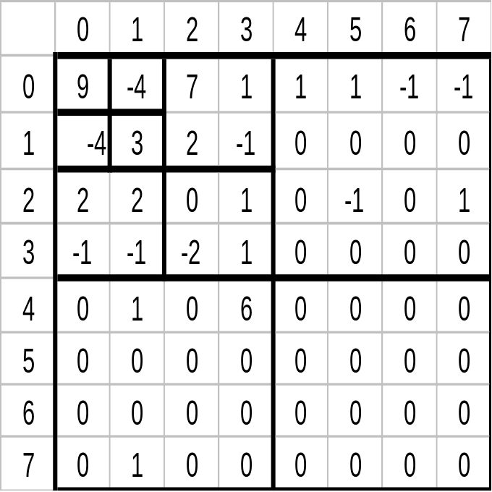
量化
q = 7

Slide 5
建構連續係數
LL₃
HL₃
HL₂
LH₃
HH₃
HL₁
LH₂
HH₂
LH₁
HH₁

Slide 6
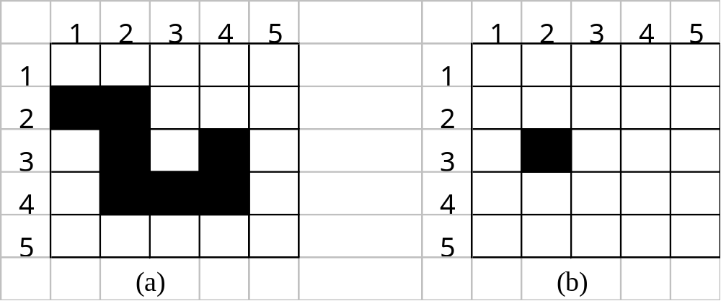
建構連續係數 (cont.)
最後的輸出結果 : SISI IIS I SII SI SII II

Slide 7
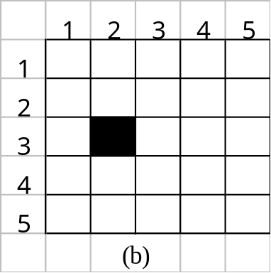
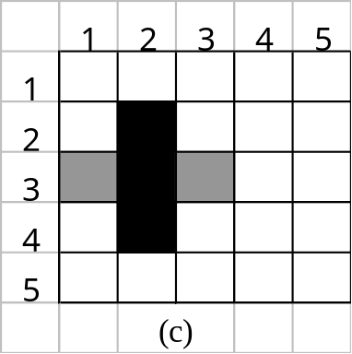
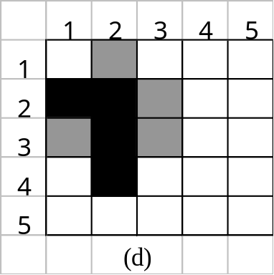
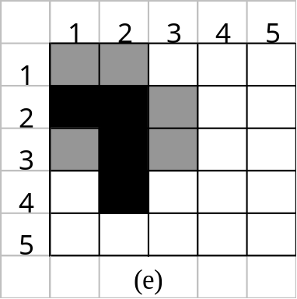
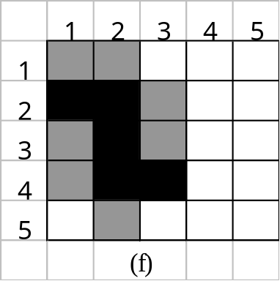
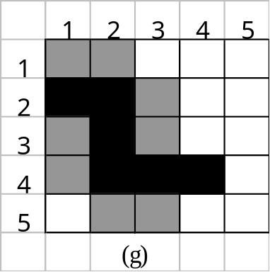
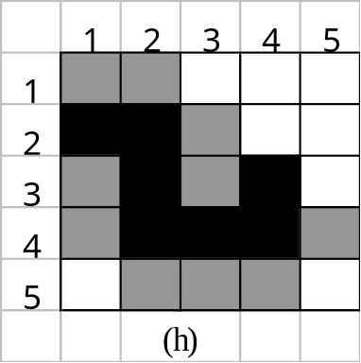
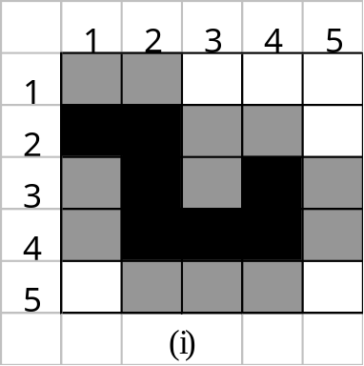
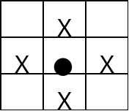


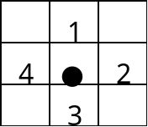
建構連續係數 (cont.)
重要係數
不重要係數
(c)SISI (d)IIS (e)I (f)SII (g)SI (h)SII (i)II

Slide 8
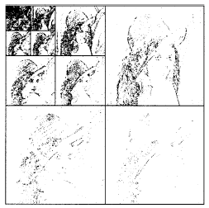
建構連續係數 (cont.)

Slide 9
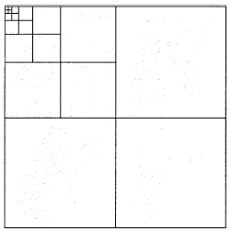
建構連續係數 (cont.)
連接起來所構成的連續要素 (即叢聚 clusters) 共有 689 個

Slide 10
建構連續係數 (cont.)
X
X
X
X
X
X
X
X
X
X
X
X
X
X
X
X
X
X
X
X
X
X
X
X
X
X
X
X
X
X
X
X
X
X
X
X
X
X
X
X
X
X
X
X
X
X
X
X

Slide 11
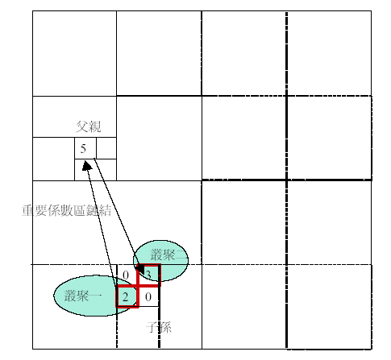
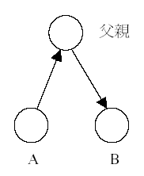
重要係數區鏈結

Slide 12
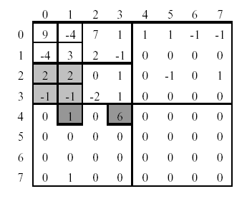
重要係數區鏈結 (cont.)

Slide 13
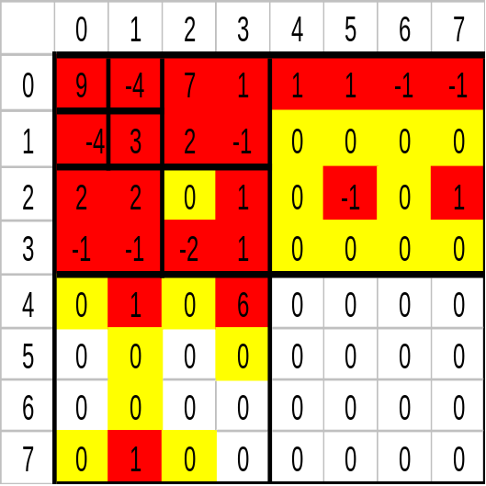
SPIHT影像壓縮程序
LSO – List of scan order
LCC – List of Child clusters
LSC – List of significant coefficient

Slide 14
LSO: (0,0)(1,0)(0,1)(1,1) (2,0)(2,1)(3,0)(3,1) (0,2)(0,3)(1,2)(1,3)
(2,2)…(4,0)…(0,4)…(4,4)...
LCC:
Root (0,0)
LSC: (0,0)
Output: (0,0) POS

Slide 15
LSO: (0,0)(1,0)(0,1)(1,1) (2,0)(2,1)(3,0)(3,1) (0,2)(0,3)(1,2)(1,3)
(2,2)…(4,0)…(0,4)…(4,4)...
LCC: (2,0)
LSC: (0,0)(1,0)
Encode-significant-coeff (1,0)
Output: (0,0) POS (1,0) NEG LINK

Slide 16
LSO: (0,0)(1,0)(0,1)(1,1) (2,0)(3,0)(2,1)(3,1) (0,2)(1,2)(0,3)(1,3)
(2,2)…(4,0)…(0,4)…(4,4)...
LCC: (2,0)(4,0) (6,0) (4,2)
LSC: (0,0)(1,0)(2,0) (3,0) (2,1) (3,1)
Encode-significant-coeff (2,0)
Encode-significant-coeff (3,0)
Encode-significant-coeff (2,1)
Encode-significant-coeff (3,1)
Output: (0,0) POS (1,0) NEG LINK POS LINK NEG LINK POS LINK NEG

Slide 17
Step 1: Encoding clusters:
1.1: Start of a new cluster: For every entry (x,y) in LSO, if c(x,y) is significant and has not yet been encoded:
1.1.1: Encode the position (x,y) // seed of the cluster
1.1.2: Call Encode-significant-coeff(x,y)
1.2: Encode child clusters: For each entry (x,y) in LCC:
1.2.1: Remove (x,y) from LCC;
1.2.2: for dx=0,1 and dy=0,1:
1.2.3: if c(x+dx,y+dy) is significant and has not been encoded, go to 1.3.
1.2.3: if c(x+dx,y+dy) is insignificant and has not been encoded, encode a ZERO symbol.
1.3: Call Encode-significant-coeff(x,y).
Step 2: Encode the magnitude of significant coefficients.

Slide 18
Encode-significant-coeff(x,y)
Step 1: Encode the sign (POS or NEG) of (x,y).
Step 2: Put (x,y) to the end of LSC.
Step 3: If c(x,y) is the parent of a child cluster that has not been linked, then:
3.1: Encode a special symbol LINK;
3.2: Move the children of (2x,2y) to the end of LCC.
Step 4: Expanding a cluster: For every (dx,dy) in the predefined neighborhood:
4.1: if c(x+dx,y+dy) is significant and has not been encoded, call Encode-significant-coeff(x+dx,y+dy);
4.2: if c(x+dx,y+dy) is insignificant, encode a ZERO symbol.
END

Slide 19
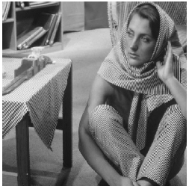
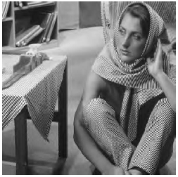
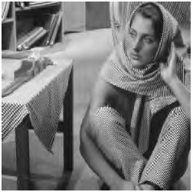

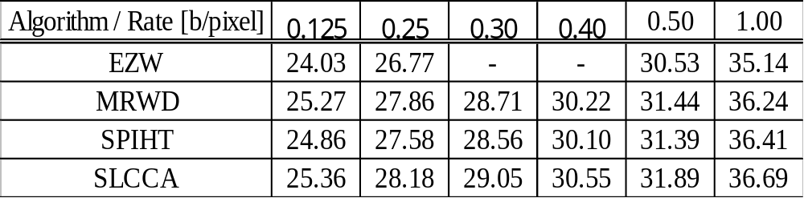
實驗結果
original
0.5 b.p.p.
0.25 b.p.p.
0.125 b.p.p.

Slide 20
