Slide 1
Chapter 8
An Improvement of Bottom-Up Variable-Sized Block Matching Technique for Video Compression

Slide 2
Contents
Introduction
Previous Works
Dynamic-Shaped Block Matching (DSBM)
Experimental Results
Conclusions

Slide 3
Introduction
Video compression has been widely used in our daily life
A video is composed of many continuous images (i.e. frames)
People usually use the similarity between frame (t-1) and frame (t) to compress video
This scheme is called the block matching

Slide 4
Previous Works
Fixed-Sized Block Matching (FSBM)
Top-Down Variable-Sized Block Matching (TDVSBM)
Bottom-Up Variable-Sized Block Matching (BUVSBM)

Slide 5
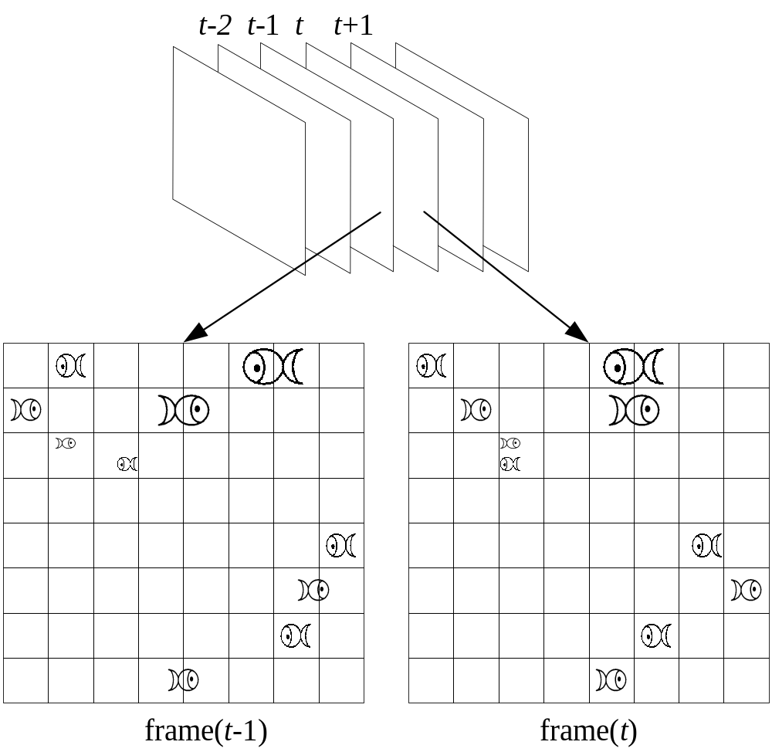
Fixed-Sized Block Matching (FSBM)
The block size of FSBM is constant

Slide 6
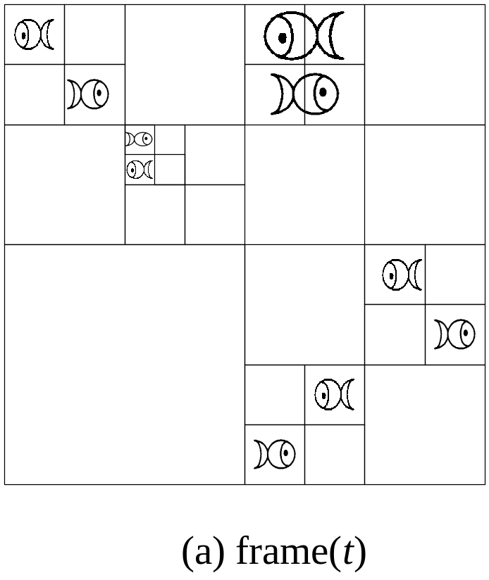
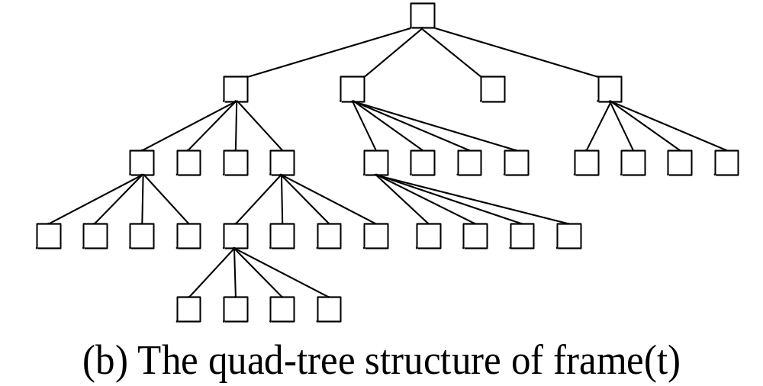
Top-Down Variable-Sized Block Matching (TDVSBM)
最後結果
The block shape of TDVSBM must be square.
The order of processing blocks is constant.
The number of blocks is limited.

Slide 7
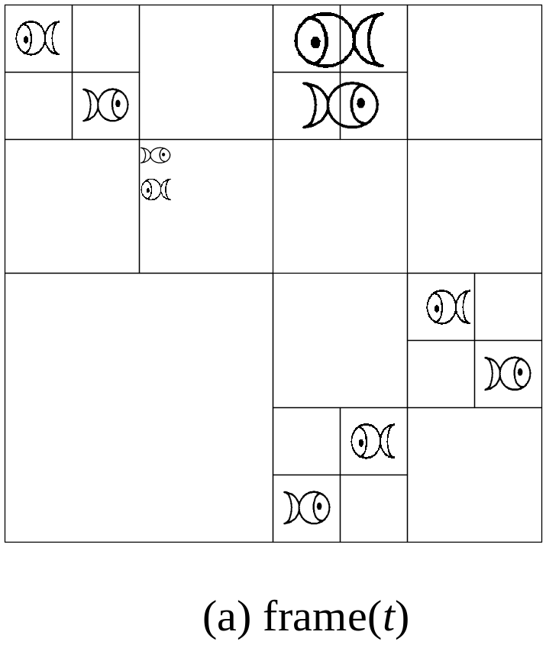
Top-Down Variable-Sized Block Matching (TDVSBM)
The block shape of TDVSBM must be square.
The order of processing blocks is constant.
The number of blocks is limited.
1 2
3 4

Slide 8
Top-Down Variable-Sized Block Matching (TDVSBM)
The block shape of TDVSBM must be square.
The order of processing blocks is constant.
The number of blocks is limited.
1 2
3 4
1 2
3 4

Slide 9
Top-Down Variable-Sized Block Matching (TDVSBM)
The block shape of TDVSBM must be square.
The order of processing blocks is constant.
The number of blocks is limited.
Stop?
1 2
3 4
1 2
3 4

Slide 10
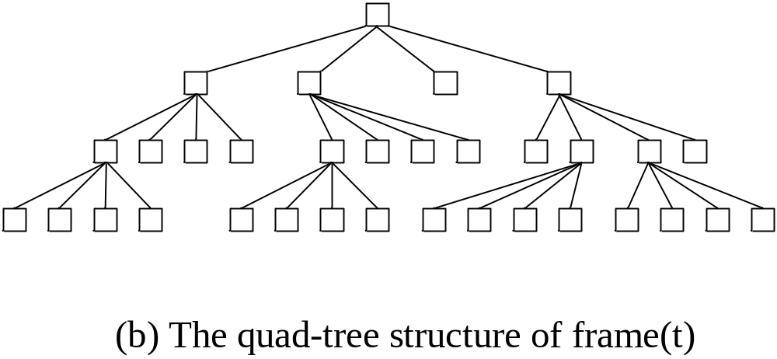
Bottom-Up Variable-Sized Block Matching (BUVSBM)
The block shape of BUVSBM must be square.
最後結果

Slide 11
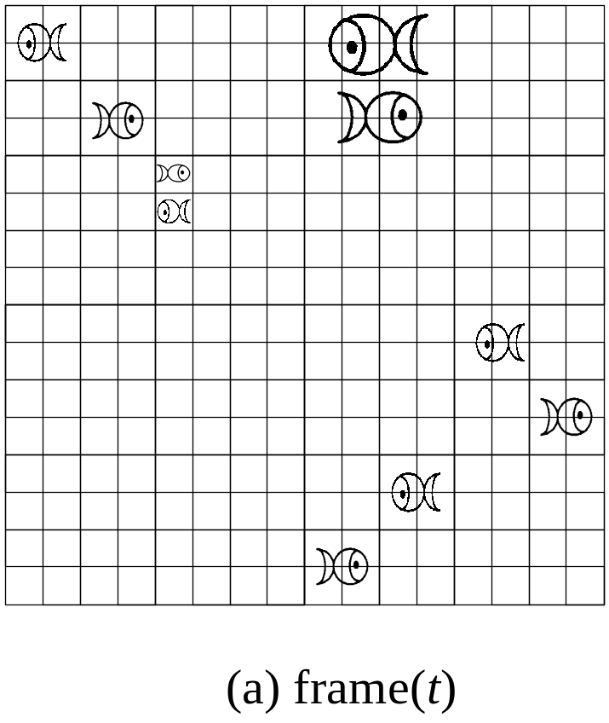
Bottom-Up Variable-Sized Block Matching (BUVSBM)
The block shape of BUVSBM must be square.

Slide 12
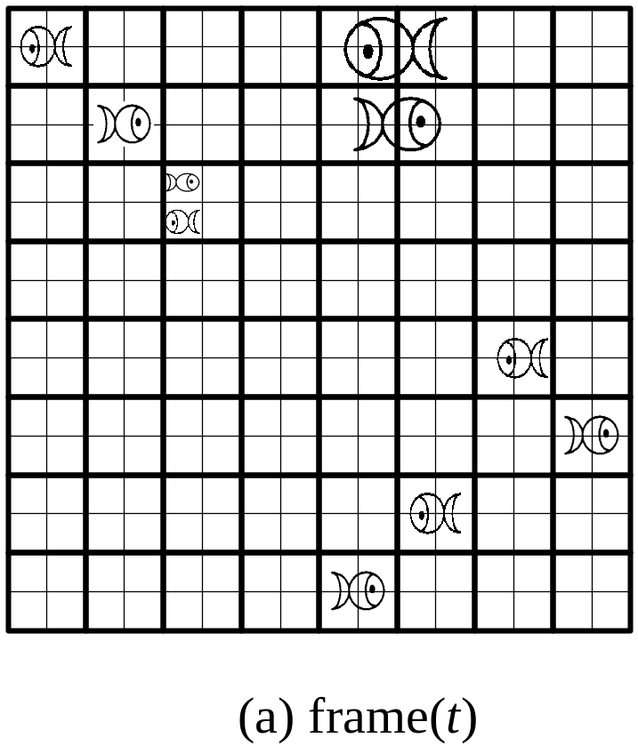
Bottom-Up Variable-Sized Block Matching (BUVSBM)
The block shape of BUVSBM must be square.

Slide 13
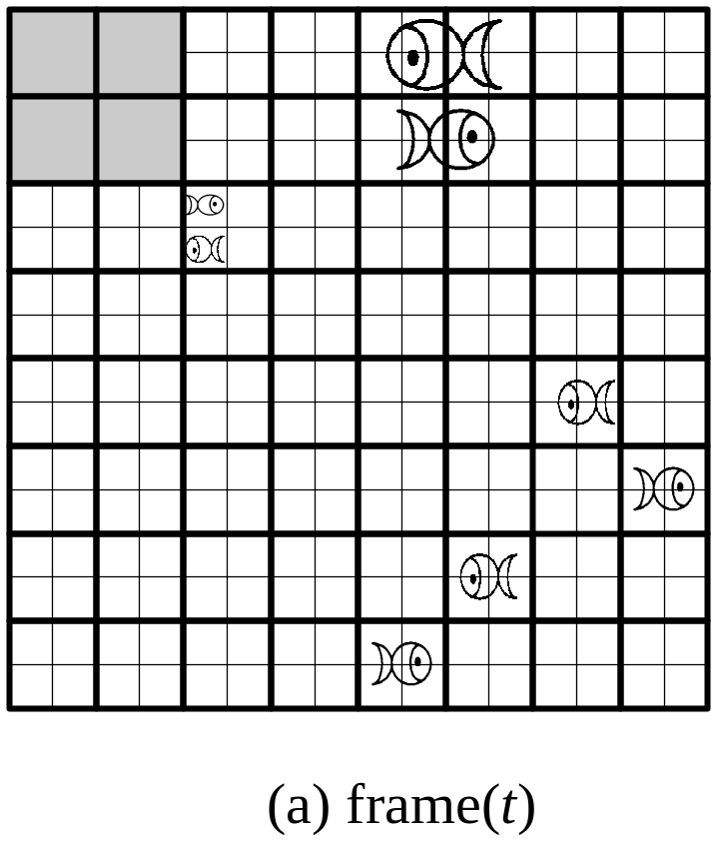
Bottom-Up Variable-Sized Block Matching (BUVSBM)
Stop?
The block shape of BUVSBM must be square.

Slide 14
Dynamic-Shaped Block Matching (DSBM)
Both TDVSBM and BUVSBM have the same weakness: Their block shape must be square
DSBM is derived from DUVSBM
DSBM considers all kinds of combinations of four leaf nodes, and tries to find a suitable combination for them

Slide 15
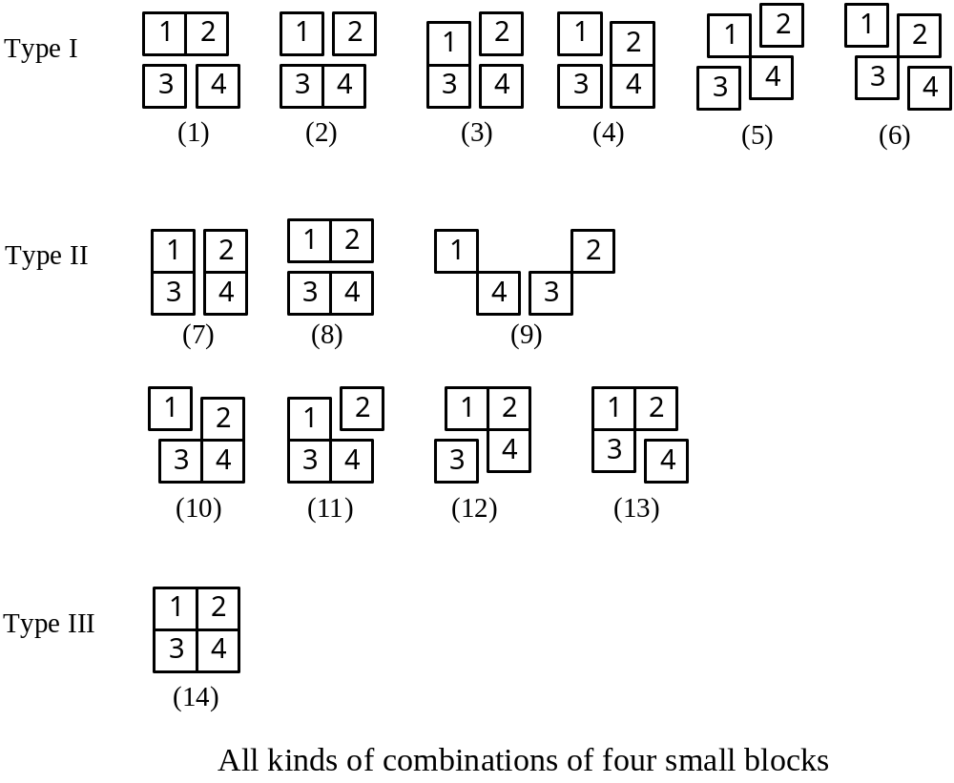

Slide 16
The requirement of the most suitable combination
The increase of MSE must be the smallest.
The decrease of the number of blocks must be the largest

Slide 17
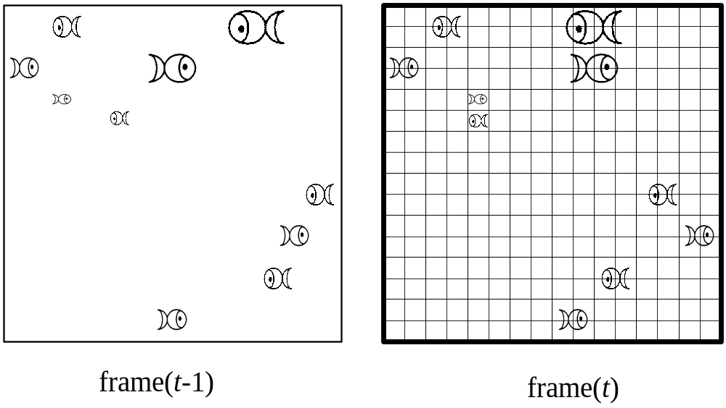
Example of DSBM

Slide 18
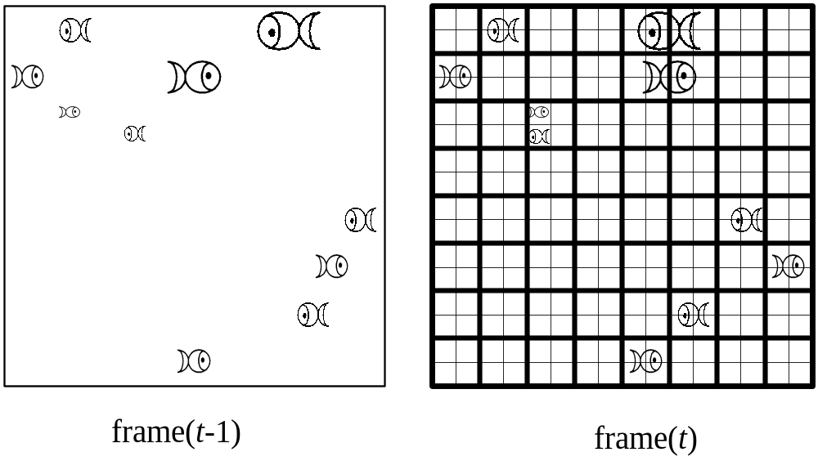
Example of DSBM

Slide 19
Example of DSBM

Slide 20
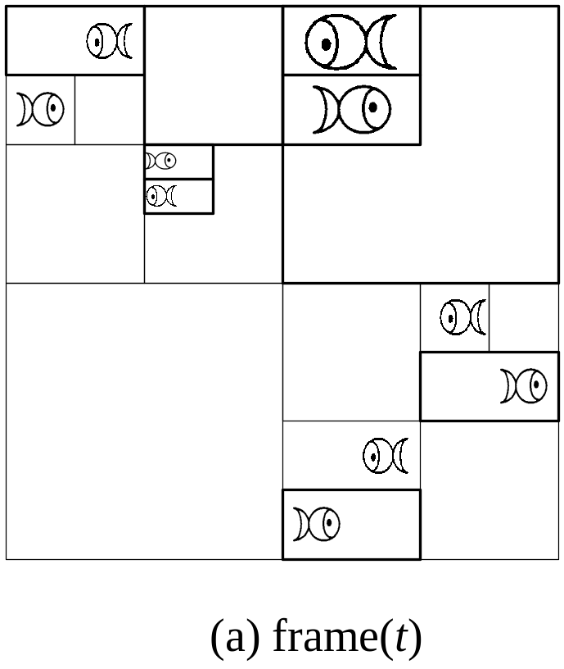
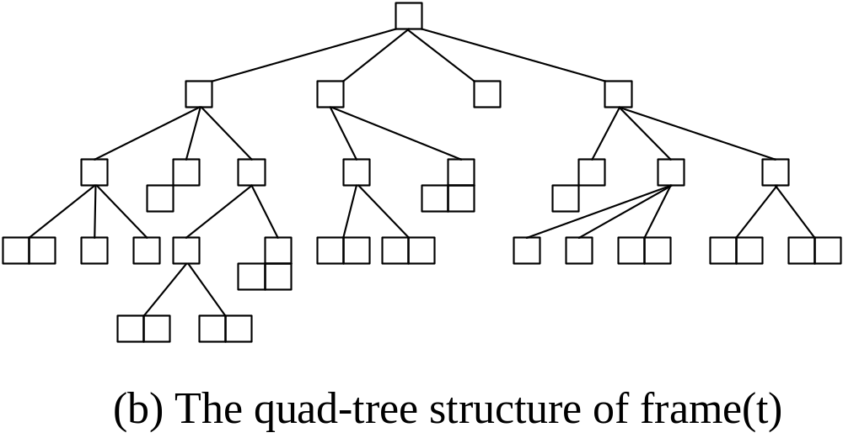
The Final Result of DSBM

Slide 21
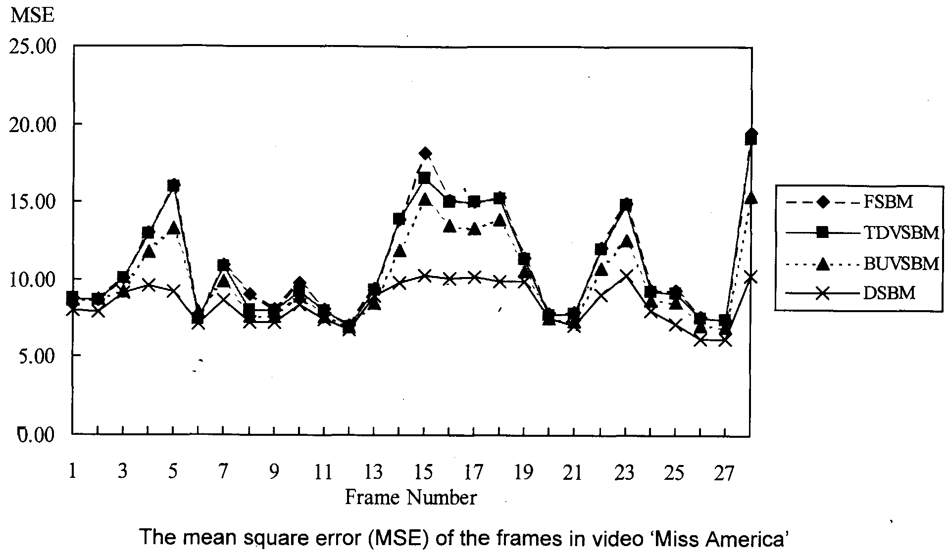

Slide 22
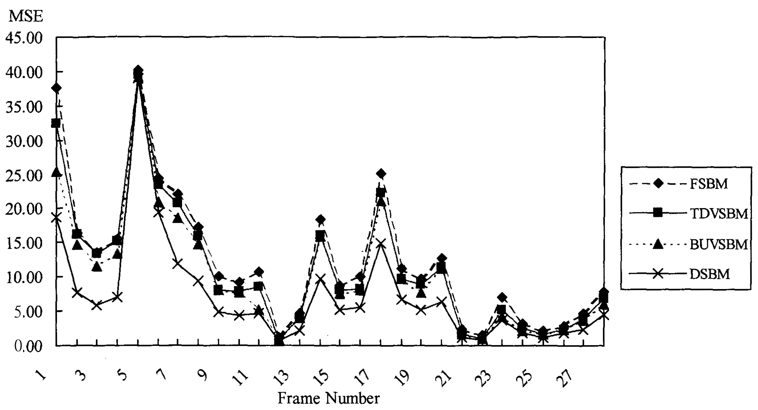
The mean square error (MSE) of the frames in video “claire”

Slide 23
Conclusions
We propose a new block matching method (I.e., DSBM) in this paper.
The block shape of this new method is dynamic.
The utility of blocks in DSBM is economic, and DSBM can use more blocks to describe the smaller moving objects.
DSBM is better than FSBM, TDVSBM, and BUVSBM in image quality.

