Slide 1
第 九 章
影像邊緣偵測

Slide 2
Outline
1. Introduction
2. Moment-Preserving threshold
3. Reduction of color space dimensionality
4. Color edge detection
5. Experimental results
6. Conclusions

Slide 3
Introduction
Edge detection is a basic operation in image processing.
It can be applied on image retrieval and pattern recognition.

Slide 4
Traditional Methods for Edge Detection
Edge location to subpixel values (ELTSV) method➔for gray–level images
Yang and Tsai’s edge detection method ➔for color images

Slide 5
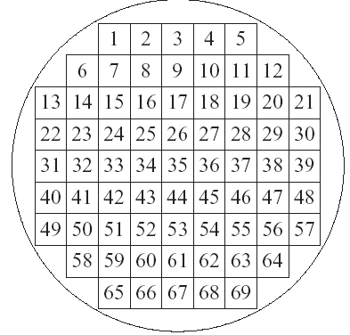
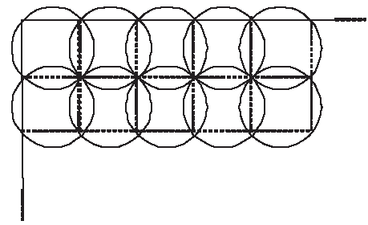
Edge Location to Subpixel Value(ELTSV)
ELTSV accepts a gray-level images and divides it into circles
Each circle consists of 69 pixels

Slide 6
ELTSV_{(for each circle)}
Two intensity levels h₁ and h₂ are calculated according to the moment-preserving principle.
If |h₁-h₂|≧δ,then there is an edge in the circle; otherwise, the circle will be skipped.
Here δ is the standard deviation of the pixel values in a circle.
ELTSV will identify an edge with a line equation for each circle.

Slide 7
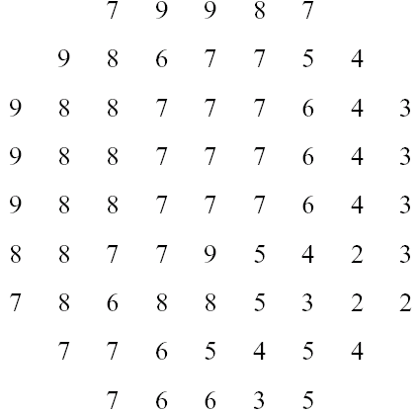
ELTSV_{(for example)}
In the following example, h₁, h₂ and δ are 7.7, 3.7 and 2, respectively.
Since |h₁-h₂|≧δ, an edge is there to separate the two intensity levels h₁ and h₂.
7.7
3.7
The gray values of a
set of grid squares
(b) An ideal border line
after edge detection

Slide 8
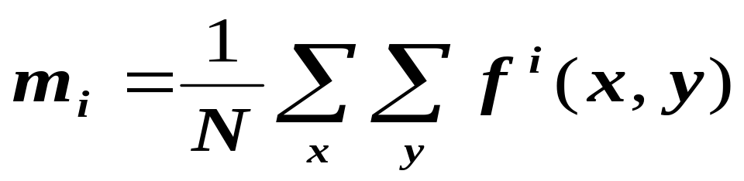
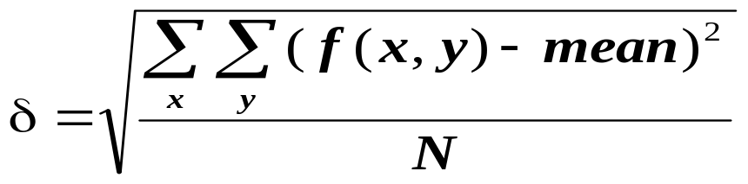
Moment-Preserving Principle
Given a gray-level image ƒ with N pixels whose gray-value at pixel is ƒ(x,y), the i^{th} moment of ƒ is
where i=0, 1,2, ….
p₁h₁+p₂h₂=m₁,
p₁h₁²+p₂h₂²=m₂,
p₁h₁³+p₂h₂³=m₃,
p₁+p₂=1,
where h₁ and h₂ are two level intensities of ƒ, p₁ and p₂ are the fractions of pixels of h₁ and h₂.
Standard deviation δ of the pixel values of the circle is

Slide 9
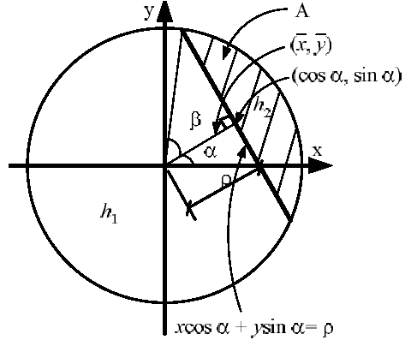
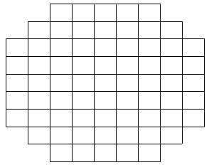
ELTSV_{(in details)}
y
(0,0)
x

Slide 10
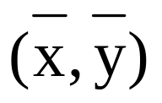
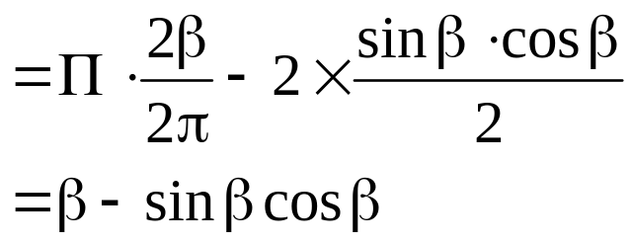
Gravity of gray values
α
A
β
ρ = cos β
xcosα+ysin α = ρ

Slide 11
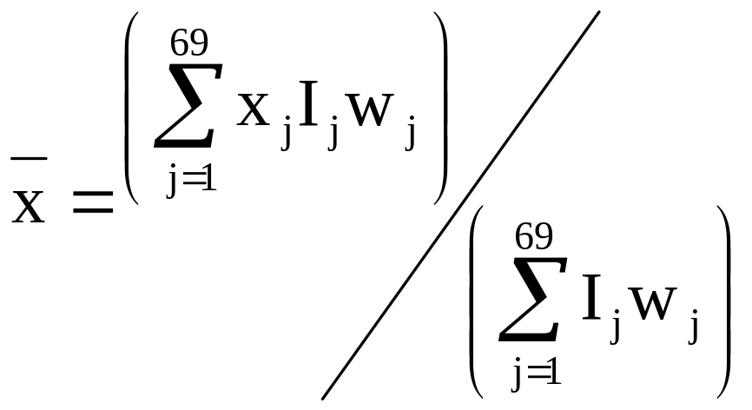
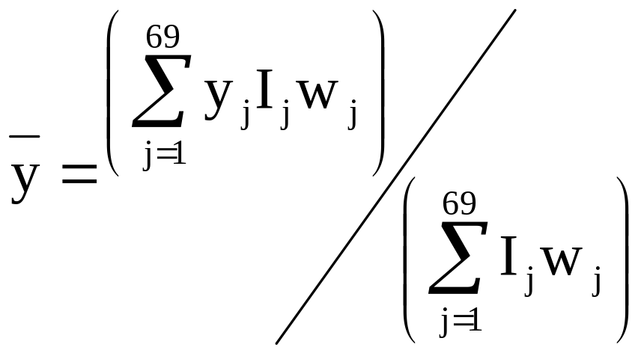
ELTSV_{(gravity of gray values)}
Let the coordinate of gravity of the gray values inside the circle be (x,y).
ELTSV calculates as follows:
Here j is the index of a pixel, (x_{j}, y_{j}) is the coordinate of the jth pixel based on (0,0), I_{j} is the intensity associated with the jth pixel, and w_{j} is the weight associated with the jth pixel.

Slide 12
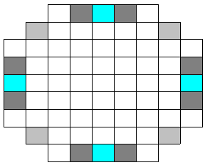
ELTSV_{(weights)}
Tabatabai and Mitchell defined the weights of the pixels in a circle as follows
  w2=w4=w22=w40=w68=w66=w48=w30=0.013782918,
  w3=w31=w39=w67=0.015573185 and
  w6=w58=w64=w12=0.013068037.
Except for the above, the weights of all the other pixels are assigned to be 0.015719006.

Slide 13
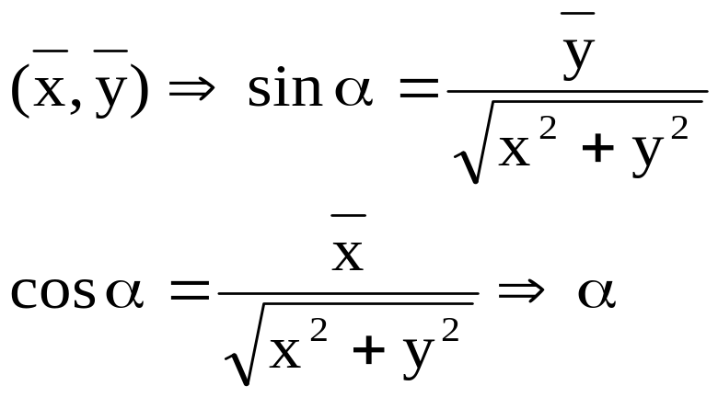
ELTSV_{(evaluations of α, β and ρ)}
Let the radius of the circle be unitary, and the angle βis set to be bounded by 0≦β ≦π/2. The the area A will be
A = β-1/2 sin 2β
Let p be the minimum of p1 and p2, where p1 and p2 are the fractions of a pixel with h1 and h2. The total area of the circle is π. Hence the area of A is πp. Hence β-1/2 sin 2β= πp➔β➔ρ=cos β

Slide 14
Yang and Tsai’s Method
Divide the input color image into blocks
For each block,
  Employed moment preserver for each color channel and obtained two intensity values for each color channel.
  (R, G, B) ➔ (R₁, G₁, B₁) and (R₂, G₂, B₂)
  Assign (R₁-R₂, G₁-G₂, B₁-B₂) to be the appropriate projection axis.
  Project the color pixels onto the axis.
Apply ELTSV on the projection results to detect the edge in each block.

Slide 15
Problems
ELTSV only works on gray-level images
Yang and Tsai’s method must draw out an appropriate projection axis for each block even if there is no edge in this block.
It is inefficient.
➔ An efficient Edge Detection Scheme of Color Images

Slide 16
Efficient Color Image Edge Detection (ECIED)
The proposed method employs two extra techniques to solve the above problems:
Principal Component Analysis
Two-level Quadtree Segmentation

Slide 17
PCA
The purpose of PCA is to find a vector D such that the projected values from vectors to D may maximally preserve the variances among vectors.
PCA first normalizes the vectors to have zero mean and unit variance. The convariance matrix of these normalized vectors is then obtained. PCA evaluates the eigenvalues λ₁, λ₂, …, λ_{n} of the covariance matrix, where λ₁≧λ₂ ≧ … ≧ λ_{n}, and obtains the corresponding eigenvectors D₁, D₂, … D_{n}.

Slide 18
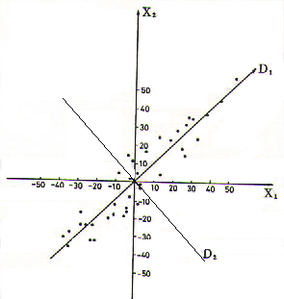
PCA
Most of the close vectors are also very close when they are projected onto D₁.
D₁ satisfies the requirement of PCA (D₁ = D).

Slide 19
PCA
PCA needs a lot of computation time
Experimental results have shown that, for image blocks, the central line direction is always close to D₁ of PCA.
PCA approximation axis is (1/3, 1/3, 1/3) in the proposed method.
The projection result of a color pixel (R_{ij}, G_{ij}, B_{ij}) is (R_{ij}+G_{ij}+B_{ij})/3.
This projection is simple and can be achieved fast.

Slide 20
Two-level Quadtree Segmentation
There are many smooth regions in an image which do not contain edges.
Yang and Tsai’s method ignores this property
Two-level quadtree segmentation will solve this problem.

Slide 21

TLQS (First level)
Divide the input color image into many big blocks (2n*2n pixels)
For each big block, if its standard deviation
> , transmit this block into the second level; otherwise, ignore this block since it is smooth.

Slide 22
TLQS (Second level)
Divide the input color image into many big blocks (2n*2n pixels)
For each big block, if its standard deviation
> , employ ELTSV to check and detect the edge of the smaller block; otherwise skip this block since it is smooth.

Slide 23
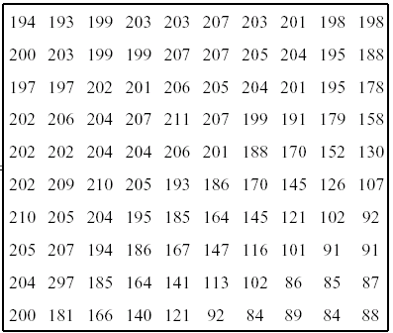
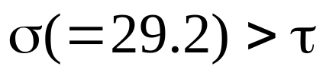
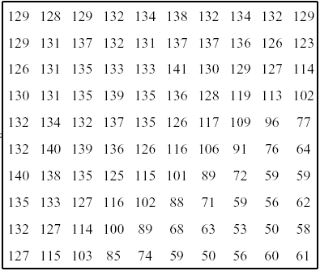
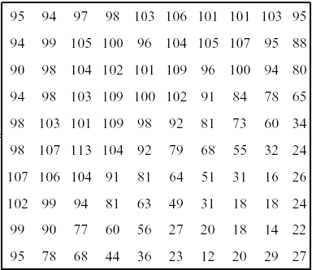
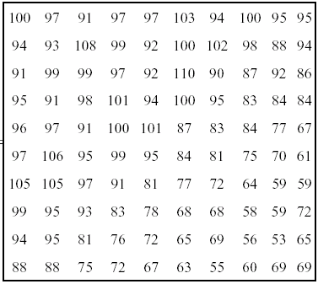
Assume = 12
1/3
1/3
1/3

Slide 24
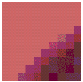
Assume = 12
1/3
1/3
1/3

Slide 25
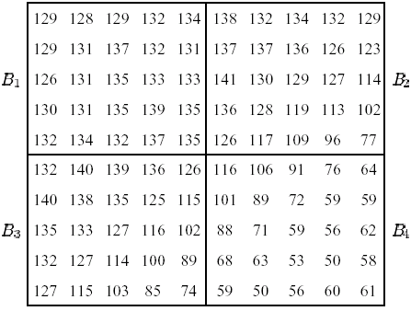






Example (cont.)
Since ₁ is smaller than , so B₁ can be skipped .
₂, ₃, and ₄ are greater than .
Thus, ELTSV will be performed on B₂, B₃, and B₄.

Slide 26
Experimental (environment)
CPU = Pentium MMX 300 CPU
RAM = 64 Mbytes
O.S. = MS Windows 98
N = 5 (i.e., big block = 10*10 pixles and smaller block = 5*5 pixels)
= 12
Each color image is of 512 * 512 pixles.
Each pixel has 24 bits; i.e., each channel (R, G, B) contains 8 bits.

Slide 27
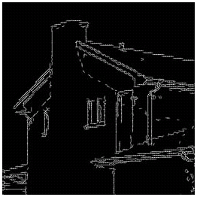
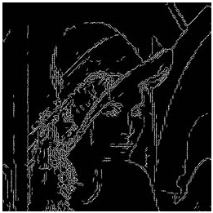
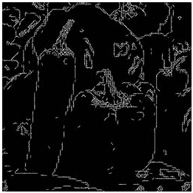
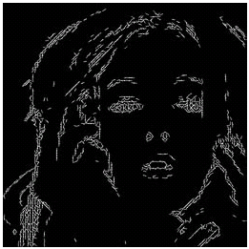
Experimental Results
The experimental results with Yang and Tsai’s method for color images

Slide 28
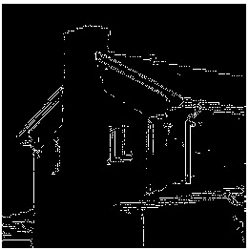
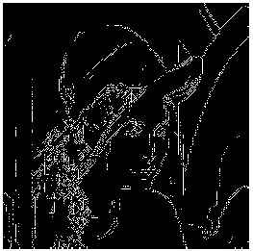
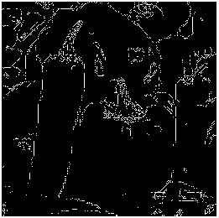
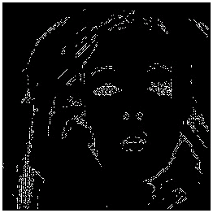
Experimental Results
The experimental results with ECIED method for color images

Slide 29
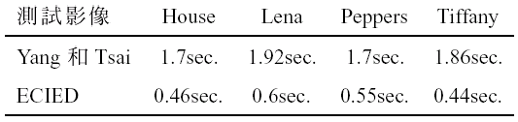
Experimental Results
The CPU time of edge detection for color images using Yang and Tsai’s method and the proposed method

Slide 30
Efficient Color Image Edge Detection (ECIED)
The proposed method employs PCA approximation axis and the two-level quardtree segmentation to save the computation cost.
We project the color pixel values onto the PCA approximation axis to reduce the three dimensions of color space to one dimension.
We further reduce the computation time and keep the quality of edge detection by applying the two-level quadtree segmentation.

Slide 31
Efficient Color Image Edge Detection (ECIED)
In experiments, the results of the edge detection of the method is similar to the results of Yang and Tsai’s method, but the method saves two – third the computation time of Yang and Tsai’s method.

Slide 32
Edge-based side match finite-state classified VQ (EBSMCVQ)
Combines SMVQ with CVQ (classified VQ)
  Nonedge blocks and edge blocks
Use quadtree data structure to reduce edge information
All the nonedge blocks are encoded before the edge blocks and using SMVQ with a smaller state codebook size.
Classify edge blocks into 16 subclasses according to characteristics, edge and nonedge of their neighboring blocks and use 16 master codebooks.

Slide 33
Edge-based side match finite-state classified VQ (EBSMCVQ)
共用了17本 codebook (每本 CB 有 256 cws)
有一本 for non-edge blocks
有 16 本 for edge blocks，至於用那一本 端看四周的block 之edge/ non-edge 型態
先送一張 edge map 給收方
(Transmitted)
a
(Transmitted)
b
(Non-Transmitted)
d
c
(Transmitted)
c

Slide 34
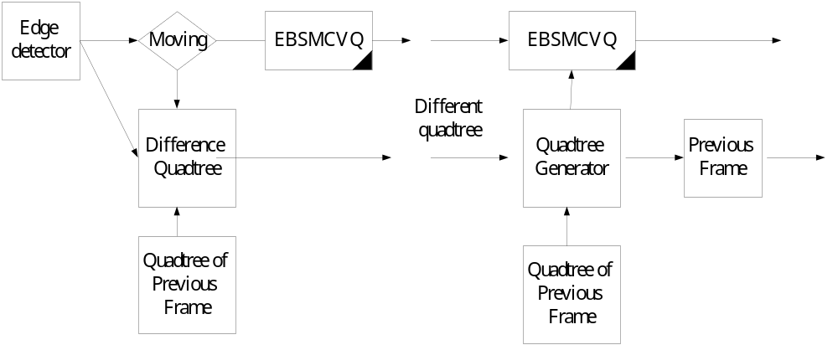
The encoder and decoder of the interfame difference quadtree EBSMCVQ

Slide 35
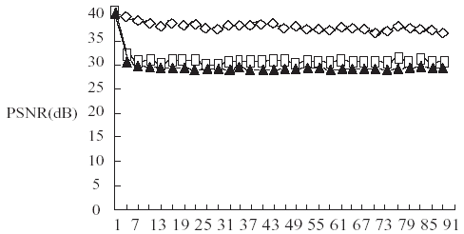
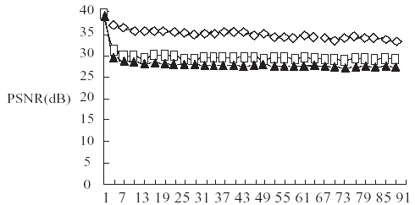

Slide 36
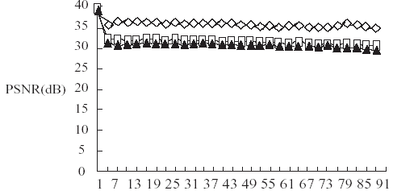
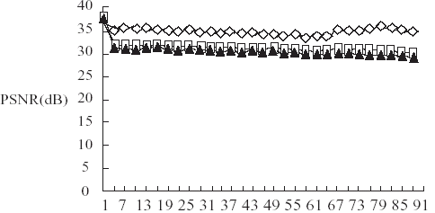

Slide 37
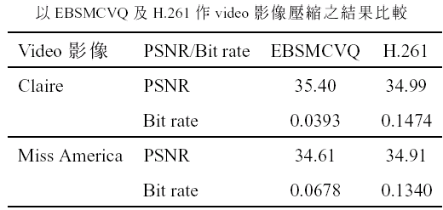

Slide 38
Apply the EBSMCVQ to image sequence coding
Only the moving blocks are encoded by EBSMCVQ
Use a new difference quadtree to reduce the information
Very suitable for very low bit rate image sequence encoding

