Slide 1
A Color Image Hiding Scheme Based on SMVQ and Modulo Operator
Authors: Chi-Shiang Chan and Chin-Chen Chang
Speaker: Chin-Chen Chang

Slide 2
Outline
1. Introduction-VQ
2. Related work-SMVQ 、CSMVQ
3. The proposed method
4. Experimental results
5. Conclusions

Slide 3
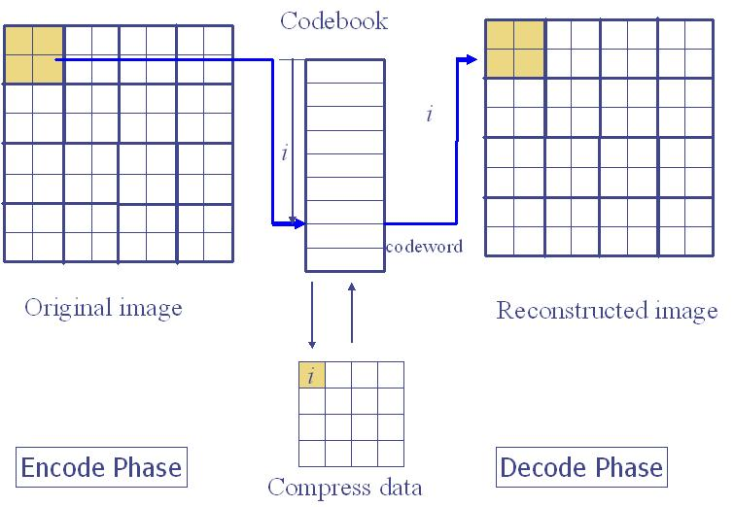
Introduction
- Vector Quantization (VQ)

Slide 4
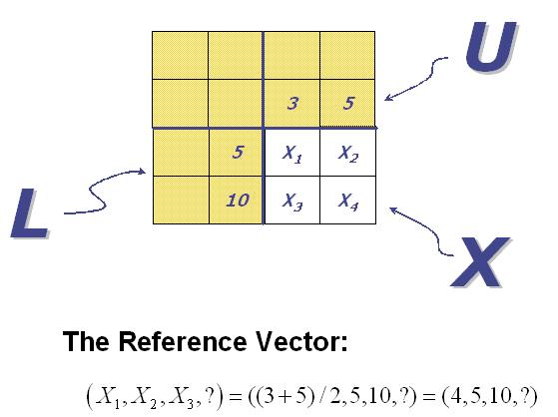

2.Related Work _{(1/3)}
-SMVQ
Notes:
There are two kinds of blocks in the image: seed blocks and residual blocks.
The blocks in the first row and first column are set as seed blocks. On the other hand, the other blocks, called residual blocks, are encoded by using a predictive method.

Slide 5
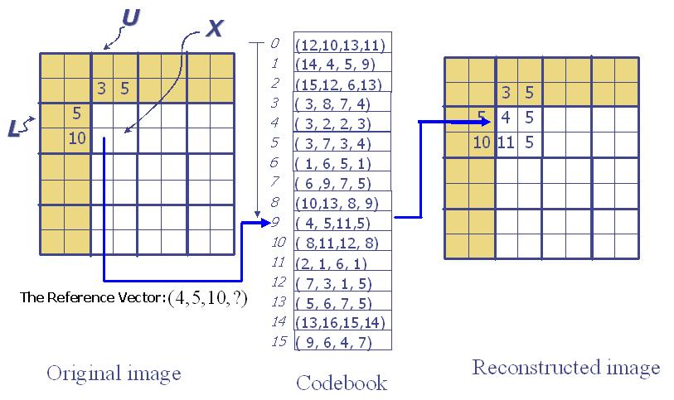
2.Related Work _{(2/3)}
-SMVQ
Notes:
Find the closest codeword according to the reference vector. If the mean square error is larger than a threshold, then the codeword found is set as a seed block. That means this block has to be encoded by using the VQ method. Otherwise, the codeword found is set as a residual block.

Slide 6
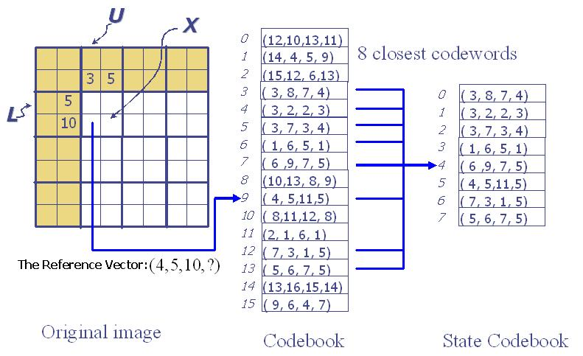
2.Related Work _{(3/3)}
-CSMVQ
Notes:
Find the n closest codeword according to the reference vector to form the State Codebook. The closest codeword in the state codebook can be picked out according to the original block. If the mean square error is unacceptable, we set this block as a seed block. Otherwise, record the index in the State Codebook.

Slide 7
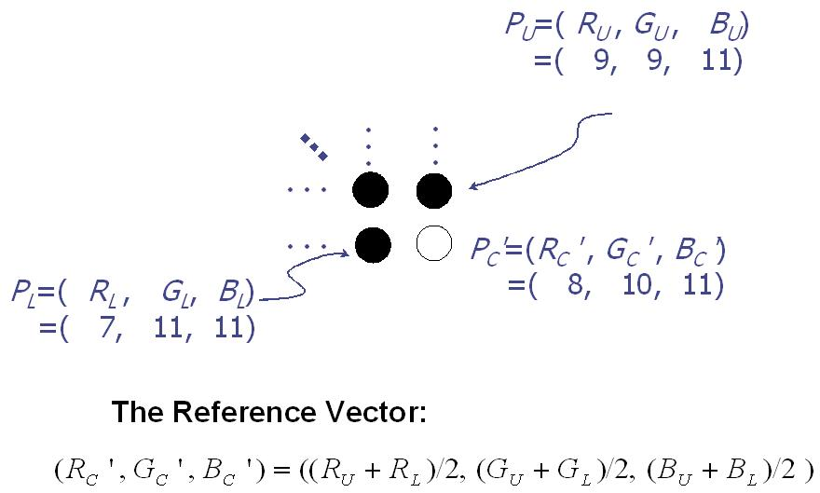
3. The proposed method_{(1/6)}
Notes:
Apply the concept of CSMVQ to encode a color host image. Meanwhile, a color secret image will be embedded into the color host image.

Slide 8
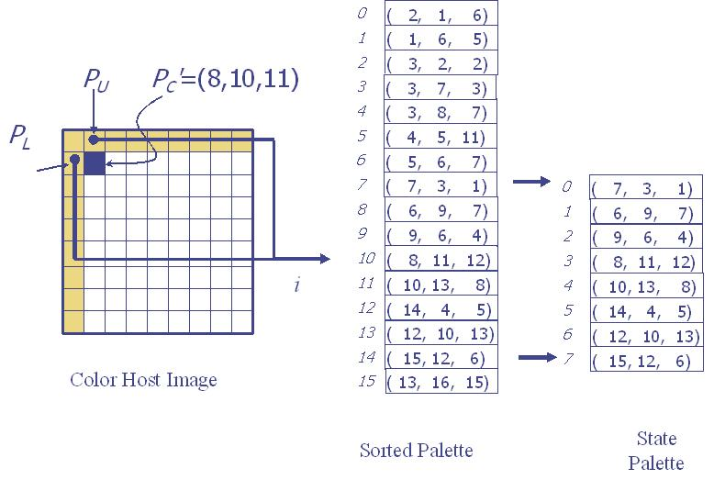
3. The proposed method _{(2/6)}
Notes:
For the reference vector, we search the sorted palette to find the most similar color pixel. Assume that the index of the most similar color pixel is i, and the size of the state palette is S. Then, we range the state palette from i- (S/2-1) to i+ (S/2).

Slide 9
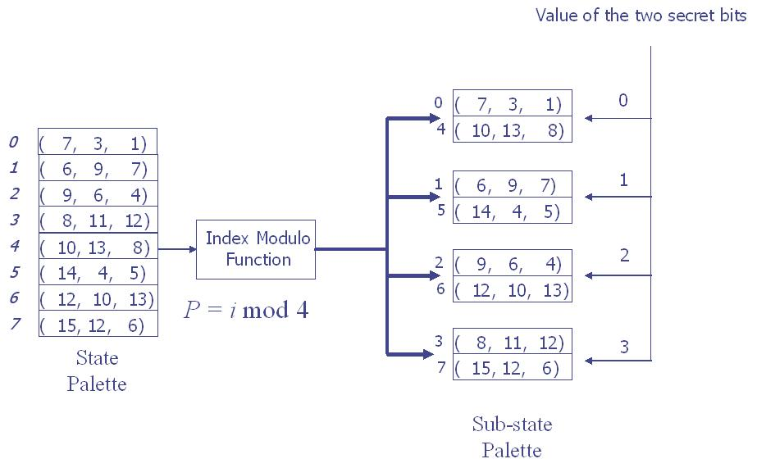
3. The proposed method _{(3/6)}
Notes:
The value i stands for the index value in the state codebook, and P is the index number of the sub-state codebook that index i belongs to. Moreover, the total number of sub-state palettes is N .
If the value of the two bits in the secret bit stream is 3, then we search the third sub-state palette to find the closet codeword. If the closest color pixel is still far away from the original color pixel, we set this color pixel as a seed pixel. Otherwise, we set this color pixel as a residual pixel and record its index in the sub-state palette.

Slide 10
3. The proposed method
-Sort Algorithm _{(4/6)}
Luminance-sorted Algorithm
Red pixel value
Blue pixel value
Luminance value
Green pixel value

Slide 11
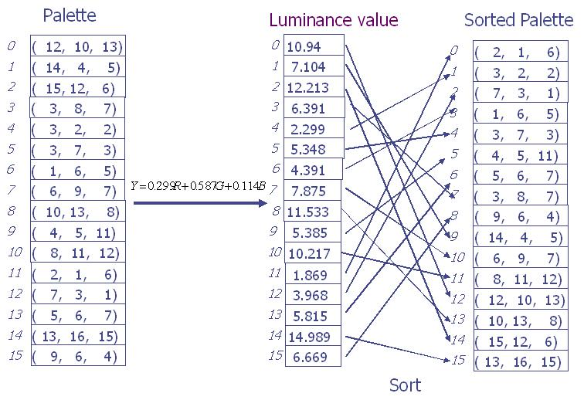
3. The proposed method
-Sort Algorithm _{(4/6)}
Luminance-sorted Algorithm

Slide 12
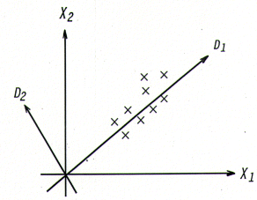
3. The proposed method
-Sort Algorithm _{(5/6)}
PCA-sorted Algorithm

Slide 13
3. The proposed method _{(6/6)}
-The Extraction Procedure
State palette
Secret bit stream
( i mod N)
Get a color pixel from the state palette
no
Compress
code
Seed
pixel?
Reconstruct
a color pixel
yes
Get a color pixel from the palette
Notes:
Assume that the index is i. Then, we can get the color pixel through the index i and the state palette. Moreover, the value of secret bits can be calculated by the modulo formula ( i mod N ).

Slide 14
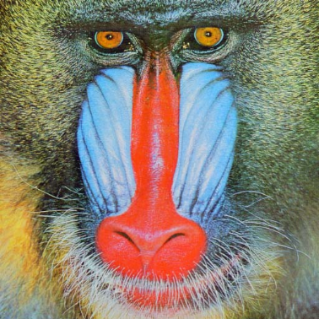

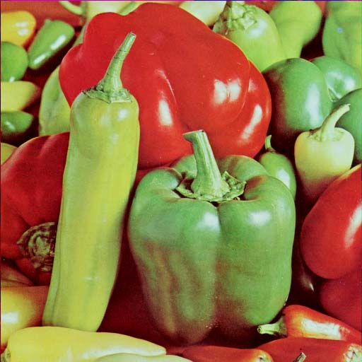

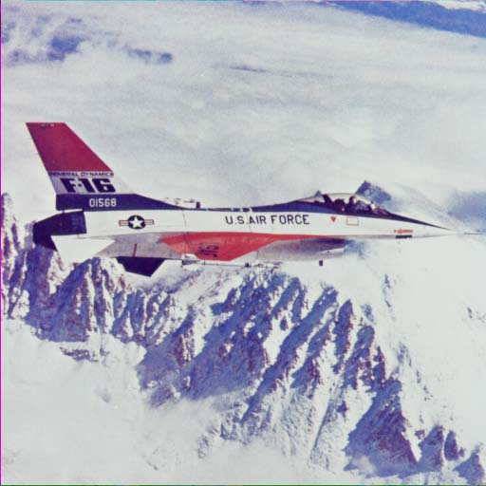
4. Experimental results (1/5)
The color host images with size 512 × 512
Baboon
Lena
Pepper
The color secret images with size 128 × 128
Tiffany
Jet

Slide 15
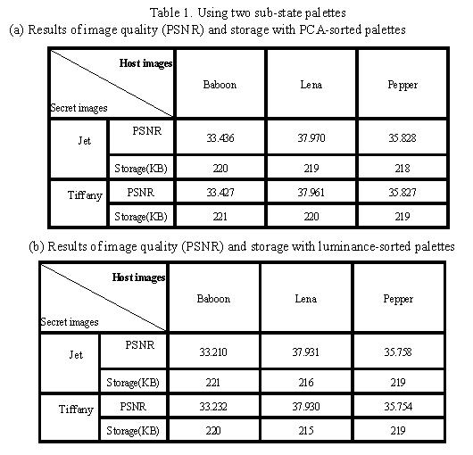
4. Experimental results (2/5)
Notes:
In our procedure, the state palette is obtained by putting together continuous indices. This way, the sorting algorithm puts similar color pixels as close as possible, so that we have the biggest chance to put a suitable color pixel in the state palette. In order to show the influence different sorting algorithms have on the image quality and storage space, in our experiment, the palette was sorted by the PCA sorting technique and by the luminance value.
Table 1 shows the results of partitioning the state palette into two sub-state palettes. In the tables, the PSNR values came from the original color host images and decoded color host images. In addition, the tables also show the storage space taken up by the compression code.

Slide 16
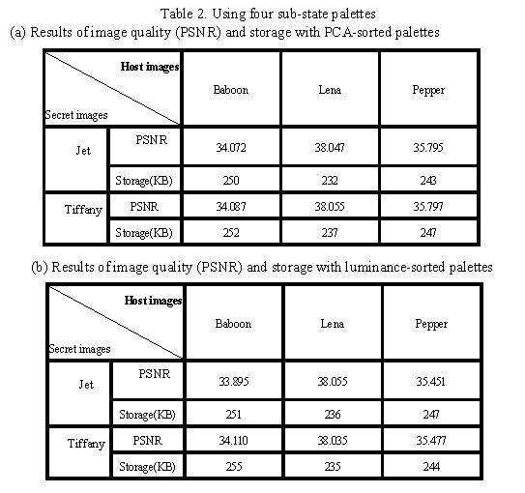
4. Experimental results (3/5)
Notes:
Table 2 shows the partitioning of the state palette into four sub-state palettes.
According to the tables, the color host images with PCA-sorted palettes have better quality and do not occupy much storage space in most cases.
Another difference between Table 1 and Table 2 is that the storage needed in Tables 2 is larger than that in Table 1. The reason is that the results in Table 2 came from partitioning the palette into four sub-state palettes. However, the cost to pay for this is that the probability of finding a suitable color in one sub-state palette became lower. The whole palette is searched to find the closest color and have its index recorded with eight bits. As a result, the storage needs rise up in the most cases.

Slide 17
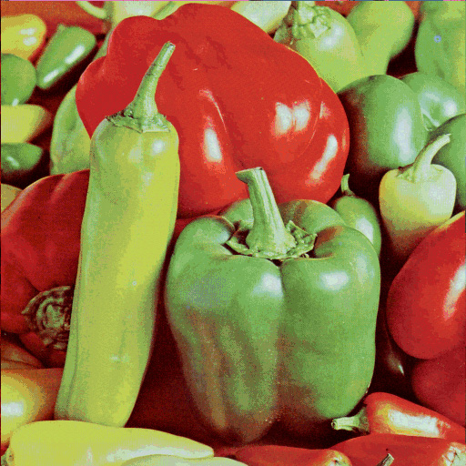
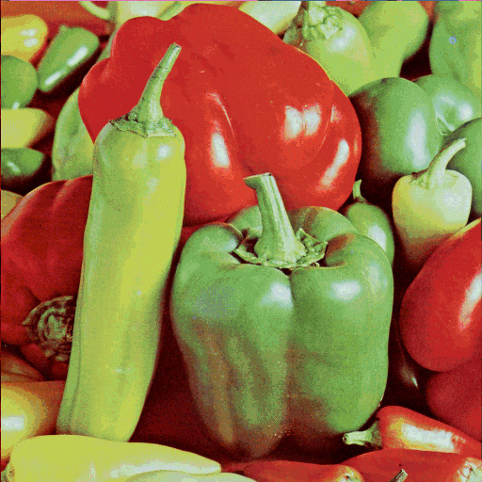
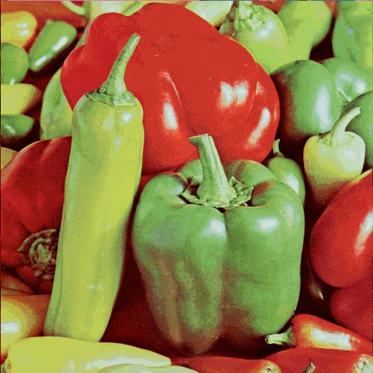

4. Experimental results (4/5)
-The decoded color host images
The result with two sub-state palettes by PCA-sorting
The result with two sub-state palettes by luminance -sorting
The result with four sub-state palettes by PCA-sorting
The result with four sub-state palettes by luminance -sorting

Slide 18


4. Experimental results (5/5)
-The Reconstructed color secret image
Notes:
According to the experimental results, by using our mew method, we can obtain both good decoded color host image quality and good reconstructed color secret image quality.

Slide 19
5.Conclusions
1. A novel method to hide a color secret image
2. Good color stego-image quality and good reconstructed color secret image quality

