Slide 1
A Content-Based Image Authentication System
With Lossless Data Hiding
Authors: Dekun Zou, Chai Wah Wu, Guorong Xuan, Yun Q. Shi
Source : Multimedia and Expo, 2003. ICME '03. Proceedings.
2003 International Conference on ,
Volume: 2 , 6-9 July 2003 Pages:213 – 216
Speaker: Jui-Yi Chang
Advisor: Chin-Chen Chang
Date: 2004/4/28

Slide 2
Introduction
Authentication of multimedia data provides an answer to protect the data integrity of it.
Two problem:
a. How tolerant is it to minor modifications?
b. how hard is it to forge an authentic image?
Extend the approach in the other papers to watermarking or data hiding solutions by combining it with a lossless data hiding technique and demonstrate its robustness and effectiveness.

Slide 3
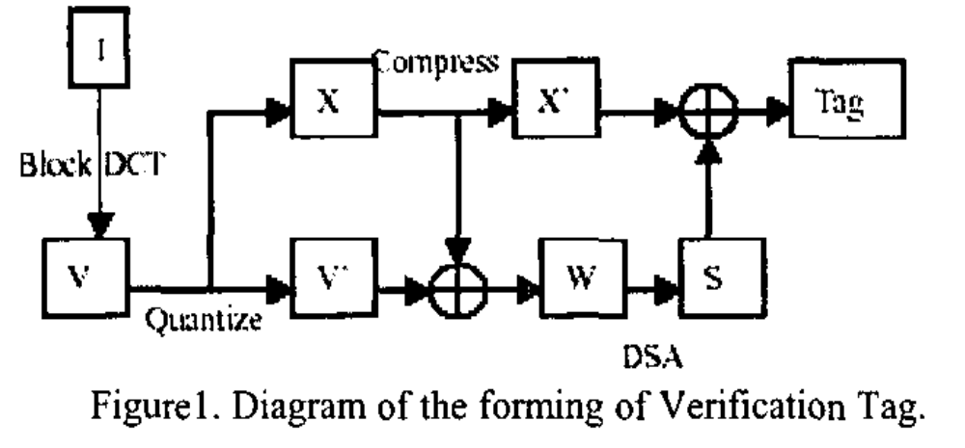
Generation of information for authentication
I: original image
Vector V: feature vector Index vector X: stored quantization function
Vector V’: quantize feature vector V Index vector X’: compressed vector X

Slide 4
Tag Embedding (Cont.)
Using circular histogram algorithm.
Divided into 8 by 8 blocks.
The 64 pixels in each block are pseudo-randomly equally divided into group A and B.
For each group, the histogram of the gray scale value is mapped onto circle.
The gray level of pixels is quantized into Q ranges.
The size of a range is P=256/Q.

Slide 5
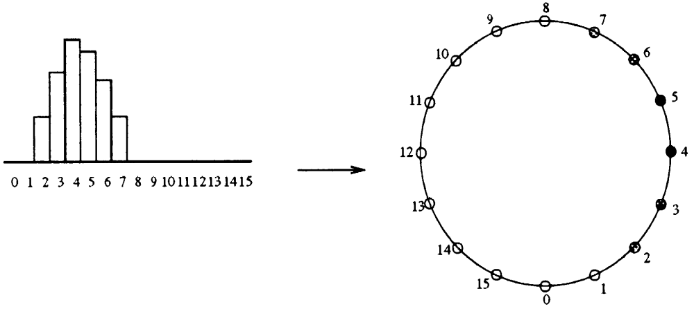
Tag Embedding (Cont.)
Circular histogram algorithm

Slide 6
Tag Embedding (Cont.)

Slide 7
Tag Embedding (Cont.)
To embed “1”
C’=C+P for pixels in group A
C’=C-P for pixels in group B
To embed “0”
C’=C-P for pixels in group A
C’=C+P for pixels in group B
C: the pixel value of the original image
C’: the pixel value of marked image
P: the step size (P=256/Q)

Slide 8
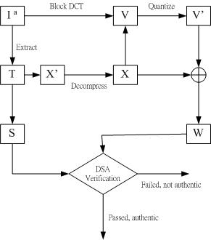
Verification procedure

Slide 9
Verification procedure (Cont.)
Result in failure of the verification:
(a) if the image is degraded too much so that the embedded tag could not be extracted correctly.
(b) When the tag extraction is correct, but the image is corrupted such that the quantized features do not verify with the extracted signature S.

Slide 10
Experiment Results (Cont.)
Table 1: Experiment Results of “Lena”
Lena Image | Authentication | PSNR(dB)
No JPEG | PASSED | Infinity
JPEG90 | PASSED | 38.72
JPEG80 | PASSED | 34.66
JPEG75 | PASSED | 33.14
JPEG70 | PASSED | 31.49
JPEG65 | FAILED | 29.86
Tampered | FAILED | 31.86

Slide 11
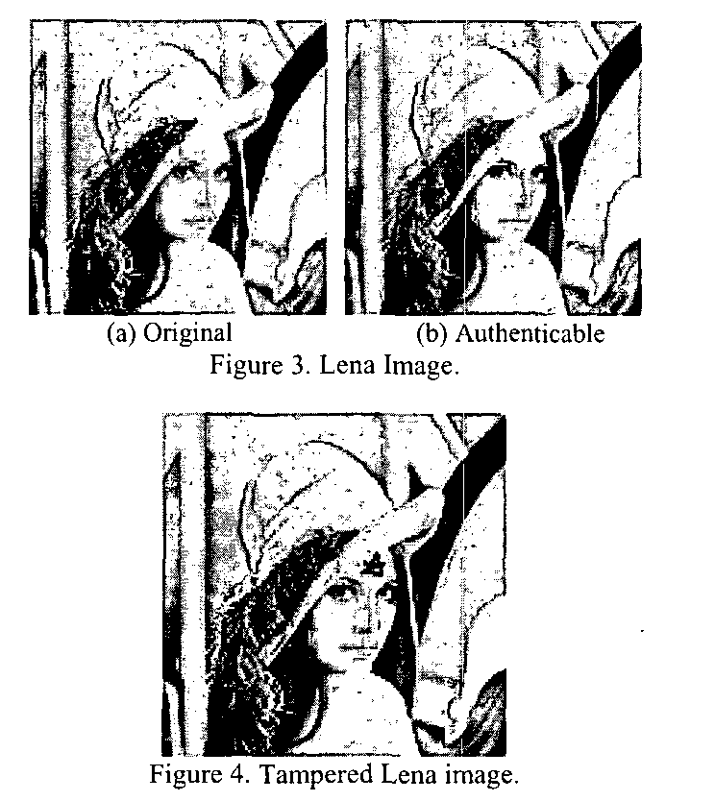

Slide 12
Experiment Results (Cont.)
Table 2: Experiment Results of “Baboon”
Lena Image | Authentication | PSNR(dB)
No JPEG | PASSED | Infinity
JPEG90 | PASSED | 36.68
JPEG85 | PASSED | 33.57
JPEG80 | PASSED | 31.74
JPEG75 | FAILED | 30.18
Tampered | FAILED | 33.59

Slide 13
Conclusions
This paper claim that the system can survive JPEG compression with quality factor 80.
This approach is not suitable for some images.
Future work:
(a) refining our method to applicable to more images.
(b) Increase the robustness of the system to tolerate lower JPEG compression quality factors.

Slide 14
Thank you !

