Slide 1
Structured Vector Quantization Using Linear Transforms
Author : Cagri O Etemoglu and Vladimir Cuperman
Source :IEEE Transaction on Signal Processing,
VOL.51, NO.6, JUNE 2003
Speaker :曾皇傑
Date :05/4/2004

Slide 2
Outline
VQ (vector quantization)
MSVQ (multi stage vector quantization)
ATVQ (affine transformation vector quantization)
SRMVQ (scaled rotation matrices vector quantization)
Performance

Slide 3
VQ
W
編碼簿
h
i
i
壓縮碼
原始影像

Slide 4
MSVQ
Input vector is quantized sequentially by a group of quantizers
--assume L-stage MSVQ
Best set of indices are used as encoding relation
--input vector X encoded into L indices
(i₀,i1,….,i_{L-1})

Slide 5
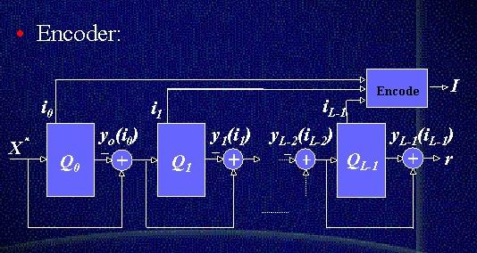
MSVQ

Slide 6
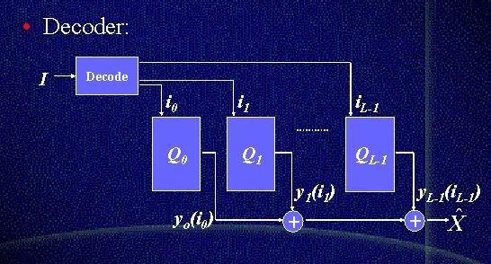
MSVQ

Slide 7
MSVQ
Example for two stage MSVQ
Input X=(10,20,15,30)
C_{1,5}=(6,10,11,20)
C_{2,20}=(5,8,2,11)
X-C_{1,5}=(4,10,4,10)
X
X’=(5,20)
=(11,18,13,31)
codebook1
codebook2

Slide 8
ATVQ
Linear transform matrix
Vector 1
Matrix 1
……
……
Vector N
Matrix N
Codebook i
Transform matrix codebook i

Slide 9
ATVQ
Input X=(10,20,15,30)
T_{1,5}*c_{2,9}=(4,10,4,10)
C_{1,5}=(6,10,11,20)
T1,i *
X
X’=(5,15)
codebook1
codebook2
New codebook2

Slide 10
ATVQ
MSVQ的結果可以寫成以下數學表示式
X’=∑C_{i} c_{i}:第i個編碼簿 L:stage的個數
例:x’=(5,20)=C_{1,5}+C_{2,20}=(6,10,11,20)+(5,8,2,11)=(11,18,13,31)
ATVQ的結果則是
X’=∑T_{i-1}C_{i} T_{j}:第J個linear transformation matrix code book
x’=(5,9)=C_{1,5}+T_{1,5}*C_{2,9}=
L
i=1
L
i=1
6 10 11 20
0 2 0 1
1 0 0 1
0 1 2 1
1 0 0 1
1 2 3 4
10 20 15 30
+
=

Slide 11
ATVQ-codebook training
T_{1,i}的第j個row,為r_{ij}^{T}的最小norm
r_{ij}^{T}=z_{ij}^{T}Y_{ij}⁺ j=1…M M:vector的維度
z_{ij}^{T}=[x_{1,j}…...x_{||Ui||,j}] - avg(X_{k,j}) X_{k,j} є U_{i}
Y_{ij}=[C_{2,1}……C_{2,||Ui||}] - avg(C_{2,k})
註:U_{i}=∪X_{i,j} ,Xi,j為input vector用到C₁第i個codeword且用
到C₂第j個codeword
N₂
J=1

Slide 12
ATVQ-codebook training
求C_{1,i}
C_{1,i}=avg(X - T₁C₂) X є U_{i}
求C_{2,j}
C_{2,,j}=min_norm(A⁺ b)
A= B= 註:V_{j}=∪X_{i,j}
X₁ - C_{1,1}
T_{1,1}
N₁
…..
…..
i=1
T_{1,||Vj||}
X_{||Vj||} - C_{1,||Vj||}

Slide 13
ATVQ-codebook training
Input set
Quantized set
Initial C₁ & T₁
Initial C₂
New C₁ & T₁
New C₂

Slide 14
SRMVQ
Scalar codebook & Rotation matrix codebook
Vector 1
scalar 1
RMatrix1
……
……
……
Vector N
scalar N
RMatrix N

Slide 15
SRMVQ
S_{1,5}*R_{1,5}*c2,9=(4,10,4,10)
C_{1,5}=(6,10,11,20)
S_{1,i} *R_{1,i}
X
X’=(5,15)
codebook1
codebook2
New codebook2

Slide 16
SRMVQ
Rotation Matrix 的結構
RM_{1,i}=Πθ_{i,j} M:vector的維度
每個θ_{i,j}是一個M*M的矩陣且代表旋轉α_{i,j}度
其形式為把一個單位矩陣的(1,1)(j+1,j+1)用
cos(α_{i,j})取代,(j+1,1)用sin(α_{i,j})取代,(1+1)用
-cos(α_{i,j})取代
M
J=1

Slide 17
SRMVQ
範例:設一vector維度為3
α_{i,1}=30 α_{i,2}=60
RM_{1,i}= cos30 -sin30 0 cos60 0 -sin60
sin30 cos30 0 0 1 0
0 0 1 sin60 0 cos60
在儲存RM時只要存一個連續sinα,cosα的資料而不用存整各M*M的矩陣

Slide 18
ATVQ與SRMVQ之儲存空間比較
Transform matrix codebook需要N₁*(M*M)
Scalar codebook需要N₁*1
Rotation matrix codebook需要N₁*2*(m-1)
N₁為codebook1之大小
ATVQ要:N₁(M²+M)+N₂M
SRMVQ要:N₁(3M-2)+N2M

Slide 19
Performance
Rate bits | Test 1 ATVQ MSVQ
10=5+5 | 15.99 15.73
12=6+6 | 16.97 16.55
14=7+7 | 17.97 17.40
Rate bits | Test 2 SRMVQ MSVQ
10=5+5 | 10.75 10.59
12=6+6 | 11.21 11.03
14=7+7 | 11.66 11.57
1
N-1
||S_{K}||²W_{K}
WSNR= ∑
N
||S_{K}-S_{K’}||²W_{K}
K=0

Slide 20
Performance
Complexity
MSVQ N1M+N2M multiplication
N1M+N2M+M addition
ATVQ N1M+N2(M2+M) multiplication
N1M+N2(M2+M-1)+M addition
SRMVQ N1M+N2(M+1)+4(M-1) multiplication
N1M+N2M+3M-2 addition

Slide 21
Performance
Vector dim (M) | Complexity ATVQ MSVQ | Memory (word) ATVQ MSVQ
M=48 | 79872 m 6144 m 78320 a 6128 a | 76800 3072
M=10 | 4480 m 1280 m 4106 a 1226 a | 3840 640

