Slide 1


數位浮水印
PSNR = 29.62 dB
正確率 99.95%

Slide 2
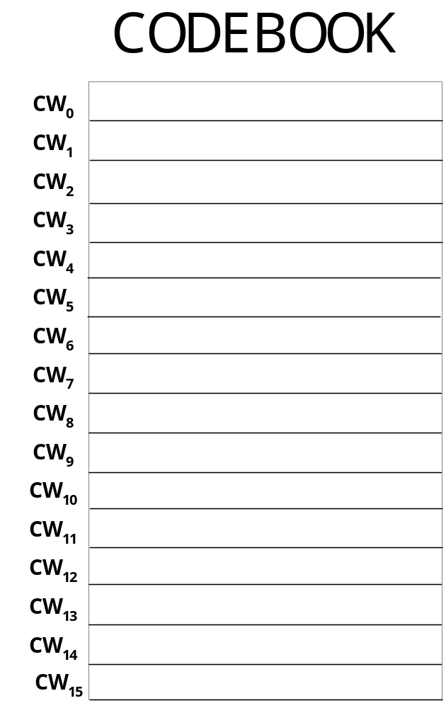
找出相近的Pairs

Slide 3
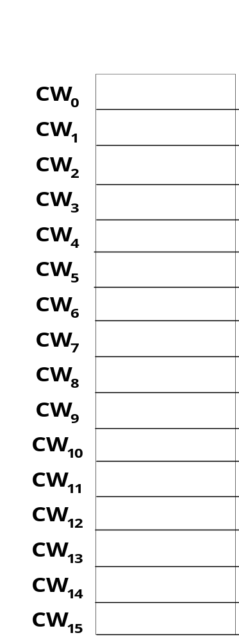
發現 d(CW₀, CW₈) > TH
d(CW₁₃, CW₁₄) > TH
CW₁
,CW₂
CW₄, CW₅
CW₆, CW₇
CW0, CW8, CW13, CW14
藏 1
CW₁₁
,CW₃
Unused
CW₁₅, CW₁₀
CW₁₂, CW₉
藏 0

Slide 4
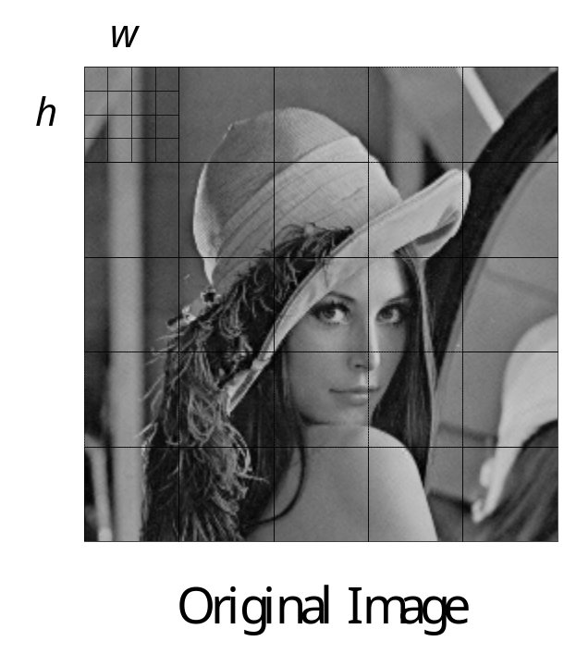
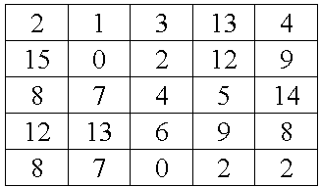
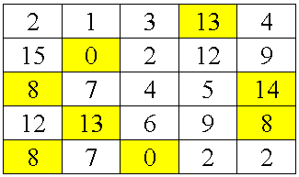
Encode
Index Table
CW0, CW8, CW13, CW14
Unused
Index Table

Slide 5
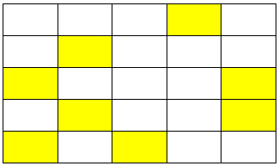
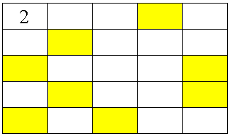
Water mark: 1 0 1 0 1 0 0 1 0 1 1 1 1 0 0
1
0
1
0
1
0
0
1
0
1
1
1
1
0
0
Index Table
Water mark
CW₁, CW₂,
CW₄, CW₅
CW₆, CW₇
CW₁₁, CW₃
CW₁₅, CW₁₀
CW₁₂, CW₉
藏 1
藏 0

Slide 6
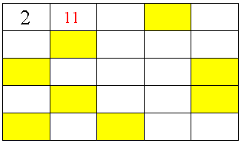
Water mark: 1 0 1 0 1 0 0 1 0 1 1 1 1 0 0
1
0
1
0
1
0
0
1
0
1
1
1
1
0
0
Index Table
Water mark
CW₁, CW₂,
CW₄, CW₅
CW₆, CW₇
CW₁₁, CW₃
CW₁₅, CW₁₀
CW₁₂, CW₉
藏 1
藏 0

Slide 7
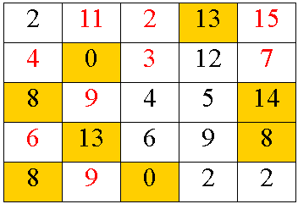
Water mark: 1 0 1 0 1 0 0 1 0 1 1 1 1 0 0
1
0
1
0
1
0
0
1
0
1
1
1
1
0
0
Index Table
Water mark

