Slide 1
反叢聚及其在資訊隱藏之應用
張 真 誠
逢甲大學 講座教授
中正大學 榮譽教授、合聘教授
清華大學 合聘教授

Slide 2

Data Hiding
Hiding system
Cover image
Stego image
1 0 1 0 1 0 0 1 0 1 1 1 1 0 0
Secret message

Slide 3
Cover Carriers
Image
Video
Sound
Text

Slide 4
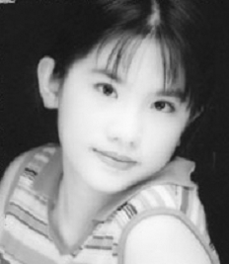
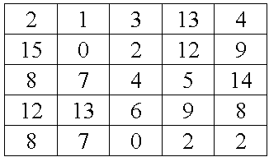
VQ Encoding
0
1
2
3
4
5
6
7
8
9
10
11
12
13
14
15
(120,155,…,80)
(90,135,…,120)
(100,125,…,150)
…
Index table
Original Image
(49,117,…,25)
(50,42,…,98)
(20,65,…,110)
Codebook

Slide 5
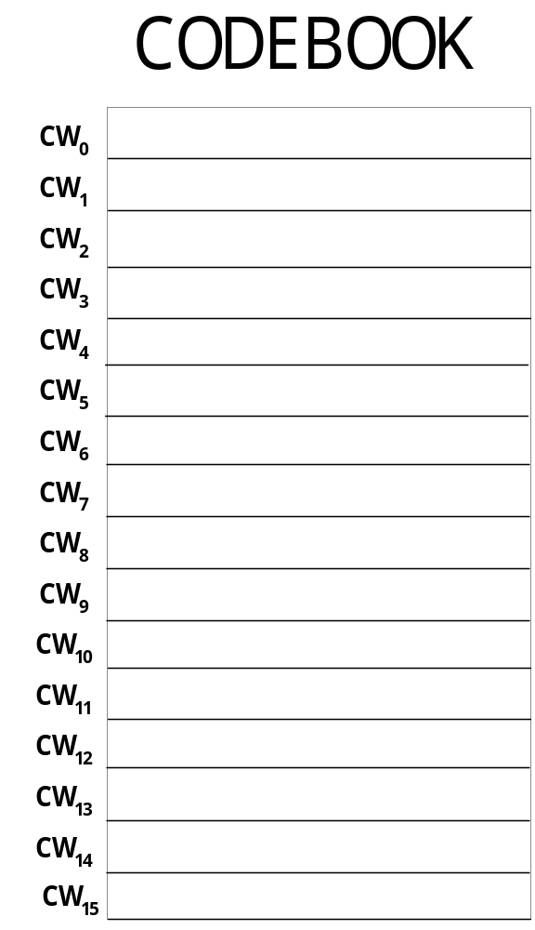
Previous Work of Steganography on VQ
To find the closest pairs

Slide 6
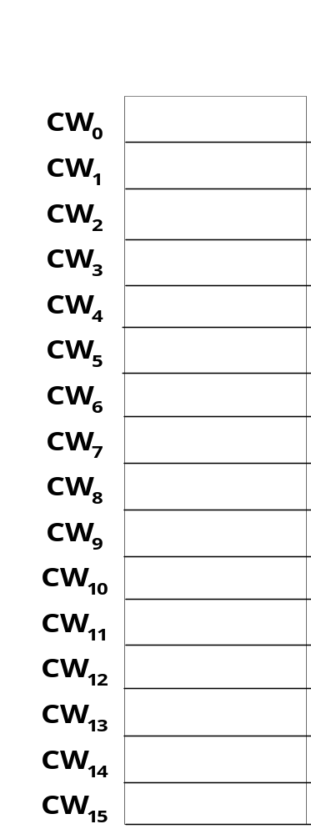
d(CW₀, CW₈) > TH
d(CW₁₃, CW₁₄) > TH
CW₁
,CW₂
CW₄, CW₅
CW₆, CW₇
CW₀,
CW₈, CW₁₃, CW₁₄
1
CW₁₁
,CW₃
Unused
CW₁₅, CW₁₀
CW₁₂, CW₉
0

Slide 7
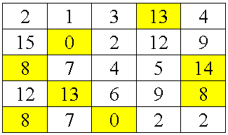
Encode
Index Table
Original Image
CW₀,
CW₈,
CW₁₃,
CW₁₄
Unused
Index Table

Slide 8
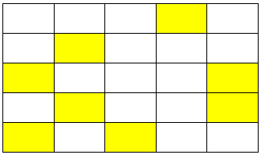
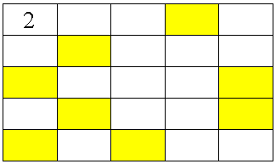
A secret message: 1 0 1 0 1 0 0 1 0 1 1 1 1 0 0
1
0
1
0
1
0
0
1
0
1
1
1
1
0
0
Index Table
Secret bits
CW₁, CW₂,
CW₄, CW₅
CW₆, CW₇
CW₁₁, CW₃
CW₁₅, CW₁₀
CW₁₂, CW₉
1
0

Slide 9
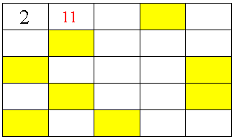
A secret message: 1 0 1 0 1 0 0 1 0 1 1 1 1 0 0
1
0
1
0
1
0
0
1
0
1
1
1
1
0
0
Index Table
Secret bits
CW₁, CW₂,
CW₄, CW₅
CW₆, CW₇
CW₁₁, CW₃
CW₁₅, CW₁₀
CW₁₂, CW₉
1
0

Slide 10
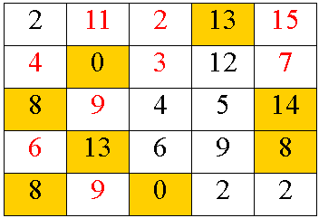
A secret message: 1 0 1 0 1 0 0 1 0 1 1 1 1 0 0
1
0
1
0
1
0
0
1
0
1
1
1
1
0
0
Index Table
Secret bits

Slide 11
Limitations of the Previous Work
Irreversible
  Original index values can not be recovered after extraction

Slide 12
Find the most dissimilar pairs
(De-clustering)
CW₁
CW₈
CW₂
CW₉
CW₃
CW₁₀
…
CW₄
CW₁₁
CW₅
CW₁₂
CW₆
CW₁₃
CW₇
CW₁₄
…
1
0
Dissimilar

Slide 13
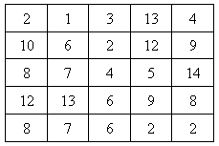
Encode
Index Table
Original Image

Slide 14
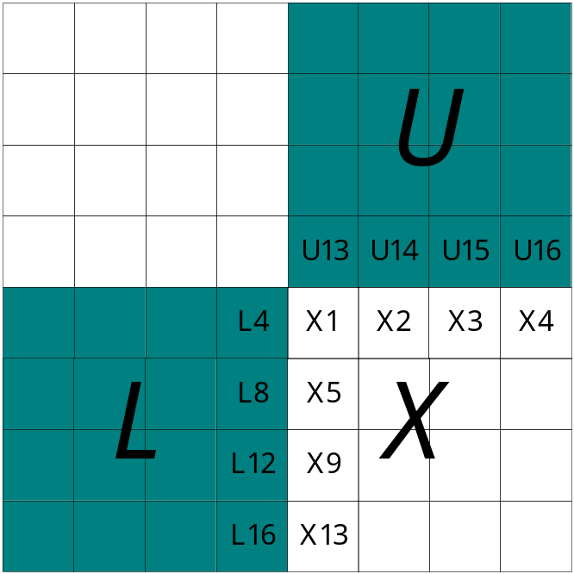
Embedding Using Side-Match
CW₁
CW₈
:Dissimilar Pair
Assume X = CW₁
V₀ = ((U13+L4)/2, U14, U15, U16, L8, L12, L16)
V₁ = (X1, X2, X3, X4, X5, X9, X13)_{CW1}
V₈ = (X1, X2, X3, X4, X5, X9, X13)_{CW8}
d₁=Euclidean_Distance(V₀, V₁)
d₈=Euclidean_Distance(V₀, V₈)
If (d₁<d₈), then Block X is replaceable
Otherwise, Block X is non-replaceable

Slide 15
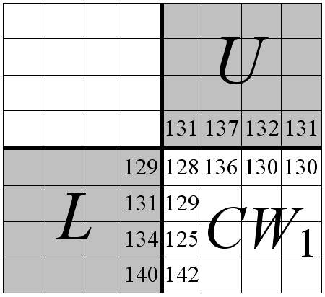
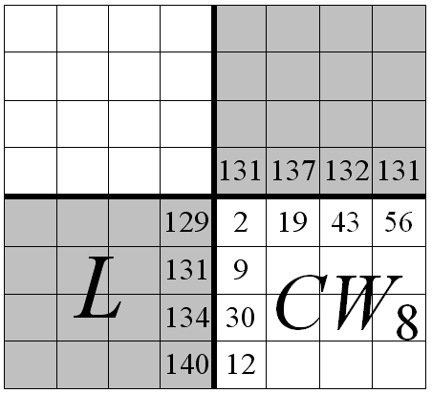
CW₁
CW₈
:Dissimilar Pair
V₀ = ((129+131)/2, 137, 132, 131, 131, 134, 140)
= (130, 137, 132, 131, 131, 134, 140)

Slide 16
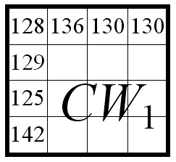
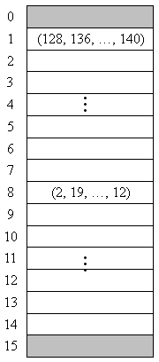
V₀ = (130, 137, 132, 131, 131, 134, 140)
(128,136,130,130,129,?,?,?,125,?,?,?,142,?,?,?)
V₁ = (128, 136, 130, 130, 129, 125, 142)
d₁=Euclidean_Distance(V₀, V₁)
=((130-128)²+(137-136)²+(132-130)²+(131-130)²+
(131-129)²+(134-125)²+(140-142)²)^{1/2}
=4.36
Codebook

Slide 17
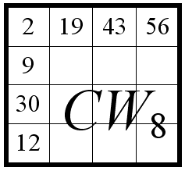
V₀ = (130, 137, 132, 131, 131, 134, 140)
d₁=4.36
(2, 19, 43, 56, 9, ?, ?, ?, 30, ?, ?, ?, 12, ?, ?, ?)
V₈ = (2, 19, 43, 56, 9, 30, 12)
d₈=Euclidean_Distance(V₀, V₈)
=((130-2)²+(137-19)²+(132-43)²+(131-56)²+
(131-9)²+(134-30)²+(140-12)²)^{1/2}
=293.15
Here, d₁ < d₈ => So block X is replaceable
Codebook

Slide 18
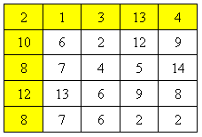
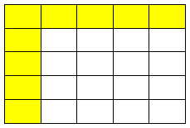
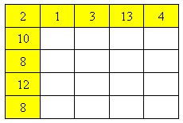
A secret message: 1 0 1 0 1 0 0 1 0 1 1 1 1 0 0 0
1
0
1
0
1
0
0
1
0
1
1
1
1
0
0
0
Index Table
Secret bits
If (d₆<d₁₃)
CW₁, CW₂,
CW₃, CW₄
CW₅, CW₆
CW₇ , CW₁₅
CW₈, CW₉
CW₁₀, CW₁₁
CW₁₂, CW₁₃
CW₁₄ , CW₀
6
1
0
Embedding Result

Slide 19
A secret message: 1 0 1 0 1 0 0 1 0 1 1 1 1 0 0 0
1
0
1
0
1
0
0
1
0
1
1
1
1
0
0
0
Index Table
Secret bits
If (d₂<d₉)
CW₁, CW₂,
CW₃, CW₄
CW₅, CW₆
CW₇, CW₁₅
CW₈, CW₉
CW₁₀, CW₁₁
CW₁₂, CW₁₃
CW₁₄ , CW₀
6
9
1
0
Embedding Result

Slide 20
A secret message: 1 0 1 0 1 0 0 1 0 1 1 1 1 0 0 0
1
0
1
0
1
0
0
1
0
1
1
1
1
0
0
0
Index Table
Secret bits
If (d₁₂>=d₅)
CW₁, CW₂,
CW₃, CW₄
CW₅, CW₆
CW₇ , CW₁₅
CW₈, CW₉
CW₁₀, CW₁₁
CW₁₂, CW₁₃
CW₁₄ , CW₀
6
9
15||12
1
0
Embedding Result
CW₁₅: embed 1

Slide 21
A secret message: 1 0 1 0 1 0 0 1 0 1 1 1 1 0 0 0
1
0
1
0
1
0
0
1
0
1
1
1
1
0
0
0
Index Table
Secret bits
If (d₉>=d₂)
CW₁, CW₂,
CW₃, CW₄
CW₅, CW₆
CW₇ , CW₁₅
CW₈, CW₉
CW₁₀, CW₁₁
CW₁₂, CW₁₃
CW₁₄ , CW₀
6
9
15||12
0||9
1
0
Embedding Result
CW₀: embed 0

Slide 22
Extraction and Recovery
6
9
15||12
0||9
1
Steganographic Index Table
Extract Secret bits
If (d₆<d₁₃)
CW₁, CW₂,
CW₃, CW₄
CW₅, CW₆
CW₇ , CW₁₅
CW₈, CW₉
CW₁₀, CW₁₁
CW₁₂, CW₁₃
CW₁₄ , CW₀
6
1
0
Recovery

Slide 23
Extraction and Recovery
6
9
15||12
0||9
1
0
Steganographic Index Table
Extract Secret bits
If (d₉>=d₂)
CW₁, CW₂,
CW₃, CW₄
CW₅, CW₆
CW₇ , CW₁₅
CW₈, CW₉
CW₁₀, CW₁₁
CW₁₂, CW₁₃
CW₁₄ , CW₀
6
2
1
0
Recovery

Slide 24
Extraction and Recovery
6
9
15||12
0||9
1
0
1
Steganographic Index Table
Extract Secret bits
CW₁, CW₂,
CW₃, CW₄
CW₅, CW₆
CW₇ , CW₁₅
CW₈, CW₉
CW₁₀, CW₁₁
CW₁₂, CW₁₃
CW₁₄ , CW₀
6
2
12
1
0
Recovery

Slide 25
Extraction and Recovery
6
9
15||12
0||9
1
0
1
0
Steganographic Index Table
Extract Secret bits
CW₁, CW₂,
CW₃, CW₄
CW₅, CW₆
CW₇ , CW₁₅
CW₈, CW₉
CW₁₀, CW₁₁
CW₁₂, CW₁₃
CW₁₄ , CW₀
6
2
12
9
1
0
Recovery

Slide 26
How to find the dissimilar pairs?
Codebook
CW₁
CW₂
CW₃
CW₄
CW₅
CW₆
CW₇
CW₈
CW₉
CW₁₀
CW₁₁
CW₁₂
CW₁₃
CW₁₄

Slide 27
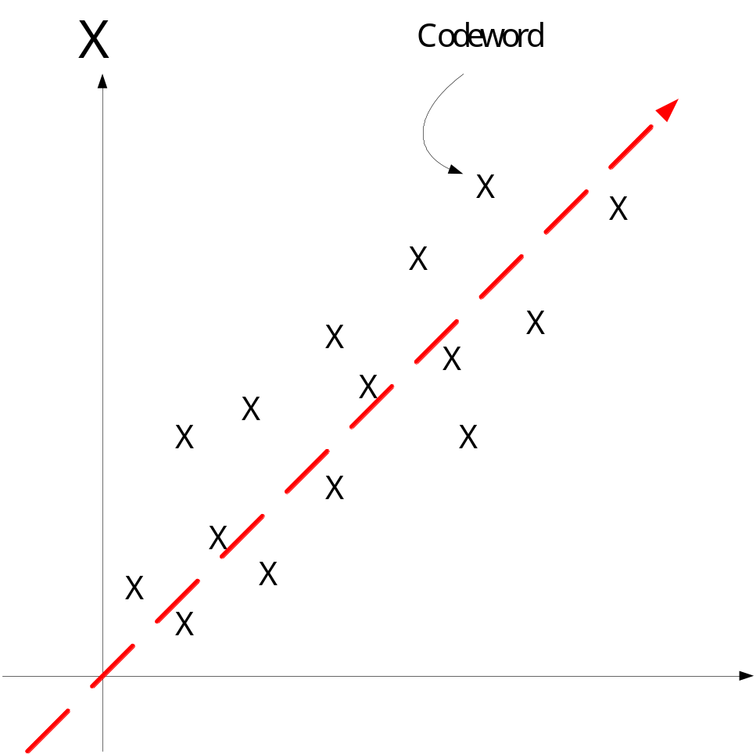
Codeword Distribution

Slide 28
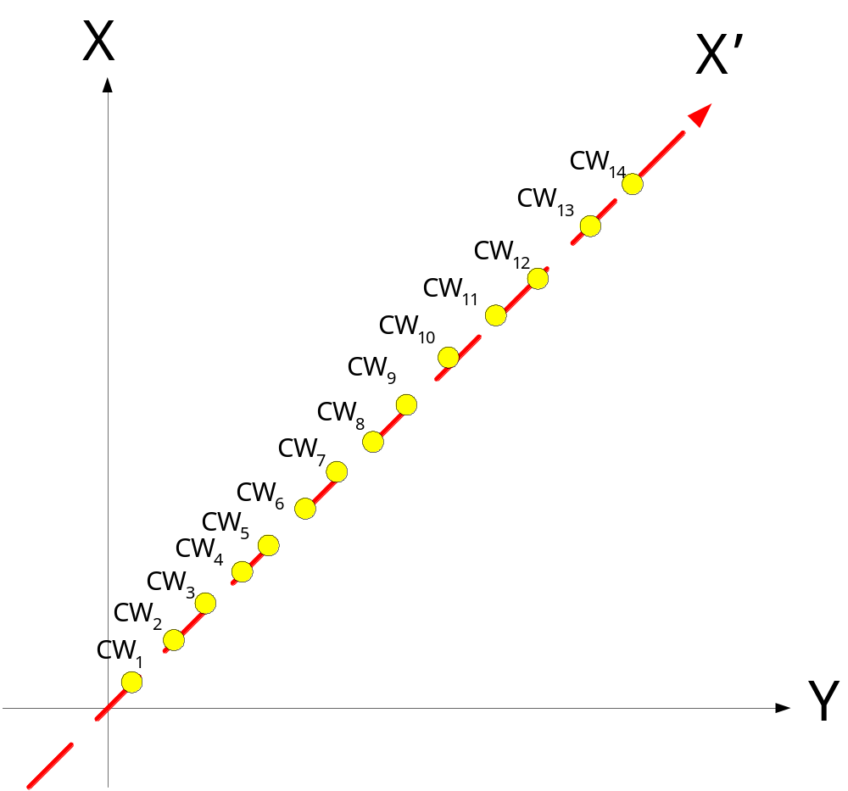
Codeword Projection by PCA
(Principle Component Analysis)

Slide 29
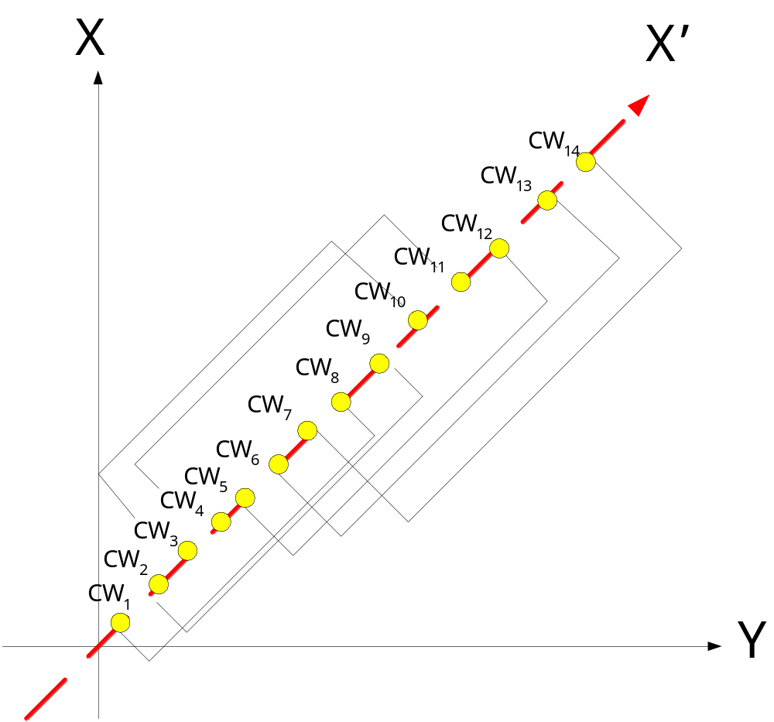
Find the Dissimilar Pairs

Slide 30

Experiments
Codebook size: 512
Codeword size: 16
The number of original image blocks:128*128=16384
The number of non-replaceable blocks: 139

Slide 31
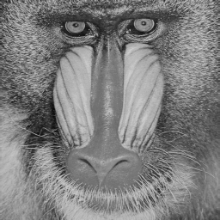
Experiments
Codebook size: 512
Codeword size: 16
The number of original image blocks:128*128=16384
The number of non-replaceable blocks: 458

Slide 32
Conclusions
A reversible VQ steganographic mehtod is proposed

Slide 33

Thank you very much for your attention !!

