Slide 1
Chapter 6
BTC與中國書法壓縮

Slide 2
6.1 Introduction
Block Truncation Coding
基因演算法與AMBTC
中國書法壓縮

Slide 3
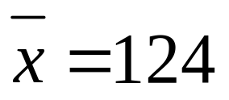
6.2BTC (Block Truncation Coding)
146 | 149 | 152 | 156
97 | 122 | 144 | 147
89 | 90 | 135 | 145
85 | 92 | 99 | 143
X=
1 | 1 | 1 | 1
0 | 0 | 1 | 1
0 | 0 | 1 | 1
0 | 0 | 0 | 1
146 | 146 | 146 | 146
96 | 96 | 146 | 146
96 | 96 | 146 | 146
96 | 96 | 96 | 146
Bitmap=
x₀=96 | x₁=146
8
8

Slide 4
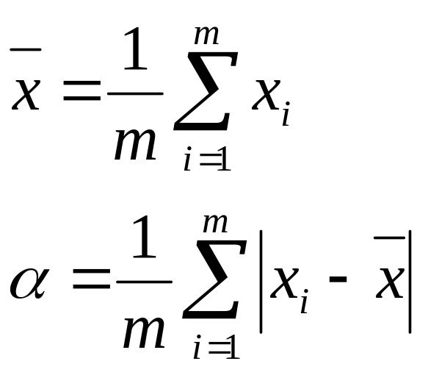
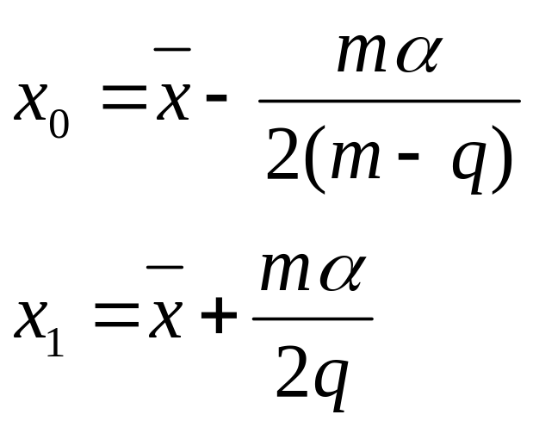
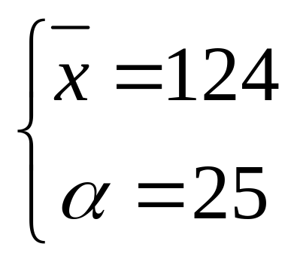

6.3 AMBTC
(Absolute Moment Block)
 | α
6
4
m: Bitmap中的總 bit 數
q: Bitmap 中‘1’ 的個數

Slide 5
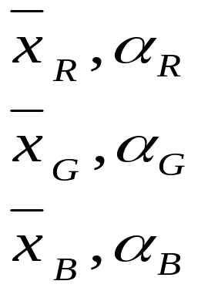
Single Bitmap AMBTC of Color Images
R G B
221 | 212 | 189 | 177
213 | 194 | 182 | 184
192 | 179 | 187 | 199
179 | 186 | 200 | 169
163 | 111 | 97 | 158
122 | 92 | 87 | 119
99 | 89 | 103 | 91
94 | 96 | 117 | 122
107 | 95 | 102 | 98
106 | 109 | 110 | 94
108 | 105 | 120 | 99
101 | 125 | 147 | 207
1 | 1 | 0 | 1
1 | 0 | 0 | 0
0 | 0 | 0 | 0
0 | 0 | 1 | 1
Common bitmap

Slide 6
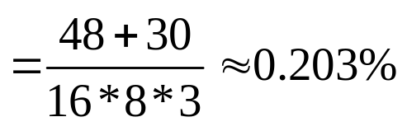
Single Bitmap AMBTC of Color Images
199 | 199 | 187 | 199
199 | 187 | 187 | 187
187 | 187 | 187 | 199
187 | 187 | 199 | 199
132 | 132 | 97 | 132
132 | 97 | 97 | 97
97 | 97 | 97 | 97
97 | 97 | 132 | 132
127 | 127 | 127 | 127
127 | 107 | 107 | 107
107 | 107 | 107 | 107
107 | 107 | 127 | 127
R G B
Rx₀=187 Rx₁=199 Gx₀=97 Gx₁=132 Bx₀=107 Bx₁=127
針對 AMBTC而言 ，壓縮率

Slide 7
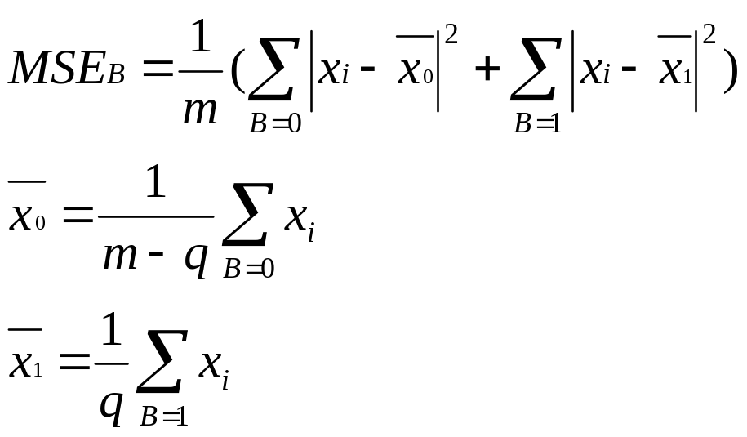
How to find the best common bitmap
B=common bitmap
x_{i}=(r_{i},g_{i},b_{i})
The best common bitmap might be found by calculating the MSE_{B} for all 2^{m} bitmaps and choosing the one with the minimum MSE_{B}

Slide 8
6.3.1 Genetic Algorithms
Selection
  The chromosome with fitness will be selected in the next generation and ones with worse fitness will die out
Crossover
  To exchange the genes between the two parent chromosomes
Mutation
  To select a gene randomly from a given chromosome and alters it

Slide 9
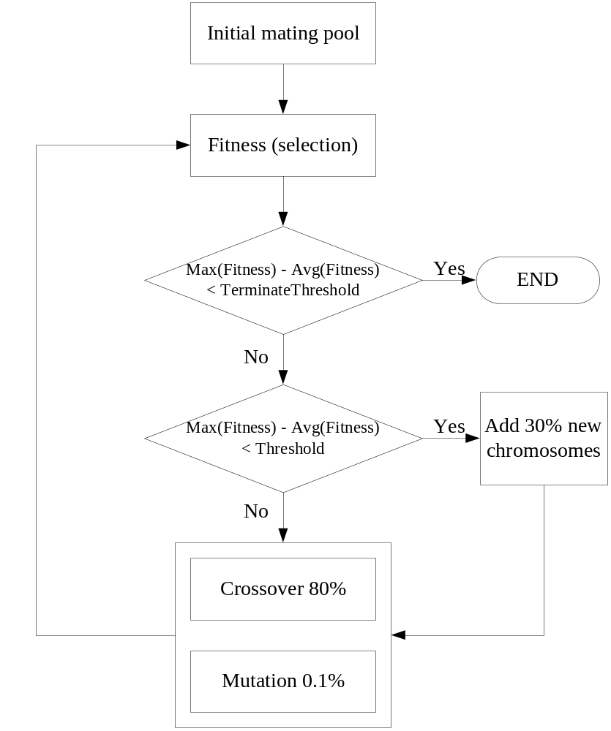
GA -AMBTC

Slide 10
Initialize the mating pool
N=12
1 | 1 | 0 | 0
1 | 1 | 0 | 0
1 | 0 | 0 | 1
0 | 0 | 1 | 0
1 | 1 | 0 | 1
1 | 0 | 0 | 1
0 | 0 | 0 | 0
0 | 0 | 1 | 1
0 | 0 | 0 | 0
0 | 0 | 0 | 0
0 | 0 | 1 | 0
0 | 1 | 1 | 1
C₁
C₅
C₉
…
…
…
1 | 1 | 0 | 0
1 | 1 | 0 | 0
1 | 0 | 0 | 1
0 | 0 | 1 | 0
1 | 1 | 0 | 1
1 | 0 | 0 | 1
0 | 0 | 0 | 0
0 | 0 | 1 | 1
0 | 0 | 0 | 0
0 | 0 | 0 | 0
0 | 0 | 1 | 0
0 | 1 | 1 | 1
C₄
C₈
C₁₂

Slide 11
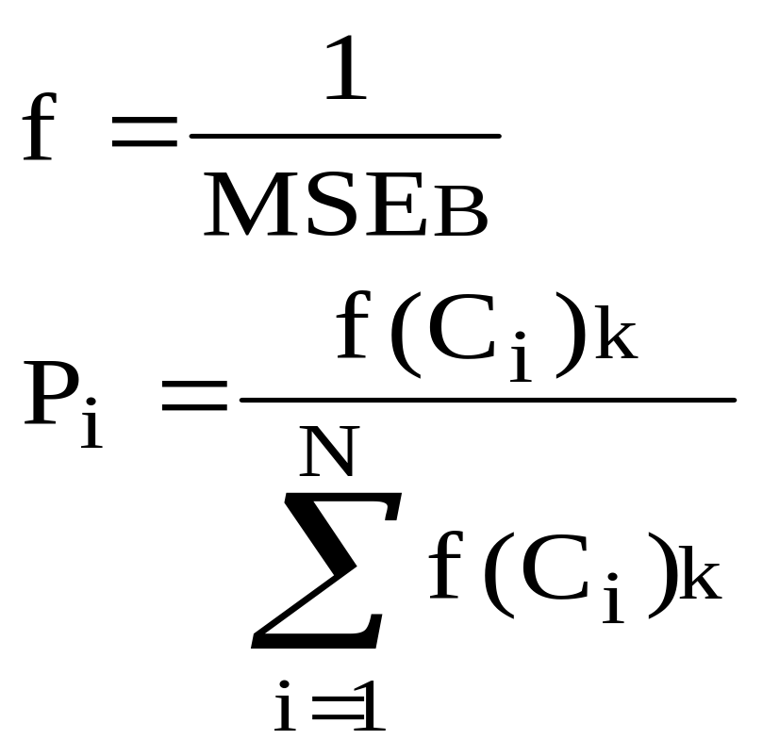
Calculate the fitness value for each chromosome (selection)
k: the kth interaction

Slide 12
Reproduction with threshold measure
If Max(fitness_{i})-Average(fitness_{i})≦threshold, then replace worse chromosomes with new chromosomes
Add new chromosomes rate=30%

Slide 13
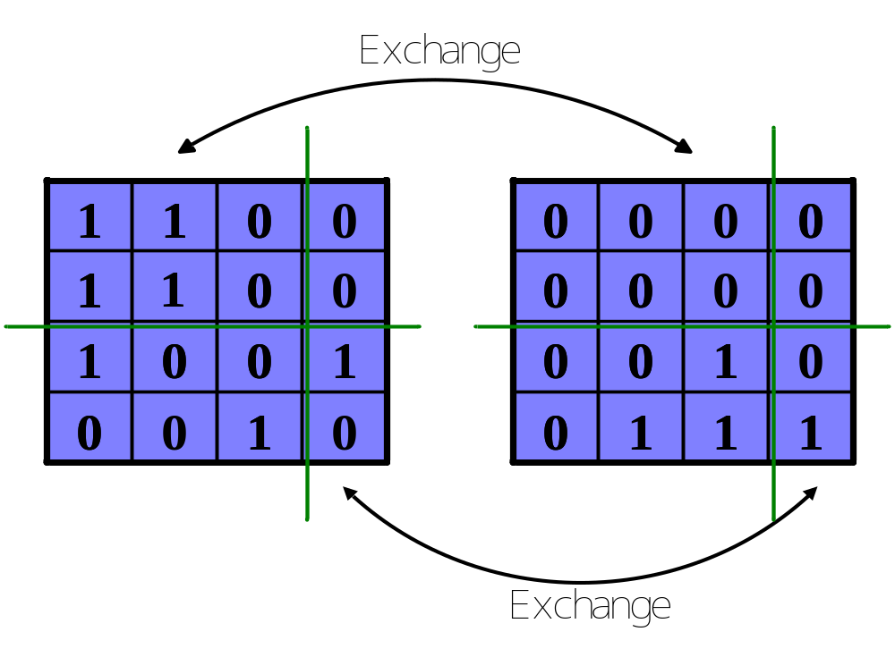
Crossover
C_{i}
C_{j}
The probability of crossover is always large
P_{c}=0.8

Slide 14
Mutation
1 | 1 | 0 | 0
1 | 1 | 0 | 0
1 | 0 | 0 | 1
0 | 0 | 1 | 0
1 | 1 | 0 | 1
1 | 0 | 0 | 1
1 | 0 | 0 | 1
0 | 0 | 1 | 1
C_{i}
C_{i}
The probability of mutation is always small
P_{m}=0.001

Slide 15
The MSE results with 4×4 block size
 |  | BTC | W-plane BTC | PCA BTC | Neural BTC | Purposed GA-AMBTC
Lena | R-plane | 25.64 | 31.85 | 31.04 | 30.37 | 29.33
 | G-plane | 41.14 | 44.86 | 44.86 | 42.49 | 40.71
 | B-plane | 29.49 | 39.42 | 36.73 | 36.20 | 32.39
 | Average | 32.09 | 38.71 | 37.54 | 36.35 | 34.14
Jet | R-plane | 38.93 | 43.56 | 42.20 | 39.30 | 37.19
 | G-plane | 51.41 | 55.93 | 53.16 | 48.15 | 44.90
 | B-plane | 21.62 | 26.5 | 26.59 | 24.41 | 22.65
 | Average | 37.32 | 41.99 | 40.65 | 37.28 | 34.91
Baboon | R-plane | 120.6 | 168.58 | 165.31 | 162.82 | 156.96
 | G-plane | 163.6 | 185.91 | 184.82 | 179.78 | 174.57
 | B-plane | 166.0 | 222.40 | 213.03 | 207.42 | 198.63
 | Average | 150.0 | 192.30 | 187.72 | 183.34 | 176.72
Scene | R-plane | 39.53 | 61.64 | 61.13 | 61.31 | 57.80
 | G-plane | 103.2 | 125.26 | 117.71 | 115.85 | 109.14
 | B-plane | 88.54 | 112.38 | 108.62 | 103.32 | 95.42
 | Average | 77.11 | 99.76 | 95.82 | 93.49 | 87.45

Slide 16
The MSE results with 8×8 block size
 |  | PCA BTC | Neural BTC | Purposed GA-AMBTC
Lena | R-plane | 65.63 | 62.07 | 61.59
 | G-plane | 90.2 | 82.90 | 80.87
 | B-plane | 64.45 | 61.49 | 59.65
 | Average | 73.42 | 68.82 | 67.37
Jet | R-plane | 89.08 | 79.74 | 78.77
 | G-plane | 108.85 | 97.46 | 93.91
 | B-plane | 50.83 | 45.19 | 43.19
 | Average | 82.92 | 74.13 | 71.95
Baboon | R-plane | 248.98 | 239.92 | 249.33
 | G-plane | 271.43 | 260.99 | 263.51
 | B-plane | 320.14 | 309.80 | 320.93
 | Average | 280.19 | 270.24 | 277.92
Scene | R-plane | 104.76 | 101.84 | 102.37
 | G-plane | 224.1 | 210.35 | 206.35
 | B-plane | 197.32 | 180.31 | 178.67
 | Average | 175.39 | 164.17 | 162.46

Slide 17
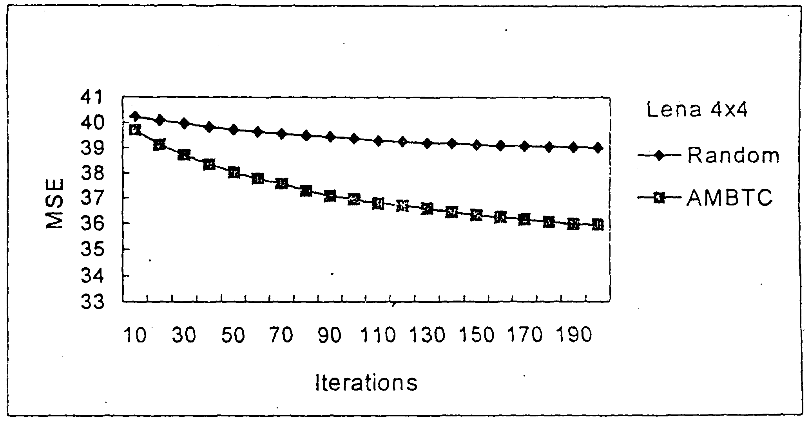
Comparison of convergence for randomly initialization and AMBTC-initialization

Slide 18
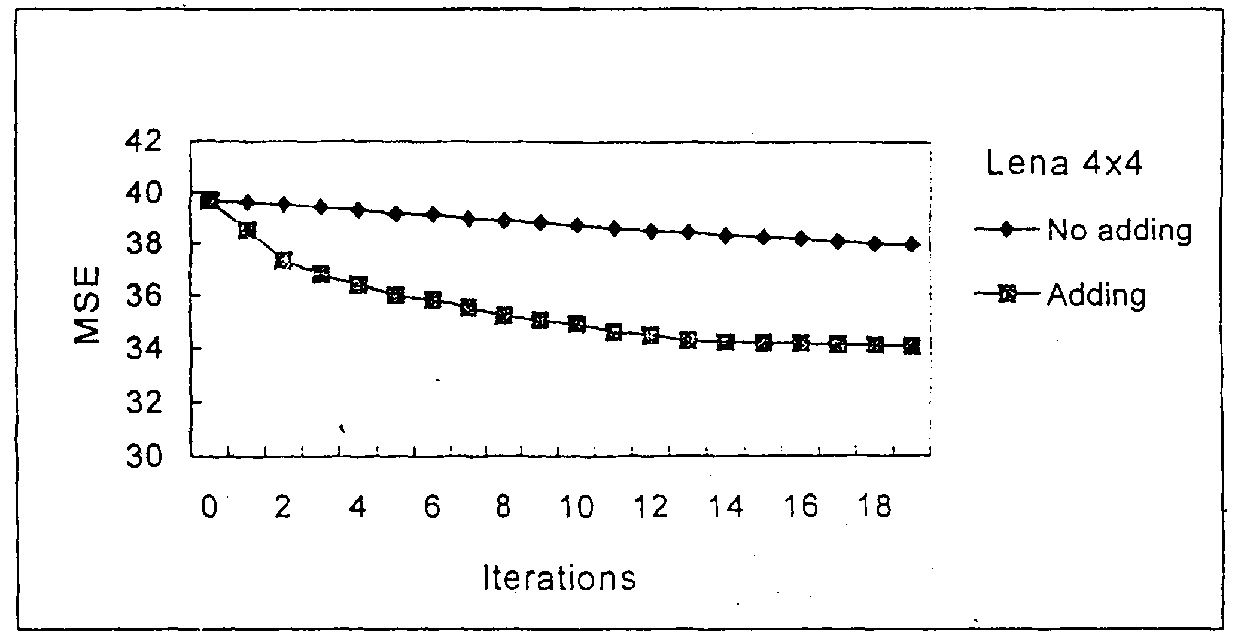
Comparison of adding new chromosomes and without adding new chromosomes, block size 4×4

Slide 19
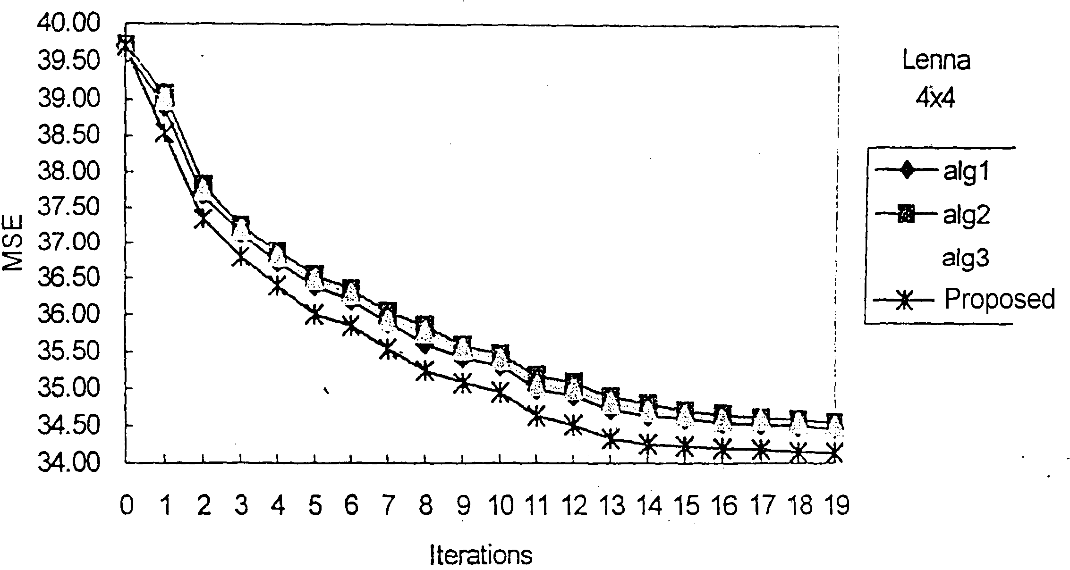
The results of different crossover methods, block size 4×4

Slide 20
Combined with the proposed crossover method and the addition of new chromosomes as a control mechanism, can get good results in fewer iterations for single bitmap AMBTC
The performance of the GA AMBTC is significantly better than that of other related schemes

Slide 21
6.4 中國書法壓縮

Slide 22
Chinese calligraphy ➔ Images
Image compression methods
  Vector quantization (VQ)
  S-tree …
New S-tree (proposed method)
Experimental results
Conclusions

Slide 23
6.4.1 S-tree
Binary images
  For example:
第一刀先垂直切
1 | 1 | 1 | 1 | 0 | 0 | 0 | 0
0 | 0 | 0 | 0 | 0 | 0 | 0 | 0
1 | 1 | 0 | 0 | 0 | 0 | 0 | 0
1 | 1 | 0 | 0 | 0 | 0 | 0 | 0
0 | 0 | 0 | 1 | 1 | 1 | 1 | 1
0 | 0 | 0 | 1 | 1 | 1 | 1 | 1
0 | 0 | 1 | 1 | 1 | 1 | 0 | 0
0 | 0 | 1 | 1 | 1 | 1 | 0 | 0

Slide 24
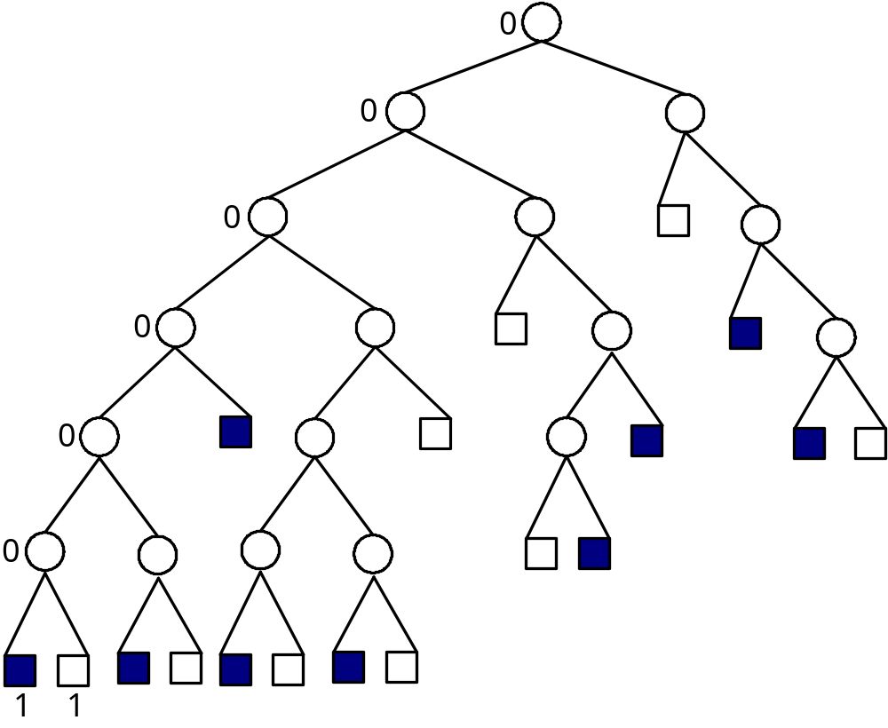
The bintree of the example
Bintree
樹葉顏色
樹的結構
Linear tree table: 00000011011100011011101001110101011
Color table: 101011010000110110
S-tree
53 bits

Slide 25
Problems of S-tree
We do not need to divide the bounded images too finely
  Solution: the proportion threshold of the bounded image
Sometimes it is not worth to divide the bounded images at all
  Solution: the process of retrenching the bintree

Slide 26
6.4.2 New S-tree
A gray level image is transferred into a binary image first
The proportion threshold of the bounded image is provided
The process of retrenching the bintree is added

Slide 27
Example of New S-tree
Chinese calligraphy image
(gray level)
Binary image
253 | 253 | 251 | 250 | 6 | 5 | 1 | 4
2 | 2 | 2 | 3 | 4 | 9 | 11 | 12
248 | 249 | 6 | 6 | 0 | 1 | 0 | 2
246 | 251 | 7 | 3 | 11 | 10 | 9 | 10
8 | 1 | 0 | 241 | 253 | 246 | 245 | 250
1 | 12 | 10 | 238 | 248 | 235 | 228 | 249
3 | 13 | 244 | 255 | 251 | 246 | 23 | 12
1 | 15 | 235 | 248 | 246 | 248 | 15 | 4
1 | 1 | 1 | 1 | 0 | 0 | 0 | 0
0 | 0 | 0 | 0 | 0 | 0 | 0 | 0
1 | 1 | 0 | 0 | 0 | 0 | 0 | 0
1 | 1 | 0 | 0 | 0 | 0 | 0 | 0
0 | 0 | 0 | 1 | 1 | 1 | 1 | 1
0 | 0 | 0 | 1 | 1 | 1 | 1 | 1
0 | 0 | 1 | 1 | 1 | 1 | 0 | 0
0 | 0 | 1 | 1 | 1 | 1 | 0 | 0

Slide 28
Flag bit ➔ 0₂: white / 1₂: black
Linear tree table
➔ 0₂: the internal node / 1₂: the leaf node
Color table
  Flag bit = 1₂
  0₂: the black block / 10₂: the white block
  11₂: the raw data block
  Flag bit = 0₂
  0₂: the white block / 10₂: the black block
  11₂: the raw data block

Slide 29
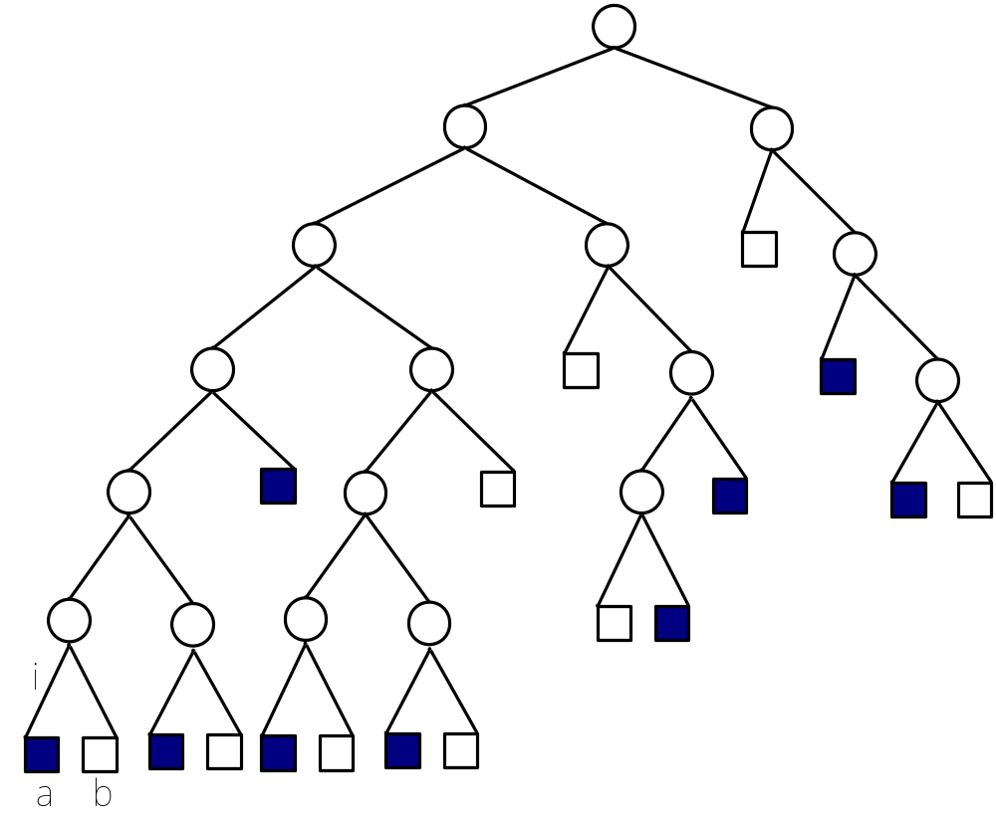
The original bintree
Flag bit=1
||a||=1 (in the linear tree table) + 1 (in the color table)
||b||=1 (in the linear tree table) + 2 (in the color table)
||i|| =1 (in the linear tree table)

Slide 30
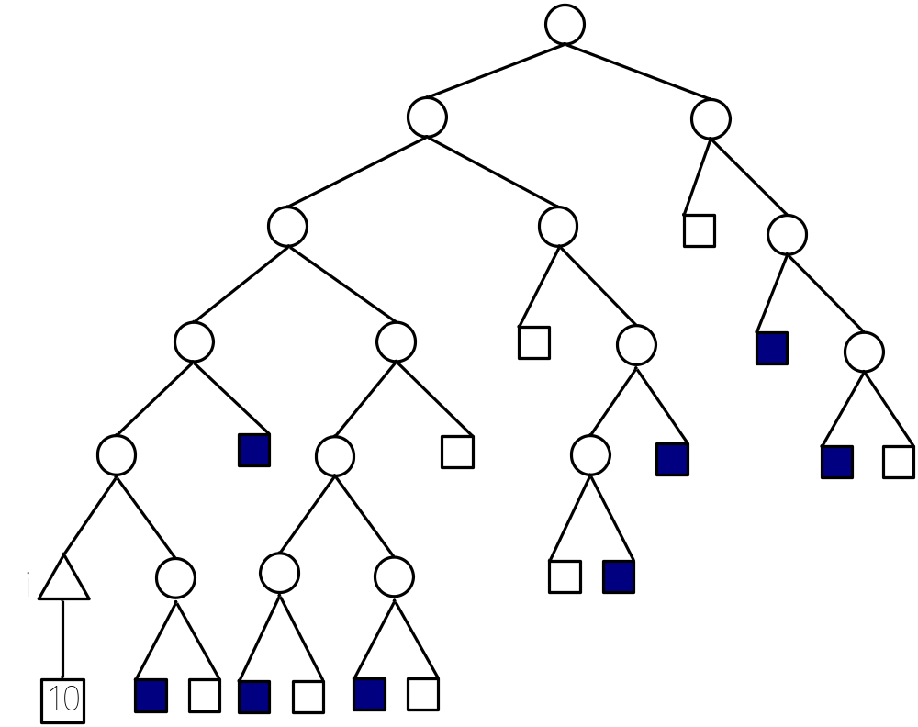
The bintree at the beginning phase of the retrenching process
Flag bit=0
||i|| =1 (in the linear tree table) +2 (in the color table) + 2 (in the raw data table)
1 11 10

Slide 31
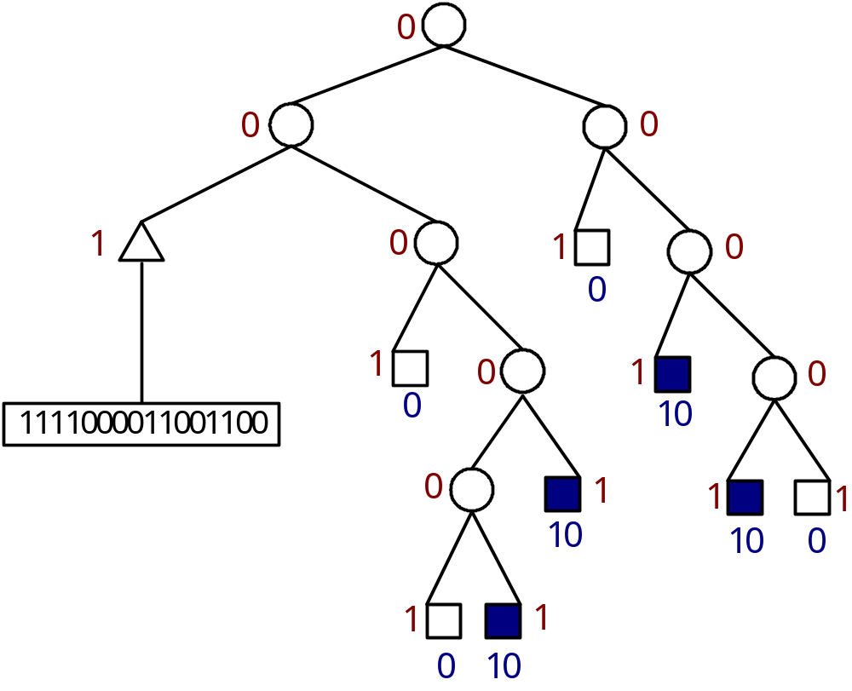
The bintree after the retrenching process
Linear tree table: 0 0 1 0 1 0 0 1 1 1 0 1 0 1 0 1 1
Color table: 11 0 0 10 10 0 10 10 0
Raw data table: 1111000011001100
47 bits

Slide 32
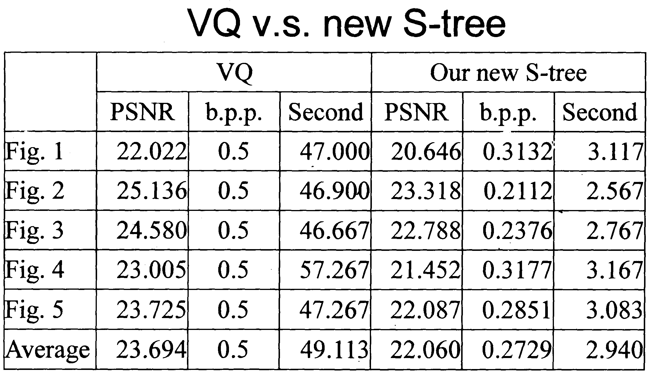
Experiment results

Slide 33
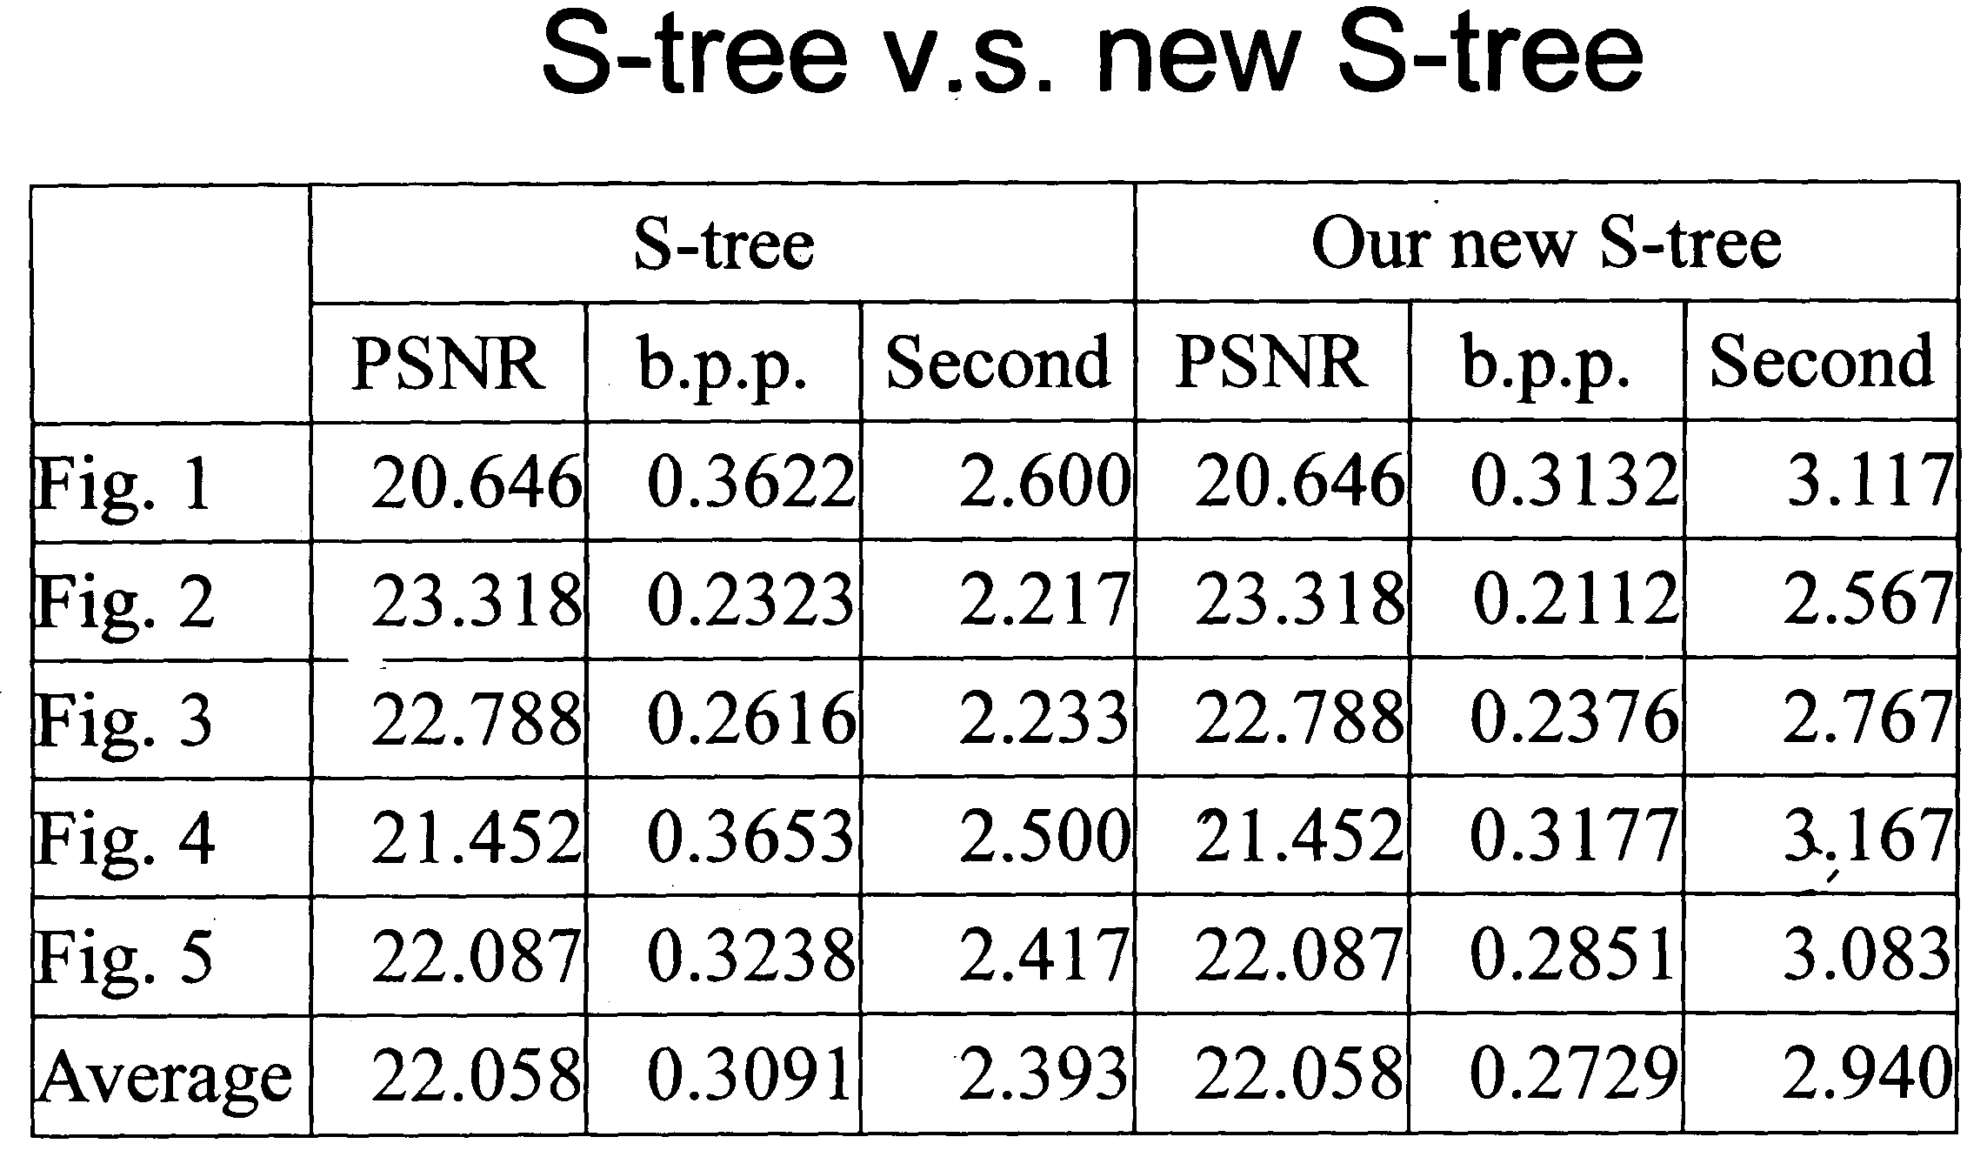

Slide 34
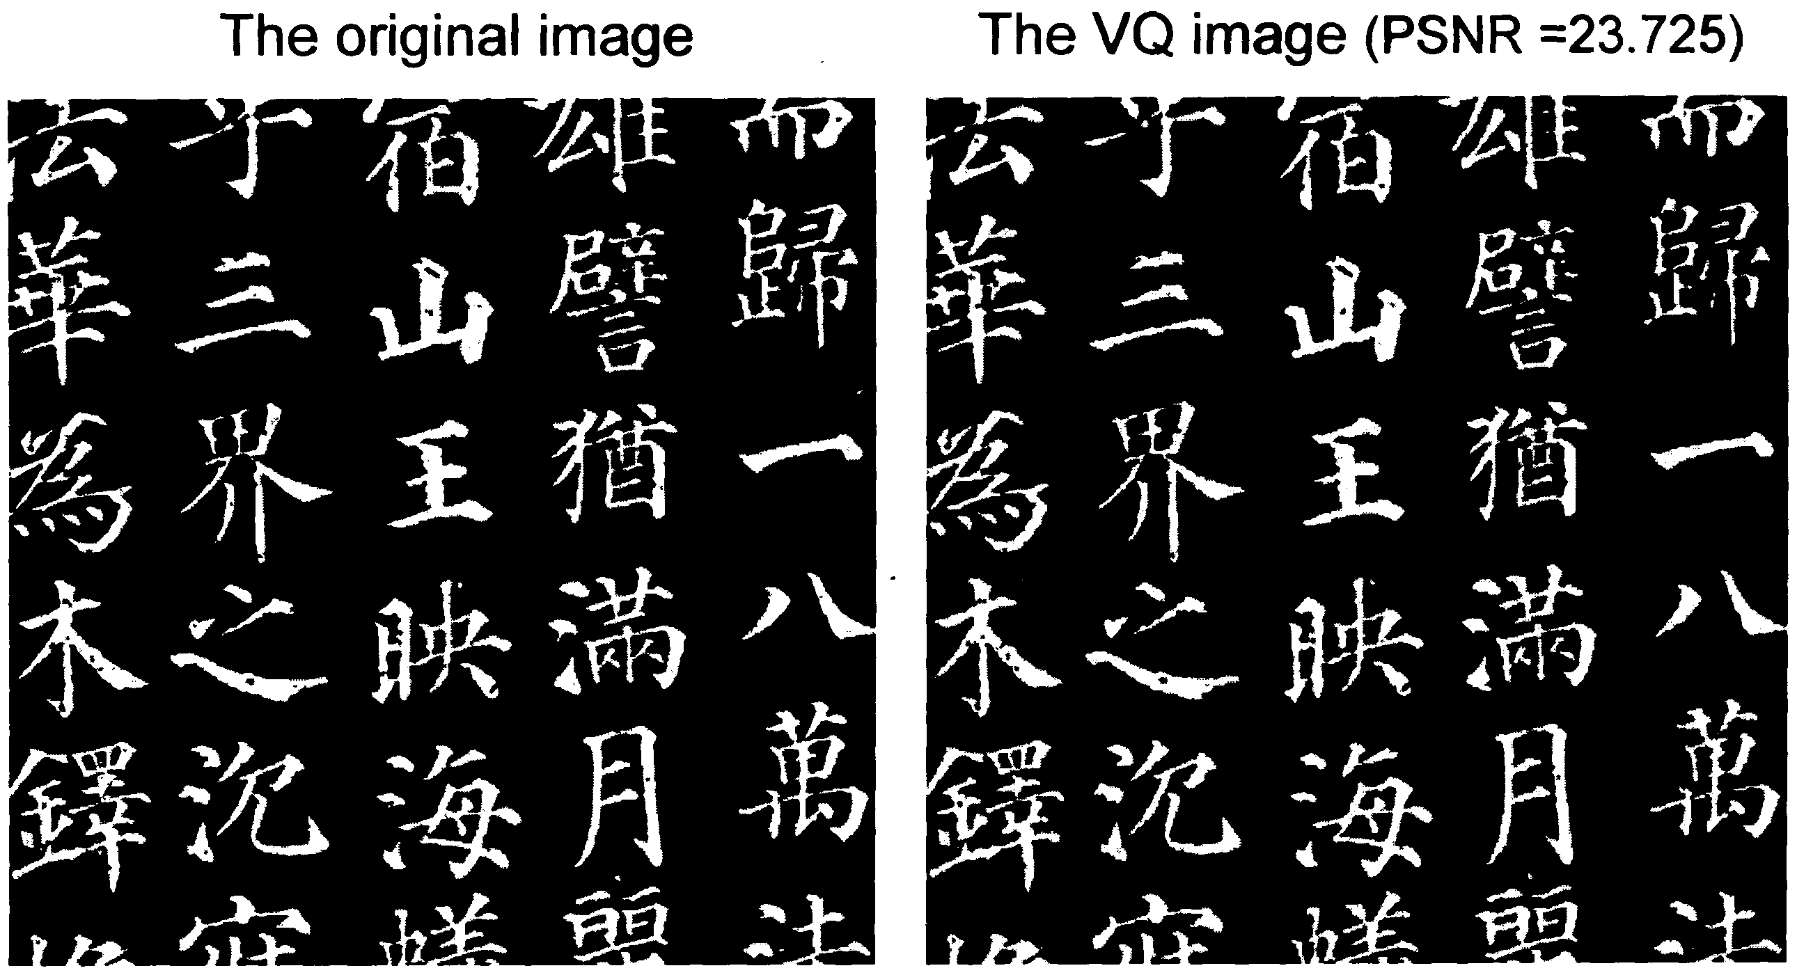

Slide 35
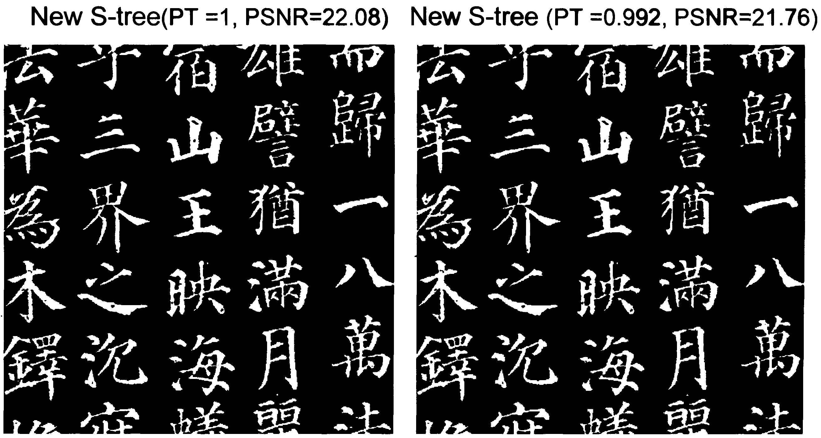

Slide 36
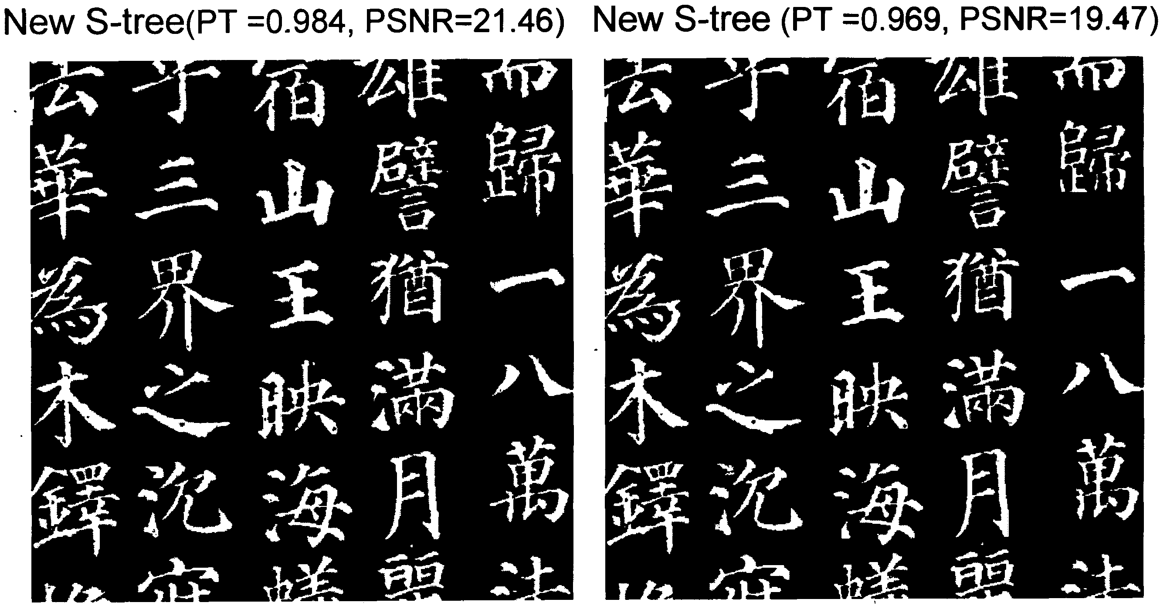

Slide 37
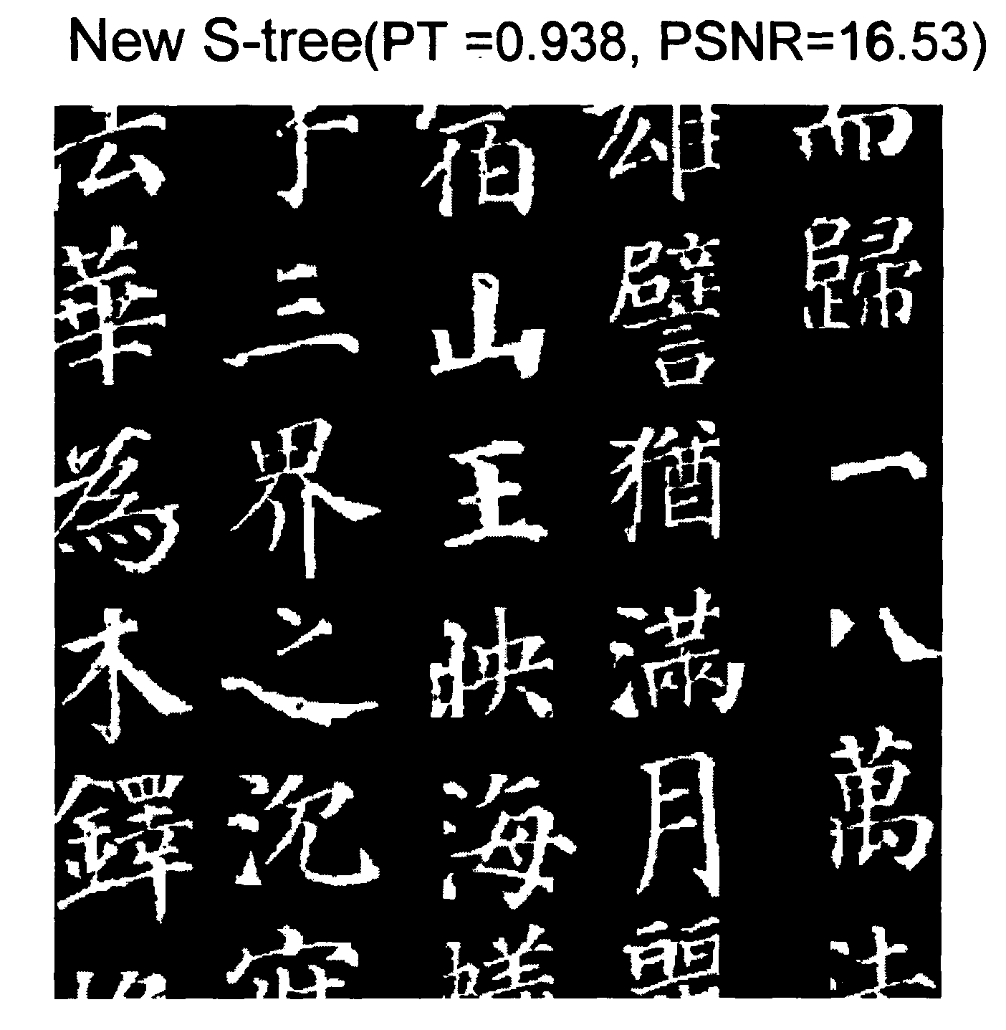

Slide 38
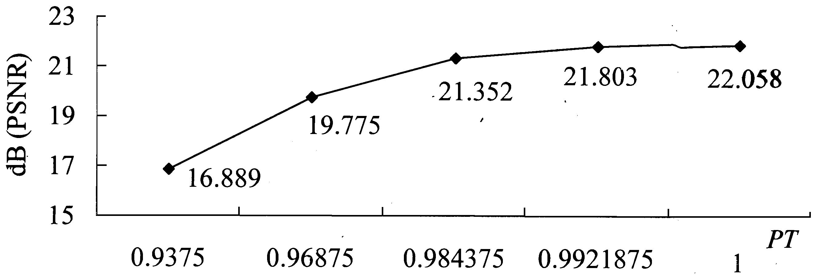
The image quality of proportion threshold

Slide 39
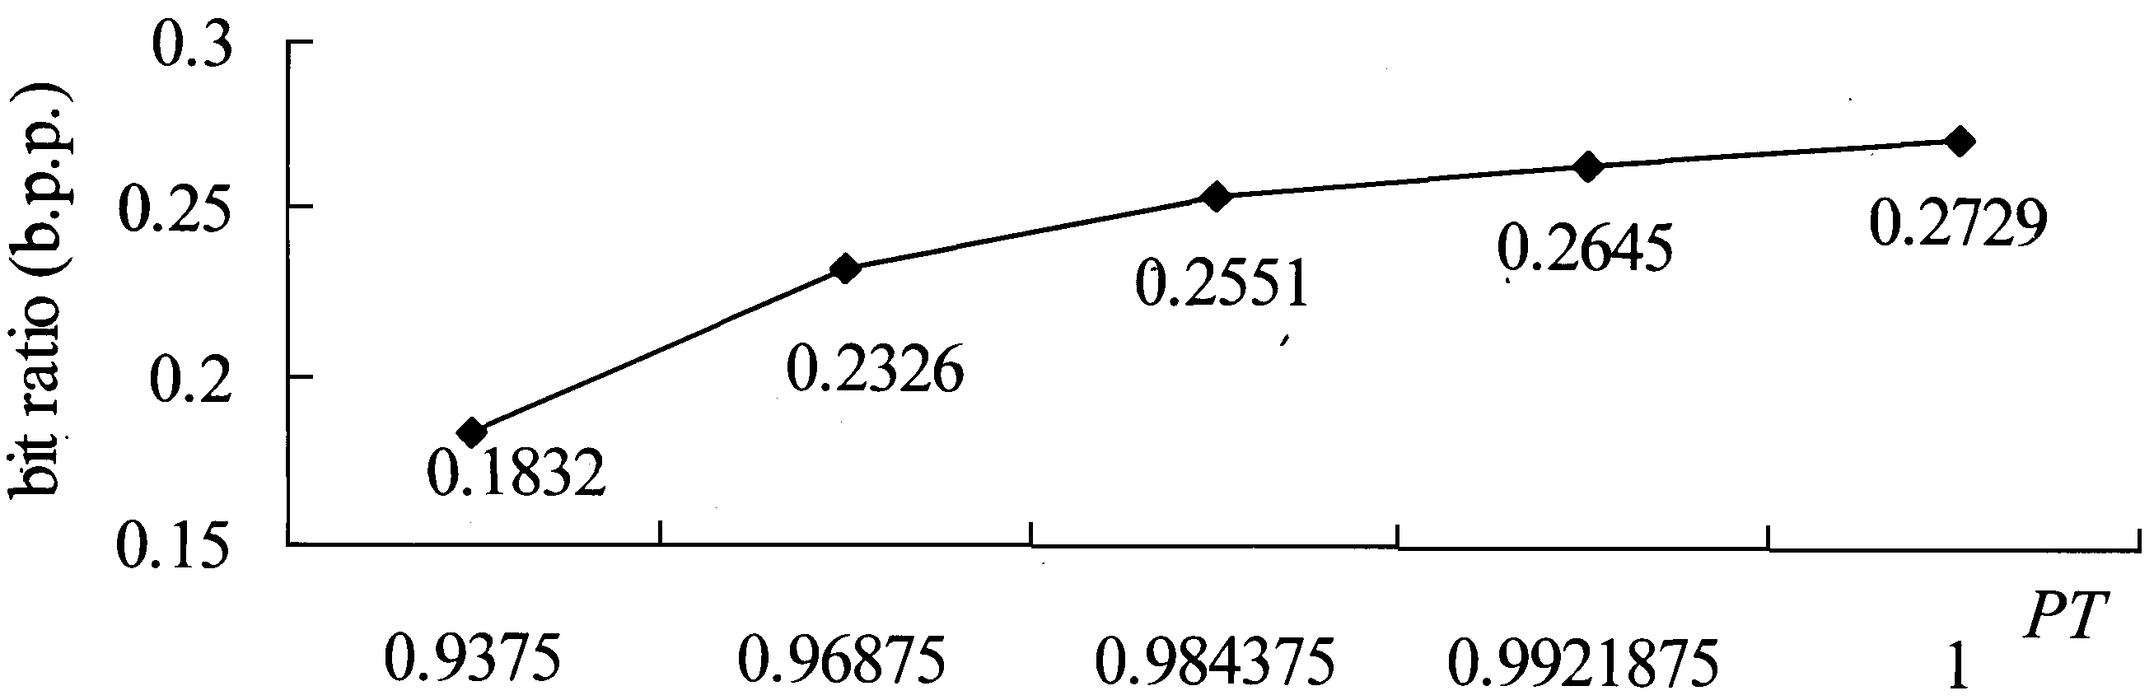
The compression ratio of proportion threshold

Slide 40
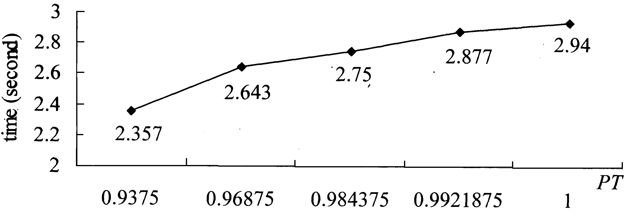
The compression time of proportion threshold

Slide 41
New S-tree ➔ Chinese calligraphy
Low compression ratio
  (10%-40%) of the storage of S-tree saved
Fast execution time
  (only 10% of the execution time of VQ needed)
Good image quality
  (the same visual quality as VQ)

