Slide 1
Reversible data hiding in encrypted images using prediction error modification and basic block compression
Authors: Xuemao Zhang,Xianquan Zhang,Chunqiang Yu,Guoxiang Li,Zhenjun Tang
Source: Signal Processing, DOI 10.1016/j.sigpro.2025.109896
Reporter: Sisheng Chen
Date: 2025.2.6

Slide 2
Outline
Introduction
Proposed method
Experimental results
Conclusions

Slide 3
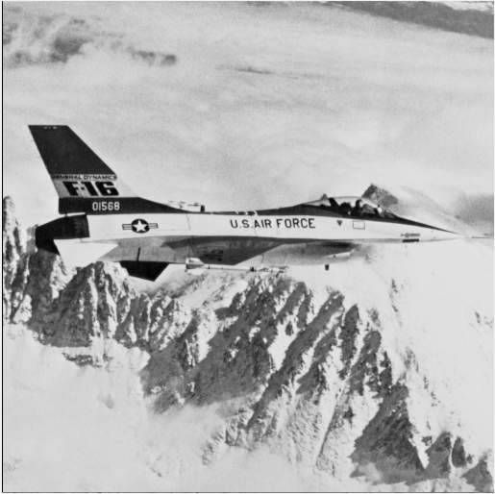

Introduction— VRBE-based RDHEI
Data hiding key
& secret data： 0101011…
Encryption key
Image encryption
Data embedding
Vacating room
&Image encryption
Additional data
Secret data: 0101011…
Data hiding key
Data extraction & image recovery
Encryption key

Slide 4
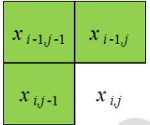
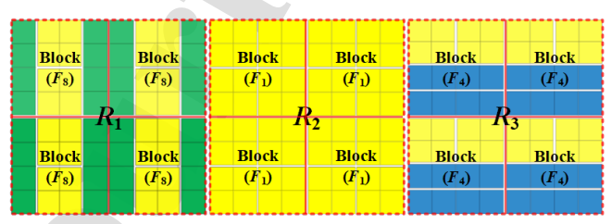
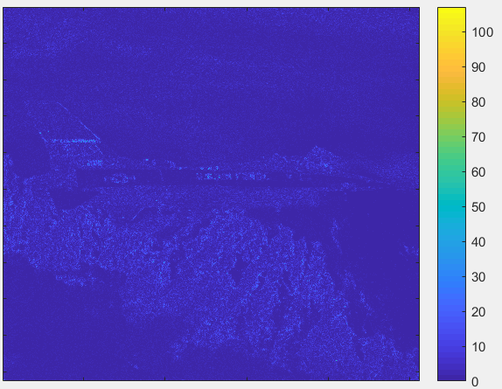
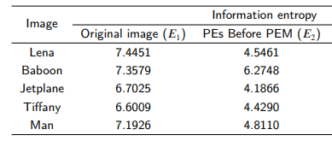
Introduction— VRBE-based RDHEI
Image compression based on prediction errors
Original image
Predicted image
Pixel predictor
Motivation: enhance the compression efficiency

Slide 5
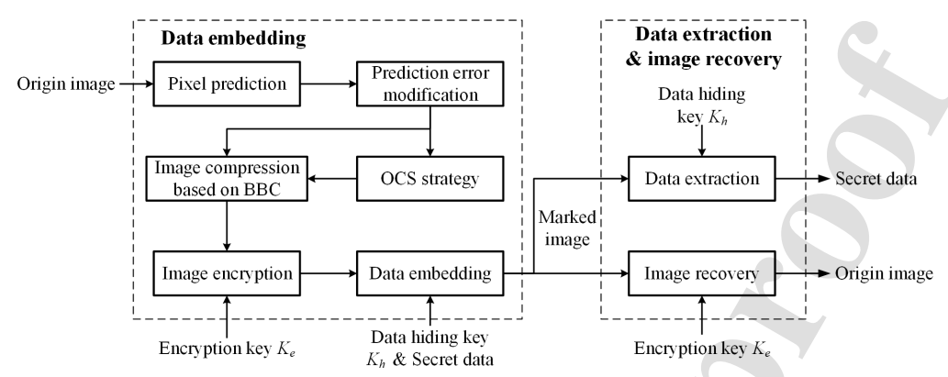
Proposed method (1/5) —
Flowchart

Slide 6
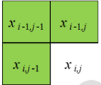
Proposed method (2/5) — Pixel prediction and prediction error modiffcation
Pixel prediction
Original image
Predicted image
180 | 179 | 180 | 180 | …
175 | 176 | 180 | 178 | …
176 | 180 | 177 | 178 | …
175 | 178 | 179 | 175 | …
… | … | … | …
0 |  |  |  | …
 |  |  |  | …
 |  |  |  | …
 |  |  |  | …
… | … | … | …
180
179
180
180
175
176

Slide 7


Proposed method (2/5) — Pixel prediction and prediction error modiffcation
Pixel prediction
180 | 179 | 180 | 180 | …
175 | 176 | 180 | 178 | …
176 | 180 | 177 | 178 | …
175 | 178 | 179 | 179 | …
… | … | … | …
0 |  |  |  | …
 |  |  |  | …
 |  |  |  | …
 |  |  |  | …
… | … | … | …
180
179
180
180
175
177
180
175
176
180
177
176
179
177
179
180 | -1 | 1 | 0 | …
-5 | 1 | 3 | -2 | …
1 | 4 | -3 | 1 | …
-1 | -1 | 2 | 0 | …
… | … | … | …

Slide 8
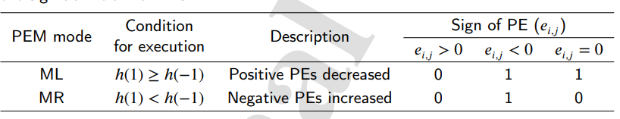
Proposed method (3/5) — Prediction errors modification
Original PEs
PEs after PEM
Signs of PEs
180 | -1 | 1 | 0 | …
-5 | 1 | 3 | -2 | …
1 | 4 | -3 | 1 | …
-1 | -1 | 2 | 0 | …
… | … | … | …
179 | 1 | 0 | 0 | …
5 | 0 | 2 | 2 | …
0 | 3 | 3 | 0 | …
1 | 1 | 1 | 0 | …
… | … | … | …
1 | 1 | 0 | 1 | …
1 | 1 | 1 | 1 | …
0 | 1 | 1 | 0 | …
1 | 1 | 0 | 1 | …
… | … | … | …
Auxiliary information

Slide 9
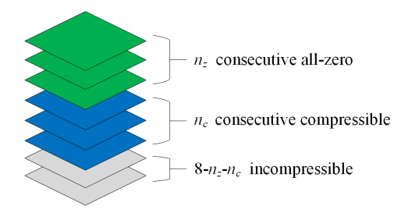
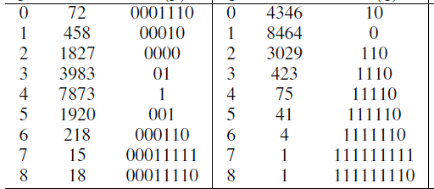





Proposed method (3/5) - Image compression based on BBC(1/9)
PEs after PEM
179 | 1 | 0 | 0 | …
5 | 0 | 2 | 2 | …
0 | 3 | 3 | 0 | …
1 | 1 | 1 | 0 | …
… | … | … | …
179 | 1 | 0 | 0
5 | 0 | 2 | 2
0 | 3 | 3 | 0
1 | 1 | 1 | 0
1 | 0 | 0 | 0
0 | 0 | 0 | 0
0 | 0 | 0 | 0
0 | 0 | 0 | 0
0 | 0 | 0 | 0
0 | 0 | 0 | 0
0 | 0 | 0 | 0
0 | 0 | 0 | 0
1 | 0 | 0 | 0
0 | 0 | 0 | 0
0 | 0 | 0 | 0
0 | 0 | 0 | 0
1 | 0 | 0 | 0
0 | 0 | 0 | 0
0 | 0 | 0 | 0
0 | 0 | 0 | 0
0 | 0 | 0 | 0
0 | 0 | 0 | 0
0 | 0 | 0 | 0
0 | 0 | 0 | 0
0 | 0 | 0 | 0
1 | 0 | 0 | 0
0 | 0 | 0 | 0
0 | 0 | 0 | 0
1 | 0 | 0 | 0
0 | 0 | 1 | 0
0 | 1 | 1 | 0
0 | 0 | 0 | 0
1 | 1 | 0 | 0
1 | 0 | 0 | 0
0 | 1 | 1 | 0
1 | 1 | 1 | 0
$$n_{z}$$
Occu.
${H(n}_{z}$)
$$n_{c}$$
Occu.
${H(n}_{c}$)
$n_{z}$=0
${H(n}_{z}$) | $${H(n}_{c}\text{)}$$ | Compressed data | Imcompressible data

Slide 10
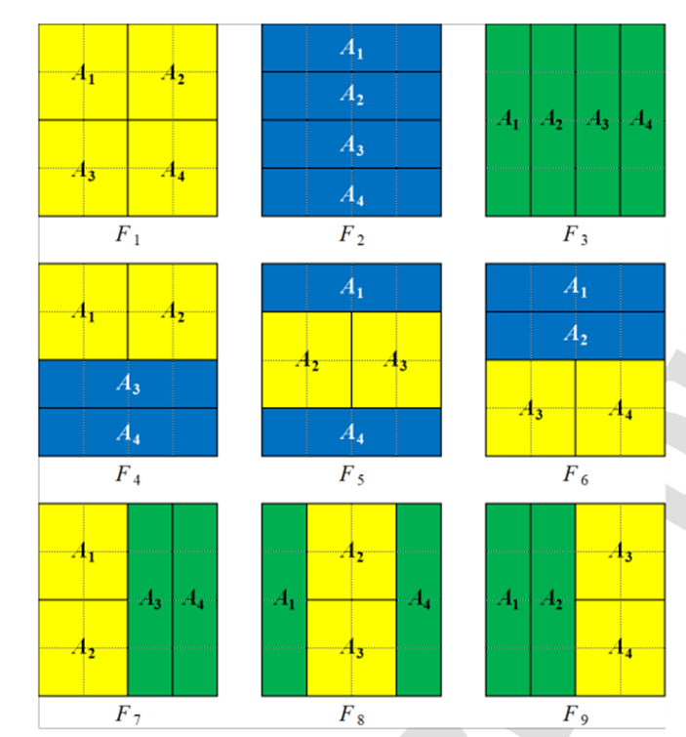
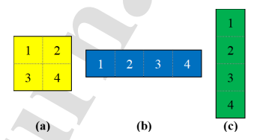

Proposed method (3/5) - Image compression based on BBC(2/9)
1 | 0 | 0 | 0
0 | 0 | 0 | 0
0 | 0 | 0 | 0
0 | 0 | 0 | 0
0 | 0 | 0 | 0
0 | 0 | 0 | 0
0 | 0 | 0 | 0
0 | 0 | 0 | 0
1 | 0 | 0 | 0
0 | 0 | 0 | 0
0 | 0 | 0 | 0
0 | 0 | 0 | 0
1 | 0 | 0 | 0
0 | 0 | 0 | 0
0 | 0 | 0 | 0
0 | 0 | 0 | 0
0 | 0 | 0 | 0
0 | 0 | 0 | 0
0 | 0 | 0 | 0
0 | 0 | 0 | 0
0 | 0 | 0 | 0
1 | 0 | 0 | 0
0 | 0 | 0 | 0
0 | 0 | 0 | 0
1 | 0 | 0 | 0
0 | 0 | 1 | 0
0 | 1 | 1 | 0
0 | 0 | 0 | 0
1 | 1 | 0 | 0
1 | 0 | 0 | 0
0 | 1 | 1 | 0
1 | 1 | 1 | 0
$n_{z}$=0
${H(n}_{z}$) | $${H(n}_{c}\text{)}$$ | Compressed data | Imcompressible data
Basic block compression (BCC)

Slide 11



Proposed method (3/5) - Image compression based on BBC(3/9)
1 | 0 | 0 | 0
0 | 0 | 0 | 0
0 | 0 | 0 | 0
0 | 0 | 0 | 0
0 | 0 | 0 | 0
0 | 0 | 0 | 0
0 | 0 | 0 | 0
0 | 0 | 0 | 0
1 | 0 | 0 | 0
0 | 0 | 0 | 0
0 | 0 | 0 | 0
0 | 0 | 0 | 0
1 | 0 | 0 | 0
0 | 0 | 0 | 0
0 | 0 | 0 | 0
0 | 0 | 0 | 0
0 | 0 | 0 | 0
0 | 0 | 0 | 0
0 | 0 | 0 | 0
0 | 0 | 0 | 0
0 | 0 | 0 | 0
1 | 0 | 0 | 0
0 | 0 | 0 | 0
0 | 0 | 0 | 0
1 | 0 | 0 | 0
0 | 0 | 1 | 0
0 | 1 | 1 | 0
0 | 0 | 0 | 0
1 | 1 | 0 | 0
1 | 0 | 0 | 0
0 | 1 | 1 | 0
1 | 1 | 1 | 0
$n_{z}$=0
${H(n}_{z}$) | $${H(n}_{c}\text{)}$$ | Compressed data | Imcompressible data
$$t_{1}t_{2}t_{3}t_{4}$$ | ${H(A}_{i})$, $A_{i}$ is no-all-zero

Slide 12
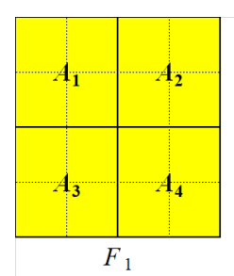













Proposed method (3/5) - Image compression based on BBC(4/9)
1 | 0 | 0 | 0
0 | 0 | 0 | 0
0 | 0 | 0 | 0
0 | 0 | 0 | 0
0 | 0 | 0 | 0
0 | 0 | 0 | 0
0 | 0 | 0 | 0
0 | 0 | 0 | 0
1 | 0 | 0 | 0
0 | 0 | 0 | 0
0 | 0 | 0 | 0
0 | 0 | 0 | 0
1 | 0 | 0 | 0
0 | 0 | 0 | 0
0 | 0 | 0 | 0
0 | 0 | 0 | 0
0 | 0 | 0 | 0
0 | 0 | 0 | 0
0 | 0 | 0 | 0
0 | 0 | 0 | 0
0 | 0 | 0 | 0
1 | 0 | 0 | 0
0 | 0 | 0 | 0
0 | 0 | 0 | 0
1 | 0 | 0 | 0
0 | 0 | 1 | 0
0 | 1 | 1 | 0
0 | 0 | 0 | 0
1 | 1 | 0 | 0
1 | 0 | 0 | 0
0 | 1 | 1 | 0
1 | 1 | 1 | 0
$$1000 000$$
$$0000$$
$$1000 000$$
$$1000 000$$
$$0000$$
$$1000 011$$
$$t_{1}t_{2}t_{3}t_{4}$$ | ${H(A}_{i})$, $A_{i}$ is no-all-zero
1 | 0 | 0 | 0
0 | 0 | 0 | 0
0 | 0 | 0 | 0
0 | 0 | 0 | 0
$$1000$$ | 000
$$v=12−3=9$$
0 | 0 | 0 | 0
0 | 0 | 0 | 0
0 | 0 | 0 | 0
0 | 0 | 0 | 0
$$0000$$
$$v=12−0=10$$
0 | 0 | 0 | 0
1 | 0 | 0 | 0
0 | 0 | 0 | 0
0 | 0 | 0 | 0
$$1000$$ | 011
$$v=12−3=9$$

Slide 13








Proposed method (3/5) - Image compression based on BBC(5/9)
1 | 0 | 0 | 0
0 | 0 | 0 | 0
0 | 0 | 0 | 0
0 | 0 | 0 | 0
0 | 0 | 0 | 0
0 | 0 | 0 | 0
0 | 0 | 0 | 0
0 | 0 | 0 | 0
1 | 0 | 0 | 0
0 | 0 | 0 | 0
0 | 0 | 0 | 0
0 | 0 | 0 | 0
1 | 0 | 0 | 0
0 | 0 | 0 | 0
0 | 0 | 0 | 0
0 | 0 | 0 | 0
0 | 0 | 0 | 0
0 | 0 | 0 | 0
0 | 0 | 0 | 0
0 | 0 | 0 | 0
0 | 0 | 0 | 0
1 | 0 | 0 | 0
0 | 0 | 0 | 0
0 | 0 | 0 | 0
1 | 0 | 0 | 0
0 | 0 | 1 | 0
0 | 1 | 1 | 0
0 | 0 | 0 | 0
1 | 1 | 0 | 0
1 | 0 | 0 | 0
0 | 1 | 1 | 0
1 | 1 | 1 | 0
$$1000 000$$
$$0000$$
$$1000 000$$
$$1000 000$$
$$0000$$
$$1000 011$$
1 | 0 | 0 | 0
0 | 0 | 0 | 0
0 | 0 | 0 | 0
0 | 0 | 0 | 0
$$t_{1}t_{2}t_{3}t_{4}$$ | ${H(A}_{i})$, $A_{i}$ is no-all-zero
$$1000 000$$
0 | 0 | 0 | 0
0 | 0 | 0 | 0
0 | 0 | 0 | 0
0 | 0 | 0 | 0
1 | 0 | 0 | 0
0 | 0 | 1 | 0
0 | 1 | 1 | 0
0 | 0 | 0 | 0
$$1111$$
$$0000$$
0 | 0 | 0 | 0
1 | 0 | 0 | 0
0 | 0 | 0 | 0
0 | 0 | 0 | 0
$$1000 011$$
m<2
incompressible

Slide 14















Proposed method (3/5) - Image compression based on BBC(6/9)
1 | 0 | 0 | 0
0 | 0 | 0 | 0
0 | 0 | 0 | 0
0 | 0 | 0 | 0
0 | 0 | 0 | 0
0 | 0 | 0 | 0
0 | 0 | 0 | 0
0 | 0 | 0 | 0
1 | 0 | 0 | 0
0 | 0 | 0 | 0
0 | 0 | 0 | 0
0 | 0 | 0 | 0
1 | 0 | 0 | 0
0 | 0 | 0 | 0
0 | 0 | 0 | 0
0 | 0 | 0 | 0
0 | 0 | 0 | 0
0 | 0 | 0 | 0
0 | 0 | 0 | 0
0 | 0 | 0 | 0
0 | 0 | 0 | 0
1 | 0 | 0 | 0
0 | 0 | 0 | 0
0 | 0 | 0 | 0
1 | 0 | 0 | 0
0 | 0 | 1 | 0
0 | 1 | 1 | 0
0 | 0 | 0 | 0
1 | 1 | 0 | 0
1 | 0 | 0 | 0
0 | 1 | 1 | 0
1 | 1 | 1 | 0
$$1000 000$$
$$0000 000$$
$$1000 000$$
$$1000 000$$
$$0000 000$$
$$1000 011$$
$n_{z}$=0
$n_{c}$=6
${H(n}_{z}$) | $${H(n}_{c}\text{)}$$ | Compressed data | Imcompressible data
$$0001110$$
$$1111110$$
(14bits)
$$1000 000$$
$$0000 000$$
$$1000 000$$
$$1000 000$$
$$0000 000$$
$$1000 011$$
(42bits)
$$1000 0010 0110 0000$$
$$1100 1000 0110 1110$$
(32bits)
Capacity: 128-14-42-32=40 bits

Slide 15
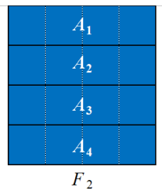













Proposed method (3/5) - Image compression based on BBC(7/9)
1 | 0 | 0 | 0
0 | 0 | 0 | 0
0 | 0 | 0 | 0
0 | 0 | 0 | 0
0 | 0 | 0 | 0
0 | 0 | 0 | 0
0 | 0 | 0 | 0
0 | 0 | 0 | 0
1 | 0 | 0 | 0
0 | 0 | 0 | 0
0 | 0 | 0 | 0
0 | 0 | 0 | 0
1 | 0 | 0 | 0
0 | 0 | 0 | 0
0 | 0 | 0 | 0
0 | 0 | 0 | 0
0 | 0 | 0 | 0
0 | 0 | 0 | 0
0 | 0 | 0 | 0
0 | 0 | 0 | 0
0 | 0 | 0 | 0
1 | 0 | 0 | 0
0 | 0 | 0 | 0
0 | 0 | 0 | 0
1 | 0 | 0 | 0
0 | 0 | 1 | 0
0 | 1 | 1 | 0
0 | 0 | 0 | 0
1 | 1 | 0 | 0
1 | 0 | 0 | 0
0 | 1 | 1 | 0
1 | 1 | 1 | 0
$$1000 000$$
$$0000 000$$
$$1000 000$$
$$1000 000$$
$$0000 000$$
$$1000 010$$
$n_{z}$=0
$n_{c}$=6
${H(n}_{z}$) | $${H(n}_{c}\text{)}$$ | Compressed data | Imcompressible data
$$0001110$$
$$1111110$$
(14bits)
$$1000 000$$
$$0000 000$$
$$1000 000$$
$$1000 000$$
$$0000 000$$
$$1000 010$$
(42bits)
$$1000 0010 0110 0000$$
$$1100 1000 0110 1110$$
(32bits)
Capacity: 128-14-42-32=40 bits

Slide 16
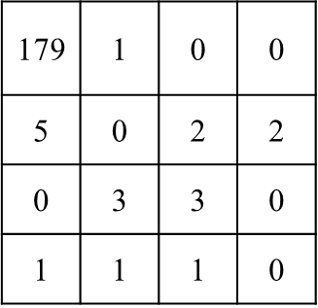










Proposed method (3/5) - Image compression based on BBC(8/9)
1 | 0 | 0 | 0
0 | 0 | 0 | 0
0 | 0 | 0 | 0
0 | 0 | 0 | 0
0 | 0 | 0 | 0
0 | 0 | 0 | 0
0 | 0 | 0 | 0
0 | 0 | 0 | 0
1 | 0 | 0 | 0
0 | 0 | 0 | 0
0 | 0 | 0 | 0
0 | 0 | 0 | 0
1 | 0 | 0 | 0
0 | 0 | 0 | 0
0 | 0 | 0 | 0
0 | 0 | 0 | 0
0 | 0 | 0 | 0
0 | 0 | 0 | 0
0 | 0 | 0 | 0
0 | 0 | 0 | 0
0 | 0 | 0 | 0
1 | 0 | 0 | 0
0 | 0 | 0 | 0
0 | 0 | 0 | 0
1 | 0 | 0 | 0
0 | 0 | 1 | 0
0 | 1 | 1 | 0
0 | 0 | 0 | 0
1 | 1 | 0 | 0
1 | 0 | 0 | 0
0 | 1 | 1 | 0
1 | 1 | 1 | 0
$$1000 000$$
$$0000$$
$$1000 000$$
$$1000 000$$
$$0000$$
$$1000 011$$
$n_{z}$=0
$n_{c}$=6
${H(n}_{z}$) | $${H(n}_{c}\text{)}$$ | Compressed data | Imcompressible data
$$0001110$$
$$1111110$$
Capacity: 128-14-42-32=40 bits
Auxiliary information: F₁

Slide 17
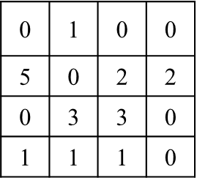






Proposed method (3/5) - Image compression based on BBC(9/9)
0 | 0 | 0 | 0
0 | 0 | 0 | 0
0 | 0 | 0 | 0
0 | 0 | 0 | 0
0 | 0 | 0 | 0
0 | 0 | 0 | 0
0 | 0 | 0 | 0
0 | 0 | 0 | 0
0 | 0 | 0 | 0
0 | 0 | 0 | 0
0 | 0 | 0 | 0
0 | 0 | 0 | 0
0 | 0 | 0 | 0
0 | 0 | 0 | 0
0 | 0 | 0 | 0
0 | 0 | 0 | 0
0 | 0 | 0 | 0
0 | 0 | 0 | 0
0 | 0 | 0 | 0
0 | 0 | 0 | 0
0 | 0 | 0 | 0
1 | 0 | 0 | 0
0 | 0 | 0 | 0
0 | 0 | 0 | 0
0 | 0 | 0 | 0
0 | 0 | 1 | 0
0 | 1 | 1 | 0
0 | 0 | 0 | 0
0 | 1 | 0 | 0
1 | 0 | 0 | 0
0 | 1 | 1 | 0
1 | 1 | 1 | 0
$$1000 010$$
$$0110 011 1000$$
$n_{z}$=5
$n_{c}$=2
${H(n}_{z}$) | $${H(n}_{c}\text{)}$$ | Compressed data | Imcompressible data
$$001$$
$$110$$
Capacity: 128-6-18-16=88 bits
Auxiliary information: F₂

Slide 18


Proposed method (4/5) — Optimal composition strategy
PEs after PEM
179 | 1 | 0 | 0 | …
5 | 0 | 2 | 2 | …
0 | 3 | 3 | 0 | …
1 | 1 | 1 | 0 | …
… | … | … | …
…
…
…
…
… | … | … | …
… | … | … | …
179 | 1 | 0 | 0
5 | 0 | 2 | 2
0 | 3 | 3 | 0
1 | 1 | 1 | 0

Slide 19
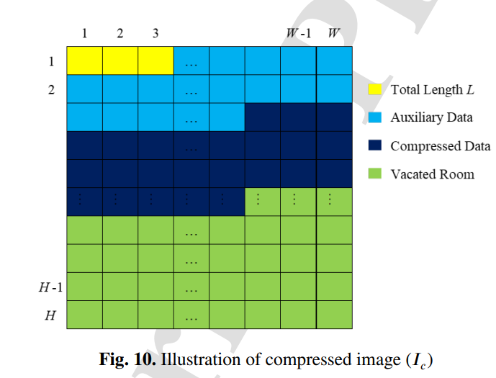
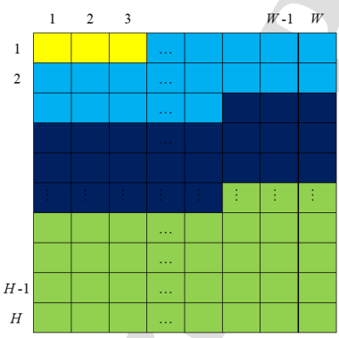

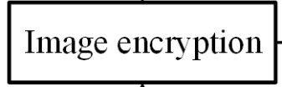
Proposed method (5/5) -Compressed image and image encryption
179 | 1 | 0 | 0 | …
5 | 0 | 2 | 2 | …
0 | 3 | 3 | 0 | …
1 | 1 | 1 | 0 | …
… | … | … | …
…
…
…
…
… | … | … | …
… | … | … | …
PEs after PEM

Slide 20
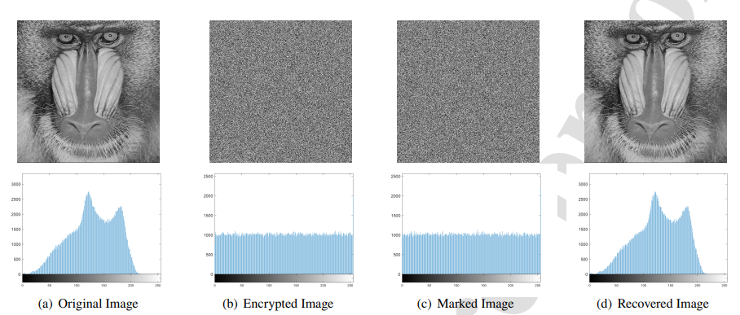
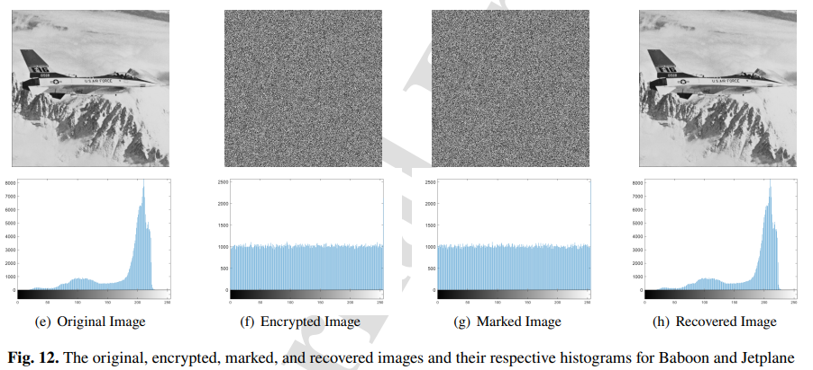
Experimental results (1/4)- Security analysis

Slide 21
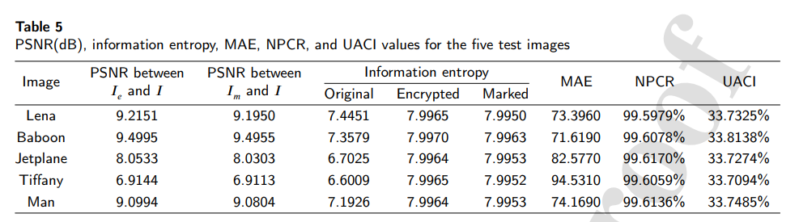


Experimental results (1/4)- Security analysis
Number of pixel changing rate (NPCR)
Uniffed average changing intensity (UACI).

Slide 22
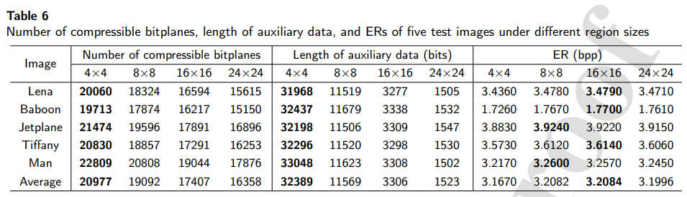
Experimental results (2/4)- Parameter setting

Slide 23
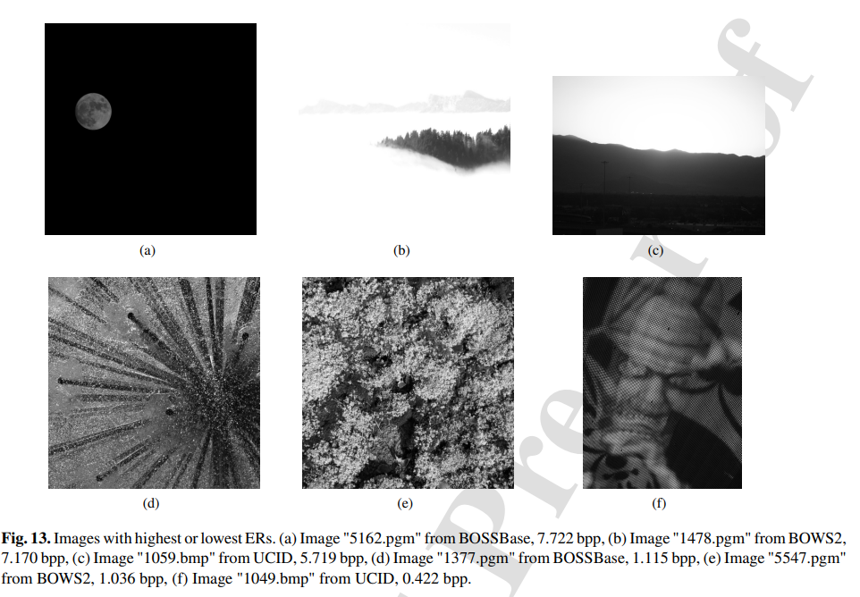
Experimental results (3/4)- Embedding performance

Slide 24
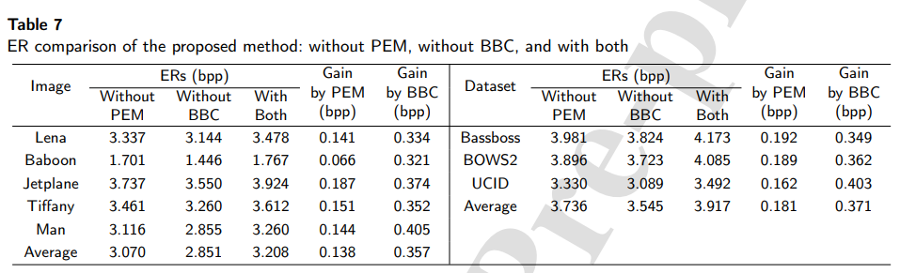
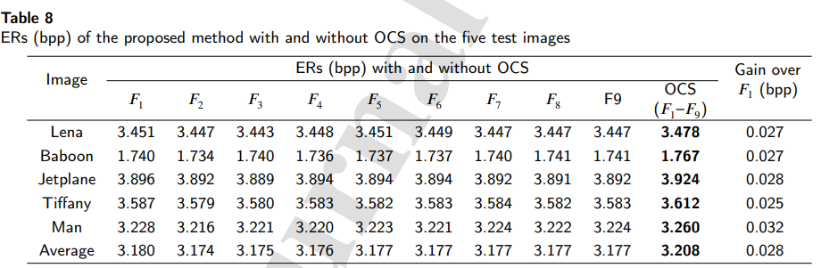
Experimental results (3/4)- Embedding performance

Slide 25
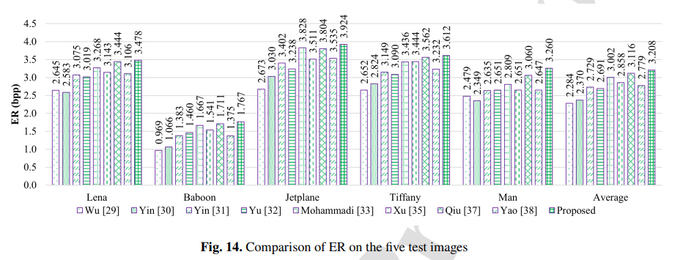
Experimental results (4/4)- Embedding performance comparison

Slide 26
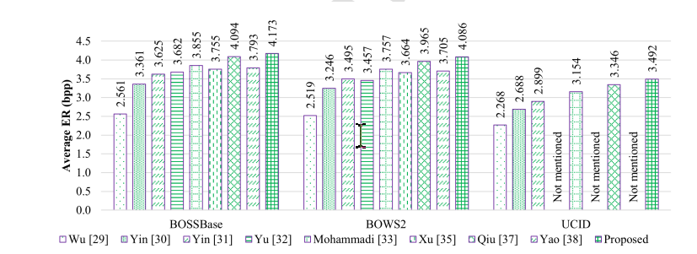
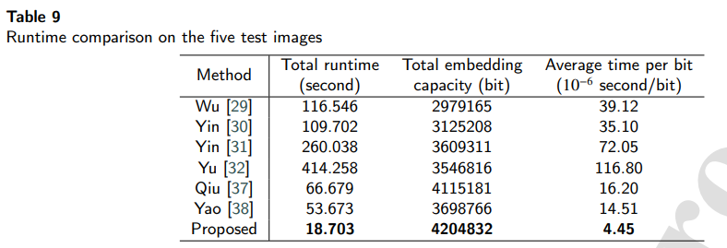
Experimental results (4/4)- Embedding performance comparison

Slide 27
Conclusions
This paper proposed a novel and high-capacity RDHEI method based on PEM and BBC
PEM is a low-complexity yet effective technique that reduces the entropy of PEs and makes them easier to compress
BBC makes better use of correlations between pixels and achieves good performance.
When the marked image has been unintentionally corrupted or deliberately modiffed, it is challenging for the proposed method to work well

