Slide 1
Chapter 1:
Creating
Java Programs

Slide 2
Learning Programming Terminology (cont’d.)
High-level programming language
  Allows you to use a vocabulary of reasonable terms
Syntax
  A specific set of rules for the language
Program statements
  Similar to English sentences
  Commands to carry out program tasks
Java Programming, Seventh Edition

Slide 3
Learning Programming Terminology (cont’d.)
Compiler or interpreter
  Translates language statements into machine code
Syntax error
  Misuse of language rules
  A misspelled programming language word
Debugging
  Freeing program of all errors
Logic errors
  Also called semantic errors
  Incorrect order or procedure
  The program may run but provide inaccurate output
Java Programming, Seventh Edition

Slide 4
Comparing Procedural and Object-Oriented Programming Concepts
Procedural programming
  Sets of operations executed in sequence
  Variables
    Named computer memory locations that hold values
  Procedures
    Individual operations grouped into logical units
Java Programming, Seventh Edition

Slide 5
Features of the Java Programming Language (cont’d.)
Java (cont’d.)
  Can be run on a wide variety of computers
  Does not execute instructions on the computer directly
  Runs on a hypothetical computer known as a Java Virtual Machine (JVM)
Source code
  Programming statements written in high-level programming language
Java Programming, Seventh Edition

Slide 6
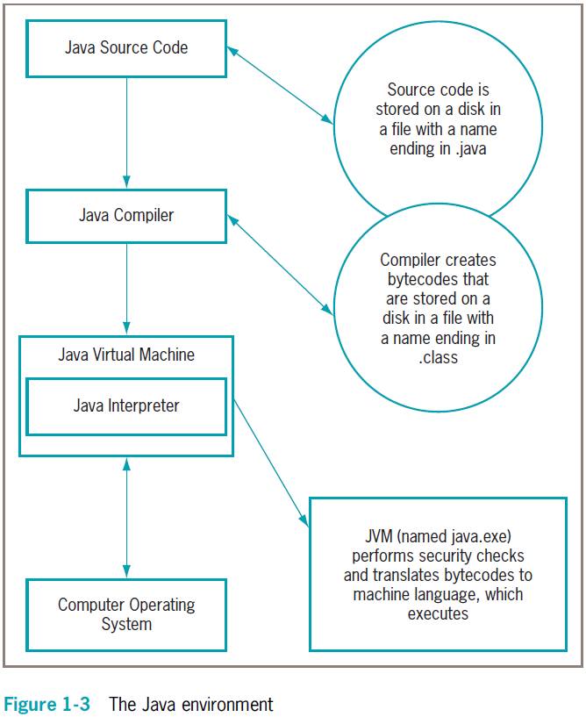
Features of the Java Programming Language (cont’d.)
Java Programming, Seventh Edition

Slide 7
Analyzing a Java Application that Produces Console Output
Even the simplest Java application involves a fair amount of confusing syntax
Print “First Java application” on the screen
Java Programming, Seventh Edition

Slide 8
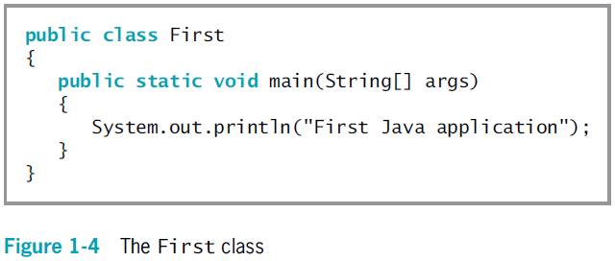
Analyzing a Java Application that Produces Console Output (cont’d.)
Java Programming, Seventh Edition

Slide 9
Understanding the Statement that Produces the Output
Literal string
  Will appear in output exactly as entered
  Written between double quotation marks
Arguments
  Pieces of information passed to a method
Method
  Requires information to perform its task
System class
  Refers to the standard output device for a system
Java Programming, Seventh Edition

Slide 10
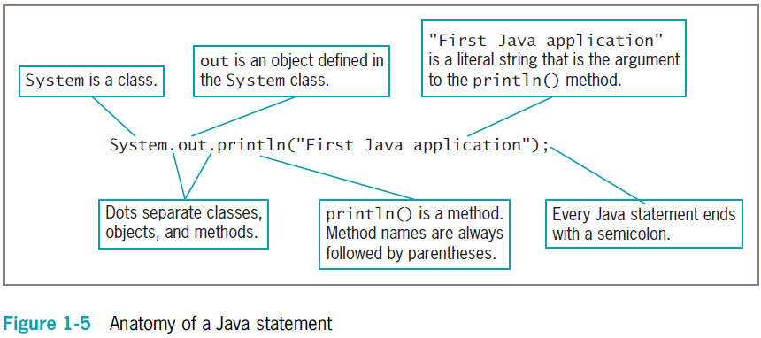
Understanding the Statement that Produces the Output (cont’d.)
Java Programming, Seventh Edition

Slide 11
Understanding the First Class
Everything used within a Java program must be part of a class
Define a Java class using any name or identifier
Requirements for identifiers
  Must begin with one of the following:
    Letter of the English alphabet
    Non-English letter (such as α or π)
    Underscore
    Dollar sign
  Cannot begin with a digit
Java Programming, Seventh Edition

Slide 12
Understanding the First Class (cont’d.)
Requirements for identifiers (cont’d.)
  Can only contain:
    Letters
    Digits
    Underscores
    Dollar signs
  Cannot be a Java reserved keyword
  Cannot be true, false, or null
Access specifier
  Defines how a class can be accessed
Java Programming, Seventh Edition

Slide 13
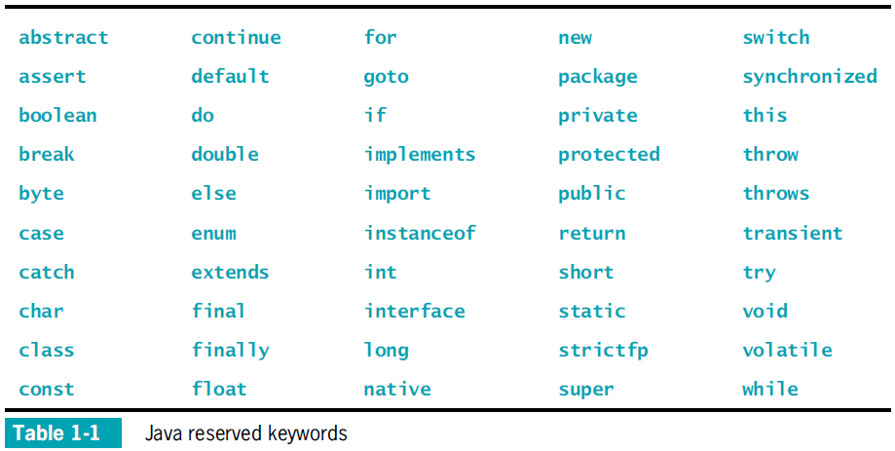
Understanding the First Class (cont’d.)
Java Programming, Seventh Edition

Slide 14
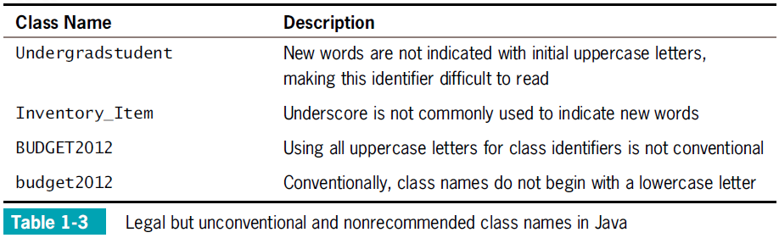
Understanding the First Class (cont’d.)
Java Programming, Seventh Edition

Slide 15
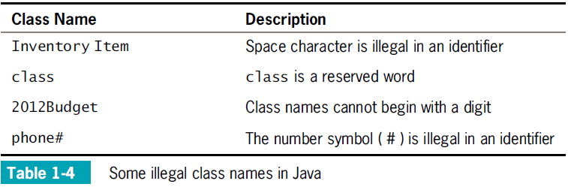
Understanding the First Class (cont’d.)
Java Programming, Seventh Edition

Slide 16
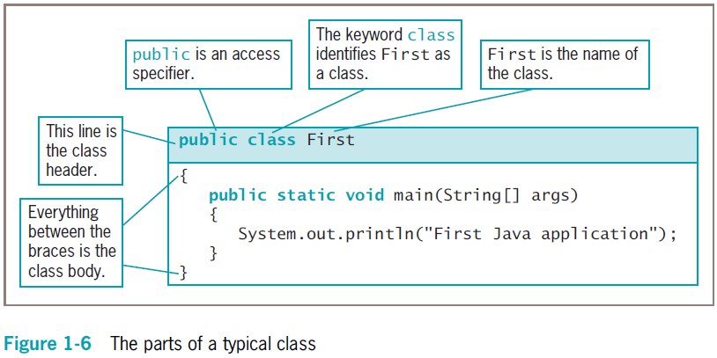
Understanding the First Class (cont’d.)
Java Programming, Seventh Edition

Slide 17
Indent Style
For every opening curly brace ( { ) in a Java program, there must be a corresponding closing curly brace
( } )
Placement of the opening and closing curly braces is not important to the compiler
Java Programming, Seventh Edition

Slide 18
Understanding the main() Method
static
  A reserved keyword
  Means the method is accessible and usable even though no objects of the class exist
void
  Use in the main() method header
  Does not indicate the main() method is empty
  Indicates the main() method does not return a value when called
  Does not mean that main() doesn’t produce output
Java Programming, Seventh Edition

Slide 19
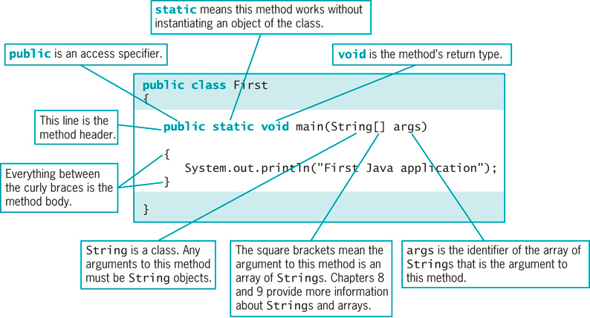
Understanding the main() Method (cont’d.)
Figure 1-7 The parts of a typical main() method
Java Programming, Seventh Edition

Slide 20
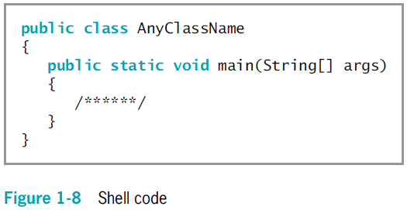
Understanding the main() Method (cont’d.)
Java Programming, Seventh Edition

Slide 21
Saving a Java Class
Saving a Java class
  Save the class in a file with exactly the same name and .java extension
    For public classes, class name and filename must match exactly
Java Programming, Seventh Edition

Slide 22
Compiling a Java Class and Correcting Syntax Errors
Compiling a Java class
  Compile the source code into bytecode
  Translate the bytecode into executable statements
    Using a Java interpreter
  Type javac First.java
Compilation outcomes
  javac is an unrecognized command
  Program language error messages
  No messages indicating successful completion
Java Programming, Seventh Edition

Slide 23
Compiling a Java Class and Correcting Syntax Errors (cont’d.)
Reasons for error messages
  Misspelled the command javac
  A misspelled filename
  Not within the correct subfolder or subdirectory on the command line
  Improper installation of Java
Java Programming, Seventh Edition

Slide 24
Correcting Syntax Errors
The first line of the error message displays:
  The name of the file where the error was found
  The line number
  The nature of the error
Next lines identify:
  The symbol
  The location
Compile-time error
  The compiler detects a violation of language rules
  Refuses to translate the class to machine code
Parsing
  Used by the process compiler to divide source code into meaningful portions
Java Programming, Seventh Edition

Slide 25
Running a Java Application and Correcting Logical Errors
Run the application from the command line
  Type java First
Shows the application’s output in the command window
The class is stored in a folder named Java on the C drive
Java Programming, Seventh Edition

Slide 26
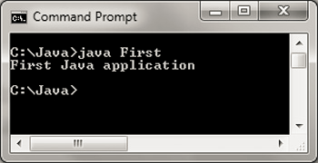
Running a Java Application and Correcting Logical Errors (cont’d.)
Figure 1-17 Output of the First application
Java Programming, Seventh Edition

Slide 27
Modifying a Compiled Java Class
Modify the text file that contains the existing class
Save the file with changes using the same filename
Compile the class with the javac command
Interpret the class bytecode and execute the class using the java command
Java Programming, Seventh Edition

Slide 28
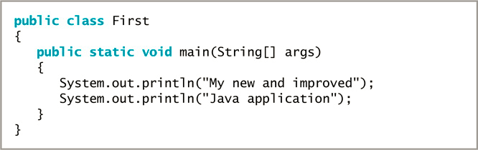
Modifying a Compiled Java Class (cont’d.)
Figure 1-18 First class containing output modified from the original version
Java Programming, Seventh Edition

Slide 29
Correcting Logical Errors
Logic error
  The syntax is correct but incorrect results were produced when executed
Run-time error
  Not detected until execution
  Often difficult to find and resolve
Java Programming, Seventh Edition

Slide 30
Adding Comments to a Java Class
Program comments
  Nonexecuting statements added to a program for documentation
  Use to leave notes for yourself or others
  Include the author, date, and class’s name or function
Comment out a statement
  Turn it into a comment
  The compiler does not translate, and the JVM does not execute its command
Java Programming, Seventh Edition

Slide 31
Adding Comments to a Java Class (cont’d.)
Types of Java comments
  Line comments
    Start with two forward slashes (//)
    Continue to the end of the current line
    Do not require an ending symbol
  Block comments
    Start with a forward slash and an asterisk (/*)
    End with an asterisk and a forward slash (*/)
Java Programming, Seventh Edition

Slide 32
Adding Comments to a Java Class (cont’d.)
Types of Java comments (cont’d.)
  Javadoc comments
    A special case of block comments
    Begin with a slash and two asterisks (/**)
    End with an asterisk and a forward slash (*/)
    Use to generate documentation
Java Programming, Seventh Edition

Slide 33
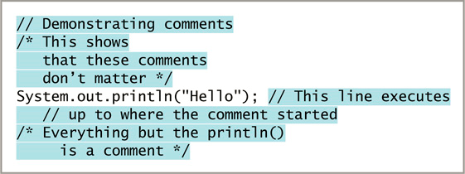
Adding Comments to a Java Class (cont’d.)
Figure 1-21 A program segment containing several comments
Java Programming, Seventh Edition

Slide 34
Summary (cont’d.)
Access specifier
  A word that defines circumstances under which a class can be accessed
All Java applications must have a method named main()
Program comments
  Nonexecuting statements
  Add to a file for documentation
javac
  A compile command
Java Programming, Seventh Edition

