Slide 1
Chapter 2:
Using Data

Slide 2
Objectives
Declare and use constants and variables
Use integer data types
Use the boolean data type
Use floating-point data types
Use the char data type
Use the Scanner class to accept keyboard input
Java Programming, Seventh Edition

Slide 3
Declaring and Using Constants and Variables
Constant
  Cannot be changed while program is running
Literal constant
  Value taken literally at each use
Numeric constant
  As opposed to a literal constant
Java Programming, Seventh Edition

Slide 4
Declaring and Using Constants and Variables (cont’d.)
Variable
  A named memory location
  Used to store a value
  Can hold only one value at a time
  Its value can change
Data type
  A type of data that can be stored
  How much memory an item occupies
  What types of operations can be performed on data
Java Programming, Seventh Edition

Slide 5
Declaring and Using Constants and Variables (cont’d.)
Primitive type
  A simple data type
Java Programming, Seventh Edition

Slide 6
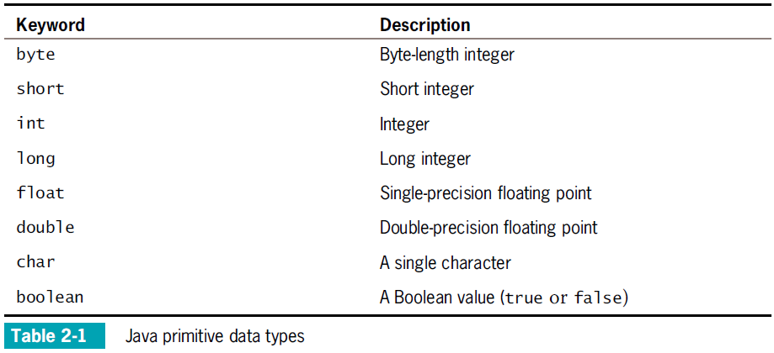
Declaring and Using Constants and Variables (cont’d.)
Java Programming, Seventh Edition

Slide 7
Declaring Variables
Name variables
  Use naming rules for legal class identifiers
Variable declaration
  A statement that reserves a named memory location
  Includes:
    Data type
    Identifier
    Optional assignment operator and assigned value
    Ending semicolon
Java Programming, Seventh Edition

Slide 8
Declaring Variables (cont’d.)
Assignment operator
  The equal sign (=)
  The value to the right is assigned to the variable on the left
Initialization
  An assignment made when declaring a variable
Assignment
  An assignment made after a variable is declared
Associativity
  The order in which operands are used with operators
Java Programming, Seventh Edition

Slide 9
Declaring Variables (cont’d.)
Declare multiple variables of the same type in separate statements on different lines
  int myAge = 25;
  int yourAge = 19;
When declaring variables of different types, you must use a separate statement for each type
Java Programming, Seventh Edition

Slide 10
Declaring Named Constants
A named constant:
  Should not change during program execution
  Has a data type, name, and value
  Has a data type preceded by the keyword final
  Can be assigned a value only once
  Conventionally is given identifiers using all uppercase letters
Java Programming, Seventh Edition

Slide 11
Concatenating Strings to Variables and Constants
print() or println() statement
  Use alone or in combination with a String
Concatenated
  A numeric variable is concatenated to a String using the plus sign
  The entire expression becomes a String
The println() method can accept a number or String
Java Programming, Seventh Edition

Slide 12
Pitfall: Forgetting That a Variable Holds One Value at a Time
Each constant can hold only one value for the duration of the program
Java Programming, Seventh Edition

Slide 13
Learning About Integer Data Types
int data type
  Stores an integer, or whole number
  Value from –2,147,483,648 to +2,147,483,647
Variations of the integer type
  byte
  short
  long
Choose appropriate types for variables
Java Programming, Seventh Edition

Slide 14
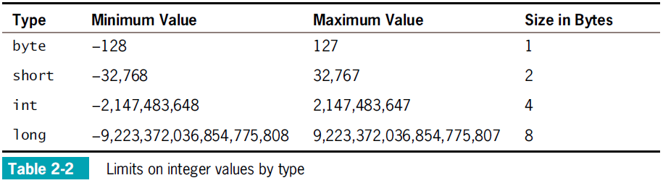
Learning About Integer Data Types (cont’d.)
Java Programming, Seventh Edition

Slide 15
Using the boolean Data Type
Boolean logic
  Based on true-or-false comparisons
boolean variable
  Can hold only one of two values
  true or false
boolean isItPayday = false;
Relational operator (comparison operator)
  Compares two items
Java Programming, Seventh Edition

Slide 16
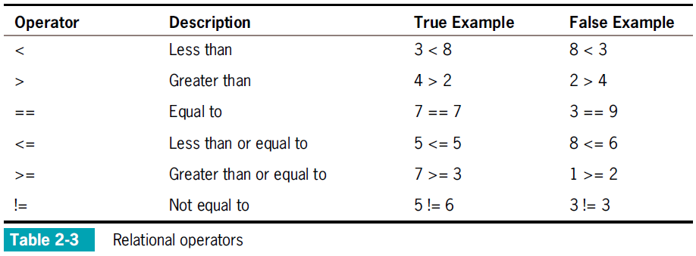
Using the boolean Data Type (cont’d.)
Java Programming, Seventh Edition

Slide 17
Learning About Floating-Point
Data Types
Floating-point number
  Contains decimal positions
Floating-point data types
  float
  double
Significant digits
  Refers to mathematical accuracy
Java Programming, Seventh Edition

Slide 18
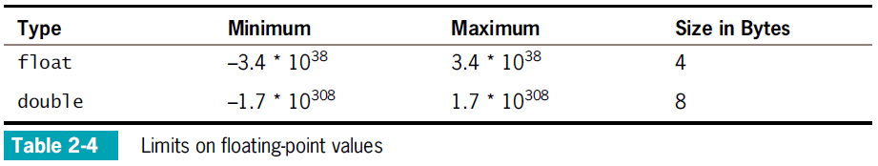
Learning About Floating-Point
Data Types (cont’d.)
Java Programming, Seventh Edition

Slide 19
Using the char Data Type
char data type
  Holds any single character
Place constant character values within single quotation marks
char myMiddleInitial = 'M';
String
  A built-in class
  Stores and manipulates character strings
  String constants are written between double quotation marks
Java Programming, Seventh Edition

Slide 20
Using the char Data Type (cont’d.)
Escape sequence
  Begins with a backslash followed by a character
  Represents a single nonprinting character
  char aNewLine = '\n';
To produce console output on multiple lines in the command window, use one of these options:
  Use the newline escape sequence
  Use the println() method multiple times
Java Programming, Seventh Edition

Slide 21
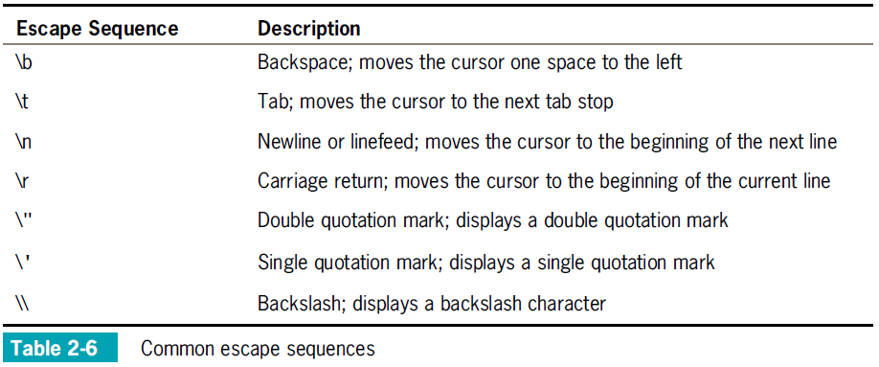
Using the char Data Type (cont’d.)
Java Programming, Seventh Edition

Slide 22
Using the Scanner Class to Accept Keyboard Input
System.in object
  Standard input device
  Normally the keyboard
  Access using the Scanner class
Scanner object
  Breaks input into units called tokens
Java Programming, Seventh Edition

Slide 23
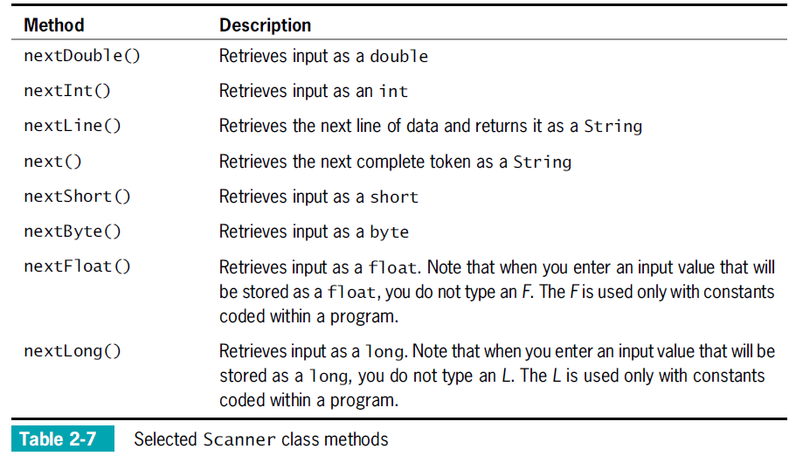
Using the Scanner Class to Accept Keyboard Input (cont’d.)
Java Programming, Seventh Edition

Slide 24
Convert String to int or double
  Use methods from the built-in Java classes Integer and Double
Java Programming, Seventh Edition

Slide 25
Using Input Dialog Boxes (cont’d.)
Type-wrapper classes
  Each primitive type has a corresponding class contained in the java.lang package
  Include methods to process primitive type values
      Integer.parseInt()
      Double.parseDouble()
Java Programming, Seventh Edition

Slide 26
Performing Arithmetic
Standard arithmetic operators
  Perform calculations with values in programs
Operand
  A value used on either side of an operator
Integer division
  Involves integer constants or integer variables
  The result is an integer
  Any fractional part of the result is lost
Java Programming, Seventh Edition

Slide 27
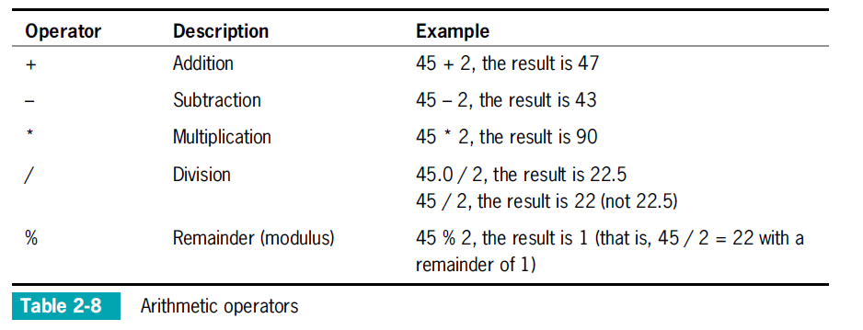
Performing Arithmetic (cont’d.)
Java Programming, Seventh Edition

Slide 28
Associativity and Precedence
Operator precedence
  The rules for the order in which parts of mathematical expressions are evaluated
  First multiplication, division, and remainder (modulus), then addition or subtraction
Java Programming, Seventh Edition

Slide 29
Writing Arithmetic Statements Efficiently
Avoid unnecessary repetition of arithmetic statements
Example of inefficient calculation:
  stateWithholding = hours * rate * STATE_RATE;
  federalWithholding = hours * rate * FED_RATE;
Example of efficient calculation:
  grossPay = hours * rate;
  stateWithholding = grossPay * STATE_RATE;
  federalWithholding = grossPay * FED_RATE;
Java Programming, Seventh Edition

Slide 30
Automatic Type Conversion
Automatically converts nonconforming operands to the unifying type
Order for establishing unifying types between two variables:
  double
  float
  long
  int
Java Programming, Seventh Edition

Slide 31
Summary
Variables
  Named memory locations
Primitive data types
Standard arithmetic operators for integers:
  +, _, *, /, and %
Boolean type
  true or false value
Relational operators:
  >, <, ==, >=, <=, and !=
Java Programming, Seventh Edition

Slide 32
Summary (cont’d.)
Floating-point data types
  float
  double
char data type
Scanner class
  Access keyboard inpu
Java Programming, Seventh Edition

