Slide 1

Personality Research for NLP
Prof. Yair Neuman
Ben-Gurion University of the Negev
co-Director, BIRL, Univ. Toronto
Visiting Prof. Weizmann Institute of Science & Oxford University
yneuman@bgu.ac.il
https://bgu.academia.edu/YairNeuman
A tutorial presented at the 2015 Conference on Empirical Methods on Natural Language Processing, September, Lisbon, Portugal

Slide 2
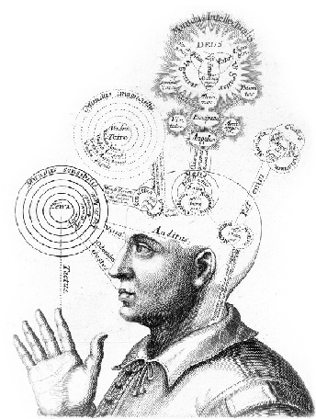
What is Personality and why is it Important for the NLP Community?

Slide 3
A psychological study once asked an interesting question:
Who divorce more?
Men who try to understand their wives?
or
Men who don’t try to understand their wives?

Slide 4
Those of you who are married can guess the answer…
Men who try to understand their wives divorce more than men who don’t try to understand their wives
The question is Why?

Slide 5
The answer that I gave elsewhere* is that
Understanding other people is a tricky issue
* Neuman, Y. (2014). Introduction to computational cultural psychology. Cambridge: Cambridge University Press.

Slide 6
Understanding involves conscious theorization
Human beings are better in applying unconscious heuristics
Gigerenzer, G., & Todd, P. M. (1999). Simple heuristics that make us smart. Oxford: Oxford University Press.‏

Slide 7
In sum, we want to understand other people but this is not an easy task
The lesson: Don’t try to understand your spouse, just adapt …

Slide 8
However …
Understanding other people is important than ever in our technological and consumer oriented society
In the past, and until quite recently in historical terms, it was more important to know WHAT you are (e.g. a Noblemen or a peasant) than WHO you are
Today the WHO you are is a central issue

Slide 9
Consumers’ Research
In consumers’ research “granular analytics” is an attempt to profile the client for high resolution tasks (e.g. marketing, advertising, priorization)
Similarly to “Personalized Medicine”, we would like to find the best “match” for a specific individual

Slide 10
e-Health
In e-Health it is important to screen the mental state of patients for diagnosis, prevention and treatment
Think for example about the importance of automatically screening for Depression
The murderous pilot of German Wings

Slide 11
Forensic Analytics
Can we screen for potential offenders such as pedophiles, school shooters or school bullies?

Slide 12
The Conclusion
Understanding other people is a must
Understanding other people is understanding their PERSONALITY

Slide 13
What is Personality?
Personality refers to the subject’s consistent patterns of
Thought
Emotion
Behavior
Consistent = Stable across time and contexts

Slide 14

The Borromean Rings of Personality
THOUGHTS
EMOTION
BEHAVIOR

Slide 15
Thoughts
Thoughts concern the cognitive aspect of personality
Mainly the schemes through which we represent our inner and outer world
Beliefs about self and others (I am .., They are …)

Slide 16
Emotions
No need to explain but … a recent interesting neuro-imaging study suggests that all of our emotions can be mapped into four dimensions
Kassam, K. S. et al. (2013). Identifying emotions on the basis of neural activation. PloS one, 8(6), e66032.‏

Slide 17
Valence (whether the stimuli is positive or negative)
Arousal (the strength of the affect)
Social aspect (e.g. jealousy)
Sexual desire (e.g. lust)

Slide 18
Behavior
Behavior concerns the actions taken by the individual
Not necessarily actual actions but fantasies and intentions too

Slide 19
Let’s illustrate these dimensions of personality through the
“understanding” husbands
vs.
“non-understanding” husbands

Slide 20
Thoughts
The “understanding” husband: “I don’t understand my wife”
The “non-understanding husband”: “I think that my wife needs me”

Slide 21
Emotions
The “understanding” husband: “I’m frustrated”
The “non-understanding husband”: “I’m OK”

Slide 22
Behavior
The “understanding” husband: “I must get divorce”
The “non-understanding husband”: “I’m going to have a pint of beer”
or a bottle of Port Wine produced in Portugal …

Slide 23
In sum
Personality involves consistent patterns of thought, emotion and behavior
Personality can be described in terms of
Types: Discrete categories of personality
or
Traits: Continuous dimensions of personality

Slide 24
How to scientifically identify a personality trait?
Human languages use numerous words and phrases to describe people: Nerd, liberal, open-minded etc.
Which of these tags can be used to describe a personality ‘trait’?

Slide 25
Not every descriptive term should be used as a personality tag (e.g. Liberal, Nerd, Funny)
However, it is difficult to decide …

Slide 26
The Lexical Approach to Personality
The naïve use of language is informative
Through subjects’ self-reports examine whether certain linguistic tags cluster together
If you identify clusters conclude that there are underlying personality factors explaining these clusters

Slide 27
Theories of Personality

Slide 28
The Five Factor Model of Personality (FFM) - The “Big Five”
The dominant model in the current personality research
John, O. P. & Srivastava, S. (1999). The Big Five trait taxonomy: History, measurement, and theoretical perspectives. In L. A. Pervin & O. P. John (Eds.), Handbook of Personality: Theory and Research (pp. 102–138). New York: Guilford Press.
McCrae, R. R. & John, O.P. (1992). An introduction to the five‐factor model and its applications. Journal of Personality, 60(2), 175-215.‏

Slide 29
“The default model of personality structure”
“anyone’s personality can be characterized in terms of the five dimensions of the FFM”
McCrae, R. R & Costa, P. T. (2013). Introduction to the empirical and theoretical status of the five-factor model of personality traits. In T. A. Widiger and P. T. Jr, Costa (Eds.), Personality disorders and the five-factor model of personality. Washington, DC: American Psychology Association.

Slide 30
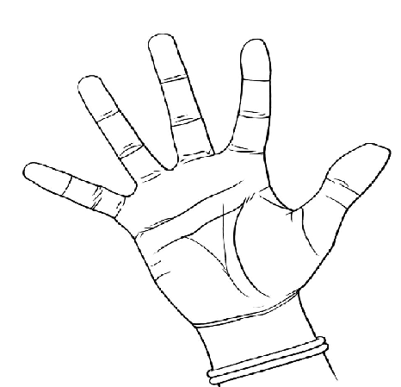
The Five Factors of Personality
CONSCIOUNTIOUSNESS
NEUROTICISM
AGREEABLENESS
OPENNESS
EXTRAVERSION

Slide 31
EXTRAVERSION
Being assertive, sociable, out-going, energetic, effective, and ambitious
The complementary dimension is
INTROVERSION

Slide 32
NEUROTICISM
Negative reaction to stress, anxious, insecure
Vs.
Calm and stable

Slide 33
AGREEABLENESS
Friendliness and cooperative behavior
Vs.
Selfishness and arrogance

Slide 34
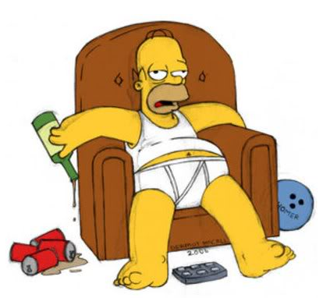
CONSCIENTIOUSNESS: organized, ordered, responsible vs.

Slide 35
OPENNESS
Openness to experience, creativity and imagination
Vs.
Closeness and rigidity

Slide 36
Dogma under criticism
The FFM is a dogma with many theoretical and empirical problems
Neuman, Y. (2014). Personality from a cognitive-biological perspective. Physics of Life Reviews, 11, 650-686.

Slide 37
For example
The FFM is based on the relations between variables across individuals but personality lies within the individual
So?

Slide 38
Molennar and Campbell (2009) analyzed data of 22 subjects who were measured on 90 consecutive days with equivalent versions of the Big Five questionnaire
Molenaar, P. C & Campbell, C. G. (2009). The new person-specific paradigm in psychology. Curr. Dir. Psychol . Sci. 18(2), 112–7.

Slide 39
The results are surprising
The analysis has shown that intra-individual variation doesn’t explain the repeated measurement scores!
It means that the correlation you may find at the group level of analysis is invalid at the individual level of analysis

Slide 40
For example, you may find a negative correlation between being ‘happy’ and ‘sad’ at the group level of analysis but when you analyze the subject’s scores, as gained through repeated measurements, the correlation vanishes …
No consistency, no personality …

Slide 41
A simpler explanation?
Neuroticism was found* to be strongly correlated with FEAR, SADNESS and ANGER
So … Maybe Neuroticism is just a fancy name for negative emotions?
*Davis, K. L. & Panksepp, J. (2011). The brain's emotional foundations of human personality and the Affective Neuroscience Personality Scales. Neuroscience & Biobehavioral Reviews, 35(9), 1946-1958.‏

Slide 42
The dimensions are highly associated, for instance
60% of the Extraverts are Agreeable
62% of those who are not Neurotic are Agreeable and so on …
* Celli, F. et al., (2013). Workshop on computational personality recognition (shared task). In Proceedings of the Workshop on Computational Personality Recognition.

Slide 43
In sum …
The FFM is the most popular model of personality, specifically in computational personality
Theoretically simple
Results are “guaranteed” (anything is associated with Neuroticism …)
Extremely limited

Slide 44
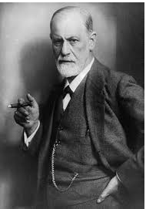
The Psychodynamic Approach: Beyond the Straw-Man of Dr. Freud

Slide 45
Personality as the adaptive ways of coping with the “exigencies of life”
Variability of personality traits is therefore variability in mental coping strategies
Personality types are presented in terms of the (1) cognitive (2) affective and (3) defensive functioning

Slide 46
Defensive Functioning
The mechanisms we use to defend ourselves from threatening thoughts and emotions
For example, splitting
Positive and negative qualities of the self and others are separated

Slide 47
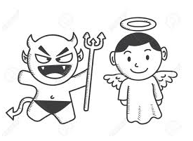
The Splitting Mind

Slide 48
Mom didn’t give me a candy
Mom is BAD
Mom gave me a hug
Mom is GOOD
Too complex!!!
Maybe there are two different mothers!

Slide 49
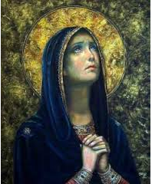
Splitting explains why through History we Find Two Orthogonal Kind of Women!

Slide 50
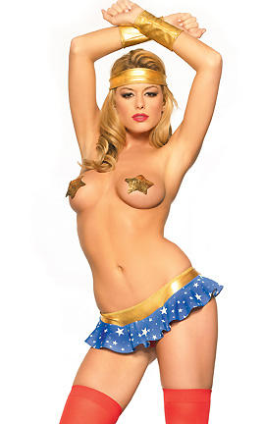
And …

Slide 51
Identifying Splitting
Highly relevant for diagnosis
Identification of potential offenders (e.g. civilian mass murderers, political extremists etc.)
Neuman, Y. Assaf, D & Cohen, Y. (in press). Automatic identification of the splitting defense mechanism in texts. In M. Arntfield & M. Danesi (Eds.), The Criminal Humanities: An Introduction. Peter Lang.

Slide 52
The Spectrum of Personality Dimensions
Personality dimensions range from
Adaptive, flexible and normal
to
Non-adaptive, rigid and pathological patterns

Slide 53
The Obsessive Personality Positive Aspects
Perfectionists, hard-workers, believe in work ethics, task-oriented and put their emotions aside when the work has to be done
Such a prototypical personality may be a highly successful surgeon or engineer

Slide 54
The Obsessive Personality Negative Aspects
Nothing is ever good enough and therefore no task can be finished
The hard-working person might be a workaholic who is "caged" in his office
The emotional constriction might be experienced as the loss of emotions that drains the joy of life and a basic sense of living

Slide 55
Personality Themes
Personality is organized around “themes” or conflicts
Psychodynamic diagnostic manual (PDM). Alliance of Psychoanalytic Organizations, 2006.‏

Slide 56
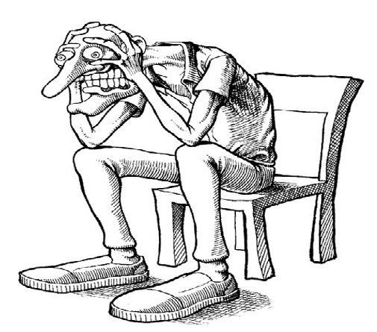
The Paranoid Personality

Slide 57
Organizing theme: Attacking/Being attacked by humiliating others
Central affect: Fear, rage
Thoughts of others: The world is full of potential attackers and users
Central ways of defense: Projection. The aggression that exists in his mind is attributed to others in the world

Slide 58
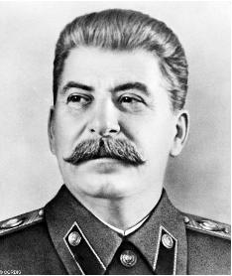
A Famous Paranoid

Slide 59
Suspicion
In fact the major conflict of the paranoid is the one of trust/suspicion
The paranoid invests energy in trust issues
Believes no one
On the other hand fully and uncritically trusts and adopts ungrounded Beliefs
Conspiracy theories

Slide 60
For example
Someone told me that his mother in law calls him regularly to “inform” him about “new scientific” inventions, trusting all possible rubbish in the media

Slide 61
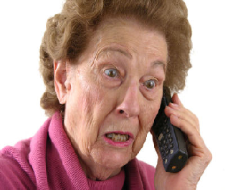
Aaron, It is amazing!
The Daily Mirror just reported that Kim Kardashian
invented a new drug for healing Cancer!

Slide 62
My diagnosis: A conflict over trust
I’ve asked him if his mother-in-law is paradoxically suspicious of well-grounded information …
He was shocked when I explained that I don’t really know his mother-in-law …

Slide 63
And don’t ask me to believe that the Americans really landed on the Moon!

Slide 64
Personality Prototypes
The Shelder-Westen Assessment Procedure (SWAP) recently identified two main personality clusters
Westen, D., Shedler, J., Bradley, B. & DeFife, J. A. (2012). An empirically derived taxonomy for personality diagnosis: bridging science and practice in conceptualizing personality. Am. J. Psychiatry, 169(3), 273-284.

Slide 65
The Internalizing Spectrum
Depressed, anxious, emotionally inhibited and socially avoidant, blame themselves, self-critical
Depressive
Anxious-Avoidant
Dependent-Victimized
Schizoid-Schizotypal

Slide 66
Depressive Personality
Prone to feelings of sadness and inadequacy
Self-critical/self-punitive
Concerns about abandonment and loss

Slide 67
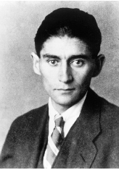
A Famous Depressed Author Franz Kafka

Slide 68
Anxious–Avoidant Personality
Socially anxious and avoidant
Manage anxiety in a way that limit and constrict their lives

Slide 69
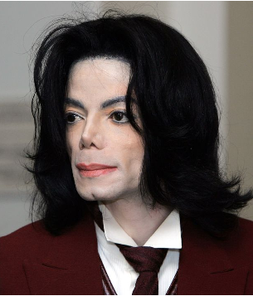
A Famous Avoidant Singer Michael Jackson

Slide 70
Dependent-Victimized Personality
Dependent and afraid of being alone
Insufficient concern for their well-being
Difficulty in expressing anger

Slide 71
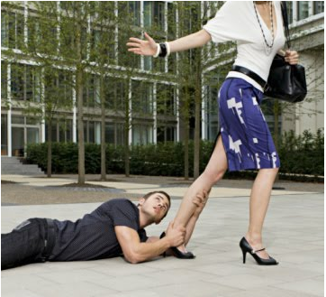

Slide 72
The Schizoid-Schizotypal
Peculiarities in interpersonal relationships and thought processes
Appear to have little need for human company
Seem detached or indifferent
Lack social skills and look awkward
Odd appearance
Feel life has no meaning

Slide 73

Willy Wonka from Charlie and the Chocolate Factory

Slide 74
We recently found that Schizoids function as “Firewalls” for the spread of rumors on Twitter
When receiving a rumor they are significantly less inclined to re-Tweet it

Slide 75
The Externalizing Spectrum
Angry and hostile, suspicious of others, conflicted about authority, prone to getting into power struggles, lack empathy, feel privileged and entitled, blame others, lack psychological insight, feel mistreated
Antisocial-Psychopathic
Paranoid
Narcissist

Slide 76
The Antisocial-Psychopathic
Exploit others
Experience little remorse and empathy
Manipulative
Lack fear
Enjoy playing the role of the predator

Slide 77
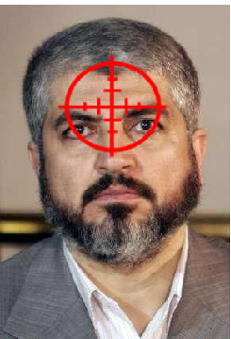
Personality Analysis and Deterrence Khaled Mashal – The Leader of Hamas

Slide 78
Narcissistic Personality
Grandiose self
Dismissive of others
Vulnerability beneath a grandiose facade

Slide 79
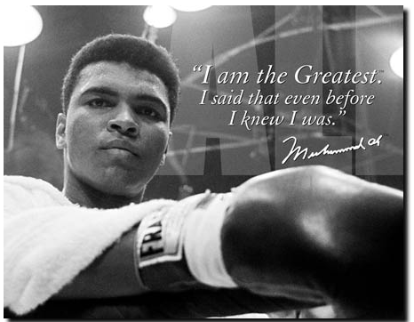
Muhammad Ali – The Boxer

Slide 80
Borderline-Dysregulated Spectrum
Impaired ability to regulate emotions
Unstable perceptions of self and others
Intense and chaotic relationships
Impulsive to include self-destructive impulses

Slide 81
Neurotic Styles
Obsessional personality
Overly rational, emotionally constricted and rigid, critical of themselves and others
Hysteric-Histrionic personality
Emotionally dramatic and theatrical, sexually provocative, idealizing others, paradoxically both intensely and superficially attached

Slide 82
Defense | Belief Others | Belief Self | Affect | Tension | Personality
withdrawal | Social interactions are painful | Dependency and love are dangerous | Pain | Fear of/longing for closeness | Schizoid
projection | World is full of offenders | Aggression is dangerous | Fear/ rage | Attacking/ being attacked | Paranoid
Omnipotent control | Everyone is manipulative | I can make anything happened | Rage/ envy | Manipulating/being manipulated | Psychopathic/Antisocial

Slide 83
In sum
The psychodynamic approach is theoretically grounded and rich in insights
Mostly applied to clinical cases
Difficult to apply in practice specifically in the context of NLP

Slide 84
The Cognitive Behavioral Approach
We have genetically determined strategies, or more accurately schemes, that aim to support our survival and reproduction
Personality is about our schemes
Beck, A. T. et al. (1990). Cognitive therapy of personality disorders. N.Y.: The Guilford Press.

Slide 85
Beliefs about self, others, future
Thoughts results from interpretation/information processing
Thoughts lead to emotions & behavior
Overdeveloped vs. underdeveloped schemes of interpretation

Slide 86
Over vs. Under Developed Schemes
Underdeveloped | Overdeveloped | Personality
Spontaneity | Control | Obsessive
Self sufficiency | Help seeking | Dependent
Trust | Mistrust | Paranoid
Intimacy | Withdraw al | Schizoid
Empathy | Self-aggrandizement | Narcissistic

Slide 87
Beliefs → Behavior
Behavior | Assumption | Others | Self | Personality
Don’t trust | If I trust then I may be attacked | Vicious | Vulnerable | Paranoid
Control as much as possible, rigidity | If I’m out of control the world will fall into chaos | Irresponsible | My world can get out of control | Obsessive
Show your superiority | If others conceive me as non-superior than I’m inferior | Superior | Inferior | Narcissistic

Slide 88
If you want to understand others analyze their beliefs, assumptions and behavior

Slide 89
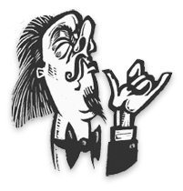
How to identify a Narcissist?

Slide 90
If someone is saying:
“I am a brilliant person who graduated from Harvard university not like my brothers who studied in a community college”

Slide 91
Dependency Parsing
nsubj(person-5, I-1)
cop(person-5, am-2)
det(person-5, a-3)
amod(person-5, brilliant-4)
The association between the “I” and “Brilliant” is indicative of the subject’s belief about the self

Slide 92
A Practical Application
Personality sensitive advertisements
For a narcissistic personality paraphrase the advertisement so that it includes words involving high status:
Harvard, Manhattan, Cartier, Ferrari, Remy Martin Cognac, etc.

Slide 93
The Affective-Neuroscience Approach
Basically seeks to ground the human affective system in the context of mammalian brains
Panksepp, J. (1998). Affective neuroscience: The foundations of human and animal emotions. Oxford university press.‏

Slide 94
Core Emotions
SEEKING, FEAR, RAGE, LUST, CARE, PANIC, and PLAY
Panksepp, J. (2005). Affective consciousness: Core emotional feelings in animals and humans. Consciousness and Cognition, 14(1), 30-80.‏

Slide 95
Adapted to Personality
ANPS – The Affective Neuroscience Personality Scales
Davis, K. L., Panksepp, J., & Normansell, L. (2003). The affective neuroscience personality scales: Normative data and implications. Neuropsychoanalysis: An Interdisciplinary Journal for Psychoanalysis and the Neurosciences, 5(1), 57-69.‏
Davis, K. L., & Panksepp, J. (2011). The brain's emotional foundations of human personality and the Affective Neuroscience Personality Scales.Neuroscience & Biobehavioral Reviews, 35(9), 1946-1958.‏

Slide 96
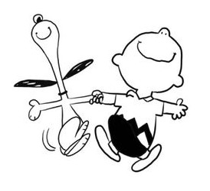
The Positive Emotions

Slide 97
Playfulness
Joy, social gaming, laugher, humor
Having fun vs. being serious, playing games with physical contact, humor, and laughter, and being generally happy and joyful.
“I am known as one who keeps work fun”

Slide 98
Seeking
Appetitive motivation system that involves a goal-directed behavior
Feeling curious, feeling like exploring, striving for solutions to problems and puzzles, positively anticipating new experiences, and a sense of being able to accomplish almost anything
“Almost any little problem or puzzle stimulates my interest”

Slide 99
Caring
Nurturing, being drawn to young children and pets, feeling softhearted toward animals and people in need, feeling empathy, liking to care for the sick, feeling affection for and liking to care for others, as well as liking to be needed by others
“I often feel a strong need to take care of others”

Slide 100
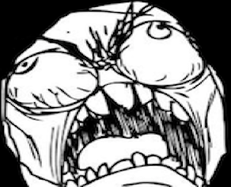
The Negative Emotions

Slide 101
Fear
Flight, escape, avoiding harm
Feelings of anxiety, feeling tense, worrying, struggling with decisions, ruminating about past decisions and statements, losing sleep, and not typically being courageous
“I often cannot fall right to sleep because something is troubling me”

Slide 102
Anger (Rage)
Anger, aroused by thwarting and frustration, affective attack
Feeling hotheaded, being easily irritated and frustrated, experiencing frustration leading to anger, expressing anger verbally or physically, and remaining angry for long periods
“When I get angry, I often feel like swearing”

Slide 103
Sadness (Panic)
A separation distress system, attachment to significant others
Feeling lonely, crying frequently, thinking about loved ones and past relationships, and feeling distress when not with loved ones
“I often have the feeling that I am going to cry”

Slide 104
Significant correlations between the ANPS and the Big Five
O | -N | C | A | E
 |  |  | .29 | .46 | PLAY
.47 |  |  |  |  | SEEK
 |  |  | .50 | .25 | CARE
 | -.75 | -.24 | -.17 | -.19 | FEAR
 | -.65 | -.30 | -.48 |  | ANGER
.17 |  |  | .26 | .15 | SADNESS

Slide 105
In sum
Grounds personality in basic emotion systems
Can it represent the complexity of HUMAN personality?
What does it mean to be a Narcissist according to the Affective Neuroscience Approach?

Slide 106
The requisite variety of personality theories: Why should we have more ideas in our tool kit

Slide 107
Higher level features may be highly relevant for sensitive and complex tasks

Slide 108
Bogdanova, Rosso and Solorio (2014) found that high-level feature were much more effective than lower-level features (e.g. n-grams) in differentiating between pedophilia chats and normative cybersex chats
Bogdanova, D., Rosso, P., & Solorio, T. (2014). Exploring high-level features for detecting cyberpedophilia. Computer Speech & Language, 28(1), 108-120.‏

Slide 109
Enriching our personality dimensions means enriching the high-level features that we may use for automatic personality analysis

Slide 110
NLP and Computational Personality

Slide 111
Automatic analysis of the subject’s personality based on his texts
You can use non-textual features for the analysis (e.g. voice) but I focus on texts only
Texts, whether written or spoken, are the richest source of information

Slide 112
Workshop on Computational Personality Recognition: Shard Task (2013)
The data: A corpus of 2468 stream-of-consciousness essays that was labeled with personality classes of the FFM
Each student got a categorical score on each of the FFM. For instance you can be a Neurotic or non-Neurotic

Slide 113
Percentage of Subjects in each of the Personality Dimensions
C | A | O | E | N
49 | 47 | 49 | 48 | 50 | 0
51 | 53 | 51 | 52 | 50 | 1

Slide 114
A Straightforward ML approach
Get a tagged corpus
Identify relevant features
Classify
The bread and butter of NLP researchers

Slide 115
Features
N-grams
LIWC
Sentiwordnet
Emotions
“top-down approaches, based on lexical resources (including the ones for sentiment analysis) and social info, in general seem to help personality recognition more than bottom-up approaches” (Celli et al. 2013)

Slide 116
Fine emotions even work better than general coarse categories
O | C | A | N | E
anxious | excited | happy | guilt | possessive
delighted | apprehensive | anger | eager | apart
blah | homesick | homesick | interested | happy
Important emotions “loaded” on each of the personality dimensions
Mohammad, S. M & Kiritchenko, S. (2013). Using nuances of emotion to identify personality. arXiv preprint arXiv:1309.6352

Slide 117
There are limits in gaining access to a tagged corpus
How representative is the corpus used for the First Comp. Pers. Workshop?
A corpus of students …
A sample of students is a non-representative sample

Slide 118
A Vectorial Semantics Approach to Personality Analysis
Identify words that are the best representatives of a certain personality trait
Represent them as a vector
Measure the distance between your personality vector and the target text
Neuman, Y & Cohen, Y. (2014). A vectorial semantics approach to personality assessment. Scientific Reports, 4.‏ doi:10.1038/srep04761

Slide 119
For instance
Extraversion: dominant, assertive, authoritarian, forceful, assured, confident, firm, persistent
Depressive: sad, depressed, hopeless, gloomy, fatalistic

Slide 120
A Top-Down Approach
Pros: Works extremely well, currently the state of the art results
F1 scores of Neuman and Cohen (NC) vs. Mohammad and Kiritchenko (MK)
 | EXT | NEU | AGR | OPN | CON
MK | 56.28 | 58.25 | 54.20 | 60.57 | 56.56
NC | 66.30 | 64.60 | 68.91 | 61.55 | 60.74

Slide 121
Cons
As a Top-Down approach it demands the expert’s knowledge for identifying the relevant words/vectors
Can we exhaust the complexity of human personality by focusing only on “words” as units of analysis?
Personality is probably expressed better as a discursive dynamics that involves the pragmatics of human communication

Slide 122
From Words to Discourse From Semantics to Pragmatics
The discursive level: Propositions, rather than words, as the target of analysis
Pragmatics: The use of language in human communication as determined by the conditions of society*
*Mey, J. L. (1993). Pragmatics: an introduction.‏ Wiley-Blackwell.

Slide 123
Understanding the “Pragmatics of Personality” is a must
Specifically if we would like to understand personalities beyond their limited Anglo-Saxon cultural context

Slide 124
This is Probably the Next Phase in Automatic Personality Analysis

Slide 125
Beyond Classification
In psychology, there has been an intensive work in developing valid psychological questionnaires for measuring psychological dimensions

Slide 126
We can use an NLP approach in which the quest/inventory is allegedly administrated to the subject or more accurately to his written text

Slide 127
"I am often nervous, fearful, and anxious, and I worry that something might go wrong"

Slide 128
We can use a TE engine and measure the degree in which the hypothesis, or several hypotheses derived from the personality items, is entailed from the subject’s written essay

Slide 129
text: I am very sad.
hypothesis: I am often nervous, fearful, and anxious, and I worry that something might go wrong
There are three possible answers to this text-hypothesis pair:
text entails hypothesis
text contradicts hypothesis
text does not entail or contradict

Slide 130
Given a text written by subject X, let each sentence in the text be Xi. For each Xi, construct a text-hypothesis pair:
text: Xi
hypothesis: Hi,
where each Hi is an item taken from the psychological questionnaire

Slide 131
Doesn’t work well…
But maybe a simpler method

Slide 132
Convert personality items into lexico-semantic patterns
Item: "I am often nervous, fearful, and anxious”
has been converted into the pattern:
nsubj(nervous, I)
nsubj(fearful, I)
nsubj(anxious, I)

Slide 133
Parse the essay and find sentences with first person pronoun
Identify matching patterns for those that have been extracted from the psychological questionnaire
Measure the similarity between the essay and the predefined patterns

Slide 134
For example
Target sentence: I am sad
Personality item for measuring Neuroticism:
"I am often nervous, fearful, and anxious”

Slide 135
I AM SAD
IF nsubj (X, I) AND IF X = JJ
THEN SIM(X, nervous/fearful/anxious)
IF advmod (X, RB = 'seldom' or 'rarely' or 'barely' or 'hardly' or 'infrequently' or 'never' or 'scarcely' or 'almost never' or 'not often')
OR
IF neg(X)
THEN SIM = SIM*(-1)

Slide 136
We tested this methodology on the identification of the FFM
Few pre-defined patterns based on the “Short Five” (S5) questionnaire (Muck et al., 2007) (e.g. only 8 patterns for NEU)
Muck, P. M. et al. (2007). Construct validation of a short five-factor model instrument: A self-peer study on the German adaptation of the Ten-Item Personality Inventory (TIPI-G). European Journal of Psychological Assessment, 23(3), 166-175.‏

Slide 137
Results
On average, the F1 score gained in this study (63.58) isn't significantly different from the one gained by Neuman and Cohen (2014) (i.e., 64.42), but is higher that the average F1 score gained by Mohammad and Kiritchenko (2013) (i.e., 57.17)

Slide 138
Practical Applications

Slide 139
Homeland Security: How to Identify a Murderer in a Haystack
Neuman, Y. et al. (2015). Profiling school shooters: Automatic text-based analysis. Frontiers in Psychiatry [http://journal.frontiersin.org/article/129117/abstract]

Slide 140
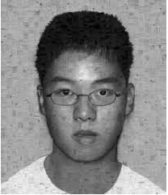
School Shooters Seung-Hui Cho murdered 23 students and faculty members at Virginia Tech on April 16, 2007

Slide 141
School shooters receive extensive media coverage and create social anxiety
There is no consistent diagnosis of school shooters
Can we profile school shooters?
Can we use the profile for future screening?

Slide 142
We selected six texts written by school shooters
For gaining comparative insights, we used the Blogs Authorship Corpus (Schler et al., 2006) and selected blogs written by males from the age of 15 to 25, ages approximately overlapping those of the school shooters
Overall, we analyzed the blogs written by 6056 subjects

Slide 143
We have analyzed only three parts of speech categories: nouns, verbs, and adjective
From each text, we selected the ten most frequent nouns, the ten most frequent verbs, and the ten most frequent adjectives
Overall, we used 30 words to represent each text as a vector

Slide 144
We measured the semantic similarity between each of the texts and word vectors representing four personality disorder traits:
Paranoid Personality Disorder (PPD),
Narcissistic Personality Disorder (NPD)
Schizotypal Personality Disorder (ScPD) and
Depressivity (DEP)

Slide 145
In addition, factors of REVENGE
Hopeless: hopeless, desperate
Lonely: lonely, lonesome
Helpless: helpless, defenseless
Pain: pain, misery, agony
Revengeful: revengeful, vengeful, vindictive
Chaotic: chaotic, disordered
Unsafe: unsafe, insecure
Abandoned: abandoned, deserted
Humiliated: humiliated, shamed

Slide 146
For measuring similarity, we used Peter Turney’s matrix
Turney, P., Neuman, Y., Assaf, D., Cohen, Y. (2011). Literal and metaphorical sense identification through concrete and abstract context. In Proceedings of the 2011 Conference on Empirical Methods in Natural Language Processing, Edinburgh, Scotland, UK, July 27–31. pp. 680–690.

Slide 147
Following the automatic identification of sexual predators (Inches & Crestani, 2012) can we produce a ranked list of suspects to prioritize the investigation?
Inches, G., Crestani, F. (2012). Overview of the international sexual predator identification competition at pan-2012. In CLEF 2012 Evaluation Labs and Workshop - Working Notes Papers, eds. P. Forner, J. Karlgren, C. Womser-Hacker (Rome, Italy).

Slide 148
Three Statistical Models
Binary Logistic Regression Analysis
Tree Classification with CHAID and ten-fold cross-validation procedure and
K Nearest Neighbors Analysis with ten-fold cross-validation

Slide 149
Averaging the ranks produced by the three classifiers, we gain the best results, which are identifying all the shooters’ texts among the top 210 ranked texts: approximately 3% of our corpus
Enormous reduction in work load for the human agent

Slide 150
Screening for Potential Offenders
Ethical considerations due to the high rate of false positives
Results can be improved by the fusion of several information sources:
Medical records: Psychiatry illness
Purchases: Weapons? Chemicals?
Criminal records: Previous convictions?

Slide 151
Military Intelligence: Profiling Political Leaders
Neuman, Y., Cohen, Y., & Shahar, G. (in press). A novel computer assisted methodology for leaders' profiling. American Intelligence Journal [Special issue: New Paradigms in [Military] Intelligence Analysis

Slide 152
Personality profiling
The "impressionist" and "informal" approach used by Jerry Post (CIA)
The “formal” approach uses informants' reports of others through the use of standard inventories (The profiling of Kim Jong-il)

Slide 153
Personality and Text-in-Context
The challenge:
Identify themes that emerge from the text in a given socio-political context as well as personality features
The way in which these themes, that may have been preformed by the leader and probably by his close circle, intermingle with the leader's personality to produce a synergetic output

Slide 154
Morsi’s Case
The speech given by the new elected Egyptian President Mohammed Morsi
A leader of the Islamic Brothers
September 26, 2012, the General Assembly of the UN

Slide 155
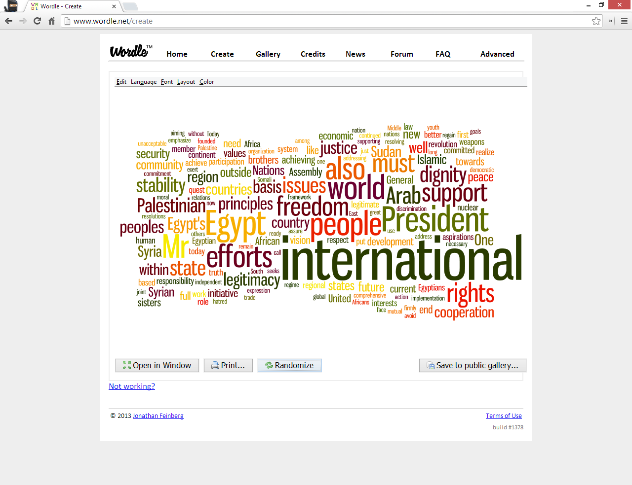
Surface Themes

Slide 156
Three Major Themes
The Palestinian – Israeli conflict and Egypt’s support of the Palestinian side
Establishing Egypt as an Arabic – African leader of the developing world
Egypt’s efforts on helping to end the violence in Syria

Slide 157
Motifs Analysis - Results
We applied MOTIFS ANALYSIS to the semantic network of the speech
By identifying the words populating most the motifs' edges three words emerge: Rights, Principles and Vision
The hypothesis: Morsi’s speech is indicative of Obsessive Compulsive Personality features

Slide 158
Obsessive Compulsive Personality
This type of personality seeks opportunity to prove himself as selflessly committed to the "greater cause”
Rigid and dogmatic personality, occupied with details, and presents an over conscientious attitude toward matters of morality and values

Slide 159
Testing the Hypothesis
The Obsessive vector: Rigid, stubborn, over-conscientious, inflexible, organized, perfectionist …
The Narcissistic vector: special, unique, selfish, envious, arrogant, contemptuous, brilliant …

Slide 160
Results
The speech was much closer to the Obsessive vector (0.09) than to the Narcissistic vector (0.02)
It was found that the speech was mostly similar to the Bureaucratic and the Purtian subtypes

Slide 161
Conclusions
President Morsi was a Bureaucratic-Puritan leader
Don’t expect him to lead a change …
The American enthusiasm was too early …
In retrospective we know that we were right

Slide 162
Customers' Service: Who is the Unhappy Customer

Slide 163
Can we better understand who is a non-satisfied customer?
The **** dataset
335,022 Reviews
70,817 users
We categorized the reviews into satisfied (3/4 stars) and non satisfied customers (1/2 starts)

Slide 164
Most reviews were very positive (70% vs. 30%)
We profiled the customers by analyzing the reviews of each customer

Slide 165
Correlations between Rating and Personality Dimensions
Neuroticism = -0.215
Angry = -0.185
Etc.
We built an index from these scores
The sum of the z-scores
Titled “Neurotic”

Slide 166
Neurotic?
YES | NO
66% | 34% | NO | A satisfied customer?
42% | 58% | YES

Slide 167
The probability of being an unsatisfied costumer is 0.32
The probability of being an unsatisfied costumer given that one is Neurotic is 0.43

Slide 168
Implications for Customers’ Service Priorization
Some customers are not satisfied as a result of the service/purchase
Some customers are not satisfied because their PERSONALITY cannot be satisfied
We found two types of unsatisfied customers: The NEUROTICS and the PERFECTIONISTS (i.e. Obsessive)

Slide 169
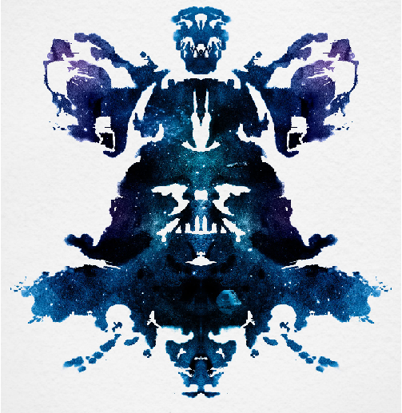
The Rorschach Test

Slide 170

It Looks Like Darth Vader from Star Wars!

Slide 171
BUT DON’T POINT TO THIS SIMILARITY
The diagnosis of those who see monsters in the ink spots isn’t positive …

Slide 172
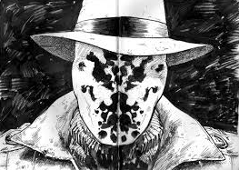
Human Personality is like a Rorschach Ink Spot

Slide 173
Sometimes we see our own projections rather than a real structure …
Automatic personality analysis
The challenge of understanding other people
From naïve impressions to scientific analysis
A pragmatic motivation – real world applications

Slide 174
Thank you for Attending this Tutorial

