Slide 1
GeoHumanities’17
1st ACM SIGSPATIAL Workshop on Geospatial Humanities
7th Nov. 2017 – Crowne Plaza Redondo Beach And Marina – Ramada 2
Opening Remarks – Bruno Martins

Slide 2
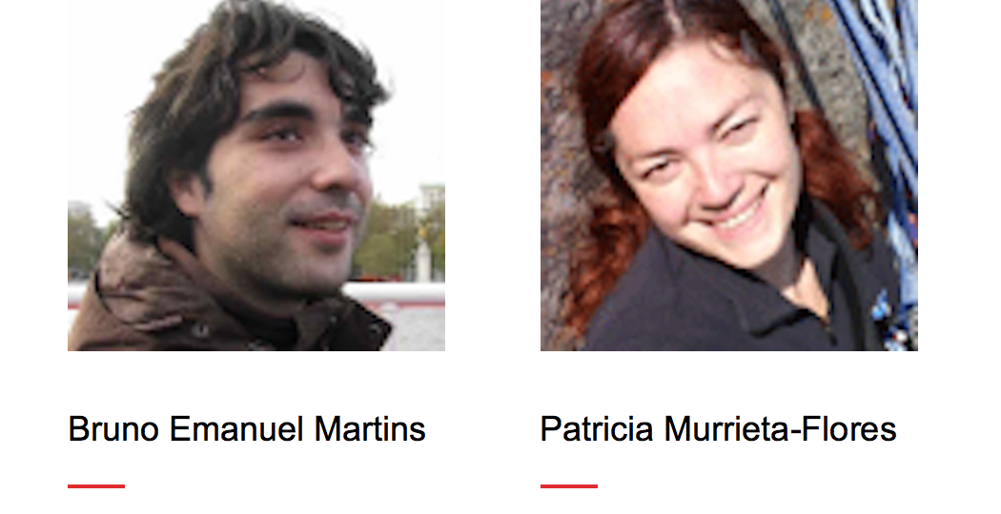
Organizers

Slide 3
GeoHumanities’17
Workshop concerned with the use of geographic information systems and other spatial technologies in humanities research
We received 13 submissions, of which we accepted 8 papers
Program Committee with 31 researchers (different backgrounds)
discussion session at the end
Workshop program contains 3 technical sessions
coffee breaks in between sessions + lunch after session 1
Details on the website - http://bgmartins.github.io/sigspatial-geohumanities/

Slide 4
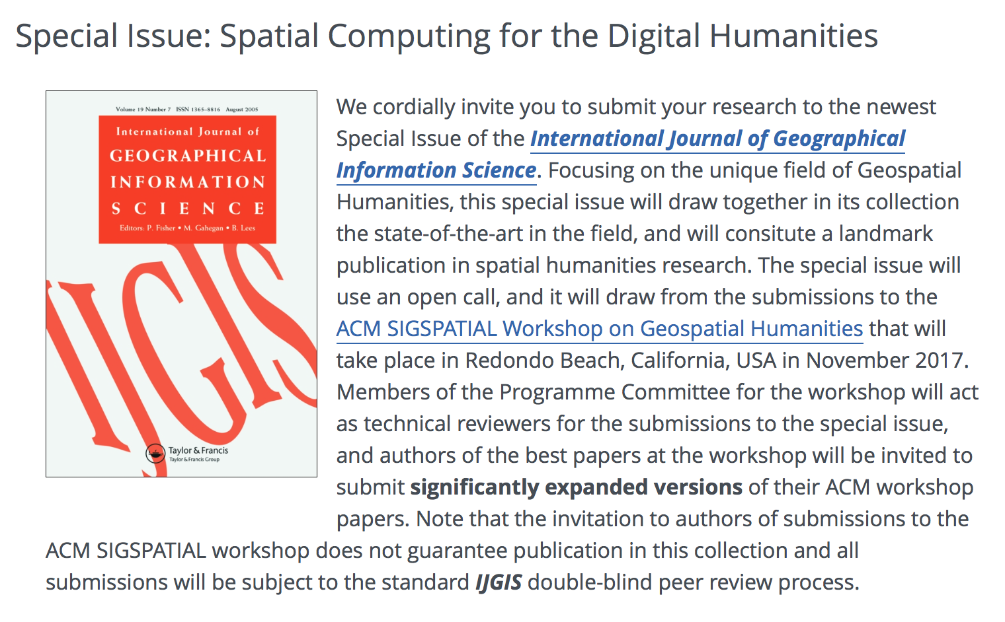
Special Issue at IJGIS

Slide 5
S1 - Text Geoparsing and Gazetteer Development
10:00 - 10:30 - Ludovic Moncla, Mauro Gaio, Thierry Joliveau and Yves-François Le Lay.
Automated Geoparsing of Paris Street Names in 19th Century Novels
11:00 - 11:30 - Paul Rayson, Alex Reinhold, James Butler, Chris Donaldson, Ian Gregory and Joanna Taylor.
A deeply annotated testbed for geographical text analysis: The Corpus of Lake District Writing
11:30 - 12:00 - Katherine McDonough and Matje van de Camp.
Mapping the Encyclopédie: Working Towards an Early Modern Digital Gazetteer

Slide 6
S2 - Spatial Analysis within Geo-Humanities and Geo-Linguistics
13:30 - 14:00 - Clément Chagnaud, Philippe Garat, Paule-Annick Davoine and Axel Vincent.
ShinyDialect : a cartographic tool for spatial interpolation of geolinguistic data
14:00 - 14:30 - Luke Bergmann and David O'Sullivan.
Computing with many spaces: Generalizing projections for the digital geohumanities and GIScience

Slide 7
S3 - Methods and Applications from Related Areas
14:30 - 15:00 - Yerach Doytsher, Ben Galon and Yaron Kanza.
Emotion Maps based on Geotagged Posts in the Social Media
15:00 - 15:30 - Caleb Robinson, Fred Hohman and Bistra Dilkina.
A Deep Learning Approach for Population Estimation from Satellite Imagery
16:00 - 16:30 - Kai Wang, Xiaolu Zhou and Lixin Li.
Disentangle crime hot spots and displacements in space and time: an analysis for Chicago from 2001 to 2016

Slide 8
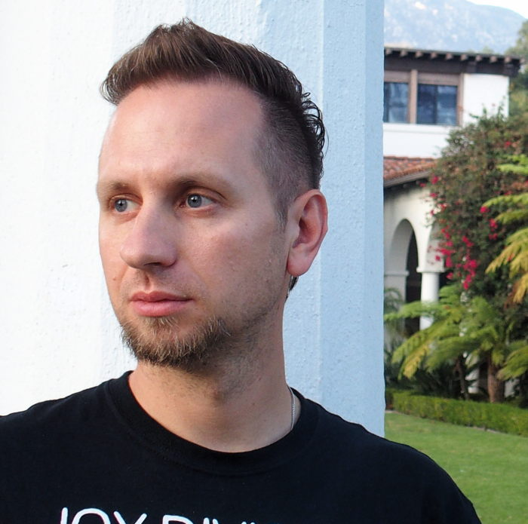
Keynote presentation by Krzysztof Janowicz ( and Yingjie Hu )
Linked Data and the Digital Humanities
A Match Made in Heaven or Hell?

Slide 9
GeoHumanities’17

