Slide 1
GeoHumanities’18
2nd ACM SIGSPATIAL Workshop on Geospatial Humanities
6th Nov. 2018 – Seattle Marriott Waterfront
Opening Remarks – Bruno Martins

Slide 2
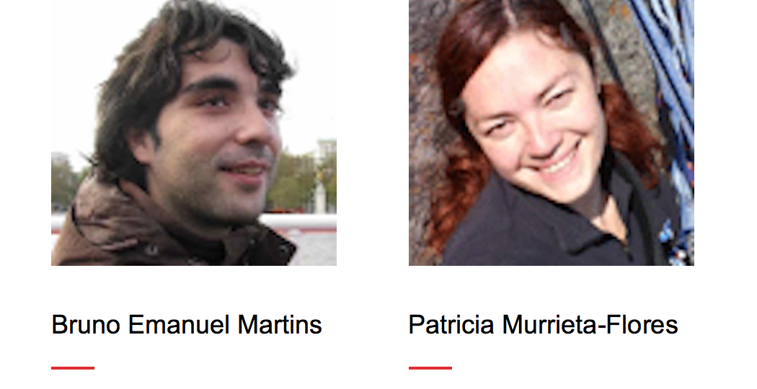
Organizers

Slide 3
GeoHumanities’18
Workshop concerned with the use of geographic information systems and other spatial technologies in humanities research
We received 5 submissions, of which we accepted 4 full-papers
Program Committee with ~ 30 researchers (different backgrounds)
Workshop program contains 2 technical sessions
coffee breaks in between sessions + lunch after the 2nd session
discussion session at the end
Details on the website - http://bgmartins.github.io/sigspatial-geohumanities/

Slide 4
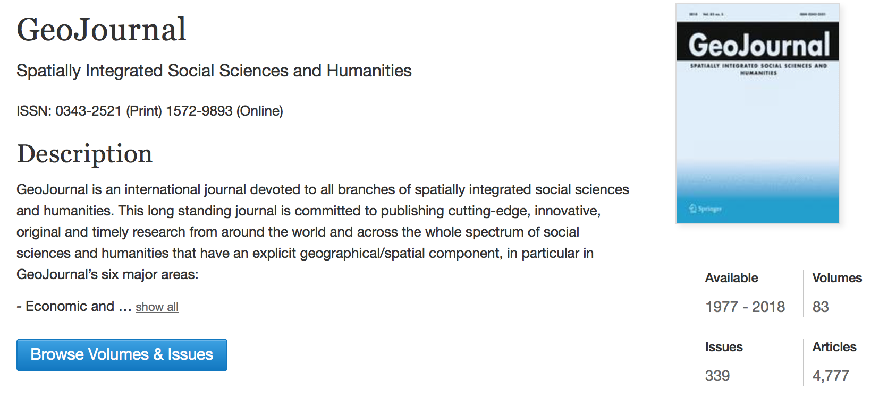
Special Issue at GeoJournal

Slide 5
Session 1
09:45 - 10:10 - Vincent Mack and Tin Seong Kam.
Is There Space for Violence? A Data-driven Approach to the Exploration of Spatial-Temporal Dimensions of Conflict
10:15 - 10:40 - Esko Ikkala, Jouni Tuominen, Jaakko Raunamaa, Tiina Aalto, Terhi Ainiala, Helinä Uusitalo, and Eero Hyvönen.
NameSampo: A Linked Open Data Infrastructure and Workbench for Toponomastic Research

Slide 6
Session 2
11:15 - 11:40 - Björn Barz, Thomas C. Van Dijk, Bert Spaan, and Joachim Denzler.
Putting User Reputation on the Map: Unsupervised Quality Control for Crowdsourced Historical Data
11:45 - 12:10 - Sohrab Rahimi and Mallika Bose.
Social class and taste in the context of US cities: Validating Bourdieu’s theory of distinction using restaurant reviews

Slide 7
GeoHumanities’18
Proceedings of the 2nd ACM SIGSPATIAL Workshop on Geospatial Humanities now available from ACM Digital Library
https://dl.acm.org/citation.cfm?id=3282933

