Slide 1
ABC
AI-Powered Scrum Master
Agent Suite
Transforming how Scrum Masters lead teams on Azure DevOps
using VS Code Copilot AI Agents — @ScrumAgent
@ScrumAgent · Azure DevOps · GitHub Copilot · GPT-4o
Confidential | Leadership Review | 2026
Notes:
Welcome. This deck showcases the AI Scrum Master Agent Suite built on VS Code Copilot and Azure DevOps. It automates every stage of the Scrum cycle — from backlog refinement through to release notes.

Slide 2
ABC
Today's Agenda
01
The Challenge
05
Agent Roadmap
Manual Scrum pain points at scale
18 additional agents planned across 4 categories
02
Solution Overview
06
Efficiency Gains
@ScrumAgent architecture on VS Code + Azure DevOps
Time savings calculated for team of X
03
Automation Flow
07
Scrum Master Evolution
All 6 Scrum stage agents — live diagram
From manual admin to AI-augmented coaching
04
Sprint Planning Deep Dive
08
Next Steps
SDLC child task auto-generation per User Story
Rollout plan — live in under one week
Notes:
8 sections. Approximately 20 minutes.

Slide 3
ABC
The Challenge — Manual Scrum Overhead
How much Scrum Master time is spent on admin vs. actual coaching?
Backlog Grooming
3–5 hrs
Daily Standups
1–2 hrs
📋
☀️
Rewriting vague stories, adding ACs one by one into ADO
Pulling blocker data from ADO, summarising for Teams
Poker Planning
2–4 hrs
Retrospectives
2–3 hrs
🃏
🔄
Running estimation sessions, recording results manually
Collecting velocity data, writing reports, follow-up items
Sprint Planning
4–6 hrs
Release Notes
2–4 hrs
🗓️
📋
Creating 5–7 child tasks per story by hand each sprint
Trawling ADO, grouping features, writing for stakeholders
⏱ Total manual overhead: 14–24 hours per sprint — time not spent coaching, unblocking, or improving the team.
Notes:
Scrum Masters are spending the majority of their time on repetitive admin. This suite automates all of it.

Slide 4
ABC
Solution: @ScrumAgent
One AI agent. Six Scrum stages. Fully automated on Azure DevOps.
VS Code
GitHub Copilot
Azure DevOps
Teams
Copilot Chat
@ScrumAgent
GPT-4o reasoning
No extra key needed
Work Items, Sprints
Test Plans, Wiki
Standup posts
Stakeholder alerts
/BacklogRefinement
Rewrites stories + generates ACs
/DailyScrum
Standup summary + blocker alerts
/PokerPlanning
Suggests story points + risk flags
/Retrospective
Velocity analysis + action items
/SprintPlanning
Assigns sprint + 7 SDLC child tasks
/ReleaseNotes
Stakeholder-ready release notes
Type @ScrumAgent / in Copilot Chat → Tab autocomplete → instant action on your Azure DevOps sprint
Notes:
The agent lives in VS Code Copilot Chat. Config is one file — config.ini with your Sprint URL and PAT. That's it.

Slide 5
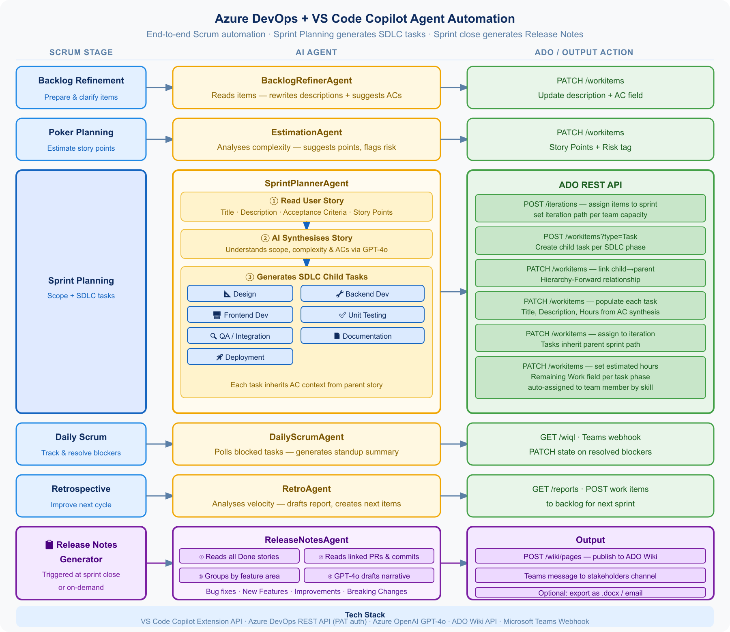
ABC
End-to-End Scrum Automation Flow
Every stage of the Scrum cycle — mapped to an AI Agent and an Azure DevOps API action
Notes:
This is the full automation flow. Each row is one stage of the Scrum cycle, one AI agent, and the resulting Azure DevOps API action. The Release Notes Generator at the bottom is triggered at sprint close.

Slide 6
ABC
Sprint Planning: SDLC Task Auto-Generation
User Story
📐
🔍
🤖
Design
QA Integration
Title
4h
8h
Patient Login with MFA
SprintPlannerAgent
Description
Synthesises all story
fields via GPT-4o
🔧
📄
As a nurse I want to log in securely...
Backend Dev
Documentation
Acceptance Criteria
12h
4h
Given / When / Then (3 ACs)
Story Points
🖥️
🚀
8 pts → ~48 target hours
Frontend Dev
Deployment
8h
6h
🧪
Unit Testing
7 tasks · 48h total · all linked to parent story in ADO · created in under 30 seconds
6h
Each task title and description is specific to THIS story — derived directly from its Acceptance Criteria. Not generic templates.
Notes:
The key capability: AI reads the full User Story, synthesises the scope and ACs via GPT-4o, and creates 7 specific SDLC tasks — each with a title and description tied to that story.

Slide 7
ABC
Agent Roadmap — What's Next for @ScrumAgent
6 agents built · 18 more planned across 4 categories
🏃 Sprint Intelligence
🧪 Quality & Testing
→ CapacityPlanner — warns if sprint overcommitted before locking
→ TestCaseGenerator — ACs to Azure Test Plans automatically
→ DependencyDetector — finds & links inter-story dependencies
→ BugTriager — classifies & routes incoming bugs to sprints
→ SprintHealthCheck — mid-sprint burndown & risk forecast
→ DefinitionOfDoneChecker — validates story before it closes
→ StaleItemAlerter — pings assignees on stuck tasks via Teams
→ PRLinker — auto-links PRs to User Stories in ADO
📢 Stakeholder Comms
🏛️ Governance & Agentic
→ SprintReviewDeck — auto-builds sprint review PowerPoint
→ AuditTrail — compliance-ready sprint change log
→ StakeholderUpdate — weekly progress email draft from ADO
→ RiskRegister — living ADO Wiki risk register per sprint
→ KPIDashboard — velocity & cycle time Markdown summary
→ OrchestratorAgent — runs full Scrum cycle autonomously
→ CommitSummariser — plain-English digest of all commits
→ SprintBootstrapper — full backlog from plain-English goal
Priority order: Sprint Intelligence → Quality & Testing → Stakeholder Comms → Governance & Agentic
Notes:
18 additional agents across 4 categories. Recommend starting with SprintHealthCheck and TestCaseGenerator as the next builds.

Slide 8
ABC
Efficiency Gains — Team of X
Assumptions: X = team size · 2-week sprints · 6 sprints per quarter · 1 Scrum Master per team
14–24h
70%
~30s
3×
Hours saved
per sprint
Reduction in
manual prep
To generate
7 SDLC tasks
Teams per
Scrum Master
Admin overhead eliminated
Per Scrum ceremony
vs. 45–60 min manually
Up from 1 to 2–3 teams
Before vs. After — Per Sprint
Activity
Manual (hrs)
@ScrumAgent (hrs)
Time Saved
Backlog Refinement
3–5
< 0.1
~4.5h
Poker Planning
2–4
< 0.1
~3h
Sprint Planning+Tasks
4–8
0.5
~6h
Daily Standup prep
1–2
0
~1.5h
Retrospective
2–3
0.3
~2.3h
Release Notes
2–4
0.1
~3h
TOTAL
14–26
~1h
~20h/sprint
💡 Scaling to 5 teams: ~100h/sprint saved organisation-wide — equivalent to 2.5 Scrum Master days per sprint reinvested into coaching.
Notes:
Replace X with your actual team size when presenting. Key message: ~20 hours per SM per sprint freed up for coaching and strategic work.

Slide 9
ABC
The Scrum Master Role — Enhanced, Not Replaced
BEFORE — Manual Scrum Master
AFTER — AI-Augmented Scrum Master
✗ Manually copying stories into refinement templates
✓ Reviews AI-refined stories — focuses on quality
✗ Running poker planning and updating ADO by hand
✓ Facilitates discussion — agent handles data entry
✗ Creating 5–7 child tasks per story each sprint
✓ Reviews AI-generated SDLC tasks, adjusts if needed
✗ Pasting standup data from ADO into Teams daily
✓ Reads agent standup summary — acts on blockers
→
✗ Writing velocity tables in retro documents
✓ Reviews velocity insights — coaches on root causes
✗ Spending 3–4 hrs drafting release notes
✓ Approves and publishes AI-drafted release notes
✗ Chasing developers to update task states
✓ Monitors ADO health via agent — acts on exceptions
✗ Limited to supporting 1 team effectively
✓ Capacity grows to support 2–3 teams at same quality
The SM shifts from task executor to strategic coach — AI handles the admin, the human handles the judgement and the people.
Notes:
Most important message for leadership: this is role enhancement, not replacement. We free SMs to do high-value coaching work that AI cannot replicate.

Slide 10
ABC
Next Steps
From leadership approval to first agent running — under one week
Week 1
Week 2
Week 3–4
Q3 2026
Install & Configure
First Full Sprint
Measure & Tune
Scale & Extend
· Clone repo, open in VS Code
· Run /BacklogRefinement pre-sprint
· Track time saved per ceremony
· Roll out to additional teams
· Fill config.ini: Sprint URL + PAT
· Run /SprintPlanning — SDLC tasks live
· Gather SM feedback on task quality
· Build SprintHealthCheck + TestCase
· npm install → F5 → test /DailyScrum
· Validate quality with the team
· Adjust prompts if needed
· Enable OrchestratorAgent
One config.ini · One Sprint URL · One PAT token · @ScrumAgent is live
Notes:
The ask: approve the pilot for one team in Week 1. Results are measurable immediately — time saved, task quality, SM satisfaction. We scale from there.

