Slide 1




SMART INDIA HACKATHON 2026
  Problem Statement ID – 26106
  Problem Statement Title- AI-Powered Email Threat Detection, GeoLocation and Forensic Intelligence Platform
  Theme- Block Chain and cyber Security
  PS Category- Software
  Team Name (Registered on portal):The Watch Dog Legion

Slide 2
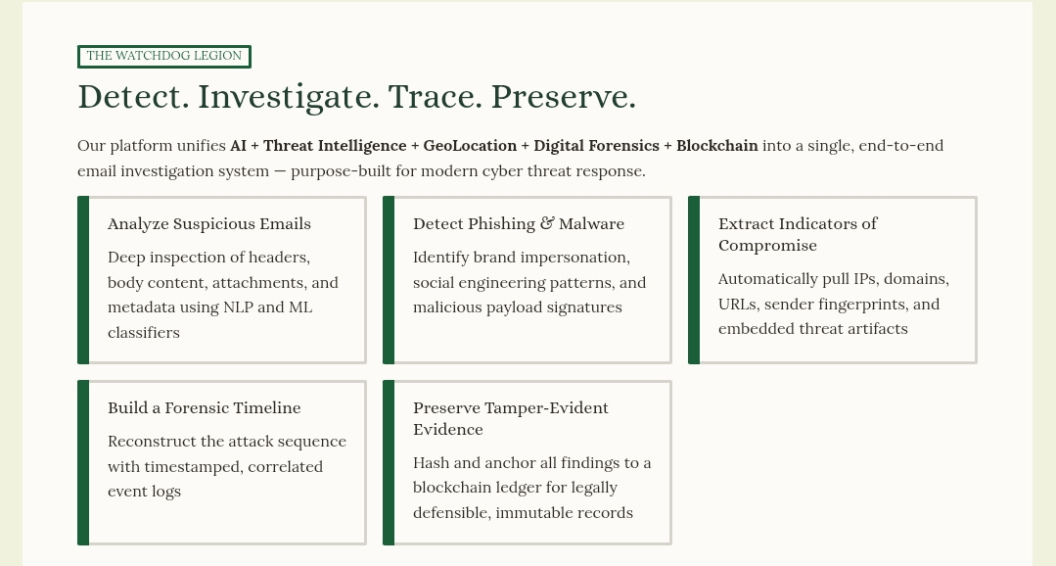
“Detect. Investigate. Trace. Preserve.”
The Watchdog Legion
2
Notes:
2

Slide 3
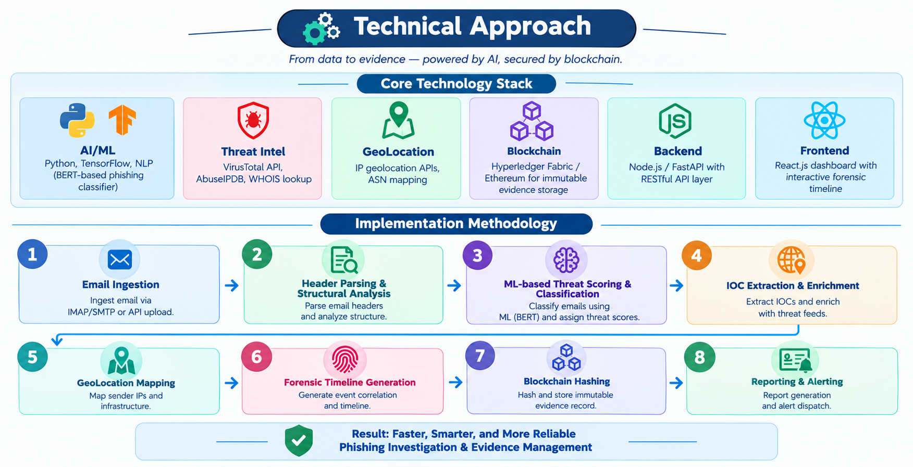
TECHNICAL APPROACH
The Watchdog legion
@SIH Idea submission- Template
3
Notes:
3

Slide 4
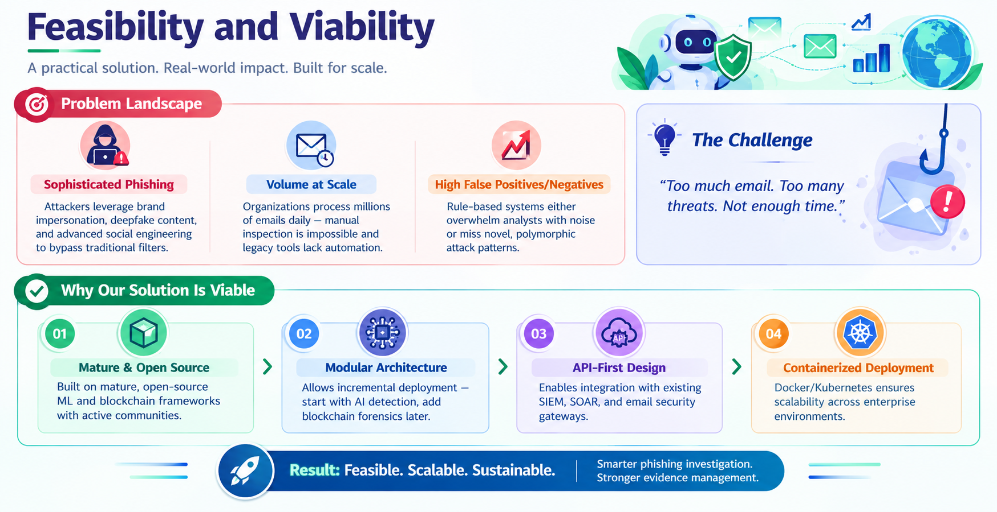
FEASIBILITY AND VIABILITY
The Watchdog Legion
@SIH Idea submission- Template
4
Notes:
4

Slide 5
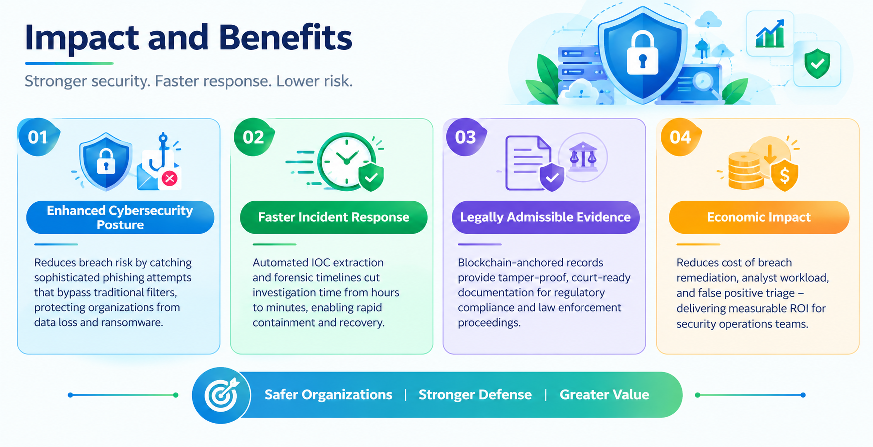
IMPACT AND BENEFITS
The Watchdog Legion
@SIH Idea submission- Template
5
Notes:
5

Slide 6
RESEARCH AND REFERENCES
The Watchdog Legion
RFC SPECIFICATIONS & CORE STANDARDS
1. Protocols & Email Security Standards
• RFC 7208: Sender Policy Framework (SPF) for validating authorized sending MTAs.
• RFC 6376: DomainKeys Identified Mail (DKIM) cryptographic RSA/Ed25519 signatures.
• RFC 7489: Domain-based Message Authentication, Reporting & Conformance (DMARC).
• RFC 8617: Authenticated Received Chain (ARC) protocol for multi-hop mail forwarders.
• RFC 5322: Internet Message Format (IMF) structural standards and Received header chaining.
CYBER THREAT INTELLIGENCE & MITRE
2. Threat Intelligence & Frameworks
• MITRE ATT&CK Matrix: Techniques T1566 (Phishing), T1078 (Valid Accounts), T1036 (Masquerading).
• OASIS STIX 2.1: Structured Threat Information Expression standard for machine-readable CTI.
• AbuseIPDB & URLhaus: Real-time global repository of verified malicious IPs and malware distribution URLs.
• Shodan InternetDB: Keyless infrastructure scanner for open mail relay ports (25, 587) and vulnerabilities.
• Spamhaus DNSBL: Real-time DNS-based blocklists for known spam hosts and compromised networks.
LEGAL ADMISSIBILITY & AI RESEARCH
3. Blockchain, Compliance & Literature
• ISO/IEC 27037:2012: Guidelines for identification, collection, acquisition & preservation of digital evidence.
• Ethereum Sepolia Testnet: Immutable decentralized smart contract ledger for tamper-evident SHA-256 anchoring.
• Indian IT Act & BSA: Admissibility compliance under Bharatiya Sakshya Adhiniyam for electronic records.
• CERT-In Guidelines: National cyber incident reporting formats for automated law-enforcement dispatch.
• Academic NLP Datasets: Benchmarking against Enron Email Dataset, SpamAssassin, and phishing corpora.
@SIH Idea submission- Template
6
Notes:
6

