Slide 1
Investigating Math Motivation and Math Anxiety in Undergraduate Students
Ben Gochanour
Advised by milos savic, phd

Slide 2
Introduction
Math anxiety
Enormous interest (scholarly and otherwise)
Avoidance of math and math-based careers (Ashcraft, 2002)
Frequently studied, but not perfectly understood
Math motivation
How can we conceptualize it?
Notes:
-The term yields almost 5,500 “hits” on Google Scholar for articles published between 2015 and 2019 alone.
-For example, some researchers have found math anxiety to have a simple inverse linear relationship with performance, while some suggest it has have a curvilinear (upside down U) relationship, where math anxiety is actual beneficial up to a point
-Almost all psychological theories have a theory of motivation within them. The question is, which should we use to conceptualize math motivation?

Slide 3


Study Motivation
Anxiety and motivation extensively studied as predictors of academic performance (e.g., Halat & Çimenci Ateş, 2016, Struthers et. al, 2000)
Math anxiety and math motivation have studied as predictors of math performance (e.g., Chang & Beilock, 2016, Steinmayr & Spinath, 2009)
Examine math anxiety and math motivation directly to better understand both concepts
Notes:
-This discussion leads us to our study motivation. (summarize bullets)
-Define performance (grades and test scores)

Slide 4
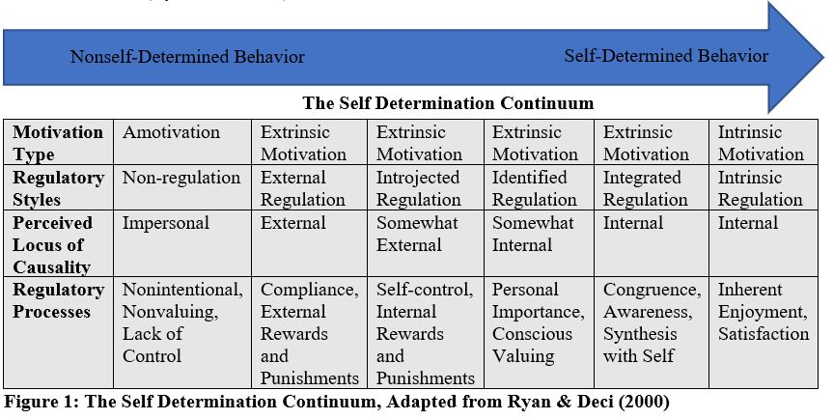
Self Determination Theory (SDT)
Richard Ryan and Edward Deci (Ryan et. al, 1985)
Growth tendencies, self-motivation, personality integration
Amotivation, Extrinsic Motivation, Intrinsic Motivation
Degree of “self-regulation” or internalization
Notes:
Earlier, we discussed how the choice of motivational theory is important. I decided to go with the Self Determination Theory, and will explain why in the next slide. However, let’s first try to cover the fundamentals of the theory. (First two bullets, then explain the figure and what it means)

Slide 5
SDT (continued)
Motivation is activity-specific
Wide range of academic disciplines, including chemistry, business, and math
Breaks down extrinsic motivation into several regulatory styles
Students A & B: A case study
Notes:
Another important thing to note is that, from the SDT perspective, motivation is activity specific. This means that math could be motivating to a student, while science is not, or that basketball could be motivating to a student, but not chemistry. Therefore, the term “math motivation” is used in this study to specifically indicate motivation related to math.
Past studies have applied SDT to a wide range of disciplines, including…..
One of the reasons why it’s been so widely used is that it breaks down extrinsic motivation into several regulatory styles
-Most students don’t find all academic subjects intrinsically motivating (Ryan et. al, 1985)
-Other theories forced to lump all such students into “extrinsic motivation” or “amotivation”
Case study, two HS students
Student A: Performs math HW because of threat of punishment from parents if he fails next exam
Student B: Performs math HW because she recognizes that working hard now will prepare her for her math studies in college
Neither student is intrinsically motivated because….but….
Student A: External Regulation
Student B: Identified Regulation

Slide 6
Math Anxiety
Ashcraft (2002): “a feeling of tension, apprehension, or fear that interferes with math performance” (p. 181)
Chang & Beilock (2016): “a separate phenomenon from general trait anxiety or test anxiety…associated with specific impairments in processing math-related or number-related tasks” (p. 33)
1. Interferes with performance on math-related tasks
2. More than test anxiety
Two key points
Notes:
Many definitions exist in the literature, but this study followed….
Very few math anxiety questionnaires (including the Math Anxiety Rating Scale developed by Suinn) asess performance and math related tasks, probably because this assessed separately in the classroom. This is also the case for the Abbreviate Math Anxiety Questionnaire used in this study. Secondly, it is important to note that math anxiety is more than just test anxiety, which is why this rating scale includes subscales for “evaluation math anxiety” which covers areas like…. and “learning math anxiety”, which covers areas like…..

Slide 7
Research Question
Does type and degree of motivation predict math anxiety experienced by undergraduates?
Hypothesis: Math motivation is predictive of math anxiety levels
Amotivation and more extrinsically-regulated forms of motivation: positive correlation
Intrinsically-regulated motivation: negative correlation

Slide 8
Methods
37-item Likert-style questionnaire
College Algebra or Precalculus for Business, Life, and the Social Sciences course (n=56)
Multiple Regression Analysis in R (R Core Team, 2018)
Literature review to construct conceptual model

Slide 9
Methods
Academic Motivation Scale-Math (AMS-Math)
Why do you take math courses?
Adapted from AMS-Chemistry (Liu et. al, 2017)
Abbreviated Math Anxiety Scale (AMAS) (Hopko et. al, 2003)
How much anxiety do you feel in the following situations?

Slide 10
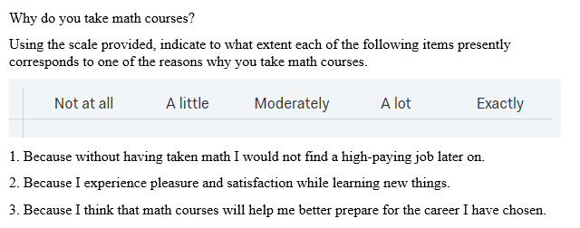
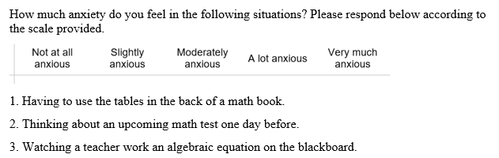

Slide 11
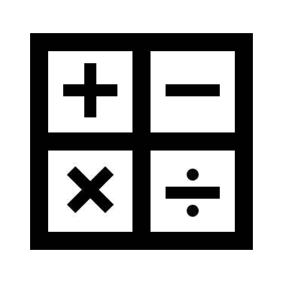

Survey Validation: Cronbach’s Alpha
AMS-Math
.87 (identified regulation) to .93 (introjected regulation)
AMAS
.88 (.90 in Hopko et. al, 2003)

Slide 12
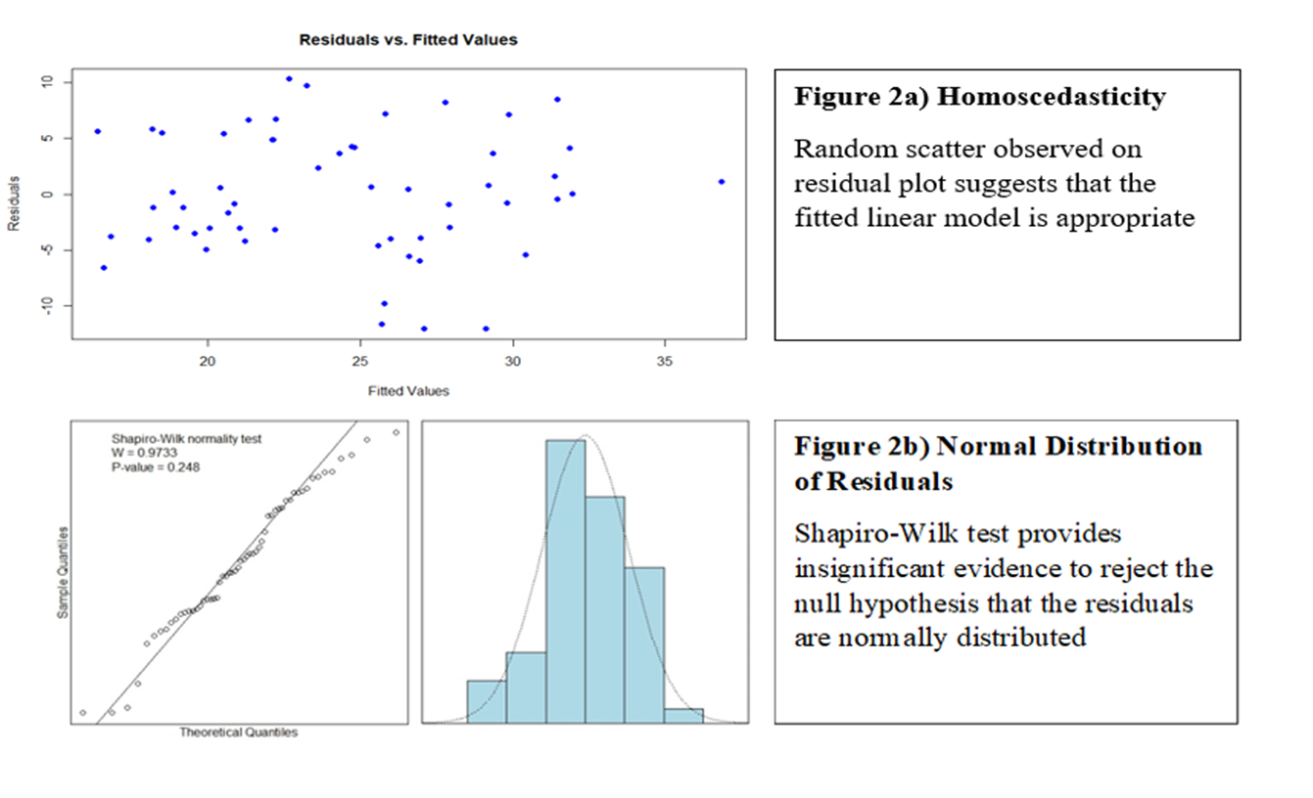
Linear Model Assumptions

Slide 13
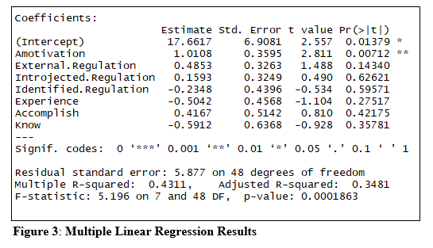
Regression Results

Slide 14
Key Findings
Amotivation is a statistically significant predictor variable (p-value=.007, point estimate=1.01)
Non-significant variables (except for “To Accomplish”) show expected slope direction
Females didn’t experience significantly higher math anxiety levels than males (p-value for difference = .77)
Notes:
95% Confidence Interval: (0.288, 1.734)
Contrary to previous findings (Hembree, 1990, Hopko et. al, 2003)

Slide 15
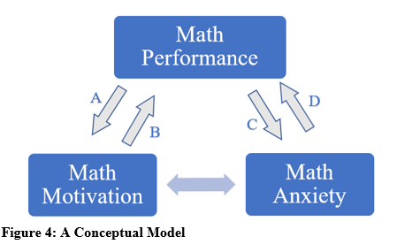
Discussion: Towards a Conceptual Model
Why the correlation between amotivation and math anxiety?
Hembree’s (1990) meta-analysis: -.64 mean correlation
Conjecture: math performance mediates relationship between math anxiety and motivation
Notes:
Hembree’s was between mot and anxiety in general remember
Conjecture: Bidirectional relationship exists between math motivation and math anxiety, is mediated by both variables’ relationships with math performance
Explain how to move through model, then “in the following slides we will take a look at the evidence supporting relationships A, B, C, and D
Performance=grades/test scores/any other measures of academic performance

Slide 16
Relationship B: Math Motivation to Math Performance
Fortier et. al (1995)
Self-determination/ autonomous motivational profile leads to higher school grades
Conceptualized this way by SDT (Ryan & Deci, 2000)
“Motivation is highly valued because of its consequences: motivation produces” (p. 69)
Practical experience: motivated students perform well
Notes:
Going to take the letters out of order. This is because for each pair, we will start with popular conception and then look at support for other causal direction.
Fortier et. al 1995 “students who feel competent and self-determined in the school context develop an autonomous motivational profile towards education which in turn leads them to obtain higher school grades”
-Insert pic to all slides and circle arrow

Slide 17
Relationship A: Math Performance to Math Motivation
Marsh & Yeung (1997)
Longitudinal study of 603 high school students in English, Math, and Science
Performance and self-concept (often considered a motivational variable) are reciprocally related
Cleary & Chen (2009)
Negative performance comparisons with other students lead to “maladaptive motivational behaviors, such as poor effort and persistence” (p. 294)
Practical example: students dropping class after poor first exam
Notes:
There is some evidence for the other direction

Slide 18

Relationship D: Math Anxiety to Math Performance
Math anxiety inhibits math performance by definition
Ashcraft (2002)
Chang & Beilock (2016)
Hembree (1990)
“Math anxiety depresses performance” (p. 44)

Slide 19
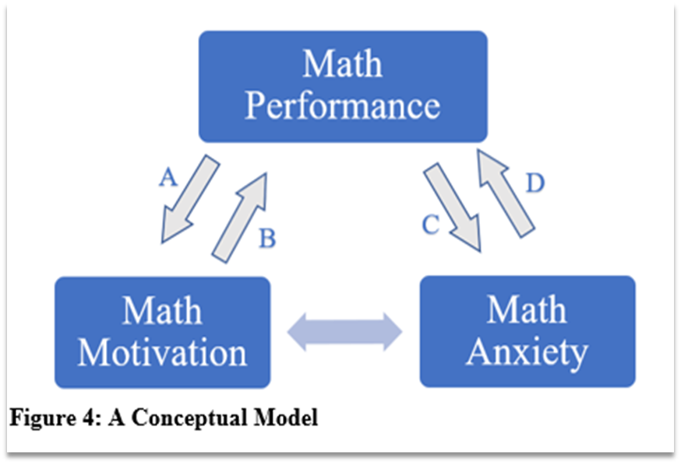
Relationship C: Math Performance to Math Anxiety
Ma & Xu (2004)
Data from Longitudinal Study of American Youth (LSAY)
“Prior low mathematics achievement significantly related to later high mathematics anxiety” (p. 165)
“Deficits model”
Poor math performance increases math anxiety
Notes:
Some evidence that it goes the other way as well…This is a longitudinal study, making it one of the best ways to evaluate this relationship

Slide 20
Study Limitations
Convenience sample, results not fully generalizable
Only lower division courses studied
Response bias
More motivated students more likely to take survey
Self-reported
Social desirability bias (Edwards, 1953)
No re-testing
Motivation levels change over the course of a semester (Liu et. al, 2017)

Slide 21
Conclusions
Amotivation is associated with math anxiety
Math performance may mediate relationship between math motivation and anxiety
Further research:
Larger sample across more levels of math, re-testing over time
Incorporate other constructs, such as study habits (Ryals & Keene, 2017) and self-efficacy (Bandura, 1997) into the conceptual model

Slide 22
Selected References
Ashcraft, M. H. (2002). Math Anxiety: Personal, Educational, and Cognitive Consequences. Current Directions in Psychological Science,11(5), 181-185. doi:10.1111/1467-8721.00196
Chang, H., & Beilock, S. L. (2016). The Math Anxiety-Math Performance Link and its Relation to Individual and Environmental Factors: A Review of Current Behavioral and Psychophysiological Research. Current Opinion in Behavioral Sciences,10, 33-38. doi:10.1016/j.cobeha.2016.04.011
Hembree, R. (1990). The Nature, Effects, and Relief of Mathematics Anxiety. Journal for Research in Mathematics Education, 21(1), 33. doi:10.2307/749455
Hopko, D. R., Mahadevan, R., Bare, R. L., & Hunt, M. K. (2003). The Abbreviated Math Anxiety Scale (AMAS), Construction, Validity, and Reliability. Assessment,10(2), 178-182. doi:10.1177/1073191103010002008

Slide 23
Selected References (continued)
Liu, Y., Ferrell, B., Barbera, J., & Lewis, J. E. (2017). Development and evaluation of a chemistry-specific version of the academic motivation scale (AMS-Chemistry). Chemistry Education Research and Practice,18(1), 191-213. doi:10.1039/c6rp00200e
Ma, X., & Xu, J. (2004). The causal ordering of mathematics anxiety and mathematics achievement: a longitudinal panel analysis. Journal of adolescence, 27(2), 165-179.
Ryan, R. M., Connell, J. P., & Deci, E. L. (1985). A motivational analysis of self-determination and self-regulation in education. Research on motivation in education: The classroom milieu, 2, 13-51.
Ryan, R. M., & Deci, E. L. (2000). Self-determination theory and the facilitation of intrinsic motivation, social development, and well-being. American Psychologist,55(1), 68-78. doi:10.1037//0003-066x.55.1.68
Suinn, R. M. (2003). The Mathematics Anxiety Rating Scale, A Brief Version: Psychometric Data. Psychological Reports,92(1), 167. doi:10.2466/pr0.92.1.167-173

