Slide 1

PMIx: Storage Integration

Slide 2
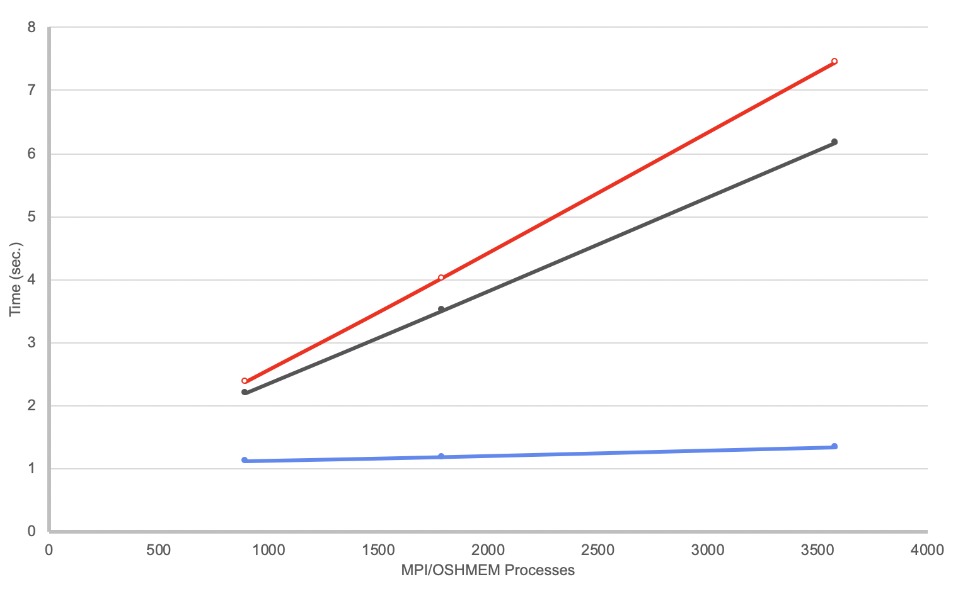










Origin: Changing Landscape
Launch time limiting scale
Programming model &
runtime proliferation
Legion
Hybrid applications
Model-specific tools
Container technologies

Slide 3
Start Someplace!
Resolve launch scaling
Pre-load information known to RM/scheduler
Pre-assign communication endpoints
Eliminate data exchange during init
Orchestrate launch procedure

Slide 4
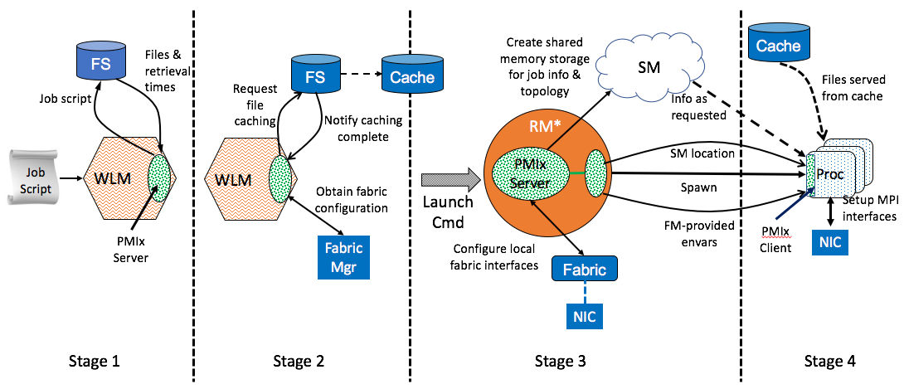
PMIx Launch Sequence
*RM daemon, mpirun-daemon, etc.

Slide 5

Build Upon It
Async event notification
Cross-model notification
Announce model type, characteristics
Coordinate resource utilization, programming blocks
Generalized tool support
Co-launch daemons with job
Forward stdio channels
Query job, system info, network traffic, process counters, etc.
Standardized attachment, launch methods

Slide 6



Sprinkle Some Magic Dust
Allocation support
Dynamically add/remove/loan nodes
Register pre-emption acceptance, handshake
Dynamic process groups
Async group construct/destruct
Notification of process departure/failure
File system integration
Pre-cache files, specify storage strategies

Slide 7
Baseline Vision
Tiered storage
Parallel file system
Caches at IO server, switches, cabinets, …
Caches hold images, files, executables, libraries, checkpoints
Bits flow in all directions
Stage locations prior to launch
Movement in response to faults, dynamic workflow, computational stages

Slide 8
Planned Support
Parse for dependencies
System PMIx server
Current data map
Usage patterns
Authorization
WLM
Query
User-specified caching, dependencies
(data & libs), persistence
Retrieval time
Job
Script

Slide 9
Planned Support
Pre-stage
(images, binaries, libs)
Allocation schedule
System PMIx server
WLM
Allocate
Launch app
Job
Script
Compute

Slide 10
Planned Support
System PMIx server
WLM
Orchestration requests
Local PMIx Server
Job
Script
Compute

Slide 11











Push Forward?
https://pmix.org https://github.com/pmix

Slide 12
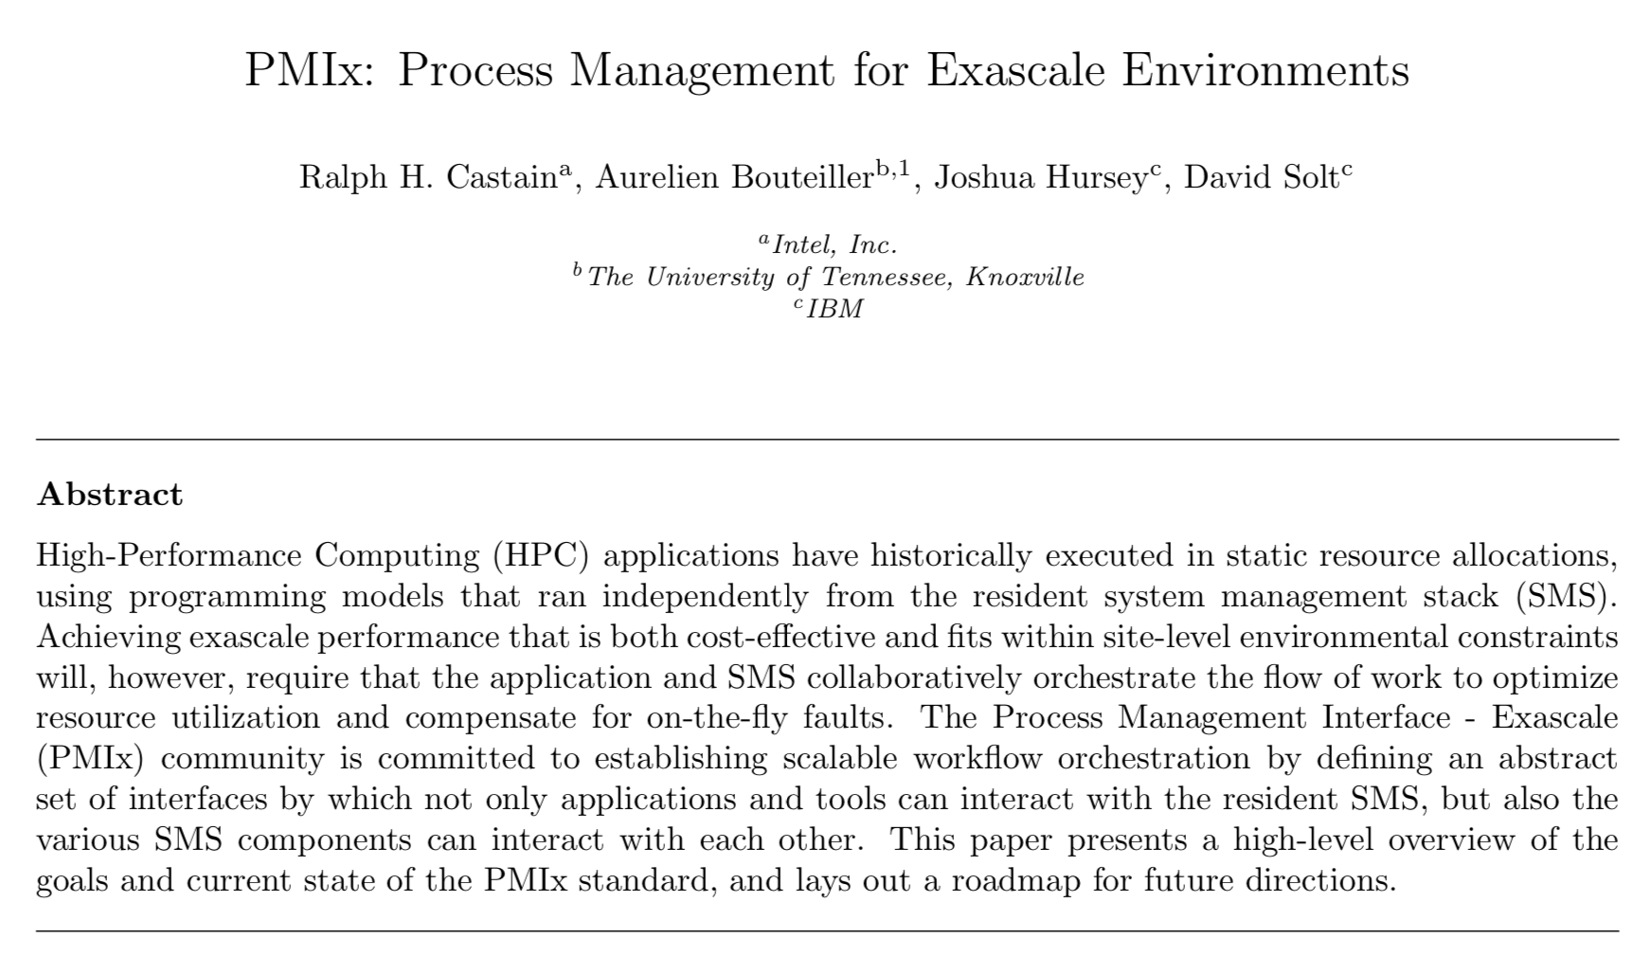
Overview Paper
Ralph H. Castain, Aurelien Bouteiller, Joshua Hursey, David Solt, “PMIx: Process management for exascale environments”, Parallel Computing, 2018.
https://doi.org/10.1016/j.parco.2018.08.002

