Slide 1
A Performance Analysis And Optimization Of PMIx-based HPC Software Stacks
Artem Y. Polyakov
Mellanox Technologies
Boris I. Karasev
Mellanox Technologies
Joshua Hursey
IBM
Joshua Ladd
Mellanox Technologies
Mikhail Brinskii
Mellanox Technologies
Elena Shipunova
Intel, Inc.
Notes:
Dear colleagues,
Today I will be talking about the work we did to optimize the jobstart phase of parallel program execution

Slide 2
PMI evolution (BNR)
Aug, 2001
Dec, 2003
BNR
paper [1]
Slurm/BNR
BNR introduced the basic concepts used by all PMI processes:
Data representation in the form of Key-Value Database (KVDb)
Access (BNR_Put, BNG_Get) and synchronization routines (BNR_Fence)
Predefined environment (accessed through BNR_Rank and BNR_Nprocs)
[1] B. Toonen, et.al. Interfacing parallel jobs to process managers, 10th IEEE HPDC, 2001, San Francisco

Slide 3
PMI evolution (PMI, aka PMI-1)
Aug, 2001
Sep, 2004
Mar, 2012
Dec, 2003
Jan, 2006
BNR
paper [1]
Slurm/PMI1 v1.0.0
MPICH/PMI1
v0.971
Slurm/BNR
OpenMPI/PMI1 v1.5.5
Extended BNR interface with:
A concept of the namespace
Process-local synchronization operation (Commit), that enables bulk Put operations
Additional predefined environment: local ranks*, universe size, application number,
Additional functions to support MPI: Publish/Lookup, Spawn, Abort
Provided an iterator to retrieve all the keys in the namespace (was abandoned in future generations)
[1] B. Toonen, et.al. Interfacing parallel jobs to process managers, 10th IEEE HPDC, 2001, San Francisco
* Bug in the paper, paper states that this feature was introduced in PMI-2

Slide 4
PMI evolution (PMI-2)
Mar, 2012
Sep, 2010
Oct, 2013
Aug, 2001
Sep, 2004
Jun, 2009
Jun, 2012
Dec, 2003
Jan, 2006
BNR
paper [1]
Slurm/PMI1 v1.0.0
PMI1/PMI2
Paper [2]
MPICH/PMI1
v0.971
MPICH/PMI2 v1.1
Slurm/PMI2 v2.4.0
Slurm/BNR
OpenMPI/PMI1 v1.5.5
OpenMPI/PMI2 v1.7.3
Extend predefined env: RM-specific job-level data (process-to-node mapping, network topology, etc.)
Node-level scope: Put/Get node attributes
Get operation allows to optionally specify the process ID that contributed the data (as a hint).
…
[1] B. Toonen, et al. Interfacing parallel jobs to process managers, 10th IEEE HPDC, 2001, San Francisco, USA
[2] Pavan Balaji, et al. PMI: A Scalable Parallel Process management Interface for Extreme-scale Systems. EuroMPI’10, Stuttgart, Germany.

Slide 5
PMI evolution (PMIx v1.x)
Mar, 2012
May, 2016
Sep, 2017
Mar, 2019
Sep, 2010
Oct, 2013
Jun, 2015
Jul, 2016
Nov, 2018
Aug, 2001
Sep, 2004
Jun, 2009
Jun, 2012
Dec, 2003
Jan, 2006
BNR
paper [1]
MPICH v3.3 PMIx v1.x
Slurm/PMI1 v1.0.0
PMI1/PMI2
Paper [2]
MPICH/PMI1
v0.971
MPICH/PMI2 v1.1
Slurm/PMI2 v2.4.0
Slurm/BNR
OpenMPI/PMI1 v1.5.5
PRI v1.0.0
PMIx standard effort
OpenMPI/PMI2 v1.7.3
Slurm/PMIx v1.x v16.05
OpenMPI v2.0.0 PMIx v1.x
PMIx paper [3]
Extend predefined environment.
New scopes: process-local, node-local, remote-only and global.
Datatypes for key values (string-only values in PMI-1 and PMI-2)
Non-blocking primitives: Fence and Get
On-demand data exchange (aka direct-modex) optimizing sparse communications
Server-side interface (helps adoption by Resource Managers)
[1] B. Toonen, et al. Interfacing parallel jobs to process managers, 10th IEEE HPDC, 2001, San Francisco, USA
[2] Pavan Balaji, et al. PMI: A Scalable Parallel Process management Interface for Extreme-scale Systems. EuroMPI’10, Stuttgart, Germany.
[3] R.H. Castain, et al. PMIx: Process Management for Exascale Environments, EuroMPI 2017, Chicago, USA

Slide 6
PMI evolution
Mar, 2012
May, 2016
Sep, 2017
Mar, 2019
Sep, 2010
Oct, 2013
Jun, 2015
Jul, 2016
Nov, 2018
Aug, 2001
Sep, 2004
Jun, 2009
Jun, 2012
Dec, 2003
Jan, 2006
BNR
paper [1]
MPICH v3.3 PMIx v1.x
Slurm/PMI1 v1.0.0
PMI1/PMI2
Paper [2]
MPICH/PMI1
v0.971
MPICH/PMI2 v1.1
Slurm/PMI2 v2.4.0
Slurm/BNR
OpenMPI/PMI1 v1.5.5
PRI v1.0.0
PMIx standard effort
OpenMPI/PMI2 v1.7.3
Slurm/PMIx v1.x v16.05
OpenMPI v2.0.0 PMIx v1.x
PMIx paper [3]
Currently PMI becomes critical for the data analytics applications
relatively short time-to-solution at the full system scale
Process Management Interface (PMI)
In some configurations, PMI is on the critical path now
March 4, 2019: PMI standardization effort
Put
Commit
Fence
Get
[1] B. Toonen, et al. Interfacing parallel jobs to process managers, 10th IEEE HPDC, 2001, San Francisco, USA
[2] Pavan Balaji, et al. PMI: A Scalable Parallel Process management Interface for Extreme-scale Systems. EuroMPI’10, Stuttgart, Germany.
[3] R.H. Castain, et al. PMIx: Process Management for Exascale Environments, EuroMPI 2017, Chicago, USA
Notes:
As far as I looked back in the history, the Process Management Interfaces started in 2001 from the BNR paper, that Bill has co-authored.
The recent generation, PMI Exascale (PMIx) is more advanced, but it preserves all the primitives proposed in that paper almost 20 years ago.

Slide 7
Motivation and goals
Motivation
The importance of efficient Process management raise along with the systems scale
This is especially critical for data analytics applications
data-driven communication patterns
relatively short time-to-solution at the full system scale
Process Management Interface (PMI)
Used to be completely transparent to the end users
Currently, for some configurations, PMI is on the critical path
Modern PMI requirements resembles a subset of MPI
March 4, 2019: PMI standardization effort
Goals
Driving vehicle: PMI Exascale (PMIx) and PRI – PMIx Reference Implementation
A complex analysis of the existing HPC SW stacks relying on PMIx
Identify the bottlenecks of PRI and surrounding SW components
Propose the solutions to overcome them
Notes:
5-7 years ago nobody was talking about PMI.
Currently we have customers that explicitly request PMIx, it is used on TOP500 systems (Summit and Sierra) and I frequently hear it is mentioned at MPI Forum.
And this spring a PMI standardization effort was started.
In this work we explored the performance characteristics of the PMIx Reference Implementation.

Slide 8
What is PMI

Slide 9
Process Management Interface - PMI
APP
APP
APP
APP
Typical PMI usage scenario:
// Environment info
rank = Get(“rank”)
size = Get(“size”)
// Connectivity info
address = comm_addr_get()
Put(key[rank], address)
// Push keys to server
[ Commit ]
// Inter-node exchange
[ Fence ]
// Connect application
for rnk in 0 … (size-1) do
addr = Get(key[rnk])
ep[rnk] = comm_cnct(addr)
. . .
Key-Value Database (KVDb)
PMI Put operation
PMI Get operation
PMI KVDb Synchronization
local: PMI Commit
Inter-process: PMI Fence/Barrier
Notes:
In the core functionality of PMI is a Key-Value Database that can be accessed with Put and Get operations.
A set of synchronization primitives are used to ensure efficient data distribution.
On the right is a simple, yet very typical example of the PMI usage that is enough to bootstrap a simple MPI program.
First, just like in MPI, the process performs self-identification in the parallel job.
Second, it retrieves the address that other processes can use to communicate with this process.

Slide 10
PMI data flow
PMI Put
Node 1
Typical PMI usage scenario:
// Environment info
rank = Get(“rank”)
size = Get(“size”)
// Connectivity info
address = comm_addr_get()
Put(key[rank], address)
// Push keys to server
[ Commit ]
// Inter-node exchange
[ Fence ]
// Connect application
for rnk in 1 … size do
addr = Get(key[rnk])
ep[rnk] = comm_cnct(addr)
PMI serv
0
0
1
1
Node 2
PMI serv
2
2
3
3
Notes:
The well-known key with the address as a value is injected into the DB
Commit ensures that data is available on the PMI server.

Slide 11
PMI data flow
PMI Put
PMI Fence
Node 1
Typical PMI usage scenario:
// Environment info
rank = Get(“rank”)
size = Get(“size”)
// Connectivity info
address = comm_addr_get()
Put(key[rank], address)
// Push keys to server
[ Commit ]
// Inter-node exchange
[ Fence ]
// Connect application
for rnk in 1 … size do
addr = Get(key[rnk])
ep[rnk] = comm_cnct(addr)
PMI serv
0
RTE agent
0
0
1
1
1
Node 2
PMI serv
RTE agent
2
2
3
3
3
2
Notes:
Next is the Fence operation. It ensures that published key are globally accessible.
This is a complex operation that consists from several steps.
Once PMIx server collects all of the local contributions it forms a synchronization message and passes it to the RTE agent.

Slide 12
PMI data flow
PMI Put
PMI Fence
Node 1
Typical PMI usage scenario:
// Environment info
rank = Get(“rank”)
size = Get(“size”)
// Connectivity info
address = comm_addr_get()
Put(key[rank], address)
// Push keys to server
[ Commit ]
// Inter-node exchange
[ Fence ]
// Connect application
for rnk in 1 … size do
addr = Get(key[rnk])
ep[rnk] = comm_cnct(addr)
PMI serv
0
RTE agent
0
0
1
0
1
1
1
RTE
Out-of-Band
channel
Node 2
PMI serv
RTE agent
2
2
3
3
3
2
3
2
Notes:
Then RunTime Agent is exchanging all the contributions in an Allgatherv-like fashion over the OOB channel

Slide 13
PMI data flow
PMI Put
PMI Fence
Node 1
Typical PMI usage scenario:
// Environment info
rank = Get(“rank”)
size = Get(“size”)
// Connectivity info
address = comm_addr_get()
Put(key[rank], address)
// Push keys to server
[ Commit ]
// Inter-node exchange
[ Fence ]
// Connect application
for rnk in 1 … size do
addr = Get(key[rnk])
ep[rnk] = comm_cnct(addr)
PMIx serv
RTE agent
3
RTE agent
0
0
0
2
1
0
0
1
1
1
1
RTE
Out-of-Band
channel
Node 2
PMIx serv
RTE agent
RTE agent
2
2
3
3
2
3
3
2
3
0
2
1

Slide 14
PMI data flow
PMI Put
PMI Fence
3
Node 1
Typical PMI usage scenario:
// Environment info
rank = Get(“rank”)
size = Get(“size”)
// Connectivity info
address = comm_addr_get()
Put(key[rank], address)
// Push keys to server
[ Commit ]
// Inter-node exchange
[ Fence ]
// Connect application
for rnk in 1 … size do
addr = Get(key[rnk])
ep[rnk] = comm_cnct(addr)
PMIx serv
RTE agent
3
RTE agent
2
PMI serv
0
0
0
0
2
1
0
1
0
1
1
1
1
RTE
Out-of-Band
channel
3
2
Node 2
PMIx serv
RTE agent
RTE agent
PMI serv
2
0
2
3
1
3
2
3
3
2
3
0
2
1
Notes:
The aggregated buffer is then passed and stored by the PMI server.

Slide 15
PMI data flow
PMI Put
PMI Fence
PMI Get
3
Node 1
Typical PMI usage scenario:
// Environment info
rank = Get(“rank”)
size = Get(“size”)
// Connectivity info
address = comm_addr_get()
Put(key[rank], address)
// Push keys to server
[ Commit ]
// Inter-node exchange
[ Fence ]
// Connect application
for rnk in 1 … size do
addr = Get(key[rnk])
ep[rnk] = comm_cnct(addr)
PMIx serv
RTE agent
3
RTE agent
2
PMIx serv
0
0
0
0
2
0
1
0
0
0
1
1
1
1
0
1
1
RTE
Out-of-Band
channel
3
2
Node 2
PMIx serv
RTE agent
RTE agent
PMIx serv
2
0
2
3
2
3
1
3
2
3
3
2
3
3
3
0
0
2
1
Notes:
Finally, the process retrieves all addresses of its peers and establishes corresponding connections.

Slide 16
Overview

Slide 17
PMIx-based HPC software stack layout
Node X
Node Y
rank = 0
rank = 1
rank = N
rank = 1
rank = 1
rank = N
Application
MPI/OSHMEM
PMIx
Comm
. . .
. . .
RTE agent
RTE agent
PMIx server
PMIx server
PMIx driver
PMIx driver
PMI Put operation
PMIx KVDb Synchronization
RM OOB channel
PMI Get operation
PMIx Server-side API
Comm
UCX, IBM PAMI
RTE
Slurm, IBM JSM, Open RTE
MPI
Open MPI, MPICH
Notes:
We consider the HPC SW stack consisting from the applications that is based on one of the available middleware, like MPI or OSHMEM.
The middleware, in turn, relies on PMIx for the process management and on some low- or high-level communication library. In this work we considered UCX and IBM PAMI.
PMIx server side is implemented as part of the RunTime Daemon (Slurm, IBM JSM or Open RTE daemon). This daemon commonly has a software component providing RTE-side support.

Slide 18
PMIx-based HPC software stack layout
Node X
Node Y
rank = 0
rank = 1
rank = N
rank = 1
rank = 1
rank = N
Application
MPI/OSHMEM
PMIx
Comm
. . .
. . .
RTE agent
RTE agent
PMIx server
PMIx server
PMIx driver
PMIx driver
PMI Put operation
PMIx KVDb Synchronization
RM OOB channel
PMI Get operation
PMIx Server-side API
Comm
UCX, IBM PAPI
RTE
Slurm, IBM JSM, Open RTE
MPI
Open MPI, MPICH
Notes:
In this work we are taking a closer look at the PRI client/server communication.

Slide 19
PMIx-based HPC software stack layout
Node X
Node Y
rank = 0
rank = 1
rank = N
rank = 1
rank = 1
rank = N
Application
MPI/OSHMEM
PMIx
Comm
. . .
. . .
RTE agent
RTE agent
PMIx server
PMIx server
PMIx driver
PMIx driver
PMI Put operation
PMIx KVDb Synchronization
RM OOB channel
PMI Get operation
PMIx Server-side API
Comm
UCX, IBM PAPI
RTE
Slurm, IBM JSM, Open RTE
MPI
Open MPI, MPICH
Notes:
The efficiency of the KVDb synchronization protocols

Slide 20
PMIx-based HPC software stack layout
Node X
Node Y
rank = 0
rank = 1
rank = N
rank = 1
rank = 1
rank = N
Application
MPI/OSHMEM
PMIx
Comm
. . .
. . .
RTE agent
RTE agent
PMIx server
PMIx server
PMIx driver
PMIx driver
PMI Put operation
PMIx KVDb Synchronization
RM OOB channel
PMI Get operation
PMIx Server-side API
Comm
UCX, IBM PAPI
RTE
Slurm, IBM JSM, Open RTE
MPI
Open MPI, MPICH
Notes:
And the RTE-side out-of-band exchanging services.

Slide 21
PRI: PMIx Get latency optimization
Notes:
We start with the client/server interoperation.

Slide 22
PRI KVDb access diagram
Node X
Node Y
Application
thread
PRI service thread
shared
memory
PRI server thread
PRI server thread
RTE Fence
write
lock
PMIx
Fence
read
lock
PMIx_Get
PMIx_Get
Notes:
During DB synchronization the aggregated message is forwarded to the PMIx server implementation.
In PRI this data is published in the shared memory and the operation is protected by the write lock.
Application threads are calling PMIx_Get to later access this data.
In the fast path case data will be found in the shmem.
In case of a slow path an inter-node communication may be required.

Slide 23
PRI KVDb access diagram
Node X
Node Y
Propose the new thread-safety scheme that allows to avoid “thread shift” on the fast path
PMIx server thread
Application
thread
PMIx service thread
shared
memory
PMIx server thread
Fence
write
lock
release
local
ranks
read
lock
PMIx_Get
Propose the new locking scheme that is optimized for the usage scenario
PMIx_Get

Slide 24
Considered KVDb locking schemes
RD1
RD2
RDN
RD1
RD2
RDN
POSIX/Pthreads
RW-lock
L1
L2
LN
WR
WR
Posix RW-lock
1N-mutex (static lock [1])
RD1
RD2
RDN
RD1
RD2
RDN
LS1
LP1
LS2
LP2
LSN
LPN
VS1
LP1
VS2
LP2
VSN
LPN
WR
WR
2N-mutex (proposed in paper)
N(mutex+signal) (a better approach)
[1] W.C. Hsieh and W.E Weihl. 1992. Scalable Reader-Writer Locks for Parallel Systems. In Proceedings of the Sixth International Parallel Processing Symposium. IEEE, 656–659. https://doi.org/10.1109/IPPS.1992.222989
Notes:
Initial version of PRI was using POSIX rwlocks as the locking implementation.
As will be demonstrated later, the main disadvantage of this approach is a high contention for the read-only workloads that are typical for PMIx.

Slide 25
Considered KVDb locking schemes (2)
rlock() {
lock(L[myidx])
}
wlock() {
for i in 1 … N do
lock(L[i])
done
}
RD1
RD2
RDN
RD1
RD2
RDN
POSIX/Pthreads
RW-lock
L1
L2
LN
WR
WR
Posix RW-lock
1N-mutex (static lock [1])
RD1
RD2
RDN
RD1
RD2
RDN
LS1
LP1
LS2
LP2
LSN
LPN
VS1
LP1
VS2
LP2
VSN
LPN
WR
WR
2N-mutex (proposed in paper)
N(mutex+signal) (a better approach)
[1] W.C. Hsieh and W.E Weihl. 1992. Scalable Reader-Writer Locks for Parallel Systems. In Proceedings of the Sixth International Parallel Processing Symposium. IEEE, 656–659. https://doi.org/10.1109/IPPS.1992.222989
Notes:
1N-mutex is a know algorithm solves this problem by isolating readers from each other with separate locks (mutexes in our case).
The writer lock latency is sacrificed.

Slide 26
Considered KVDb locking schemes (3)
RD1
RD2
RDN
rlock() {
lock(LS[myidx])
lock(LP[myidx])
unlock(LS[myidx])
}
wlock() {
// Lock the signal lock
for i in 1 … N do
lock(LS[i])
done
// Take the Protection lock
for i in 1 … N do
lock(LP[i])
done
}
RD1
RD2
RDN
POSIX/Pthreads
RW-lock
L1
L2
LN
WR
WR
Posix RW-lock
1N-mutex (static lock [1])
RD1
RD2
RDN
RD1
RD2
RDN
LS1
LP1
LS2
LP2
LSN
LPN
VS1
LP1
VS2
LP2
VSN
LPN
WR
WR
2N-mutex (proposed in paper)
2N-mutex (a better approach)
[1] W.C. Hsieh and W.E Weihl. 1992. Scalable Reader-Writer Locks for Parallel Systems. In Proceedings of the Sixth International Parallel Processing Symposium. IEEE, 656–659. https://doi.org/10.1109/IPPS.1992.222989
Notes:
In our work we proposed an improvement of the 1N-mutex that has an additional signaling lock that is only briefly held by the readers and allows writer to obtain the lock faster.

Slide 27
Considered KVDb locking schemes (4)
rlock() {
if (VS[myidx] = 1) then
do
if trylock(LP[myidx]) then
if (VS[myidx] = 1) then
unlock(LP[myidx])
continue
else
goto exit
else
goto lock;
endif
while(1)
endif
lock:
lock(LP[myidx])
exit:
}
wlock() {
// Signal that write lock
for i in 1 … N do
VS[i] = 1
done
// Take the Protection lock
for i in 1 … N do
lock(LP[i])
done
}
RD1
RD2
RDN
RD1
RD2
RDN
POSIX/Pthreads
RW-lock
L1
L2
LN
WR
WR
Posix RW-lock
1N-mutex (static lock [1])
RD1
RD2
RDN
RD1
RD2
RDN
LS1
LP1
LS2
LP2
LSN
LPN
VS1
LP1
VS2
LP2
VSN
LPN
WR
WR
2N-mutex (proposed in paper)
N(mutex+signal) (a better approach)
[1] W.C. Hsieh and W.E Weihl. 1992. Scalable Reader-Writer Locks for Parallel Systems. In Proceedings of the Sixth International Parallel Processing Symposium. IEEE, 656–659. https://doi.org/10.1109/IPPS.1992.222989
Notes:
Finally we recently came up with the further improved locking scheme where signaling lock is replaced with the regular variable.
This scheme has a more complicated reader lock algorithm, but demonstrates best results on our micro-benchmarks.

Slide 28
Locking schemes comparison (micro-benchmark [1])
[1] https://github.com/artpol84/poc/tree/master/arch/concurrency/locking/shmem_locking
Notes:
On this slide we show the comparison of the four schemes.
In the write-only scenario pthread lock shows the best performance, but it is not the use case we optimizing for.
In the read-only workload 1N-mutex and N(mutex+signal) locks demonstrate linear scaling of the cumulative lock rate with 2N-mutex being a bit behind because of more lock acquisitions.
In the read-write scenario 2N-mutex and N(mutex+signal) demonstrate a significant advantage over the 1N-mutex.
Same holds for the cumulative reader lock rate

Slide 29
Thread-safety scheme optimization (fastpath)
Original thread-safety scheme
Proposed thread-safety scheme
Application
thread
PRI service thread
PRI server thread
Application
thread
PRI service thread
PRI server thread
PMIx_Get
shmem
PMIx_Get
shmem
shmem
shmem
PMIx_Get
PMIx_Get
Resolve req
Resolve req
Notes:
As I mentioned before, in addition to the improved locking we optimized the thread-safety scheme. In particular we were able to avoid the expensive thread shift step for shmem lookups.

Slide 30
PRI/PMIx_Get optimization evaluation
Intel 64 system, 2 nodes
SW stack: Open RTE / PMIx (varied) / micro-bench. [1]
Node: 2 Intel CPUs, 128 GB RAM
CPU: 14-core Broadwell, 1 HW threads / core
ORNL Summit system (256 nodes)
SW stack: IBM JSM / Open MPI / IBM PAMI / PMIx
Node: 2 IBM POWER CPUs, 600 GB RAM
CPU: 22-core IBM POWER 9, 8 HW threads / core
[1] PMIx performance tool https://github.com/pmix/pmix/tree/master/contrib/perf_tools
Notes:
This slide presents the results of PMIx Get latency evaluations on Intel and POWER systems.
While effect is similar, the POWER system (a 256-node ORNL Summit allocation) benefit more because of higher PPN count.
On the left we also show the performance of the lockless execution that demonstrates no visible overhead from locking on Intel machine.

Slide 31
PRI/PMIx_Get optimization evaluation
Currently there is a proposal pending the PMIx standard inclusion [1] that allows to address additional overheads discovered in the course of this work.
[1] https://github.com/pmix/pmix-standard/pull/210
Notes:
In addition we are showing a potential of further optimizations from our POC branch that eliminates memory allocations from the Get fastpath.
Partially in response to our input the PMIx standard currently has a pending proposal that aims to enable those optimizations.

Slide 32
PRI/Protocol optimizations

Slide 33
PRI/UCX bootstrap protocol efficiency
PMI Put
PMI Fence
Node 1
Node X
PMIx serv
RTE agent
3
RTE agent
0
0
0
2
rank = 0
rank = 1
rank = N
1
0
0
1
Application
1
1
1
MPI/SHMEM
PMIx
UCX
. . .
RTE
Out-of-Band
channel
RTE agent
Node 2
PMIx server
PMIx serv
RTE agent
RTE agent
2
2
PMIx driver
3
3
2
3
3
2
3
0
2
1
Notes:
Next we explored the space-efficiency of data exchanged during PMIx Fence.
The addressing information is encoded by the communication libraries (taking UCX as an example).
And later packed into the message by the PMIx server and passed to RTE agent for exchange.

Slide 34
UCX worker address optimization
Anew UCP worker query flag:
FLAG_NET_ONLY
That allows to take advantage of PMIx scope system by excluding the shared-memory addressing information from the inter-node exchange.
Unified Cluster mode
Do not include the information known locally
Notes:
For the UCX we were able to significantly reduce the addressing information by eliminating performance characteristics required for the general case, but exhaustive in case of homogeneous clusters.
We also leeraged the PMIx scoping subsystem by adding a new flag to the UCX API allows to request inter-node only portion of the address.
Overall, for some transport configuration the size was reduced about 60%.

Slide 35
PRI KVDb synchronization protocol optimization (1)
KVDb synchronization message (node contribution)
HEADER
Rank 0 info
Rank 1 info
Rank N info
1
PMIx_Fence(const pmix_proc_t procs[], size_t nprocs, const pmix_info_t info[], size_t ninfo)
Attributes procs and nprocs define the signature of the Fence operation by enumerating namespace/rank pairs with a wildcard option to include all processes in a namespace.
Use throughout numbering of ranks to eliminate this component.
Notes:
Next we analyzed the content of the DB sync message that consists from a header and rank-info objects (one per each local process).
We found that process identifier field contains redundant information and can be computed locally.
This allowed to replace the string/integer structure with a single 32bit integer.

Slide 36
PRI KVDb access protocol optimization (2)
KVDb synchronization message (node contribution)
HEADER
Rank 0 info
Rank 1 info
Rank N info
2
PMIx_Get(pmix_proc_t *proc, pmix_key_t key, pmix_info_t info[], ...)
PMIx Get primitive expects the ID of the process that owns the requested key (proc parameter).
This allows applications to use identical key names for business cards (Open MPI/MPICH).
Introduction of key names lookup table in the HEADER section eliminates this contribution.
Notes:
In PMIx KVBb the key is uniquely identified by the tuple (namespace, rank, key name).
This allows to use identical key names (i.e. “bc” in MPICH) for the same values on different ranks.
To take advantage of this we introduced of a key name lookup table translating key names to integer Identifiers
This allowed to exclude one string per key-value pair at the cost of a small lookup table in the header

Slide 37
PRI KVDb access protocol optimization (3)
KVDb synchronization message (node contribution)
HEADER
Rank 0 info
Rank 1 info
Rank N info
Width of protocol fields is exhaustive
We propose to leverage Little-Endian Base 128 (LEB128) encoding to reduce the message size.
LEB128 property of implicitly representing the byte count allowed to additionally eliminate “type” fields (marked as blue).
Notes:
Finally we realized that most of the integral fields are overkill size-wise and proposed to use Little-Endian Base 128 encoding to further reduce the overall size.

Slide 38
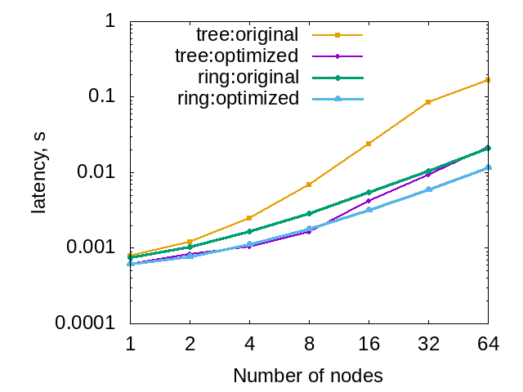
Evaluation
Slurm Fence algorithm
Open MPI
Modex time
Intel 64 system (64 nodes)
SW stack: Slurm / Open MPI / UCX / PMIx (varied)
Node: 2 Intel CPUs, 128 GB RAM
CPU: 16-core Intel Broadwell (2.6 GHz), 1 HW threads / core
Notes:
As the results we significantly reduced the message sizes and made them agnostic of the shared-memory part.
We observed a proportional improvement for the tree-based Fence implementation.
While we observed reduction in Fence latency for the ring-based algorithm, it was not proportional

Slide 39
PRI/Protocol optimizations

Slide 40
PMI data flow
PMI Put
PMI Fence
PMI Get
3
Node 1
Typical PMI usage scenario:
// Environment info
rank = Get(“rank”)
size = Get(“size”)
// Connectivity info
address = comm_addr_get()
Put(key[rank], address)
// Push keys to server
[ Commit ]
// Inter-node exchange
[ Fence ]
// Connect application
for rnk in 1 … size do
addr = Get(key[rnk])
ep[rnk] = comm_cnct(addr)
PMIx serv
Slurm Stepd
3
Slurm Stepd
2
PMIx serv
0
0
0
0
2
0
1
0
0
0
1
1
1
1
0
1
1
RTE
Out-of-Band
channel
3
2
Node 2
PMIx serv
Slurm Stepd
Slurm Stepd
PMIx serv
2
0
2
3
2
3
1
3
2
3
3
2
3
3
3
0
0
2
1
Notes:
In order to propagate the advantages from the protocol optimizations we then concentrated on the RTE component of the HPC stack.

Slide 41
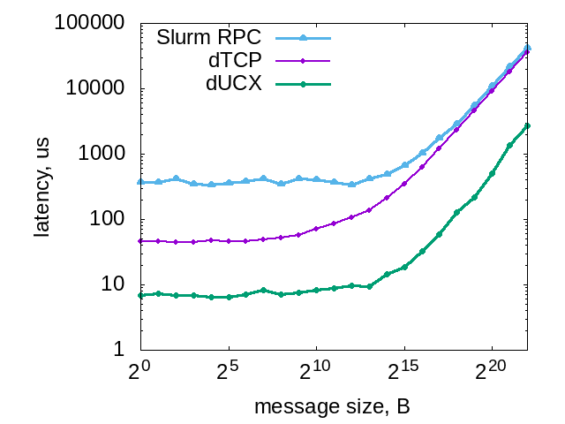
Out-of-band channel implementation (Slurm)
Motivation
HPC systems is equipped with the low-latency, high-bandwidth fabric.
If the PMI performance is important, why not take advantage of it?
Implementation
Native Slurm TCP-based RPC has high latency [1]
A new Out-of-band channel implementation was introduced in Slurm PMIx plugin
Ability to select the fabric:
TCP
IB (through UCX)
[1] A.Y. Polyakov, et al. (2017) Towards Exascale: Leveraging InfiniBand to accelerate the performance and scalability of Slurm jobstart. https://slurm.schedmd.com/SC17/Mellanox_Slurm_pmix_UCX_backend_v4.pdf (Slurm booth presentation, SC17).
Notes:
First we analyzed the OOB implementation used Slurm PMIx plugin.
The native RPC performance is characterized by a high latency.
To overcome this an independent OOB implementation was developed for the PMIx plugin
supporting non-blocking mode and TCP- and UCX-based communications.

Slide 42
PMIx Fence implementation
RTE agent
3
RTE agent
Observations
PMIx Fence operation is similar to MPI Allgatherv.
Each process submits the contribution
RTE agents perform the Allgather-like distribution of the contributions
While contributions are typically close in their size, it is not exactly the same in general
2
0
0
1
1
RTE
Out-of-Band
channel
RTE agent
RTE agent
3
3
2
2
0
1
Notes:
Next we considered the efficiency of the collective algorithm implementing the Fence operation.
As already mentioned, the closest known collective is Allgatherv. [v] is required as the contributions are not necessarily equal, though usually pretty close in size.

Slide 43
PMIx Fence implementation
Observations
PMIx Fence operation is similar to MPI Allgatherv.
Each process submits the contribution
RTE agents perform the Allgather-like distribution of the contributions
While contributions are typically close in their size, it is not exactly the same in general
Previous step: message size range is [1; 2] KB.

Slide 44
PMIx Fence implementation
Observations
PMIx Fence operation is similar to MPI Allgatherv.
Each process submits the contribution
RTE agents perform the Allgather-like distribution of the contributions
While contributions are typically close in their size, it is not exactly the same in general
Previous step: message size range is [1; 2] KB.
This range is still affected by the latency.

Slide 45
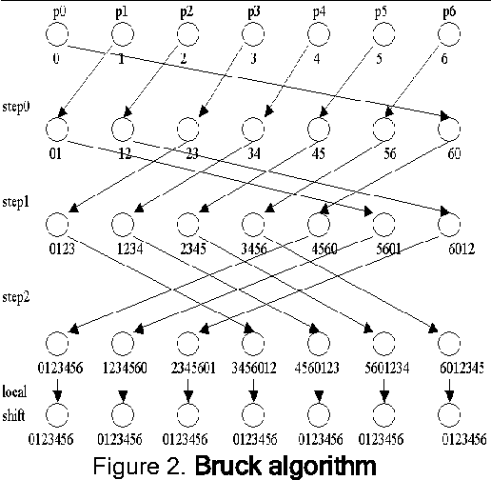
PMIx Fence implementation
Observations
PMIx Fence operation is similar to MPI Allgatherv.
Each process submits the contribution
RTE agents perform the Allgather-like distribution of the contributions
While contributions are typically close in their size, it is not exactly the same in general
Previous step: message size range is [1; 2] KB.
This range is still affected by the latency.
From MPI experience: try to use Bruck algorithm

Slide 46
PMIx Fence vs MPI Allgatherv
int MPI_Allgatherv(const void *sendbuf, int sendcount, … ,
void *recvbuf, const int recvcounts[], const int displs[], …)
static pmix_status_t fencenb_fn(… char *sendbuf, size_t ndata, … );
typedef void (*pmix_modex_cbfunc_t)(… const char *recvbuf, size_t ndata, …)
MPI: block sizes are known in advance (input parameters), arbitrary displacements
PMIx: block sizes are determined dynamically (encoded in the message); the message is always consecutive (no need in displacements)

Slide 47
Bruck algorithm for the non-power of 2 ranks
0
1
2
3
4
5
6
0
1
2
3
4
5
6
1
2
3
4
5
6
0
2
3
4
5
6
0
1
3
4
5
6
0
1
2
4
5
6
0
1
2
3
5
6
0
1
2
3
4
6
0
1
2
3
4
5
Step 0
Step 1
Step 2

Slide 48
Bruck algorithm for the non-power of 2 ranks
0
1
2
3
4
5
6
0
1
2
3
4
5
6
1
2
3
4
5
6
0
2
3
4
5
6
0
1
3
4
5
6
0
1
2
4
5
6
0
1
2
3
5
6
0
1
2
3
4
6
0
1
2
3
4
5
Step 0
Step 1
Step 2

Slide 49
Bruck algorithm for the non-power of 2 ranks
0
1
2
3
4
5
6
0
1
2
3
4
5
6
1
2
3
4
5
6
0
2
3
4
5
6
0
1
3
4
5
6
0
1
2
4
5
6
0
1
2
3
5
6
0
1
2
3
4
6
0
1
2
3
4
5
Step 0
In PMIx there is no global knowledge of the block sizes
This prevents the direct application of the Bruck algorithm
Step 1
Step 2

Slide 50
Adaptation of the Bruck algorithm for the PMIx use-case
Number of processes | 62
Elements on the last step | 30
Unroll of the rank 0 buffer on the 6th step
Notes:
To explain the main idea behind the proposed modification let’s consider rank 0 at the 6th step of the Bruck algorithm.
Rank 0 has to send the first 30 elements from it’s buffer.
Offset 30 is equal to offset 16 that is known + offset 14 that is hidden inside block 5.
If we undo one step and look how rank 16 assembled block 5 we will see that rank 16 knows the offset of block 8, but not aware about additional offset 6 hidden inside the block 4.
Unrolling further we end up with the rank 28 that has exact knowledge of the offset of the block 29.
In our modification of the Bruck algorithm, we identify the steps that require the propagation of the offset and piggyback the offset data into the regular message.

Slide 51
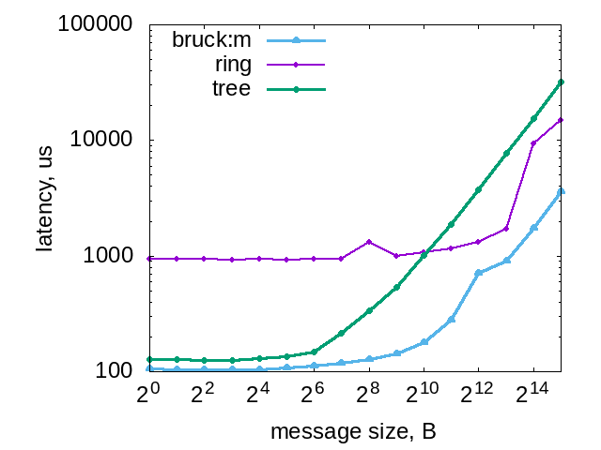
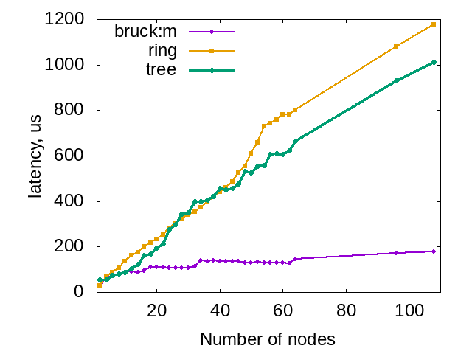
Performance evaluation (Slurm-based RTE)
108 nodes
1K messages
Intel 64 system (108 nodes)
SW stack: Slurm, UCX-based OOB
Node: 2 Intel CPUs, 128 GB RAM
CPU: 16-core Intel Broadwell (2.6 GHz), 1 HW threads / core
Notes:
On the left plot the latency of different message sizes for a 108-node system are shown (UCX is used as the fabric).
It can be seen that our bruck modification outperforms other implementation on all data points.
On the right the scaling of 1KB message exchange on different number of nodes is shown. Here Bruck demonstrates logarithmic caling.

Slide 52
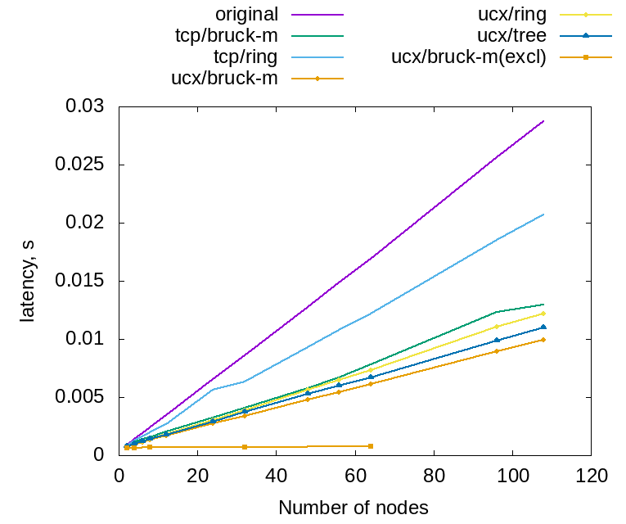
Performance evaluation (Slurm-based RTE)

Slide 53
Performance evaluation (Slurm-based RTE)
Further work
With and without aggregated message unpack

Slide 54
Conclusions
A complex analysis of the PMIx-based HPC SW stacks.
Several bottlenecks identified and addressed in PRI:
PMIx Get latency
PMIx Fence latency
As the result of this work
Most of the optimizations were accepted upstream
locking and thread-safety schemes
PRI synchronization protocol optimizations
We proposed an adaptation of the Bruck algorithm (Work In Progress) that can be used in any PMIx-enabled job manager.
UCX API was extended to allow better integration with PMIx
PMIx Get API is currently being extended with additional flags to avoid identified overhead
Slurm PMIx plugin was extended with IB support

Slide 56
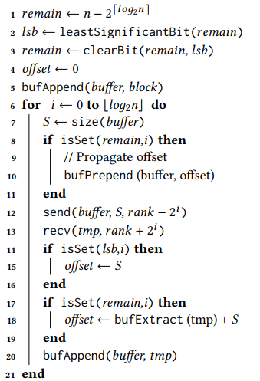
Adaptation of the Bruck algorithm for the PMIx use-case

Slide 57
Performance evaluation (Slurm-based RTE)
With and without aggregated message unpack

