Slide 1
SBML Level 3 Math Packages
Sarah Keating

Slide 2

Math in SBML
Limited subset of MathML
L3V2 core may add further constructs
Packages can add MathML as needed

Slide 3
Need to use a math construct
mean

Slide 4
Where is it specified ?
mean
?
?
?
X
X
L3V1 Core
L3V2 Core
L3V1 Arrays V1

Slide 5
Software supporting it ?
L3V1 Arrays V1
mean
?
?
?
L3V1 Core
L3V1 Arrays V1
mean

Slide 6
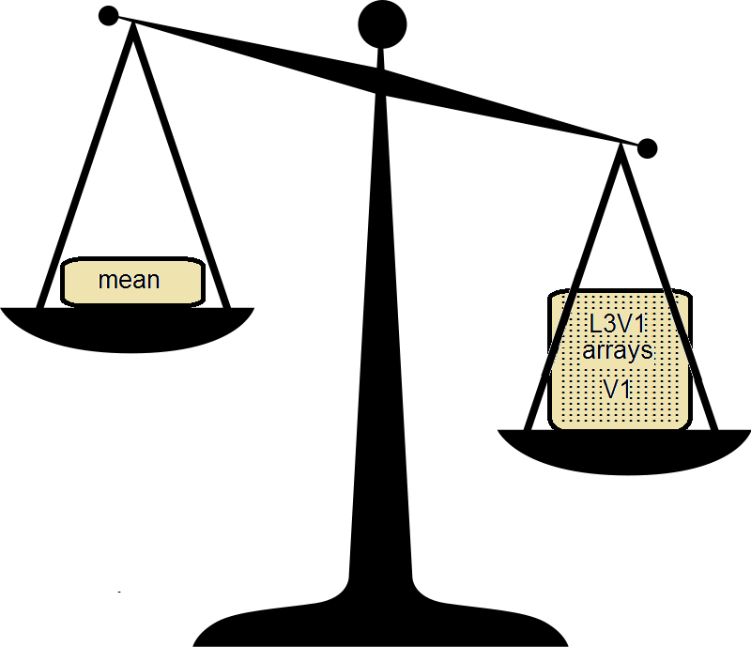
Software wanting to support it ?

Slide 7
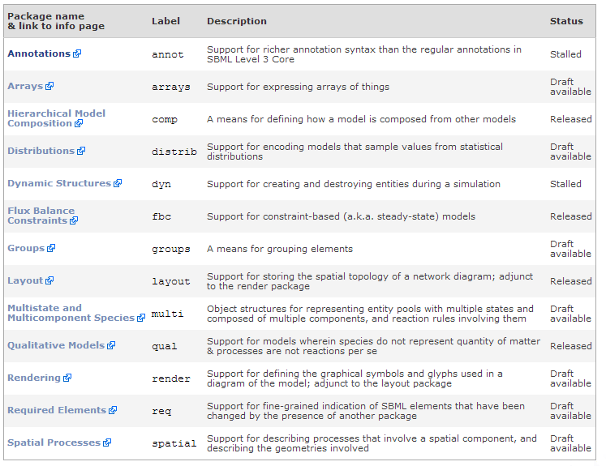
SBML Level 3 Packages

Slide 8
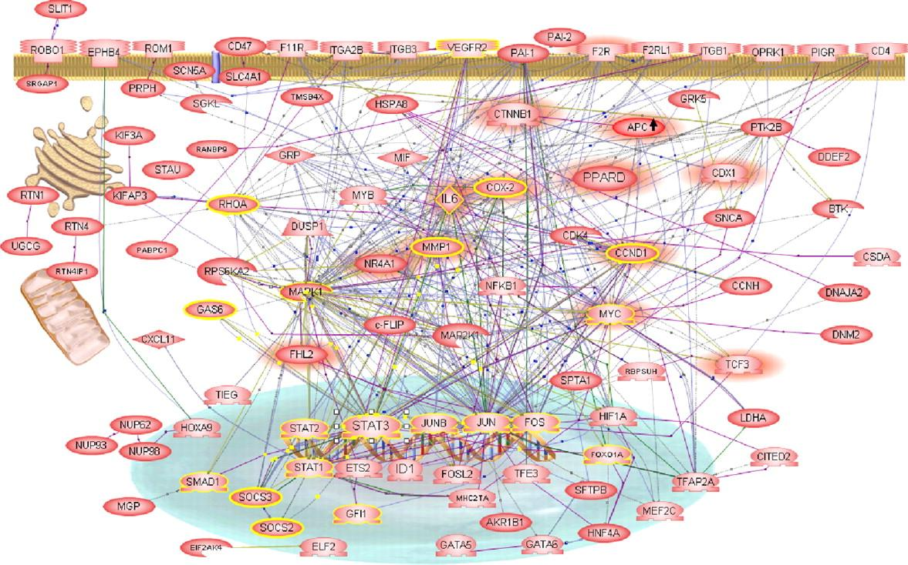

Limited subset of MathML

Slide 9

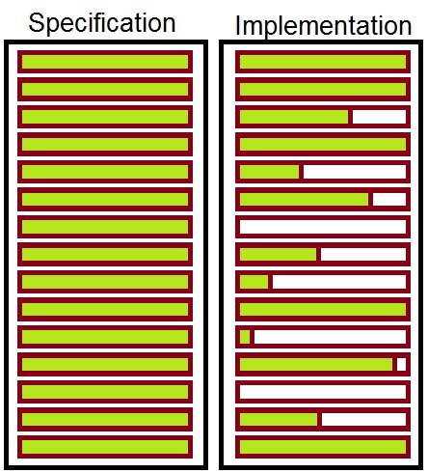
Way forward …
Allow any MathML
Huge burden on software development
Mismatch between specification and implementation

Slide 10

Way forward …
Allow any MathML
Put useful functions into L3V2 core
Discussed at HARMONY

Slide 11

Radical thought …

Slide 12
Radical thought …
Group similar MathML constructs into
small math package
– e.g. vectors/stats
Core/Packages do not extend MathML
– depend on necessary math package
- e.g. arrays would depend on ‘vectors’

Slide 13
Advantages
Any math construct is only defined once but can be used by any package that requires it
Additional math in packages would be usable with L3V1
Developers will have smaller targets to support

