Slide 1
Microservicios con Docker,ASP,Elastic Beanstalk AWS,Spring
Aidee González Fabra

Slide 2
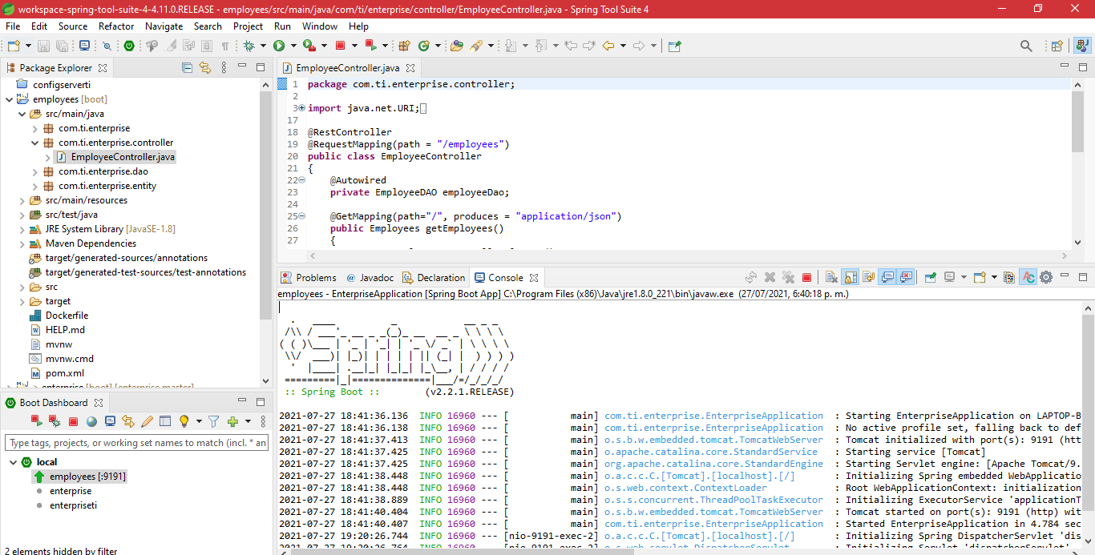
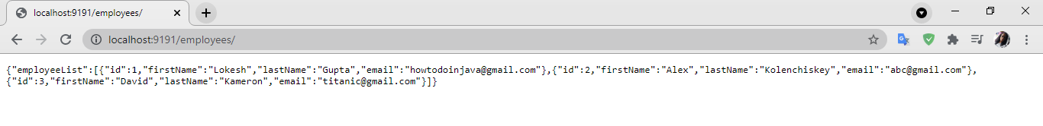
S5.MicroServiceRestEmployeesEjemplo

Slide 3
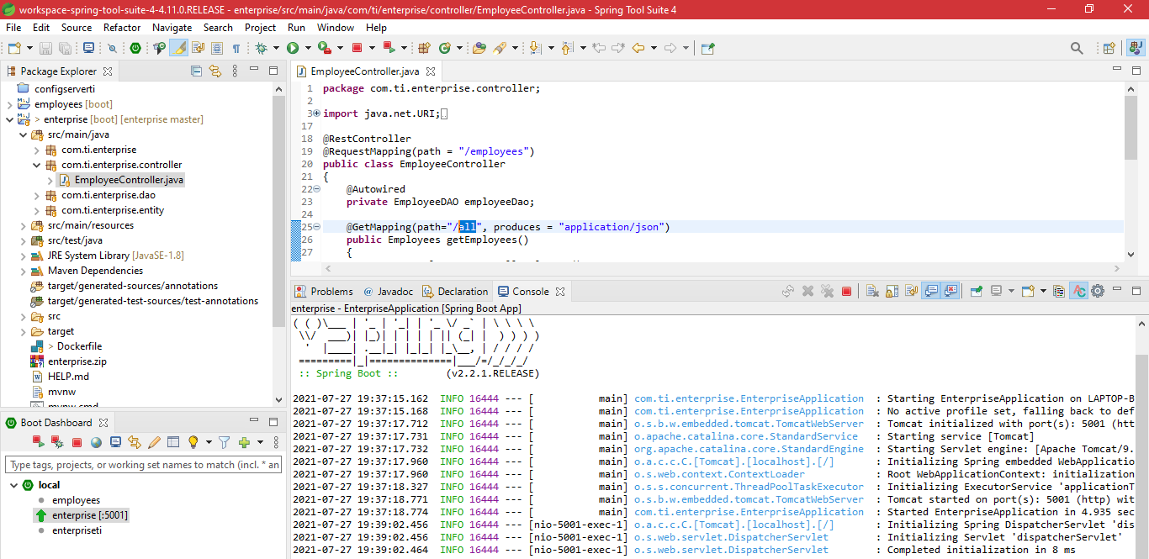
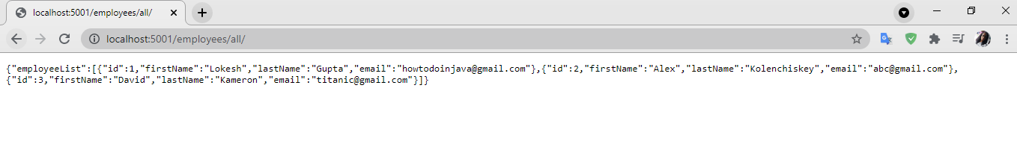
S5.MicroServiceRestEmployeesAll

Slide 4
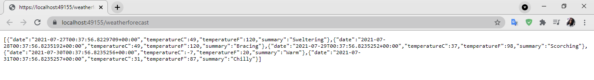
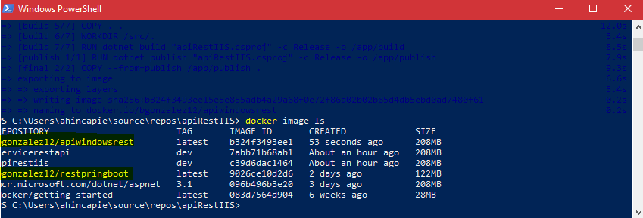
Docker

Slide 5
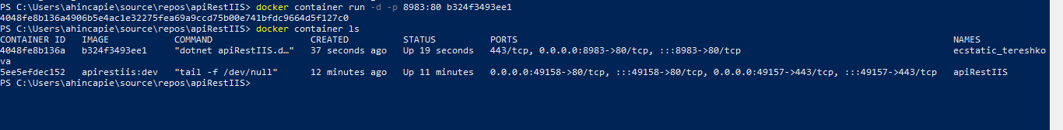
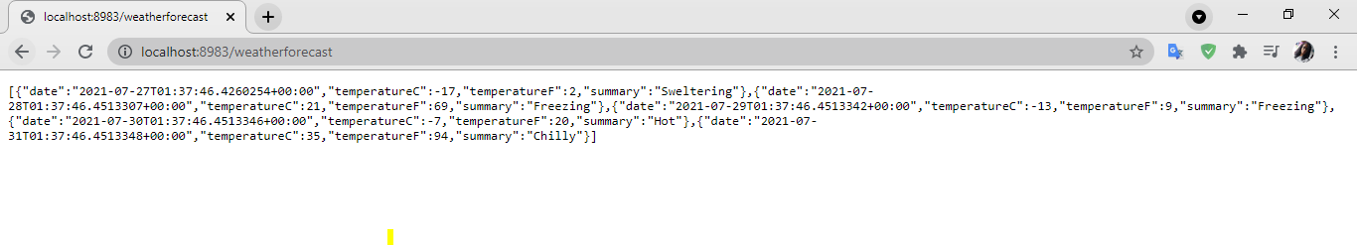
Docker Container

Slide 6
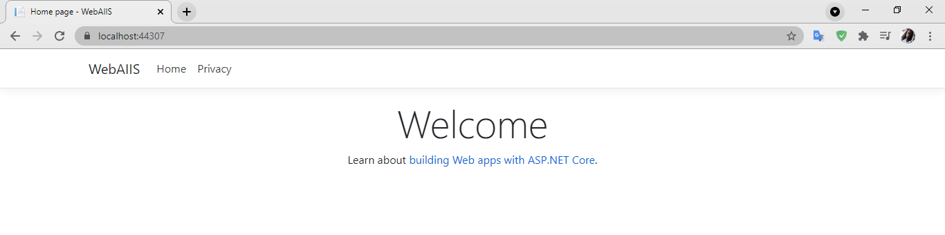
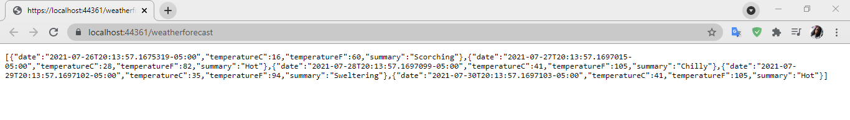
apiRestIIS

Slide 7
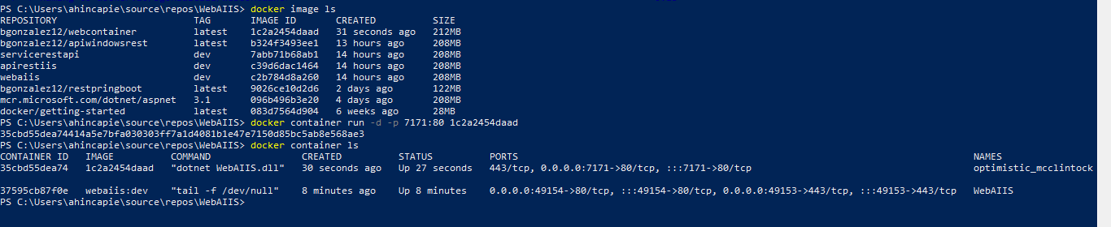
web ASP.NET - Docker

Slide 8
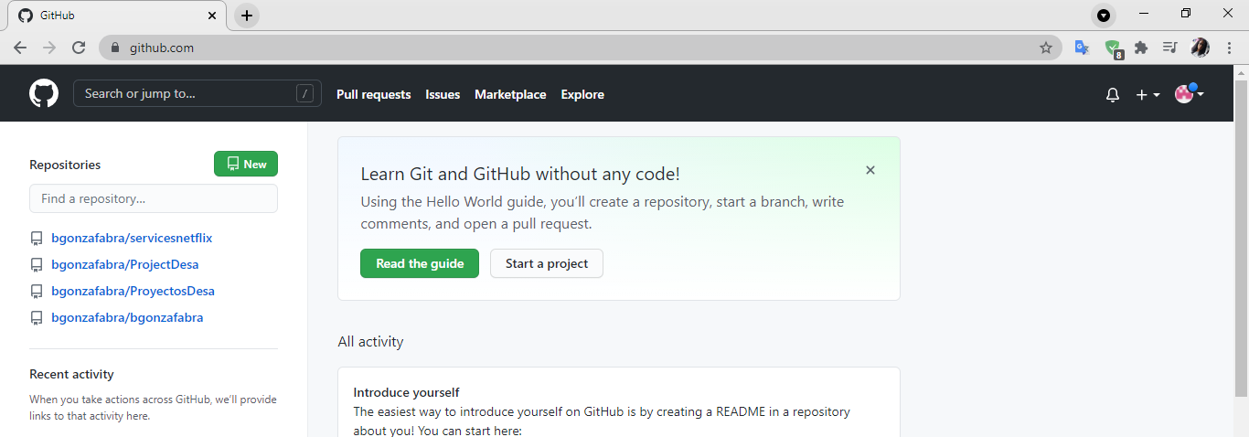
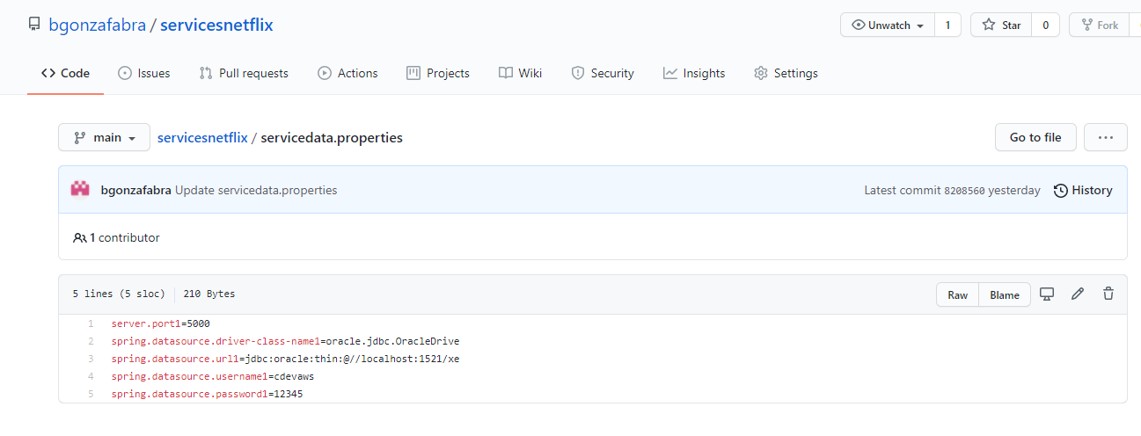
s9.SpringCloudNetflix

Slide 9
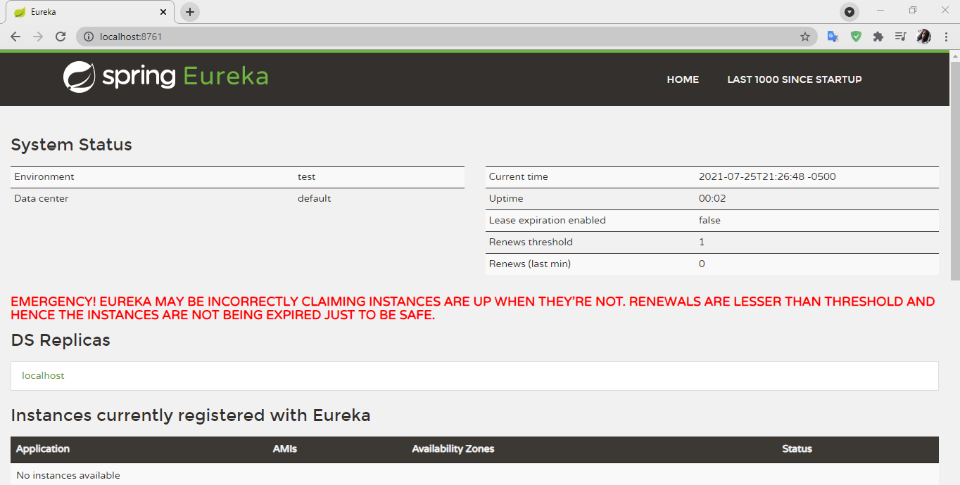
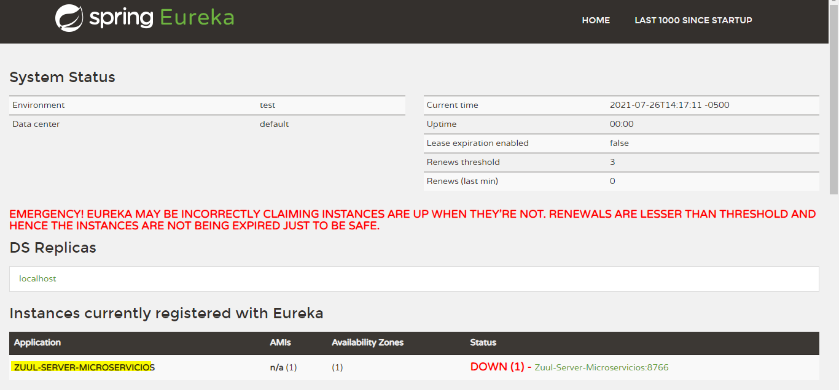
s9_Eureka - S9.SERVER_ZUUL

Slide 10
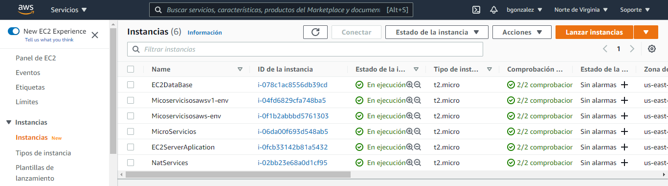
s10.cx_AWS_EC2_ini Server WEB

Slide 11
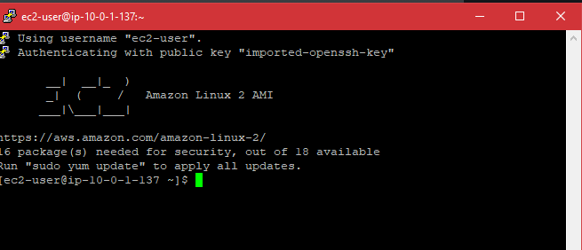
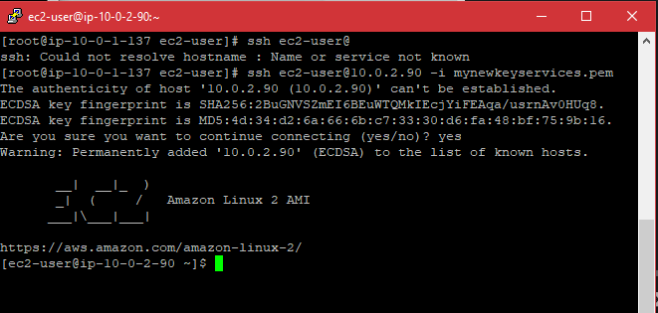
s11.cx_AWS - s11.cx_AWS_DB

Slide 12
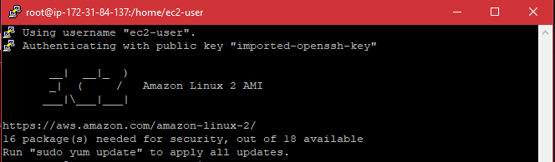
s11.cx_AWS_EC2
s10.cx_AWS_EC2_ini Server WEB

Slide 13
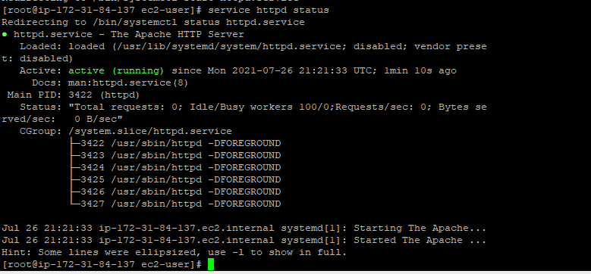
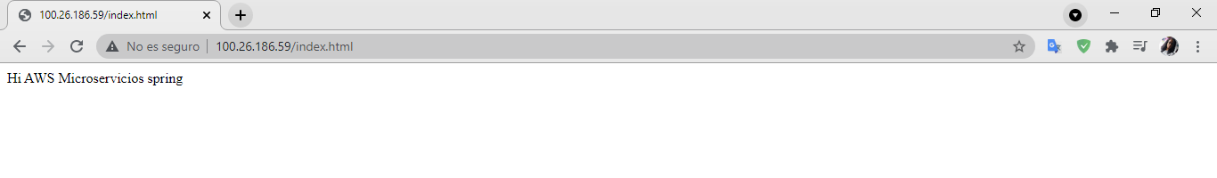
s11.cx_AWS_EC2_Status Server WEB
s11.cx_AWS_EC2_ Server WEB

Slide 14
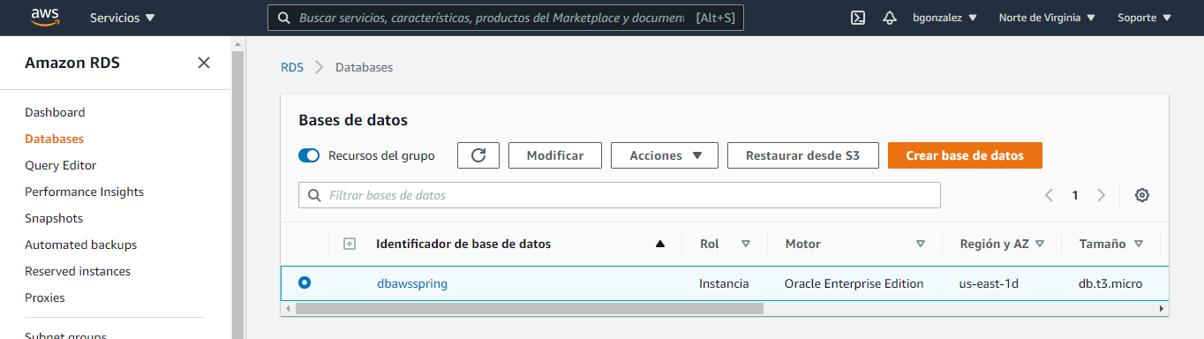
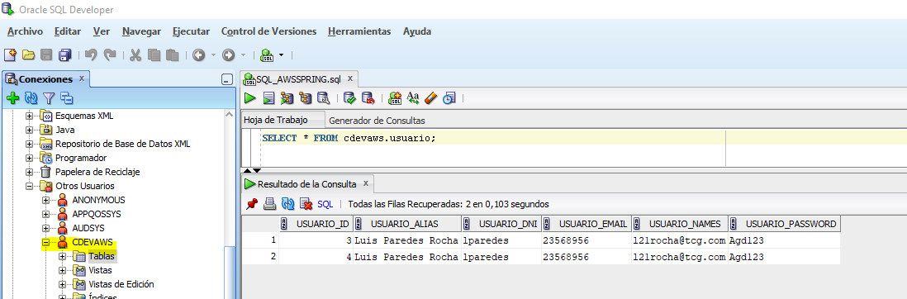
s11.cx_AWS_DataBase
s11.cx_AWS_DB_create

Slide 15
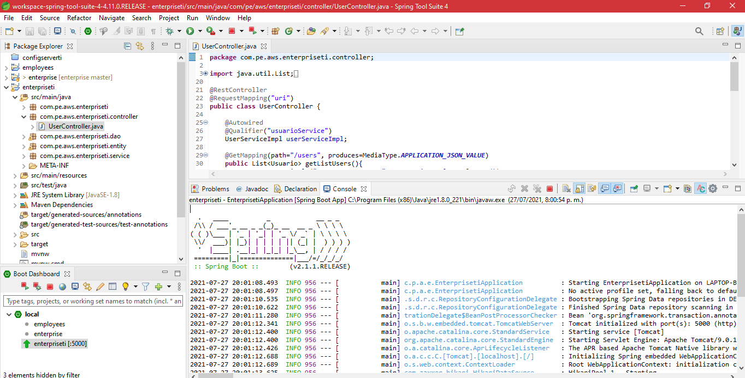
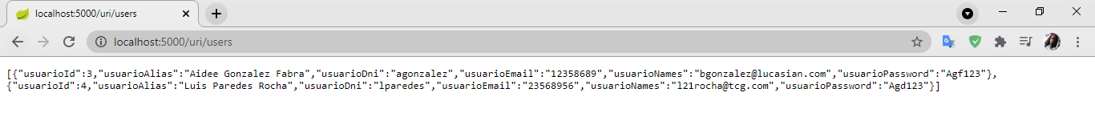
s11.cx_AWS_DB_prueba servicio spring

Slide 16
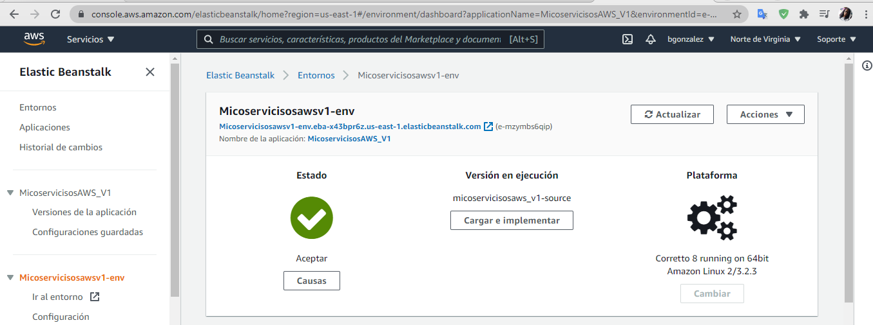
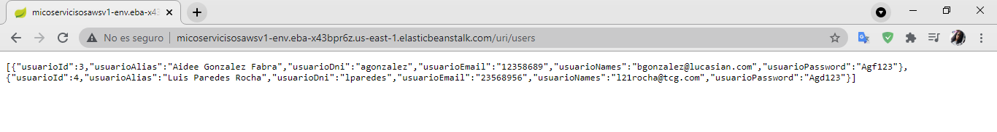
s11. Despliegue servicio en AWS_Elastic Beanstalk

Slide 17
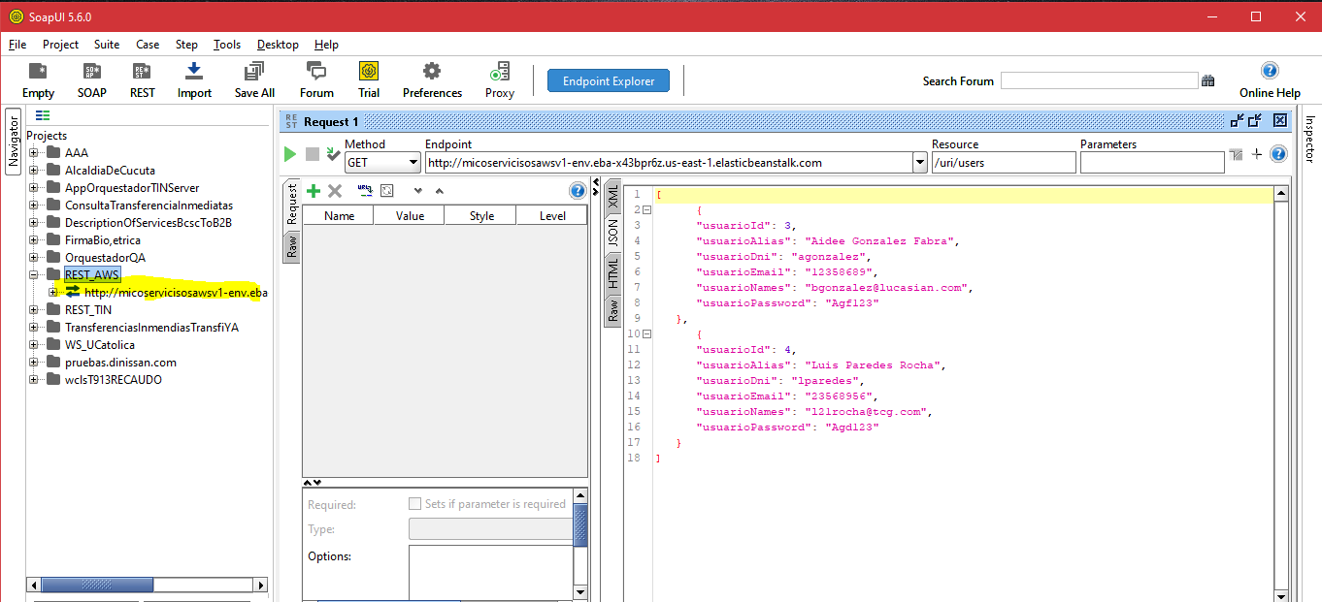
PruebaFinal SoapUI_AWS

Slide 18
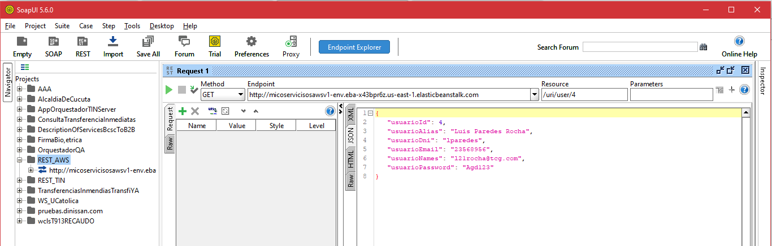
PruebaFinal SoapUI_AWS_xUser

Slide 19
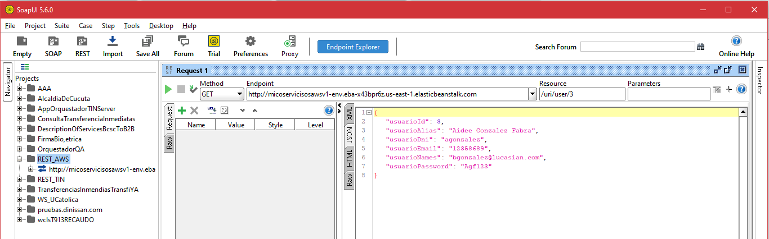
PruebaFinal SoapUI_AWS_xidUser

Slide 20
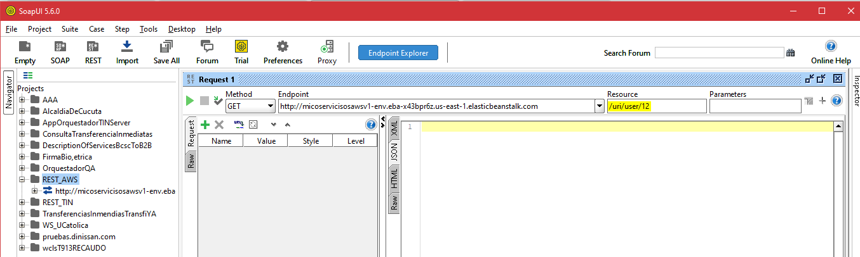
PruebaFinal SoapUI_AWS_xUserQno Existe

Slide 21
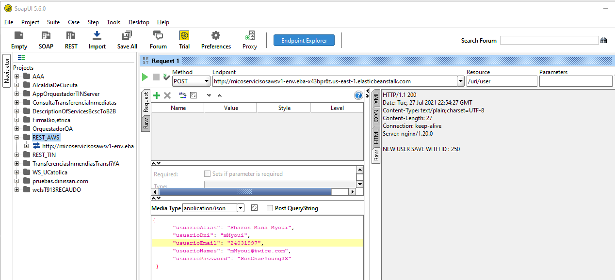
s11.cx_AWS_DB_prueba Crear usuario

Slide 22
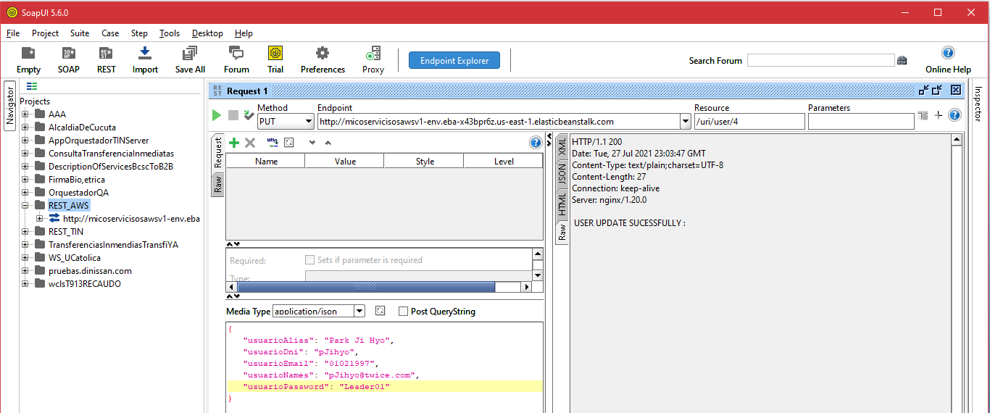
s11.cx_AWS_DB_prueba actualizar_usuario

Slide 23
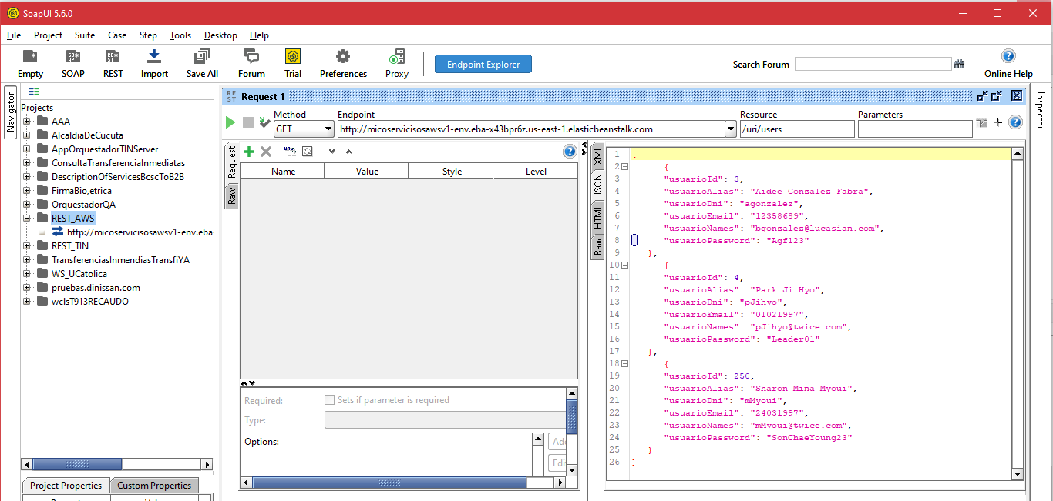
s11.cx_AWS_DB_prueba consultar usuarios

Slide 24
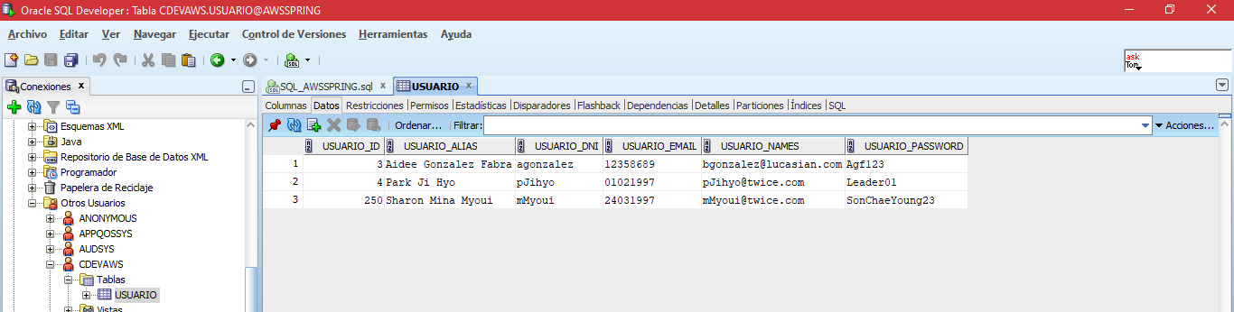
PruebaFinal DB_AWS_xUser

