Slide 1
Proportions and ODDS Ratios
Unit 10

Slide 2
CLASS Exercises

Slide 3
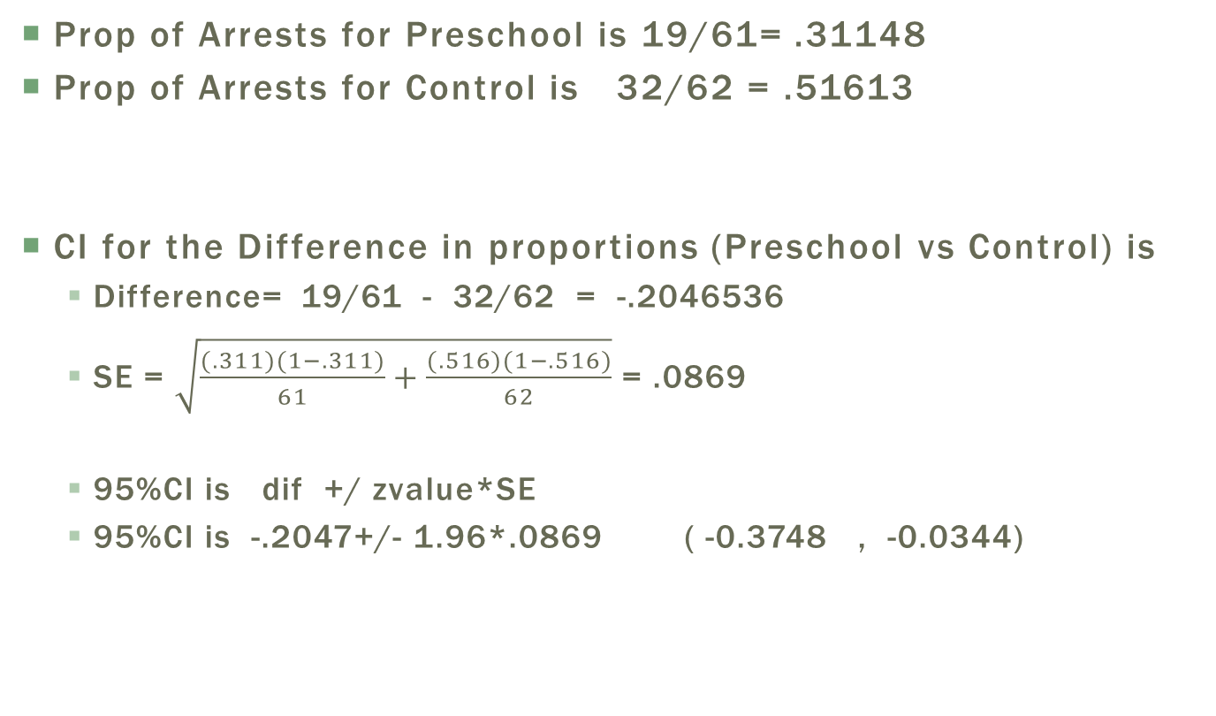
Proportions
Prop of Arrests for Preschool is 19/61= .31148
Prop of Arrests for Control is 32/62 = .51613
CI for the Difference in proportions (Preschool vs Control) is
Difference= 19/61 - 32/62 = -.2046536
SE = $\sqrt{\frac{(.311)(1−.311)}{61}+\frac{(.516)(1−.516)}{62}}$ = .0869
95%CI is dif +/ zvalue*SE
95%CI is -.2047+/- 1.96*.0869 ( -0.3748 , -0.0344)

Slide 4
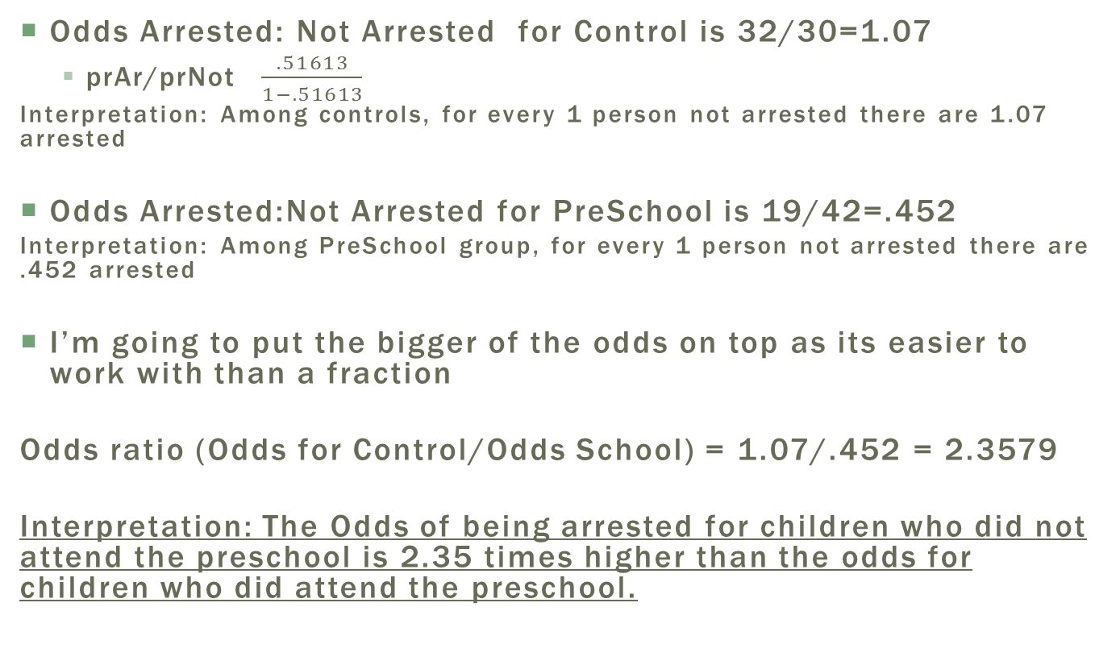
ODDS
Odds Arrested: Not Arrested for Control is 32/30=1.07
prAr/prNot $\frac{.51613}{1−.51613}$
Interpretation: Among controls, for every 1 person not arrested there are 1.07 arrested
Odds Arrested:Not Arrested for PreSchool is 19/42=.452
Interpretation: Among PreSchool group, for every 1 person not arrested there are .452 arrested
I’m going to put the bigger of the odds on top as its easier to work with than a fraction
Odds ratio (Odds for Control/Odds School) = 1.07/.452 = 2.3579
Interpretation: The Odds of being arrested for children who did not attend the preschool is 2.35 times higher than the odds for children who did attend the preschool.

Slide 5
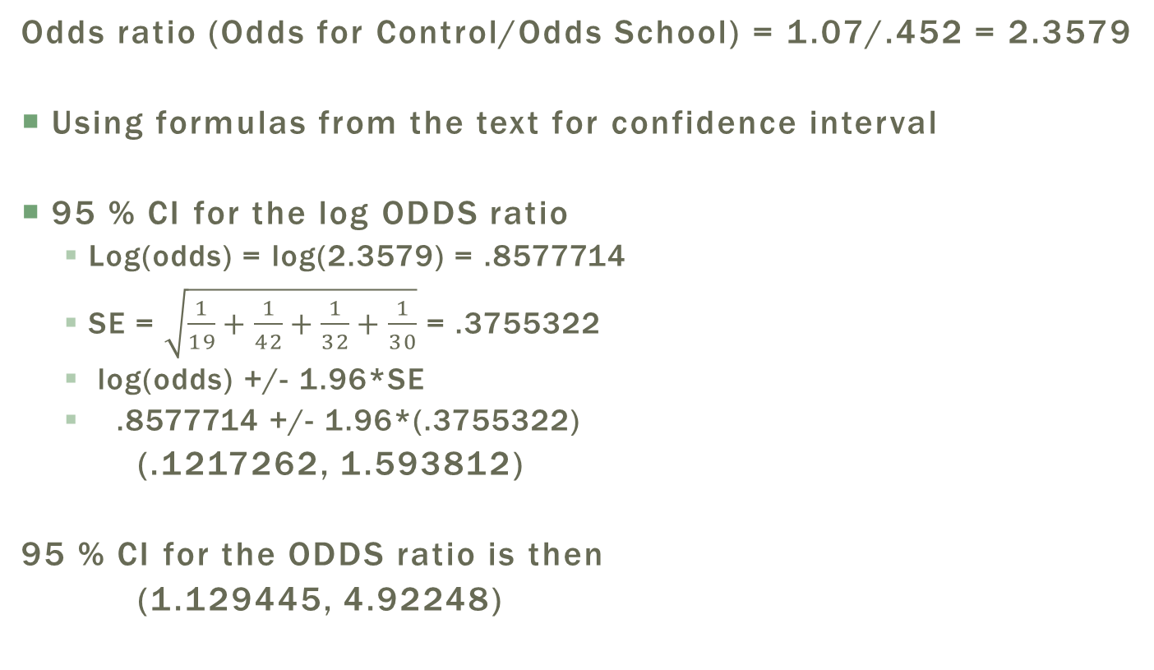
ODDS
Odds ratio (Odds for Control/Odds School) = 1.07/.452 = 2.3579
Using formulas from the text for confidence interval
95 % CI for the log ODDS ratio
Log(odds) = log(2.3579) = .8577714
SE = $\sqrt{\frac{1}{19}+\frac{1}{42}+\frac{1}{32}+\frac{1}{30}}$ = .3755322
log(odds) +/- 1.96*SE
.8577714 +/- 1.96*(.3755322)
(.1217262, 1.593812)
95 % CI for the ODDS ratio is then
(1.129445, 4.92248)

Slide 6
Exercise
Suppose this is the whole population (THE TRUTH)
 | Arrested | Not Arrested | Total
No Pre School | 250 | 550 | 800
Pre School | 50 | 150 | 200
Total | 300 | 700 | 1000
Proportion of Arrested if they went to school = 50/200 = .25
Similarly for no preschool = 250/800 = .3125
Proportion of PreSchool if you were arrested is 50/300 = 1/6=.1666
ODDS Ratio = 1.36

Slide 7
Exercise
Suppose now we did a retrospective study and filled in the expected counts based on what we know from the truth
Proportion of Arrested if they went to school = 50/200 = .25
Similarly for no preschool = 250/800 = .3125
Proportion of PreSchool if you were arrested is 50/300 = 1/6=.1666
ODDS Ratio = 1.36

Slide 8
Exercise
Suppose now we did a retrospective study and filled in the expected counts based on what we know from the truth
Proportion of Arrested if they went to school = 50/200 = .25
Similarly for no preschool = 250/800 = .3125
Proportion of PreSchool if you were arrested is 50/300 = 1/6=.1666
ODDS Ratio = 1.36

Slide 9
Exercise
Suppose now we did a retrospective study and filled in the expected counts based on what we know from the truth
Proportion of Arrested if they went to school = 50/200 = .25
Similarly for no preschool = 250/800 = .3125
Proportion of PreSchool if you were arrested is 50/300 = 1/6=.1666
ODDS Ratio = 1.36

Slide 10
Exercise
Suppose now we did a retrospective study and filled in the expected counts based on what we know from the truth

Slide 11
Exercise
Suppose now we did a retrospective study and filled in the expected counts based on what we know from the truth
Proportion of Arrested if they went to school = 16/37 = .43
We know the truth is 50/200 = .25 not even close
The ODDS ratio is still sitting close to 1.36 (off because of rounding)

Slide 13
General Comments
2x2 tables with two dichotomous variables
Difference in proportions and ODDS ratios are both measures trying to get at the same thing:
Does the chance of my response occurring depend on what group I’m in.
Obviously if the proportions are the same for each group then it doesn’t matter which group I’m in, the chance is the same regardless
(Works as intended in prospective settings)
Same logic holds for Odds Ratio: if the proportions are the same then the ODDS Ratio is equal to 1.
(Works in prospective as well as retrospective settings)

Slide 14
A Higher Level View

Slide 15
A high Level View

Slide 16
2X2 Contingency tables
Response / Outcome
Explanatory/
Exposure
Try to remain consistent, as it will help keep your thoughts straight. I put response on top (columns) and Explanatory in rows.

Slide 17
Identify the study design How the Observations were sampled
Response / Outcome
Explanatory/
Exposure
PROSPECTIVE Experimental/Observations
Children were randomly placed into (or selected from) the explanatory groups. Row totals are fixed ahead of time.

Slide 18
Identify the study design How the Observations were sampled
Response / Outcome
 | Died | Alive | Total
OBESE | 16 | 2045 | 2061
NOT OBESE | 7 | 1044 | 1051
Total | 23 | 3089 | 3112
Explanatory/
Exposure
Completely OBSERVATIONAL
The only number that was fixed in advanced was the total sample size. In these situations it is sometimes more open to what is the response and what is the explanatory.
Here the two observed quantities had an order (obese definition in 1976, and then observed if the died in the window (1976 to 1982).
Sometimes there is no order, here we have a more general type of hypothesis that will be discussed next session

Slide 19
Identify the study design How the Observations were sampled
Response / Outcome
Explanatory/
Exposure
RETROSPECTIVE Observational
Subjects were selected based on their Response outcome and then the explanatory outcome was then observed.
The problem with this is that technically we just flipped the experiment around where Response is really the Explanatory and the Explanatory is really the Response.
But we still want to make conclusions and talk about the Arrested/Not Arrested as the response

Slide 20
Summary statistics
Just like in other topics we can summarize the 2x2 table using percentage breakdowns
Percentages With Respect to Total Sample Size

Slide 21
Summary statistics
Just like in other topics we can summarize the 2x2 table using percentage breakdowns
Row Percent's
Ex. Percentage of Arrested individuals who did not attend school is 51.61

Slide 22
Summary statistics
Just like in other topics we can summarize the 2x2 table using percentage breakdowns
Column Percent's
Ex. Percentage of Folks Attending Preschool who were arrested is 37.25 * Note: This estimate is not accurate because we forced there to be equal number of control and preschool groups. It doesn’t really tell us anything.

Slide 23
Summarizing percentages/Probabilities
When you get comfortable you just let SAS print off all of the summary percent's and you can pluck off the ones you need.
Perhaps a better exercise is to ask yourself what type of sampling was conducted.
If the Rows were fixed ahead of time, then column percent's are not informative
If cols are fixed, the row percent's are not informative
If only the total sample size was fixed, you can use everything
Tell SAS to only include the ones that are informative

Slide 24
General Guidance when dealing with tests for differences of proportions and ODDS ratios
Determine how the data is sampled and what proportions are actually useable
In general, we have a more global tests that works regardless of being in retrospective or prospective cases. This is covered in the next unit (ANALYSIS PLAN IS COMING NEXT TIME)
Fishers Exact test (no sample size rules to remember)
We will use this in practice to conduct hypothesis tests versus conducting the hypothesis tests in this section.
What you will want to use is the confidence intervals. Once the hypothesis test is conducted, you would then report the appropriate measure either differences in proportions or an odds ratio value and its confidence interval.

Slide 25
Interpreting AN ODDS RATIO and Something called (Relative Risk)
#1 OR=3 The odds for getting arrested given you did not go to the pre school is 3 times the odds for those not attending the pre school
We have to make sure we are saying “ODDS of this is 3 times ODDS of that”
#2 What we’d like to say and some times misspeak is “We are 3 times more likely to be arrested if we don’t attend pre-school”
There is actually an estimate for this its just not the OR. In certain situations the OR can be used with that interpretation but not in general. To be able to say the comment above we need to know the RELATIVE RISK

Slide 26
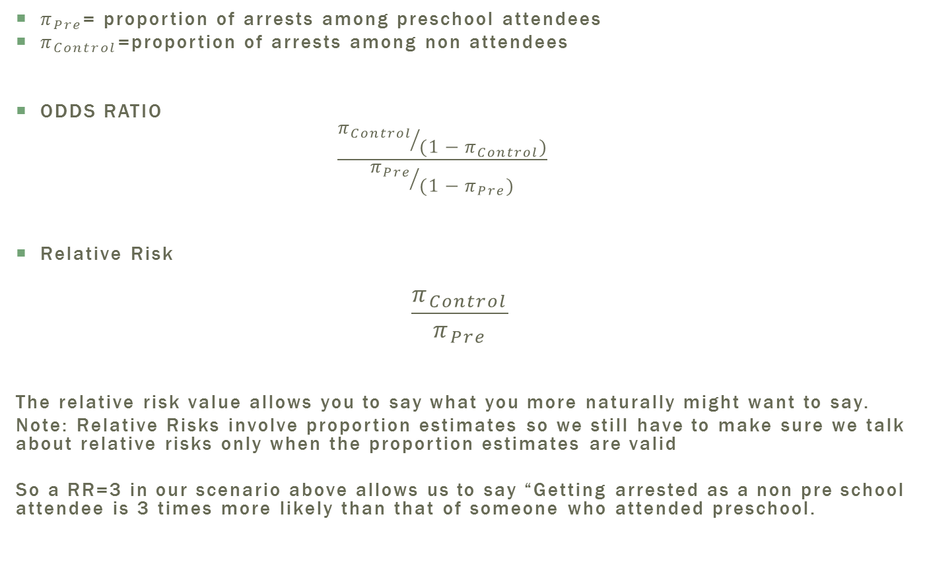
Relative Risk (SAS option RISK DIFF)
$π_{Pre}$= proportion of arrests among preschool attendees
$π_{Control}$=proportion of arrests among non attendees
ODDS RATIO
$$\frac{{π_{Control}}/{(1−π_{Control})}}{{π_{Pre}}/{(1−π_{Pre})}}$$
Relative Risk
$$\frac{π_{Control}}{π_{Pre}}$$
The relative risk value allows you to say what you more naturally might want to say.
Note: Relative Risks involve proportion estimates so we still have to make sure we talk about relative risks only when the proportion estimates are valid
So a RR=3 in our scenario above allows us to say “Getting arrested as a non pre school attendee is 3 times more likely than that of someone who attended preschool.

Slide 27
SOME SAS to play around with
proc format;
value ExpFmt 1='Control'
0='Pre School';
value RspFmt 1='Arrested'
0='Not Arrested';
run;
data GoToSchool;
input Exposure Response Count;
label Response='Arrest Status';
datalines;
0 0 42
0 1 19
1 0 30
1 1 32
;
proc sort data=GoToSchool;
by descending Exposure descending Response;
run;
proc freq data=GoToSchool order=data;
format Exposure ExpFmt. Response RspFmt.;
tables Exposure*Response / chisq riskdiff(equal var=null) relrisk;
exact pchi or fisher;
weight Count;
title ' Prospective Study ';
run;

