Slide 1
Live Session 13
Clustering Discussion and Examples

Slide 2
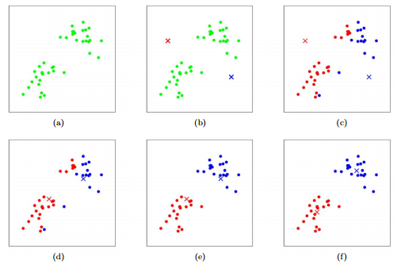
K-Means
Kmeans vs Hierarchical
Kmeans (Specified number of clusters = 2)

Slide 3
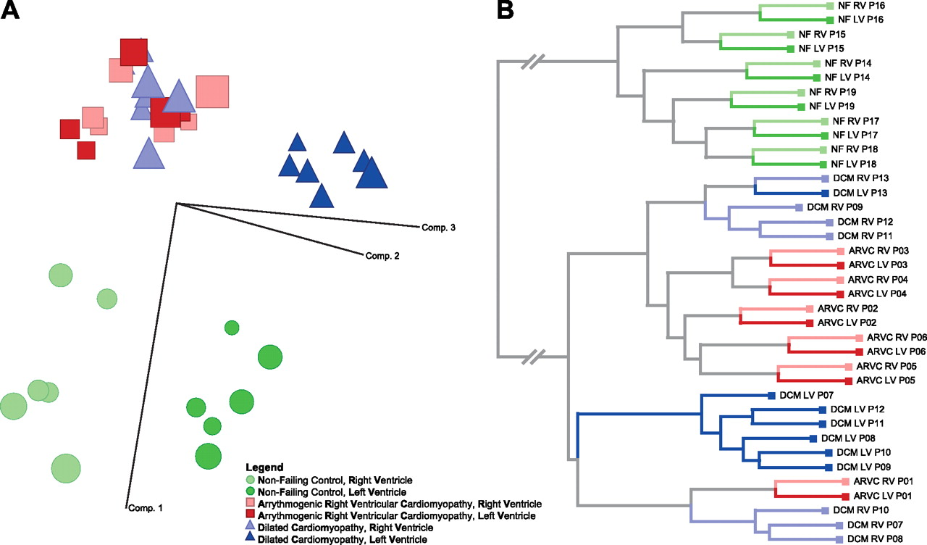
Hierarchical
Technically – Hierarchical doesn’t give you a number of clusters, it just provides a web of observations that are more similar than others through the dendrogram
http://physiolgenomics.physiology.org/content/44/1/99

Slide 4
Cut the Tree to get Cluster numbers
http://physiolgenomics.physiology.org/content/44/1/99
2 Clusters

Slide 5
Cut the Tree to get Cluster numbers
http://physiolgenomics.physiology.org/content/44/1/99
4 Clusters

Slide 6
This SEEMS a lot like LDA???
Difference
LDA’s algorithm uses known classification (clusters) to help define a classification rule. “Supervised since we give it that information”
Clustering methods do not use any knowledge about how the observations are categorized at all (completely “unsupervised”)

Slide 7
Methods of Assessing Cluster Validity
External vs Internal (Outside truths or just measuring fit)
External
Known Class or Groups
We could use Chisquare tests
INTERNAL
RMSSTD-small
SPRSQ – high
Cubic Clustering Criterion
Pseudo t2
Silhouette Statistic *not in videos
Dunn‘s Index *not in videos

Slide 8
Methods of Assessing Cluster Validity
External vs Internal (Outside truths or just measuring fit)
External
Known Class or Groups
We could use Chisquare tests
INTERNAL
RMSSTD-small
SPRSQ – high
Cubic Clustering Criterion
Pseudo t2
Silhouette Statistic *not in videos
Dunn‘s Index *not in videos
 | Group1 | Group2 | Group3
Cluster 1 | 100 | 20 | 3
Cluster 2 | 10 | 80 | 70
Cluster 3 | 30 | 20 | 150
Clusters tend to be associated with known groups , aka, good job

Slide 9
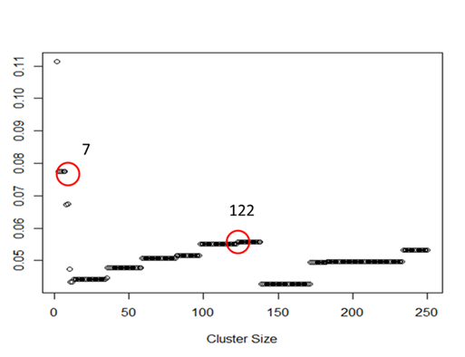
Picking number of Clusters
Typically plotting one or several of the internal values across a wide range of possible cluster numbers
Example using Dunn’s Index – There’s never a clear rule.

Slide 10
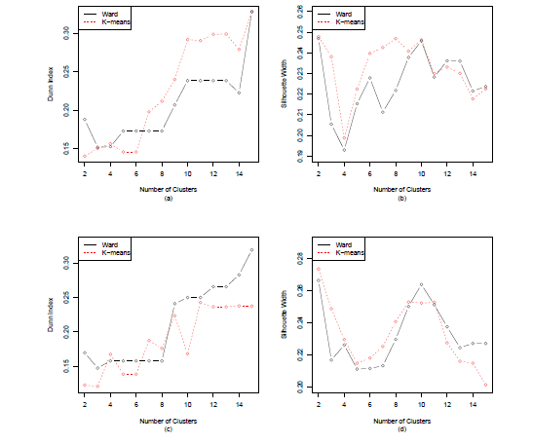
Clustering Cricket Batsmen

Slide 11
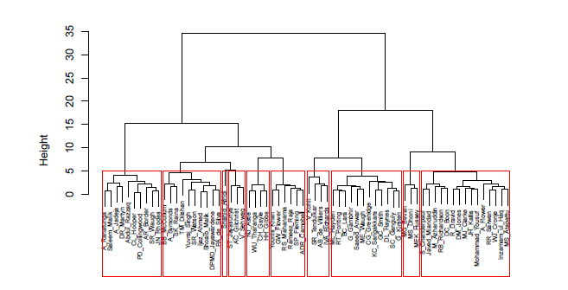
Clustering Cricket Batsmen

Slide 12
How can clustering big data help?
My opinion – Real power of clustering goes hand in hand with heat map visualizations
Heatmaps - a plot of raw or standardized continuous variables where (each row is an observation or variables) each column is the other (variables/ observations)
Plot is a grid of squares or rectangles color coded by the value of the underlying data set
Hierarchical clustering can be applied seperately to both the rows and the columns to see how the data clusters naturally

Slide 13
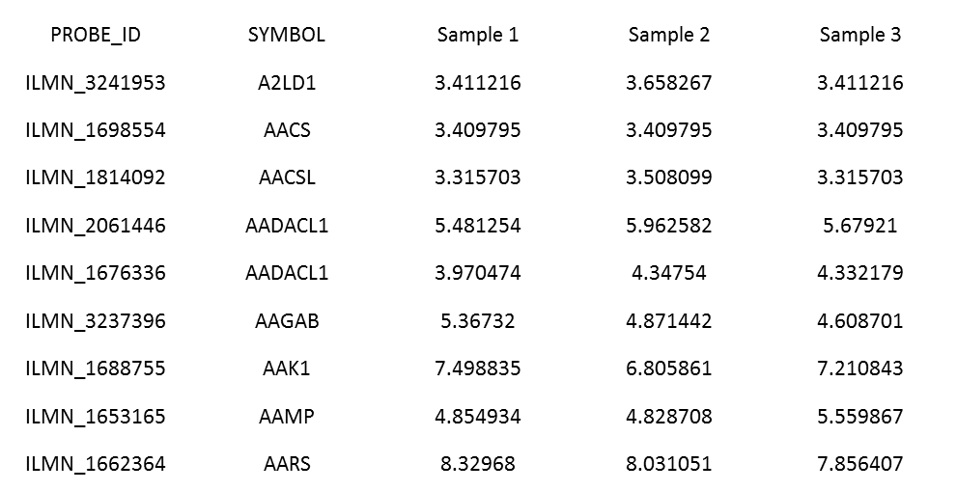
Heatmap example
Typical microarray data
Observations
Variables (20k)

Slide 14
Heatmap Example
Clustering helps identify variability in your data whether its technical artifacts (blocking type variables) or its real biological/meaningful variability
Helps to identify outliers
Can help identify if you are going to find statistical differences between groups
Can help identify variables that are highly correlated (similar) that may be of meaningful importance

Slide 15
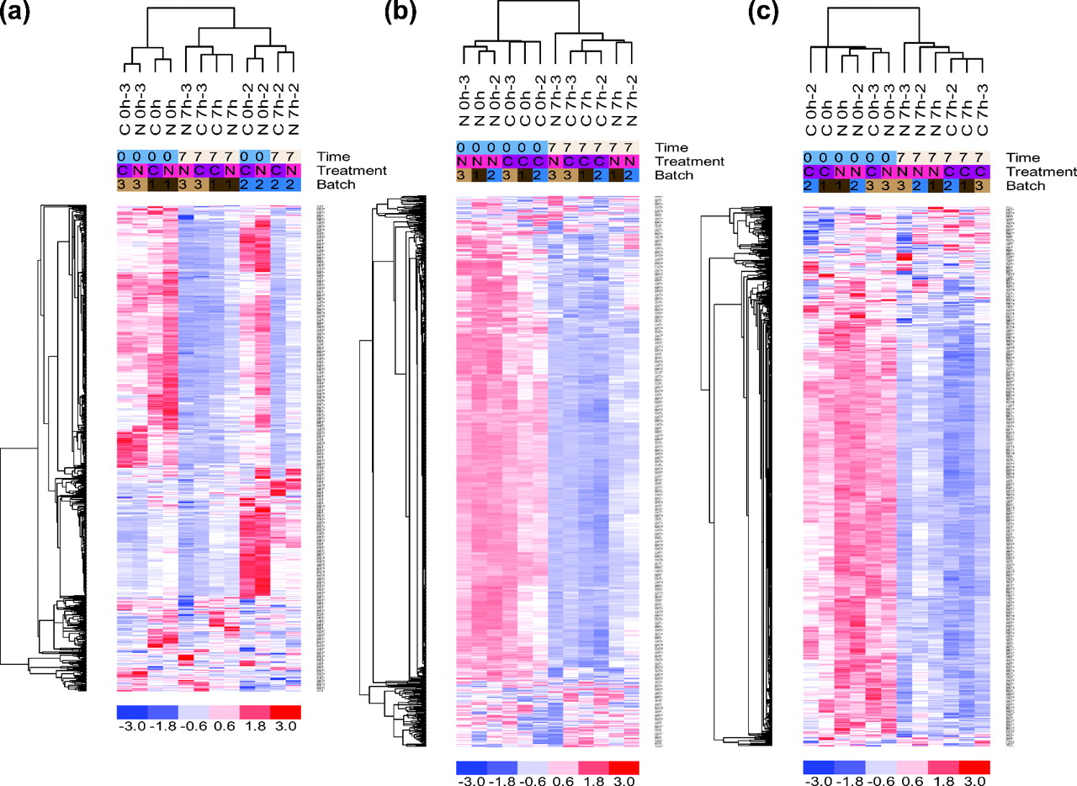
Heatmap Example
Information: Col clusters
Outliers: Dark Red,Dark Blue, or whole column just looks out of place compared to the rest.
Variability: Most of the variability is in time point. Within time some evidence of clustering between treatment
W. Evan Johnson et al. Biostat 2006;8:118-127

Slide 16
Heatmap Example
Information: Row clusters
Bulk of the variables behave the same way
We will have many variables that will find statistical differences between time7 vs time0
The cluster of variables that are similar may have similar biological function and could be investigated further
W. Evan Johnson et al. Biostat 2006;8:118-127

Slide 17
Picking cluster numbers Revisited

Slide 18
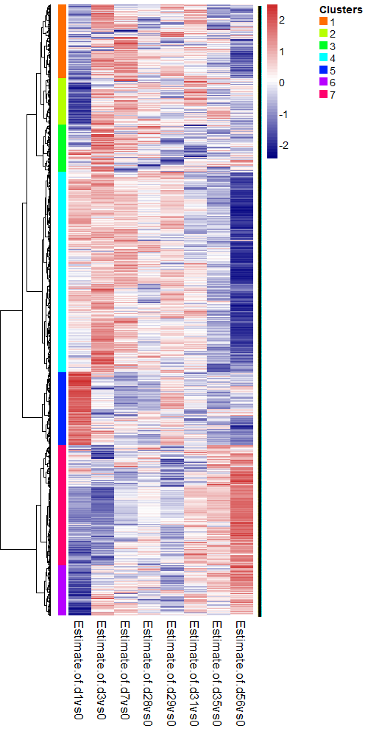
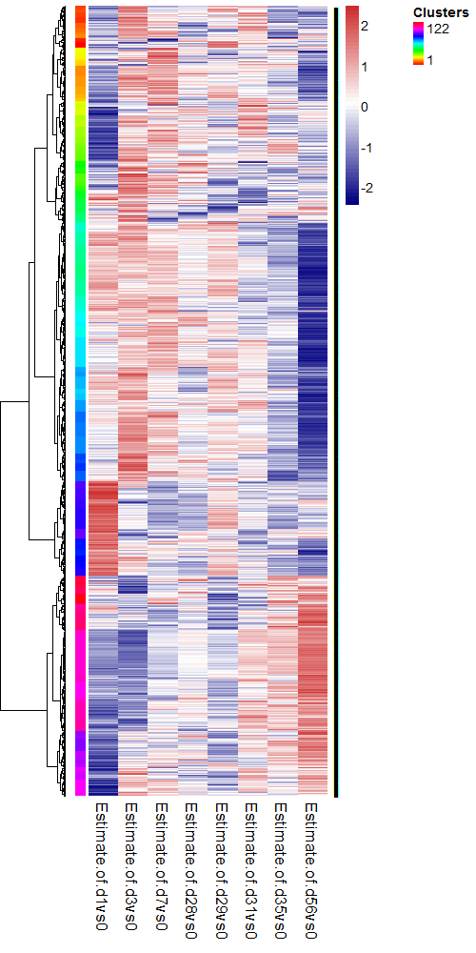
Interesting thing to note: The columns here are not individual observations but different summary statistics. So interpretations change depending on what type of data you decide to cluster

Slide 19
Clustering Recap
Methods often times yield similar results
It does depend on the type of data you have however.
See McGee’s video for special scenarios
Dendrograms and clustering are good, but pairing them up with heat map visualizations often times can give you great information
Checking for outliers and unique patterns
Clustering can happen on variables or on observations
Standardizing variables are the norm, as variables on different scales may cluster just because they are far apart in pure distance (similar to the rational of standardizing variables before PCA)
Upcoming class: We are going to have a quick primer on decision trees and random forests. What I want you guys to do is to read through the following sections in the ISLR textbook
Section 5.2. Bootstrap
Section 8.1 Decision Tree
Section 8.2 Bagging (Bootstrap aggregation), Random Forrest
The main goal of pre live is to give you guys a feel for how these nonparametric strategies differ from things like we’ve covered in class that typically involve some sort of probability model. Implementing these are easy in R (examples are in the Cancer Example). We will make sure you are clear on some of the options that you need to be aware of.

