Slide 1
A Case Study in Beer
by Ben Goodwin & Justin Ehly

Slide 2
Analysis Questions
How many breweries are present in each state?
Why are there missing values?
What is the median ABV and IBU for each state?
Which state(s) has the highest ABV and which state(s) has the highest IBU values?
Provide summary statistics and distribution of ABV.
Is there a relationship between the bitterness of the beer and its alcoholic content?
Is there a difference between IPA’s and Ale’s?
Possible opportunities to grow the Budweiser brand.

Slide 3
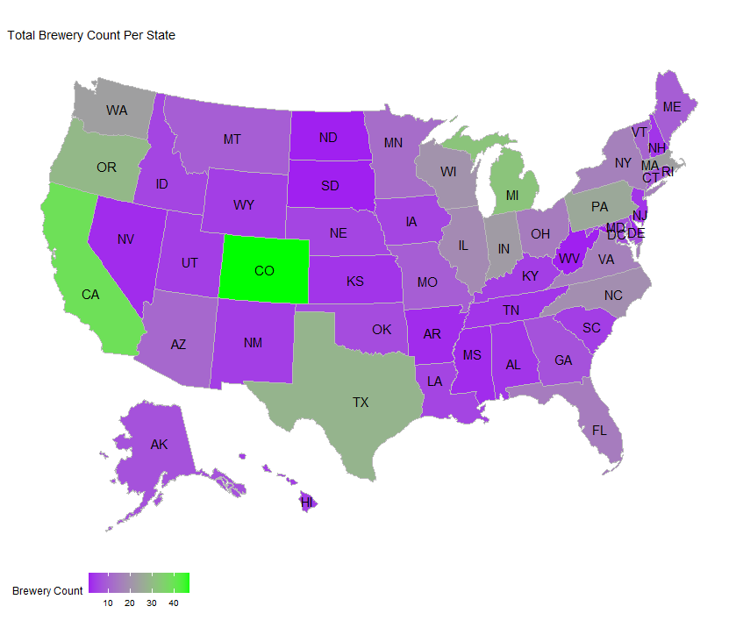
Breweries by State Nationally

Slide 4
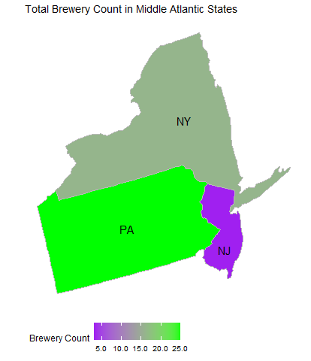
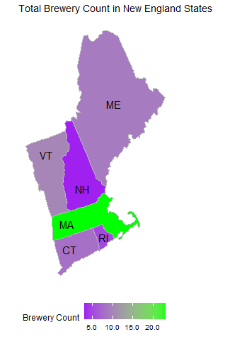
Breweries in USC Northeast Region

Slide 5
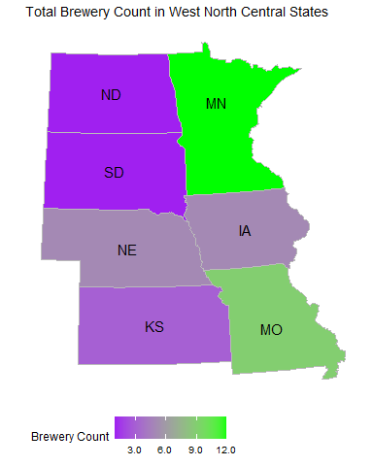
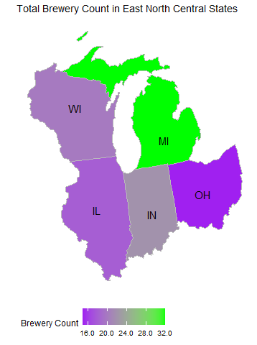
Breweries in USC Midwest Region

Slide 6
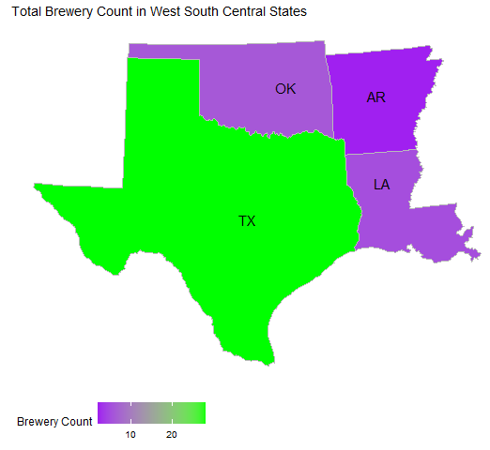
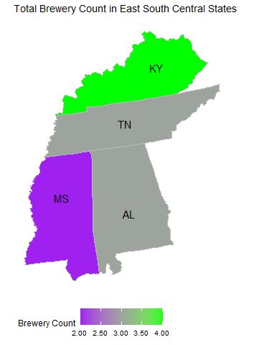
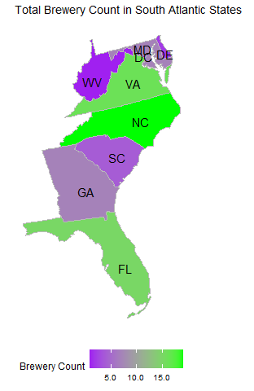
Breweries by USC South Region

Slide 7
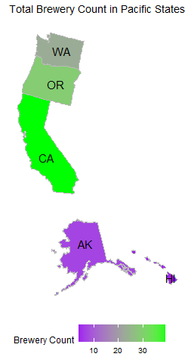
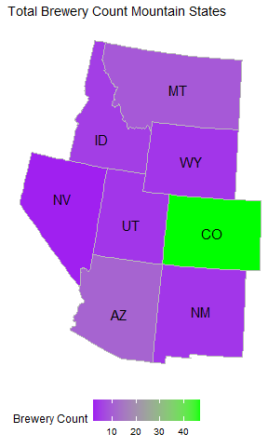
Breweries by USC West Region

Slide 8
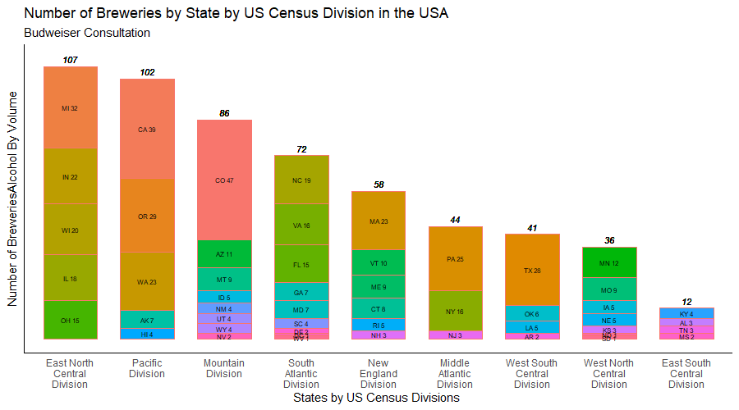
Breweries by State by US Census Divisions
Top 10 States by Brewery
Colorado -- 47
California – 39
Michigan -- 32
Oregon -- 29
Texas -- 28
Pennsylvania -- 25
Washington -- 23
Massachusetts -- 23
Indiana -- 22
Wisconsin -- 20

Slide 9
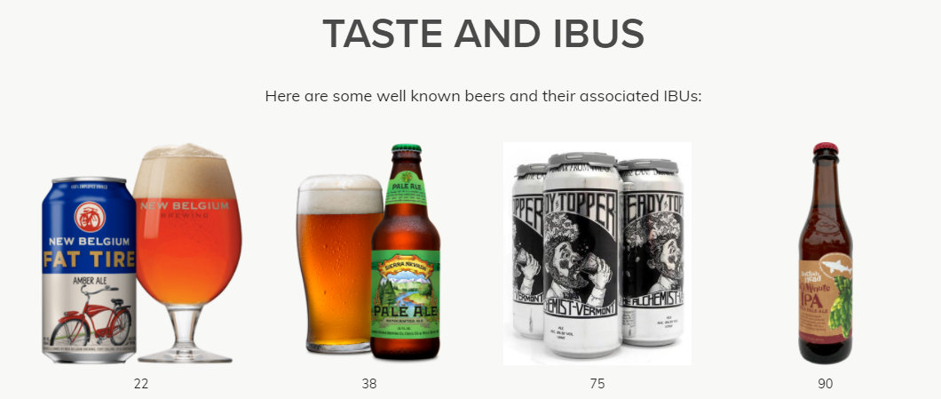
Missing Values
2 Options
Impute NA’s based on average of ABV/ IBU by Style
Disregard NA’s based on
IBU
Cost vs Relevance
Rating vs Taste
ABV
Legal Requirements (vary by state)
Availability (label approval vs packaging)
Photo Credit: https://www.thebrewenthusiast.com/ibus
Notes:
IBU
Smaller breweries cannot afford the equipment to measure IBU and therefore do not use it.
Large breweries can afford the necessary equipment to measure IBU, but tend to use the IBU scale for quality control
isn’t necessarily a true measure of bitterness taste, rather it is a measure of the chemicals in the beer that make it taste bitter (confounding variables can alter this measure though so a lower scoring IBU may taste more bitter than a higher scoring IBU – thebewenthusiast.com for example sites strong Amber ales having IBUs in the 60s that taste less bitter than Pale Ales with mid-50s IBUs
ABV
was actually illegal until 1995 when Coors sued to have it included in its packaging.
mixed and aged beers don’t know ABV until the time the beer is packaged, then it may or may not be stamped onto the bottom of the can, but not necessarily reported.

Slide 10
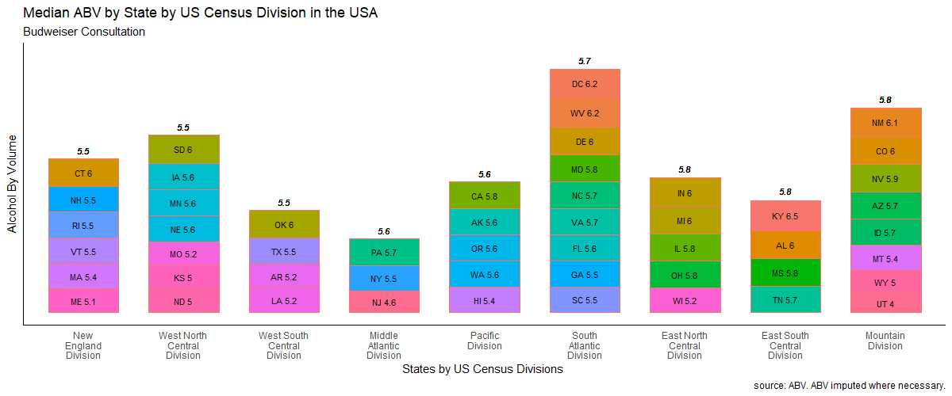
Median ABV by State
National Median ABV (All States)
5.6%

Slide 11
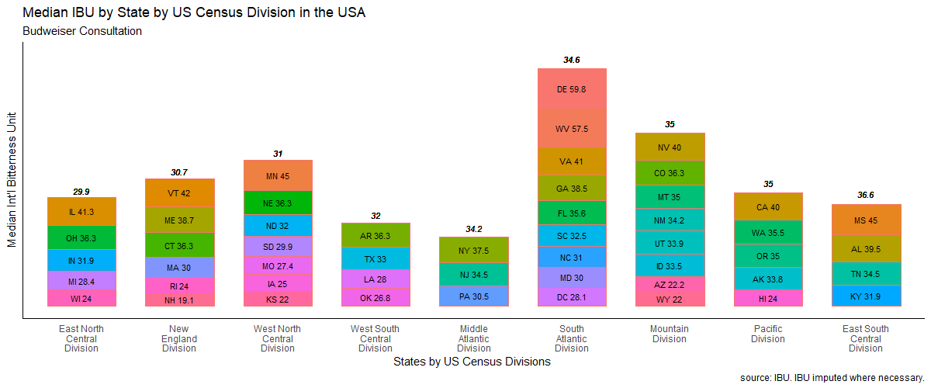
Median IBU by State
National Median IBU (All States)
33.9

Slide 12
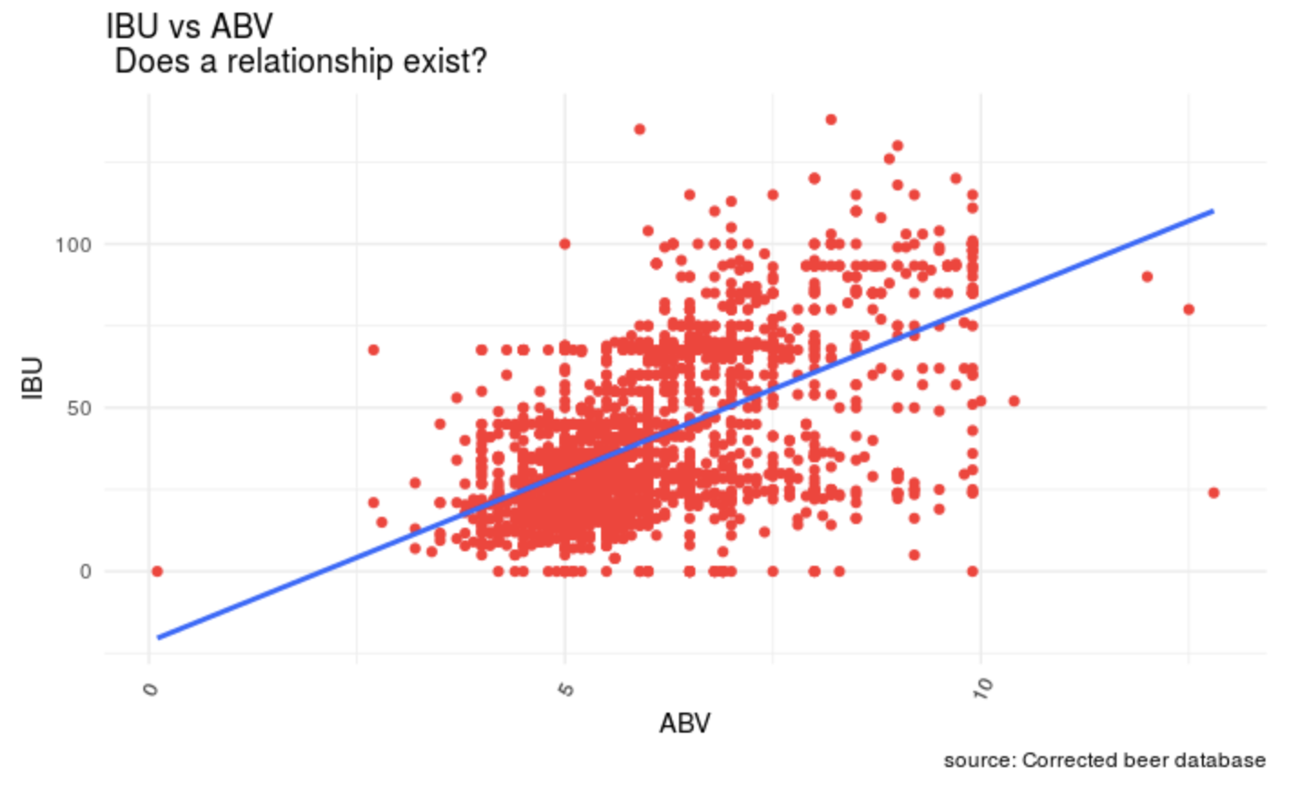
Median ABV vs Median IBU – Does a relationship exist
Visually positive relationship between IBU vs AVB across all beers
Overall median IBU = 33.9
Overall median ABV = 5.6%
What does this relationship tell us?
IBU can be used to interpolate and estimate ABV of a given beer solely based on IBU.
We can develop a model and make predictions based on historical IBU and ABV data
Example, predicted ABV of a beer with 32 IBU
Predicted ABV of 5.72% (97.5% CI: 3.24,8.21)
Note:
West Virginia: ABV is 0.05% - 12.0% ABV for all malt based beverages (SOURCE:https://en.wikipedia.org/wiki/Alcohol_laws_of_West_VirginiaRaising_the_ABV%_Cap)
Utah: Max ABV is 4%, or 3.2 percent by weight for beer. (SOURCE: https://utah.com/state-liquor-laws:~:text=The%20maximum%20alcohol%20content%20is,state%20liquor%20stores%20throughout%20Utah.)

Slide 13
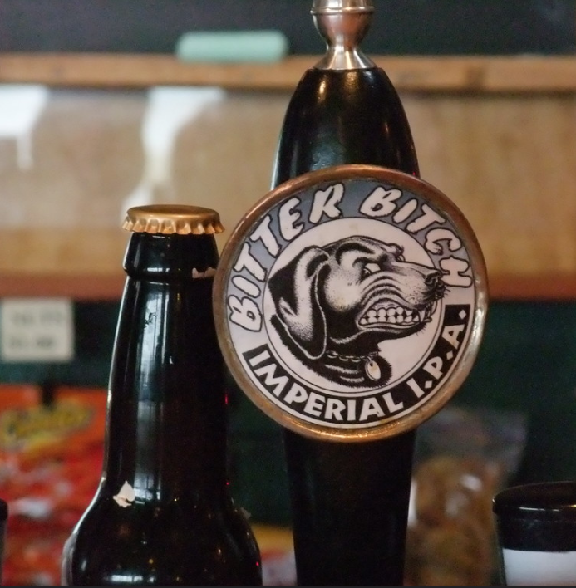
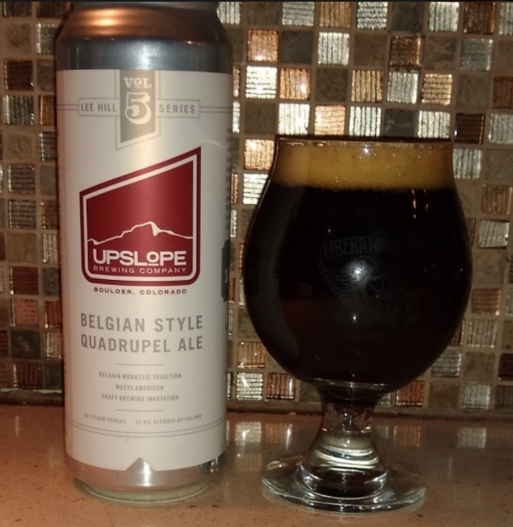
States With Highest ABV and IBU
State with Highest IBU
Oregon: 138 IBU
Beer: Bitter Bitch Imperial IPA
Style: American Double/ Imperial IPA
Brewery: Astoria Brewing Company in Astoria, OR.
State with the Highest ABV
Colorado: 12.8% ABV
Beer: Lee Hill Series Vol. 5
Style: Belgian Style Quadrupel Ale
Brewery: Upslope Brewing Company in Boulder, CO.

Slide 14
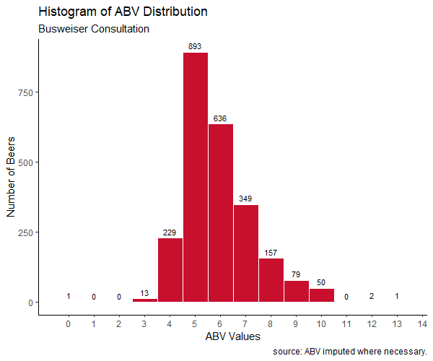
Summary Statics of ABV
All beers have AVB: 0.10 - 12.80
25% have AVB below 5.0
Middle value for all beers: 5.65
50% of beers have an AVB = 5.0 - 6.7
For Example:
Bud Ice (5.5%)
Bud Light Platinum (6%)
Natural Ice (5.9%)
Bud Ice (5.5%)
Budweiser (5%)
Blue Moon (5%)
Stella Artois (5%)
Heineken (5%)
Pabst Blue Ribbon (4.74%)
Miller Genuine Draft (4.6%)
25% have AVB above 6.7
50% have AVB
between 5.0 and 6.7
25% have
AVB above 6.7
25% have AVB above 6.7
SOURCE: https://worldfood.guide/list/list_of_beers_in_america_by_alcohol_content_abv/

Slide 15
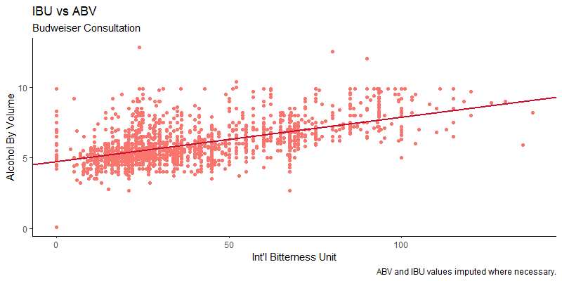
Relationship between IBU and ABV
There is visual evidence of a positive relationship between the IBU and ABV of beer in the USA.
After analyzing the data, it is determined
IBU and ABV are independent variables
We have a positive correlation between IBU and ABV

Slide 16
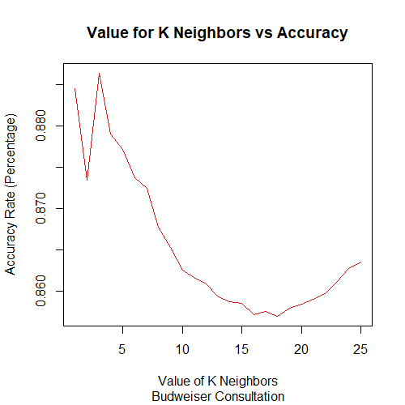
Investigate the Difference between IPA and Ale’s using a kNN classifier
Using KNN (next door neighbors)
Determine optimal number of neighbors to best accuracy at predicting beer of IPA or Ale
Reduces dataset from 2,410 to 945 beers
Graph to right shows about 3 neighbors is appropriate
87% accuracy using 3 of the closest beers
Independently
 | Ale | IPA
Correct | 90% | 83%
Not Correct | 10% | 17%

Slide 17
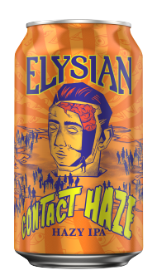
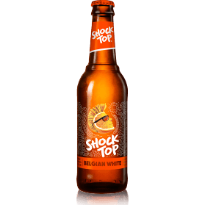
Investigate the Difference between IPA and Ale’s using a Naïve Bayes classifier
Using Naïve Bayes Classifier to compare to kNN
Saw overall 87% accuracy in classifying beers correctly
Very similar performance between Ales and IPAs
 | Ale | IPA
Correct | 90% | 83%
Not Correct | 10% | 17%
OR

Slide 18
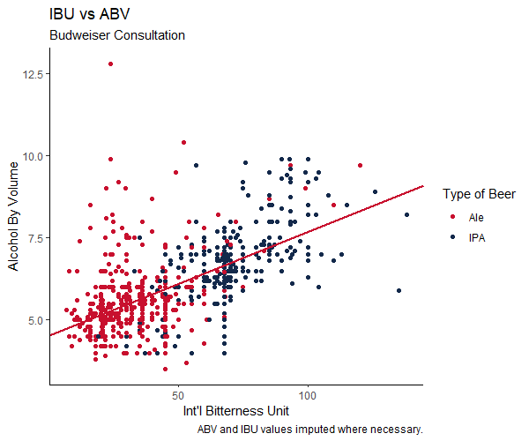
Investigate the Difference between IPA and Ale’s using a kNN classifier
Ale and IPA have some overlap on a chart
 | ABV |  |  | IBU
 | Min | Median | Max | Min | Median | Max
Ale | 3.5 | 5.4 | 12.8 | 7 | 31 | 120
IPA | 4 | 6.7 | 9.9 | 19 | 67.6 | 138
Graph shows how little the overlap between IPA’s and Ale’s there actually is

Slide 19
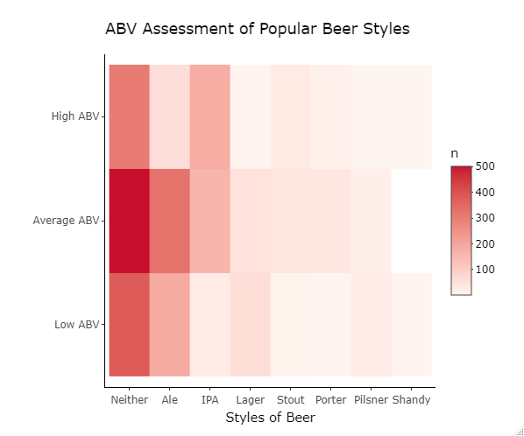
Possible New Product Opportunities
There appears to be opportunity to create a new product where one does not exist.
Shandy is similar to a lemon seltzer, Budweiser has several products on the market already, but not a Budweiser labeled product that I could find.
4 Shandy in dataset
3 with AVB < 5.0
1 with AVB > 6.7
Opportunity to create Shandy with AVB > 5.0
58 Ales out of 573 (~10%) have ABV > 6.7
Opportunity to create Ale with ABV > 6.7
3 Lagers out of 109 (~2.8%) have AVB > 6.7
Opportunity to create Lager with ABV > 6.7
 | Shandy | Pilsner | Porter | Stout | Lager | IPA | Ale | Neither
Number of Beers | 4 | 40 | 54 | 73 | 109 | 372 | 573 | 1185

Slide 20
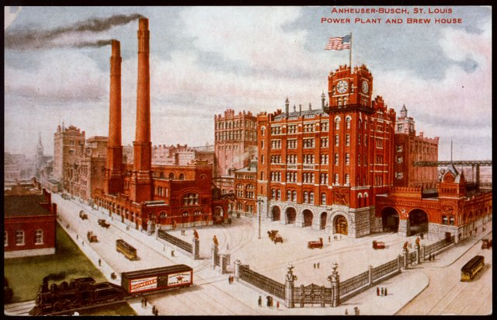
Key Takeaways
Colorado (Mountain Div = 86) has more breweries: 47
East North Central Division has most: 107
ABV and IBU Values
ABV
Not a federal requirement, but is in some states
ABV values not always ready when labels are submitted to TTB (Alcohol and Tobacco Tax and Trade Bureau)
IBU
Expensive (big brewers use it for QC, little ones can’t afford it)
Only measure of chemical compounds known to cause bitterness
Does not actually predict bitterness (other ingredients balance flavor)
Highest Median ABV’s: DC (5.7) / S. Atlantic Div. (5.7)
Highest Median IBU’s: De (59.8)/ E. S. Central Div. (38.6)
Highest ABV: Colorado (Ale – 12.8, in Mountain Division)
Highest IBU: Oregon (IPA - 138, in Pacific Division)
50% of beers ABV between 5.0 – 6.7 (typical mass-produced beer)
Classification: Ale’s are distinguishable from IPA’s
Opportunities: Enter Shandy market, create Ale and/ or Lager with ABV> 6.7

